Slide 1
EENG 284 Lab 09
Datapath
Notes:
Usually the <title of the lab> is what will be called the “System” through the rest of this document

Slide 2
Lab Objectives
The objective of this lab is to design a datapath to store and manipulate the information need to run a stopwatch.
Lab 8 - Mod10 Counter
Lab 9 - Stop Watch Datapath
Lab 10 - Stopwatch Control Unit
Lab 11 - Stopwatch

Slide 3
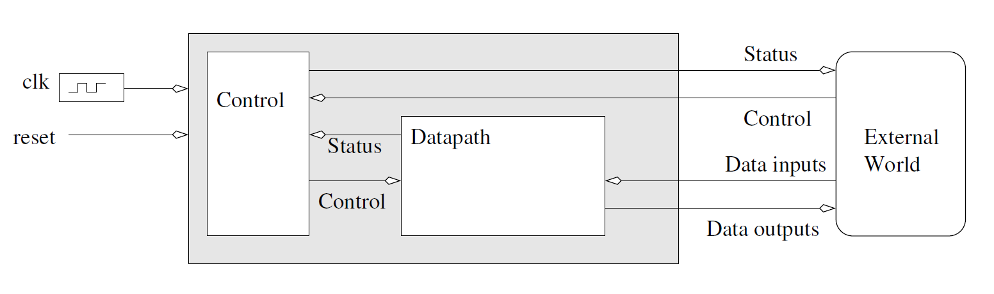
Theory
Design of Complex Systems
Datapath = basic building block
Finite State Machine = D flip flops + logic TBD
Notes:
Replace <System> with the name of the

Slide 4
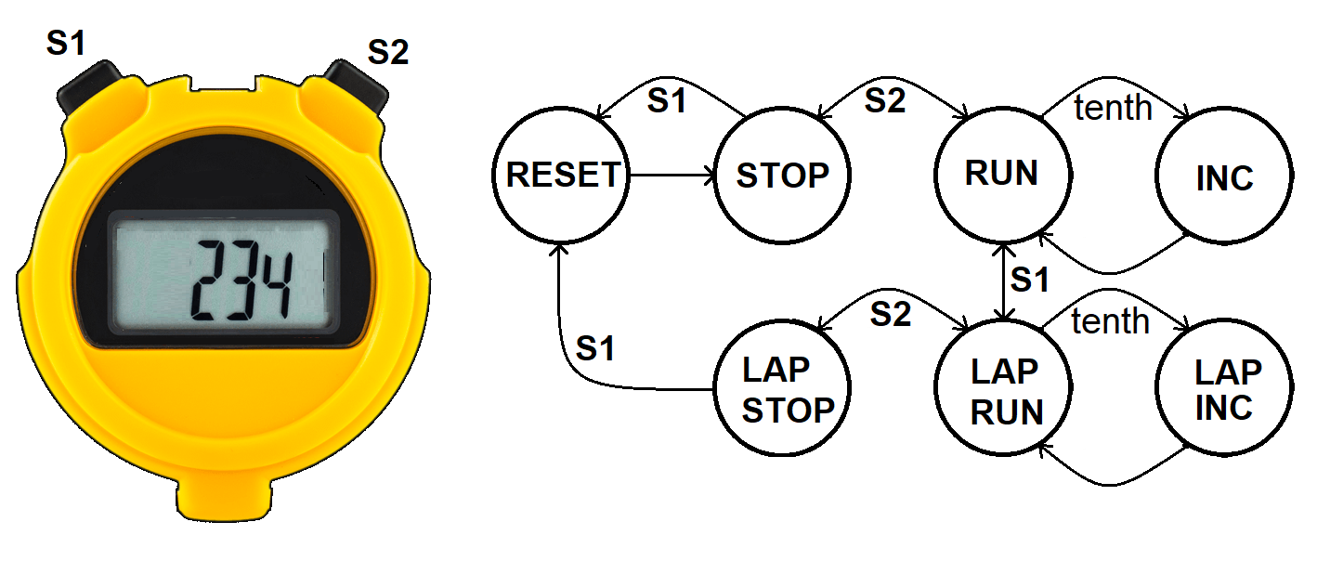
Stopwatch
Measure time down to a 1/10th of a second
Three digit display:
tenths of a second, unit second and tens of seconds
Measuring time intervals from 0.1 to 99.9 sec
Two buttons S1 and S2 determine behavior
Notes:
Replace <System> with the name of the

Slide 5
Stopwatch States
RESET – Reset the internal and displayed time values.
STOP – Stop the 10th second timer and hold the displayed time.
RUN – Run the 10th second timer and display the stored time.
INC – Increment the stored time
LAP RUN – Run the 10th second timer and hold the displayed time.
LAP INC - Increment the stored time.
LAP STOP – Stop the 10th timer and hold the displayed time.
Notes:
Talk about the input is transformed into the output using the system architecture

Slide 6
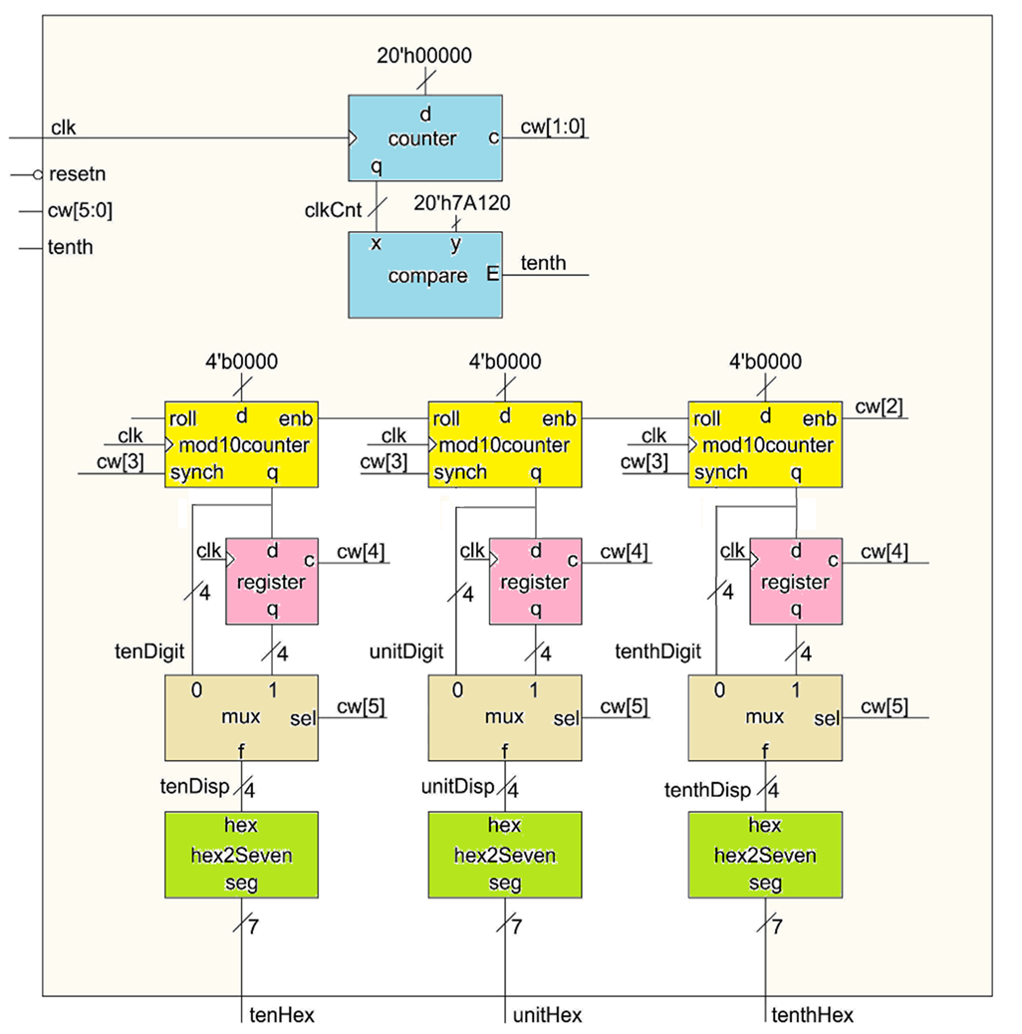
Datapath Architecture
The clk input is 50MHz.
The blue cnt/cmp 1/10th second
Three yellow mod10 counters are the internal timer
The displayed time is held in pink regs.
The tan multiplexers control what is displayed.
Define cw for each state.

Slide 7
Datapath Control Word
 | cw[5] 2x1 mux | cw[4] lap register | cw[3] mod10 reset | cw[2] mod10 count | cw[1:0] timer counter
 | 0 = mod10 | 1 = load | 1 = reset | 1 = count up | 11 = load
 | 1 = register | 0 = hold | 0 = hold | 0 = hold | 10 = count up
 |  |  |  |  | 01 = not used
 |  |  |  |  | 00 = hold
RESET |  |  | 1
STOP
RUN
INC
RUN2LAP |  |  |  | 0
LAP RUN |  |  |  |  | 10
LAP INC |  | 0
LAP STOP | 1
RUN state Run internal timer and update displayed time
Tan Mux display yellow counter
Pink Register load or hold
Yellow Mod10 reset no reset
Yellow Mod10 counter hold
Blue Timer counter Count up

Slide 8
Simulation
To simplify the process of setting up the waveforms, you script all the wave adds, assignment of radix and colors using the provided DO file.
Download “datapathLab10_tbWaveSetup.do” into the: <projectDirectory>\stopWatch\simulation\modelsim
Edit datapathLab10_tbWaveSetup.do file using Notepad.
You should use the do file immediately after you launch Model Sim by typing:
VSIM 3> do datapathLab10_tbWaveSetup.do

Slide 9
Synthesis
No synthesis this week

Slide 10
Deliverables
Complete Table 1, and Table 2.
Verilog code for the body of the datapath module.
Copy of your timing diagram. Fill horizontal space and use signal color and order given.
Demonstrate that your datapath and do file work in ModelSim.

