Slide 1
Library Mangement System
Presented by
Logesh P

Slide 2
OVERVIEW
Library Mangement System web application using Spring Boot,MySql,Angular
In this project we can view list of books available in bookstore and we can add books ,update books and delete books

Slide 3
Abstract
A Library Management System is a system that is used to maintain the records of the library. It contains work like the number of the available books, the number of books issued, the number of books to return or renew. It helps to maintain a database that is useful to enter new books and records of books borrowed by the members with the respective submission dates. It will reduce the manual work done by the librarian to maintain the record of the library. It allows maintaining the resources in a more operative manner that will help to save the time. It is also convenient for the librarian to manage the process of books allocation. It is useful for students as well as a librarian to keep the constant track of the availability of all books in a library.

Slide 4
Spring Boot:
Spring Boot is a tool that makes developing web application and microservices with Spring Framework faster and easier.

Slide 5
Spring Boot Flow Architecture
Client
Controller
Service
Repository
Database

Slide 6
Dependency we need
1.Spring Web
2. Spring Data JPA
3.MySql Database

Slide 7
Technologies we used:
1.Spring Boot
2.MySql database
3.Angular

Slide 8
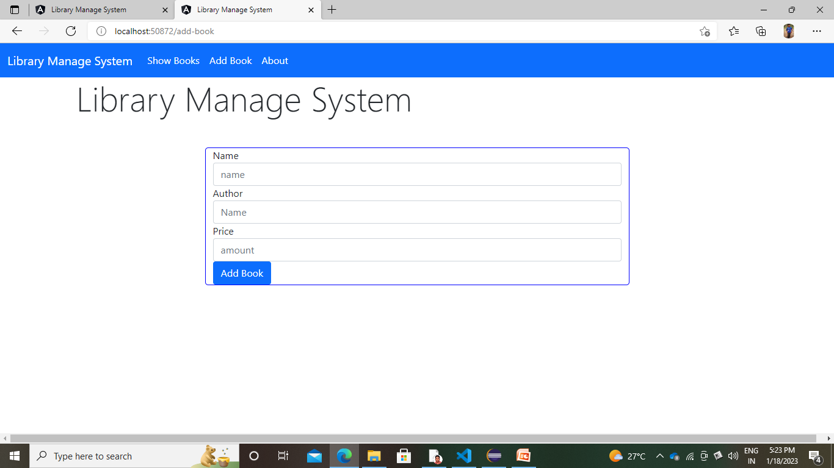
User interface

Slide 9
THANK YOU

