Slide 1

Kasi Connect
Shop local , shop global, shop smart!!

Slide 2
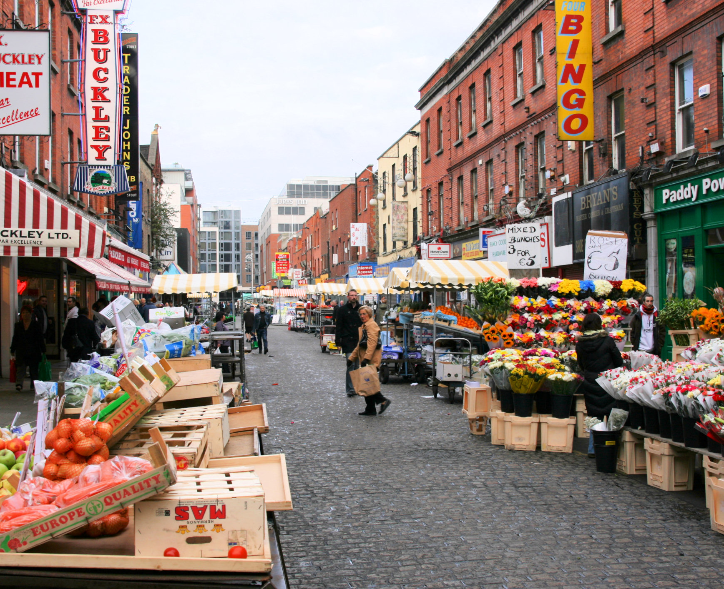
INTRODUCTION
Welcome to kasi connect,your gateway to local markets!
Kasi is an innovative app designed to bridge the gap between local markets and customers . Our mission is to empower small businesses economic growth and community development.
With kasi connect ,you can
-discover local markets and products near you .
- browse through a variety of categories and find what you need.
-connect directly with sellers and negotiate prices.
- support local economies and communities.
This Photo by Unknown Author is licensed under CC BY-SA

Slide 4
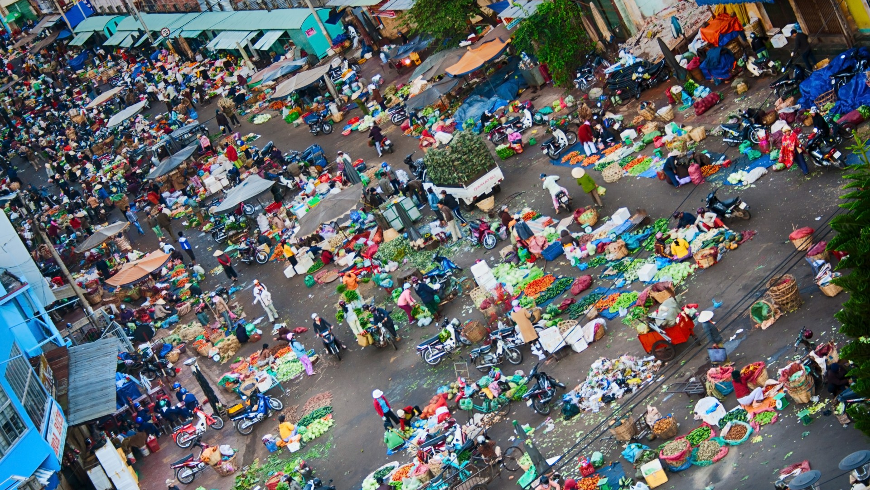
PROBLEM STATEMENT
Local markets in region face significant challenges in reaching customers , promoting their products , and competing with larger businesses , resulting in
- limited market access and visibility
- Inefficient marketing and advertising methods
- Difficulty in connecting with customers and building loyalty
- limited access to resources , training , and support
- Struggling to adapt to the digital age and leverage technology for growth
This leads to : decline of local entrepreneurship and innovation
: limited opportunities for local business to scale and expand

Slide 5
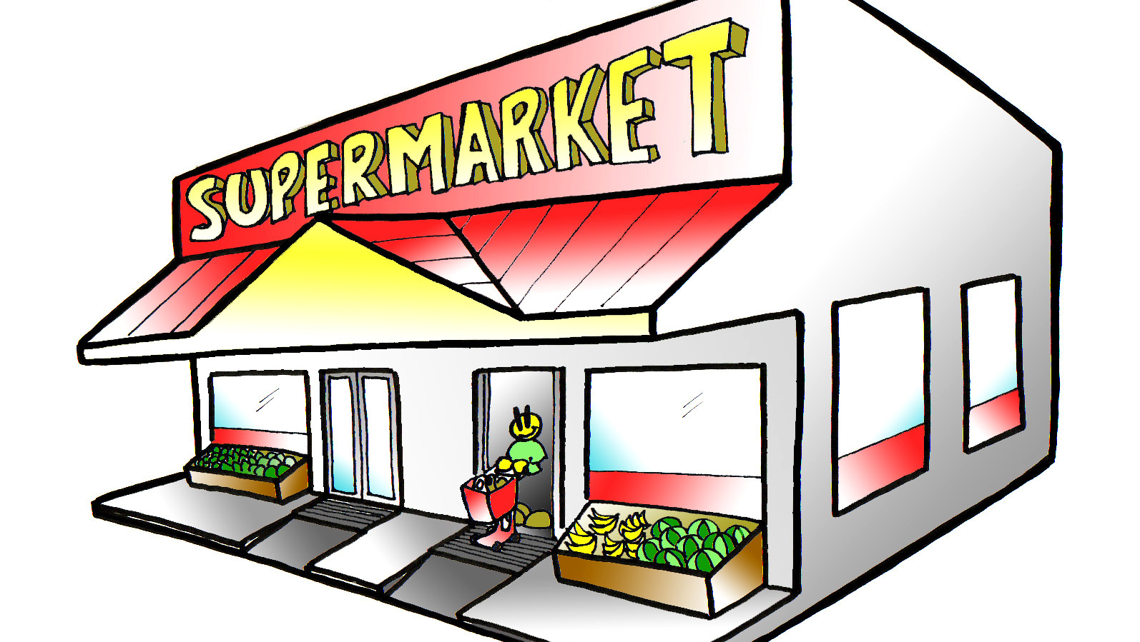
PROBLEM SOLUTION
Kasi connect is a mobile app that connects local markets with customers , providing a user-friendly platform for entrepreneurs to promote their products , build customers loyalty and access resources and training . The app offers:
- A digital marketplace for local businesses to showcase and sell their products
- Marketing and advertising tools to reach aa wider customer base
Kasi connect aims to
Improve economic growth and development in local communities
Support local entrepreneurship and innovation
Increase market access visibility for local businesses
By providing a comprehensive solution to the challenges faced by local markes , Kasi Connect aims to make a positive impact on local communities and contributes to their economic groeth and development.
This Photo by Unknown Author is licensed under CC BY-NC-ND

