Slide 1

KASI CONNECT
EMPOWERING INDIVIDUALS AND SMALL BUSINESSES

Slide 2
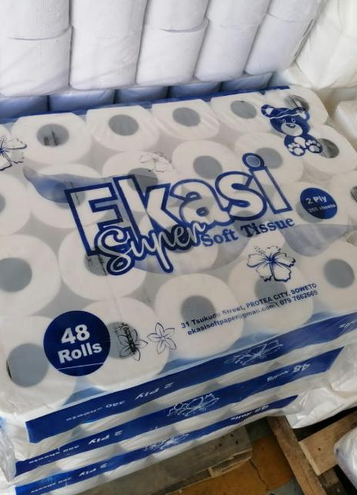
introduction
Welcome to our website! We are thrilled to have you here and we can`t wait to show Welcome to our website!. Our mission is to provide you with an outstanding online experience, whether you are here for marketing jobs or looking for skilled workers with or without qualification.
Our team has worked tirelessly to create a website that is both visually stunning and user-friendly. We have incorporated the latest technology and design trends to ensure that your time spent here is enjoyable and productive.
We are confident that you will find everything you need right at your fingertips. So sit back, relax, and explore all that our website has to offer. We are excited to have you here and look forward to serving you in every way possible. Welcome to KASI CONNECT!

Slide 3
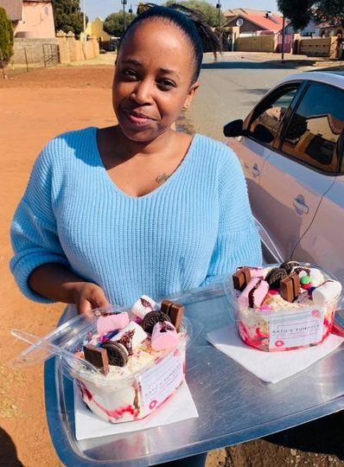
LITERATURE
Economic instability: South Africa has been experiencing economic challenges in recent years, including low GDP growth, high unemployment rates, and a weakening currency. Local businesses struggle to grow and expand in such an uncertain economic environment.
Skills shortage: South Africa faces a shortage of skills in key sectors, such as technology, finance, and healthcare. Local businesses may struggle to find qualified employees with the necessary expertise to help them grow and succeed.
Crime and security concerns: South Africa has high levels of crime, including theft, vandalism, and white-collar crime. This can impact businesses in terms of safety and security measures, as well as insurance costs.

Slide 4

Problem statement
Difficulty standing out in a crowded digital marketplace with larger competitors
Limited resources and time to dedicate to marketing efforts
Difficulty measuring the effectiveness of their advertising campaigns and reaching the right demographics
Not having the expertise or knowledge to effectively market their products or services online.

Slide 5
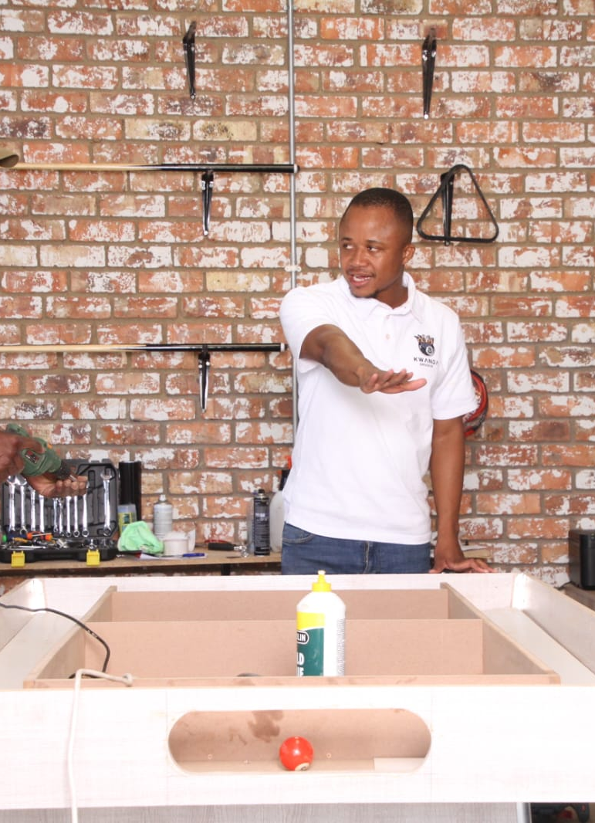
solution
Pricing options for businesses interested in using the platform
How the platform ensures security and protects user data
Examples of successful collaborations that have taken place on the platform

Slide 6
diagram
Platform System
uses
Business
seller
System
Register
Create
Search
Listing Services
Platform System
uses
Business
seller
System
Register
Create
Search
Listing Services

Slide 7

Tools for software development
Frontend:
- HTML: Markup language used to create the structure of web pages
- CSS: Styling language used to define the appearance of web pages
Backend:
- Node.js: JavaScript runtime environment used for building server-side applications
Database:
- MongoDB: NoSQL database used to store and retrieve data for the platform
Visual:
- Icons representing the tools and technologies such as a <code>&lt;html&gt;</code> tag for HTML, a <code>&lt;style&gt;</code> tag for CSS, a <code>&lt;script&gt;</code> tag for JavaScript, a Node.js logo for Node.js, an Express.js logo for Express.

Slide 8

conclusion
join our platform today and connect with other like-minded businesses and individuals in our community. Together, we can collaborate, network, and support each other in reaching our goals. Let's grow together and make a positive impact!
You're invited! Join us today!

Slide 9

Thank you
Thank you all for your attention and engagement today. Your support means everything to us as we strive to connect communities and bring people together. We truly appreciate your time and energy in joining us on this journey.
Together, we can create a vibrant, inclusive network that fosters unity and collaboration. Let's continue to build bridges and strengthen relationships across all borders.
Thank you once again for being a part of our platform. Let's keep working together to make a positive impact in the world.

