Slide 1
Title: Interactive Sales Dashboard in Tableau Subtitle: Step-by-Step Dashboard Design Guide By: LOHITH KUMAR N Tools: Tableau Desktop / Tableau Public Dataset: Car Prices Cleaned Dataset (from Kaggle)

Slide 2
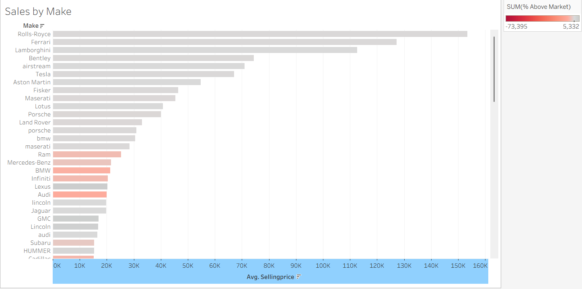
Sheet 1: Sales by Make
This sheet creates a bar chart that ranks each car brand by its average selling price. The color intensity shows which brands are most consistently sold for a high percentage above their market value.

Slide 3
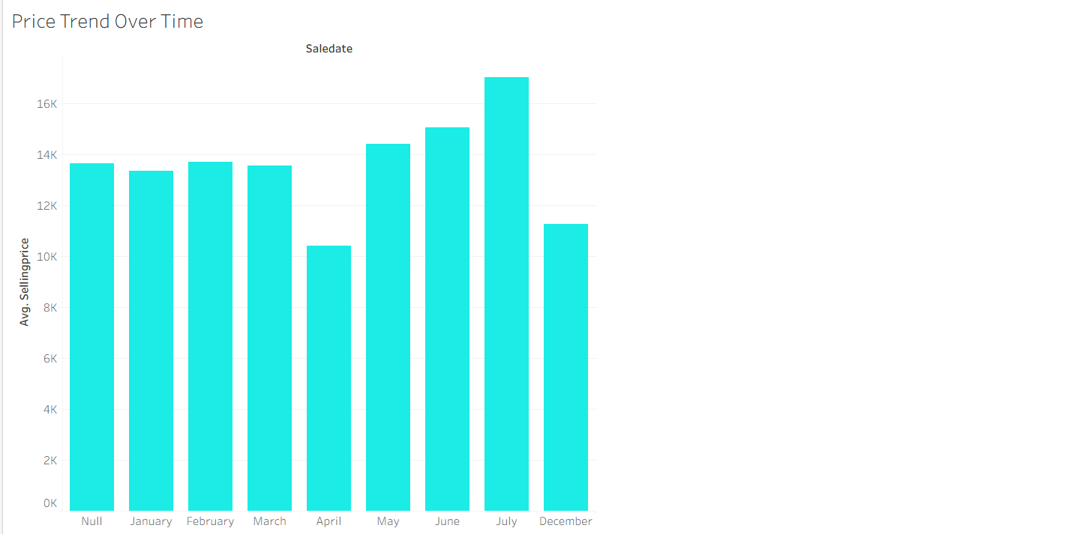
Sheet 2: Price Trend Over Time
This sheet builds a line chart to track the average selling price of cars month by month. It helps visualize seasonal trends and see how prices for different brands have changed throughout the year.

Slide 4
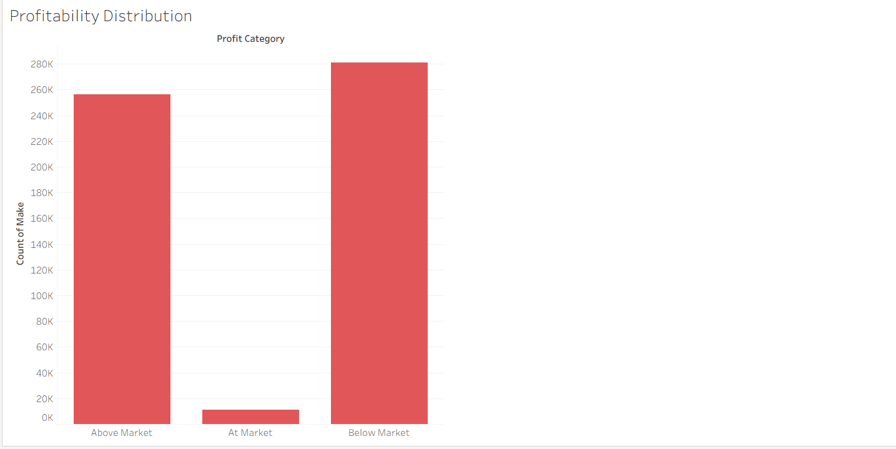
Sheet 3: Profitability Distribution
This sheet is a bar chart that counts how many cars fall into different profit categories (like "Above Market" or "Below Market"). It quickly shows what percentage of the total car sales were profitable versus those that were not.

Slide 5
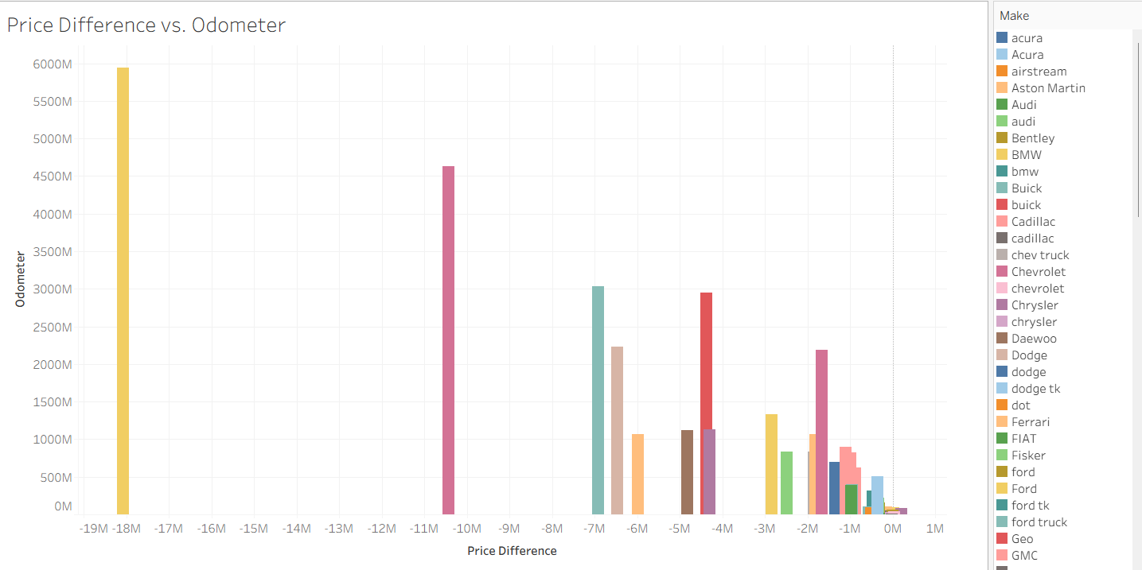
Sheet 4: Price Difference vs. Odometer
This sheet creates a scatter plot to compare a car's mileage (odometer) against the profit made on it (Price Difference). It's used to spot correlations, such as whether cars with lower mileage consistently sell for a higher profit.

Slide 6
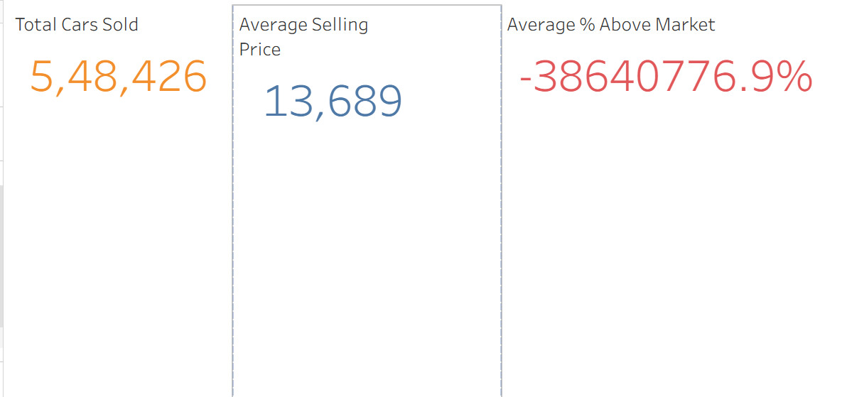
Sheet 5: Summary Cards (KPIs)
This step creates three individual text cards that display the most important, high-level business numbers. These "Key Performance Indicators" give a quick summary of total cars sold, the overall average price, and the average profit margin.

