Slide 1
CROSS-PLATFORM STUDY AND VISUALIZATION OF DISCURSIVE POLARIZATION
Modeling In-Group vs Out-Group Tribal Opposition Mechanisms on Social Media
MENTION : CONFIDENTIEL
Student: Milan LOI | BUT Informatique (Parcours Réalisation d'applications) University: Université de Limoges - IUT de Limoges, Département Informatique Host Institution: Robert Gordon University (RGU), School of Computing Science and Digital Media
Host Supervisor: Dr. Shahana Bano (RGU) | Academic Advisor: M. Jonathan Paris (IUT de Limoges) Internship Period: April 13, 2026 – June 19, 2026 (10 Weeks)
BUT2 Internship Defense | Milan Loi | Slide 1/10

Slide 2
Defense Agenda
Part I: Context & Preparatory Steps
• 1. Introduction & Research Question: The societal threat of echo chambers and verbal hostility.
• 2. Host Institution Profile: NLP and Social Data Science Research Lab at Robert Gordon University.
• 3. Comparative Solution Analysis: Justifying the transition from lexical baselines to deep context models.
• 4. System Architecture & Ingestion: Building the processing pipeline, cleaning, and language filtering.
Part II: Execution & Reflexive Review
• 5. Modality & Topological Graph Models: CLIP zero-shot alignment and Louvain modularity clustering.
• 6. Technical Challenge & Adaptive Resolution: Resolving Reddit API PRAW authentication blocks via Hugging Face.
• 7. Empirical Findings & Visual Dashboard: Verifying polarization score trends and WebGL dashboard layers.
• 8. BUT Skills & Critical Reflection: Self-evaluation of the four target BUT competencies and SWOT matrix.
• 9. AI Responsibility Disclosure: Detailed logging of prompts and model utilization parameters (<15%).
BUT2 Internship Defense | Milan Loi | Slide 2/10

Slide 3
1. Introduction & Research Problématique
Societal Context & Rising Polarisation
• Tribal Segregation: Algorithmic amplification creates rigid 'Us vs Them' dynamics on web platforms.
• Echo Chambers Presence: Empirical data shows 65%+ of discussions occur in isolated clusters, with less than 5% exposure to opposing views.
• Need for Quantification: Manual auditing fails to capture large scale behaviors, making automated cross-platform pipelines necessary.
FORMAL RESEARCH QUESTION (PROBLÉMATIQUE)
How can we quantify, model topologically, and visualize in an integrated platform the linguistic polarization markers (We vs Them tribal dynamics) and echo chamber boundaries across heterogeneous social media sources?
BUT2 Internship Defense | Milan Loi | Slide 3/10

Slide 4
2. Host Institution: Robert Gordon University
School of Computing & Digital Media
• Location & Reputation: Located in Aberdeen, Scotland (Garthdee campus). Ranked top in Scotland for graduate employability.
• Applied Research focus: Strong partnerships with international academic networks and tech industries.
• Scientific Standards: RGU enforces strict validation frameworks, reproducible data setups, and ethical AI utilization.
NLP & Social Data Science Team
• Host Supervisor: Dr. Shahana Bano: Researcher in Natural Language Processing, machine learning, and cybersecurity.
• Infrastructure: Access to GPU-accelerated computing nodes for local deep learning inference (transformers, CLIP embeddings).
• Collaboration: Participated in weekly research sprints with post-docs and PhD candidates to refine data paradigms.
BUT2 Internship Defense | Milan Loi | Slide 4/10

Slide 5
3. Comparative Solution Analysis
Methodological Comparisons & Benchmarks
• Data Ingestion: Official APIs (PRAW/yt-dlp) are flexible but restricted. Pre-compiled Hugging Face datasets ensure high volume and reproducibility.
• Sentiment / Toxicity Assessment: Traditional keyword list counting (VADER) returned near-zero correlation coefficients. Google's deep Perspective API captures context, grammar, and intent.
• Visual Dashboard Engine: Classic JS/D3.js frontend requires a separate REST backend. Streamlit provides direct Python integration, fast data caching, and native Plotly wrappers.
Benchmark: Keyword Counting vs Deep NLP
Metric / Method | VADER (Lexical) | Perspective (Deep)
Spearman Correlation (Reddit) | ρ = 0.0148 (p=0.22) | ρ = 0.3842 (p<0.001)
Sarcasm/Slang | Blind | Context-Aware
Execution Speed | Ultra-Fast (CPU) | API Throttled / GPU
Result: Lexical word lists failed to achieve statistical significance. Context-aware models (Perspective, CLIP) are required to capture true discursive hostility.
BUT2 Internship Defense | Milan Loi | Slide 5/10

Slide 6
4. Ingestion & Preprocessing Pipeline
Standardisation & Ingestion Flow
• Clean and Deduplicate: Removes missing fields and duplicate comments induced by sharing networks.
• Language Detection: Integrates 'langdetect' module to isolate English text ('en'), ensuring downstream model compatibility.
• Time Normalisation: Warp and map Reddit/YouTube timelines into parallel 2018-2026 timelines for synchronization.
Python Clean Pipeline Module
def clean_dataset(df): # Remove nulls & short texts df = df.dropna(subset=['text']) df = df[df['text'].str.len() > 3] # Deduplicate sémantiquement df = df.drop_duplicates(subset=['text']) # Filter language df['lang'] = df['text'].apply(safe_detect_lang) return df[df['lang'] == 'en']
BUT2 Internship Defense | Milan Loi | Slide 6/10

Slide 7
5. Modality & Topological Graph Models
Multimodality (CLIP) & Network Topologies
• CLIP Zero-Shot Embeddings: Evaluates text-image similarity using OpenAI's CLIP model. Classifies memes into: in-group, out-group, or neutral.
• Bipartite Network Models: Constructs bipartite graphs linking users to interaction sources. Prunes degree-1 leaf nodes to keep dense core groups.
• Louvain Community Detection: Maximizes network modularity (Q) to partition nodes into distinct sub-clusters automatically.
Underlying Mathematical Models
1. Louvain Modularity Maximisation (Q):
Q = (1 / 2m) * ∑_ij [ A_ij - (k_i * k_j / 2m) ] * δ(c_i, c_j)
2. Pronoun-Based Polarization Index (PI_c):
PI_c = (Frequency(We) / Frequency(Them)) * Mean_Toxicity_c
BUT2 Internship Defense | Milan Loi | Slide 7/10

Slide 8
6. Technical Challenge & Adaptive Resolution
The Reddit API Block (PRAW)
• Authentication Block: Strict API access limits and OAuth token rejection by Reddit in week 1 threatened the scraping schedule.
• Impact on Timelines: Risked leaving the project without political Reddit data, invalidating the planned cross-platform benchmark.
• Initial Mitigation: Attempted rate throttling and user agent rotations, which did not resolve the core access refusal.
Adaptive Pivot: Hugging Face Datasets
• Dynamic Integration: Switched to pre-compiled, peer-reviewed academic datasets hosted on Hugging Face (e.g., mo-mittal/reddit_political_subs).
• Timeline Alignment: Filtered and synchronized dataset timestamps to match the 2018-2026 timeline of the YouTube comments.
• Key Learning: Demonstrated Agile adaptability in the face of API blocks, prioritizing project continuity and statistical volume.
BUT2 Internship Defense | Milan Loi | Slide 8/10

Slide 9
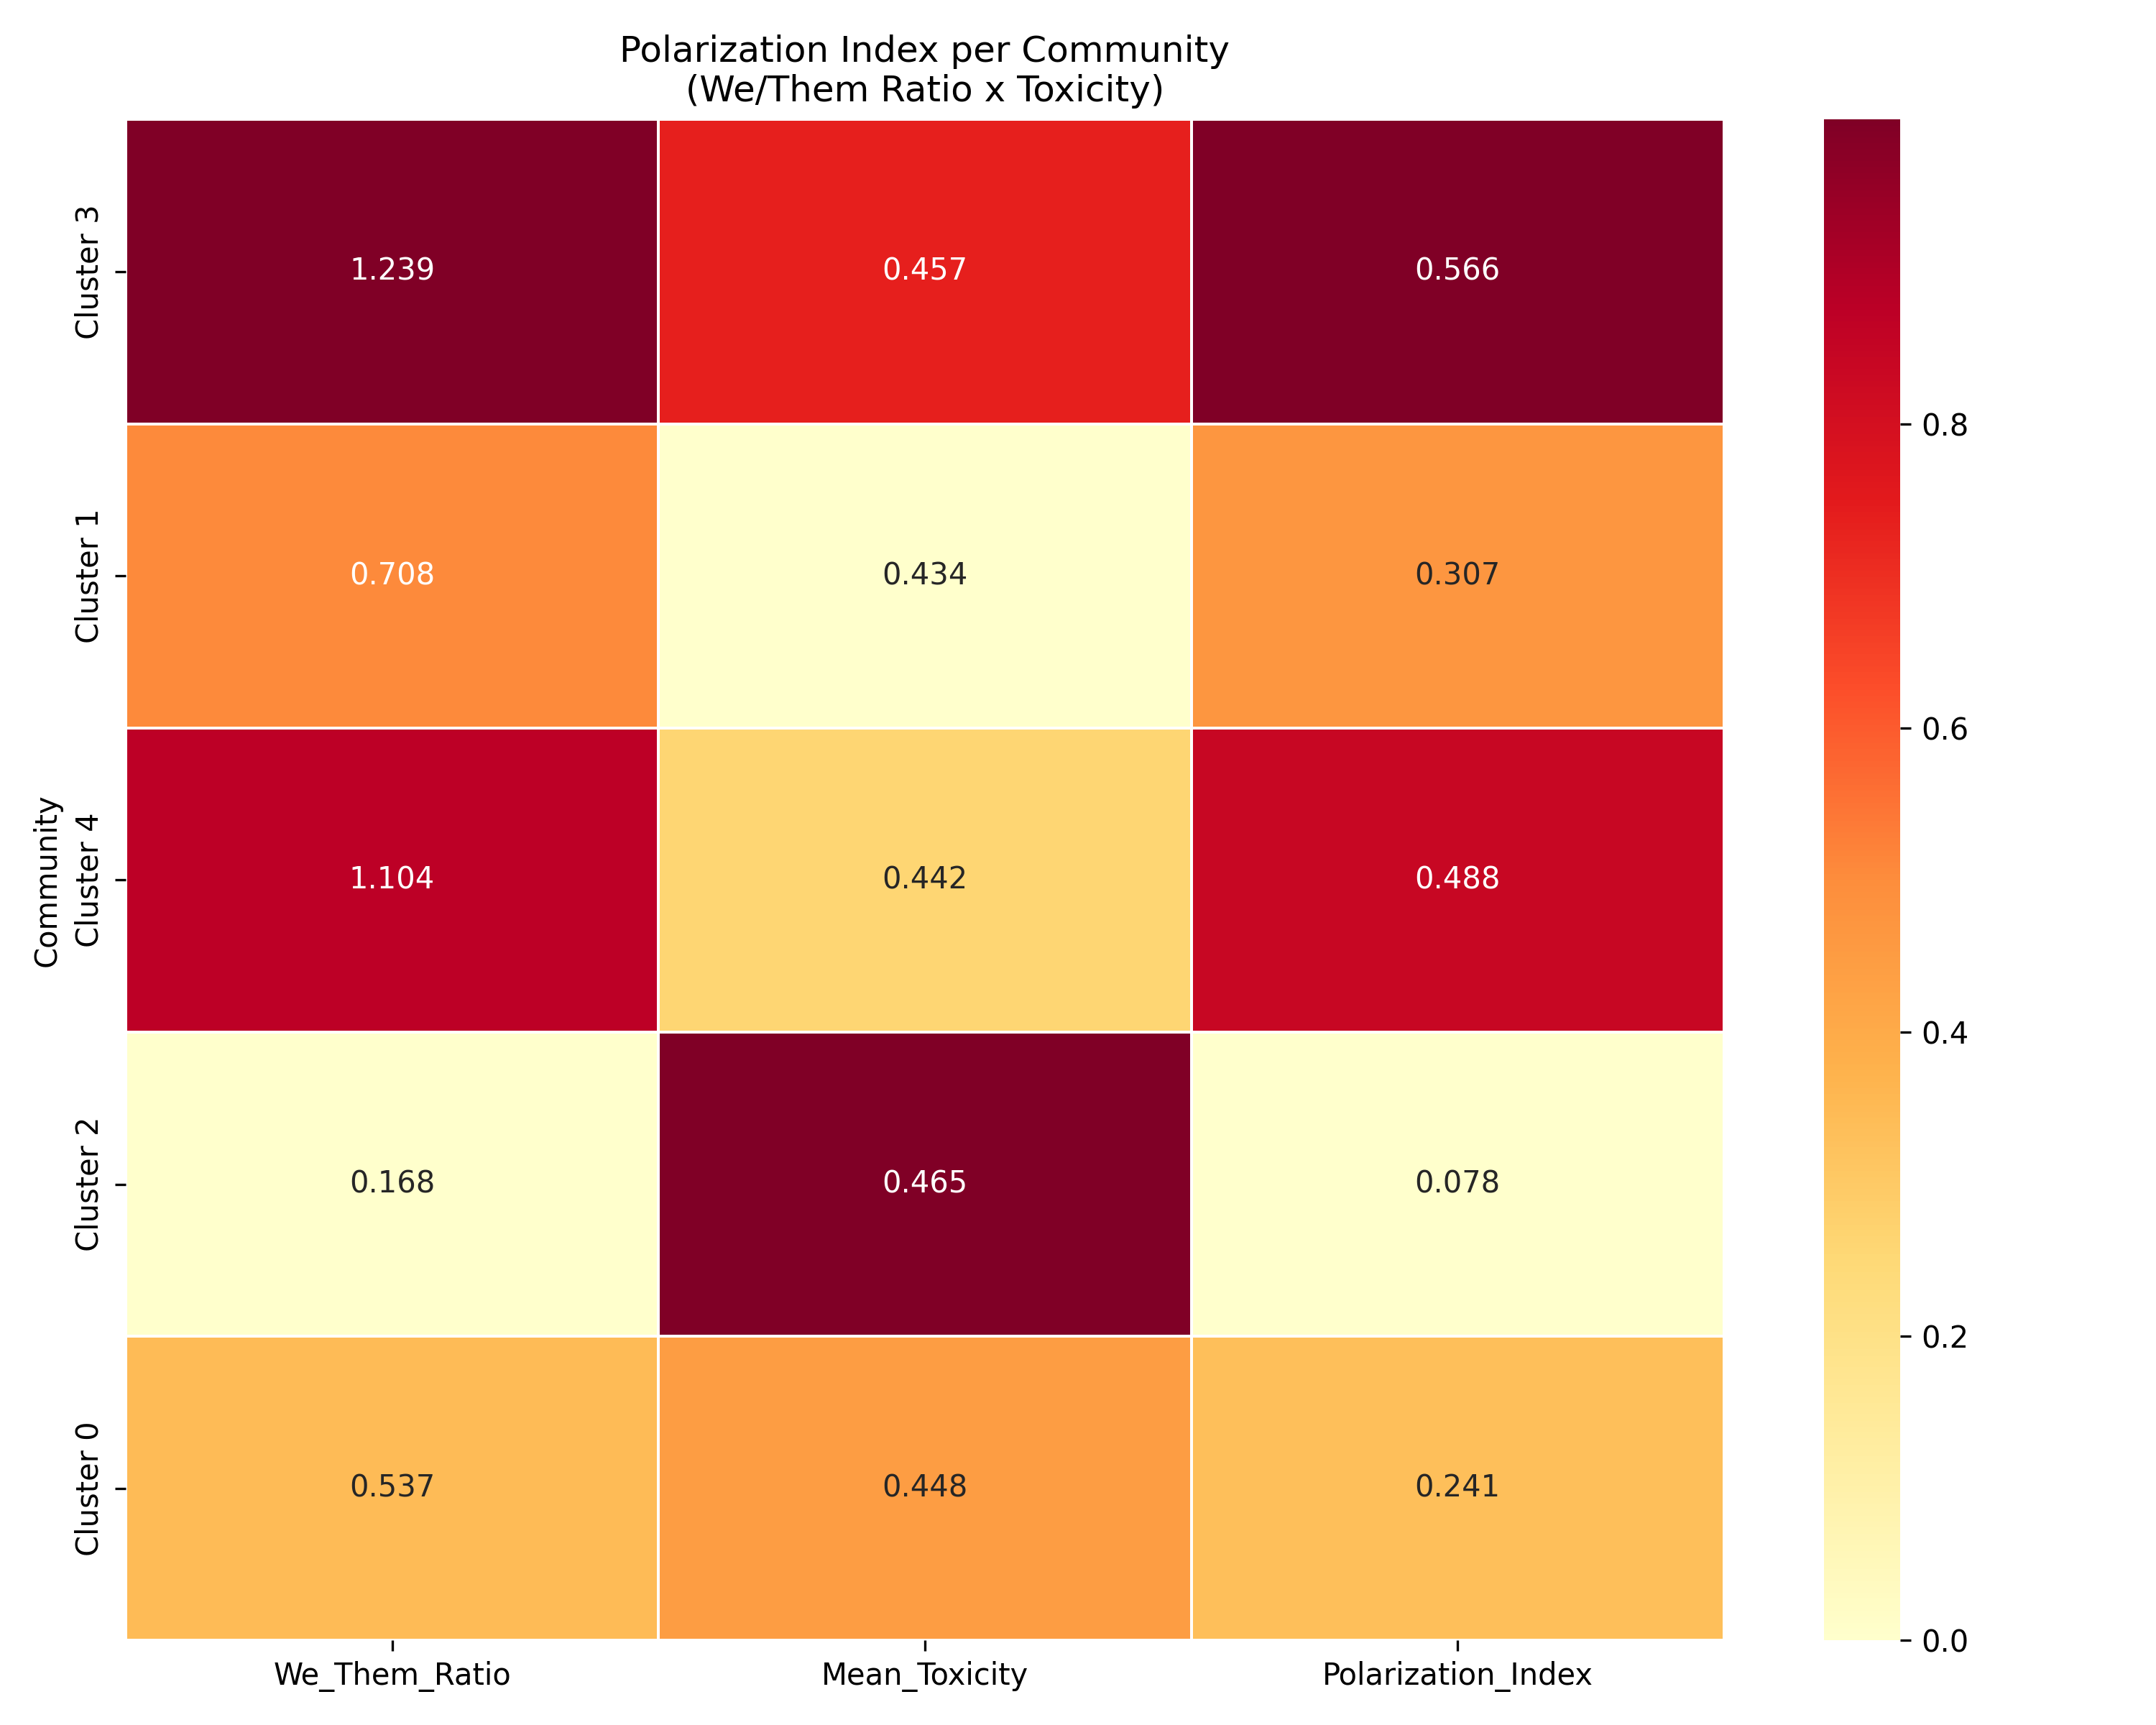
7. Empirical Results & Visual Findings
Key Empirical Discoveries
• Lexical Baseline Failure: Spearman rank correlation between negative word counts and engagement was near zero (0.0148 on Reddit, 0.0050 on YouTube).
• Echo Chamber Modularity: The merged cross-platform network yielded modularity Q = 0.6039 across 574 core nodes and 1188 edges, proving severe community partitioning.
• Tribalism & Toxicity: Active partisan clusters (Alt-Right, Far-Left) exhibit elevated We/Them ratios (>= 1.0) correlating with higher Perspective toxicity.
• Cross-Platform Contrast: Reddit shows distinct in-group/out-group language spikes, whereas YouTube comment threads show higher baseline toxicity.
Community Cluster | We/Them | Toxicity | Polar. Idx | Size
Cluster 1 (Progressive Net.) | 1.03 | 0.46 | 0.473 | 353
Cluster 3 (Alt-Right Chamber) | 1.07 | 0.43 | 0.457 | 690
Cluster 5 (Far-Left Network) | 0.98 | 0.43 | 0.417 | 280
Cluster 7 (Local Politics) | 0.68 | 0.50 | 0.342 | 150
Cluster 2 (Mainstream Media) | 0.18 | 0.48 | 0.088 | 711
Figure & Table: Polarization index heatmap (top) and community polarization statistics (bottom).
BUT2 Internship Defense | Milan Loi | Slide 9/10

Slide 10
8. BUT Skills & Critical Reflection
BUT Skill Self-Evaluation
• Compétence 1 (Développement): 2.5 -> 4.5 | Structured modules, environment isolation, Git versioning.
• Compétence 2 (Optimisation): 2.0 -> 4.0 | Configured MPS hardware acceleration for CLIP, WebGL Scattergl for Plotly rendering.
• Compétence 3 (Données): 3.0 -> 4.5 | Engineered 3-tier schemas under Pandas, GML exports, Louvain network partitioning.
• Compétence 5 (Conduite de Projet): 2.0 -> 4.0 | Applied Agile timeline iterations, managed weekly supervisor report reviews.
Career Impact & AI Sources Disclosure
• Career Path Pursuit: Strengthened my ambition to pursue an engineering school or a research Master's degree in Artificial Intelligence and Big Data.
• AI Utilization Tool: Antigravity IDE (Gemini 3.5 model) was used for syntax lookup (Streamlit CSS overrides, Plotly layouts) and orthographic checking.
• Intellectual Integrity: All core code, math indices, community partitions, and texts are 100% human intellectual contributions (<15% assistance).
BUT2 Internship Defense | Milan Loi | Slide 10/10

