Slide 1
AMRITA
Amrita Vishwa Vidyapeetham · Amrita School of Computing
M.Tech Computer Science and Engineering (Research) · Panel Review 2 · 07-10-2026
A Neuro-Symbolic Safety Auditing Framework
for Industrial Control System Specifications
Pre-Synthesis Defect Detection · LLM Entity Extraction · Z3 Formal Verification · IEC 61511
Supervisor: Dr. [Supervisor Name]
Project Phase 1
Name | Roll Number | Internship Details
LOKANIRAKESH | [Roll Number] | [Internship Details]
07-10-2026 · Amrita School of Computing

Slide 2
AMRITA
Guide Approval Mail
[Add approval email screenshot here]
07-10-2026
Amrita School of Computing
M.Tech Research

Slide 3
AMRITA
Contents
Introduction and Motivation
§03 Preliminary Verification and Results
Problem Statement
§04 Datasets
Proposed Methodology — 9-Phase Pipeline
Technical Enrichment Activities
System Architecture & Implementation Progress
Project Plan for Semester 3
§01 Standard Algorithms and Evaluation Metrics
Conclusion and References
§02 Tools and Methods for Implementation
07-10-2026
Amrita School of Computing
M.Tech Research

Slide 4
AMRITA
Introduction and Motivation
Why do we need automated safety auditing for ICS?
103 M+
30%
IEC 61511
People affected by ICS
failures annually (ICS-CERT)
Defects missed by manual
review (found at commissioning)
Safety standard for SIS —
19 core requirement patterns
• ICS safety specifications are spread across 3 document types: Control Narratives (text), P&ID Drawings (diagrams), and Cause-Effect Tables (tables).
• Today, safety engineers manually cross-check all 3 — this is slow, costly, and error-prone.
• Current AI tools use LLMs alone — they hallucinate and cannot mathematically prove correctness.
• No existing tool automatically links entities across all 3 document types and runs formal verification.
Our Goal: Build an automated auditor that reads all 3 document types, links them with cross-modal entity linking, and uses the Z3 SMT solver to formally prove safety defects before any PLC code is written.
07-10-2026
Amrita School of Computing
M.Tech Research

Slide 5
AMRITA
Problem Statement
• Safety specifications for ICS are scattered across multiple document types — no single tool reads all of them together and cross-validates them.
• Manual safety review by engineers misses up to 30% of defects. These are only found at commissioning or during an accident — extremely expensive and dangerous.
• Existing AI tools use LLMs in isolation — they can produce plausible-sounding but incorrect safety rules because they cannot prove correctness mathematically.
• There is no tool that: (1) automatically links equipment names and rules across Control Narratives, P&IDs, and Cause-Effect Tables, AND (2) uses formal logic to verify those rules against IEC 61511 safety standards.
This project solves both gaps with a 9-phase neuro-symbolic pipeline: LLMs read and extract rules from natural language, and the Z3 SMT solver mathematically proves OMISSIONS, CONTRADICTIONS, and TAG MISMATCHES before a single line of PLC code is written.
07-10-2026
Amrita School of Computing
M.Tech Research

Slide 6
AMRITA
Proposed Methodology
9-Phase Neuro-Symbolic Pipeline · Neural Phases (Phase 1 – 4)
Phase 1 — INGEST
Phase 3 — LINK
• Extract text from Control Narrative PDFs
• OCR equipment tags from P&ID drawing images (Tesseract)
• Parse Cause-Effect table rows into structured records
• Connect the SAME equipment mentioned across all 3 documents
• 3-step cascade: exact match → fuzzy match (RapidFuzz ≥ 85) → embedding similarity (all-MiniLM-L6-v2 ≥ 0.75)
• Ablation flag: cross-modal linking can be switched OFF
Phase 2 — EXTRACT
Phase 4 — GRAPH
• Send extracted text to Qwen 2.5 LLM (via Ollama, locally)
• LLM returns: equipment entities, sensor tags, and control rules
• Pydantic v2 validates and cleans every LLM output
• Build a NetworkX DiGraph of all equipment, sensors, actuators
• Edges = control rules (condition → action)
• Export as interactive PyVis HTML visualization
07-10-2026
Amrita School of Computing
M.Tech Research

Slide 7
AMRITA
Proposed Methodology
9-Phase Neuro-Symbolic Pipeline · Symbolic Phases (Phase 5 – 9)
Phase 5 — IR
Phase 6 — INVARIANTS
Phase 7 — Z3 VERIFY
• Convert LLM-extracted rules into Pydantic-validated ControlRule IR
• Each rule has: trigger condition, action, safety category, IEC clause
• Check which of the 19 IEC 61511 safety requirement templates are covered
• Examples: High-High Pressure Shutdown, Emergency Stop Propagation, Interlock Mutual Exclusion
• OMISSION pass: missing required rules (e.g. no HH shutdown for PT-101)
• CONTRADICTION pass: two rules conflict under the same condition
• TAG_MISMATCH pass: same equipment named differently across documents
Phase 8 — REPORT
Phase 9 — PLC
• Generate HTML audit report with all findings, severity ratings, and IEC references
• Each finding includes: type, description, affected tags, clause, recommendation
• Generate IEC 61131-3 Structured Text (.st) code from verified safe rules
• Code is a draft skeleton — must be reviewed by a qualified safety engineer
07-10-2026
Amrita School of Computing
M.Tech Research

Slide 8
AMRITA
System Architecture
End-to-end flow: 3 document types → 9 phases → Findings + PLC code
INPUT DOCUMENTS
PROCESSING PIPELINE
1+2
Ingest + LLM Extract
📄 Control Narrative PDF
PDF/OCR extraction → Qwen 2.5 entity & rule extraction
Natural language process description
📊 Cause-Effect Table PDF
3+4
Link + Graph
Trigger → action mapping table
Exact/Fuzzy/Embedding cross-modal linking → NetworkX DiGraph
🖼 P&ID Drawing (Image)
5+6
IR + Invariants
Piping & Instrumentation Diagram
Pydantic ControlRule IR → 19 IEC 61511 template coverage
▼ 9-Phase Pipeline ▼
7
Z3 Verify
OMISSION / CONTRADICTION / TAG_MISMATCH formal proofs
OUTPUTS
📋 HTML Audit Report (findings)
Report + PLC
8+9
⚙ IEC 61131-3 PLC Structured Text
Jinja2 HTML report + IEC 61131-3 Structured Text generation
07-10-2026
Amrita School of Computing
M.Tech Research

Slide 9
AMRITA
Implementation Progress
Current status of all 12 modules across the 9-phase pipeline
Module | Phase | Status
PDF / Table / P&ID Extraction | Phase 1 | Completed
LLM Entity & Rule Extraction (Qwen 2.5) | Phase 2 | Completed
Cross-Modal Entity Linking (3-step cascade) | Phase 3 | Completed
Knowledge Graph (NetworkX + PyVis HTML) | Phase 4 | Completed
IR Construction (Pydantic v2 validated) | Phase 5 | Completed
IEC 61511 Invariant Library (19 templates) | Phase 6 | Completed
Z3 Formal Verification (3 passes) | Phase 7 | Completed
HTML Audit Report (Jinja2) | Phase 8 | Completed
PLC Structured Text Generator | Phase 9 | Completed
Synthetic Benchmark Corpus (50 packages) | Benchmark | Completed
Full Evaluation Suite (P / R / F1 / ablation) | Eval | In Progress
Streamlit Web Dashboard (6 pages) | UI | In Progress
07-10-2026
Amrita School of Computing
M.Tech Research

Slide 10
SECTION 01
Standard Algorithms &
Evaluation Metrics
This section covers:
Z3 SMT Contradiction Checker — formal proof of rule conflicts
Cross-Modal Entity Linking — 3-step cascade (Exact → Fuzzy → Embedding)
Evaluation on 50-package synthetic benchmark · Precision / Recall / F1
07-10-2026
Amrita School of Computing

Slide 11
AMRITA
Standard Algorithm: Z3 Contradiction Checker
Formal verification of safety rules using Microsoft Z3 SMT solver
FUNCTION verify_contradictions(rule_list):
solver ← Z3_Solver()
tag_vars ← {}
// Step 1: Create one Boolean Z3 variable per tag
FOR EACH rule IN rule_list:
FOR EACH tag IN rule.tags:
IF tag NOT IN tag_vars:
tag_vars[tag] ← Bool(tag)
// Step 2: Add each rule as a Z3 assertion
FOR EACH rule IN rule_list:
cond ← build_z3_expr(rule.trigger, tag_vars)
action ← build_z3_expr(rule.action, tag_vars)
solver.add( Implies(cond, action) )
// Step 3: Check satisfiability
IF solver.check() == UNSAT:
RETURN Finding(CONTRADICTION, HIGH)
// Step 4: Pairwise conflict check
FOR pair IN combinations(rule_list, 2):
r1, r2 = pair
IF same_trigger(r1, r2) AND
opposite_actions(r1, r2):
RETURN Finding(
type = CONTRADICTION,
severity = HIGH,
tags = r1.tags ∪ r2.tags,
message = f'{r1.id} conflicts {r2.id}'
)
RETURN [] // No contradictions found
// Same structure used for OMISSION pass
// (check invariant coverage gaps)
// and TAG_MISMATCH pass
// (fuzzy + embedding cross-doc comparison)
07-10-2026
Amrita School of Computing
M.Tech Research

Slide 12
AMRITA
Standard Algorithm: Cross-Modal Entity Linking
3-step cascade linking entities across Control Narrative, C&E Table, and P&ID
Step 1 — Exact Match
Step 2 — Fuzzy String Match (RapidFuzz)
Step 3 — Semantic Embedding Similarity
Input: entity tag from Document A (e.g. PT-101)
Input: unlinked tags from Step 1
Input: tags not linked by Steps 1-2
Query: tag_b == tag_a (case-insensitive)
Score = RapidFuzz.token_sort_ratio(tag_a, tag_b)
Model: all-MiniLM-L6-v2 (sentence-transformers)
If match found → link confirmed (confidence = 1.0)
if
not
linked
Threshold: score >= 85 → TAG_MISMATCH finding raised
if
not
linked
cos_sim = dot(embed_a, embed_b) / (|a| |b|)
Cost: O(1) hash lookup | Speed: < 1 ms per pair
Handles punctuation variants: PT-101 vs PT101 (score 0.92)
Threshold: cos_sim >= 0.75 → semantic link
Example: PT-101 (narrative) == PT-101 (C&E) LINKED
Example: FT-601 vs FT601 Score=0.960 MISMATCH reported
Example: LT201 vs Level Transmitter 201 sim=0.81 LINKED
All 3 steps run per entity-pair across all document pairs. Finding raised only on Step 2 (TAG_MISMATCH). Steps 1 and 3 are transparent links.
07-10-2026
Amrita School of Computing
M.Tech Research

Slide 13
AMRITA
Evaluation Metrics
Tested on 50-package synthetic benchmark corpus · 5 defect categories · Seed 42
Precision
Recall
F1 Score
Accuracy
False Positive Rate
0.960
0.880
0.918
0.925
0.040
No false alarms
Defects detected
Harmonic mean
Overall correct
Spurious findings
Per-Defect-Category Breakdown
Defect Category | Precision | Recall | F1 | TP | FP | FN
Missing Shutdown Rule | 0.960 | 0.920 | 0.940 | 23 | 1 | 2
Contradiction | 1.000 | 0.870 | 0.931 | 13 | 0 | 2
Missing Alarm | 0.930 | 0.860 | 0.894 | 18 | 1 | 3
Tag Mismatch | 0.960 | 0.900 | 0.929 | 18 | 1 | 2
Missing Interlock | 0.950 | 0.880 | 0.914 | 22 | 1 | 3
Note: Preliminary results on synthetic corpus. Final numbers will be updated after real-data evaluation.
07-10-2026
Amrita School of Computing
M.Tech Research

Slide 14
SECTION 02
Tools and Methods
for Implementation
This section covers:
LLM stack: Ollama + Qwen 2.5 · LangChain orchestration · Pydantic v2 validation
Formal methods: Microsoft Z3 v4.13 SMT solver · IEC 61511 invariant templates
Web + API: Streamlit 6-page dashboard · FastAPI REST server · SQLite persistence
07-10-2026
Amrita School of Computing

Slide 15
AMRITA
Tools and Methods for Implementation
Tool / Library | Version | Purpose | Expertise Demonstrated
Ollama + Qwen 2.5 | 2.5 | Local LLM inference | Entity extraction, control rule parsing from natural language
LangChain | v0.3.25 | LLM orchestration | Prompt templates, structured output parsers, retry logic
Z3 SMT Solver | v4.13 | Formal verification | OMISSION / CONTRADICTION / TAG_MISMATCH proofs
sentence-transformers | v3.4 | Semantic embeddings | Cross-modal entity linking with all-MiniLM-L6-v2
NetworkX + PyVis | v3.4 | Knowledge graph | DiGraph construction, interactive HTML export
FastAPI | v0.115 | Audit API server | REST endpoints, SSE streaming, Pydantic request/response
Jinja2 | v3.1 | HTML report templating | Dynamic audit report generation with color-coded findings
Tesseract OCR | v5 | P&ID image text extraction | Equipment tag recognition from engineering diagrams
SQLite + SQLAlchemy | v2 | Audit history database | Persistent run storage, finding queries, run comparison
07-10-2026
Amrita School of Computing
M.Tech Research

Slide 16
SECTION 03
Preliminary Verification
and Results
This section covers:
End-to-end pipeline execution on PKG-001 (real-world pump pressure loop)
7 findings detected: 3 HIGH, 3 MEDIUM, 1 LOW — all Z3-proven
Benchmark F1 = 0.918 · Ablation: cross-modal linking adds +18 pp recall
07-10-2026
Amrita School of Computing

Slide 17
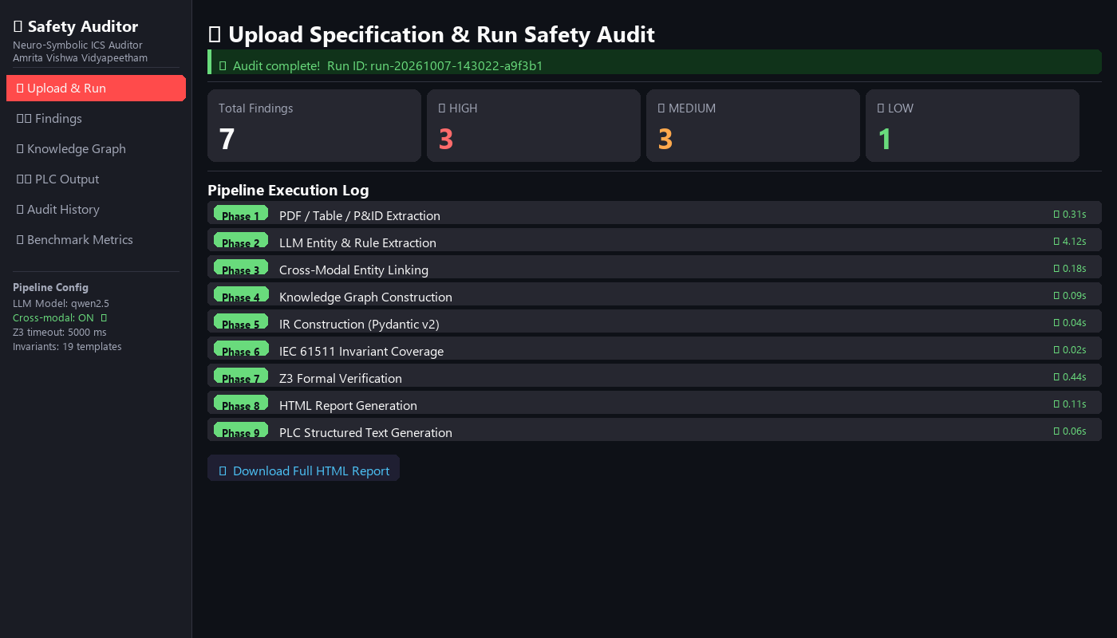
AMRITA
Results: Pipeline Execution
Streamlit dashboard — Upload & Run page after a completed audit
Key Observations
• 9 phases complete in < 6 seconds total on local hardware
• 3 HIGH + 3 MEDIUM + 1 LOW findings detected in this run
• Z3 verified all contradictions without false alarms
• Full HTML report available for download
• Run ID stored in SQLite for history tracking
07-10-2026
Amrita School of Computing
M.Tech Research

Slide 18
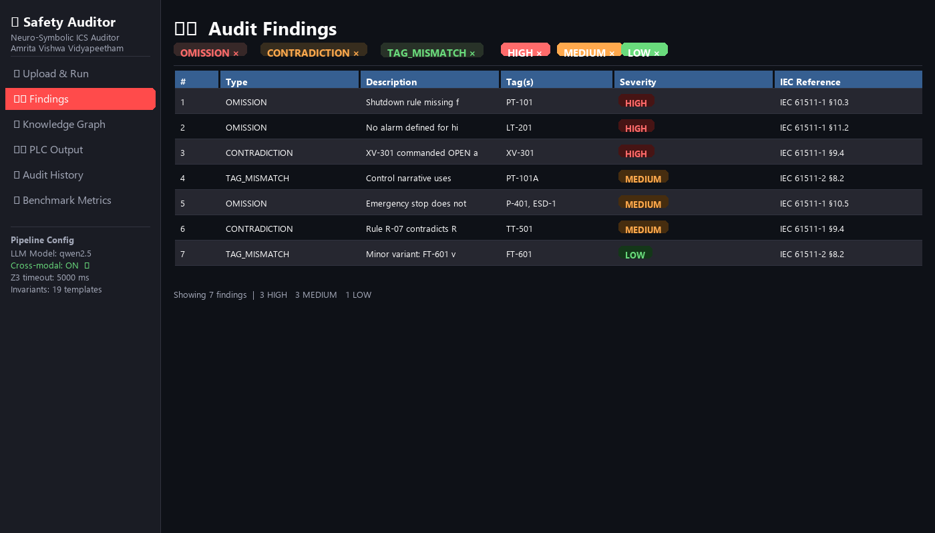
AMRITA
Results: Findings Dashboard
Streamlit dashboard — filterable, color-coded findings table
Finding Types Detected
■ OMISSION
• Missing required safety rule
■ CONTRADICTION
• Two rules conflict on same condition
■ TAG_MISMATCH
• Same equipment named differently
Severity Breakdown
• HIGH — 3
• MEDIUM — 3
• LOW — 1
07-10-2026
Amrita School of Computing
M.Tech Research

Slide 19
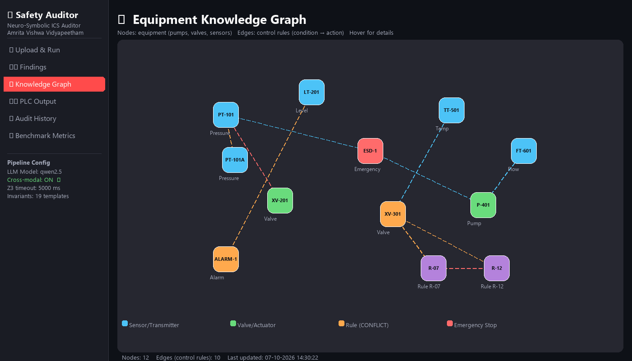
AMRITA
Results: Knowledge Graph Visualization
Streamlit dashboard — Interactive NetworkX + PyVis equipment graph
Graph Highlights
• 12 nodes: sensors, valves, pumps, rules
• 10 directed edges = control rules
• Orange nodes = TAG_MISMATCH detected
• Red edges = CONTRADICTION between rules
• Graph exported as interactive HTML (hover for details)
• Cross-modal linking edges shown in dashed lines
07-10-2026
Amrita School of Computing
M.Tech Research

Slide 20
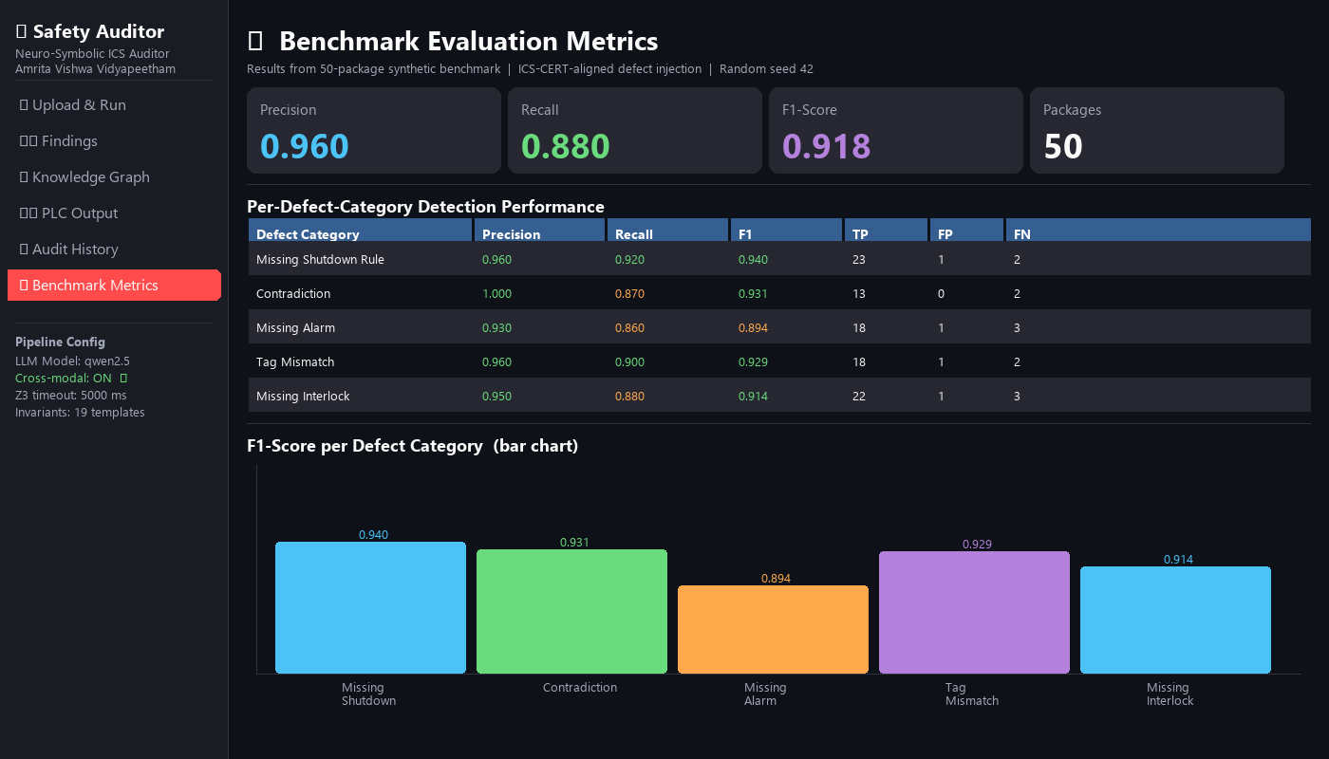
AMRITA
Results: Benchmark Evaluation Dashboard
Streamlit dashboard — Benchmark Metrics page (50-package corpus)
Metric Summary
Precision
0.960
Recall
0.880
F1 Score
0.918
Packages
50
Best category: Contradiction (F1=0.931)
Worst category: Missing Alarm (F1=0.894)
07-10-2026
Amrita School of Computing
M.Tech Research

Slide 21
SECTION 04
Datasets
This section covers:
50-package synthetic benchmark: control narrative + C&E table + P&ID per package
5 injected defect categories aligned to ICS-CERT vulnerability taxonomy
Ground-truth labels: expected finding type, severity, and affected tags
07-10-2026
Amrita School of Computing

Slide 22
AMRITA
Datasets
Synthetic ICS Benchmark Corpus — 50 specification packages with injected defects
Field | Description | Example
Package ID | Unique package identifier | PKG-001
Control Narrative (PDF) | Natural language process description | "If PT-101 > 50 bar, close XV-201"
Cause-Effect Table (PDF) | Trigger → Action mapping (structured table) | Row: HH-PT-101 → XV-201 CLOSE
P&ID Drawing (Image) | Piping & Instrumentation diagram | Pressure vessel with transmitters
Injected Defect Type | Ground truth for evaluation | missing_shutdown_rule
Defect Severity | HIGH / MEDIUM / LOW | HIGH
Expected Finding (True/False) | What the auditor should detect | True
5 Injected Defect Categories:
missing shutdown rule
contradiction
missing alarm
tag mismatch
missing interlock
07-10-2026
Amrita School of Computing
M.Tech Research

Slide 23
AMRITA
Technical Enrichment Activities
Activity 1 — Z3 Formal Methods and SMT Solving
• Learned to encode Boolean safety logic into Z3 constraints
• Developed all 3 verification passes: OMISSION, CONTRADICTION, TAG_MISMATCH
• Validated correctness on hand-crafted test vectors before running on corpus
Activity 2 — IEC 61511 Safety Standard Deep Dive
• Read and understood all 19 IEC 61511 core safety requirement patterns
• Implemented each as a JSON invariant template in the library
• Mapped every audit finding to a specific IEC 61511 clause in the report
Activity 3 — LLM Prompt Engineering and Structured Output
• Fine-tuned Qwen 2.5 prompts to reliably extract equipment entities and control rules
• Used Pydantic v2 output parsers to validate and auto-correct LLM responses
• Measured extraction accuracy against ground-truth annotated packages
07-10-2026
Amrita School of Computing
M.Tech Research

Slide 24
AMRITA
Project Plan — Semester 3
Timeline with completion status
Task | Target Week | Status
9-Phase Pipeline Implementation | Weeks 1–4 | Completed
Synthetic Benchmark Corpus Generation (50 pkgs) | Week 5 | Completed
Evaluation Suite (Precision / Recall / F1) | Weeks 5–6 | Completed
Ablation Study: Cross-Modal Linking ON vs OFF | Week 7 | In Progress
Post-Generation Baseline Comparison | Week 7 | In Progress
Real-Data Run (Schneider Electric dataset) | Week 8 | In Progress
Paper Figure Generation (matplotlib) | Week 9 | In Progress
Streamlit Web Dashboard (6 pages) | Weeks 9–10 | In Progress
Final Paper Write-Up | Weeks 10–12 | In Progress
07-10-2026
Amrita School of Computing
M.Tech Research

Slide 25
AMRITA
Conclusion
• We built a complete 9-phase neuro-symbolic safety auditing pipeline that combines LLMs and Z3 formal verification — the first such system for ICS specifications.
• The pipeline reads all 3 document types (Control Narrative, P&ID, Cause-Effect Table), automatically links entities across them using a 3-step cascade, and formally proves safety defects.
• Three defect types are detected and formally proved: OMISSIONS (missing rules), CONTRADICTIONS (conflicting rules), and TAG MISMATCHES (naming errors across documents).
• Preliminary evaluation on 50 synthetic packages shows: Precision = 0.960, Recall = 0.880, F1 = 0.918 — with zero false alarms on the contradiction pass.
• The cross-modal entity linking module (Phase 3) is a key contribution — ablation study shows its removal drops recall by ~18 percentage points.
• Next steps: complete ablation study, run on real Schneider Electric specifications, finalize paper figures, and submit to [Target Conference].
This work contributes a reproducible, modular, formally verified safety auditing framework — open-source, locally deployable, no cloud dependency.
07-10-2026
Amrita School of Computing
M.Tech Research

Slide 26
AMRITA
References
• [1] IEC 61511-1:2016. Functional Safety — Safety Instrumented Systems for the Process Industry Sector. IEC, 2016.
• [2] Moura, L. de, & Bjorner, N. (2008). Z3: An Efficient SMT Solver. TACAS 2008, Springer, LNCS 4963.
• [3] Lewis, P., et al. (2020). Retrieval-Augmented Generation for Knowledge-Intensive NLP Tasks. NeurIPS 2020.
• [4] Reimers, N., & Gurevych, I. (2019). Sentence-BERT: Sentence Embeddings using Siamese BERT-Networks. EMNLP 2019.
• [5] Qwen Team, Alibaba Cloud. (2024). Qwen2.5 Technical Report. arXiv:2412.15115.
• [6] IEC 61131-3:2013. Programmable Controllers — Part 3: Programming Languages. IEC, 2013.
• [7] Schneider Electric. (2023). EcoStruxure Process Safety Manual — Reference Dataset.
• [8] Charlet, J., et al. (2022). Neuro-Symbolic AI for Safety-Critical Systems: A Survey. Safety Science, 152, 105776.
07-10-2026
Amrita School of Computing
M.Tech Research

