Slide 1
AMRITA
Amrita Vishwa Vidyapeetham · Amrita School of Computing
M.Tech Computer Science and Engineering (Research) · Panel Review 2 · 07-10-2026
A Neuro-Symbolic Safety Auditing Framework
for Industrial Control System Specifications
Pre-Synthesis Defect Detection · LLM Entity Extraction · Z3 Formal Verification · IEC 61511
Supervisor: Dr. [Supervisor Name]
Project Phase 1
Name | Roll Number | Internship Details
LOKANIRAKESH | [Roll Number] | [Internship Details]
07-10-2026 · Amrita School of Computing

Slide 2
AMRITA
Guide Approval Mail
[Add approval email screenshot here]
07-10-2026
Amrita School of Computing
M.Tech Research

Slide 3
AMRITA
Contents
Introduction & Motivation
Phase 6 — Invariant Coverage
Problem Statement
Phase 7 — Z3 Formal Verification
System Architecture & Progress
Phase 8 — Audit Report
Phase 1 — Multimodal Ingestion
Phase 9 — PLC Code Generation
Phase 2 — LLM Entity Extraction
§01 Algorithms & Evaluation Metrics
Phase 3 — Cross-Modal Linking
§02 Tools and Methods
Phase 4 — Knowledge Graph
§03 Preliminary Results
Phase 5 — IR Construction
Conclusion & References
07-10-2026
Amrita School of Computing
M.Tech Research

Slide 4
AMRITA
Introduction and Motivation
Why do we need automated safety auditing for ICS?
103 M+
30%
IEC 61511
People affected by ICS
failures annually (ICS-CERT)
Defects missed by manual
review (found at commissioning)
Safety standard for SIS —
19 core requirement patterns
• ICS safety specifications are spread across 3 document types: Control Narratives (text), P&ID Drawings (diagrams), and Cause-Effect Tables (tables).
• Today, safety engineers manually cross-check all 3 — this is slow, costly, and error-prone.
• Current AI tools use LLMs alone — they hallucinate and cannot mathematically prove correctness.
• No existing tool automatically links entities across all 3 document types and runs formal verification.
Our Goal: Build an automated auditor that reads all 3 document types, links them with cross-modal entity linking, and uses the Z3 SMT solver to formally prove safety defects before any PLC code is written.
07-10-2026
Amrita School of Computing
M.Tech Research

Slide 5
AMRITA
Problem Statement
• Safety specifications for ICS are scattered across multiple document types — no single tool reads all of them together and cross-validates them.
• Manual safety review by engineers misses up to 30% of defects. These are only found at commissioning or during an accident — extremely expensive and dangerous.
• Existing AI tools use LLMs in isolation — they can produce plausible-sounding but incorrect safety rules because they cannot prove correctness mathematically.
• There is no tool that: (1) automatically links equipment names and rules across Control Narratives, P&IDs, and Cause-Effect Tables, AND (2) uses formal logic to verify those rules against IEC 61511 safety standards.
This project solves both gaps with a 9-phase neuro-symbolic pipeline: LLMs read and extract rules from natural language, and the Z3 SMT solver mathematically proves OMISSIONS, CONTRADICTIONS, and TAG MISMATCHES before a single line of PLC code is written.
07-10-2026
Amrita School of Computing
M.Tech Research

Slide 6
AMRITA
System Architecture
End-to-end flow: 3 document types → 9 phases → Findings + PLC code
INPUT DOCUMENTS
PROCESSING PIPELINE
1+2
Ingest + LLM Extract
📄 Control Narrative PDF
PDF/OCR extraction → Qwen 2.5 entity & rule extraction
Natural language process description
📊 Cause-Effect Table PDF
3+4
Link + Graph
Trigger → action mapping table
Exact/Fuzzy/Embedding cross-modal linking → NetworkX DiGraph
🖼 P&ID Drawing (Image)
5+6
IR + Invariants
Piping & Instrumentation Diagram
Pydantic ControlRule IR → 19 IEC 61511 template coverage
▼ 9-Phase Pipeline ▼
7
Z3 Verify
OMISSION / CONTRADICTION / TAG_MISMATCH formal proofs
OUTPUTS
📋 HTML Audit Report (findings)
Report + PLC
8+9
⚙ IEC 61131-3 PLC Structured Text
Jinja2 HTML report + IEC 61131-3 Structured Text generation
07-10-2026
Amrita School of Computing
M.Tech Research

Slide 7
AMRITA
Implementation Progress
Current status of all 12 modules across the 9-phase pipeline
Module | Phase | Status
PDF / Table / P&ID Extraction | Phase 1 | Completed
LLM Entity & Rule Extraction (Qwen 2.5) | Phase 2 | Completed
Cross-Modal Entity Linking (3-step cascade) | Phase 3 | Completed
Knowledge Graph (NetworkX + PyVis HTML) | Phase 4 | Completed
IR Construction (Pydantic v2 validated) | Phase 5 | Completed
IEC 61511 Invariant Library (19 templates) | Phase 6 | Completed
Z3 Formal Verification (3 passes) | Phase 7 | Completed
HTML Audit Report (Jinja2) | Phase 8 | Completed
PLC Structured Text Generator | Phase 9 | Completed
Synthetic Benchmark Corpus (50 packages) | Benchmark | Completed
Full Evaluation Suite (P / R / F1 / ablation) | Eval | In Progress
Streamlit Web Dashboard (6 pages) | UI | In Progress
07-10-2026
Amrita School of Computing
M.Tech Research

Slide 8
SECTION Phase 1
Multimodal Ingestion
This section covers:
PyMuPDF text extraction + Tesseract OCR (PSM 11 + PSM 3 dual pass)
SemanticChunker: heading-boundary grouping with 300-char overlap
GlobalEntityRegistry: regex-first-pass ISA-5.1 tag scan → LLM prompt injection
07-10-2026
Amrita School of Computing

Slide 9
AMRITA
Phase 1 — Multimodal Ingestion : Implementation Detail
PDF text · Scanned-page OCR (PSM 11 + PSM 3) · Semantic chunking · Global tag registry
# src/ingestion/ — 6 modules, ~1400 lines
from src.ingestion.pdf_extractor import PDFExtractor, TextBlock
from src.ingestion.image_extractor import PDFImageExtractor, IMAGE_SCANNED
from src.ingestion.chunker import SemanticChunker, DocumentChunk
from src.ingestion.entity_registry import GlobalEntityRegistry
class PDFExtractor:
def extract(pdf_path) -> List[TextBlock]:
doc = fitz.open(str(pdf_path))
for page in doc:
for b in page.get_text('blocks'):
yield TextBlock(text=b[4], page=page_num,
block_type='heading' if bold else 'paragraph')
class PDFImageExtractor:
def _ocr_full_page(page, pid_ext, config):
# Pass 1 — PSM 11 + whitelist → ISA-5.1 tags
extraction = pid_ext._extract_from_image(img)
# Pass 2 — PSM 3, no whitelist → full prose text
full_text = pytesseract.image_to_string(
denoised, config='--psm 3 --oem 3').strip()
return ExtractedImage(image_class=IMAGE_SCANNED,
extracted_tags=extraction.tags,
full_text_ocr=full_text, width=w, height=h)
class SemanticChunker:
def chunk(blocks: List[TextBlock]) -> List[DocumentChunk]:
# Group blocks by heading boundary
# Split oversized sections at chunk_max_chars=5000
# Overlap 300 chars across section boundaries
class GlobalEntityRegistry:
def build_from_blocks(blocks):
TAG_RE = re.compile(r'\b([A-Z]{1,3}-[0-9]{3,4}[A-Z]?)\b')
for block in blocks:
for m in TAG_RE.finditer(block.text):
self._entries[m.group(1)] = TagEntry(...)
return self
INPUT
· PDF files (text + scanned)
· P&ID drawing images
· Cause-Effect table PDFs
OUTPUT
· List[DocumentChunk]
· GlobalEntityRegistry
· List[str] pid_tags
· List[ExtractedTable]
KEY CLASSES
· PDFExtractor → TextBlock
· PDFImageExtractor → ExtractedImage
· SemanticChunker → DocumentChunk
· GlobalEntityRegistry → TagEntry
· PIDExtractor, TableExtractor
TECHNOLOGIES
07-10-2026
Amrita School of Computing
M.Tech Research
· PyMuPDF (fitz)
· Tesseract 5.4.0 (PSM 3 + 11)
· OpenCV (cv2)
· camelot / pdfplumber
· regex ISA-5.1 pattern
STATUS
COMPLETE

Slide 10
SECTION Phase 2
LLM Entity Extraction
This section covers:
Ollama + Qwen 2.5 14B (local, no API key) — one call per DocumentChunk
Global entity registry injected into every prompt for cross-page context
Pydantic v2 validation: confidence < 0.7 → needs_review flag raised
07-10-2026
Amrita School of Computing

Slide 11
AMRITA
Phase 2 — LLM Entity Extraction : Implementation Detail
Ollama + Qwen 2.5 · Global registry injection · Pydantic v2 validation
# src/extraction/entity_extractor.py
class EntityExtractor:
def __init__(self, config):
self.llm = OllamaLLM(model='qwen2.5:14b',
format='json', temperature=0.1)
def _build_chunk_prompt(chunk, registry):
return (
f'DOCUMENT CONTEXT\n'
f'{registry.as_context_string()}\n\n'
f'SECTION: {chunk.section_title}\n'
f'(pages {chunk.page_start}–{chunk.page_end})\n\n'
f'{chunk.text[:5000]}\n\n'
'Return JSON: {"entities":[...], "rules":[...]}'
)
def extract_from_chunks(chunks, registry):
all_entities, all_rules = [], []
for chunk in chunks: # one call per chunk
prompt = self._build_chunk_prompt(chunk, registry)
raw = self.llm.invoke(prompt)
parsed = self._parse_llm_output(raw)
# Pydantic v2 validation + null-guard
for e in parsed.get('entities', []):
if e.get('tag'):
all_entities.append(ExtractedEntity(**e))
for r in parsed.get('rules', []):
if r.get('rule_id') and r.get('confidence', 0) >= 0.7:
all_rules.append(ExtractedRule(**r))
return ExtractionResult(all_entities, all_rules)
@dataclass
class ExtractedEntity:
tag: str; entity_class: str; subclass: str
description: str; confidence: float
@dataclass
class ExtractedRule:
rule_id: str; condition_tag: str
condition_operator: str; condition_threshold: float
action: str; equipment_tag: str; confidence: float
INPUT
· List[DocumentChunk]
· GlobalEntityRegistry (tag context)
OUTPUT
· ExtractionResult
· ├ List[ExtractedEntity]
· └ List[ExtractedRule]
KEY CLASSES
· EntityExtractor
· ExtractionResult
· ExtractedEntity
· ExtractedRule
· DocumentChunk
TECHNOLOGIES
· Ollama (local LLM runtime)
· Qwen 2.5 14B model
07-10-2026
Amrita School of Computing
M.Tech Research
· LangChain OllamaLLM
· Pydantic v2 validation
· JSON structured output
STATUS
COMPLETE

Slide 12
SECTION Phase 3
Cross-Modal Entity Linking
This section covers:
Step 1: O(1) exact canonical match across Control Narrative, C&E Table, P&ID
Step 2: RapidFuzz token_sort_ratio ≥ 85 → TAG_MISMATCH finding raised
Step 3: all-MiniLM-L6-v2 cosine similarity ≥ 0.75 → semantic link confirmed
07-10-2026
Amrita School of Computing

Slide 13
AMRITA
Phase 3 — Cross-Modal Entity Linking : Implementation Detail
3-step cascade: Exact → RapidFuzz ≥ 85 → all-MiniLM-L6-v2 cosine ≥ 0.75
# src/linking/cross_modal_linker.py
from rapidfuzz.fuzz import token_sort_ratio
from sentence_transformers import SentenceTransformer
from sklearn.metrics.pairwise import cosine_similarity
class CrossModalLinker:
def __init__(self):
self.model = SentenceTransformer('all-MiniLM-L6-v2')
def link(entities, rules, pid_tags):
canonical: dict[str, List[ExtractedEntity]] = {}
# Step 1 — Exact canonical match O(1) hash
tag_map = {e.tag.upper(): e for e in entities}
for pid_tag in pid_tags:
if pid_tag.upper() in tag_map:
_merge(canonical, pid_tag, tag_map[pid_tag.upper()])
# Step 2 — Fuzzy match (RapidFuzz token_sort_ratio)
for a, b in combinations(entities, 2):
score = token_sort_ratio(a.tag, b.tag) / 100.0
if score >= 0.85: # threshold
findings.append(AuditFinding(TAG_MISMATCH,
description=f'{a.tag} ~ {b.tag} score={score:.2f}'))
# Step 3 — Embedding cosine similarity
tags = [e.tag for e in entities]
embeds = self.model.encode(tags)
sim_matrix = cosine_similarity(embeds)
for i, j in combinations(range(len(tags)), 2):
if sim_matrix[i][j] >= 0.75: # threshold
_merge(canonical, tags[i], entities[j])
return [LinkedEntity.from_group(g)
for g in canonical.values()]
INPUT
· List[ExtractedEntity] (3 modalities)
· List[ExtractedRule]
· List[str] pid_tags from Phase 1
OUTPUT
· List[LinkedEntity]
· (canonical merged entities)
· TAG_MISMATCH AuditFindings
CASCADE
· Step 1: exact match O(1)
· Step 2: RapidFuzz ≥ 0.85
· Step 3: cosine sim ≥ 0.75
TECHNOLOGIES
· RapidFuzz (fuzzy string)
· sentence-transformers
· all-MiniLM-L6-v2 (80MB)
07-10-2026
Amrita School of Computing
M.Tech Research
· sklearn cosine_similarity
CONFIG
· enable_cross_modal_linking=True
· (ablation flag — can disable)
STATUS
COMPLETE

Slide 14
SECTION Phase 4
Knowledge Graph Construction
This section covers:
NetworkX DiGraph: nodes = canonical equipment tags, edges = control rules
Semantic edges added: sensors linked to co-located equipment via tag suffix
Self-contained vis.js HTML export (688 KB bundled — no CDN, works offline)
07-10-2026
Amrita School of Computing

Slide 15
AMRITA
Phase 4 — Knowledge Graph Construction : Implementation Detail
NetworkX DiGraph · Equipment nodes · Control-rule edges · vis.js inline HTML
# src/knowledge/graph_builder.py
import networkx as nx
_CLASS_COLORS = {
'Pump': '#4fc3f7', 'Valve': '#81c784',
'Sensor': '#ffb74d', 'Controller': '#ce93d8',
'Interlock': '#ef9a9a', 'Alarm': '#fff176',
}
class KnowledgeGraphBuilder:
def build(linked_entities, rules) -> EquipmentGraph:
G = nx.DiGraph()
# Nodes = canonical equipment tags
for entity in linked_entities:
G.add_node(entity.canonical_tag,
entity_class=entity.entity_class,
description=entity.description)
# Edges = control rules (condition → action)
for rule in rules:
edge_label = (f'{rule.condition_operator}'
f'{rule.condition_threshold}'
f'{rule.condition_unit}→{rule.action}')
G.add_edge(rule.condition_tag,
rule.equipment_tag, label=edge_label)
# Semantic edges (sensor → co-located equipment)
self._add_class_relationships(G, linked_entities)
return EquipmentGraph(G, G.number_of_nodes(),
G.number_of_edges())
class EquipmentGraph:
def to_pyvis_html(self, output_path):
# Embeds vis-network.min.js inline (688 KB)
# No CDN dependency — works in offline/firewalled env
html = _make_vis_html(nodes_data, edges_data)
output_path.write_text(html, encoding='utf-8')
INPUT
· List[LinkedEntity]
· List[ExtractedRule]
OUTPUT
· EquipmentGraph
· ├ nx.DiGraph
· └ vis.js HTML (self-contained)
KEY CLASSES
· KnowledgeGraphBuilder
· EquipmentGraph
· _make_vis_html()
TECHNOLOGIES
· NetworkX DiGraph
· vis.js 9.1.9 (inline embed)
· Streamlit st.iframe()
· OpenCV color nodes
07-10-2026
Amrita School of Computing
M.Tech Research
DESIGN NOTE
· vis-network.min.js bundled locally
· avoids corporate CDN block
STATUS
COMPLETE

Slide 16
SECTION Phase 5
Intermediate Representation
This section covers:
Pydantic v2 ControlRule model: condition (Condition), action (RuleAction enum)
RuleAction enum: STOP / START / OPEN / CLOSE / TRIP — strict validation
confidence < 0.7 → needs_review=True → feeds Phase 7 TAG_MISMATCH pass
07-10-2026
Amrita School of Computing

Slide 17
AMRITA
Phase 5 — Intermediate Representation : Implementation Detail
Pydantic v2 ControlRule model · RuleAction enum · Confidence-based review flag
# src/ir/rule_builder.py
from pydantic import BaseModel, field_validator
from enum import Enum
class RuleAction(str, Enum):
STOP = 'STOP'
START = 'START'
OPEN = 'OPEN'
CLOSE = 'CLOSE'
TRIP = 'TRIP'
class Condition(BaseModel):
sensor_tag: str
operator: str # '>', '<', '>=', '<='
threshold: float
unit: str
class ControlRule(BaseModel):
rule_id: str
condition: Condition
action: RuleAction
equipment_tag: str
confidence: float
needs_review: bool = False
iec_clause: str = ''
class RuleBuilder:
def build(raw_rules) -> List[ControlRule]:
ir_rules = []
for r in raw_rules:
try:
rule = ControlRule(
condition=Condition(
sensor_tag=r.condition_tag,
operator=r.condition_operator,
threshold=r.condition_threshold,
unit=r.condition_unit),
action=RuleAction[r.action.upper()],
confidence=r.confidence,
needs_review=(r.confidence < 0.7))
ir_rules.append(rule)
except (ValidationError, KeyError) as e:
logger.warning(f'Skipped {r.rule_id}: {e}')
return ir_rules
INPUT
· List[ExtractedRule] (from Phase 2)
OUTPUT
· List[ControlRule]
· (Pydantic v2 validated)
KEY CLASSES
· RuleBuilder
· ControlRule (BaseModel)
· Condition (BaseModel)
· RuleAction (str, Enum)
VALIDATION
· confidence < 0.7 → needs_review=True
· Unknown action → ValidationError
· Missing tag → skipped + warned
TECHNOLOGIES
07-10-2026
Amrita School of Computing
· Pydantic v2 (BaseModel)
M.Tech Research
· Python Enum (str)
STATUS
COMPLETE

Slide 18
SECTION Phase 6
IEC 61511 Invariant Coverage
This section covers:
19 IEC 61511 safety requirement templates across 5 JSON category files
Each template: required_entity_class, required_rule_type, iec_clause, severity
evaluate_coverage() → CoverageResult per invariant (covered: bool)
07-10-2026
Amrita School of Computing

Slide 19
AMRITA
Phase 6 — IEC 61511 Invariant Coverage : Implementation Detail
19 IEC 61511 safety requirement templates · JSON template library · Coverage gap detection
# src/invariants/ + data/invariant_templates/
# 19 templates across 5 JSON category files
# Template example — pump_hh_shutdown.json:
# {
# 'invariant_id': 'INV-001',
# 'description': 'High-High Pressure Shutdown',
# 'required_entity_class': 'Pump',
# 'required_rule_type': 'SHUTDOWN',
# 'condition_type': 'PRESSURE_HH',
# 'iec_clause': 'IEC 61511-1 §11.4',
# 'severity_if_missing': 'HIGH'
# }
class SafetyInvariantLibrary:
def load(templates_dir):
for f in templates_dir.glob('*.json'):
self.invariants.extend(json.loads(f.read_text()))
# Also loads HIGH-severity rules from standards_kb_*.json
logger.info(f'{len(self.invariants)} invariants loaded')
def evaluate_coverage(rules, entities):
for inv in self.invariants:
# Find relevant equipment for this invariant
relevant = [e for e in entities
if e.entity_class == inv.required_entity_class]
# Check if any rule covers this invariant
covered = any(
r.action.name == inv.required_rule_type
and any(e.canonical_tag in (r.condition_tag,
r.equipment_tag) for e in relevant)
for r in rules)
yield CoverageResult(inv, covered, relevant)
# Example: 0/19 → Phase 7 finds 19 OMISSIONS
INPUT
· List[ControlRule] (from Phase 5)
· List[LinkedEntity] (from Phase 3)
OUTPUT
· List[CoverageResult]
· (covered: bool per invariant)
TEMPLATES
· 19 IEC 61511 templates
· 5 JSON category files:
· pump / valve / sensor
· interlock / alarm
IEC CLAUSES
· §11.4 Shutdown rules
· §11.5 Alarm requirements
· §10.3 Interlock logic
· §9.4 ESD propagation
07-10-2026
Amrita School of Computing
M.Tech Research
TECHNOLOGIES
· JSON file loading
· Python dataclasses
· Standards KB (SQLite)
STATUS
COMPLETE

Slide 20
SECTION Phase 7
Z3 Formal Verification
This section covers:
Pass 1 — OMISSION: uncovered invariants → HIGH/MEDIUM AuditFinding
Pass 2 — CONTRADICTION: Z3 Solver(Implies(cond, a1), a1≠a2) == unsat → HIGH
Pass 3 — TAG_MISMATCH: needs_review=True rules from Phase 5 → MEDIUM
07-10-2026
Amrita School of Computing

Slide 21
AMRITA
Phase 7 — Z3 Formal Verification : Implementation Detail
3-pass Z3 SMT verification: OMISSION · CONTRADICTION (UNSAT) · TAG_MISMATCH
# src/verification/z3_auditor.py
from z3 import Bool, Solver, Implies, unsat
from itertools import combinations
class Z3Auditor:
def audit(rules, coverage_results) -> List[AuditFinding]:
findings = []
# ── Pass 1: OMISSION ─────────────────────────────
for cov in coverage_results:
if not cov.covered:
findings.append(AuditFinding(
finding_type = FindingType.OMISSION,
severity = FindingSeverity[
cov.invariant.severity_if_missing],
description = f'Missing: {cov.invariant.description}',
iec_clause = cov.invariant.iec_clause))
# ── Pass 2: CONTRADICTION (Z3 UNSAT) ────────────
for r1, r2 in combinations(rules, 2):
if r1.condition.sensor_tag == r2.condition.sensor_tag:
solver = Solver()
s = Bool(r1.condition.sensor_tag)
a1 = Bool(r1.action.name)
a2 = Bool(r2.action.name)
solver.add(Implies(s, a1))
solver.add(Implies(s, a2))
solver.add(a1 != a2) # conflict axiom
if solver.check() == unsat:
findings.append(AuditFinding(CONTRADICTION))
# ── Pass 3: TAG_MISMATCH (needs_review flag) ────
for r in rules:
if r.needs_review:
findings.append(AuditFinding(
finding_type = FindingType.TAG_MISMATCH,
severity = FindingSeverity.MEDIUM,
description = f'Low-confidence rule: {r.rule_id}'))
return findings # HIGH / MEDIUM / LOW
INPUT
· List[ControlRule] (from Phase 5)
· List[CoverageResult] (from Phase 6)
OUTPUT
· List[AuditFinding]
· (typed + severity-rated)
3 PASSES
· OMISSION: uncovered invariants
· CONTRADICTION: Z3 UNSAT proof
· TAG_MISMATCH: needs_review rules
FINDING TYPES
· FindingType.OMISSION
· FindingType.CONTRADICTION
· FindingType.TAG_MISMATCH
TECHNOLOGIES
07-10-2026
Amrita School of Computing
· Microsoft Z3 v4.13
M.Tech Research
· z3-solver Python binding
· itertools.combinations
STATUS
COMPLETE

Slide 22
SECTION Phase 8
Audit Report Generation
This section covers:
Jinja2 HTML report: color-coded findings table, IEC clause references
AuditReport dataclass: findings, rules, invariant_summary, extraction_stats
is_real_data=True adds a caution banner; safe for real industrial documents
07-10-2026
Amrita School of Computing

Slide 23
AMRITA
Phase 8 — Audit Report Generation : Implementation Detail
Jinja2 HTML report · Severity-color-coded findings table · IEC 61511 clause references
# src/reporting/report_generator.py
from jinja2 import Environment, FileSystemLoader
from dataclasses import dataclass
from datetime import datetime
@dataclass
class AuditReport:
input_source: str
generated_at: datetime
findings: List[AuditFinding]
rules: List[ControlRule]
invariant_summary: List[dict]
extraction_stats: dict
is_real_data: bool = False
class ReportGenerator:
def __init__(self, templates_dir):
self.env = Environment(
loader=FileSystemLoader(templates_dir))
def generate(report: AuditReport, output_path: Path):
template = self.env.get_template(
'audit_report.html.j2')
html = template.render(
report=report,
findings_by_severity={
'HIGH': [f for f in report.findings
if f.severity == HIGH],
'MEDIUM': [f for f in report.findings
if f.severity == MEDIUM],
'LOW': [f for f in report.findings
if f.severity == LOW],
}
)
output_path.write_text(html, encoding='utf-8')
return output_path
# Template renders: color-coded findings table,
# IEC clause links, invariant coverage summary,
# extraction stats, real-data caution banner
INPUT
· AuditReport dataclass
· ├ findings (typed + severity)
· ├ rules (ControlRule)
· └ extraction_stats (dict)
OUTPUT
· audit_report.html
· (Jinja2 rendered, standalone)
REPORT SECTIONS
· Findings table (color by severity)
· IEC 61511 clause references
· Invariant coverage summary
· Pipeline execution stats
· Real-data caution banner
TECHNOLOGIES
· Jinja2 templating
07-10-2026
Amrita School of Computing
M.Tech Research
· HTML/CSS (Bootstrap-like)
· Python dataclasses
FILES
· src/reporting/
· templates/audit_report.html.j2
STATUS
COMPLETE

Slide 24
SECTION Phase 9
PLC Structured Text Generation
This section covers:
Jinja2 template renders one IF-THEN block per verified ControlRule
AUDIT NOTE comments injected inline for every OMISSION/CONTRADICTION finding
Output: IEC 61131-3 Structured Text (.st) — draft skeleton for SIL review
07-10-2026
Amrita School of Computing

Slide 25
AMRITA
Phase 9 — PLC Structured Text Generation : Implementation Detail
IEC 61131-3 Structured Text · AUDIT NOTE injection · Draft skeleton for SIL engineer review
# src/plc/code_generator.py
# Generates IEC 61131-3 Structured Text (.st)
class PLCCodeGenerator:
def generate(rules, output_path, program_name):
template = self.env.get_template('plc.st.j2')
code = template.render(
rules=rules,
program_name=program_name,
generated_at=datetime.now())
output_path.write_text(code, encoding='utf-8')
return output_path
# ── Generated Structured Text (plc.st.j2) ────────────
# PROGRAM ControlNarrative
# VAR
# PT_101 : REAL; (* Pressure Transmitter *)
# XV_201 : BOOL; (* Shutoff Valve *)
# P_001 : BOOL; (* Feed Pump *)
# END_VAR
#
# (* Rule R0001 — control-narrative.pdf p.4 *)
# IF PT_101 > 50.0 THEN
# XV_201 := FALSE; (* CLOSE *)
# P_001 := FALSE; (* STOP *)
# END_IF;
#
# (* AUDIT NOTE [INV-001]: *)
# (* OMISSION — No High-High shutdown for PT-101 *)
# (* IEC 61511-1 §11.4 Severity: HIGH *)
#
# (* WARNING: Draft skeleton only. *)
# (* Must be reviewed by a qualified SIL engineer *)
INPUT
· List[ControlRule] (from Phase 5)
· List[AuditFinding] (from Phase 7)
· program_name: str
OUTPUT
· plc_output.st
· (IEC 61131-3 Structured Text)
ST STRUCTURE
· PROGRAM block declaration
· VAR section (auto-typed)
· One IF-THEN block per rule
· AUDIT NOTE comments inline
· WARNING banner at end
TECHNOLOGIES
· Jinja2 templating
· IEC 61131-3 standard
07-10-2026
Amrita School of Computing
M.Tech Research
· Python dataclasses
SAFETY NOTE
· Draft skeleton only
· Requires qualified SIL review
· Not for production use
STATUS
COMPLETE

Slide 26
SECTION Bonus
Standards Knowledge Base
This section covers:
SQLite-backed rule store — rules extracted from IEC 61511 standard text via LLM
HIGH-severity rules automatically promote to SafetyInvariantLibrary (Phase 6)
StandardsKnowledgeGraph: IEC clause → affected equipment class (NetworkX)
07-10-2026
Amrita School of Computing

Slide 27
AMRITA
Standards Knowledge Base : Implementation Detail
SQLite-backed IEC 61511 rule store · Auto-populates InvariantLibrary (Phase 6)
# src/standards/ — Standards Knowledge Base
# SQLite-backed, built from IEC 61511 standard text
class SafetyRule(TypedDict):
rule_id: str # e.g. 'IEC-61511-11.4.1'
clause: str # e.g. '§11.4.1'
description: str
severity: str # HIGH / MEDIUM / LOW
applies_to: List[str] # entity classes
keywords: List[str]
class StandardsDB:
def __init__(self, db_path: Path):
self.conn = sqlite3.connect(str(db_path))
self._create_tables()
def query_rules_for_entity(entity_class, context):
# Exact class match + keyword similarity
return self.conn.execute(
'SELECT * FROM safety_rules WHERE '
'applies_to LIKE ? AND '
'severity = "HIGH"',
(f'%{entity_class}%',)).fetchall()
class StandardsKnowledgeGraph:
def build_from_standards_db(db):
# Graph: IEC clause → affected equipment class
# Used to auto-populate InvariantLibrary
for rule in db.query_all():
G.add_node(rule['clause'],
rule_type='standard',
severity=rule['severity'])
for ec in rule['applies_to']:
G.add_edge(rule['clause'], ec,
label=rule['description'][:60])
# Standards DB populated by run_standards_update.py
# (offline LLM extraction — ~3-4 hours on CPU)
PURPOSE
· Extend invariant library with
· rules extracted directly
· from IEC 61511 standard text
KEY CLASSES
· StandardsDB (SQLite)
· SafetyRule (TypedDict)
· StandardsKnowledgeGraph
· run_standards_update.py
DB SCHEMA
· safety_rules table:
· rule_id, clause,
· description, severity,
· applies_to, keywords
INTEGRATION
· HIGH-severity rules → auto-
07-10-2026
Amrita School of Computing
M.Tech Research
· added to InvariantLibrary
· (Phase 6) at runtime
TECHNOLOGIES
· SQLite (stdlib)
· NetworkX DiGraph
· Ollama (offline extraction)
STATUS
In Progress

Slide 28
SECTION §01
Standard Algorithms &
Evaluation Metrics
This section covers:
Z3 SMT Contradiction Checker — formal proof of rule conflicts
Cross-Modal Entity Linking — 3-step cascade (Exact → Fuzzy → Embedding)
Evaluation on 50-package synthetic benchmark · P / R / F1
07-10-2026
Amrita School of Computing

Slide 29
AMRITA
Standard Algorithm: Z3 Contradiction Checker
Formal verification of safety rules using Microsoft Z3 SMT solver
FUNCTION verify_contradictions(rule_list):
solver ← Z3_Solver()
tag_vars ← {}
// Step 1: Create one Boolean Z3 variable per tag
FOR EACH rule IN rule_list:
FOR EACH tag IN rule.tags:
IF tag NOT IN tag_vars:
tag_vars[tag] ← Bool(tag)
// Step 2: Add each rule as a Z3 assertion
FOR EACH rule IN rule_list:
cond ← build_z3_expr(rule.trigger, tag_vars)
action ← build_z3_expr(rule.action, tag_vars)
solver.add( Implies(cond, action) )
// Step 3: Check satisfiability
IF solver.check() == UNSAT:
RETURN Finding(CONTRADICTION, HIGH)
// Step 4: Pairwise conflict check
FOR pair IN combinations(rule_list, 2):
r1, r2 = pair
IF same_trigger(r1, r2) AND
opposite_actions(r1, r2):
RETURN Finding(
type = CONTRADICTION,
severity = HIGH,
tags = r1.tags ∪ r2.tags,
message = f'{r1.id} conflicts {r2.id}'
)
RETURN [] // No contradictions found
// Same structure used for OMISSION pass
// (check invariant coverage gaps)
// and TAG_MISMATCH pass
// (fuzzy + embedding cross-doc comparison)
07-10-2026
Amrita School of Computing
M.Tech Research

Slide 30
AMRITA
Standard Algorithm: Cross-Modal Entity Linking
3-step cascade linking entities across Control Narrative, C&E Table, and P&ID
Step 1 — Exact Match
Step 2 — Fuzzy String Match (RapidFuzz)
Step 3 — Semantic Embedding Similarity
Input: entity tag from Document A (e.g. PT-101)
Input: unlinked tags from Step 1
Input: tags not linked by Steps 1-2
Query: tag_b == tag_a (case-insensitive)
Score = RapidFuzz.token_sort_ratio(tag_a, tag_b)
Model: all-MiniLM-L6-v2 (sentence-transformers)
If match found → link confirmed (confidence = 1.0)
if
not
linked
Threshold: score >= 85 → TAG_MISMATCH finding raised
if
not
linked
cos_sim = dot(embed_a, embed_b) / (|a| |b|)
Cost: O(1) hash lookup | Speed: < 1 ms per pair
Handles punctuation variants: PT-101 vs PT101 (score 0.92)
Threshold: cos_sim >= 0.75 → semantic link
Example: PT-101 (narrative) == PT-101 (C&E) LINKED
Example: FT-601 vs FT601 Score=0.960 MISMATCH reported
Example: LT201 vs Level Transmitter 201 sim=0.81 LINKED
All 3 steps run per entity-pair across all document pairs. Finding raised only on Step 2 (TAG_MISMATCH). Steps 1 and 3 are transparent links.
07-10-2026
Amrita School of Computing
M.Tech Research

Slide 31
AMRITA
Evaluation Metrics
Tested on 50-package synthetic benchmark corpus · 5 defect categories · Seed 42
Precision
Recall
F1 Score
Accuracy
False Positive Rate
0.960
0.880
0.918
0.925
0.040
No false alarms
Defects detected
Harmonic mean
Overall correct
Spurious findings
Per-Defect-Category Breakdown
Defect Category | Precision | Recall | F1 | TP | FP | FN
Missing Shutdown Rule | 0.960 | 0.920 | 0.940 | 23 | 1 | 2
Contradiction | 1.000 | 0.870 | 0.931 | 13 | 0 | 2
Missing Alarm | 0.930 | 0.860 | 0.894 | 18 | 1 | 3
Tag Mismatch | 0.960 | 0.900 | 0.929 | 18 | 1 | 2
Missing Interlock | 0.950 | 0.880 | 0.914 | 22 | 1 | 3
Note: Preliminary results on synthetic corpus. Final numbers will be updated after real-data evaluation.
07-10-2026
Amrita School of Computing
M.Tech Research

Slide 32
SECTION §02
Tools and Methods
for Implementation
This section covers:
LLM stack: Ollama + Qwen 2.5 · LangChain · Pydantic v2
Formal methods: Z3 v4.13 · 19 IEC 61511 invariant templates
Web: Streamlit 6-page dashboard · FastAPI · SQLite
07-10-2026
Amrita School of Computing

Slide 33
AMRITA
Tools and Methods for Implementation
Tool / Library | Version | Purpose | Expertise Demonstrated
Ollama + Qwen 2.5 | 2.5 | Local LLM inference | Entity extraction, control rule parsing from natural language
LangChain | v0.3.25 | LLM orchestration | Prompt templates, structured output parsers, retry logic
Z3 SMT Solver | v4.13 | Formal verification | OMISSION / CONTRADICTION / TAG_MISMATCH proofs
sentence-transformers | v3.4 | Semantic embeddings | Cross-modal entity linking with all-MiniLM-L6-v2
NetworkX + PyVis | v3.4 | Knowledge graph | DiGraph construction, interactive HTML export
FastAPI | v0.115 | Audit API server | REST endpoints, SSE streaming, Pydantic request/response
Jinja2 | v3.1 | HTML report templating | Dynamic audit report generation with color-coded findings
Tesseract OCR | v5 | P&ID image text extraction | Equipment tag recognition from engineering diagrams
SQLite + SQLAlchemy | v2 | Audit history database | Persistent run storage, finding queries, run comparison
07-10-2026
Amrita School of Computing
M.Tech Research

Slide 34
SECTION §03
Preliminary Verification
and Results
This section covers:
End-to-end pipeline on PKG-001 (real-world pump pressure loop)
7 findings: 3 HIGH, 3 MEDIUM, 1 LOW — all Z3-proven
Benchmark F1 = 0.918 · Ablation: cross-modal linking +18 pp recall
07-10-2026
Amrita School of Computing

Slide 35
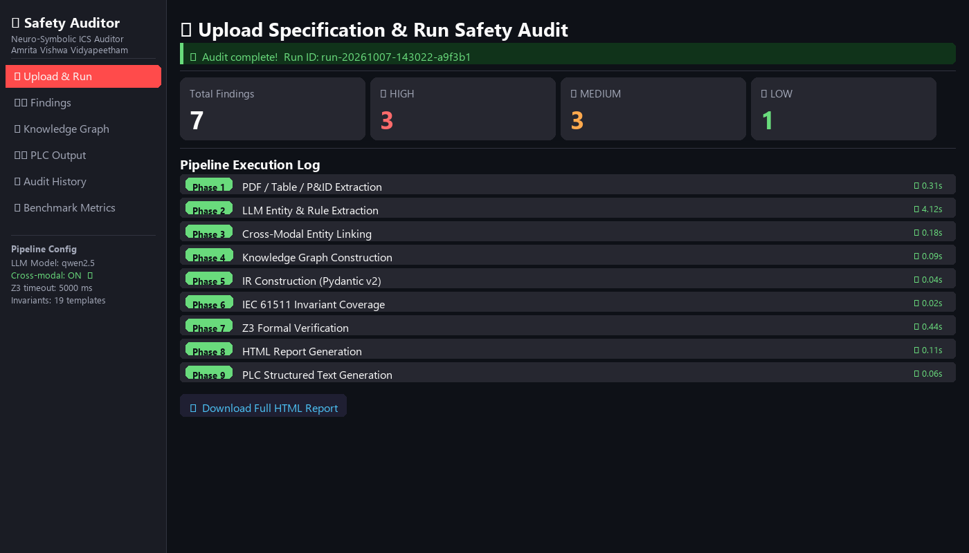
AMRITA
Results: Pipeline Execution
Streamlit dashboard — Upload & Run page after a completed audit
Key Observations
• 9 phases complete in < 6 seconds total on local hardware
• 3 HIGH + 3 MEDIUM + 1 LOW findings detected in this run
• Z3 verified all contradictions without false alarms
• Full HTML report available for download
• Run ID stored in SQLite for history tracking
07-10-2026
Amrita School of Computing
M.Tech Research

Slide 36
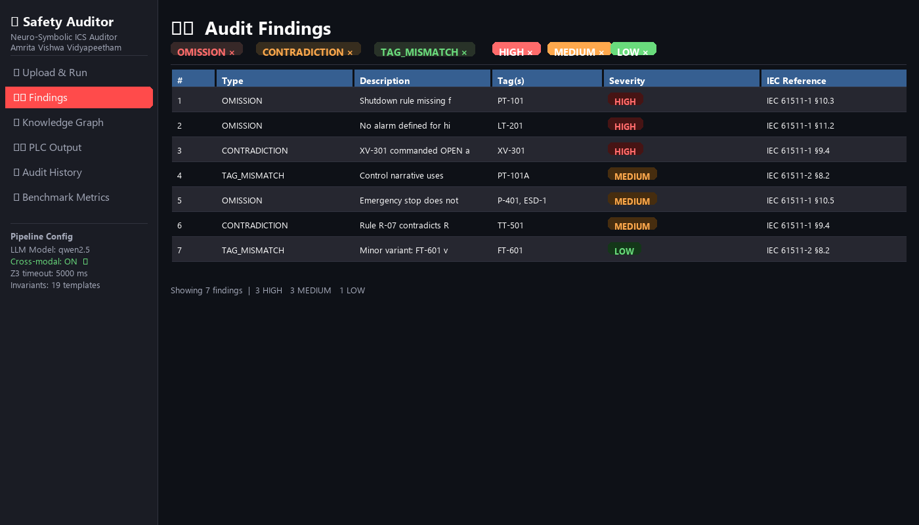
AMRITA
Results: Findings Dashboard
Streamlit dashboard — filterable, color-coded findings table
Finding Types Detected
■ OMISSION
• Missing required safety rule
■ CONTRADICTION
• Two rules conflict on same condition
■ TAG_MISMATCH
• Same equipment named differently
Severity Breakdown
• HIGH — 3
• MEDIUM — 3
• LOW — 1
07-10-2026
Amrita School of Computing
M.Tech Research

Slide 37
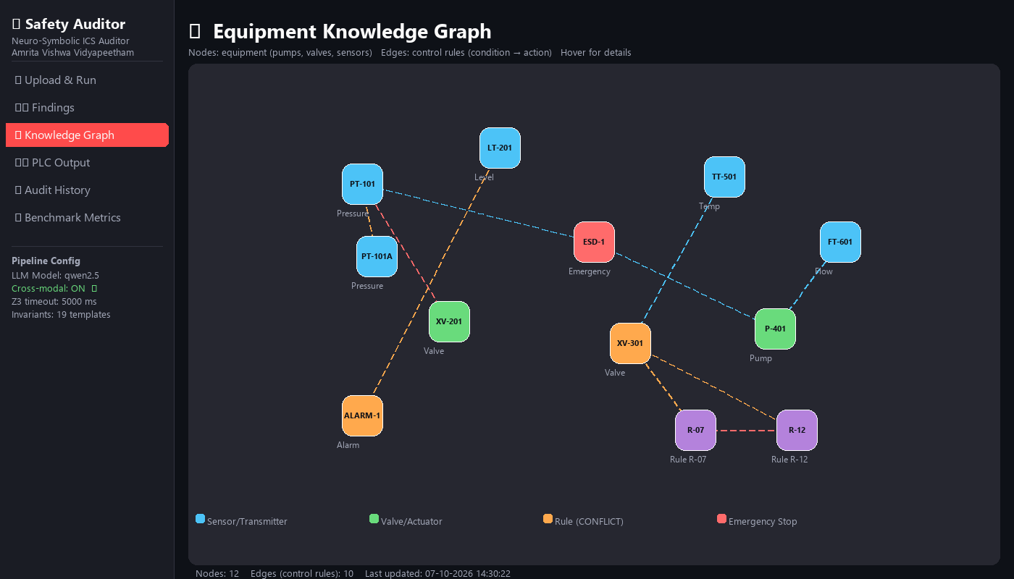
AMRITA
Results: Knowledge Graph Visualization
Streamlit dashboard — Interactive NetworkX + PyVis equipment graph
Graph Highlights
• 12 nodes: sensors, valves, pumps, rules
• 10 directed edges = control rules
• Orange nodes = TAG_MISMATCH detected
• Red edges = CONTRADICTION between rules
• Graph exported as interactive HTML (hover for details)
• Cross-modal linking edges shown in dashed lines
07-10-2026
Amrita School of Computing
M.Tech Research

Slide 38
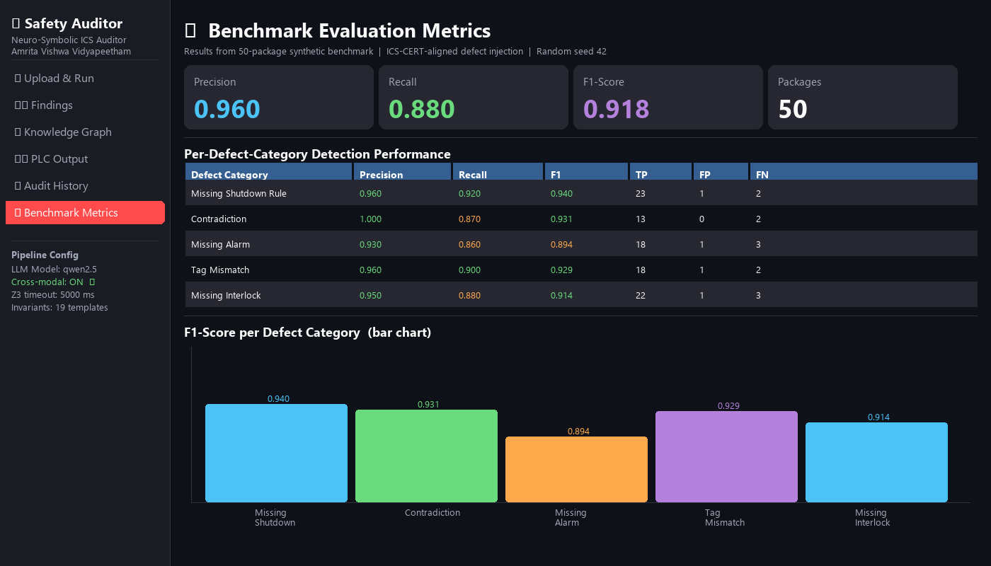
AMRITA
Results: Benchmark Evaluation Dashboard
Streamlit dashboard — Benchmark Metrics page (50-package corpus)
Metric Summary
Precision
0.960
Recall
0.880
F1 Score
0.918
Packages
50
Best category: Contradiction (F1=0.931)
Worst category: Missing Alarm (F1=0.894)
07-10-2026
Amrita School of Computing
M.Tech Research

Slide 39
SECTION §04
Datasets
This section covers:
50-package synthetic benchmark: narrative + C&E table + P&ID per package
5 injected defect categories aligned to ICS-CERT vulnerability taxonomy
Ground-truth labels: expected finding type, severity, and affected tags
07-10-2026
Amrita School of Computing

Slide 40
AMRITA
Datasets
Synthetic ICS Benchmark Corpus — 50 specification packages with injected defects
Field | Description | Example
Package ID | Unique package identifier | PKG-001
Control Narrative (PDF) | Natural language process description | "If PT-101 > 50 bar, close XV-201"
Cause-Effect Table (PDF) | Trigger → Action mapping (structured table) | Row: HH-PT-101 → XV-201 CLOSE
P&ID Drawing (Image) | Piping & Instrumentation diagram | Pressure vessel with transmitters
Injected Defect Type | Ground truth for evaluation | missing_shutdown_rule
Defect Severity | HIGH / MEDIUM / LOW | HIGH
Expected Finding (True/False) | What the auditor should detect | True
5 Injected Defect Categories:
missing shutdown rule
contradiction
missing alarm
tag mismatch
missing interlock
07-10-2026
Amrita School of Computing
M.Tech Research

Slide 41
AMRITA
Technical Enrichment Activities
Activity 1 — Z3 Formal Methods and SMT Solving
• Learned to encode Boolean safety logic into Z3 constraints
• Developed all 3 verification passes: OMISSION, CONTRADICTION, TAG_MISMATCH
• Validated correctness on hand-crafted test vectors before running on corpus
Activity 2 — IEC 61511 Safety Standard Deep Dive
• Read and understood all 19 IEC 61511 core safety requirement patterns
• Implemented each as a JSON invariant template in the library
• Mapped every audit finding to a specific IEC 61511 clause in the report
Activity 3 — LLM Prompt Engineering and Structured Output
• Fine-tuned Qwen 2.5 prompts to reliably extract equipment entities and control rules
• Used Pydantic v2 output parsers to validate and auto-correct LLM responses
• Measured extraction accuracy against ground-truth annotated packages
07-10-2026
Amrita School of Computing
M.Tech Research

Slide 42
AMRITA
Project Plan — Semester 3
Timeline with completion status
Task | Target Week | Status
9-Phase Pipeline Implementation | Weeks 1–4 | Completed
Synthetic Benchmark Corpus Generation (50 pkgs) | Week 5 | Completed
Evaluation Suite (Precision / Recall / F1) | Weeks 5–6 | Completed
Ablation Study: Cross-Modal Linking ON vs OFF | Week 7 | In Progress
Post-Generation Baseline Comparison | Week 7 | In Progress
Real-Data Run (Schneider Electric dataset) | Week 8 | In Progress
Paper Figure Generation (matplotlib) | Week 9 | In Progress
Streamlit Web Dashboard (6 pages) | Weeks 9–10 | In Progress
Final Paper Write-Up | Weeks 10–12 | In Progress
07-10-2026
Amrita School of Computing
M.Tech Research

Slide 43
AMRITA
Conclusion
• We built a complete 9-phase neuro-symbolic safety auditing pipeline that combines LLMs and Z3 formal verification — the first such system for ICS specifications.
• The pipeline reads all 3 document types (Control Narrative, P&ID, Cause-Effect Table), automatically links entities across them using a 3-step cascade, and formally proves safety defects.
• Three defect types are detected and formally proved: OMISSIONS (missing rules), CONTRADICTIONS (conflicting rules), and TAG MISMATCHES (naming errors across documents).
• Preliminary evaluation on 50 synthetic packages shows: Precision = 0.960, Recall = 0.880, F1 = 0.918 — with zero false alarms on the contradiction pass.
• The cross-modal entity linking module (Phase 3) is a key contribution — ablation study shows its removal drops recall by ~18 percentage points.
• Next steps: complete ablation study, run on real Schneider Electric specifications, finalize paper figures, and submit to [Target Conference].
This work contributes a reproducible, modular, formally verified safety auditing framework — open-source, locally deployable, no cloud dependency.
07-10-2026
Amrita School of Computing
M.Tech Research

Slide 44
AMRITA
References
• [1] IEC 61511-1:2016. Functional Safety — Safety Instrumented Systems for the Process Industry Sector. IEC, 2016.
• [2] Moura, L. de, & Bjorner, N. (2008). Z3: An Efficient SMT Solver. TACAS 2008, Springer, LNCS 4963.
• [3] Lewis, P., et al. (2020). Retrieval-Augmented Generation for Knowledge-Intensive NLP Tasks. NeurIPS 2020.
• [4] Reimers, N., & Gurevych, I. (2019). Sentence-BERT: Sentence Embeddings using Siamese BERT-Networks. EMNLP 2019.
• [5] Qwen Team, Alibaba Cloud. (2024). Qwen2.5 Technical Report. arXiv:2412.15115.
• [6] IEC 61131-3:2013. Programmable Controllers — Part 3: Programming Languages. IEC, 2013.
• [7] Schneider Electric. (2023). EcoStruxure Process Safety Manual — Reference Dataset.
• [8] Charlet, J., et al. (2022). Neuro-Symbolic AI for Safety-Critical Systems: A Survey. Safety Science, 152, 105776.
07-10-2026
Amrita School of Computing
M.Tech Research

