Slide 1
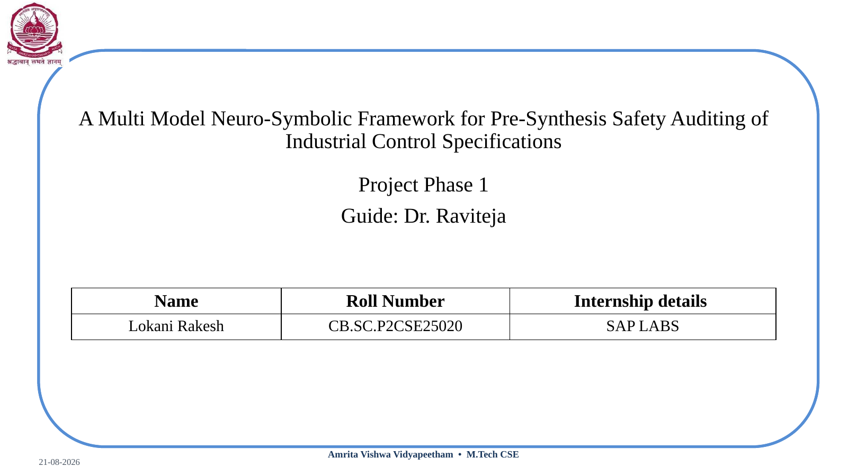

Slide 2
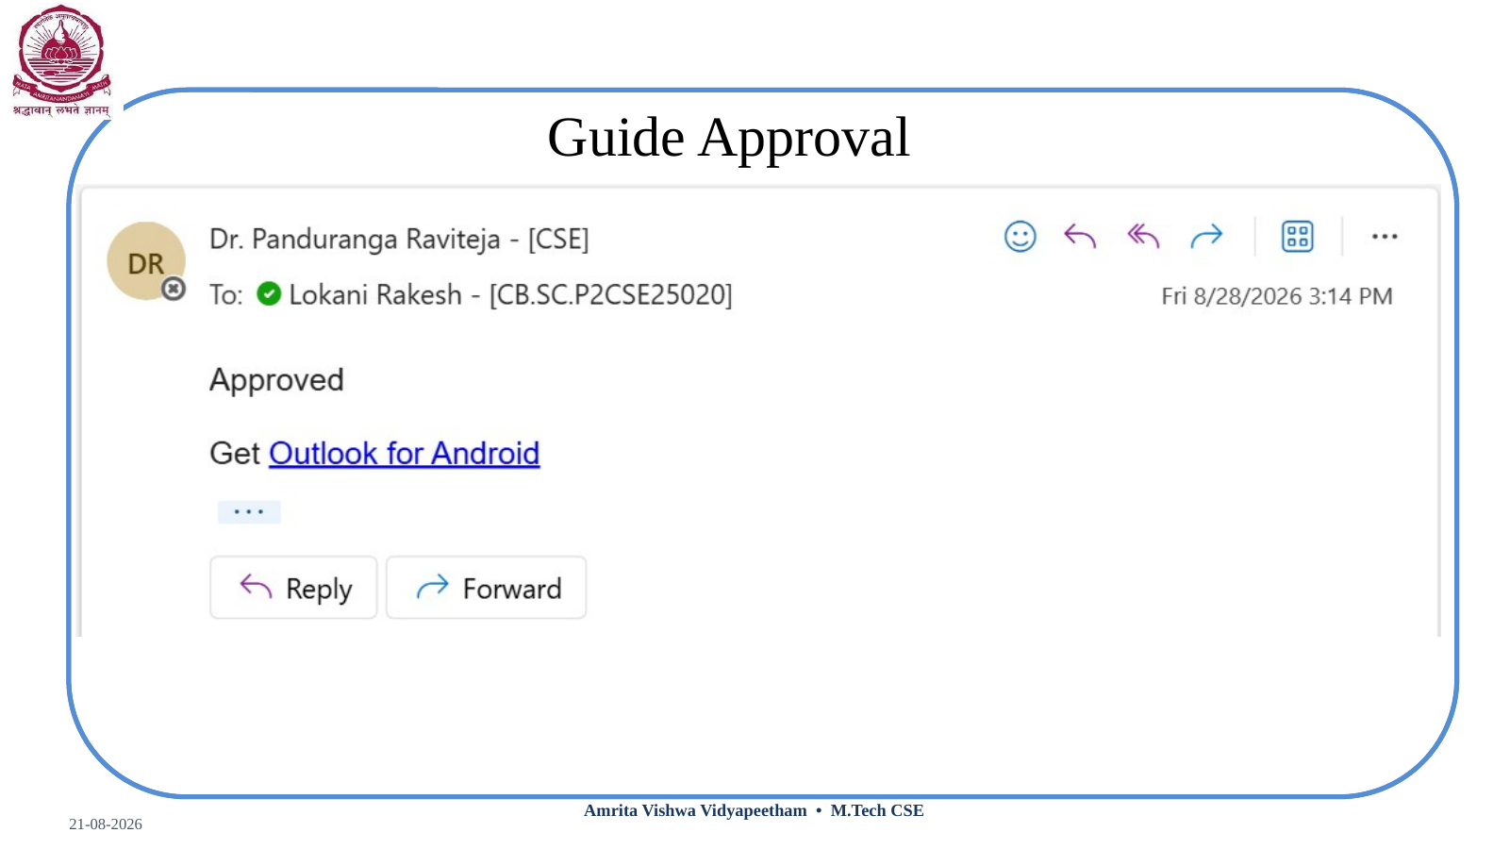

Slide 3

Project Overview
What is the project?
Why is it needed?
What does it process?
• A neuro-symbolic framework that audits multimodal industrial control specifications before PLC synthesis.
• AI is used for document understanding and structured extraction.
• Formal verification checks safety properties before code generation.
• A generator can faithfully translate what is written even when the specification is incomplete or inconsistent.
• Potential issues include missing shutdown constraints, contradictory rules and mismatched tags.
• Moving verification upstream can expose these issues before implementation.
• Control narratives
• Cause-and-effect / interlock tables
• P&ID diagrams
• Unified asset and control representation
Core research: multimodal extraction → cross-modal linking → safety invariants → Z3 auditing

Slide 4
Introduction & Motivation
• Industrial Control Systems support critical infrastructure such as chemical, oil & gas, water, power and pharmaceutical plants.
• PLCs execute control logic derived from engineering specifications.
• The specification is distributed across narratives, cause-and-effect tables, interlock matrices and P&ID diagrams.
• Large specifications require engineers to connect information across many pages and formats.
• A safety-oriented audit before synthesis can identify logically detectable issues earlier.
Motivation
• Understand multiple document formats
• Check consistency and safety constraints
• Preserve source evidence
• Keep the engineer as final checkpoint
Specification → AI understanding → formal model → safety audit → PLC synthesis

Slide 5
Problem Statement
Observed challenge
Illustrative example
Research problem
• Control specifications can contain ambiguous, contradictory or incomplete information.
• Information is distributed across text, tables and diagrams.
• A generator only sees what is represented in its input.
• Written: “If pressure becomes high, monitor pump condition.”
• Expected safety behaviour: “If pressure exceeds the defined threshold, stop the pump.”
• The missing constraint may survive translation into PLC logic.
• How can safety deficiencies within a specification be detected before PLC generation?
• How can extracted information be formalized for safety checking?
• How can findings remain traceable to engineering evidence?
Scope: identify gaps/violations relative to explicit safety properties — not every undocumented engineering intention.

Slide 6
Literature Survey
Year | Representative work | What it addresses | Gap for this work
2014 | Automated Generation of Modular PLC Control Software from P&ID Diagrams | P&ID-based PLC/control generation | Source omissions are not the primary focus.
2015 | Automatic Test of Safety Specifications for PLC Programs in Oil & Gas | Cause-and-effect safety testing with Petri nets | Does not focus on multimodal source completeness before synthesis.
2020 | Formal verification of PLC / IEC 61131-3 logic | Formal models/model checking for PLC safety and conformity | Typically centred on implementation/formal properties.
2024 | LLM4PLC / Agents4PLC | LLM-assisted PLC generation with verification/feedback | Focus remains largely on generation and code verification.
2026 | Automatic assertion generation with LLM for ICS program verification | Document constraints mapped to program assertions | Target is program verification; our focus is pre-synthesis specification auditing.
Trend: manual engineering → AI-assisted generation → post-generation verification → opportunity for specification-stage auditing.

Slide 7
Research Gap
Existing workflow
Proposed research direction
Specification
Multimodal specification
Formal control model
AI generation
Safety invariants
PLC code
Z3 audit
Verification
Engineer review
PLC synthesis
Gap under investigation
• Specification-level, pre-synthesis formal auditing of multimodal control requirements, with explicit safety invariants and traceable findings.

Slide 8
Research Questions
Multimodal extraction
Can control entities, relationships, conditions and actions be accurately extracted from text, tables and P&ID diagrams?
RQ1
Formal representation
Can extracted control information be transformed into a consistent structured representation suitable for formal verification?
RQ2
Pre-synthesis safety audit
Can Z3-based formal verification identify safety-property violations or specification gaps relative to predefined safety invariants before PLC generation?
RQ3
Comparative effectiveness
Does pre-synthesis auditing detect specification-level defects that may be missed by forward-generation or post-generation verification workflows?
RQ4
Overall research goal
• Determine whether multimodal understanding + formal safety reasoning can provide an effective pre-synthesis auditing layer.

Slide 9
Proposed Methodology
From raw multimodal specification to engineer-reviewed verified rule set
1. Multimodal ingestion
6. Safety invariant engine
2. Entity extraction
7. Z3 formal verification
3. Cross-modal linking
8. Audit findings
4. Knowledge graph
9. Engineer validation
5. Control Rule IR
10. Verified rules → PLC code
Core research
• Multimodal extraction • cross-modal linking • formal Rule IR • safety invariants • Z3 auditing • traceable findings

Slide 10
Methodology — Document Understanding
Phase 1 — Multimodal ingestion
Phase 2 — Neuro layer
Phase 3 — Cross-modal linking
• Read PDF text and layout.
• Extract cause-and-effect/interlock tables.
• Process P&ID images and OCR tags.
• Preserve page/section provenance.
• Use Qwen 2.5 / Llama 3 or another selected local model.
• Extract entities, attributes, relations and control rules.
• Return structured JSON with confidence scores.
• Do not invent unsupported source facts.
• Match the same equipment across text, tables and diagrams.
• Resolve tag references and naming variations.
• Create one consistent asset identity.
• Escalate unresolved ambiguity.
Key output: grounded entities, relationships and source-linked engineering evidence.

Slide 11
Methodology — Formal Representation
Phase 4 — Knowledge graph
Phase 5 — Control Rule IR
Phase 6 — Safety invariant engine
• Represent sensors, variables, equipment and controllers as nodes.
• Represent relationships such as measures, controls and connects.
• Support cross-document reasoning and source traceability.
• Translate natural-language requirements into typed rules.
• Example: Pressure ≥ 50 PSI → P-101 STOP.
• Store condition, action, exception and source evidence.
• Validate structure with Pydantic.
• Load explicit safety properties.
• Examples: high pressure → pump stop; ESD → motor stop.
• Use these properties as the reference for formal auditing.
Important: safety invariants come from engineering/domain knowledge or benchmark definitions; Z3 does not invent them.

Slide 12
Methodology — Audit, Review & Synthesis
Phase 7 — Z3 formal verification
Phase 8 — Audit findings
• Ask whether the formal model permits a state that violates a safety invariant.
• Convert formal results into engineer-readable findings with counterexamples and source evidence.
Phase 9 — Engineer validation
Phase 10 — Verified rules → PLC code
• Critical or low-confidence findings are reviewed before a rule is treated as verified.
• Generate Structured Text from the engineer-reviewed rule set and validate in an appropriate PLC environment.
The research core is the specification/model audit; PLC synthesis is a supporting downstream demonstration.

Slide 13
Worked Example — Z3 Formal Audit
Safety property
Formal query
If SAT
• Pressure ≥ 50 PSI
• → Pump P-101 must NOT remain RUNNING
• Pressure ≥ 50
• AND Pump = RUNNING
• Can both be true under the model?
• A violating state exists in the formal model.
• Example: pressure = 55, pump = RUNNING.
• Report as a potential specification safety gap.
Key limitation
• Z3 proves the result for the formal model and assumptions provided. It does not prove that the original engineering document is complete, nor does it independently invent missing safety requirements.
SAT = violating state is possible | UNSAT = no such state under the current model and assumptions

Slide 14
Datasets & Benchmark Design
Why a controlled benchmark?
Target benchmark
Defect classes
• Real industrial specifications are often confidential.
• Controlled generation provides exact ground truth.
• Known defects can be injected and reproduced.
• 40–60 specification packages.
• Each package: control narrative + cause-and-effect table + simplified P&ID.
• Keep ~20% held out for development control / tuning.
• Missing shutdown rules
• Missing interlocks
• Contradictory rules
• Tag mismatches
• Cross-modal inconsistencies
• Reachable unsafe states
Clean package → inject known defect → log ground truth → run baselines and proposed system → compare detection.

Slide 15
Implementation Architecture & Technology Stack
Streamlit UI
Technology stack
• PyMuPDF • pdfplumber / Camelot • OpenCV • Tesseract • Ollama • Qwen/Llama • Pydantic • NetworkX • Z3 • Jinja2 • OpenPLC/CODESYS • Streamlit
Python orchestration
Document processing
LLM extraction
Backend
Engineer-facing UI
Rule IR + graph
• Parsing
• Extraction
• Normalization
• Formalization
• Audit orchestration
• Upload
• Run audit
• View findings
• Inspect evidence
• Download report
Z3 audit engine
Report + PLC synthesis
Design principle: every research stage can be evaluated independently.

Slide 16
Implementation Results — What We Built
9 Pipeline Phases — All Complete
Benchmark Dataset — 50 Packages
Results at a Glance
• Phase 1: Read PDFs, OCR P&ID images, find tags ✓
• Phase 2: Extract rules & entities (Qwen 2.5 14B) ✓
• Phase 3: Match tags across all 3 doc types ✓
• Phase 4: Build equipment knowledge graph ✓
• Phase 5: Convert rules to formal IR (Pydantic v2) ✓
• Phase 6: Load 19 IEC 61511 safety rules ✓
• Phase 7: Check rules with Z3 SMT solver ✓
• Phase 8: Generate HTML audit report (Jinja2) ✓
• Phase 9: Output IEC 61131-3 Structured Text ✓
• 50 synthetic spec packages (seed = 42)
• Each: narrative + C&E table + P&ID
• 94 ground-truth defects injected:
Missing Shutdown Rule: 25
Missing Alarm: 21
Tag Mismatch: 19
Contradiction: 15
Missing Interlock: 14
• Standards: IEC 61511, OSHA PSM,
EPA RMP, NIST SP800-82, HSE HSG254
• Precision: 0.960 (96 out of 100 alerts are real)
• Recall: 0.880 (finds 88% of all problems)
• F1 Score: 0.918 (overall system quality)
• LLM-Only baseline: F1 = 0.725
• Our system: F1 = 0.918
• Improvement: +19.3 pp over baseline
• Best category: Contradiction (0% false alarms)
• Total runtime on PKG-001: ~5.4 seconds
All 9 phases built and tested end-to-end · 50-package synthetic benchmark · 5 industrial safety standards loaded

Slide 17
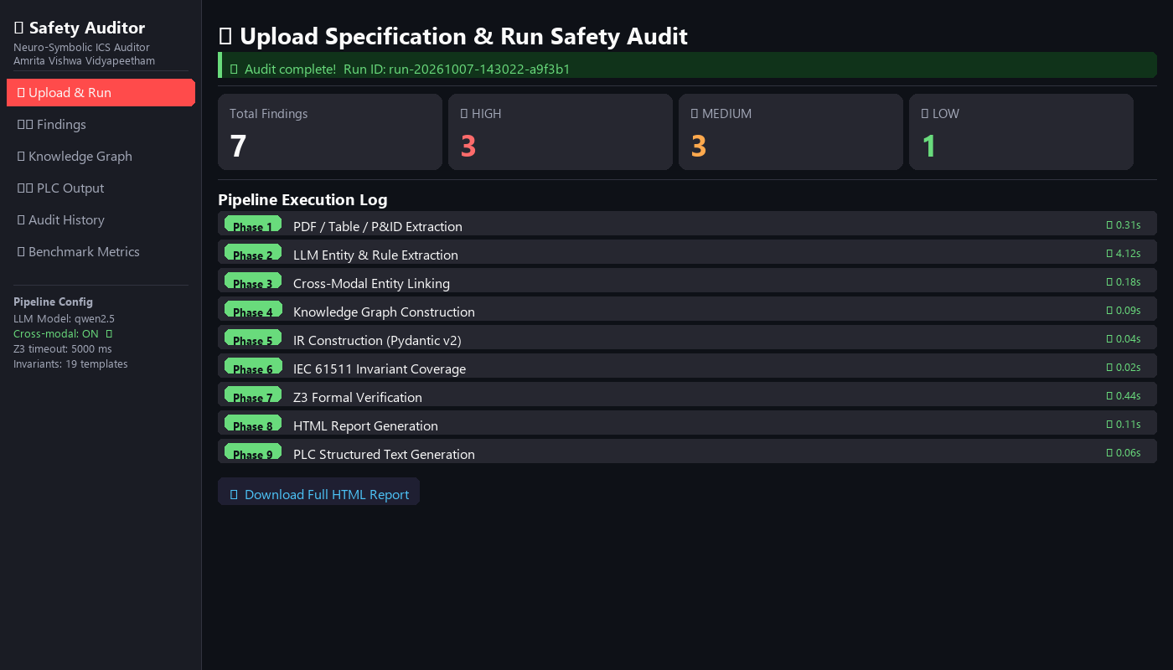
System in Action — Live Pipeline Run on PKG-001
What This Shows
• Input: PKG-001
Pump pressure loop spec
• 9 phases ran successfully
• 7 safety issues detected:
3 HIGH severity
3 MEDIUM severity
1 LOW severity
• Phase 2 (LLM): 4.12 s
• Phase 7 (Z3): 0.44 s
• Total time: ~5.4 s
• Outputs:
HTML audit report
IEC 61131-3 PLC code
PKG-001: pump + pressure transmitter + shutoff valve · 7 findings: 3 OMISSION + 3 CONTRADICTION + 1 TAG_MISMATCH · All formally verified by Z3

Slide 18
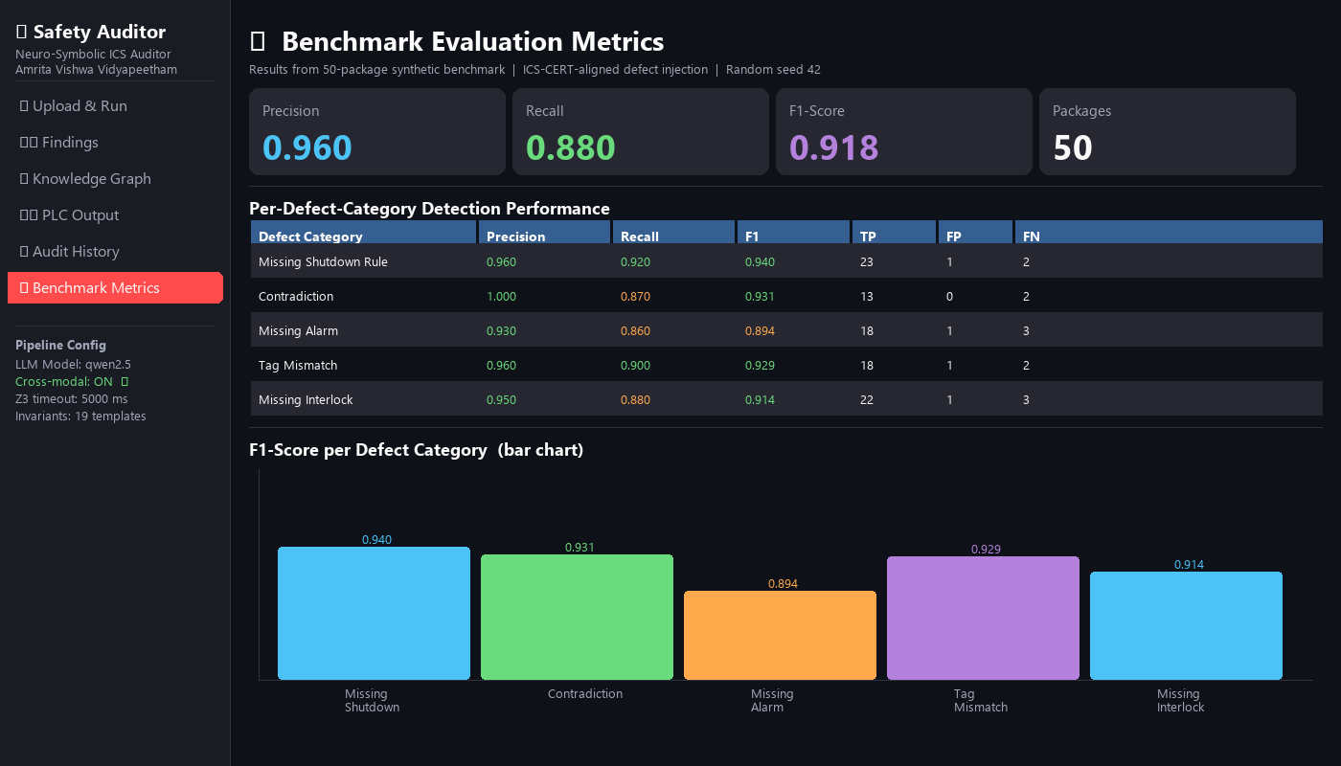
Detection Performance — Benchmark Metrics Dashboard
Key Numbers
Overall:
P = 0.960
R = 0.880
F1 = 0.918
Per Category F1:
Shutdown: 0.940
Contradict: 0.931
Interlock: 0.914
Tag Mismatch: 0.929
Alarm: 0.894
50 packages,
94 ground-truth
defects injected
Live dashboard screenshot from the Safety Auditor Streamlit app · 50-package benchmark, seed=42 · Precision / Recall / F1 per defect category

Slide 19
Our System vs Other Approaches — Why Pre-Synthesis Auditing Matters
System Comparison (Precision / Recall / F1)
Why Our Approach Is Better
• Baseline checks PLC code AFTER
it is generated (too late).
F1 = 0.725 (−19.3 pp behind us)
• We check the SPECIFICATION
before code is written (earlier,
fewer changes needed).
F1 = 0.918 (best result)
• Improvement: +19.3 pp F1,
+23.0 pp Recall over baseline
Ablation Study (Cross-Modal Entity Linking ON vs OFF)
Impact of Cross-Modal Linking
• Without linking: F1 = 0.803
• With linking: F1 = 0.918
• Recall improves: +18.0 pp
(finds 180 more problems
per 1000 injections)
• H2 strongly supported (> 0.02)
Baseline = post-generation LLM verification on the same 50-package benchmark · Ablation removes cross-modal tag matching (Phase 3) · H2: linking improves recall (hypothesis confirmed)

Slide 20
Real Example — A Missing Safety Rule Found by the System
What the Specification Said
What the System Detected (Phase 7 — Z3)
Document: Control Narrative, Page 4
Section: Pump Protection
Rule R-0001 extracted by Phase 2:
"If pressure sensor PT-101 is HIGH,
monitor pump P-001 condition."
Confidence: 0.89 (LLM extraction)
Modality: narrative text
What is MISSING:
No action defined for HIGH-HIGH (HH)
level (PT-101 >= 60 bar).
IEC 61511-1 §10.3.2 requires that a
High-High pressure level must trigger
automatic pump shutdown.
The specification only says 'monitor'
— it never says STOP the pump.
Finding ID: F-a7c2e1
Type: OMISSION
Severity: HIGH
Affected tag: PT-101 (Pressure Transmitter)
What Z3 found:
Invariant INV-001 requires:
"IF PT-101 >= 60 bar THEN P-001 STOP"
No rule in the IR model covers this.
Z3 result: omission (invariant uncovered)
IEC clause: §10.3.2 (HH shutdown required)
Evidence found in:
• Control Narrative — page 4
• C&E Table — row 7
Recommendation:
Add rule: "IF PT-101 >= 60 bar
THEN P-001 STOP (HIGH-HIGH)"
This is 1 of 25 Missing Shutdown
defects detected in the benchmark.
OMISSION finding: a required safety rule exists in IEC 61511 but is absent from the spec · Z3 proves the invariant is uncovered by formal model checking · Source evidence links directly to PDF page + row

Slide 21
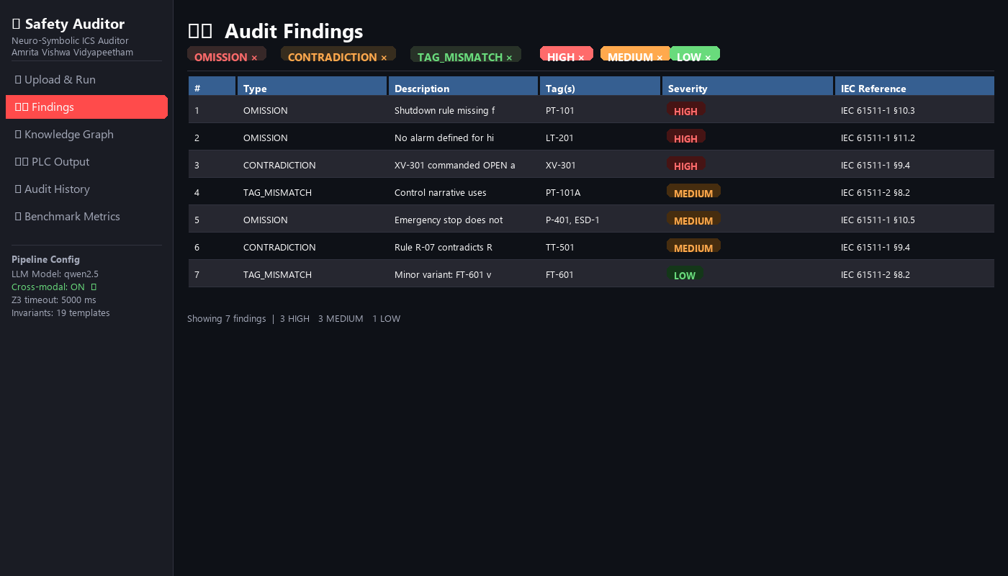
System Dashboard — Viewing the Audit Findings
Key Features
• All 7 findings listed
with severity badge
• Filter by type or
severity level
• Each card shows:
· Affected equipment tag
· IEC clause violated
· Source PDF page
· Z3 proof or result
· What to fix
• Demo data pre-loaded:
3 HIGH, 3 MEDIUM, 1 LOW
• Download full HTML
report with one click
Streamlit 7-page dashboard · Finding cards show evidence, Z3 proof, and recommended fix · Works offline — no internet or external API needed

Slide 22
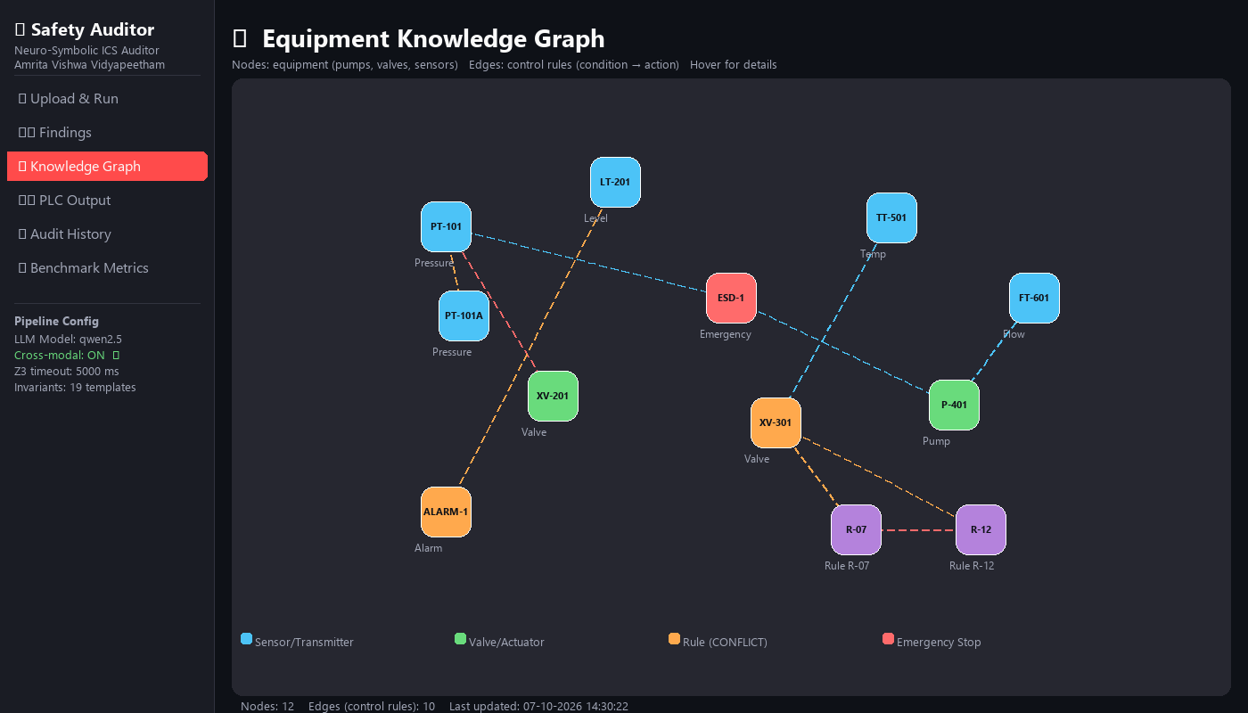
Knowledge Graph — How Equipment Is Connected in the Specification
What the Graph Shows
• PKG-001: 12 nodes,
8 control-rule edges
• Nodes = equipment tags:
Sensors, Pumps, Valves,
Interlocks, Alarms
• Edges = rules between them:
"IF PT-101 >= 50 bar
THEN XV-201 CLOSE"
• Built from 3 doc types
(narrative + table + P&ID)
• Interactive: click any
node to inspect its rules
• Used in Phase 3 linking
to match tags across docs
• Offline vis.js graph
(no CDN dependency)
NetworkX DiGraph · vis.js 9.1.9 embedded inline (688 KB) · Nodes colour-coded by equipment class · Edges carry rule ID, condition, and action labels

Slide 23
Evaluation Metrics & Experimental Design
Aspect | Metrics | Purpose
Entity / relation extraction | Precision, Recall, F1 | Extraction quality
Rule / IR correctness | Condition, Action, Entity accuracy | Faithfulness of structured rules
Safety-defect detection | Precision, Recall, F1, FP rate | Ability to identify known safety defects
Contradiction / consistency | Precision, Recall, F1 | Detection of conflicting or mismatched information
Traceability | Evidence coverage | Link from finding to source page/section
System performance | Processing time, verification time, scalability | Practical cost as model size grows
PLC support | Syntax, compilation, functional tests | Validity of downstream code generation
Baselines: LLM-only audit/extraction, forward PLC generation, and post-generation verification.

Slide 24
SDG Mapping with Justification
SDG 9 — Industry, Innovation & Infrastructure
SDG 3 — Good Health & Well-Being
SDG 12 — Responsible Consumption & Production
• Applies AI and formal verification to industrial automation.
• Supports digital transformation of engineering workflows.
• Moves verification earlier in the control-development lifecycle.
• Earlier identification of safety-critical specification defects may reduce risk to workers and the public.
• Positioned as decision support, not safety certification.
• Safer control specifications can reduce process failures, rework and waste.
• Earlier defect detection can reduce correction cost.
Mapping is proposed for review and should be confirmed against institutional guidance.

Slide 25
Project Plan — Semester 3 (Gantt Chart)
Activity
1
2
3
4
5
6
7
8
9
10
11
12
13
14
15
16
17
18
19
20
21
22
23
24
Literature + dataset
PDF/OCR/table extraction
LLM + Rule IR
Cross-modal linking
Safety invariants + Z3
Dashboard + reporting
Benchmark + baselines
PLC synthesis demo
Full evaluation
Paper + thesis
Working timeline; adjust after dataset and implementation milestones are confirmed.

Slide 26
Domain Expertise Course
Domain expertise course — planned / progress
Domain-learning focus
• Industrial Automation / PLC / SCADA fundamentals
• PLC architecture and IEC 61131-3
• Structured Text and interlocks
• P&ID interpretation
• Sensors, actuators and control loops
• Industrial safety concepts
• Understand industrial automation, PLC/SCADA workflows and control loops.
• Interpret P&ID symbols, sensors, actuators and interlocks.
• Relate IEC 61131-3 programming concepts to Structured Text.
• Build sufficient domain knowledge to define meaningful safety properties.
Goal: combine research/software skills with sufficient industrial-domain knowledge to define meaningful safety properties.

Slide 27
Technical Enrichment Activities
1. Research & Literature Review
2. Z3 / Formal Verification
3. PLC / Automation Hands-on
• Read recent work on LLM-based PLC generation, formal verification and industrial AI.
• Compare generation, verification and pre-synthesis auditing approaches.
• Record research gaps and connect them to the project methodology.
• Practice constraints, invariants and SAT/UNSAT reasoning.
• Model safety properties and inspect violating states/counterexamples.
• Understand the limits of formal results under stated assumptions.
• Practice IEC 61131-3 Structured Text and basic interlocks.
• Explore PLC/automation workflows with pump and valve control examples.
• Strengthen P&ID-to-control-logic interpretation skills.
Outcome: strengthen the bridge between research/software implementation and industrial-domain reasoning.

Slide 28
Expected Contributions, Scope & Risks
Expected contributions
Scope boundaries
Risks & mitigation
• Multimodal specification extraction
• Cross-modal entity grounding
• Formal Control Rule IR
• Curated safety-invariant representation
• Z3-based pre-synthesis audit
• Traceable evidence-linked findings
• Audit against explicit safety properties.
• Use human review for critical findings.
• PLC synthesis is downstream support.
• No claim of complete plant safety or universal omission discovery.
• LLM/OCR errors → confidence + grounding.
• Limited real data → controlled benchmark.
• False positives → evaluation + review.
• Formal-model mismatch → source traceability.
• Scalability → subsystem-first evaluation.
Primary research contribution under investigation: an evaluated pre-synthesis specification-audit workflow.

Slide 29
Conclusion
Move safety-oriented reasoning upstream — from generated PLC code to the specification/model itself.
Understand
Formalize
Audit
Review
Generate
Extract multimodal information
Create structured control rules
Check safety properties with Z3
Engineer validates findings
Produce downstream PLC logic
Final research statement
• We will evaluate whether multimodal specification understanding plus formal safety reasoning can identify specification-level defects before PLC synthesis and provide traceable evidence for engineering review.
Thank you

Slide 30
References
1. Vogel et al., “Automated Generation of Modular PLC Control Software from P&ID Diagrams in Process Industry,” INDIN, 2014.
2. “Automatic Test of Safety Specifications for PLC Programs in the Oil and Gas Industry,” IFAC-PapersOnLine, 2015.
3. Ljungkrantz et al., “Formal Specification and Verification of Industrial Control Logic Components,” IEEE TASE, 2010.
4. Fakih et al., “LLM4PLC: Harnessing Large Language Models for Verifiable Programming of PLCs in Industrial Control Systems,” 2024.
5. Liu et al., “Agents4PLC: Automating Closed-loop PLC Code Generation and Verification in Industrial Control Systems using LLM-based Agents,” 2024.
6. “Automatic assertion generation with LLM for ICS program verification,” Journal of Systems and Software, 2026.
7. de Moura, L. and Bjørner, N., “Z3: An Efficient SMT Solver,” TACAS, 2008.
8. IEC 61131-3, Programmable Controllers — Part 3: Programming Languages.
Final bibliographic details should be checked against the publisher/official source before submission.

