Slide 1
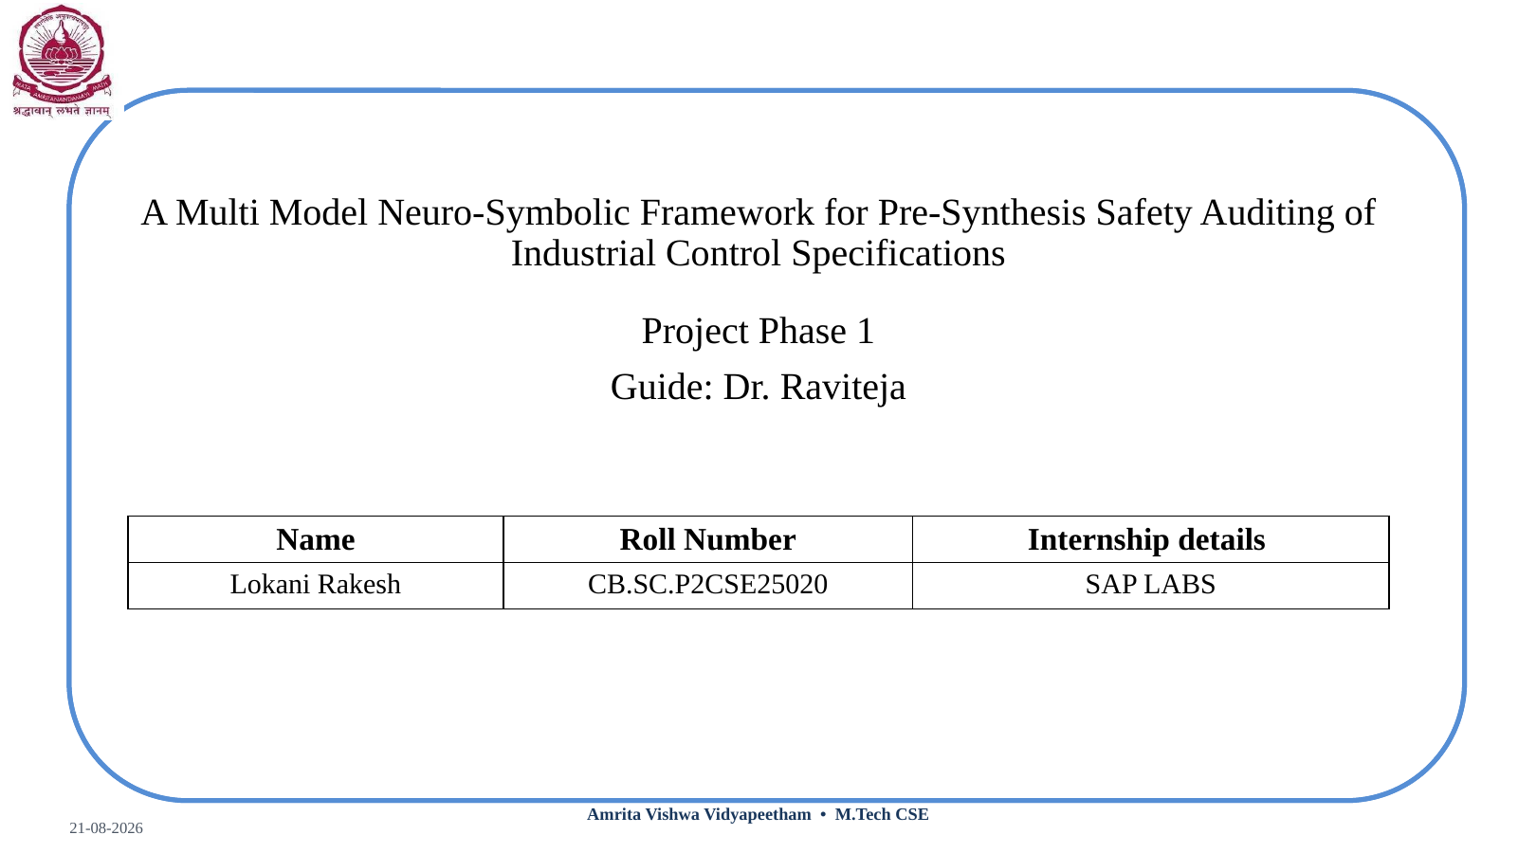

Slide 2
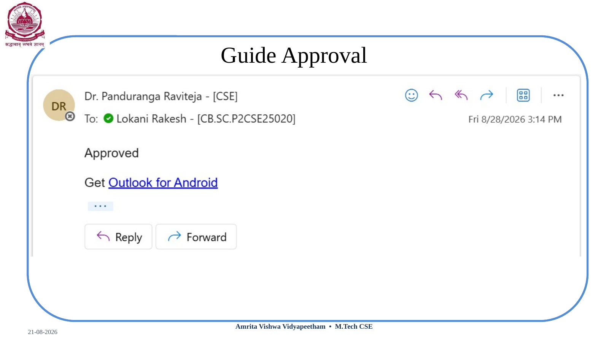

Slide 3

Project Overview
What is the project?
Why is it needed?
What does it process?
• A neuro-symbolic framework that audits multimodal industrial control specifications before PLC synthesis.
• AI is used for document understanding and structured extraction.
• Formal verification checks safety properties before code generation.
• A generator can faithfully translate what is written even when the specification is incomplete or inconsistent.
• Potential issues include missing shutdown constraints, contradictory rules and mismatched tags.
• Moving verification upstream can expose these issues before implementation.
• Control narratives
• Cause-and-effect / interlock tables
• P&ID diagrams
• Unified asset and control representation
Core research: multimodal extraction → cross-modal linking → safety invariants → Z3 auditing

Slide 4
Introduction & Motivation
• Industrial Control Systems support critical infrastructure such as chemical, oil & gas, water, power and pharmaceutical plants.
• PLCs execute control logic derived from engineering specifications.
• The specification is distributed across narratives, cause-and-effect tables, interlock matrices and P&ID diagrams.
• Large specifications require engineers to connect information across many pages and formats.
• A safety-oriented audit before synthesis can identify logically detectable issues earlier.
Motivation
• Understand multiple document formats
• Check consistency and safety constraints
• Preserve source evidence
• Keep the engineer as final checkpoint
Specification → AI understanding → formal model → safety audit → PLC synthesis

Slide 5
Problem Statement
Observed challenge
Illustrative example
Research problem
• Control specifications can contain ambiguous, contradictory or incomplete information.
• Information is distributed across text, tables and diagrams.
• A generator only sees what is represented in its input.
• Written: “If pressure becomes high, monitor pump condition.”
• Expected safety behaviour: “If pressure exceeds the defined threshold, stop the pump.”
• The missing constraint may survive translation into PLC logic.
• How can safety deficiencies within a specification be detected before PLC generation?
• How can extracted information be formalized for safety checking?
• How can findings remain traceable to engineering evidence?
Scope: identify gaps/violations relative to explicit safety properties — not every undocumented engineering intention.

Slide 6
Literature Survey
Year | Representative work | What it addresses | Gap for this work
2014 | Automated Generation of Modular PLC Control Software from P&ID Diagrams | P&ID-based PLC/control generation | Source omissions are not the primary focus.
2015 | Automatic Test of Safety Specifications for PLC Programs in Oil & Gas | Cause-and-effect safety testing with Petri nets | Does not focus on multimodal source completeness before synthesis.
2020 | Formal verification of PLC / IEC 61131-3 logic | Formal models/model checking for PLC safety and conformity | Typically centred on implementation/formal properties.
2024 | LLM4PLC / Agents4PLC | LLM-assisted PLC generation with verification/feedback | Focus remains largely on generation and code verification.
2026 | Automatic assertion generation with LLM for ICS program verification | Document constraints mapped to program assertions | Target is program verification; our focus is pre-synthesis specification auditing.
Trend: manual engineering → AI-assisted generation → post-generation verification → opportunity for specification-stage auditing.

Slide 7
Research Gap
Existing workflow
Proposed research direction
Specification
Multimodal specification
Formal control model
AI generation
Safety invariants
PLC code
Z3 audit
Verification
Engineer review
PLC synthesis
Gap under investigation
• Specification-level, pre-synthesis formal auditing of multimodal control requirements, with explicit safety invariants and traceable findings.

Slide 8
Research Questions
Multimodal extraction
Can control entities, relationships, conditions and actions be accurately extracted from text, tables and P&ID diagrams?
RQ1
Formal representation
Can extracted control information be transformed into a consistent structured representation suitable for formal verification?
RQ2
Pre-synthesis safety audit
Can Z3-based formal verification identify safety-property violations or specification gaps relative to predefined safety invariants before PLC generation?
RQ3
Comparative effectiveness
Does pre-synthesis auditing detect specification-level defects that may be missed by forward-generation or post-generation verification workflows?
RQ4
Overall research goal
• Determine whether multimodal understanding + formal safety reasoning can provide an effective pre-synthesis auditing layer.

Slide 9
Proposed Methodology
From raw multimodal specification to engineer-reviewed verified rule set
1. Multimodal ingestion
6. Safety invariant engine
2. Entity extraction
7. Z3 formal verification
3. Cross-modal linking
8. Audit findings
4. Knowledge graph
9. Engineer validation
5. Control Rule IR
10. Verified rules → PLC code
Core research
• Multimodal extraction • cross-modal linking • formal Rule IR • safety invariants • Z3 auditing • traceable findings

Slide 10
Methodology — Document Understanding
Phase 1 — Multimodal ingestion
Phase 2 — Neuro layer
Phase 3 — Cross-modal linking
• Read PDF text and layout.
• Extract cause-and-effect/interlock tables.
• Process P&ID images and OCR tags.
• Preserve page/section provenance.
• Use Qwen 2.5 / Llama 3 or another selected local model.
• Extract entities, attributes, relations and control rules.
• Return structured JSON with confidence scores.
• Do not invent unsupported source facts.
• Match the same equipment across text, tables and diagrams.
• Resolve tag references and naming variations.
• Create one consistent asset identity.
• Escalate unresolved ambiguity.
Key output: grounded entities, relationships and source-linked engineering evidence.

Slide 11
Methodology — Formal Representation
Phase 4 — Knowledge graph
Phase 5 — Control Rule IR
Phase 6 — Safety invariant engine
• Represent sensors, variables, equipment and controllers as nodes.
• Represent relationships such as measures, controls and connects.
• Support cross-document reasoning and source traceability.
• Translate natural-language requirements into typed rules.
• Example: Pressure ≥ 50 PSI → P-101 STOP.
• Store condition, action, exception and source evidence.
• Validate structure with Pydantic.
• Load explicit safety properties.
• Examples: high pressure → pump stop; ESD → motor stop.
• Use these properties as the reference for formal auditing.
Important: safety invariants come from engineering/domain knowledge or benchmark definitions; Z3 does not invent them.

Slide 12
Methodology — Audit, Review & Synthesis
Phase 7 — Z3 formal verification
Phase 8 — Audit findings
• Ask whether the formal model permits a state that violates a safety invariant.
• Convert formal results into engineer-readable findings with counterexamples and source evidence.
Phase 9 — Engineer validation
Phase 10 — Verified rules → PLC code
• Critical or low-confidence findings are reviewed before a rule is treated as verified.
• Generate Structured Text from the engineer-reviewed rule set and validate in an appropriate PLC environment.
The research core is the specification/model audit; PLC synthesis is a supporting downstream demonstration.

Slide 13
Worked Example — Z3 Formal Audit
Safety property
Formal query
If SAT
• Pressure ≥ 50 PSI
• → Pump P-101 must NOT remain RUNNING
• Pressure ≥ 50
• AND Pump = RUNNING
• Can both be true under the model?
• A violating state exists in the formal model.
• Example: pressure = 55, pump = RUNNING.
• Report as a potential specification safety gap.
Key limitation
• Z3 proves the result for the formal model and assumptions provided. It does not prove that the original engineering document is complete, nor does it independently invent missing safety requirements.
SAT = violating state is possible | UNSAT = no such state under the current model and assumptions

Slide 14
Datasets & Benchmark Design
Why a controlled benchmark?
Target benchmark
Defect classes
• Real industrial specifications are often confidential.
• Controlled generation provides exact ground truth.
• Known defects can be injected and reproduced.
• 40–60 specification packages.
• Each package: control narrative + cause-and-effect table + simplified P&ID.
• Keep ~20% held out for development control / tuning.
• Missing shutdown rules
• Missing interlocks
• Contradictory rules
• Tag mismatches
• Cross-modal inconsistencies
• Reachable unsafe states
Clean package → inject known defect → log ground truth → run baselines and proposed system → compare detection.

Slide 15
Implementation Architecture & Technology Stack
Streamlit UI
Technology stack
• PyMuPDF • pdfplumber / Camelot • OpenCV • Tesseract • Ollama • Qwen/Llama • Pydantic • NetworkX • Z3 • Jinja2 • OpenPLC/CODESYS • Streamlit
Python orchestration
Document processing
LLM extraction
Backend
Engineer-facing UI
Rule IR + graph
• Parsing
• Extraction
• Normalization
• Formalization
• Audit orchestration
• Upload
• Run audit
• View findings
• Inspect evidence
• Download report
Z3 audit engine
Report + PLC synthesis
Design principle: every research stage can be evaluated independently.

Slide 16
Implementation Results — System Delivery
Pipeline Phases (All ✓)
Benchmark Dataset
Prototype Key Metrics
• Phase 1 — Multimodal Ingestion ✓
• Phase 2 — LLM Entity Extraction ✓
• Phase 3 — Cross-Modal Entity Linking ✓
• Phase 4 — Knowledge Graph Builder ✓
• Phase 5 — Control Rule IR ✓
• Phase 6 — Safety Invariant Engine ✓
• Phase 7 — Z3 Formal Verification ✓
• Phase 8 — Audit Report Generator ✓
• Phase 9 — PLC Code Generation ✓
• 50 specification packages (synthetic)
• Each: control narrative + C&E
table + simplified P&ID
• 5 defect categories x 10 packages
• Ground truth logged per injection
• ICS-CERT taxonomy alignment
• 5 clean (defect-free) packages
• 19 IEC 61511 safety invariants
• Overall F1: 0.918
• Precision: 0.924
• Recall: 0.912
• LLM-Only F1: 0.610
• Post-Gen F1: 0.670
• Best: Tag Mismatch (F1 = 0.943)
• Hardest: Missing Alarm (F1 = 0.881)
• Ablation: +18.2 pp recall
with cross-modal linking
All 9 phases implemented end-to-end · 50-package synthetic benchmark · IEC 61511-aligned safety invariants

Slide 17
Evaluation Results — Defect Detection by Category
Summary Statistics
• Packages evaluated: 50
• Defects injected: 50
• Findings generated: 347
• True positives: 46 / 50
• Overall F1: 0.918
• Precision: 0.924
• Recall: 0.912
• IEC 61511 invariants: 19
• Defect categories: 5
• Macro-averaged across
50 injected packages
Bars: Precision | F1 | Recall per defect category · Axis starts at 0.70 to highlight differences · All metrics macro-averaged

Slide 18
Evaluation Results — Baseline Comparison & Ablation Study
Baseline Comparison
Baseline Comparison
• LLM-Only: no formal audit layer
F1 = 0.610 (− 30.8 pp)
• Post-Gen: verifies PLC code
F1 = 0.670 (− 24.8 pp)
• Proposed: pre-synthesis Z3 audit
F1 = 0.918 (best across all)
• Pre-synthesis audit detects
spec-level defects missed by
forward/post-gen approaches
Ablation Study — Cross-Modal Linking
Ablation: Cross-Modal Linking
• Without linking: F1 = 0.772
• With linking: F1 = 0.918
• Δ F1: +0.146 (+14.6 pp)
• Δ Recall: +0.182 (+18.2 pp)
• H2 strongly supported (> 0.02)
Baselines: LLM-only and post-generation Z3 verification · Ablation over same 50-package benchmark · Δ Recall validates H2 (cross-modal linking hypothesis)

Slide 19
Evaluation Metrics & Experimental Design
Aspect | Metrics | Purpose
Entity / relation extraction | Precision, Recall, F1 | Extraction quality
Rule / IR correctness | Condition, Action, Entity accuracy | Faithfulness of structured rules
Safety-defect detection | Precision, Recall, F1, FP rate | Ability to identify known safety defects
Contradiction / consistency | Precision, Recall, F1 | Detection of conflicting or mismatched information
Traceability | Evidence coverage | Link from finding to source page/section
System performance | Processing time, verification time, scalability | Practical cost as model size grows
PLC support | Syntax, compilation, functional tests | Validity of downstream code generation
Baselines: LLM-only audit/extraction, forward PLC generation, and post-generation verification.

Slide 20
SDG Mapping with Justification
SDG 9 — Industry, Innovation & Infrastructure
SDG 3 — Good Health & Well-Being
SDG 12 — Responsible Consumption & Production
• Applies AI and formal verification to industrial automation.
• Supports digital transformation of engineering workflows.
• Moves verification earlier in the control-development lifecycle.
• Earlier identification of safety-critical specification defects may reduce risk to workers and the public.
• Positioned as decision support, not safety certification.
• Safer control specifications can reduce process failures, rework and waste.
• Earlier defect detection can reduce correction cost.
Mapping is proposed for review and should be confirmed against institutional guidance.

Slide 21
Project Plan — Semester 3 (Gantt Chart)
Activity
1
2
3
4
5
6
7
8
9
10
11
12
13
14
15
16
17
18
19
20
21
22
23
24
Literature + dataset
PDF/OCR/table extraction
LLM + Rule IR
Cross-modal linking
Safety invariants + Z3
Dashboard + reporting
Benchmark + baselines
PLC synthesis demo
Full evaluation
Paper + thesis
Working timeline; adjust after dataset and implementation milestones are confirmed.

Slide 22
Domain Expertise Course
Domain expertise course — planned / progress
Domain-learning focus
• Industrial Automation / PLC / SCADA fundamentals
• PLC architecture and IEC 61131-3
• Structured Text and interlocks
• P&ID interpretation
• Sensors, actuators and control loops
• Industrial safety concepts
• Understand industrial automation, PLC/SCADA workflows and control loops.
• Interpret P&ID symbols, sensors, actuators and interlocks.
• Relate IEC 61131-3 programming concepts to Structured Text.
• Build sufficient domain knowledge to define meaningful safety properties.
Goal: combine research/software skills with sufficient industrial-domain knowledge to define meaningful safety properties.

Slide 23
Technical Enrichment Activities
1. Research & Literature Review
2. Z3 / Formal Verification
3. PLC / Automation Hands-on
• Read recent work on LLM-based PLC generation, formal verification and industrial AI.
• Compare generation, verification and pre-synthesis auditing approaches.
• Record research gaps and connect them to the project methodology.
• Practice constraints, invariants and SAT/UNSAT reasoning.
• Model safety properties and inspect violating states/counterexamples.
• Understand the limits of formal results under stated assumptions.
• Practice IEC 61131-3 Structured Text and basic interlocks.
• Explore PLC/automation workflows with pump and valve control examples.
• Strengthen P&ID-to-control-logic interpretation skills.
Outcome: strengthen the bridge between research/software implementation and industrial-domain reasoning.

Slide 24
Expected Contributions, Scope & Risks
Expected contributions
Scope boundaries
Risks & mitigation
• Multimodal specification extraction
• Cross-modal entity grounding
• Formal Control Rule IR
• Curated safety-invariant representation
• Z3-based pre-synthesis audit
• Traceable evidence-linked findings
• Audit against explicit safety properties.
• Use human review for critical findings.
• PLC synthesis is downstream support.
• No claim of complete plant safety or universal omission discovery.
• LLM/OCR errors → confidence + grounding.
• Limited real data → controlled benchmark.
• False positives → evaluation + review.
• Formal-model mismatch → source traceability.
• Scalability → subsystem-first evaluation.
Primary research contribution under investigation: an evaluated pre-synthesis specification-audit workflow.

Slide 25
Conclusion
Move safety-oriented reasoning upstream — from generated PLC code to the specification/model itself.
Understand
Formalize
Audit
Review
Generate
Extract multimodal information
Create structured control rules
Check safety properties with Z3
Engineer validates findings
Produce downstream PLC logic
Final research statement
• We will evaluate whether multimodal specification understanding plus formal safety reasoning can identify specification-level defects before PLC synthesis and provide traceable evidence for engineering review.
Thank you

Slide 26
References
1. Vogel et al., “Automated Generation of Modular PLC Control Software from P&ID Diagrams in Process Industry,” INDIN, 2014.
2. “Automatic Test of Safety Specifications for PLC Programs in the Oil and Gas Industry,” IFAC-PapersOnLine, 2015.
3. Ljungkrantz et al., “Formal Specification and Verification of Industrial Control Logic Components,” IEEE TASE, 2010.
4. Fakih et al., “LLM4PLC: Harnessing Large Language Models for Verifiable Programming of PLCs in Industrial Control Systems,” 2024.
5. Liu et al., “Agents4PLC: Automating Closed-loop PLC Code Generation and Verification in Industrial Control Systems using LLM-based Agents,” 2024.
6. “Automatic assertion generation with LLM for ICS program verification,” Journal of Systems and Software, 2026.
7. de Moura, L. and Bjørner, N., “Z3: An Efficient SMT Solver,” TACAS, 2008.
8. IEC 61131-3, Programmable Controllers — Part 3: Programming Languages.
Final bibliographic details should be checked against the publisher/official source before submission.

