Slide 1
APB
Advanced Peripheral Bus

Slide 2
Contents
Introduction to AMBA APB
AMBA APB Signals
Operating States,APB State Machine
APB Transfers
Interface Parity Protection

Slide 3
About the APB protocol
The APB is the member of the AMBA 3 protocol family.
It implements a low cost interface which minimizes the power consumption and reduces the interface complexity.
APB has unpipelined protocol.
APB can interface with the AHB and AXI protocols via bridge.

Slide 4
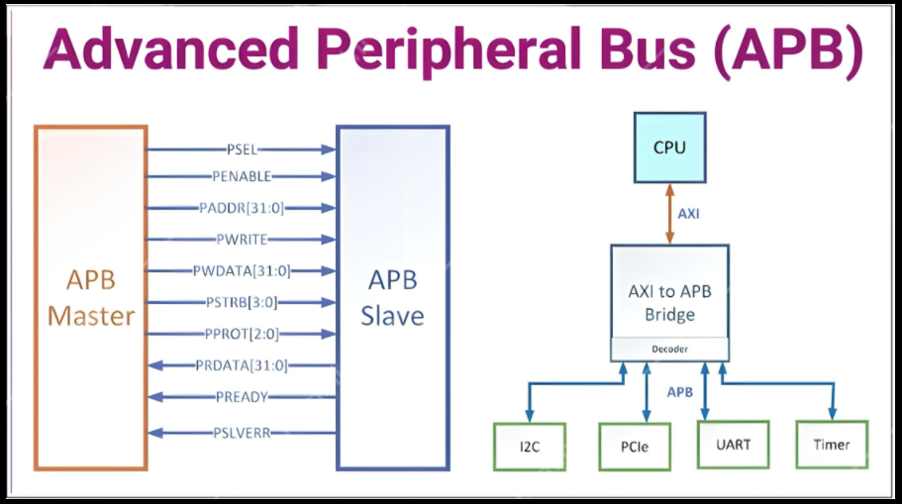

Slide 5
AMBA APB signals
1.PCLK : PCLK is a clock signal.
All APB signals are timed against the rising edge of PCLK.
2. PSELx : Select
The Requester generates a PSELx signal for each Completer. PSELx indicates that the Completer is selected and that a data transfer is required.
3. PRESETn: Reset signal.
PRESETn is the reset signal and is active-LOW. PRESETn is normally connected directly to the system bus reset signal.
4. PENABLE : Enable
PENABLE indicates the second and subsequent cycles of an APB transfer.

Slide 6
AMBA APB signals
5. PADDR: ADDR_WIDTH
PADDR is the APB address bus. PADDR can be up to 32 bits wide.
6. PWRITE : Direction
PWRITE indicates an APB write access when HIGH and an APB read access when LOW.
7. PWDATA : DATA_WIDTH Write data
The PWDATA write data bus is driven by the APB bridge Requester during write cycles when PWRITE is HIGH. PWDATA can be 8 bits, 16 bits, or 32 bits wide.
8. PRDATA: DATA_WIDTH Read data
The PRDATA read data bus is driven by the selected Completer during read cycles when PWRITE is LOW. PRDATA can be 8 bits, 16 bits, or 32 bits wide.

Slide 7
AMBA APB signals
9. PREADY : Ready.
PREADY is used to extend an APB transfer by the Completer.
10. PSLVERR : Transfer error.
PSLVERR is an optional signal that can be asserted HIGH by the Completer to indicate an error condition on an APB transfer.
11. PSTRB : DATA_WIDTH/8 Write strobe.
PSTRB indicates which byte lanes to update during a write transfer. There is one write strobe for each 8 bits of the write data bus.
PSTRB[n] corresponds to PWDATA[(8n + 7):(8n)]. PSTRB must not be active during a read transfer.

Slide 8
AMBA APB signals
12. PPROT[2:0] : Protection type.
PPROT indicates the normal, privileged, or secure protection level of the transaction and whether the transaction is a data access or an instruction access.
13. PNSE : Extension to protection type.
PNSE must be valid when PSEL is asserted.
14. PWAKEUP : Wake-up.
PWAKEUP indicates any activity associated with an APB interface.
It provides a glitch-free signal that can be routed to a clock controller, or similar component, to enable power and clocks to connected components.

Slide 9
AMBA APB signals
15. PAUSER : User request attribute. USER_REQ_WIDTH
PAUSER is recommended to have a maximum width of 128 bits.
16. PWUSER: User write data attribute. USER_DATA_WIDTH
PWUSER is recommended to have a maximum width of DATA_WIDTH/2.
17. PRUSER : User read data attribute. USER_DATA_WIDTH
PRUSER is recommended to have a maximum width of DATA_WIDTH/2.
18. PBUSER: User response attribute. USER_RESP_WIDTH
PBUSER is recommended to have a maximum width of 16 bits.

Slide 10
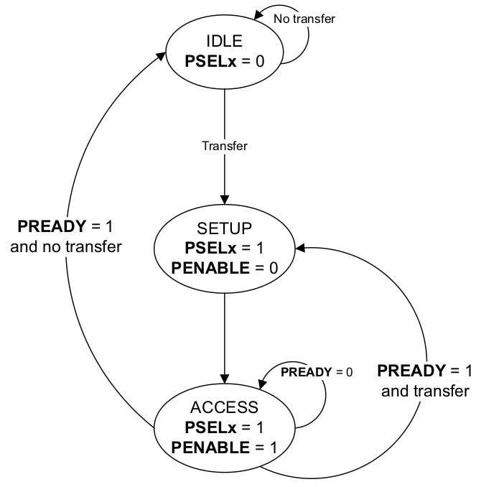
Operating States

Slide 11
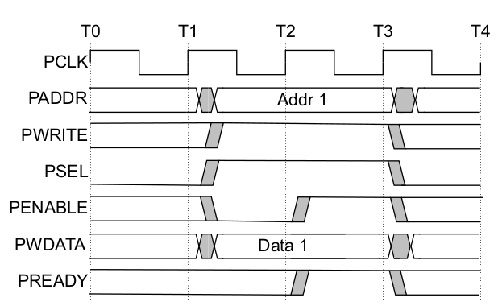
APB Transfers
WRITE Transfers
This section describes the following types of write transfer:•Write transfer with wait states
•Write transfer with no wait states
Fig1: Write transfer with no wait states

Slide 12
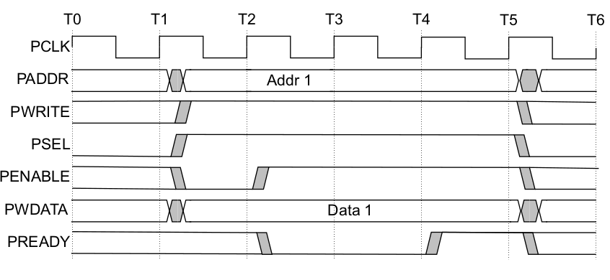
APB Transfers
Fig2: Write transfer with wait states

Slide 13
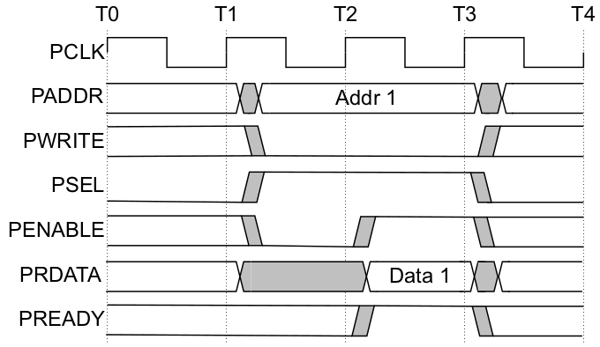
APB Transfers
READ Transfers
This section describes the following types of read transfer:•Read transfer with wait states
•Read transfer with no wait states
Fig3: Read transfer with no wait states

Slide 14
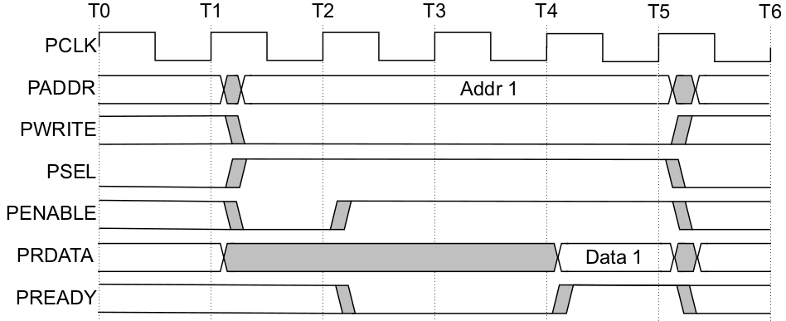
APB Transfers
Fig4: Read transfer with wait states

Slide 15
Interface parity protection
Protection using parity:
Purpose Detect and correct transient and functional errors on individual SoC wires.
Maintain end-to-end Error Detection and Correction (EDC) across logic and interconnects.
  The EDC scheme of the interface is defined by the Check_Type property.
  False : There are no checking signals on the interface.
  Odd_Parity_Byte_All : Odd parity checking is included for all signals.
Each bit of the parity signal covers up to 8 bits.
If Check_Type is not declared, it is considered to be False.

Slide 16
Thank You !

