Slide 1
Cache
K.LOKESH
Chipweave Technologies Private Limited

Slide 2
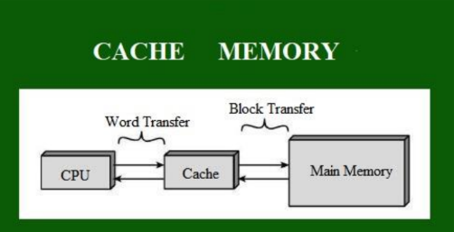
What is cache memory ?
  Cache memory is a fast temporary memory that helps the CPU access data quickly by storing the most frequently used information.

Slide 3
The Main Memory consists of memory blocks and these blocks are made up of fixed number of words. A typical address in main memory is split into two parts:
  Index Field: It represent the block number. Index Field bits tells us the location of block where a word can be.
  Block Offset: It represent words in a memory block. These bits determines the location of word in a memory block.
The Cache Memory consists of cache lines. These cache lines has same size as memory blocks. The address in cache memory consists of:
  Block Offset: This is the same block offset we use in Main Memory.
  Index: It represent cache line number. This part of the memory address determines which cache line (or slot) the data will be placed in.
  Tag: The Tag is the remaining part of the address that uniquely identifies which block is currently occupying the cache line.

Slide 4
cache line
  The smallest unit of data transferred between main memory ↔ cache memory.
  Usually 32B, 64B, or 128B, containing a contiguous block of memory addresses.
cache Tag
  The upper portion of the main memory address stored in a cache line
  Acts as a unique identifier for the memory block held in that cache line.
  Stores the mapping information between main memory block ↔ cache line

Slide 5
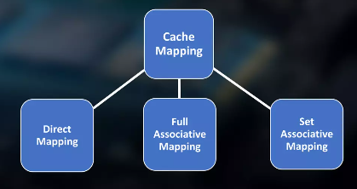
Cache mapping refers to the method used to store data from main memory into the cache. It determines how data from memory is mapped to specific locations in the cache.
There are three different types of mapping used for the purpose of cache memory which is as follows:
  Direct Mapping
  Fully Associative Mapping
  Set-Associative Mapping

Slide 6
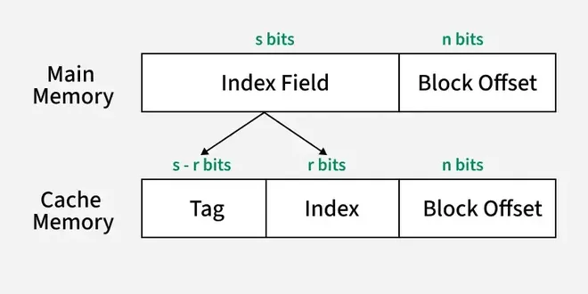
Direct Mapping
  Direct mapping is a simple and commonly used cache mapping technique where each block of main memory is mapped to exactly one location in the cache called cache line.
  If two memory blocks map to the same cache line, one will overwrite the other, leading to potential cache misses.
  Direct mapping performance is directly proportional to the Hit ratio.

Slide 7
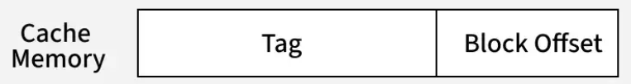
Fully Associative Mapping
  Fully associative mapping is a type of cache mapping where any block of main memory can be stored in any cache line.
  This improves the hit ratio but requires a more complex system for searching and managing cache lines.
  In fully associative mapping, the cache does not have an index field. It only have a tag which is same as Index Field in memory address.
  To determine whether a block is present in the cache, the tag is compared with the tags stored in all cache lines.

Slide 8
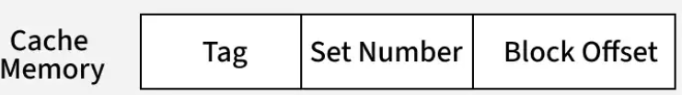
Set - Associative Mapping
  Set-associative mapping is a compromise between direct-mapped and fully-associative mapping in cache systems.
  It combines the flexibility of fully associative mapping with the efficiency of direct mapping. In this scheme, multiple cache lines (typically 2, 4, or more) are grouped into sets.

Slide 9

Data writing policies
Data can be written to memory using a variety of techniques, but the two main ones involving cache memory are the following:
  Write-through:
    In the write-through policy, Data is written to both the cache and main memory simultaneously.
    This ensures data consistency between the cache and main memory at the cost of higher write latency.
    Slower write operations due to simultaneous writes.

Slide 10

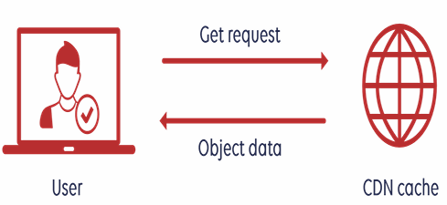
Cache Hit
  When the CPU finds the required data in the cache memory, allowing for quick access. On searching in the cache if data is found, a cache hit has occurred.
  Results in fast data access with no delay.

Slide 11
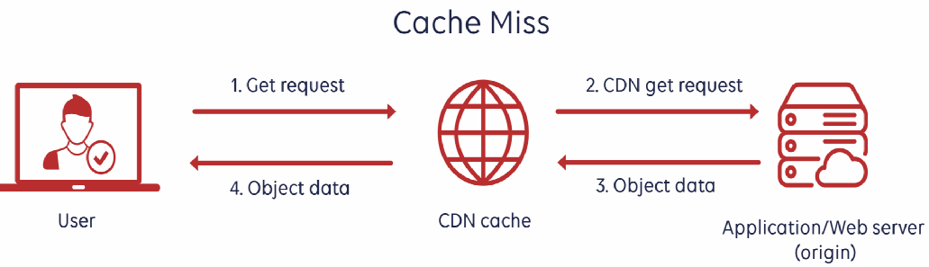
Cache Miss
  When the required data is not found in the cache, forcing the CPU to retrieve it from the slower main memory. On searching in the cache if data is not found, a cache miss has occurred.
  Results in slower access.

Slide 12
Hit Ratio
  Performance of cache is measured by the number of cache hits to the number of searches. This parameter of measuring performance is known as the Hit Ratio.
  Hit ratio = (Number of cache hits)/(Number of searches).
  Higher hit ratio = better cache performance.
  Hit ratio improves with good locality, larger cache size, and efficient replacement policies.
  Hit Ratio measures how often the CPU successfully finds data in the cache.
  Designers use hit ratio to analyze cache performance and optimize hardware for better speed.

Slide 13
Data writing policies
Data can be written to memory using a variety of techniques, but the two main ones involving cache memory are the following:
  Write-through:
    In the write-through policy, Data is written to both the cache and main memory simultaneously.
    This ensures data consistency between the cache and main memory at the cost of higher write latency.
    Slower write operations due to simultaneous writes.

Slide 14
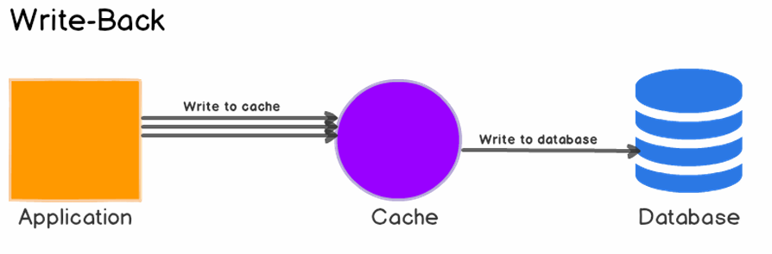

Data writing policies
Write-back:
  The write-back policy, also known as write-behind, allows data to be written only to the cache initially.
  The modified data is written to the main memory at a later time, either when the cache block is evicted or at specific intervals.

Slide 15
Write-Allocate (Fetch-on-Write):
  On a write miss, the block is loaded into the cache, then the write is performed.
No-Write-Allocate (Write-No-Allocate)
  On a write miss, data is written directly to memory, bypassing the cache.
  It avoids filling the cache with data that may not be used again, helping maintain better cache efficiency.
  No-write allocation reduces cache pollution, but may increase memory traffic during frequent write misses

Slide 16
Locality
The ability of cache memory to improve a computer's performance relies on the concept of locality of reference.
Locality describes various situations that make a system more predictable.
There are several types of locality. Two key ones for cache are:
    Temporal locality: This is when the same resources are accessed repeatedly in a short amount of time.
    Spatial locality: This refers to accessing various data or resources that are near each other.

Slide 17
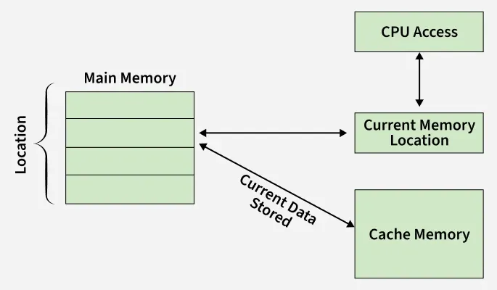
Locality
Temporal Locality (Locality in Time)
  Temporal locality states that if a particular memory location (data or instruction) is accessed at one time, it is likely to be accessed again in the near future.
    Programs often contain loops, counters, and frequently used variables.
    Since these are used repeatedly within short intervals, storing them in cache memory ensures faster access.

Slide 18

Locality
Spatial Locality (Locality in Space)
  Spatial locality states that if a particular memory location is accessed, the nearby memory locations are also likely to be accessed soon. Instructions and data are stored in contiguous memory locations.
    When a program accesses one location, the next few instructions or data items are often located adjacent to it.
    Hence, caching nearby blocks of memory improves performance.

Slide 19
Valid Bit
  The valid bit indicates whether the data stored in a cache line is usable or not
  If the valid bit = 1, the cache line contains correct, updated data.
  If the valid bit = 0, the data is invalid or empty
  At system startup or after cache flush, all valid bits are usually set to 0 because cache contains no useful data.
  During memory access, the CPU checks the valid bit first to decide whether the cache line can be used or a cache miss must occur.

Slide 20
Dirty Bit
  The dirty bit indicates whether the data in a cache line has been modified compared to main memory.
  If dirty bit = 1, the cache contains updated/modified data that must be written back to memory before eviction.
  If dirty bit = 0, the data in the cache is clean and matches main memory, so no write-back is needed.
  Dirty bit is mainly used in write-back caching to reduce unnecessary writes to main memory

Slide 21
ROM
ROM is a non-volatile memory, meaning it permanently stores data even when power is turned off.
It contains pre-programmed instructions, usually written during manufacturing and cannot be easily modified.
Used to store firmware, bootloaders, and essential system code that the computer needs during startup.
ROM is more reliable than RAM because the stored data does not change or get erased accidentally.
Types of ROM include PROM, EPROM, and EEPROM, FLash each offering different levels of re programmability.

Slide 22
Thank You !

