Slide 1
PHY Interface for the PCI Express

Slide 2
PIPE Operational Behavior
Clocking ​
There are three clock signals used by the PHY interface component.
The first clock (CLK) is a reference clock that the PHY uses to generate internal bit rate clocks for transmitting and receiving data.
The specifications for this signal are implementation dependent and must be fully specified by vendors.
The specifications may vary for different PHY operating modes.
This clock may have a spread spectrum modulation that matches a system Reference Clock (REFCLK).

Slide 3
PIPE Operational Behavior
The second clock (PCLK) is an output from the PHY in “PCLK as PHY Output” mode and an input to each PHY lane in the “PCLK as PHY Input” mode and is the parallel interface clock used to synchronize data transfers across the parallel interface.
This clock runs at a rate dependent on the Rate, PCLK Rate, and PHY Mode control inputs and data interface width.
The rising edge of this clock is the reference point. This clock may also have a spread spectrum modulation.
The CLK and PCLK must be sourced from the same reference clock and must contain the same clocking characteristics, that is, they can be mesochronous with each other.

Slide 4
PIPE Operational Behavior
The third clock (MAX PCLK) is a constant frequency clock with a frequency determined by the maximum signaling rate supported by the PHY
And is only required in “PCLK as PHY Input” mode or in all modes for a PHY that supports PCIe at 8 GT/s or higher maximum speed.
The Max PCLK value should be set to the maximum PCLK supported by the PHY.
The fourth clock (MacCLK) is an optional clock with support advertised by the PHY vendor parameter “MacCLK Support”.
This clock is independent of the data lanes and is specified using MacCLK lane signals.

Slide 5
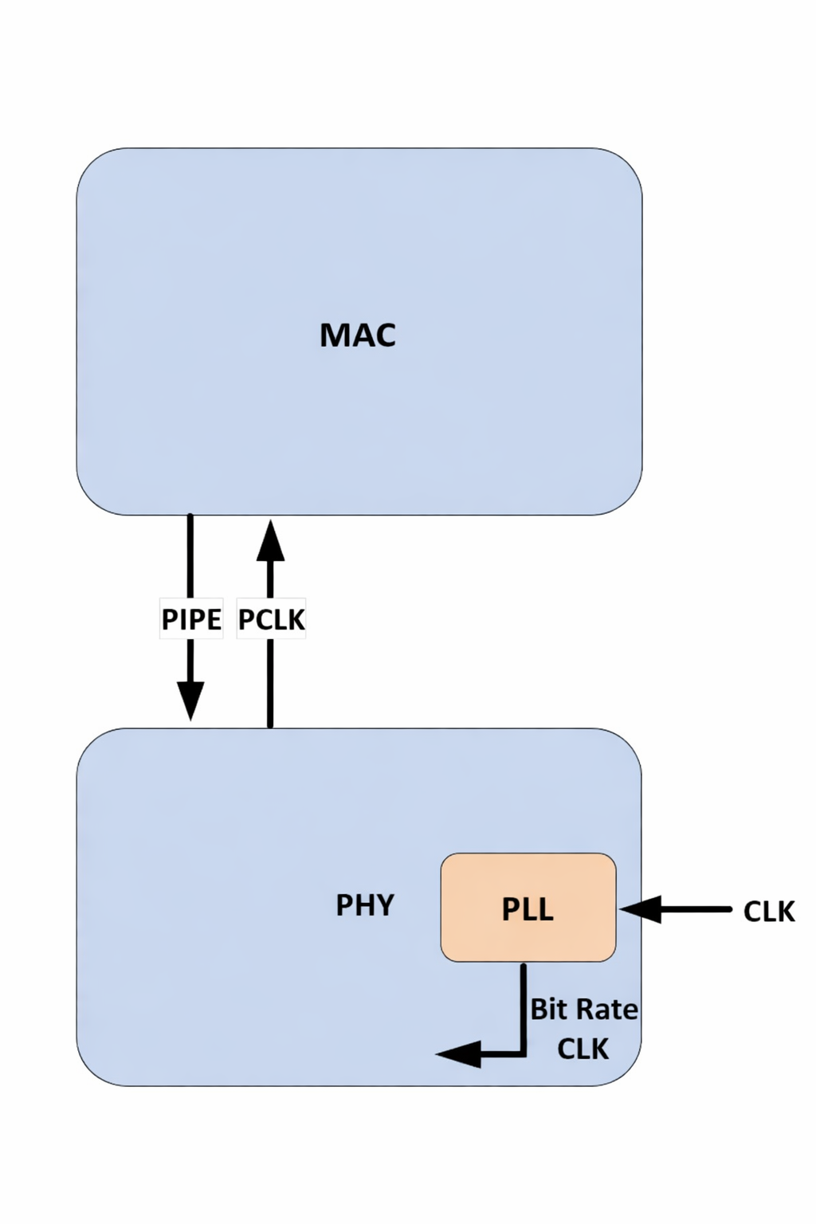
PIPE Operational Behavior
Clocking Topologies
This section describes some clocking topologies that are compatible with PIPE.
This Figure shows PCLK as a PHY output.
This topology is only applicable for legacy
PIPE implementations and is not supported
For PCIe Gen5 designs, USB4 or DisplayPort.

Slide 6
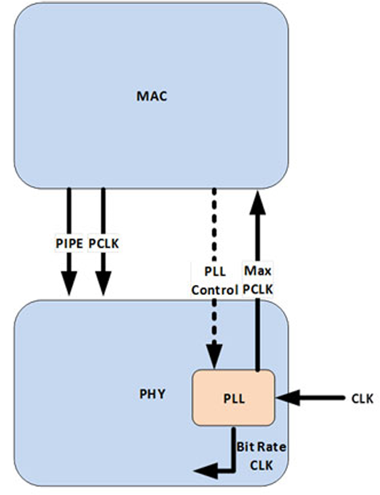
PIPE Operational Behavior
This figure shows PCLK as a PHY input with the PLL residing in the PHY;
The PHY provides a source for PCLK, in this case, MAX PCLK, that is mesochronous to the PHY’s bit rate clock.

Slide 7
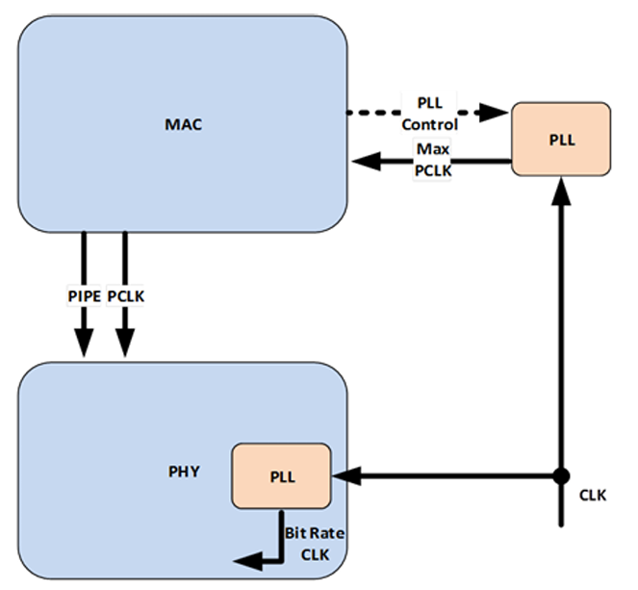
PIPE Operational Behavior
This Figure shows PCLK as a PHY input with the PLL that provides the PCLK source residing outside of the PHY;
The reference clock for PLL that sources the bit rate clock and the PLL that provides the PCLK source must be the same.

Slide 8
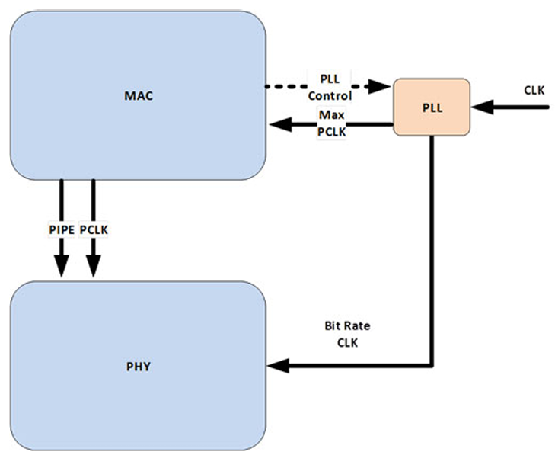
PIPE Operational Behavior
This Figure shows CLK as a PHY input with a single PLL that provides the source for PCLK as well as for the bit rate clock.

Slide 9
PIPE Operational Behavior
MacCLK Clocking Scheme :
  The MacCLK is an optional clock that is independent of data lanes.
  MacCLK frequency is controlled via a MacCLK lane.
  Each MacCLK lane consists of the following signals:
  MacCLKReset#,
  MacCLK,
  MacCLKReq,
  MacCLKSSCEnable,
  MacCLKAck,
  MacCLKPHYMode,
  MacCLKRate.

Slide 10
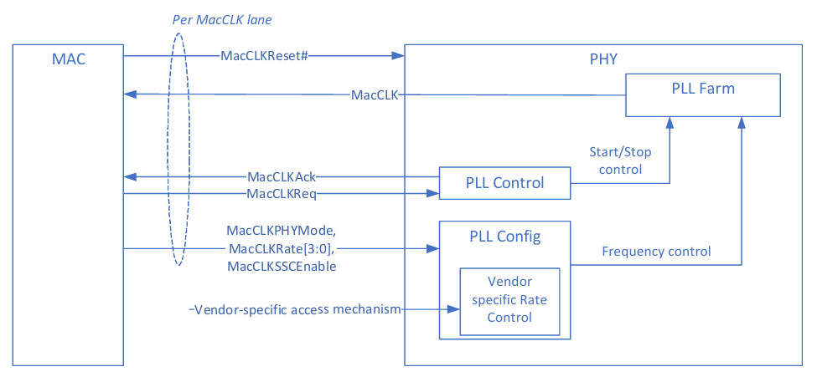
PIPE Operational Behavior
MacCLK Lane :

Slide 11
PIPE Operational Behavior
The following rules apply to each MacCLK lane:
  MacCLKPHYMode, MacCLKRate, MacCLKSSCEnable, MacCLKReq, MacCLKAck must be at a valid value at MacCLKReset# deassertion.
  MacCLKPHYMode must not change after MacCLKReset# deassertion.
  Once MacCLK is running, it must remain stable until MacCLKReq is deasserted.
  Signals that affect MacCLK frequency are sampled only on the rising edge of MacCLKReq.
  MacCLKRate is permitted to change only when MacCLKReq and MacCLKAck are deasserted.
  MACCLKSSCEnable is permitted to be dynamically asserted or deasserted while MacCLK is running. The PHY specifies the maximum time it takes to complete a SSC enable or disable via the MaxSSCEnableDisableTime parameter.
  MacCLKRate defines an override encoding that indicates that a vendor specific mechanism of specifying MacCLK frequency is used.

Slide 12
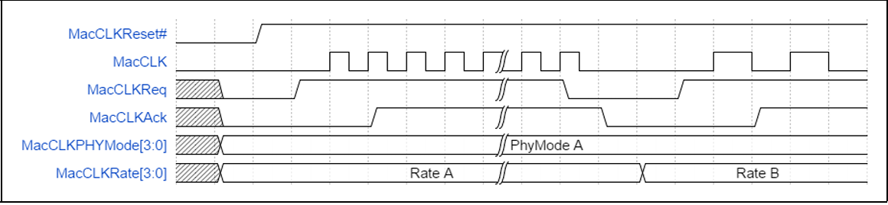
PIPE Operational Behavior
Basic MacCLK Lane Operation
  In this example, MacCLk is requested at an initial rate; subsequently,
  MacCLKReq and MacCLKAck deassert before a a new rate is requested.

Slide 13
PIPE Operational Behavior
Reset
  When the MAC wants to reset the PHY (for instance, during the initial power-on),
  the MAC must hold the PHY in reset until the power and CLK to the PHY are stable.
  When PCLK is generated by the PHY, the PHY indicates that PCLK and MAX PCLK are stable and running at the correct frequency by deasserting PhyStatus after the reset releases .
  The MAC must not perform any operational sequences until the PhyStatus is returned for the Reset# deassertion.

Slide 14
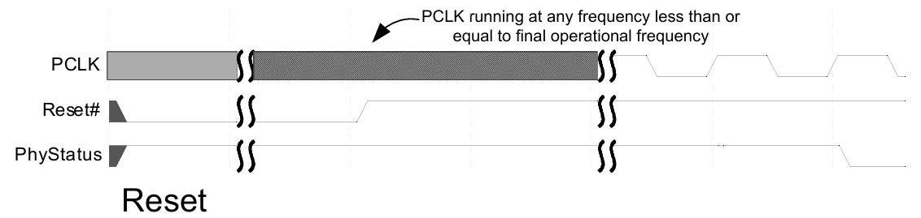
PIPE Operational Behavior
MAC Configuration During Reset While Reset# is asserted, the MAC sets:
  TxDetectRx/Loopback → deasserted
  TxElecIdle → asserted
  TxCompliance → deasserted
  PowerDown → P1 (PCIe), P2 (USB), or default (SATA)
  PHY mode, SerDes architecture (PIPE/SerDes),
    DP_Mode_Tx_Rx, and link rate (PCIe: 2.5 GT/s, USB: 5 or 10 GT/s, SATA: supported rate) are configured during reset;
    TxSwing and RxTermination behavior are implementation specific.

Slide 15
PIPE Operational Behavior
Power Management – PCIe Mode
  The Power management signals allow the PHY to reduce power consumption.
  The PHY must meet all PCIe timing requirements for clock recovery and link training in all power states.
  The PHY must satisfy all transmitter and receiver termination requirements.
  Four standard power states are defined: P0, P0s, P1, and P2
  P0 is the normal operating state of the PHY
  When moving from P0 to a lower power state, the PHY can immediately apply power-saving actions
  The PHY may support additional PHY-specific power states (required for L1 substate support)
  The MAC can use these PHY-specific states as long as PCIe specification requirements are met

Slide 16
PIPE Operational Behavior
  In P0, P0s, and P1 states, PCLK must remain active
  For transitions between P0, P0s, P1, or any PHY-specific state where PCLK is active:
    The PHY indicates a successful transition by asserting PhyStatus for one clock cycle
  Transitions into or out of P2 (or PHY-specific states where PCLK is not active) are handled separately
  For all power state transitions, the MAC:
    Must wait for PhyStatus
    Must not start operations or request another transition until the current one is complete

Slide 17
PIPE Operational Behavior
PHY Power States and LTSSM Mapping
  PHY power states are mapped to corresponding LTSSM states defined in the PCIe base specification
  This mapping ensures correct link behavior and compliance
  The MAC may use PHY-specific power states
  PHY-specific states are allowed as long as PCIe base specification requirements are met
  P0 Power State (PHY)
    P0 is the normal operating state of the PHY
    In P0, all internal clocks are active
    PCIe transmit and receive signaling occurs only in P0
    P0 is used for most LTSSM states.

Slide 18
PIPE Operational Behavior
P0s Power State (PHY)
  PCLK remains operational in P0s state
  The MAC can move the PHY to P0s only when the transmit channel is idle
  P0s is typically used when the transmitter is in Tx_L0s.Idle state
  While in P0 or P0s, if the receiver detects electrical idle, it may apply power-saving measures
  When data transmission resumes on the receive channel, the PHY must quickly lock to the signal
  The PHY must achieve bit lock and symbol lock within the specified time (N_FTS)
    Applies with or without a common clock
  This requirement applies only if the receiver was already locked earlier
    That is, the receiver was previously in P0 or P0s state

Slide 19
PIPE Operational Behavior
P1 Power State (PHY)
  In P1 state, some internal PHY clocks can be turned off to save power
  PCLK must remain operational
  The MAC moves the PHY to P1 only when both TX and RX are idle
  The PHY signals successful entry into P1 by asserting PhyStatus only after:
    PCLK is stable
    DC common-mode voltage is stable and within specification
  P1 state is used for LTSSM states:
    Disabled
    Detect states
    L1.Idle (only if L1 substates are not supported)

Slide 20
PIPE Operational Behavior
P2 Power State (PHY)
  P2 is a deep low-power state
  Some internal PHY clocks are turned off
  PCLK is turned OFF
  The parallel interface operates in asynchronous mode
  P2 state is used for LTSSM states:
    L1.Idle
    L2.Idle
    L2.TransmitWake

Slide 21
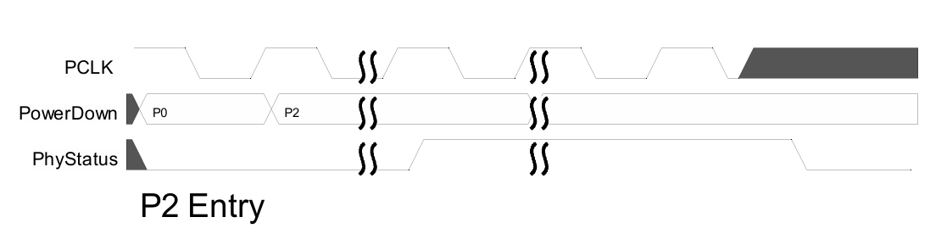
PIPE Operational Behavior
PCIe P2 Entry and Exit with PCLK as PHY Output
  Entering P2 state:
    PHY asserts PhyStatus before PCLK is turned OFF
    PHY then deasserts PhyStatus once PCLK is fully OFF
    This indicates the PHY has successfully entered P2

Slide 22
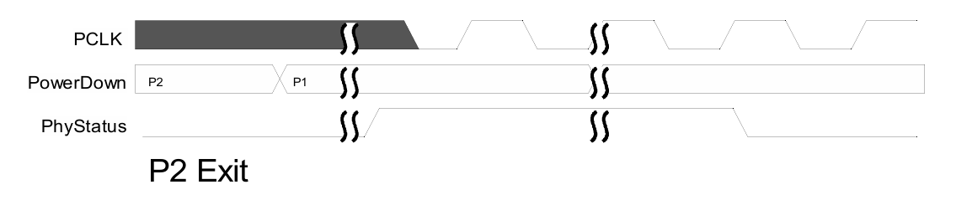
PIPE Operational Behavior
PCIe P2 Entry and Exit with PCLK as PHY Output
  Exiting P2 state:
    PHY asserts PhyStatus as soon as possible
    PhyStatus remains asserted until PCLK becomes stable
    This indicates the PHY is ready to resume operation

Slide 23
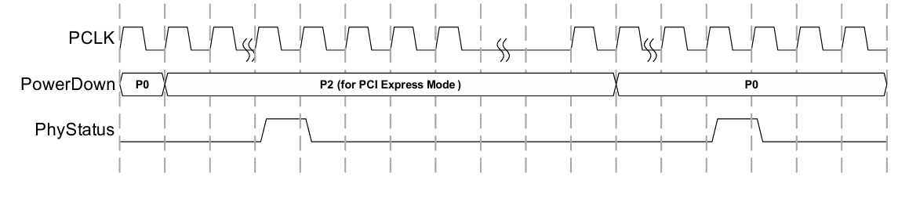
PIPE Operational Behavior
PCIe P2 Entry and Exit with PCLK as PHY Input
  Entering P2 state:
    PHY asserts PhyStatus for one PCLK cycle
    This indicates the PHY is ready for PCLK to be removed
  Exiting P2 state:
    PHY asserts PhyStatus for one PCLK cycle as soon as possible
    This occurs after the PHY transitions back to P0
    Indicates the PHY is ready for normal operation

Slide 24
PIPE Operational Behavior
Transitions Without PCLK & P2 Power Behavior
  When transitioning between two power states where PCLK is not available:
    The PHY asserts PhyStatus once the transition is complete
    PhyStatus remains asserted until the MAC asserts AsyncPowerChangeAck
    After receiving AsyncPowerChangeAck, the PHY deasserts PhyStatus
  In P2 state, the PHY should be designed to minimize power consumption
  This is important because, in P2, the device operates under VAUX power limits defined by the PCIe specification

Slide 25
PIPE Operational Behavior
Legal PHY Power State Transitions
  The MAC is allowed to request only specific power state transitions:
    P0 → P0s
    P0 → P1
    P0 → P2
    P0s → P0
    P1 → P0
    P2 → P0
  The PCIe base specification defines what events cause these transitions.
  Transitions involving PHY-specific power states are also allowed by PIPE
  The MAC must ensure that all PCIe timing requirements are met during any transition

Slide 26
PIPE Operational Behavior
L1 SubState Entry and Exit with PCLK as PHY Output
  L1 SubState Entry
    MAC requests low-power state (P2 / P2-like)
    PHY asserts PhyStatus before shutting down clocks
    PCLK is turned OFF
    REFCLK may be removed
    PHY enters L1 / L1.1 / L1.2 (L1.Idle)
  L1 SubState Exit
    PHY starts wake-up from P2 / P2-like state
    PCLK is restored
    PHY asserts PhyStatus as soon as possible
    PhyStatus remains asserted until PCLK is stable
    MAC acknowledges using AsyncPowerChangeAck
    PHY returns to P1 / P0 and normal operation resumes

Slide 27
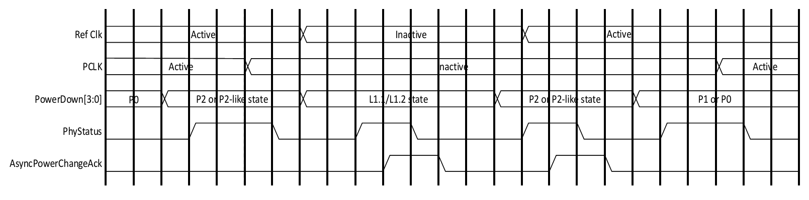
PIPE Operational Behavior
L1 SubState Entry and Exit with PCLK as PHY Output

Slide 28
PIPE Operational Behavior
Changing Signaling Rate, PCLK Rate, or Data Bus Width – PCIe Mode
Rate / Width / PCLK Change – Rules
  Link signaling rate, PCLK rate, or data bus width can be changed only in P0 or P1
  TxElecIdle must be asserted
  RxStandby must be asserted (only in P0)
  MAC must wait for PHY confirmation before:
    Starting any operation
    Changing power states
    Deasserting TxElecIdle / RxStandby
    Making another rate or width change

Slide 29
PIPE Operational Behavior
PCLK as PHY Input Mode
MAC changes:
  Rate
  Width
  PCLK_Rate (if required)
PHY asserts PclkChangeOk to indicate safe PCLK change
MAC:
  Changes input PCLK
  Asserts PclkChangeAck
PHY:
  Asserts PhyStatus for one input PCLK cycle
  Deasserts PclkChangeOk
PCLK as PHY Output Mode
MAC changes:
  Rate
  Width
  PCLK_Rate
PHY performs the changes
PHY signals completion by:
  Asserting PhyStatus for one clock cycle
MAC proceeds only after PhyStatus

Slide 30
PIPE Operational Behavior
Note:
    PclkChangeOk is used by the PHY when the MAC changesPCLK_Rate and signaling rate.
    The PHY datasheet specifies whether this handshake isalso required for every rate change.
MAC Actions After PCLK / Rate Change
  The MAC deasserts PclkChangeAck when PclkChangeOk is sampled LOW
  The MAC may deassert TxElecIdle and/or RxStandby only after PhyStatus is sampled HIGH
Priority Rule for LTSSM Transitions
  In some cases, the LTSSM requests both:
    A rate / width / PCLK change, and
    A power state change
  In such cases, the MAC must:
    First complete the signaling rate, width, and/or PCLK rate change
    Then perform the power state change

Slide 31
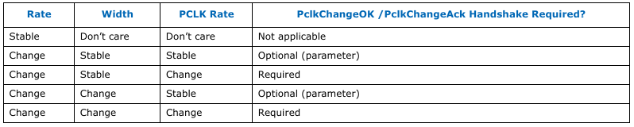
PIPE Operational Behavior
    PclkChangeOK/PclkChangeAck Requirements

Slide 32
PIPE Operational Behavior
Combined Rate and Power State Change
  Some PHY architectures support changingrate/width/PCLK and power state at the sametime
  If supported:
      The MAC must change Rate, Width, and/or PCLK rate
      At the same PCLK edge as changing the PowerDownsignals
  This typically occurs during transitions:
      P0 → P1
      P0 → P2
Completion Indication
  The same completion mechanism used for power state changes applies
  Completion indicates:
    Power state change is complete
    Rate, width, or PCLK rate change is also complete

Slide 33
PIPE Operational Behavior
Transmitter Margining – PCIe Mode and USB Mode
  While the PHY is in P0 (normal operation), the transmit voltage level can be adjusted
  The MAC changes the voltage using TxMargin[2:0]
  After the change, the PHY must:
    Apply the new transmit voltage
    Start transmitting with the new setting within 128 ns
  Only a limited set of valid TxMargin[2:0] and Rate combinations is allowed
  The MAC must select only supported combinations
  PCIe mode:
    Legal settings are defined in the PCIe base specification

Slide 34
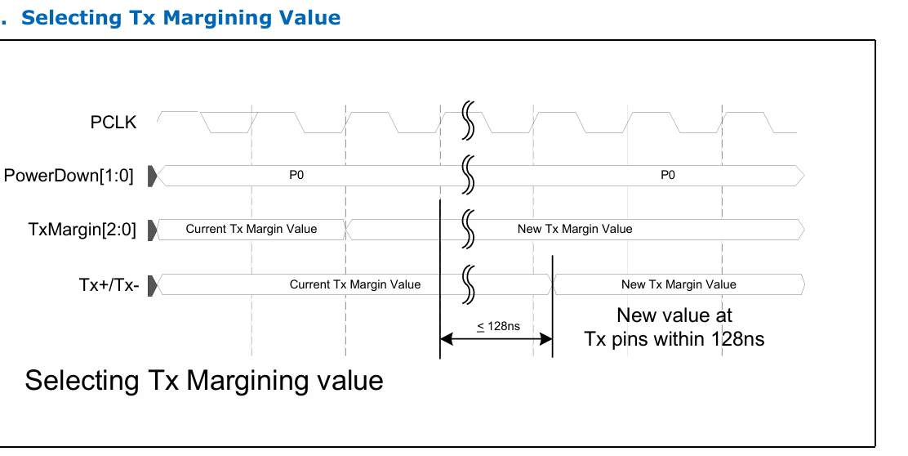
PIPE Operational Behavior
Transmitter Margining – PCIe Mode and USB Mode

Slide 35
PIPE Operational Behavior
Selectable De-Emphasis – PCIe Mode
TX Equalization (TxDeemph) Change – P0 State
  In P0 power state, the PHY supports transmitter equalization changes
  Supported signaling rates:
    5.0, 8.0, 16, 32, 64, and 128 GT/s
  The MAC updates transmitter equalization using TxDeemph
PHY Update Time Requirement
  At 5.0 GT/s:
    PHY must apply the new TxDeemph value within 128 ns
  At 8.0 GT/s and higher (16/32/64/128 GT/s):
    PHY must apply the new TxDeemph value within 256 ns

Slide 36
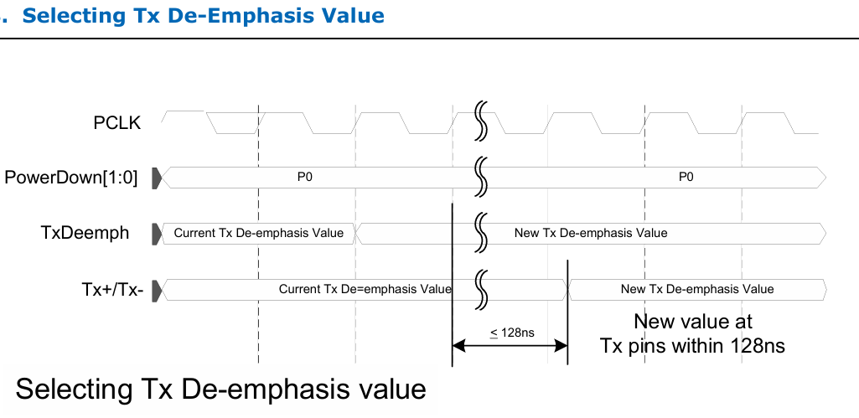
PIPE Operational Behavior
TxDeemph and Rate Rules
  Only a limited set of valid TxDeemph and Rate combinations is allowed
  The MAC must select only supported combinations
  Detailed legal combinations are defined in the PCIe base specification
  When Rate = 2.5 GT/s, the MAC must set TxDeemph to –3.5 dB

Slide 37
PIPE Operational Behavior
Receiver Detection – PCIe Mode
  Receiver detection is allowed in P1 (optionally P2) power state
  Receiver Detection Process
    MAC initiates detection by asserting:
      TxDetectRx/Loopback
    PHY performs the receiver detect sequence
    On completion:
      PHY asserts PhyStatus for one clock
      PHY drives RxStatus with the detection result
  MAC must hold TxDetectRx/Loopback until PHY completes detection, especially in deep power states like P2 or P3.

Slide 38
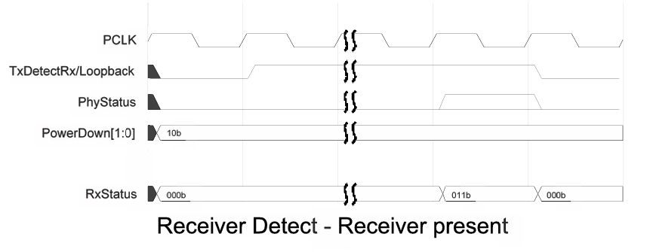
PIPE Operational Behavior
Receiver Detection – PCIe Mode
Detected Condition | RxStatus Code
Receiver not present | 000b
Receiver present | 011b

Slide 39
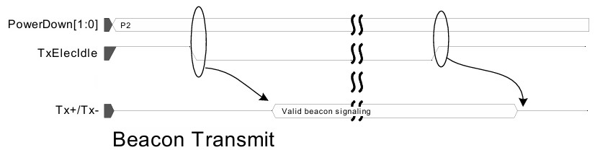
PIPE Operational Behavior
Transmitting a Beacon – PCIe Mode
  When the PHY is in P2 state, and the MAC wants to transmit a beacon:
    MAC deasserts TxElecIdle
    PHY generates a valid beacon signal
  The PHY continues transmitting the beacon:
    Until TxElecIdle is asserted again
  Before transitioning PHY from P2 → P0:
    MAC must assert TxElecIdle
  A beacon is a low-power wake-up signal
  transmitted by the PHY to indicate link
  presence during deep power states.

Slide 40
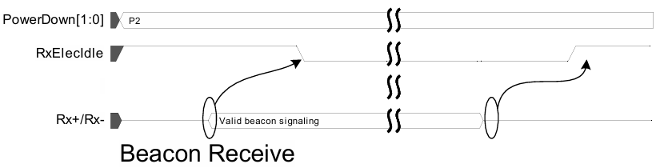
PIPE Operational Behavior
Detecting a Beacon – PCIe Mode
  The PHY receiver must continuously monitor for electrical idle
    Except during reset
    Or when RxEIDetectDisable is set
  When the PHY is in P2 power state:
    If RxElecIdle is deasserted
    It indicates that a beacon is detected

Slide 41
PIPE Operational Behavior
Error Detection – PCIe Mode
  The PHY detects different types of receive errors
  Errors are reported to the MAC using:
    RxStatus[2:0] signals
  Due to higher-layer error checking (e.g., CRC in Data Link layer):
    Exact symbol identification is not required
    But correct timing of the error is important
  Error Signaling Method
  When a receive error occurs:
    PHY asserts the appropriate error code
    For one clock cycle
    At the point in the parallel data stream closest to the error location

Slide 42
PIPE Operational Behavior
Error Priority (Highest to Lowest)
  If multiple errors occur in the same data unit, report in this priority order:
  8B/10B decode error or Block decode error
  Elastic buffer overflow
  Elastic buffer underflow (Cannot occur in Nominal Empty buffer model)
  Disparity error
  Misalign error (SATA mode only)
Header Error Handling
  The PHY does NOT detect:
    128/130B header errors (PCIe)
  The PHY passes raw header bits to the controller
  The controller (MAC/Data Link layer) is responsible for:
    Header error detection
    Error handling

Slide 43
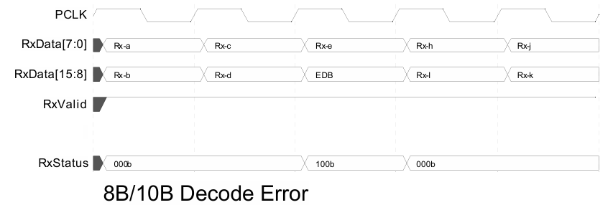
PIPE Operational Behavior
8B/10B Decode Errors
  If PHY detects an 8B/10B decode error:
  Replace bad byte with:
    End Bad [EDB (PCIe / SATA)]
  PHY sets RxStatus = Decode Error
  Error is indicated for one clock cycle
Important Rule
  If both decode error and disparity error occur:
    Decode error has higher priority

Slide 44
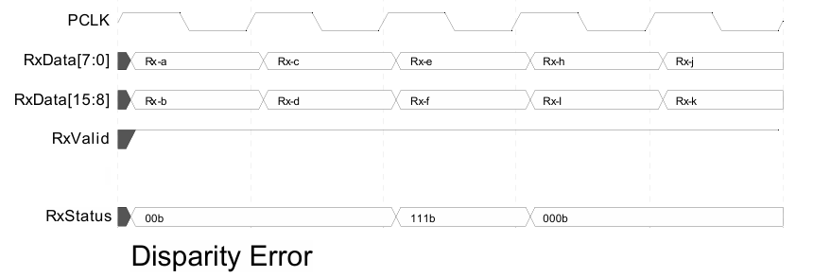
PIPE Operational Behavior
Disparity Errors
  If PHY detects a disparity error:
    It asserts RxStatus = Disparity Error
    Error is indicated during the clock cycle of the affected byte
  In wider interfaces (16/32/64-bit):
    It may not be possible to know which exact byte had the error
Important Notes
  PHY may optionally signal disparity error as:
    8B/10B decode error (0b100)
  Many MACs treat:
    Decode errors and disparity
    errors the same

Slide 45
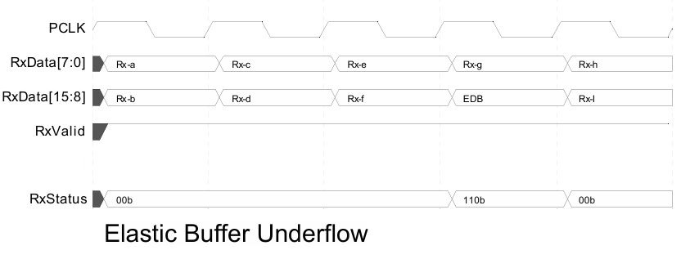
PIPE Operational Behavior
                Elastic Buffer Errors
Elastic Buffer Underflow Error
  If elastic buffer underflow occurs:
    PHY inserts: EDB (PCIe / SATA)
  The inserted symbol appears in the data stream
  During that clock cycle:
    PHY sets RxStatus = Buffer Underflow

Slide 46
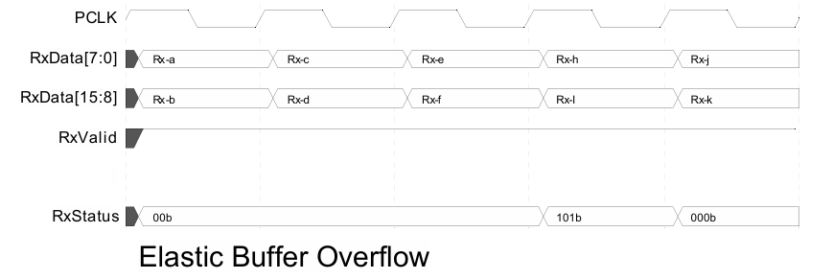
PIPE Operational Behavior
                Elastic Buffer Errors
Elastic Buffer Overflow Error
  If elastic buffer overflow occurs:
    One or more symbols are dropped
  PHY signals the overflow:
    During the clock cycle when the dropped symbol would have appeared
    By setting RxStatus = Buffer Overflow

Slide 47
PIPE Operational Behavior
Elastic Buffer Reset
Elastic Buffer (EB) Reset Sequence
  MAC initiates EB reset by setting:
    ElasticBufferResetControl bit
  PHY must complete reset within:
    16 PCLK cycles
1. Assert RxStatus to value of 1xx with RxValid
2. Hold RxStatus to 1xx while maintaining RxValid and RxDataValid
3. Move pointers back to their initial state
4. Release RxStatus to indicate clean data is being forwarded again

Slide 48


