Slide 1
Power
K.LOKESH
Chipweave Technologies Private Limited

Slide 2
Introduction
VLSI (Very Large-Scale Integration) packs millions/billions of transistors onto a single chip.
In the present era of VLSI design for low power is one of the major concerns in complex integrated circuits.
Due to higher levels of integration density, tens of millions of gates are being implemented on a relatively small die.
This leads to increase in power density and total power dissipation.
As technology scales down, power consumption becomes a major challenge in IC design.
At lower technology nodes like from 65-nm designs, leakage power dominates the dynamic power.

Slide 3
Energy versus Power
Energy is the capacity to do some physical activities or work,while power is defined as the rate at which the energy is transferred, or the work is completed.
The unit used to measure energy is joules. Power is measured in watts.
P = E / t
  P – Power
  E – Energy
  t – Time taken

Slide 4
Energy versus Power
The total power for a VLSI circuit consists of two components:
  dynamic power
  static power
Dynamic power is the power consumed when the device is active, that is, when signals are changing values.
Static power is the power consumed when the device is powered up but no signals are changing value.

Slide 5
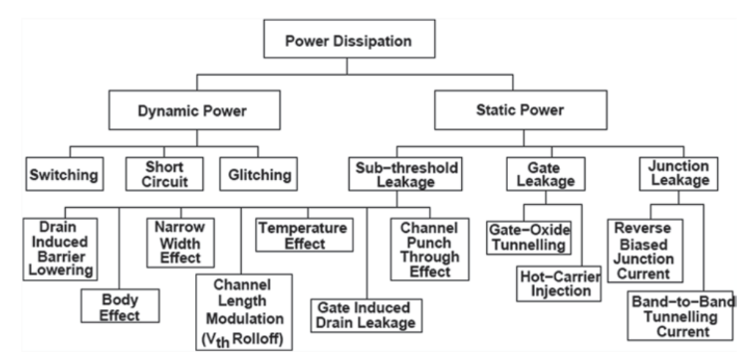

Slide 6
Dynamic Power
Dynamic power is the power consumed when the device is active, that is, when signals are changing values.
It is generally categorized into three types:
  Switching power
  Short-circuit power
  Glitching power

Slide 7
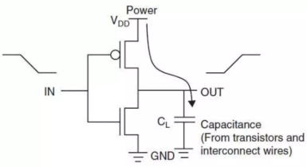
Switching Power
The first and primary source of dynamic power consumption is the switching power.
This is the power required to charge and discharge the output capacitance on a gate.

Slide 8
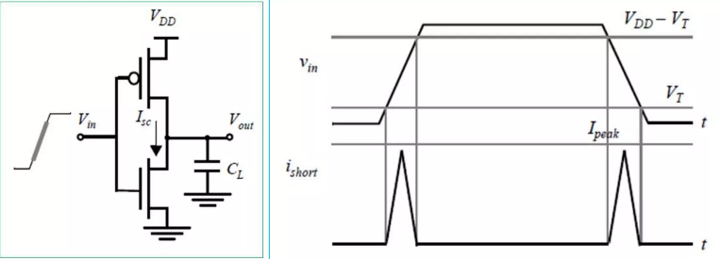
Short Circuit Power
The Short-circuit currents occur when both PMOS and NMOS transistors on.
Now we consider that input takes some finite time to change, similarly output
So, both transistors are ON for a finite time.
This causes a direct path between VDD and GND.

Slide 9
Glitching Power
The glitching power arises due to finite delay of the gates.
Glitches occur because the input signals to a particular logic block arrive at different times, causing a number of intermediate transitions to occur before the output of the logic block stabilizes.
These additional transitions result in power dissipation, which is categorized as the glitching power.

Slide 10
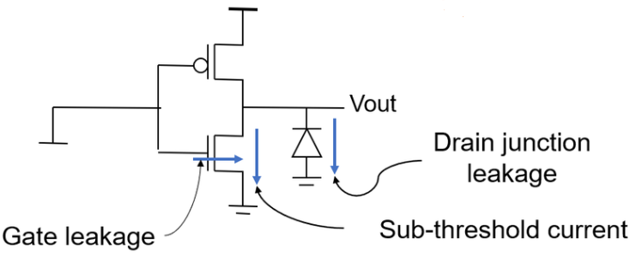
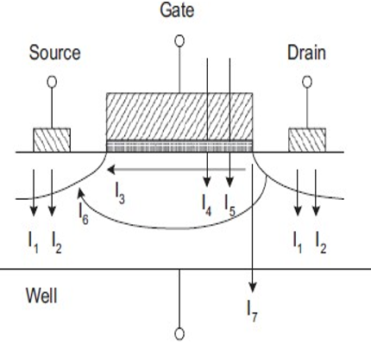
Static Power
Static power dissipation takes place as long as the device is powered ON, even in the absence of signal changes.
Static power dissipation occurs due to various leakage mechanisms.
I1 is the reverse-bias p–n junction diode leakage current.
I2 is the reverse-biased p–n junction current due to the tunneling of elections from the valence bond of the p region to the conduction bond of the n region, known as band-to- band tunneling current.

Slide 11
Static Power
I3 is the Sub-threshold leakage current between source and drain when the gate voltage is less than the threshold voltage Vt.
I4 is the Oxide-tunneling current due to a reduction in the oxide thickness.
I5 is the Gate current due to a hot-carrier injection of elections.
I6 is the Gate-induced drain-leakage (GIDL) current due to high field effect in the drain junction.
I7 is the Channel punch-through current due to close proximity of the drain and the source in short-channel devices.

Slide 12
Static Power
The subthreshold leakage current in CMOS circuits is due to carrier diffusion between the source and the drain regions of the transistor in weak inversion, when the gate voltage is below Vt.
Various mechanisms which affect threshold leakage current are:
    Drain-induced barrier lowering (DIBL)
    Body effect
    Narrow-width effect
    Effect of channel length and V_{th} roll-off
    Effect of temperature

Slide 13
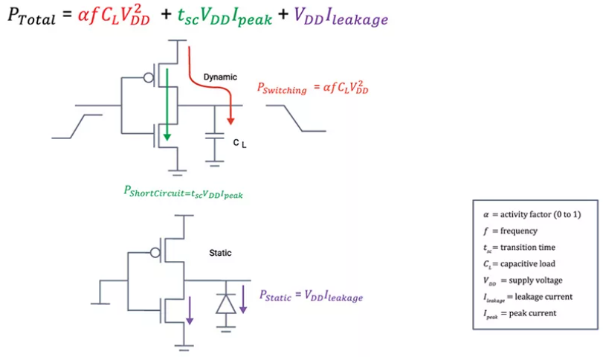

Slide 14
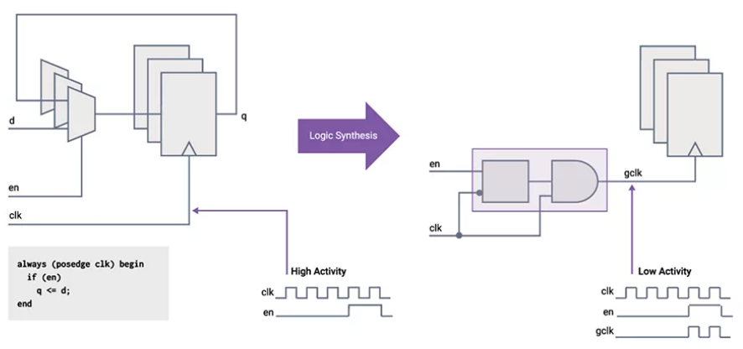
Low Power Design Techniques
Clock Gating
  Fundamentally clock gating means stopping the clock to a logic block when the operations of that block are not needed (or the inputs to the block are not changing).
  Turning off the clock signals to certain parts of the IC can greatly reduce power consumption, as the transistors in those areas will not be switching and consuming power.
  Thus only leakage power dissipation takes place when a circuit/block is clock gated.

Slide 15
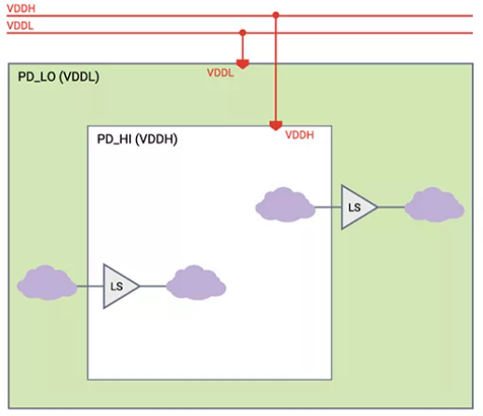
Low Power Design Techniques
Multi Voltage:
  In multi-voltage designs, the chip is divided into separate voltage islands(multiple voltage domains), where each block operates at a different supply voltage based on performance requirements.

Slide 16
Low Power Design Techniques
High-performance blocks operate at a higher supply voltage to meet speed requirements.
Low-performance or non-critical blocks operate at a lower supply voltage to reduce power consumption.
This approach avoids designing the entire chip at a high voltage, which would be simpler but more power-hungry.
When signals cross from one voltage island to another, Level Shifter (LS) cells are required to safely translate signal levels between different voltages.

Slide 17
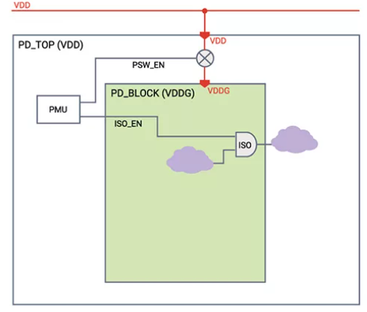
Low Power Design Techniques
Power Gating
  Power gating is a low-power technique where an IC is divided into power domains, and the supply to each domain is controlled using power switches (sleep transistors).
  The supply voltage is cut off using switch-like logic controlled by the Power Management Unit (PMU)

Slide 18
Low Power Design Techniques
When a block is not in use, the power switch is turned OFF, completely cutting off the supply voltage to that block.
Since the supply voltage becomes zero, both dynamic and static (leakage) power are eliminated while the block is powered down.
Power gating provides the most aggressive power savings, and the goal is to turn OFF as many blocks as possible, as often as possible, without affecting functionality.

Slide 19
Low Power Design Techniques
Multi Vth Design
  As the name suggests, inside the design we use standard cells of different threshold voltage (Vth).
  Types of Standard Cells
    High-Vth (HVT) Cells
      High threshold voltage
      Low leakage power, but slow speed
      Used in non-timing-critical paths to save static power
    Low-Vth (LVT) Cells
      Low threshold voltage
      High speed, but high leakage power
      Used in timing-critical paths
    Standard-Vth (SVT) Cells
      Medium threshold voltage
      Balanced power and performance
      Used when timing is close to being met

Slide 20
Low Power Design Techniques
Dynamic Voltage and Frequency Scaling (DVFS)
  DVFS is a low-power technique used to optimize power consumption based on workload variations.
  In systems like CPUs, the workload changes over time depending on the application being executed.
  If voltage and frequency are kept constant, the processor consumes fixed power, even when full performance is not required.
  DVFS dynamically adjusts the operating voltage and frequency according to the workload.
  The IP is designed with multiple performance modes instead of operating at a single fixed power level.
  Each performance mode has:
    A specific operating frequency
    A corresponding required supply voltage
  Based on workload and performance demand, system software selects the appropriate performance mode.
  Since power depends on voltage and frequency, DVFS significantly reduces dynamic power and overall energy consumption during low or medium workloads.

Slide 21
Low Power Design Techniques
  DVFS
    Uses predefined voltage–frequency pairs
    Adjusts based on workload only
  AVFS (Adaptive Voltage and Frequency Scaling )
    Adaptive Voltage and Frequency Scaling (AVFS) is a closed-loop power management technique used in VLSI systems to reduce power consumption while maintaining performance.
    Uses real-time feedback
    Adjusts based on actual silicon behavior, not worst-case assumptions

Slide 22
Thank You !

