Slide 1
Memory
K.LOKESH
Chipweave Technologies Private Limited

Slide 2
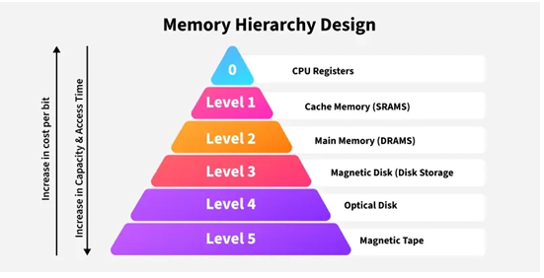
Memory Hierarchy
A memory hierarchy organizes different types of memory in a computer system based on access speed, cost, and capacity.
It aims to balance speed and cost by providing fast but smaller memory closer to the CPU and slower but larger memory further away.
This arrangement allows for efficient data access, as frequently used data can be stored in faster memory levels, while less frequently used data can be stored in slower, larger, and more cost-effective levels.

Slide 3
Levels of Memory Hierarchy
CPU Registers The fastest and smallest memory, directly accessed by the CPU, often used for current operations and data.
Cache Memory Faster than main memory but smaller in capacity, used to store frequently accessed data and instructions for faster retrieval by the CPU.
Main Memory (RAM) Larger and slower than cache memory, the primary storage for active programs and data, readily accessible by the CPU.
Secondary Storage (Hard Disks, SSDs) Slower than main memory but with high capacity, used for storing data that is not currently in use but needs to be preserved.
Tertiary Storage (Magnetic Tapes, Optical Disks) The slowest and largest memory, used for archival storage of data that is rarely accessed.

Slide 4
Classification Of Memory
Volatile Memory
  Loses data when power is off.
Registers
  Located inside the CPU Store immediate data like operands, counters
  Extremely fast (access time in nanoseconds)
  Very limited in size (typically 8–32 general-purpose registers)
Cache Memory
  Small memory between CPU and RAM
  Stores frequently accessed data/instructions
  Types:
    L1 Cache: Closest to CPU, smallest and fastest
    L2 Cache: Slightly larger and slower
    L3 Cache: Shared among CPU cores, larger but slower

Slide 5
Classification Of Memory
RAM
  Used for storing runtime data like variables, stack, heap, buffers.
    SRAM (Static RAM)
    DRAM (Dynamic RAM)
Non-Volatile Memory
  Retains data without power, common types are:
    1. ROM (Pre-programmed)
    2. Flash Memory (USB,Microcontrollers)
    3. Secondary Memory (HDD,SSD)

Slide 6
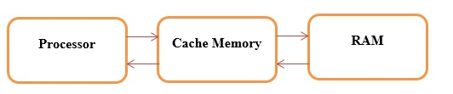
Cache Memory
The cache is a high-speed data storage mechanism used to temporarily store frequently accessed or recently used data and instructions.
It is situated between the main memory (RAM) and the central processing unit (CPU) in a computer system. By storing frequently accessed data closer to the CPU, cache enables quicker access times, reducing the latency associated with fetching data from slower main memory.
Types of Cache
  CPU Cache
  Disk Cache
  Web Cache
  DNS Cache

Slide 7
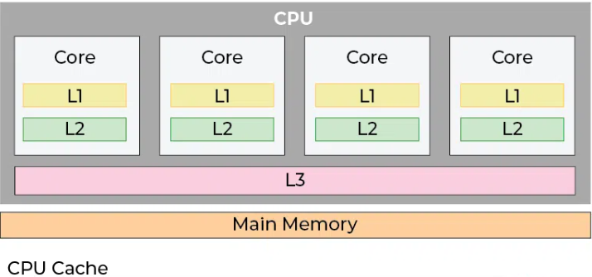
CPU cache
CPU cache, a fundamental component of modern processors.
A small, very fast memory inside or near the CPU.
Significantly impacts system performance by reducing the time it takes to access frequently used data and instructions

Slide 8
Types of CPU cache
L1 Cache:
    L1 cache is divided into separate instruction cache (L1i),which stores CPU operation information, and data cache (L1d), which stores operation data.
    L1 cache is extremely fast but limited in size, typically ranging from a few KBs to a few MBs per core.
    CPU determines L1 cache size.
L2 Cache:
    L2 cache serves as a secondary cache, larger than L1 but slower in access speed. It is shared among CPU cores within a single CPU core complex or chip.
L3 Cache:
    L3 cache is the last level of cache in the hierarchy, shared among multiple CPU cores or across multiple CPU sockets. It is larger than L2 cache but slower in access speed.

Slide 9
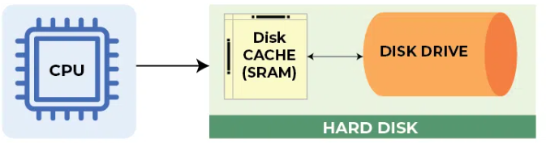
Disk cache
Disk cache, also known as buffer cache, [A memory buffer between RAM and storage devices (HDD/SSD)].
It is a mechanism used to improve disk I/O performance by temporarily storing recently accessed data in memory.

Slide 10
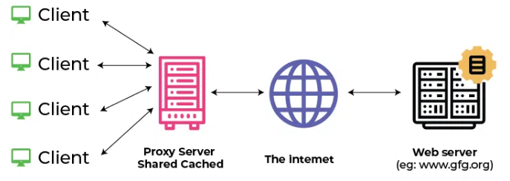
Web cache
Web cache, also known as a web proxy cache, is a mechanism used to store copies of web content such as HTML pages, images, and multimedia files locally on servers or client devices.

Slide 11
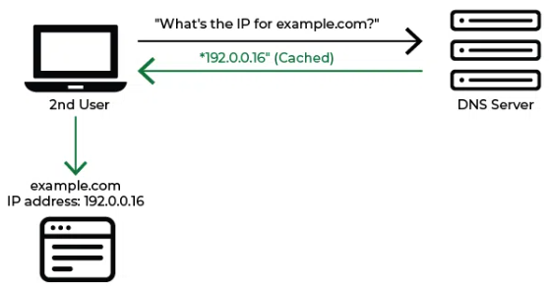
DNS(Domain Name System) cache
DNS cache, also known as a resolver cache, is a mechanism used to temporarily store recently resolved domain name-to-IP address mappings locally on client devices or DNS servers.

Slide 12
SRAM
Static Random-Access Memory (SRAM) is a type of semiconductor memory that uses bistable latching circuitry to store each bit of data.
Static means data is retained as long as power is supplied, without the need for refreshing.
Random access means that each bit of the data could be read/written independently.
Used for fast-access, low-latency applications.
Requires no refresh like DRAM because it uses flip-flop circuits.
Larger in size. (Low density device)
There are two kinds of power: Static and Dynamic Power. In SRAM:
    Static power consumption = High (Due to leakage in the always-on transistors).
    Dynamic power consumption = Low (There’s no refresh as DRAM)
Commonly used in:
  CPU caches (L1, L2, L3)
  Register files
  On-chip buffers

Slide 13
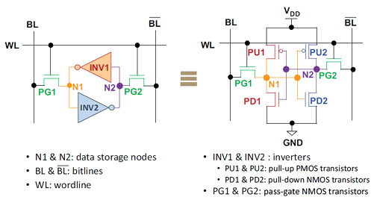
6T SRAM Cell Design
The core of the 6T cell includes:
    INV1 and INV2: Two cross-coupled inverters l.e Complementary storage nodes.
    N1 and N2: These are two storage nodes of the SRAM cell, as the data are stored at one of these two nodes.
    BL and BLB (Bit Lines): The storage nodes are connected to BL and BLB through two access transistors, whose gates are controlled by the same wordline (WL).
    WL(Word Line): Controls access to the cell.

Slide 14
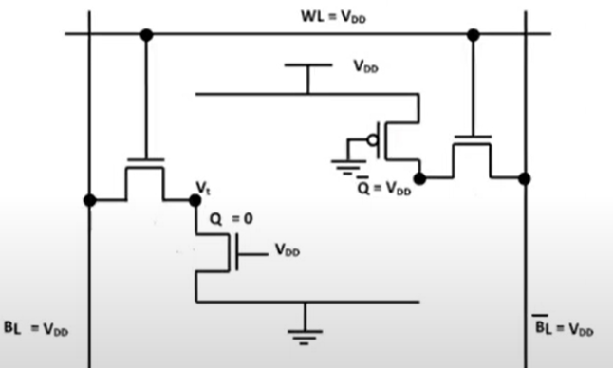
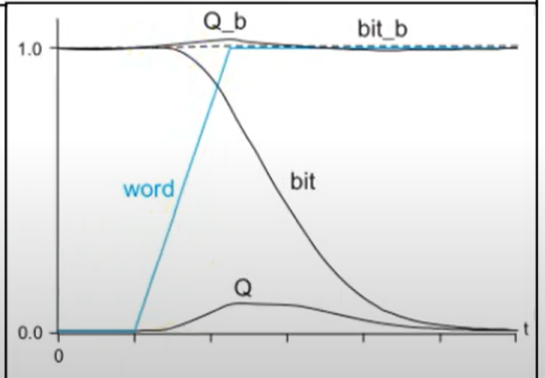
SRAM Read Operation
Assume ”0” at Q and ”1” at QB
The drivers first recharge all the bitlines (BL and BLB) to VDD (logical 1 value)
Q = 0 and QB = 1, BL start discharging and BLB stay at high.
A small voltage difference (e.g., 100 mV) builds up between BL and BLB.
Now sense amplifier comes in picture. A sense amplifier compares the two and rapidly drives the output to logic level:
  If BL > BLB Output = 1
  If BL < BLB Output = 0

Slide 15
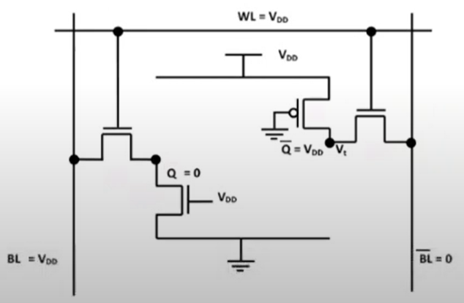
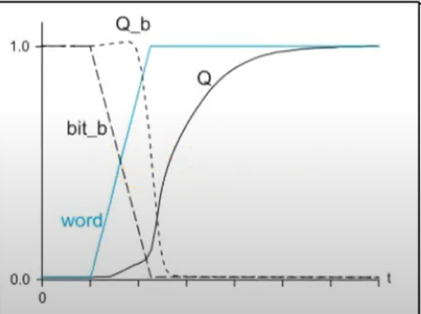
SRAM Write Operation
Bit Lines (BL and BLB) are driven externally with the value to be written. Write drivers pull BL and BLB to the desired logic levels.
Word Line Activation : WL goes high, turning ON access transistors. This connects the internal cell nodes Q and QB to BL and BLB
Cell Overwrite: The strong write drivers force the voltage onto N1 and N2.
  If we are writing ‘1’: Q = 0, QB = 1
  If we are writing ‘0’: Q = 1, QB = 0
  The previous value stored is overwritten by overpowering the cross-coupled inverter.

Slide 16
DRAM
DRAM (Dynamic Random-Access Memory) is a volatile semiconductor memory used for temporary data storage in most digital systems.
Dynamic refers to this need for periodic refresh to keep the data intact.
Random access means that each bit of the data could be read/written independently.
1T1C design :
  It stores each bit of data using a single capacitor and one access transistor.
DRAM is denser, compact, and low-cost, ideal for large memories.
DRAM is 20-times less area/bit than an SRAM bit cell.
It uses charge-based storage, capacitor leaks charge, must be refreshed periodically (every 64 ms).
  When there is Charge in capacitor = 1 (High)
  When there is NO Charge in capacitor = 0 (LOW)

Slide 17
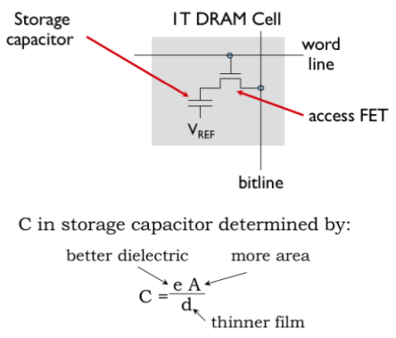
DRAM
There are two kinds of power: Static and Dynamic Power. In DRAM:
    Static power consumption = Low.
    Dynamic power consumption = High (Due to refreshing).
Commonly used in:
  Main RAM in laptops, desktops, servers
  Works in modules: DDR4, DDR5
  Graphics DRAM (GDDR)
  Mobile DRAM (LPDDR)
The basic DRAM memory cell consists of:
  1 Transistor (Access switch) :
    To select which bits will be affected by read and write operations.
  1 Capacitor (Storage element) :
    If the capacitor > threshold, we’re storing a 1 bit, otherwise 0.

Slide 18
DRAM Write Operation
DRAM write operations are straightforward: simply turn on the access FET with the wordline and charge or discharge the storage capacitor through the bitline.
Let say we want to write ’1’
Set Write Data on Bit Line:
  Drive Bitline(BL) to VDD or GND, for writing ’1’, Bit Line is driven to VDD (logic high)
Activate Word Line:
  Row decoder selects the required row WL goes high.Access transistor (T) turns ON.
  Bit Line and Capacitor are now connected.
Data Stored in Capacitor:
  If BL = VDD capacitor charges up stores logic ‘1’
  If BL = 0 capacitor discharges stores logic ‘0’
  This state remains as long as leakage doesn’t drain the capacitor (hence refresh needed).
Deactivate Word Line: WL is pulled low Access transistor turns OFF Cell is isolated with data stored as charge or no charge

Slide 19
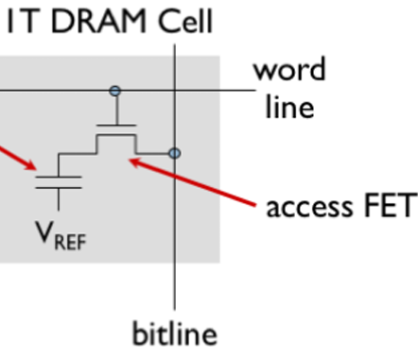
DRAM Read Operation
Reads are bit more complicated. We want read the stored data (weather it’s charge or no charge) from a DRAM cell without damaging the rest of the array.
Precharge Phase:
  Bitline (BL) is precharged to VDD/2.
  Then the precharge circuitry is disconnected.
  This sets a reference voltage so the sense amplifier can detect small deviations
Activate Word Line:
  The wordline is activated, connecting the storage capacitor of the selected cell to the bitline.
  It further cause the charge on the capacitor to be shared with the charge stored by the capacitance of the bitline.
As now capacitor and bitline share charge
  If capacitor was discharged, bitline voltage decreases slightly.
  If capacitor was charged, bitline voltage increases slightly.
Sense amplifiers are used to detect this small voltage change to produce a digital output value.

Slide 20
Thank You !

