Slide 1
KONGU ENGINEERING COLLEGE (AUTONOMOUS) PERUNDURAI – 638 060
BUS MANAGEMENT SYSTEM
MICRO PROJECT REPORT
JAVA PROGRAMMING (22ITC31)
Submitted by
LOKESH KUMAR S (23EIR054)
LOGESH B N (23EIR053)
NISHANTH (23EIL120)

Slide 2
ABSTRACT
The Bus Management System is a software solution for managing bus schedules and records. The system allows users to add, update, delete, and view bus details such as bus number, route, in-time, and out-time. It also enables sorting of records by time and ensures input validation to maintain data integrity. The system provides an intuitive interface to streamline bus management operations, making it ideal for small to medium-sized transportation setups. This project demonstrates the application of object-oriented programming principles in developing a user-friendly and efficient system.

Slide 3
PROBLEM STATEMENT
Managing bus schedules manually can lead to inefficiencies and errors. This project aims to develop an automated bus management system that allows users to add, update, delete, and sort bus records efficiently. The system ensures accurate data handling, robust validation, and a user-friendly interface for streamlined operations.

Slide 4
METHODOLOGY
THIS PROJECT EMPLOYS:
Requirement Gathering: Define functionalities like adding,
updating, deleting, and sorting records with
user-friendly operations and robust validation.
System Design: Use OOP principles; create Bus for details
and BusManagementSystem for operations.
Implementation: Develop a Java-based menu-driven
interface with sorting and validation.
Testing: Validate inputs, test sorting accuracy, and
ensure error handling.

Slide 5
IMPLEMENTATION
The Bus Management System was implemented in Java with key features including:
In-memory storage for fast data retrieval.
Dynamic input handling with validation to prevent errors.
Automated sorting of bus records by in-time and out-time.
Menu-driven interface for easy user interaction.

Slide 6
RESULTS AND DISCUSSION
Key outcomes include :
Successfully implementing core functionalities such as adding, updating, and deleting bus records.
Sorting by in-time and out-time is now flexible, supporting both ascending and descending orders.
Input validation ensures no invalid or duplicate entries, while usability is enhanced through an intuitive, menu-driven interface.

Slide 7
CONCLUSION
The Bus Management System successfully automates bus record management, ensuring accuracy, efficiency, and user-friendliness. By leveraging object-oriented programming, the system offers modularity and scalability. Future enhancements, such as real-time data integration and GUI development, can further improve its utility and applicability for larger transportation networks.

Slide 8
SAMPLE CODING
// Adding a new bus
public void addBus(String number, String route, String inTime, String outTime) {
Bus bus = new Bus(number, route, inTime, outTime);
busList.add(bus);
}
// Displaying all buses
public void displayAllBuses() {
if (busList.isEmpty()) {
System.out.println("No buses available.");
} else {
for (Bus bus : busList) {
System.out.println(bus);
}
}
}
// Sorting buses by time
public void displayBusesByTime(String timeType, boolean ascending) {
if (timeType.equalsIgnoreCase("in")) {
busList.sort(ascending ? Comparator.comparing(bus -> bus.inTime)
: Comparator.comparing(bus -> bus.inTime).reversed());
} else if (timeType.equalsIgnoreCase("out")) {
busList.sort(ascending ? Comparator.comparing(bus -> bus.outTime)
: Comparator.comparing(bus -> bus.outTime).reversed());
}
displayAllBuses();
}

Slide 9
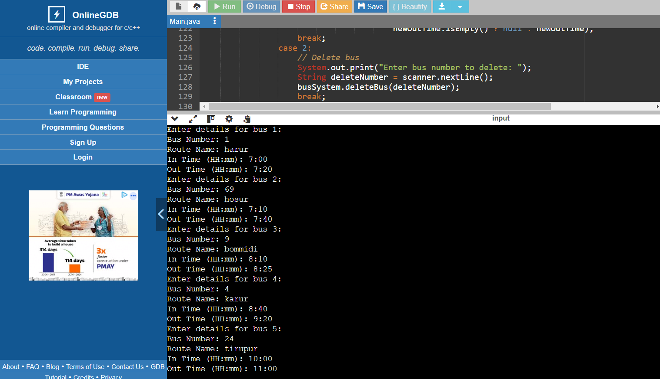
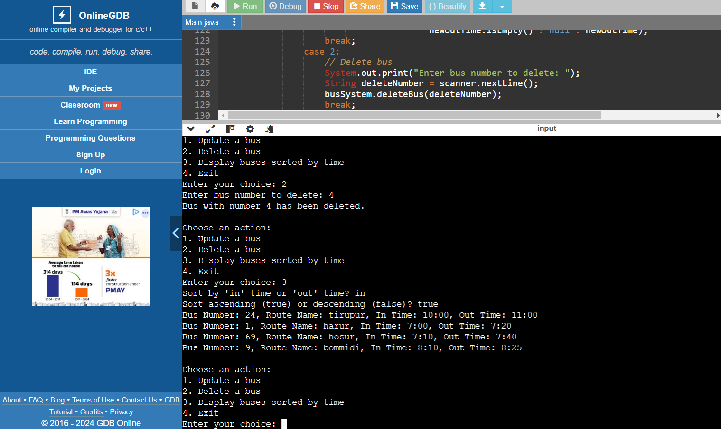
OUTPUT
ALL BUSES WITH IN AND OUT TIME ALONG WITH ROUTE NAME
DELETE, UPDATE AND SORT BUSES

Slide 10
THANK YOU

