Slide 1
03
Constraint Develop
Clock Diagram
Start Point, End Point, Timing Path Groups
What is SDC ?
Clock Creation
Constraining Input/output Paths
Case Analysis / Disable Timing Arcs
False Path
Asynchronous Clock Group
{ Logically Exclusive | Physically Exclusive }

Slide 2
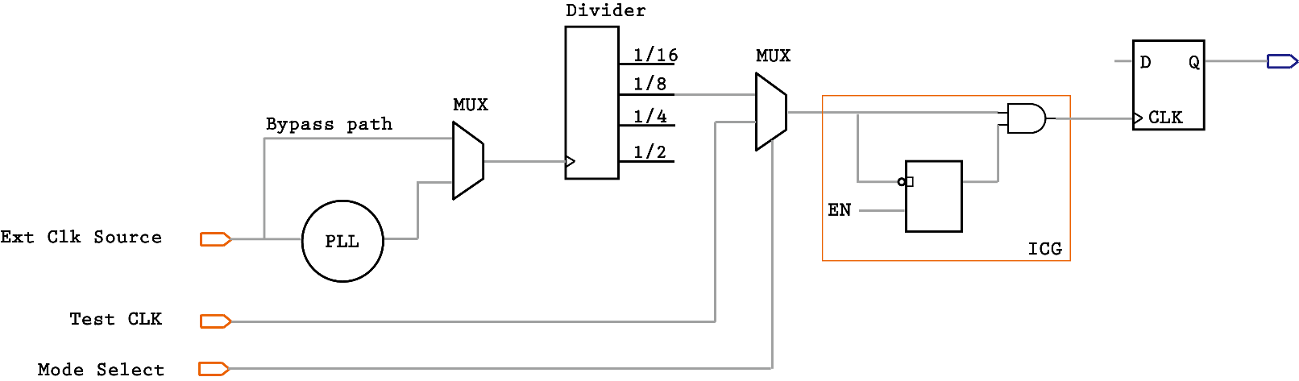

Clock Diagram
Clock Gating
Architectural or inferred clock gating for clock tree power saving. Integrated part of today’s ASIC design.
Clock Selection
Select which clock to be propagated to the downstream design according to functionality
Clock Generation
Clock source can be from external or generated internally
ASIC Boot Camp
Static Timing Analysis – Chapter 3 : Constraint Develop
Notes:
A synchronous design is one where a control signal triggers the circuit to transition from one state to another.
The trigger can happen at the positive or negative edge or both edges of the control signal.
Such a control signal which acts as a trigger for a synchronous design is called a clock and the edge on which the design triggers is called the active edge of the clock.
Clock Diagram is the first thing the STA engineering should get from the clock architecture designer. The clock scheme of a design is largely depending on the functionality it want to realize.
But normally all the clock structures have something in common. The picture shown here is a very generic clock diagram.
First, let’s exam what kind of elements are there in this clock diagram.
You will see the mainly three parts: clock generation part, clock selection part and clock gating part before the clock actually reaches the clock pin of the flip flop.
For clock generation, the on chip system clock is usually generated from an analog block called phase lock loop. The PLL has a feedback loop which can raise the clock frequency of a low frequency reference clock source to the real operating speed of the chip. But depends on the application, the on chip clock may not be the only clock source get used. That’s why we have clock selection logics.
System clocks can come from either outside the chip as a external source, or generated from PLL. Beside functional clocks, we could have test clocks targeting at debug the chip. The clock selection logic select the proper clock to be propagated for downstream logic under certain functionality.
As the power saving is more and more of a concern in an ASIC design, clock gating technique is widely used. The clock gating allows the designer to disable the toggle on certain clock when it is not used by downstream logics, so it can save a lot power. The clock gates can be architectural designed coded in the RTL, or it can be inferred by the physical implementation tool. We will explain more in a few slides.

Slide 3
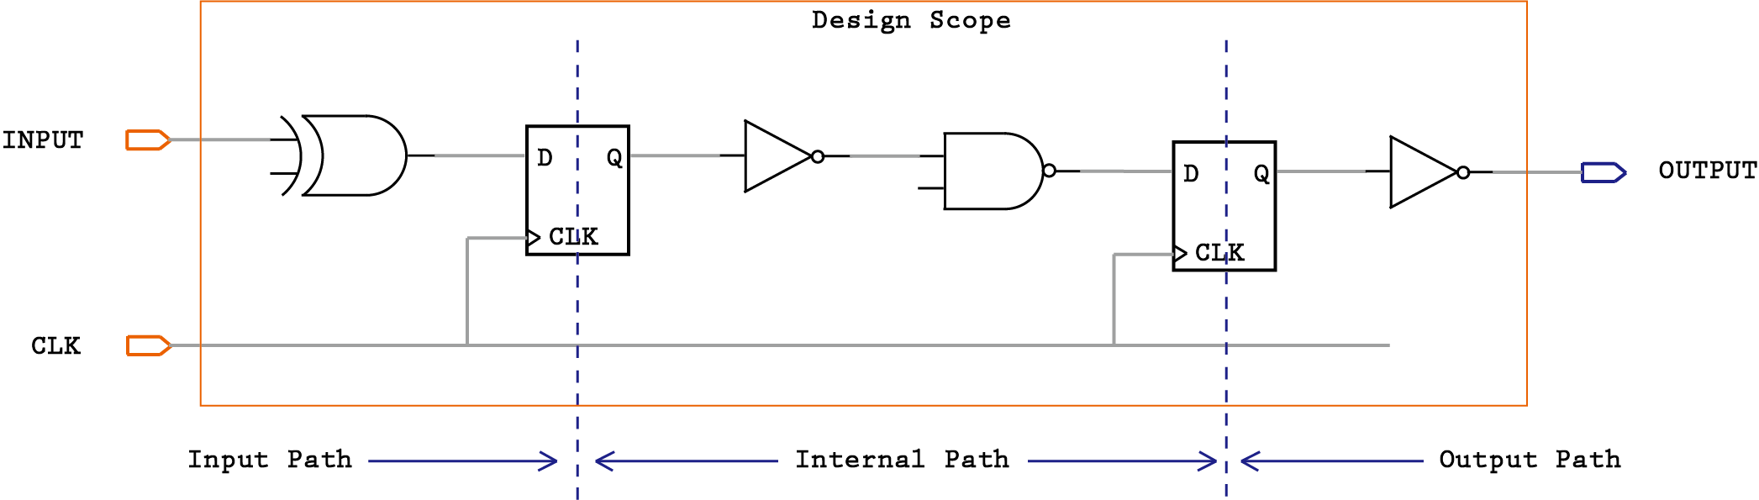
Timing Path Groups
Start Point Definition
Valid startpoints are: input ports / clock pins of synchronous devices
Timing Path
1) Input data port -> Output data port (Feed through path)
2) Input data port -> Data input of a flop/memory
3) Clock pin of a flop -> Output data port
4) Clock pin of a flop -> Data input of a flop/memory
End point Definition
Valid endpoints are: output ports / data input pins of synchronous devices
Path Groups
Timing paths are sorted into path groups by the endpoint clock domain. STA is performed on each path group separately.
Default path group includes all non-clocked paths (asynchronous)
ASIC Boot Camp
Static Timing Analysis – Chapter 3 : Constraint Develop
Notes:
To develop timing constraints, we have to first lean about timing path groups.
We define the startpoint of a timing path as input ports, clock pins of synchronous devices such as flop clock pin or memory clock pin.
We define the endpoint of a timing path as output ports or data input pin of synchronous devices.
Generally speaking, the path groups for a design can be divided into external paths and internal paths.
External paths are the path talking to outside design. For example if the launch clock is from another partition but ending in the current partition.
Internal paths are the one completely inside current partition.
A more detailed categorization can be:
1) Paths from input data port to output data port, which we call it a feed through path.
2) Input data port -> Data input of a flop/memory
3) Clock pin of a flop -> Output data port
4) Clock pin of a flop -> Data input of a flop/memory
In most mainstream STA tool such as Primetime, the tool creates internal path group for each clock domain according to endpoint clock domain.
Default path group includes all non-clocked paths (asynchronous)
The default report_timing commands will dump out the worst timing path for each of these path groups.

Slide 4
Create Path Groups
A common way to create default path groups
Usually we create path groups for:
register to output port (REGOUT)
input to register (REGIN, input port excludes clock ports)
input to output port (FEEDTHROUGH)
Dedicated custom path groups in addition to all of above (REG2REG)
E.g.
group_path
-weight <weight_value>
Specifies a cost function weight for this group. The weight_value must be a number between 0.0 and 100.0. The default is 1.0
ASIC Boot Camp
Static Timing Analysis – Chapter 3 : Constraint Develop
Notes:
<show a PT report_timing report>
Set input_paths [remove_from_collection [all_inputs] $clock_ports]
Set output_paths [all_outputs]
Group_path –name INPUT_PATH –from $input_paths
Group_path –name OUTPUT_PATH –to $output_paths
Group_path –name FEEDTHROUGH –from $input_paths –to $output_paths

Slide 5

What is SDC ?
Standard for Specifying Timing Constraints
A TCL based text format
Clock
Creation
Constrain
IO path
Setup
Environment
Timing
Exceptions
create_clock
create_generated_clock
set_input_delay
set_output_delay
set_case_analysis
set_multicycle_path
set_false_path
ASIC Boot Camp
Static Timing Analysis – Chapter 3 : Constraint Develop
Notes:
So how do we actually tell the STA tool about our timing requirement of a design?
The industry standard is by using synopsys design constraints or simply called SDC.
SDC is a tcl based text format with commands created by synopsys for timing constraints. BTW, this is one of the reason why the job position requires you to have experience and knowledge of tcl language.
The most essential commands to constrain a design can be clock creation, input/output delay constraints, environment setup and timing exceptions.
By using these commands, the STA engineering guide the STA tool to look at the real design issues but not false paths. A good timing constraint is valuable for a timely design closure and critical for a functional success.

Slide 6
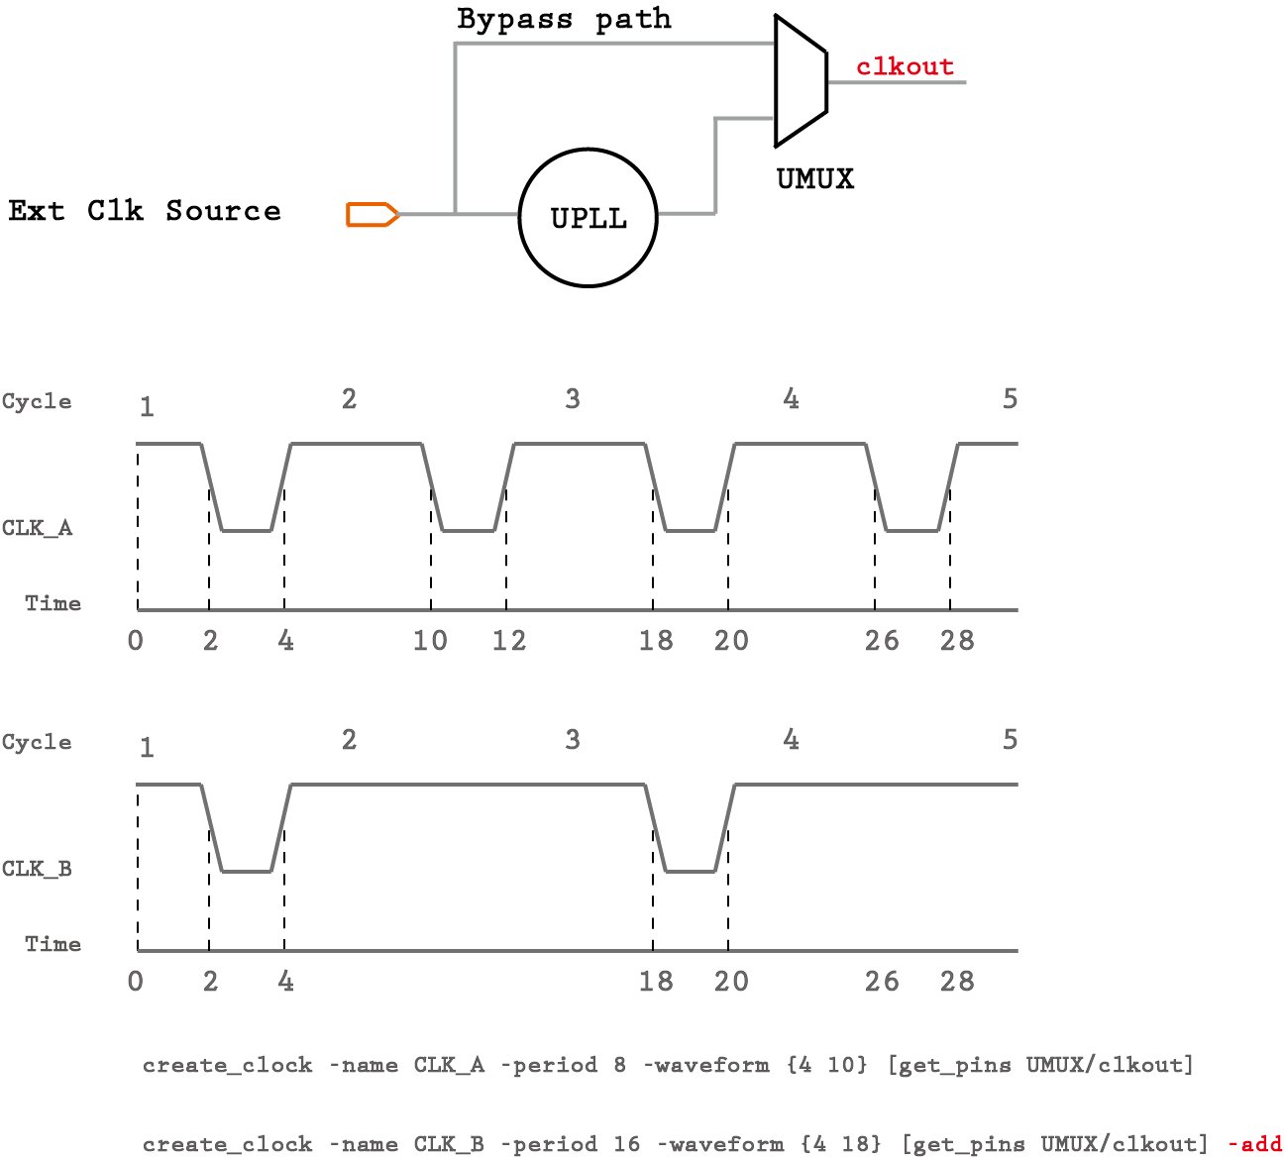
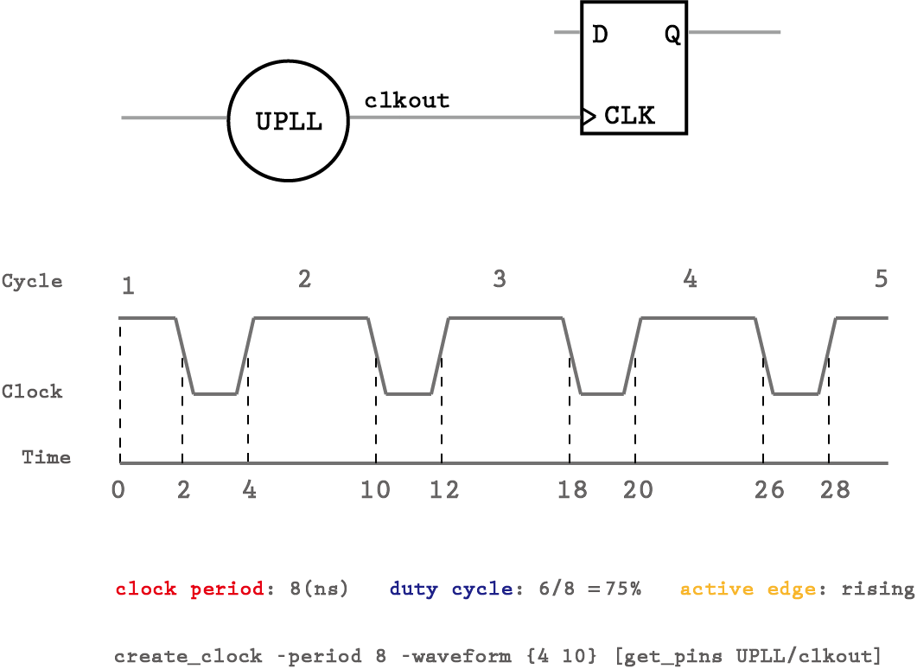
Master Clock Creation
ASIC Boot Camp
Static Timing Analysis – Chapter 3 : Constraint Develop
Notes:
System clocks and their delays are extremely important constraints in ASIC designs. System clocks are typically supplied externally, but can be generated inside an ASIC. All delay, especially in a synchronous ASIC design are dependent upon the system clocks. So the typical Scenario for a master clock creation is to model clock generated from Off-chip Oscillator (external source) | On-chip Phase Lock Loop (internal source)
Remember we have divide all the timing path as external path and internal path. after the clock creation, ideally all the functional flop-flop will be clocked so internal timing path can already be analyzed.
The way in STA to create a clock source is by describing its waveform. Waveform option specifies the waveform within one clock period, which then repeats itself.
Let’s take a look at this example:
The first argument specifies the time at which rising edge occurs, the second argument specifies the time at which the falling edge occurs. All the edges must be monotonically increasing and within one period. The edge time alternate starting from the first rising edge after time zero, then falling edge, then rising edge and so on. There must be an even number of edges specified.
When the option is not specified, the clock is assumed to have a 50 % duty cycle. This is equivalent to saying that the waveform is { 0 period/2 }.
If there are more than one clock on the same clock source, we must use -name and -add switch to make them co-exists. Otherwise, the one defines later will override the one defined earlier.
Define clock correctly is extremely important to the STA analysis. If even a single clock is specified incorrectly, the impact could be felt by millions of paths within the design.
It may cause the block to not meet timing. Even if the block meets timing, it may give a false sense of timing closure.
A missing clock constraint would also mean that a huge number of paths in the design may not be timed.
Since clock specifications impact maximum number of paths, even a single incorrect or missing specification could be highly detrimental to the design.

Slide 7
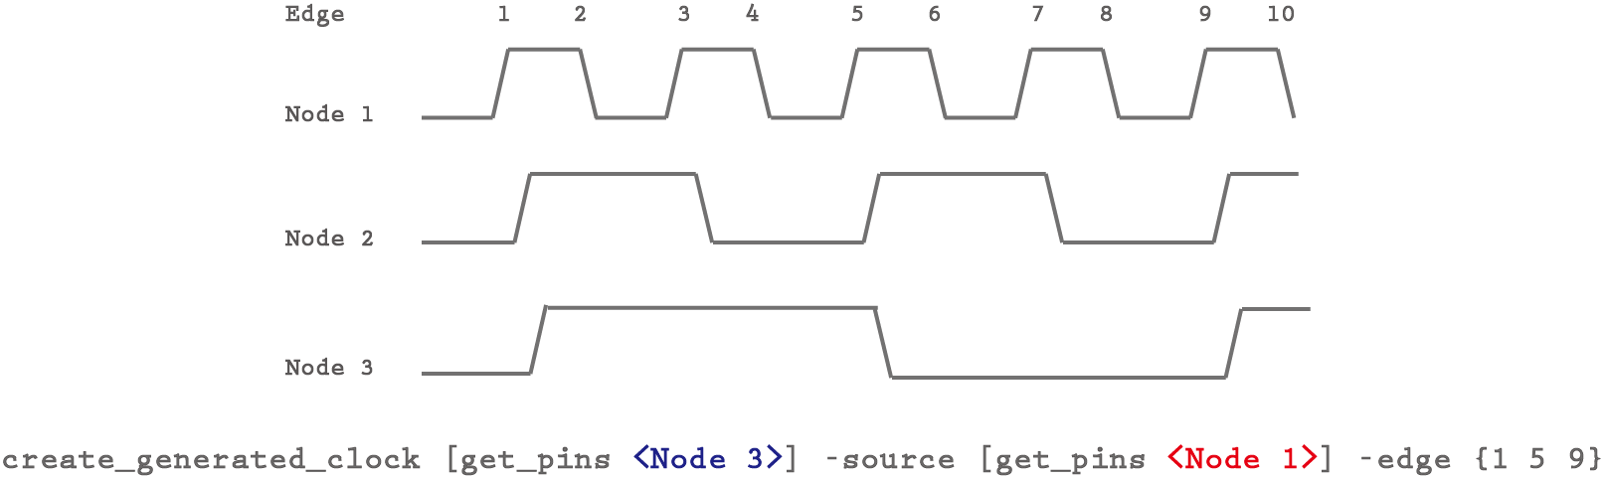
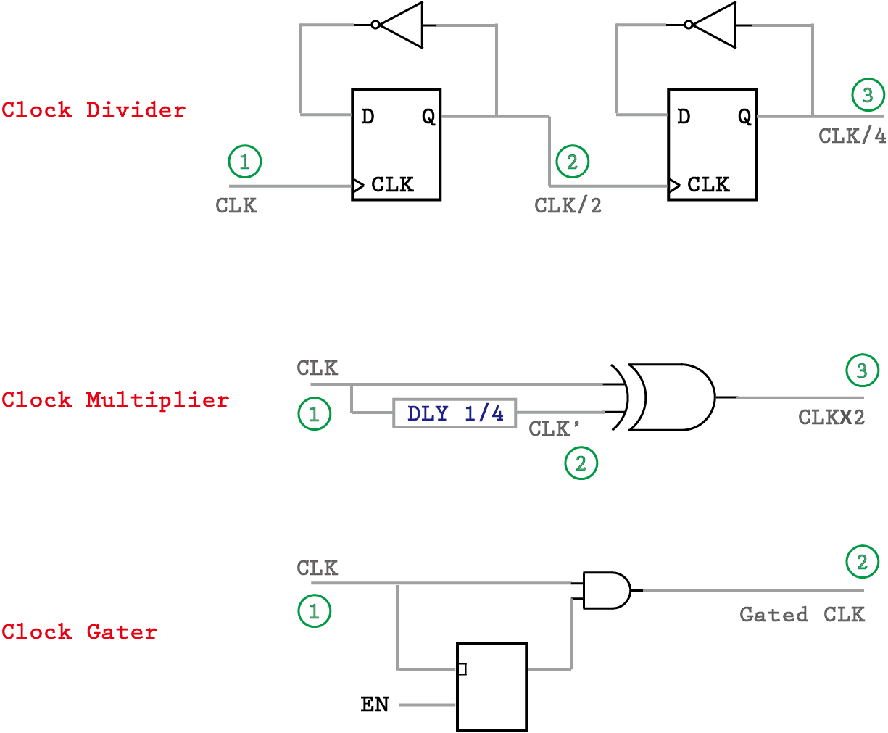
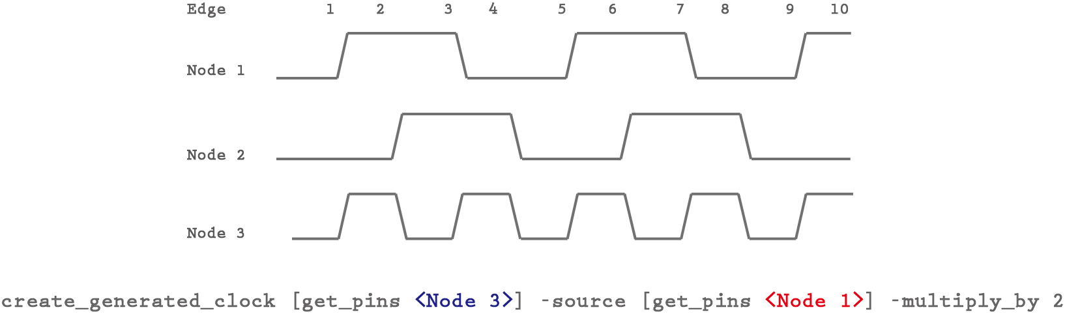
Generated Clock Creation
ASIC Boot Camp
Static Timing Analysis – Chapter 3 : Constraint Develop
Notes:
Most complex designs require more than one clock for its functioning. When there are multiple clocks in a design, they would need to interact or share a relationship.
For most part of the design, the sequential elements are driving by synchronous system clocks, which means those clocks share a fixed phase relationship.
In most cases, synchronous clocks originate from the same source.
When a new clock is generated in a design that is based on a master clock, which means it will have phase relationship with the master clock, it can be defined as a generated clock. This definition is needed because STA does not know that the clock period has been changed at the output of clock divider and what is the new period should it be.
Typical scenario for generated clock is when the signal coming out of a clock divider Logic, clock multiplier or clock gating logic. To distinguish the divided version or gated version of the clock, a new generated clock needs to be created.
a source object can have more than one clock. If the master clock source pin has more than one clock in its fanin cone, then the generated clock must indicate the master clock which causes the generated clock to be
derived. This is specified using the -master_clock option. This option takes the name of the SDC clock that has been defined to drive the master clock source pin.
Once a generated clock has been defined, the clock characteristics (waveform, period, etc.) would be derived by the tool, based on the characteristics of the waveform at the source.
To describe the waveform relation between the master clock and generated clock, one can use following options:
-edges
this is represented as a list of integers that correspond to the edge of the source clock from which the generated clock has been obtained. The edges
indicate alternating rising and falling edge of the generated clock. The edges must contain an odd number of integers and should at the very minimum contain 3 integers to represent one full cycle of the generated clock. The count of edge starts with “1” and this number (“1”) represents the first rising edge of the source clock.
2. -divide_by
this represents a generated clock where the frequency has been divided by a factor, which means the period is multiplied by the same factor.
3. -multiply_by
this represents a generated clock where the frequency has been multiplied by a factor, which means the period is divided by the same factor. It should be noted that though clocks are defi ned using period characteristic, the multiply_by and divide_by are specified using frequency characteristic in mind (which is inverse of period).
When a generated clock defined using -divide_by or -multiply_by options need to be inverted, then it can be specified using the -invert option. It should be noted that the presence of -invert does not change the edge of the
source clock at which generated clock will have a transition. It only impacts whether the generated clock will start with a rising transition or a falling transition.

Slide 8
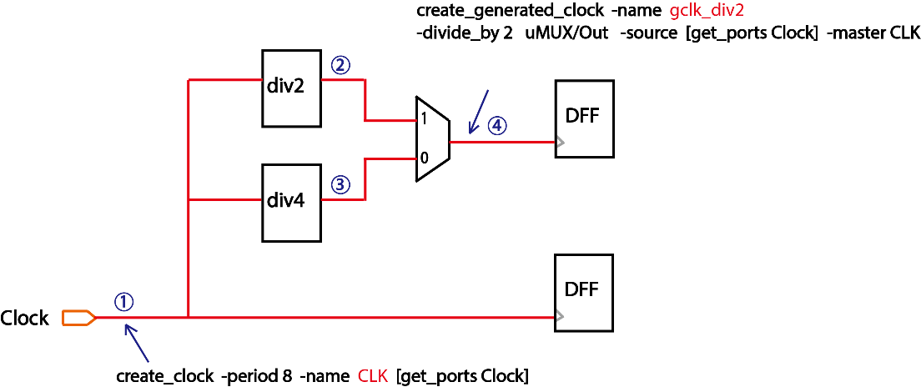
Topic 12: generated clock blockage
Generated clock blocks master clock propagation
When a generated clock is created at a pin, all other clocks arriving at that pin are blocked unless they too have generated clock versions created at that pin.
Few Observation
Since only generated clock for div2 clock are created..
No divided by 4 clock show up at node #4;
No master clock show up at node #4;
Define new generated clock for div4 at node 4 is a possible fix, but not preferred. (think why)
Define new generated clock for div4 at node 3 and move div2 clock back to node 2 is a better way.
Should define exclusive relation between div2 and div4. If not constraining the select pin of the MUX, it will propagate both div2 and div4 clocks;
ASIC Boot Camp
Static Timing Analysis – Chapter 3 : Constraint Develop
Notes:
Most complex designs require more than one clock for its functioning. When there are multiple clocks in a design, they would need to interact or share a relationship.
For most part of the design, the sequential elements are driving by synchronous system clocks, which means those clocks share a fixed phase relationship.
In most cases, synchronous clocks originate from the same source.
When a new clock is generated in a design that is based on a master clock, which means it will have phase relationship with the master clock, it can be defined as a generated clock. This definition is needed because STA does not know that the clock period has been changed at the output of clock divider and what is the new period should it be.
Typical scenario for generated clock is when the signal coming out of a clock divider Logic, clock multiplier or clock gating logic. To distinguish the divided version or gated version of the clock, a new generated clock needs to be created.
a source object can have more than one clock. If the master clock source pin has more than one clock in its fanin cone, then the generated clock must indicate the master clock which causes the generated clock to be
derived. This is specified using the -master_clock option. This option takes the name of the SDC clock that has been defined to drive the master clock source pin.
Once a generated clock has been defined, the clock characteristics (waveform, period, etc.) would be derived by the tool, based on the characteristics of the waveform at the source.
To describe the waveform relation between the master clock and generated clock, one can use following options:
-edges
this is represented as a list of integers that correspond to the edge of the source clock from which the generated clock has been obtained. The edges
indicate alternating rising and falling edge of the generated clock. The edges must contain an odd number of integers and should at the very minimum contain 3 integers to represent one full cycle of the generated clock. The count of edge starts with “1” and this number (“1”) represents the first rising edge of the source clock.
2. -divide_by
this represents a generated clock where the frequency has been divided by a factor, which means the period is multiplied by the same factor.
3. -multiply_by
this represents a generated clock where the frequency has been multiplied by a factor, which means the period is divided by the same factor. It should be noted that though clocks are defi ned using period characteristic, the multiply_by and divide_by are specified using frequency characteristic in mind (which is inverse of period).
When a generated clock defined using -divide_by or -multiply_by options need to be inverted, then it can be specified using the -invert option. It should be noted that the presence of -invert does not change the edge of the
source clock at which generated clock will have a transition. It only impacts whether the generated clock will start with a rising transition or a falling transition.

Slide 9
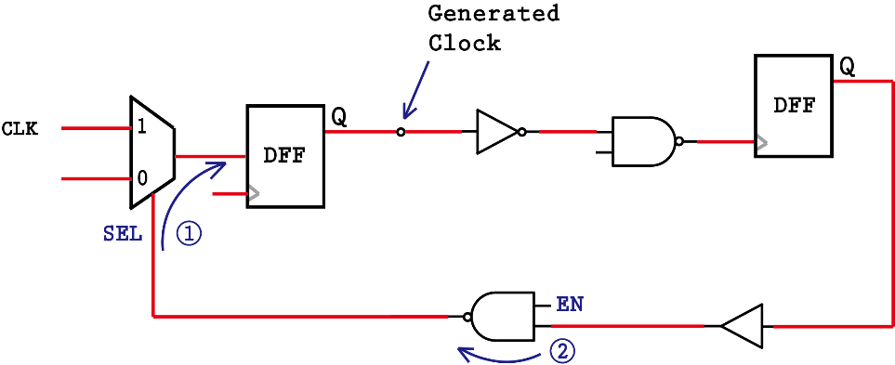
Topic 13: Break generated clock timing loop
Check_timing –override generated_clock -verbose
Timing loop needs to be breaked if not well constrained
Few Observation
Timing loop exists for the clock generation path..
Flop on the left is generating the clock for flop on the right
The output of the flop on the right feeds back to the Datapath of the flop on the left
Ideally, the feedback path shouldn’t be enabled when the clock MUX selects the bottom branch
As a temporary workaround, we can break the timing arc at either node 1 or node 2 using set_disable_timing
Primetime automatically breaks loop
PT will break a timing loop in order to time the design, but it is not recommended to rely on PT. It can break the loop at different locations from design to design and may break valid timing paths.
So it’s better to understand design and disable timing arc manually to maintain design coverage and consistency.
ASIC Boot Camp
Static Timing Analysis – Chapter 3 : Constraint Develop
Notes:
Most complex designs require more than one clock for its functioning. When there are multiple clocks in a design, they would need to interact or share a relationship.
For most part of the design, the sequential elements are driving by synchronous system clocks, which means those clocks share a fixed phase relationship.
In most cases, synchronous clocks originate from the same source.
When a new clock is generated in a design that is based on a master clock, which means it will have phase relationship with the master clock, it can be defined as a generated clock. This definition is needed because STA does not know that the clock period has been changed at the output of clock divider and what is the new period should it be.
Typical scenario for generated clock is when the signal coming out of a clock divider Logic, clock multiplier or clock gating logic. To distinguish the divided version or gated version of the clock, a new generated clock needs to be created.
a source object can have more than one clock. If the master clock source pin has more than one clock in its fanin cone, then the generated clock must indicate the master clock which causes the generated clock to be
derived. This is specified using the -master_clock option. This option takes the name of the SDC clock that has been defined to drive the master clock source pin.
Once a generated clock has been defined, the clock characteristics (waveform, period, etc.) would be derived by the tool, based on the characteristics of the waveform at the source.
To describe the waveform relation between the master clock and generated clock, one can use following options:
-edges
this is represented as a list of integers that correspond to the edge of the source clock from which the generated clock has been obtained. The edges
indicate alternating rising and falling edge of the generated clock. The edges must contain an odd number of integers and should at the very minimum contain 3 integers to represent one full cycle of the generated clock. The count of edge starts with “1” and this number (“1”) represents the first rising edge of the source clock.
2. -divide_by
this represents a generated clock where the frequency has been divided by a factor, which means the period is multiplied by the same factor.
3. -multiply_by
this represents a generated clock where the frequency has been multiplied by a factor, which means the period is divided by the same factor. It should be noted that though clocks are defi ned using period characteristic, the multiply_by and divide_by are specified using frequency characteristic in mind (which is inverse of period).
When a generated clock defined using -divide_by or -multiply_by options need to be inverted, then it can be specified using the -invert option. It should be noted that the presence of -invert does not change the edge of the
source clock at which generated clock will have a transition. It only impacts whether the generated clock will start with a rising transition or a falling transition.

Slide 10
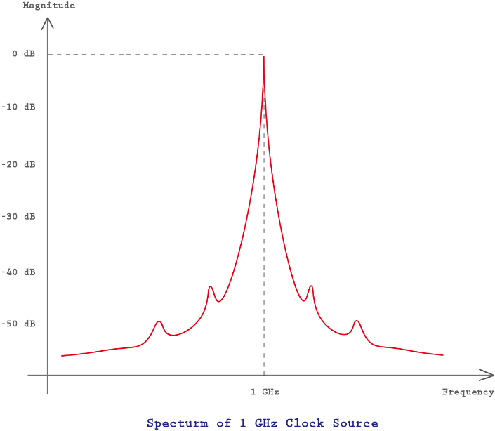
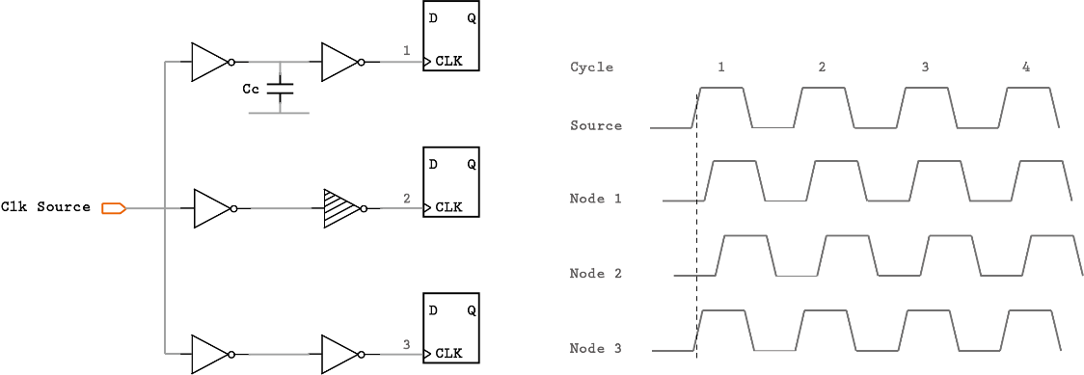
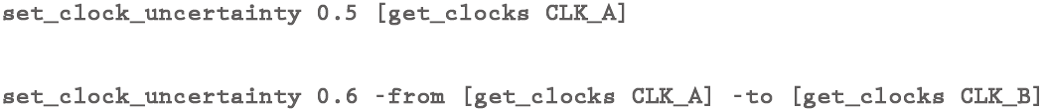
Clock Uncertainty
Clock Skew
Clock Jitter
ASIC Boot Camp
Static Timing Analysis – Chapter 3 : Constraint Develop
Notes:
Clock uncertainty can also be defined as a window within which a clock edge can occur. The uncertainty is to account for several factors such as clock period jitter and clock skews or any other clock margin used in STA analysis.
Clock Skew
When a clock is generated by a source, it may not arrive at all the fl ops at the same time. The difference in the arrival time at various fl ops could be because of different paths through clock network, or coupling capacitance or other PVT (Process, Voltage, Temperature) variations in the design. This causes the edges of the same clock not to align when they reach the various devices. This difference between clock arrivals at different points in the design is referred to as clock skew . Clock skew can be between different points of the same clock ( intraclock ) or different (usually, synchronous ) clocks ( interclock ).
Clock Jitter
At the clock generating device (say: PLL) itself, a clock’s edge may not be deterministic on account of crosstalk or electromagnetic interference or due to PLL characteristics.
This undesired deviation in the periodicity of a clock is referred to as jitter .
The above two phenomenon means the clock period itself could have variation. Thus, in STA we use clock uncertainty to take these variations into consideration.
Another important aspect of uncertainty is that its value varies between Prelayout and post-layout. In the pre-layout stage there is no CTS performed; the uncertainty value must take into effect the possible impact of skew that will be inserted. However post CTS, the skew portion is already known and doesn’t need to be specified as uncertainty. So, the clock uncertainty in the post-layout stage is generally less than pre-layout.

Slide 11
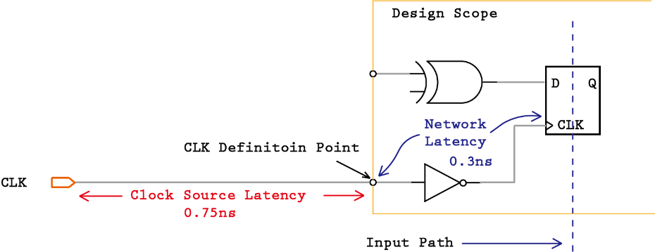
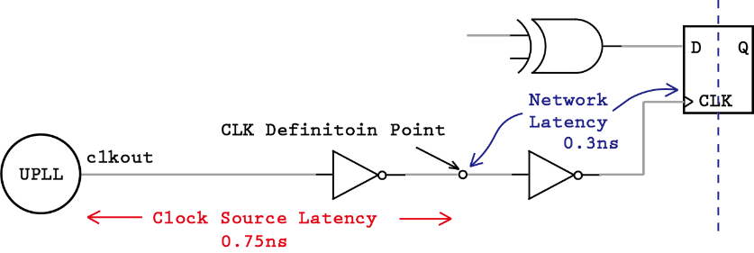
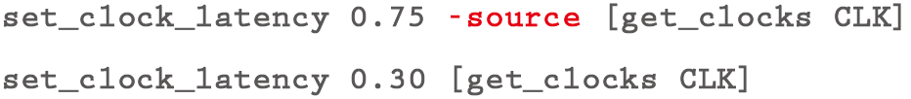
Clock Latency & Insertion Delay
Internal Clock Source
External Clock Source
ASIC Boot Camp
Static Timing Analysis – Chapter 3 : Constraint Develop
Notes:
Clock Latency is the time it takes from the clock source to an endpoint, it includes network latency and source latency (insertion delay)
There are two types of clock latencies: network latency and source latency.
Network latency is the delay from the clock definition point (create_clock) to the clock pin of a flip-flop.
The network latency is an estimate of the delay of the clock tree prior to clock tree synthesis. After the clock tree is built, network latency can be ignored.
Source latency, also called insertion delay, is the delay from the clock source to the clock definition point.
Source latency could represent either on-chip or off-chip latency.
After clock tree synthesis, the total clock latency from clock source to a clock pin of a flip-flop is the source latency plus the actual delay of the clock tree from the clock definition point to the flip-flop
It is recommended to use set_propagated_clock command to give directive to the tool that clock network latency needs to be computed based on the actual circuit elements – including parasitics
Clock latency can be specified using set_clock_latency command.

Slide 12
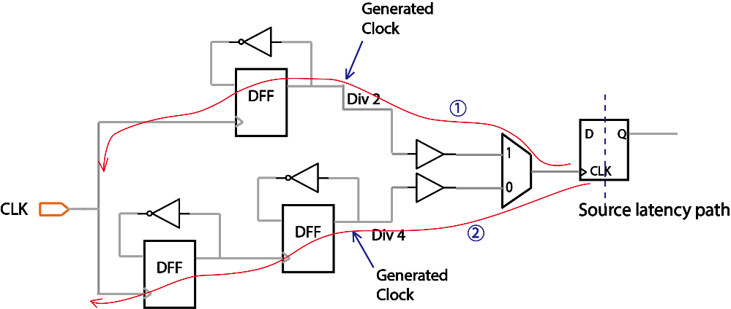
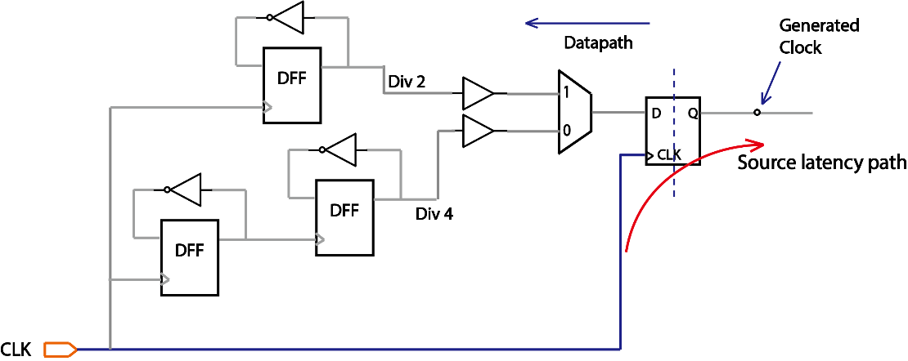
Topic 14: generated clock source latency path
Two source latency paths with different delay -> increased clock skew
Control the source latency path of generated clocks
Source latency path only traces through clock path, so putting divider logic onto the datapath
Only one source latency path for two clock version: divider logic is on the datapath.
ASIC Boot Camp
Static Timing Analysis – Chapter 3 : Constraint Develop
Notes:
Most complex designs require more than one clock for its functioning. When there are multiple clocks in a design, they would need to interact or share a relationship.
For most part of the design, the sequential elements are driving by synchronous system clocks, which means those clocks share a fixed phase relationship.
In most cases, synchronous clocks originate from the same source.
When a new clock is generated in a design that is based on a master clock, which means it will have phase relationship with the master clock, it can be defined as a generated clock. This definition is needed because STA does not know that the clock period has been changed at the output of clock divider and what is the new period should it be.
Typical scenario for generated clock is when the signal coming out of a clock divider Logic, clock multiplier or clock gating logic. To distinguish the divided version or gated version of the clock, a new generated clock needs to be created.
a source object can have more than one clock. If the master clock source pin has more than one clock in its fanin cone, then the generated clock must indicate the master clock which causes the generated clock to be
derived. This is specified using the -master_clock option. This option takes the name of the SDC clock that has been defined to drive the master clock source pin.
Once a generated clock has been defined, the clock characteristics (waveform, period, etc.) would be derived by the tool, based on the characteristics of the waveform at the source.
To describe the waveform relation between the master clock and generated clock, one can use following options:
-edges
this is represented as a list of integers that correspond to the edge of the source clock from which the generated clock has been obtained. The edges
indicate alternating rising and falling edge of the generated clock. The edges must contain an odd number of integers and should at the very minimum contain 3 integers to represent one full cycle of the generated clock. The count of edge starts with “1” and this number (“1”) represents the first rising edge of the source clock.
2. -divide_by
this represents a generated clock where the frequency has been divided by a factor, which means the period is multiplied by the same factor.
3. -multiply_by
this represents a generated clock where the frequency has been multiplied by a factor, which means the period is divided by the same factor. It should be noted that though clocks are defi ned using period characteristic, the multiply_by and divide_by are specified using frequency characteristic in mind (which is inverse of period).
When a generated clock defined using -divide_by or -multiply_by options need to be inverted, then it can be specified using the -invert option. It should be noted that the presence of -invert does not change the edge of the
source clock at which generated clock will have a transition. It only impacts whether the generated clock will start with a rising transition or a falling transition.

Slide 13
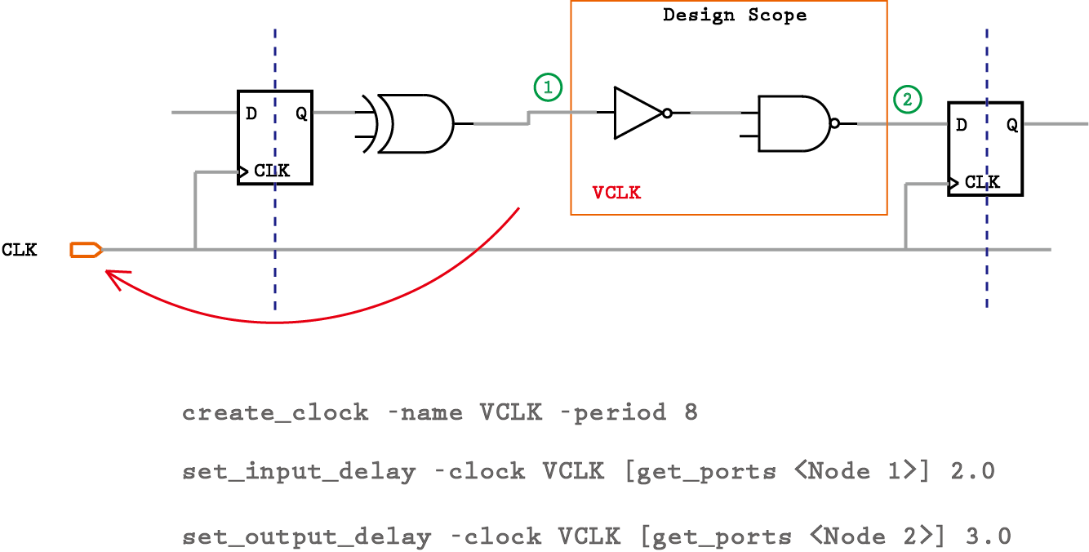
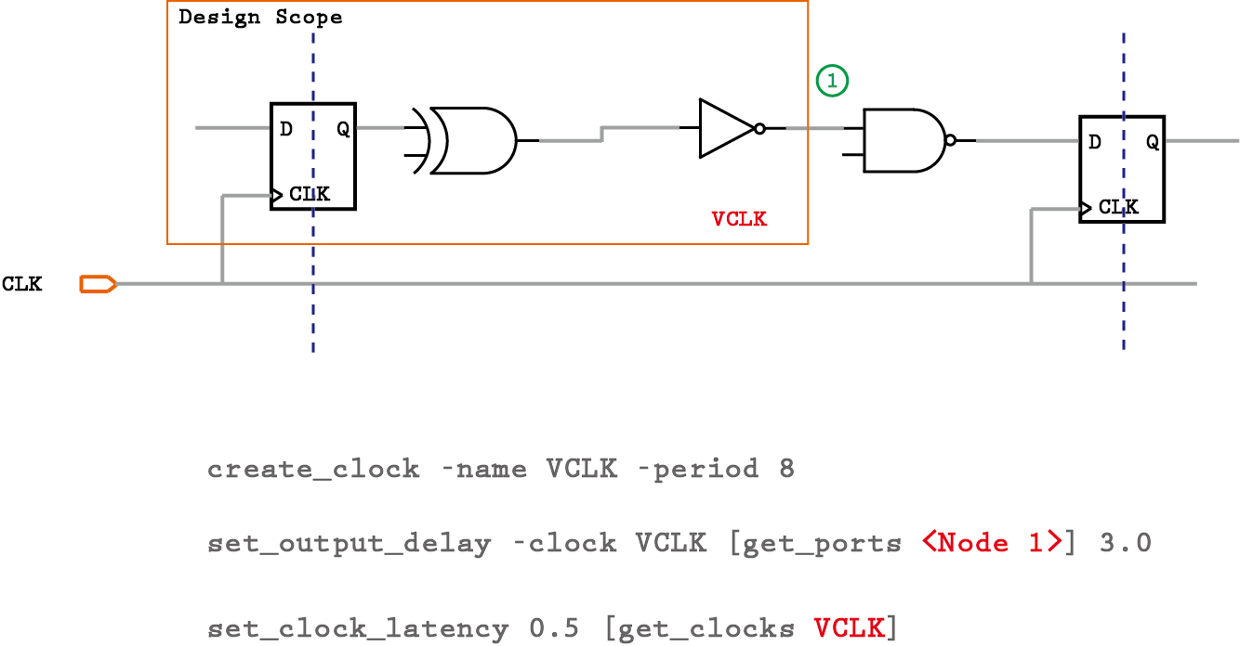
Virtual Clock
Case 1 Feed-through Combinational Logic
Case 2 External Path
ASIC Boot Camp
Static Timing Analysis – Chapter 3 : Constraint Develop
Notes:
in some cases the user needs to constraint ports/pins in a block that has no clocks. In such cases, ports/pins are assumed to be triggered by or dependent on clocks outside the block.
A virtual clock has no source specified. In reality, it might have a source, but that source could be outside the block being constrained.
In case 1, we have a pure combinational path between one input port and the other output port. Their related clocks are not used anywhere else within the partition. Instead of using a clock which is being declared for this block, a virtual clock can be declared, just for constraining the combinational path.
In case 2, in order to constrain the output port which goes to an external flop, we can specify a delay with respect to the real clock itself, but the flop outside the partition will also get the same clock latency in STA calculation. We can specify the output delay with –source_latency_included option, but that will hard code the delay values and we have to change every time if it is changed.
Thus, in this situation, to define a virtual clock can help out to specify a unique clock source latency for the flop outside the partition boundary. And if the clock insertion delay changed outside, we can just modify the virtual clock latency for all the port associated with it.
In practice, virtual clocks are not often used
But in the end, all the virtual clocks have to be removed and replaced with real clocks for timing signoff.

Slide 14
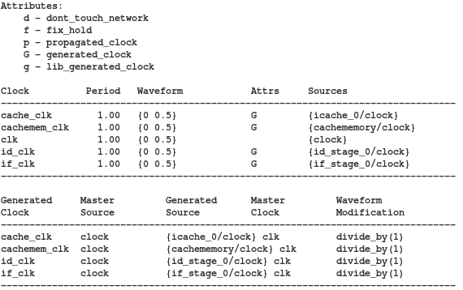
Topic 15: report_clocks
> report_clocks
Shows clock definitions in the design, period, waveform, clock root, etc..
ASIC Boot Camp
Static Timing Analysis – Chapter 3 : Constraint Develop
Notes:
Most complex designs require more than one clock for its functioning. When there are multiple clocks in a design, they would need to interact or share a relationship.
For most part of the design, the sequential elements are driving by synchronous system clocks, which means those clocks share a fixed phase relationship.
In most cases, synchronous clocks originate from the same source.
When a new clock is generated in a design that is based on a master clock, which means it will have phase relationship with the master clock, it can be defined as a generated clock. This definition is needed because STA does not know that the clock period has been changed at the output of clock divider and what is the new period should it be.
Typical scenario for generated clock is when the signal coming out of a clock divider Logic, clock multiplier or clock gating logic. To distinguish the divided version or gated version of the clock, a new generated clock needs to be created.
a source object can have more than one clock. If the master clock source pin has more than one clock in its fanin cone, then the generated clock must indicate the master clock which causes the generated clock to be
derived. This is specified using the -master_clock option. This option takes the name of the SDC clock that has been defined to drive the master clock source pin.
Once a generated clock has been defined, the clock characteristics (waveform, period, etc.) would be derived by the tool, based on the characteristics of the waveform at the source.
To describe the waveform relation between the master clock and generated clock, one can use following options:
-edges
this is represented as a list of integers that correspond to the edge of the source clock from which the generated clock has been obtained. The edges
indicate alternating rising and falling edge of the generated clock. The edges must contain an odd number of integers and should at the very minimum contain 3 integers to represent one full cycle of the generated clock. The count of edge starts with “1” and this number (“1”) represents the first rising edge of the source clock.
2. -divide_by
this represents a generated clock where the frequency has been divided by a factor, which means the period is multiplied by the same factor.
3. -multiply_by
this represents a generated clock where the frequency has been multiplied by a factor, which means the period is divided by the same factor. It should be noted that though clocks are defi ned using period characteristic, the multiply_by and divide_by are specified using frequency characteristic in mind (which is inverse of period).
When a generated clock defined using -divide_by or -multiply_by options need to be inverted, then it can be specified using the -invert option. It should be noted that the presence of -invert does not change the edge of the
source clock at which generated clock will have a transition. It only impacts whether the generated clock will start with a rising transition or a falling transition.

Slide 15
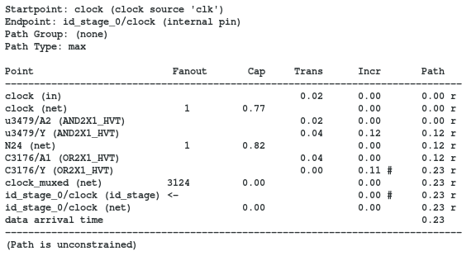
Topic 16: report clock path
> report_timing -from [all_fanout -flat -clock_tree -levels 0] -to id_stage_0/clock -nosp
Report_timing to the clock pin of the sequential to check its clock path.
Note: the timing report would show the path is unconstrained
> Functional clock path
Timing path is going through C3176/A1
ASIC Boot Camp
Static Timing Analysis – Chapter 3 : Constraint Develop
Notes:
Clock Latency is the time it takes from the clock source to an endpoint, it includes network latency and source latency (insertion delay)
There are two types of clock latencies: network latency and source latency.
Network latency is the delay from the clock definition point (create_clock) to the clock pin of a flip-flop.
The network latency is an estimate of the delay of the clock tree prior to clock tree synthesis. After the clock tree is built, network latency can be ignored.
Source latency, also called insertion delay, is the delay from the clock source to the clock definition point.
Source latency could represent either on-chip or off-chip latency.
After clock tree synthesis, the total clock latency from clock source to a clock pin of a flip-flop is the source latency plus the actual delay of the clock tree from the clock definition point to the flip-flop
It is recommended to use set_propagated_clock command to give directive to the tool that clock network latency needs to be computed based on the actual circuit elements – including parasitics
Clock latency can be specified using set_clock_latency command.

Slide 16
Topic 17: Show unconstrained path
> Switch to show unconstrained path if there is any
set_app_var timing_report_uncontrained_path [true|false]
By default, report_timing or get_timing_paths command will only search for constrained path.
But sometimes we want to debug unconstrained path, so by turning it on, it allows you to check timing path in most cases even if it is not constrained.
ASIC Boot Camp
Static Timing Analysis – Chapter 3 : Constraint Develop
Notes:
Clock Latency is the time it takes from the clock source to an endpoint, it includes network latency and source latency (insertion delay)
There are two types of clock latencies: network latency and source latency.
Network latency is the delay from the clock definition point (create_clock) to the clock pin of a flip-flop.
The network latency is an estimate of the delay of the clock tree prior to clock tree synthesis. After the clock tree is built, network latency can be ignored.
Source latency, also called insertion delay, is the delay from the clock source to the clock definition point.
Source latency could represent either on-chip or off-chip latency.
After clock tree synthesis, the total clock latency from clock source to a clock pin of a flip-flop is the source latency plus the actual delay of the clock tree from the clock definition point to the flip-flop
It is recommended to use set_propagated_clock command to give directive to the tool that clock network latency needs to be computed based on the actual circuit elements – including parasitics
Clock latency can be specified using set_clock_latency command.

Slide 17
Ideal network
What are ideal nets/network
Ideal nets are networks of nets that are free from the max_cap/max_fanout DRC
Ideal networks, which are an extension of ideal nets, incorporate automatic propagation of the ideal attribute.
set_ideal_network
Specifies a list of objects (ports, pins, or nets) to mark as the sources of an ideal network.
Source object can be:
Input ports / Internal leaf pin
Internal net → only with -no_propagate option. all the net’s global driver pins are marked as ideal network source.
The -no_propagate option is very useful when you want to target a specific net and cell. It only set ideal attribute to the net directly connected to the ideal network sources. With this option, the ideal attribute won’t pass through logic gates.
DRC checking is turned off so the nets in an ideal network are free of max_capacitance, max_fanout, and max_transition design rule constraints
In addition to disabling timing updates and timing optimizations, all cells and nets in the ideal network have the dont_touch attribute set.
The latency and transition times of an ideal network are 0 by default, but you can override them by using the set_ideal_latency and set_ideal_transition commands.
> Clock network is usually treated as ideal network before CTS (clock tree synthesis)
Clock network has a very large fanout, basically all sequential elements need clock;
Clock path delay should be controlled and minimized in most case;
Clock skews should be minimized during CTS.
To avoid pre-synthesized clock network introduce large load into the timing path in the design and adversely affect timing optimization, clock network needs to be treated as ideal in pre-layout/pre-CTS stage.
> Set/Reset/test enable signals are also usually treated as ideal network
These signals don’t need to have balanced skew, but still need buffer tree to split the load and meet design rule constraints (DRC)
Also, to avoid large load show on these nets to affect overall timing optimization, these nets should be set to ideal.
ASIC Boot Camp
Static Timing Analysis – Chapter 3 : Constraint Develop
Notes:
Input or Output paths are external timing paths to the design scope. That means only a portion of the entire timing path is inside the partition.
Input paths are the ones being launched externally but captured inside the partition, while output paths are launched locally but captured outside.
To the partition boundary, we only see a data port on the datapath and a clock port sending/receiving clock signals.
Thus, to correctly model how long it takes for the signal travel outside the boudrary, we can use SDC command set_input_delay and set_output_delay.
This value can come from interface budgeting in the beginning of the project or be back-annotated from actual full chip database once people start to iterate and optimize the design.
-clock option is used to specify the reference clock, with respect to which the delay value is specified. This should usually refer to the name of the clock which is used to trigger/sample the signal that reaches this input port. if the clock which samples the data does not enter the block of interest, we would need to specify a virtual clock with the same characteristics and use that virtual clock.

Slide 18
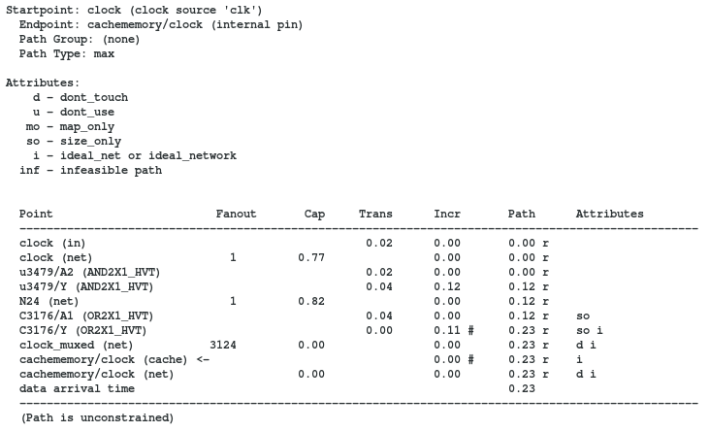
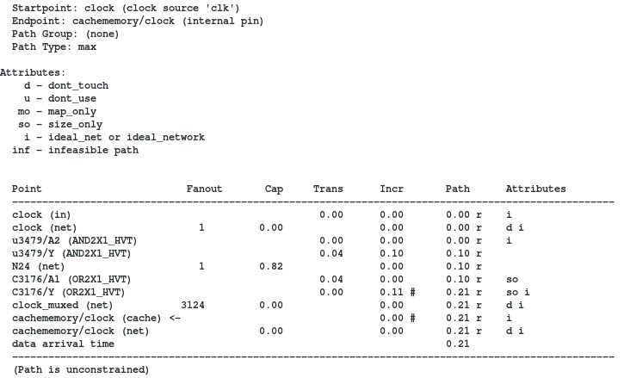
Ideal network
Original clock path
Step 1: set_ideal_network at the clock source
set_ideal_network [get_ports clock]
ASIC Boot Camp
Static Timing Analysis – Chapter 3 : Constraint Develop
Notes:
Input or Output paths are external timing paths to the design scope. That means only a portion of the entire timing path is inside the partition.
Input paths are the ones being launched externally but captured inside the partition, while output paths are launched locally but captured outside.
To the partition boundary, we only see a data port on the datapath and a clock port sending/receiving clock signals.
Thus, to correctly model how long it takes for the signal travel outside the boudrary, we can use SDC command set_input_delay and set_output_delay.
This value can come from interface budgeting in the beginning of the project or be back-annotated from actual full chip database once people start to iterate and optimize the design.
-clock option is used to specify the reference clock, with respect to which the delay value is specified. This should usually refer to the name of the clock which is used to trigger/sample the signal that reaches this input port. if the clock which samples the data does not enter the block of interest, we would need to specify a virtual clock with the same characteristics and use that virtual clock.

Slide 19
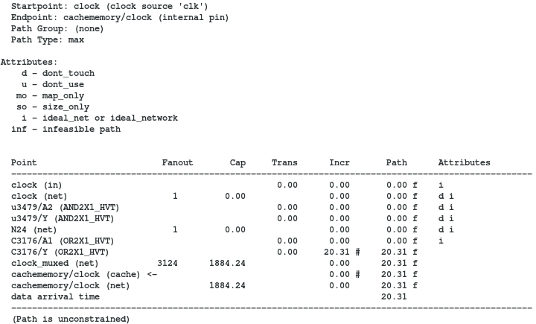
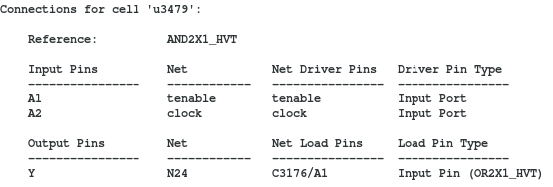
Ideal network
Step 2: set_ideal_network at the tenable port
set_ideal_network [get_ports tenable]
Rule #1:
A combinational cell is marked as ideal if all of its input pins are either ideal or attached to a constant net (and other input pins are ideal).
Setting the tenable to be ideal so u3479 will also become ideal
ASIC Boot Camp
Static Timing Analysis – Chapter 3 : Constraint Develop
Notes:
Input or Output paths are external timing paths to the design scope. That means only a portion of the entire timing path is inside the partition.
Input paths are the ones being launched externally but captured inside the partition, while output paths are launched locally but captured outside.
To the partition boundary, we only see a data port on the datapath and a clock port sending/receiving clock signals.
Thus, to correctly model how long it takes for the signal travel outside the boudrary, we can use SDC command set_input_delay and set_output_delay.
This value can come from interface budgeting in the beginning of the project or be back-annotated from actual full chip database once people start to iterate and optimize the design.
-clock option is used to specify the reference clock, with respect to which the delay value is specified. This should usually refer to the name of the clock which is used to trigger/sample the signal that reaches this input port. if the clock which samples the data does not enter the block of interest, we would need to specify a virtual clock with the same characteristics and use that virtual clock.

Slide 20
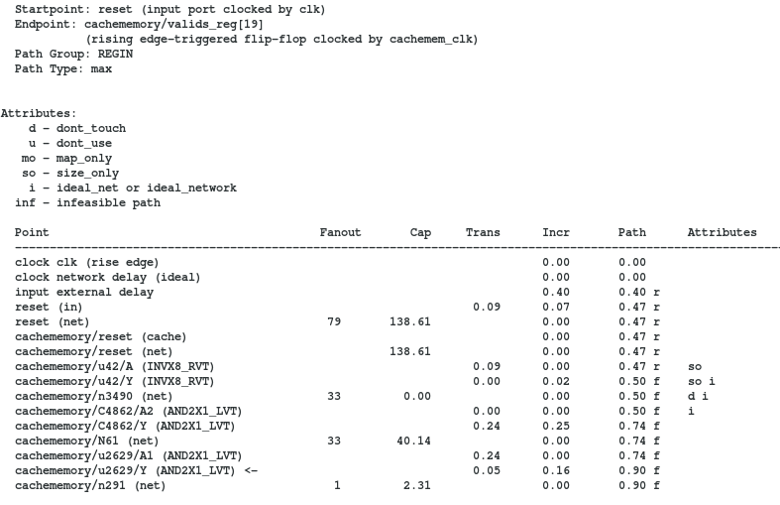
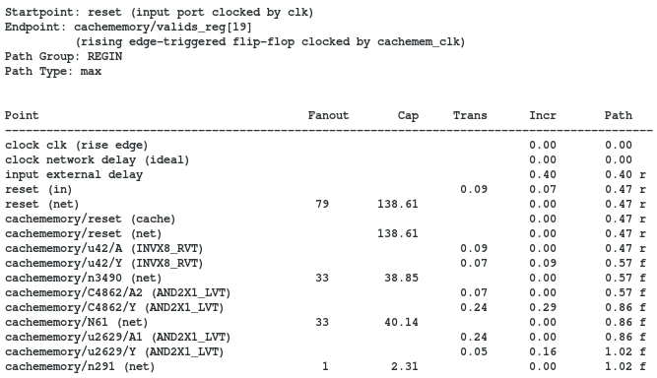
Ideal network
Step 1: set_ideal_network with no_propagate
set_ideal_network [get_nets cachememory/n3490] -no_propagate
Original clock path
Rule #2
The size_only attribute is set on all cells of ideal network sources. If nets are specified, size_only is set on all cells that are cells of the specified nets' global driver pins. This guarantees that ideal network sources are not optimized away by compile.
ASIC Boot Camp
Static Timing Analysis – Chapter 3 : Constraint Develop
Notes:
Input or Output paths are external timing paths to the design scope. That means only a portion of the entire timing path is inside the partition.
Input paths are the ones being launched externally but captured inside the partition, while output paths are launched locally but captured outside.
To the partition boundary, we only see a data port on the datapath and a clock port sending/receiving clock signals.
Thus, to correctly model how long it takes for the signal travel outside the boudrary, we can use SDC command set_input_delay and set_output_delay.
This value can come from interface budgeting in the beginning of the project or be back-annotated from actual full chip database once people start to iterate and optimize the design.
-clock option is used to specify the reference clock, with respect to which the delay value is specified. This should usually refer to the name of the clock which is used to trigger/sample the signal that reaches this input port. if the clock which samples the data does not enter the block of interest, we would need to specify a virtual clock with the same characteristics and use that virtual clock.

Slide 21
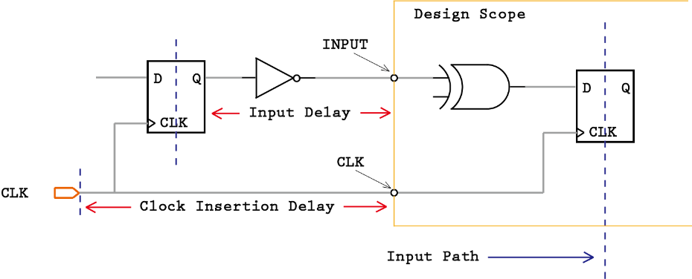
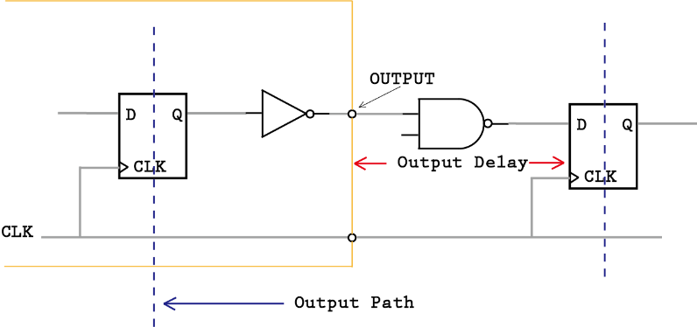
Constrain IO paths
ASIC Boot Camp
Static Timing Analysis – Chapter 3 : Constraint Develop
Notes:
Input or Output paths are external timing paths to the design scope. That means only a portion of the entire timing path is inside the partition.
Input paths are the ones being launched externally but captured inside the partition, while output paths are launched locally but captured outside.
To the partition boundary, we only see a data port on the datapath and a clock port sending/receiving clock signals.
Thus, to correctly model how long it takes for the signal travel outside the boudrary, we can use SDC command set_input_delay and set_output_delay.
This value can come from interface budgeting in the beginning of the project or be back-annotated from actual full chip database once people start to iterate and optimize the design.
-clock option is used to specify the reference clock, with respect to which the delay value is specified. This should usually refer to the name of the clock which is used to trigger/sample the signal that reaches this input port. if the clock which samples the data does not enter the block of interest, we would need to specify a virtual clock with the same characteristics and use that virtual clock.

Slide 22
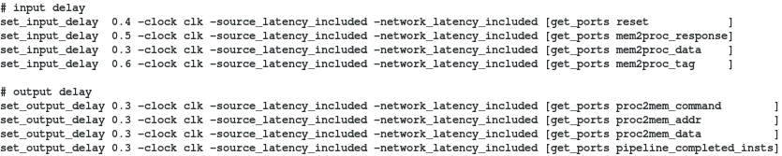
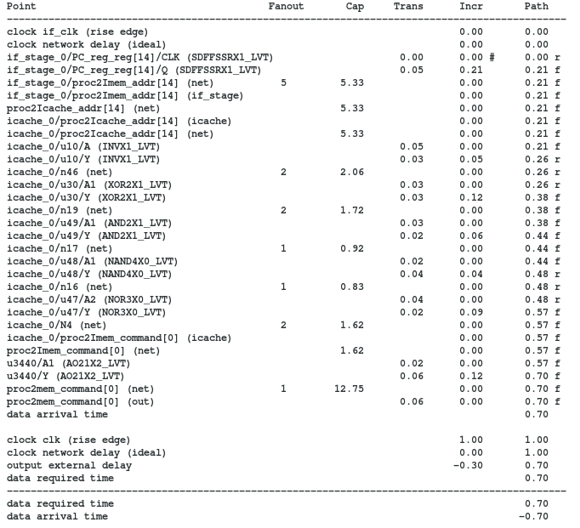
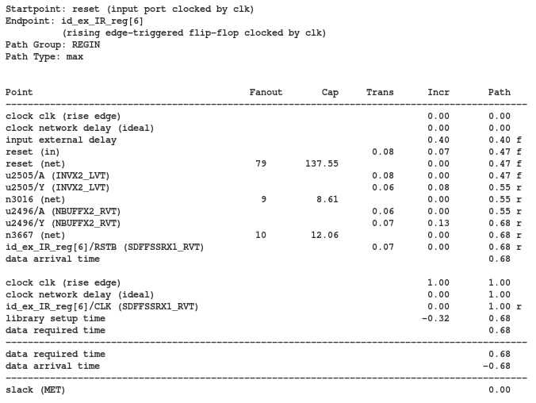
Constrain IO paths
ASIC Boot Camp
Static Timing Analysis – Chapter 3 : Constraint Develop
Notes:
Input or Output paths are external timing paths to the design scope. That means only a portion of the entire timing path is inside the partition.
Input paths are the ones being launched externally but captured inside the partition, while output paths are launched locally but captured outside.
To the partition boundary, we only see a data port on the datapath and a clock port sending/receiving clock signals.
Thus, to correctly model how long it takes for the signal travel outside the boudrary, we can use SDC command set_input_delay and set_output_delay.
This value can come from interface budgeting in the beginning of the project or be back-annotated from actual full chip database once people start to iterate and optimize the design.
-clock option is used to specify the reference clock, with respect to which the delay value is specified. This should usually refer to the name of the clock which is used to trigger/sample the signal that reaches this input port. if the clock which samples the data does not enter the block of interest, we would need to specify a virtual clock with the same characteristics and use that virtual clock.

Slide 23
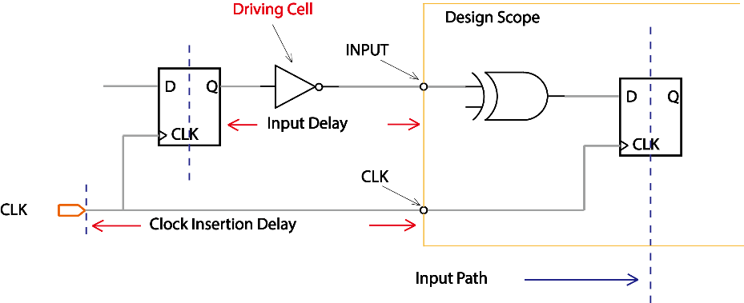
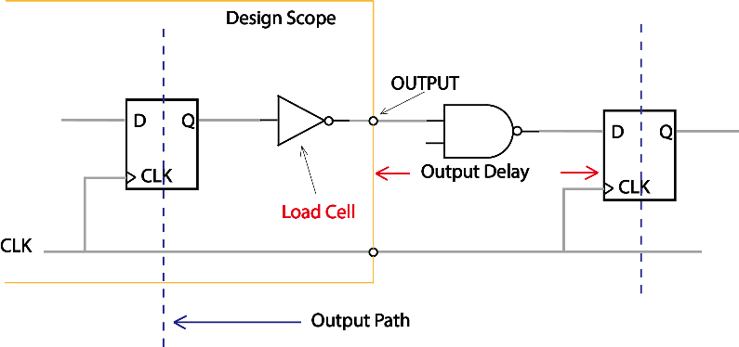
Constrain IO paths (cont’d)
set_driving_cell
set_driving_cell -lib_cell BFN [get_ports A]
set_load
set_load [get_attribute [get_lib_pins NAND2/A1] pin_capacitance] [get_ports B]
ASIC Boot Camp
Static Timing Analysis – Chapter 3 : Constraint Develop
Notes:
Input or Output paths are external timing paths to the design scope. That means only a portion of the entire timing path is inside the partition.
Input paths are the ones being launched externally but captured inside the partition, while output paths are launched locally but captured outside.
To the partition boundary, we only see a data port on the datapath and a clock port sending/receiving clock signals.
Thus, to correctly model how long it takes for the signal travel outside the boudrary, we can use SDC command set_input_delay and set_output_delay.
This value can come from interface budgeting in the beginning of the project or be back-annotated from actual full chip database once people start to iterate and optimize the design.
-clock option is used to specify the reference clock, with respect to which the delay value is specified. This should usually refer to the name of the clock which is used to trigger/sample the signal that reaches this input port. if the clock which samples the data does not enter the block of interest, we would need to specify a virtual clock with the same characteristics and use that virtual clock.

Slide 24
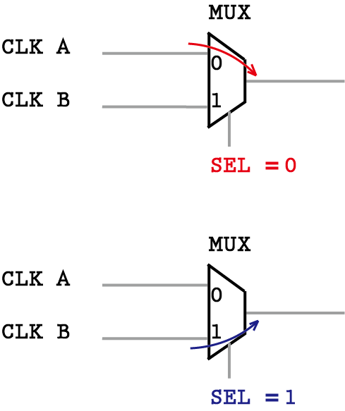
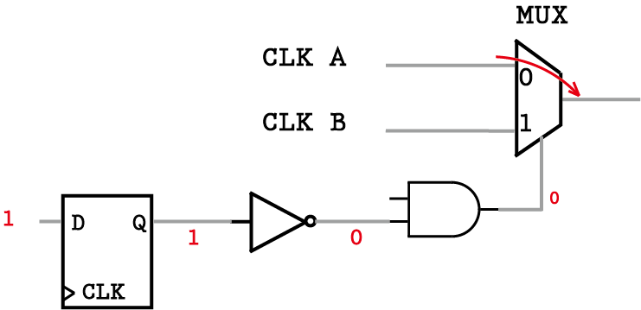
Case Analysis
set_case_analysis
Specifies constant value on a pin of cell, or on an input port, this is used to specifying inactive signals.
User-specified Case Value
In such case, user directly set case value on the pin. The user specified value will override any value from logic propagation.
Constant Propagated Case Value
The case value for certain node is derived from constant value propagated through the fan-in cone.
ASIC Boot Camp
Static Timing Analysis – Chapter 3 : Constraint Develop
Notes:
Setting case analysis value is a very often used technique in STA to setup design environment. We know that the same chip will be working under different circumstances.
Each circumstance will require corresponding analysis setup. For example, in one functional scenario, CLK A might be chosen to be the system clock while in another scenario, the CLK B serves as the main clock.
So we have to have a way to tell the STA tool when to use what clock source for the analysis.
By using case analysis, designer could control the right value to be propagated through the logic cone. There are two types of case values in the design. One is the user-specified value, where the case value is explicitly set by the user on a certain pin or port. so that the logic value of that node is forced to be the value designer want; the other way is for the tool to automatically determine constant value from the logic propagation from upstream.
This usually happens on nodes that are not set by the user directly.
To correctly constrain the design, we need to make sure the case value follows the design intention and the derived constant value is not going to wrong logics and causing trouble. We will talk more on this in constraint debug course.

Slide 25
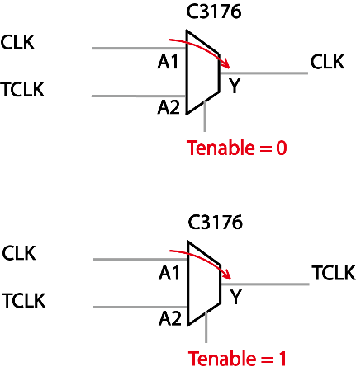
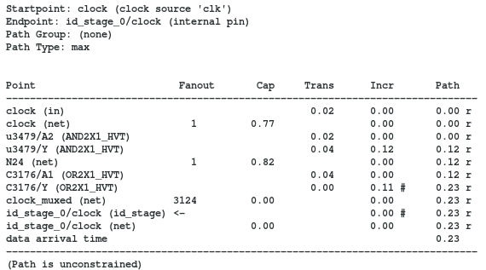
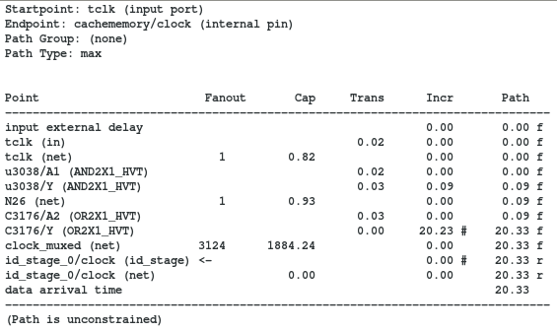
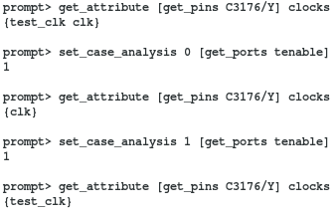
Case Analysis
Clock source path
Tclk source path
ASIC Boot Camp
Static Timing Analysis – Chapter 3 : Constraint Develop
Notes:
Setting case analysis value is a very often used technique in STA to setup design environment. We know that the same chip will be working under different circumstances.
Each circumstance will require corresponding analysis setup. For example, in one functional scenario, CLK A might be chosen to be the system clock while in another scenario, the CLK B serves as the main clock.
So we have to have a way to tell the STA tool when to use what clock source for the analysis.
By using case analysis, designer could control the right value to be propagated through the logic cone. There are two types of case values in the design. One is the user-specified value, where the case value is explicitly set by the user on a certain pin or port. so that the logic value of that node is forced to be the value designer want; the other way is for the tool to automatically determine constant value from the logic propagation from upstream.
This usually happens on nodes that are not set by the user directly.
To correctly constrain the design, we need to make sure the case value follows the design intention and the derived constant value is not going to wrong logics and causing trouble. We will talk more on this in constraint debug course.

Slide 26
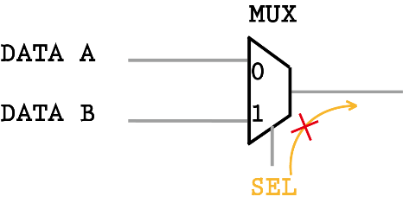
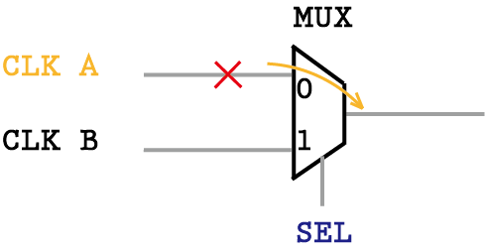
Disable Timing Arc / Clock Propagation
set_disable_timing
Break a timing arc of a cell, this is used when some timing arc within a cell cannot happen on data path
set_clock_sense -stop_propagation
Break a timing arc of a cell, this is used when some timing arc within a cell cannot happen on clock path
ASIC Boot Camp
Static Timing Analysis – Chapter 3 : Constraint Develop
Notes:
If in some cases, we don’t need to analyze certain signal through a particular logic cone according to design intention, we can guide the STA tool not even propagates the logic value downstream.
The most command way to stop the propagation is:
For data signals, we can use set_disable_timing command to break the timing arc of a cell.
For clock signals, we can use set_clock_sense –stop_propagation to block clock propagation through certain timing arc.

Slide 27
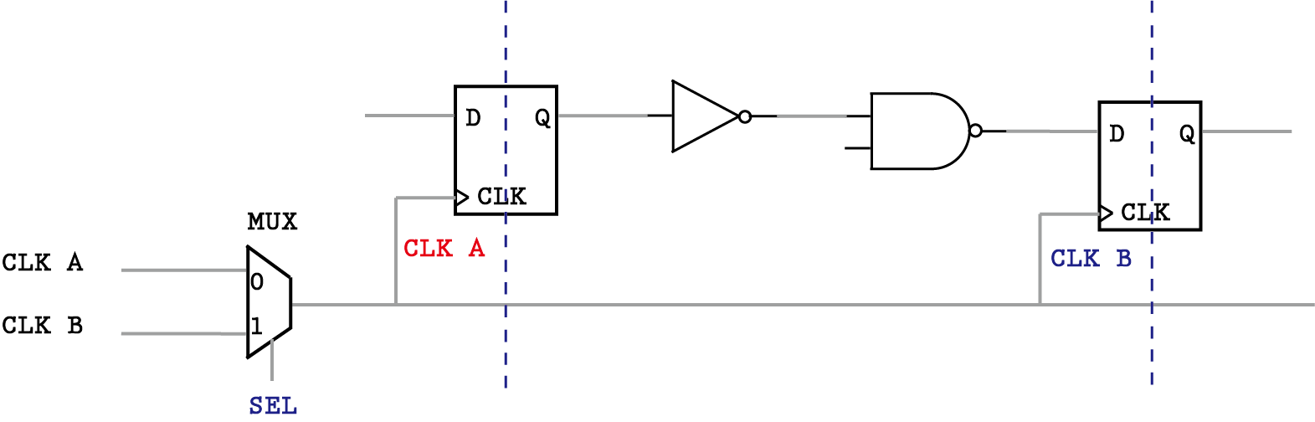
False Path
set_false_path -from CLK_A -to CLK_B
Disable STA checks on Non-existing Paths
ASIC Boot Camp
Static Timing Analysis – Chapter 3 : Constraint Develop
Notes:
It is possible that certain timing paths are not real/not possible in the actual functional operation of the design.
Such path can be turned off in STA.
The advantage of identifying the false paths is that the analysis space is reduced, thereby allowing the analysis to focus only on the real paths, also cut down the run time.
For example, the CLK A and CLK B are two inputs of the same MUX. According to design intention, only one of them can be propagated through the MUX at one time.
However, if we somehow forget to set the case analysis and also didn’t say anything about the relation between CLK A and CLK B, the STA will make both clocks propagate through the MUX and start analyzing timing paths between these two clocks.
From the STA perspective, this is the most comprehensive way to handle this case so it wont miss any possible timing paths.
But from the designer’s perspective, such timing path will never going to happen so this analysis does not make any sense.
Thus, we can set false path between these two clock domains.

Slide 28
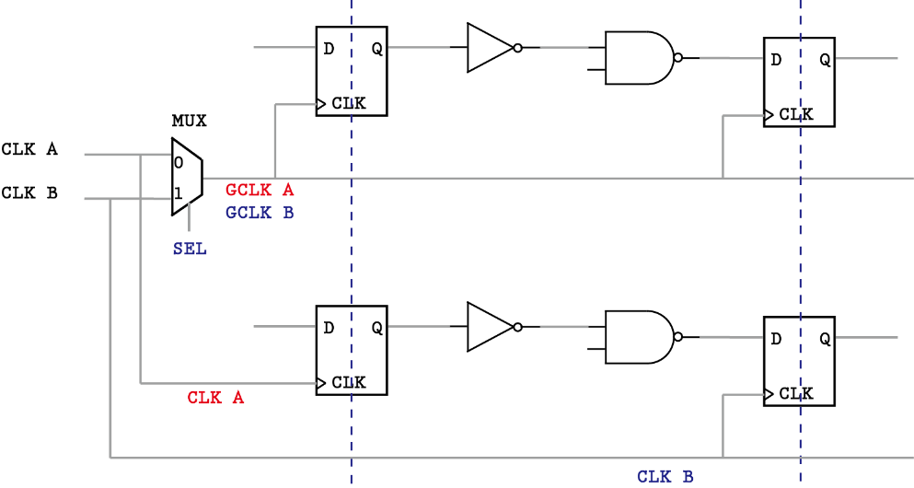
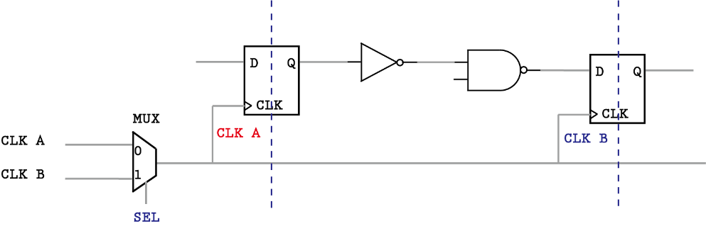
Asynchronous Clock Group
Logically Exclusive
Physically Exclusive
set_clock_group -logically_exclusive -group CLK_A -group CLK_B
set_clock_group -physically_exclusive -group GCLK_A -group GCLK_B
ASIC Boot Camp
Static Timing Analysis – Chapter 3 : Constraint Develop
Notes:
Sometimes, you would have designs where clocks may not be talking to each other depending on how the design is architected.
Such as the function clocks will not interfere with test clocks. We can of course set false paths between them, but a more preferred way to define such clock relation is to set clock groups.
The clock group definition will tell the tool which clocks are belonging to same synchronous design, and the tool will assume all other clocks not specified in the same clock group to be async to that group.
There are two basic relation between two asyc clock.
First one is they are logically exclusive, which means both clocks coexists in the design, but they don’t talk to each other (no timing path between them). Such as CLK_A and CLK_B in left figure.
The other one is they are physically exclusive. That means only one clock can exist in the design at one time when multiple clocks are define on the same design object. Such as the GCLK_A and GCLK_B
Note that the CLK_A and CLK_B are not logically exclusive anymore in the right picture since they have timing path in between on the other part of the design.

Slide 29
Timing Derate
Derating
set_timing_derate -early/-late
Clock / Data Derating
set_timing_derate -clock/-date
Cell / Wire Derating
set_timing_derate -net_delay/-cell_delay/-cell_check
OCV and Derating
Global OCV – flat derating factor across all paths, computes worst-case early/late bounds, pessimistic at smaller process nodes.
AOCV – LUT (look-up table) based derating factor annotated on paths according to logic depth and path distance
ASIC Boot Camp
Static Timing Analysis – Chapter 3 : Constraint Develop
Notes:
Derating = Making timing path slower/faster and then validate the behavior of the design. Since the clock and data paths can be affected differently by the OCV, STA can model the OCV by making the PVT condition for launch and capture path to be slightly different. (different derating factor)

Slide 30
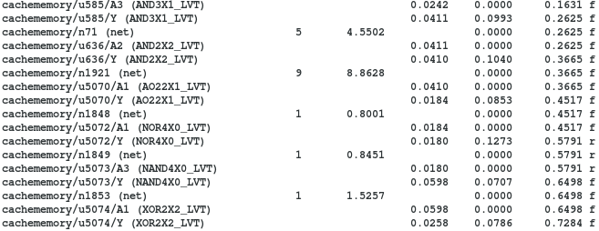

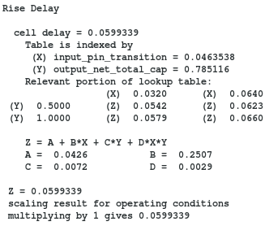
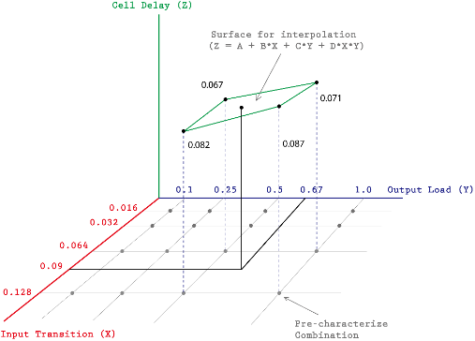
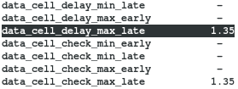
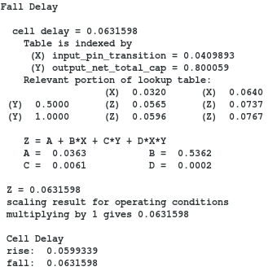
Topic 18: set_timing_derate
Since it’s using WLM, we want to set some timing derate to safeguard the margin.
In this report, we are enlarge all the datapath cell delay by a factor of 1.35
The calculated fall cell delay is 0.0631, multiply it by the derating factor 1.35 results in 0.085, which matches the timing report
ASIC Boot Camp
Static Timing Analysis – Chapter 2 : Delay Calculation
Notes:
In PBA mode, on the contrary, the slew and signal arrival time is calculate separately. Each path is isolated from each other so they don’t interfere.
This time, the faster transition is able to be propagated through the NAND gate so the above path could see a real transition even after the slew merge point.
The signal arrival time is calculated specific to this path and it has only single switching edge. So we can calculate noise more accurately from it.
Normally, PBA mode timing QoR is more accurate because of above reasons and should be always looks better than GBA mode.
But since it has to isolate each path and store unique slew rate and arrival time for each timing node, it requires much more computing power to process this high volume of data.
The normal strategy is to use GBA for timing closure when the design still has quite a lot failing path or timing violation. Then after all major timing problem have been solved and only very few tail paths left, we can enable to PBA mode for accurate signoff check.

Slide 31

Chapter Summary
Clock Diagram
Start Point, End Point, Timing Path Groups
What is SDC ?
Clock Creation
Constraining Input/output Paths
Case Analysis / Disable Timing Arcs
False Path
Asynchronous Clock Group
{ Logically Exclusive | Physically Exclusive }

