Slide 1
Authentication, Authorization and Security
Sreelekha Vijaya
Shivani Reddy Dodla
Sai Rakesh Avirineni
Lokeswari Pittu
Abhinay Reddy Kaitha

Slide 2





Team members
Sreelekha
Shivani
Rakesh
Lokeswari
Abhinay

Slide 3
Contents
Introduction
IIS
Authentication
Authorization
Summary

Slide 4
Introduction
Security is one of the most important part of any website or a web application.
Hackers are waiting out there for us and use various ways to exploit a website / web-application.
Hacker can attack in many ways.
Brute force, Sniffers, Spoofing, Social Engineering and SQL injection.
Sreelekha Vijaya

Slide 5
Introduction - Different ways to secure your Application
Design your Application well
Encrypting the data while storing
Input Validation
Forcing users for strong passwords
Authentication and Authorization
Sreelekha Vijaya

Slide 6
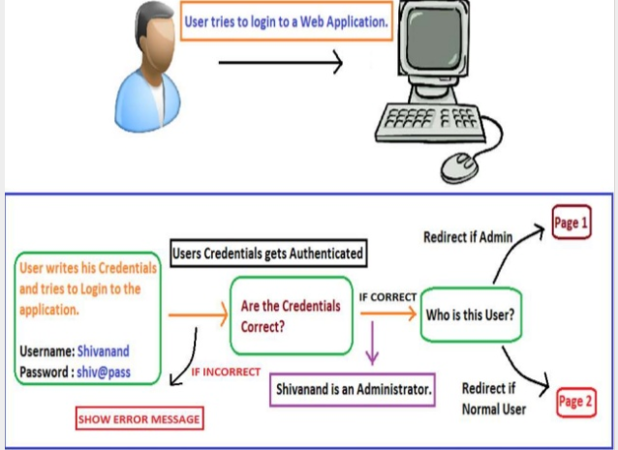
Introduction
Authentication and authorization are the two interlinked concepts in security.
Authentication is the process of obtaining some sort of credentials from the users and using those credentials to verify the user's identity.
Sreelekha Vijaya

Slide 7
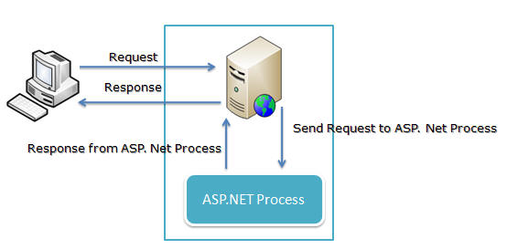
What is Internet Information Service?
One of the most powerful Web server developed by Microsoft to host ASP .NET Websites or Applications.
It’s responsibility is to give response back to the request sent by the client.
Sreelekha Vijaya

Slide 8
Authentication
ASP.net provides flexible set of alternatives for authentication.
An ASP.net application has two separate authentication layers.
All requests flow through IIS before they are handed to ASP.net.
IIS can decide to deny access without the ASP.net process even knowing that someone requested a particular page
Shivani Reddy

Slide 9
Authentication providers
ASP .net provides 3 types of service providers.
The windows Authentication provider lets you authenticates users based on their windows accounts.
The passport authentication provider uses Microsoft's passport service to authenticate users.
The forms authentication provider uses custom HTML forms to collect authentication information and lets you use your own logic to authenticate users.
Shivani Reddy

Slide 10
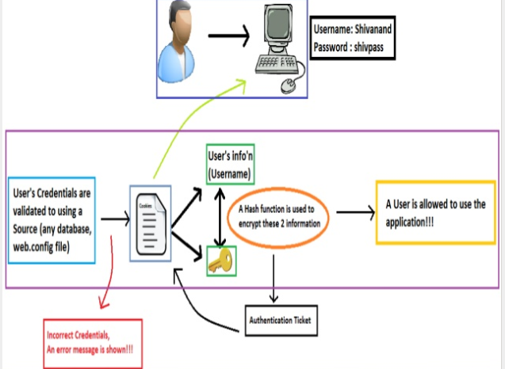
Forms Authentication:
It is nothing but a Cookie based Authentication where a cookie is stored on client’s machine.
It makes use of Custom Form to accept user’s credentials
Credentials are validated with the information stored in a specific source.
Shivani Reddy

Slide 11

Advantages
It is the simplest way of authenticating users for the websites and applications
Users does not have a login again and again to the same application
Shivani Reddy

Slide 12
Passport Authentication
Passport authentication lets you to use Microsoft's passport service to authenticate users of your application.
Passport uses an encrypted cookie mechanism to indicate authenticated users. If users have already signed into passport when they visit your site, they'll be considered authenticated by ASP.NET.
To use passport authentication you have to download the Passport Software Development Kit (SDK) and install it on your server.
Sai Rakesh

Slide 13
Windows Authentication
It is used in Intranet Environment
If you select windows on your ASP.NET application , you also have to configure authentication within IIS.
User credentials are validated with the information stored in the Windows Users Group.
It is not available in Windows 7 Home - Premium, Basic and Starter versions.
Sai Rakesh

Slide 14
Windows Authentication
Four different authentication methods.
Anonymous: It does not authenticate the user
Basic: User is authenticated and the information is sent in BASE-64 Encoded format
Digest: Works like basic authentication, but sends information in an encrypted format
Integrated Windows Authentication: It uses the Kerberos type of authentication.
Sai Rakesh

Slide 15
Authentication using Kerberos Mechanism
Authentication using kerberos, contains 3 main components
Authentication Service(AS)
Validates the username and password and sends a simple ticket
2) Ticket Granting Service(TGT)
The client sends the ticket to the TGT, which sends a Service Ticket
3) Service Broker(SB)
The SB, generates the connection and creates session for the user to use the application
Abhinay Reddy

Slide 16
Authorization
Authorization is the process of allowing an authenticated user access to resources.
Authentication is always precedes to Authorization.
Impersonation is a technique that allows the ASP.NET process to act as the authenticated user, or as an arbitrary specified user.
ASP.NET impersonation is controlled by entries in the applications web.config file.
Abhinay Reddy

Slide 17
Authorization
<identity impersonate="false"/>
With this setting ASP.NET does not perform impersonation. It means that ASP.NET will runs with its own privileges.
<identity impersonate="true"/>
<identity impersonate="true" username="DOMAIN\username" password="password"/>
Abhinay Reddy

Slide 18

Lokeswari Pittu

Slide 19
Summary
If there is nothing sensitive about the application, stick with no authentication in ASP.NET and anonymous authentication in IIS.
If you have to authenticate users, there are several choices.
If different users must have different privileges, impersonation in ASP.net configuration files needs to be turn on.
Lokeswari Pittu

Slide 20


