Slide 1
IOT BASED MANHOLE
MONITORING SYSTEM

Slide 2
ABSTRACT
This project focuses on the development of an IoT-based manhole monitoring system designed to enhance urban safety and prevent hazardous incidents. Utilizing a NodeMCU CP2102 microcontroller, the system integrates several key sensors, including a BMP180 pressure sensor and a DHT11 temperature sensor, to monitor environmental conditions within manholes. The hardware setup is constructed on a long breadboard, with the components connected using 10 male-to-male and 10 male-to-female connectors, along with a B-type USB data cable for power and data transmission.
The primary objective is to detect abnormal changes in pressure and temperature, which may indicate blockages, gas leaks, or other dangerous conditions. Data collected from the sensors is transmitted in real-time to the ThingSpeak platform, an IoT analytics service, where it is stored, processed, and visualized. Alerts are generated and sent to a connected smartphone when the system identifies readings that deviate from predefined safety thresholds. This proactive monitoring approach allows for prompt maintenance and timely interventions, reducing the risk of accidents and improving public safety.
The integration of ThingSpeak not only facilitates remote monitoring but also provides a robust mechanism for data logging and analysis, enabling long-term trend analysis and predictive maintenance. The use of widely available and cost-effective components ensures that the system is affordable and scalable, making it suitable for deployment in urban areas with extensive underground infrastructure. This project demonstrates the potential of IoT technologies to revolutionize infrastructure monitoring, offering a practical solution to the challenges of urban safety management.

Slide 3
CONTENT
INTRODUCTION
WHY
COMPONENTS
NODEMCU CP2102
SENSORS
THINKSPEAK
BENEFITS

Slide 4
INTRODUCTION
This project aims to develop an IoT-based manhole monitoring system using readily available components, including the NodeMCU CP2102 microcontroller, BMP180 pressure sensor, DHT11 temperature sensor, MQ-7 gas sensor, and MQ-3 smoke sensor. The system will transmit data to the cloud (ThingSpeak), where it can be monitored and analyzed to trigger alerts when necessary.
Urban infrastructure maintenance, particularly manholes, is critical for ensuring public safety and preventing accidents. Traditional inspection methods are often inadequate due to the inaccessibility and environmental conditions inside manholes. The advent of IoT (Internet of Things) offers a solution by enabling real-time monitoring through sensor networks, allowing authorities to respond promptly to potential hazards.

Slide 5
WHY
A manhole monitoring system is essential for safeguarding public safety, protecting infrastructure, and ensuring environmental health. By continuously tracking key parameters such as gas levels, pressure, temperature, and smoke, the system can quickly identify potential dangers like gas leaks, flooding, or structural failures. This enables authorities to take immediate action, preventing accidents, reducing the risk of environmental contamination, and avoiding expensive emergency repairs. Moreover, such systems help cities comply with safety regulations, optimize maintenance efforts, and contribute to the broader goals of smart city development and sustainable urban management.

Slide 6
COMPONENTS
NODEMCU CP2102
Pressure sensor(BMP180)
Temp sensor(DHT11)
GAS SENSOR (MQ-7)
SMOKE SENSOR(MQ-3)
Long breadboard
10 male to male connector and
10 male to female connector
B type USB Data cable

Slide 7
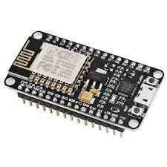
NODEMCU CP2102
The NodeMCU CP2102 is a development board that combines the ESP8266 Wi-Fi module with a USB-to-UART bridge, enabling easy programming and serial communication through a USB connection. It features a powerful microcontroller with built-in Wi-Fi, making it perfect for IoT applications that require wireless connectivity. The CP2102 chip on the board facilitates a reliable connection to your computer, allowing for straightforward uploading of code and debugging. This board is popular in IoT projects due to its affordability, ease of use, and strong community support.

Slide 8
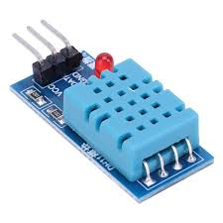
Temperature sensor(DHT11)
The DHT11 is a basic, low-cost temperature and humidity sensor that provides digital output data. It measures temperature with an accuracy of ±2°C and humidity with an accuracy of ±5%. The DHT11 is commonly used in home automation, weather stations, and other IoT projects that require monitoring of environmental conditions. It is easy to interface with microcontrollers like Arduino or NodeMCU, thanks to its single-wire communication. Despite being less precise than some other sensors, the DHT11 is popular for its affordability and ease of use in simple temperature and humidity sensing applications.

Slide 9
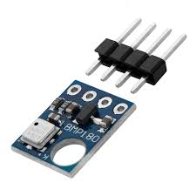
Pressure sensor(BMP180)
The BMP180 is a high-precision, low-power barometric pressure sensor used to measure atmospheric pressure. It operates with an I2C interface, making it easy to integrate with microcontrollers like Arduino or NodeMCU. The BMP180 can provide pressure readings that can be used to calculate altitude, making it ideal for applications in weather monitoring, altitude tracking, and environmental sensing. Known for its accuracy and reliability, the BMP180 is widely used in various IoT and embedded systems projects where pressure data is crucial.

Slide 10
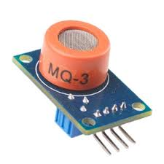
SMOKE SENSOR(MQ-3)
The MQ-3 is a versatile smoke sensor capable of detecting a range of gases, including smoke, alcohol, and carbon monoxide (CO). It provides an analog output that varies with the concentration of detected gases, requiring an analog-to-digital converter (ADC) for interfacing with microcontrollers like Arduino or NodeMCU. The MQ-3 is commonly used in smoke detectors and air quality monitoring systems due to its sensitivity to smoke and other combustion-related gases, making it a valuable component for safety and environmental monitoring applications.

Slide 11
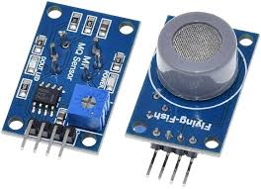
GAS SENSOR (MQ-7)
The MQ-7 is a gas sensor designed to detect carbon monoxide (CO) levels in the air. It operates using an analog output, which requires an analog-to-digital converter (ADC) to interface with microcontrollers like Arduino or NodeMCU. The sensor is sensitive to low concentrations of CO and provides an indication of the gas level through changes in resistance. The MQ-7 is commonly used in applications such as air quality monitoring, gas leak detection, and safety systems due to its ability to provide real-time measurements of potentially hazardous gases.

Slide 12

THINGSPEAK
ThingSpeak is an IoT analytics platform that enables users to collect, visualize, and analyze data from various sensors and devices in real-time. It provides a cloud-based service for storing data and creating visualizations such as graphs and charts. ThingSpeak supports integration with a range of IoT devices and microcontrollers, including Arduino, NodeMCU, and Raspberry Pi, allowing users to send data via HTTP requests or MQTT protocol.
Key features of ThingSpeak include:
Data Channels: Users can create channels to store data from different sensors or devices. Each channel can have multiple fields for different types of data.
Real-Time Data Visualization: Provides tools to create custom graphs, charts, and dashboards for visualizing data trends over time.
Alerts and Notifications: Users can set up automated alerts based on predefined conditions or thresholds.

Slide 13
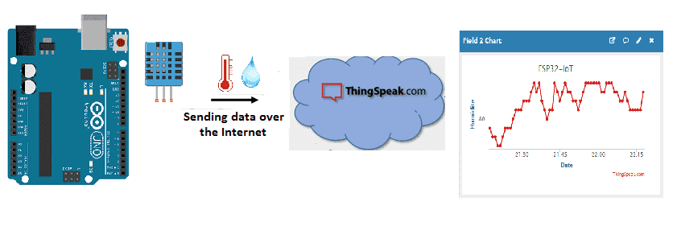
HOW THINGSPEAKS WORKS

Slide 14
BENEFITS
1. Enhanced Public Safety Early Detection of Hazards: Real-time monitoring of gases, smoke, pressure, and temperature helps in the early detection of dangerous conditions like gas leaks, fires, or structural issues. This allows for prompt intervention, reducing the risk of accidents and injuries.
2. Improved Infrastructure Maintenance Preventive Maintenance: Regular data collection allows for the early identification of potential maintenance needs, reducing the likelihood of emergency repairs and extending the lifespan of manhole infrastructure.
3. Efficient Resource Management Real-Time Data Access: The system provides real-time data on various parameters, enabling efficient decision-making and resource allocation for maintenance and safety management.

Slide 15
4. Environmental Protection Pollution Prevention: Monitoring for gases and smoke helps in preventing environmental contamination due to leaks or emissions, protecting local ecosystems and water sources.
5. Compliance and Regulation Safety Regulations: The system supports compliance with safety regulations by providing continuous oversight and documentation of manhole conditions, ensuring adherence to health and safety standards.
6. Cost-Effective Implementation Affordable Components: The use of cost-effective components like NodeMCU and various sensors ensures that the system is budget-friendly, making it feasible for large-scale deployment.
7. Smart City Development Part of Smart Infrastructure: The system contributes to the development of smart cities by integrating advanced technology for real-time monitoring and data-driven management of urban infrastructure.

Slide 16
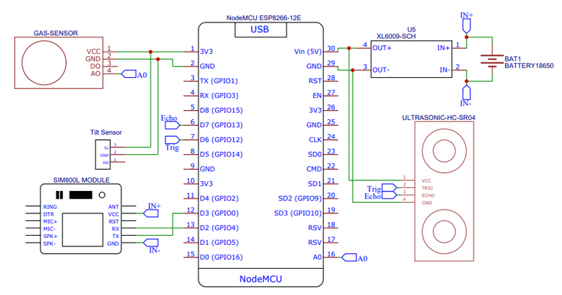

Slide 17
THANKS FOR
WATCHING

