Slide 1

Personalized Trip Planner with AI
Revolutionizing Travel Experience Through Intelligent Automation
[Your Team Name]
[Current Date]
Created By AI

Slide 2
CONTENTS / 目录
01
01
The Travel Planning Challenge
08
Revenue Streams
02
Our AI-Powered Solution
09
Development Timeline
03
Core AI Technologies
10
Our Team
04
System Architecture
11
Funding Requirements
05
What Makes Us Different
12
Key Performance Indicators
06
Market Opportunity
13
Transforming Travel Through AI
07
Live Demo Walkthrough

Slide 3
01
SECTION ONE
The Travel Planning Challenge

Slide 4







Current Pain Points in Travel Planning
Information Overload
Fragmented Experience
Generic Recommendations
Travelers spend 5+ hours researching destinations
Multiple platforms for flights, hotels, activities
One-size-fits-all approach ignores personal preferences
Time-Consuming Process
Budget Uncertainty
Real-time Disruptions
Manual coordination of schedules and bookings
Difficulty tracking and optimizing travel costs
Poor handling of flight delays, weather changes

Slide 5






Market Impact of Poor Travel Planning
67%
of travelers report planning stress
38
average websites visited before booking
$100B
lost annually due to poor travel experiences

Slide 6
02
SECTION TWO
Our AI-Powered Solution

Slide 7







Intelligent Trip Planning Engine
Personalized AI Recommendations
Real-time Optimization
Unified Platform
based on user preferences, history, and behavior
for budget, time, and preferences
integrating all travel services
Smart Itinerary Generation
Continuous Learning
with automatic scheduling
from user feedback and interactions

Slide 8
Key Value Proposition of the AI Solution
Key Value Proposition:
“
From scattered planning to seamless experiences -
From scattered planning to seamless experiences -
AI that understands your travel DNA
AI that understands your travel DNA
”

Slide 9
03
SECTION THREE
Core AI Technologies

Slide 10




🧠 Machine Learning Engine Capabilities
Collaborative Filtering
Natural Language Processing
Recommendations based on similar user patterns
Conversational trip planning interface
Predictive Analytics
Computer Vision
Price forecasting and optimal booking times
Photo-based destination discovery

Slide 11







Personalization and Real-time Intelligence Features
🎯 Personalization Features
🔄 Real-time Intelligence
Preference Learning:Adapts to user behavior over time
Live Updates:Flight delays, weather alerts, local disruptions
Context Awareness:Weather, local events, seasonal factors
Alternative Planning:Instant rebooking and rerouting
Sentiment Analysis:Reviews and ratings processing
Dynamic Pricing:Real-time budget optimization
Crowd Intelligence:Real-time popularity and availability data
Smart Suggestions:Proactive recommendations for activities and dining

Slide 12
04
SECTION FOUR
System Architecture

Slide 13







Frontend and AI/ML Layers of the Architecture
Frontend Layer
AI/ML Layer
Mobile App:React Native for iOS/Android
Recommendation Engine:TensorFlow/PyTorch models
Web Portal:Progressive Web App (PWA)
NLP Service:OpenAI GPT integration
Voice Interface:Integration with Alexa/Google Assistant
Prediction Models:Time series forecasting
Image Recognition:Custom CNN for photo analysis

Slide 14






Backend Services and External Integrations
Backend Services
External Integrations
Microservices Architecture:Node.js/Python APIs
Travel APIs:Amadeus, Skyscanner, Booking.com
Real-time Processing:Apache Kafka streams
Payment Gateway:Stripe/PayPal integration
Database:MongoDB for user data, Redis for caching
Maps & Location:Google Maps API
Authentication:OAuth 2.0 with JWT tokens
Weather Data:OpenWeatherMap API

Slide 15
05
SECTION FIVE
What Makes Us Different

Slide 16


Hyper-Personalization and Real-time Adaptation as USPs
Hyper-Personalization
Real-time Adaptation
Travel DNA Profiling:Deep learning from 100+ preference points
Dynamic Replanning:Instant adjustments for disruptions
Live Optimization:Continuous budget and time optimization
Contextual Intelligence:Considers mood, occasion, and companions
Smart Notifications:Proactive alerts and suggestions
Predictive Preferences:Suggests experiences before you know you want them

Slide 17





Conversational AI and Privacy-First Approach
🤝Conversational AI
🔒Privacy-First Approach
Natural Language Planning
Local Processing
"Plan a romantic weekend in Paris under $2000"
Sensitive data processed on-device
Multi-modal Input
Transparent AI
Text, voice, and image-based requests
Explainable recommendations
Context Retention
User Control
Remembers preferences across conversations
Granular privacy settings

Slide 18
06
SECTION SIX
Market Opportunity

Slide 19



Market Size and Growth Potential
Total Addressable Market
$1.4 Trillion
(Global Travel Industry)
Serviceable Addressable Market
$180 Billion
(Digital Travel Booking)
Serviceable Obtainable Market
$5.4 Billion
(AI-powered travel tools)
Growth Rate
15% CAGR
(in AI travel technology)

Slide 20







Target Demographics and Competitive Landscape
Target Demographics
Competitive Landscape
Primary:Tech-savvy millennials and Gen Z (25-40 years)
Traditional OTAs:Expedia, Booking.com (lacking personalization)
Secondary:Busy professionals seeking efficiency (30-50 years)
AI Startups:TripActions, Lola (B2B focused)
Tech Giants:Google Travel (limited AI integration)
Tertiary:Experience-focused luxury travelers (35-65 years)
Our Advantage:Consumer-focused, true AI personalization

Slide 21




Revenue Projections
Year 1
Year 2
Year 3
$500K
$5M
$25M
10K users
100K users
500K users
$50 average revenue
Improved monetization
Premium features

Slide 22
07
SECTION SEVEN
Live Demo Walkthrough

Slide 23








Onboarding and Trip Planning Process
1. Onboarding Experience
2. Trip Planning Process
Preference Quiz
Quick 2-minute setup
Natural Language Input
"Plan a 5-day trip to Japan in spring"
Travel Style Assessment
Adventure, luxury, cultural, relaxation
AI Processing
Real-time analysis of preferences, budget, and availability
Budget and Constraint Input
Flexible AI-guided questions
Smart Recommendations
Curated itinerary with explanations

Slide 24









Personalization, Real-time Features & Continuous Learning
3. Personalization in Action
4. Real-time Features
5. Learning & Improvement
Dynamic Suggestions:
Activities based on user interests
Live Updates:
Weather-based activity suggestions
Feedback Loop:
Rating and review integration
Budget Optimization:
Automatic cost balancing
Smart Notifications:
"Your flight is delayed, here's a new restaurant nearby"
Pattern Recognition:
Improving future recommendations
Schedule Intelligence:
Optimal timing and routing
Preference Evolution:
Adapting to changing user needs
Instant Rebooking:
One-tap alternatives for disruptions

Slide 25
08
SECTION EIGHT
Revenue Streams

Slide 26






Commission and Subscription Revenue Models
Commission Model
of revenue
60%
Subscription Tiers
of revenue
25%
Booking Commissions:3-8% from hotels, flights, activities
Basic:
Free
limited features, ads
Premium Partnerships:Higher commissions for preferred vendors
Volume Incentives:Scaled rates based on booking volume
Premium:
$9.99/month
unlimited planning, no ads
Pro:
$19.99/month
exclusive deals, priority support

Slide 27






AI Services and Data Insights as Revenue Streams
3. AI Services (10% of revenue)
4. Data Insights (5% of revenue)
White-label Solutions
Licensing AI engine to travel companies
Anonymized Trends
Market intelligence for travel industry
Custom Integration
Enterprise API access
Predictive Analytics
Demand forecasting services
Consulting Services
Travel optimization for corporations
Research Partnerships
Academic and industry collaboration

Slide 28
09
Section Nine
Development Timeline

Slide 29







Phase 1: Foundation and Phase 2: Intelligence
Phase 1: Foundation (Months 1-6)
Phase 2: Intelligence (Months 7-12)
MVP Launch:Core recommendation engine
Advanced AI:Conversational interface launch
Basic Integrations:Flight and hotel booking
Real-time Features:Live optimization and updates
User Acquisition:10K initial users
Mobile App:Native iOS/Android applications
Feedback Integration:Continuous improvement loop
Expanded Inventory:Activities, restaurants, local experiences

Slide 30








Phase 3: Scale and Phase 4: Innovation
Phase 3: Scale (Months 13-18)
Phase 4: Innovation (Months 19-24)
Global Expansion:International market entry
AR/VR Integration:Immersive trip preview
Enterprise Features:Business travel solutions
IoT Connectivity:Smart luggage and device integration
API Platform:Third-party developer access
Blockchain Implementation:Secure identity and payments
Advanced Personalization:Behavioral prediction models
Sustainability Focus:Carbon footprint optimization

Slide 31
10
SECTION 10
Our Team

Slide 32







Technical Leadership and Domain Expertise
Technical Leadership
Domain Expertise
AI/ML Engineers
Travel Industry Veterans
5+ years in recommendation systems
15+ years in travel technology
Backend Developers
UX/UI Designers
Scalable microservices expertise
Consumer app design specialists
Mobile Developers
Business Development
React Native and native app experience
Partnership and monetization experience
Data Scientists
Product Managers
Travel industry analytics background
AI product development expertise

Slide 33








Advisory Board and Key Achievements
Advisory Board
Key Achievements
Industry Advisors:Former executives from Expedia, Airbnb
Combined Experience:50+ years in travel technology
Previous Exits:2 successful travel tech startups
Technical Advisors:AI researchers from leading universities
Academic Credentials:PhDs in AI/ML and Computer Science
Investment Advisors:VCs with travel tech portfolio experience
Industry Recognition:Speakers at major travel tech conferences

Slide 34
11
SECTION 11
Funding Requirements

Slide 35


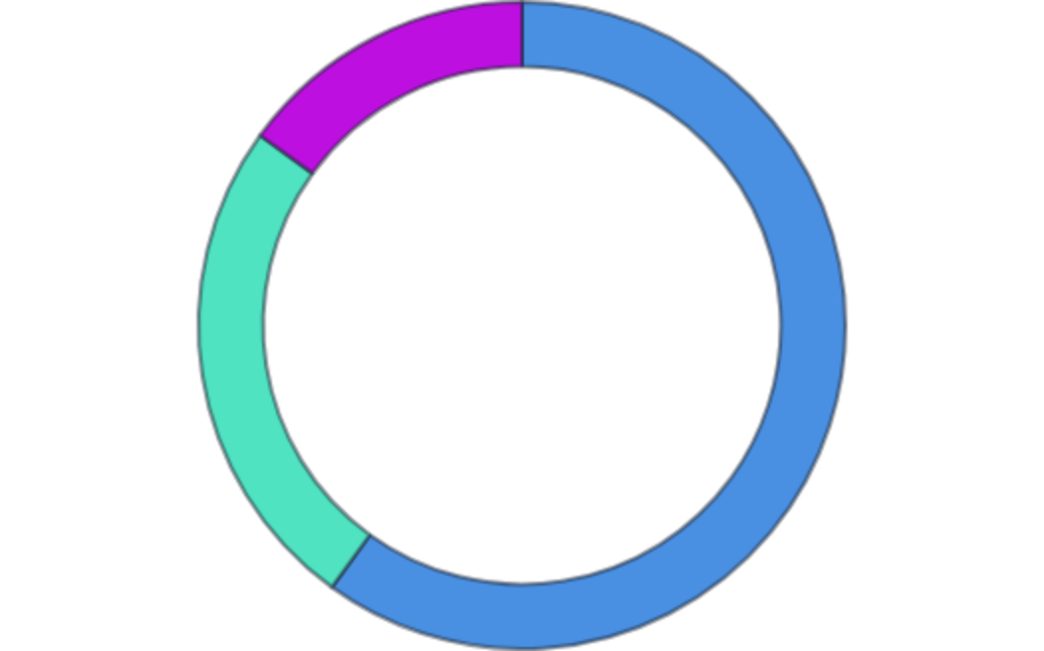
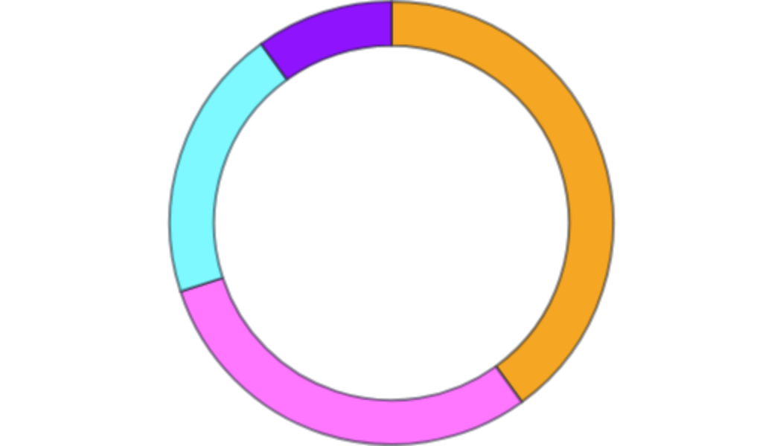
Seed Round and Series A Funding Allocation
Seed Round
Series A
$2M
$8M
(12-month runway)
(24-month runway)
Market Expansion
40%
($3.2M)
Product Development
60%
($1.2M)
Technology Development
30%
($2.4M)
User Acquisition
25%
($500K)
Partnership Development
20%
($1.6M)
Operations & Team
15%
($300K)
Working Capital
10%
($800K)

Slide 36






Key Milestones and Risk Mitigation
Key Milestones
Risk Mitigation
Technology Risk:Proven AI frameworks and experienced team
6 Months
12 Months
25K
$1M
active users
ARR
Market Risk:Large addressable market with clear demand
Competition Risk:Strong IP and first-mover advantage
18 Months
24 Months
International
$10M
expansion
ARR, Series B ready
Execution Risk:Experienced team with track record

Slide 37
12
SECTION TWELVE
Key Performance Indicators

Slide 38






User Engagement and Business Metrics
User Engagement
Business Metrics
70%
>85%
$75
<$25
of monthly users
of planned trips
annual average
per user
Daily Active Users
Trip Completion Rate
Revenue per User
Customer Acq. Cost
60%
15+
>$300
40%
six-month retention
minutes per session
per user
growth rate
User Retention
Session Duration
Lifetime Value
Monthly Rec. Revenue

Slide 39








AI Performance and Market Impact Metrics
AI Performance
Market Impact
>90%
user satisfaction
2%
AI travel segment
Recommendation Accuracy
Market Share
3x
higher engagement
100+
integrated providers
Personalization
Partnership Growth
85%
price forecast accuracy
10
countries by year 2
Prediction Accuracy
Geographic Expansion
<2s
for recommendations
Top 3
travel innovation awards
Response Time
Industry Recognition

Slide 40
13
SECTION 13
Transforming Travel Through AI

Slide 41





Our Vision, Impact Summary, and Next Steps
Our Vision
"Making personalized travel planning as simple as having a conversation with your most knowledgeable travel friend"
Impact Summary
Next Steps
For Travelers:Stress-free planning, perfect matches, seamless experiences
1. Partnership Opportunities:
Integration with travel providers
For Industry:Increased efficiency, better customer satisfaction, new revenue streams
2. Investment Rounds:
Seeking strategic investors and funding
For Society:More accessible travel, reduced waste, cultural exchange
3. Beta Testing:
Early user program launching next month
4. Hiring:
Expanding our team with top talent

Slide 42



Join Us in Revolutionizing Travel
Together, let's make intelligent travel planning accessible to everyone
your.email@example.com
+1 (123) 456-7890
www.example.com

