Slide 1
Construction site attendance application
Omid, Lana, Liana

Slide 2
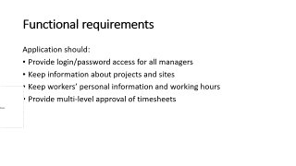
Functional requirements
Application should:
Provide login/password access for all managers
Keep information about projects and sites
Keep workers’ personal information and working hours
Provide multi-level approval of timesheets

Slide 3
Non-functional requirements
Application should:
Handle 6 projects with 6 sites and 50 workers
Be available 24/7
Be user friendly with simple UI

Slide 4
Interview notes
Person interviewed: Athar , customer representor
Interviewer: Omid, Liana, Lana
Purpose of interview:
Understand the current attendance process
Identify the issues
Identify stakeholders
Customer expectations
Summary of interview:
The basic issue is that there’s no automated system to handle the workers’ attendance
The expectation is that a new system can handle multi-level management of attendance based on site and project
Open items:
Get current report example (talk to Charmaine)
Integration with the payment system
Encryption of timesheets
In future make web-based application and provide role–based functions for users.

