Slide 1


K.RAMAKRISHNAN COLLEGE OF TECHNOLOGY
(AUTONOMOUS), TRICHY.
MOBILE TRACKING SYSTEM
PRESENTED
Godfrey T R
2303811710421047
SUPERVISOR
Mr. M. Saravanan, M.E.,
AP/CSE.

Slide 2
PRESENTATION OVERVIEW
Objective
Project Introduction
Problem Statement
Methodologies (Programming concepts relevant to problem statement)
Architecture of the proposed system
List of Modules
Merits
Results and Discussion
Queries

Slide 3
OBJECTIVE
The primary objective of the Mobile Tracking System (MTS) is to enhance the security and utility of mobile devices by providing tools for real-time location tracking, lost or stolen device reporting, and remote data security.
This system ensures user peace of mind in case of device theft or misplacement by enabling swift action and secure handling of sensitive data.

Slide 4
PROJECT INTRODUCTION
The Mobile Tracking System is designed to improve mobile security by allowing users to track, locate, and report lost or stolen mobile devices.
This project uses Java as the programming language and implements a Graphical User Interface (GUI) for ease of use.
The system provides three main functionalities:
  Tracking the location of a mobile device (simulated with random latitude and longitude).
  Reporting a device as lost and storing it in a list.
  Displaying all tracked and lost devices for future reference.
This system is aimed at offering a prototype for a mobile tracking solution that can later be enhanced with real-time GPS integration and additional security features such as device locking and remote data wiping.

Slide 5
PROBLEM STATEMENT
In the current technological landscape, mobile devices are integral to daily life, but their vulnerability to loss or theft poses significant security risks.
In the event of theft or misplacement, users often struggle to track their devices and secure their data.
Many existing mobile tracking systems are either too complex for general users or lack basic features such as real-time tracking and remote data security.
The Mobile Tracking System (MTS) addresses these issues by providing a simple and effective platform for tracking lost devices, reporting theft, and securing sensitive data remotely.

Slide 6
METHODOLOGIES
Object-Oriented Programming (OOP):
  The system is built using OOP principles, ensuring modularity and maintainability. Classes like Godfrey (the main class) and the use of objects such as Button, Label, and TextField ensure that the code is organized and scalable.
Event-Driven Programming:
  The project relies on event-driven programming using ActionListener to respond to user actions (e.g., button clicks). This ensures that the system remains responsive and interacts with the user efficiently.
Data Structures:
  ArrayList is used to store the mobile numbers that are tracked and reported as lost. This allows dynamic data storage that can grow or shrink based on user input.
GUI Development:
  The system uses AWT for creating a GUI that is both functional and easy to use, ensuring that even non-technical users can interact with the system.
API Key Validation:
  Although the actual GPS data is simulated, a validateApiKey() method is included to simulate authentication, ensuring that only authorized users can access tracking functionalities.

Slide 7
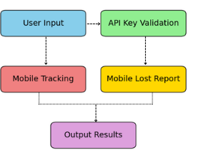
ARCHITECTURE OF THE PROPOSED SYSTEM

Slide 8
LIST OF MODULES
User Interface Module:
Creates a graphical user interface for the system using AWT components like Label, TextField, TextArea, and Button.
Event Handling Module:
Handles user interactions through ActionListener, where the system performs specific actions based on button clicks (tracking, reporting, displaying data).
Tracking Module:
Simulates location tracking by generating random latitude and longitude values for a given mobile number.
Lost Device Reporting Module:
Allows users to report a mobile as lost by adding the mobile number to the lost devices list.
Data Storage Module:
Uses ArrayList to store and manage the tracked and lost mobile numbers.
API Key Validation Module:
Simulates authentication of the system with an API key to ensure that the tracking service is accessible only to authorized users.
Exit and Window Handling Module:
Handles window closing behavior and asks for confirmation before exiting the system.

Slide 9
MERITS
User-Friendly Interface:
  The system features a simple and intuitive graphical user interface that allows users to easily interact with the application.
Real-Time Tracking Simulation:
  Although simulated, the system demonstrates how location tracking could work in a real-world scenario.
Device Security:
  Allows users to report lost devices, enhancing mobile security by storing data for reference.
Extensible Architecture:
  The system is modular and can be easily extended to include additional features such as real GPS integration, remote data wiping, or device locking.
Efficient Data Management:
Uses ArrayList for storing and retrieving data dynamically, ensuring quick access and modification.

Slide 10
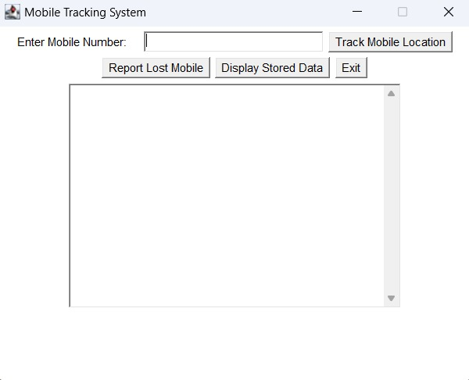
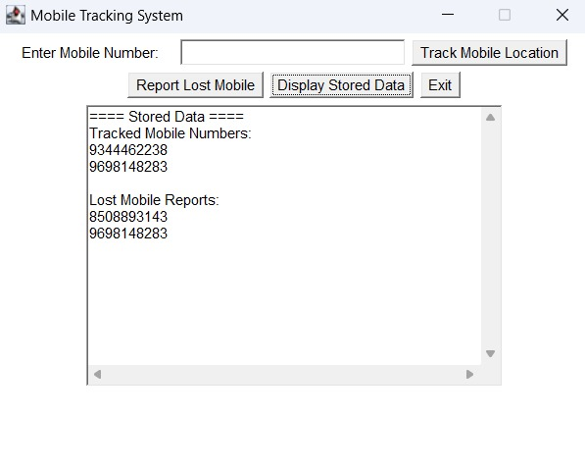
RESULTS AND DISCUSSION

Slide 11
QUERIES ?

