Slide 1
Spatiotemporal Data Management and Analytics Spatial Data Organization 2
By Prof Xiaofang Zhou, Dr Lei Li and Dr Pingfu Chao
University of Queensland

Slide 2
Learning Modules
 | Date | Lecture | Lecturer
1 | 22/6 | Course Introduction and RDBMS Review | Prof Xiaofang Zhou
2 | 22/6 | Introduction to Spatial Databases
3 | 23/6 | Spatial Data Organisation | Dr Lei Li
4 | 23/6 | Spatial Query Processing
5 | 24/6 | Managing Spatiotemporal Data | Dr Pingfu Chao
6 | 24/6 | Managing High Dimensional Data | Dr Lei Li
 | 25/6 | 端午节
7 | 26/6 | Advanced Topic: Route Planning in Road Networks | Dr Lei Li
8 | 26/6 | Future Trends, Course Review and Discussions | All
 |  | Revision Period
 | 9 July | Final Report Due

Slide 3
Spatial Indexing
Purpose:
Efficiency in processing spatial selection, join and other spatial operations
Two strategies to organize space and objects
Map spatial objects into 1D space and use a standard index structure (B-tree)
Dedicated external data structures
Basic ideas
Approximation
Bounding box, Grids
Hierarchical Data Organization

Slide 4
Object Approximation
A fundamental idea of spatial indexing is the use of approximation
Continuous Approximation
Object centric
Example:
Use of MBRs (Minimum Bounding Rectangles)
R-Tree
Grid Approximation
Space centric
Faster mapping
Uniform / Non-uniform
High-D?
Example:
Quadtree

Slide 5
Data Access Methods
One Dimensional
Hashing and B-Trees
Line Data
Interval Tree, Segment Tree
Point Data
Hashing: GRID and EXCELL
Hierarchical
Quadtree: Point and Region Quadtrees
kd-Tree
Z-values and B-tree
Polygon Data
Transformation: End point mapping and Z-values
Overlapping: R-tree and R*-tree
Clipping: R⁺-tree

Slide 6
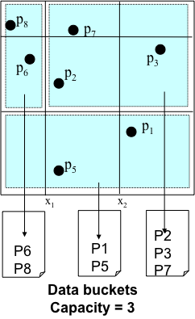
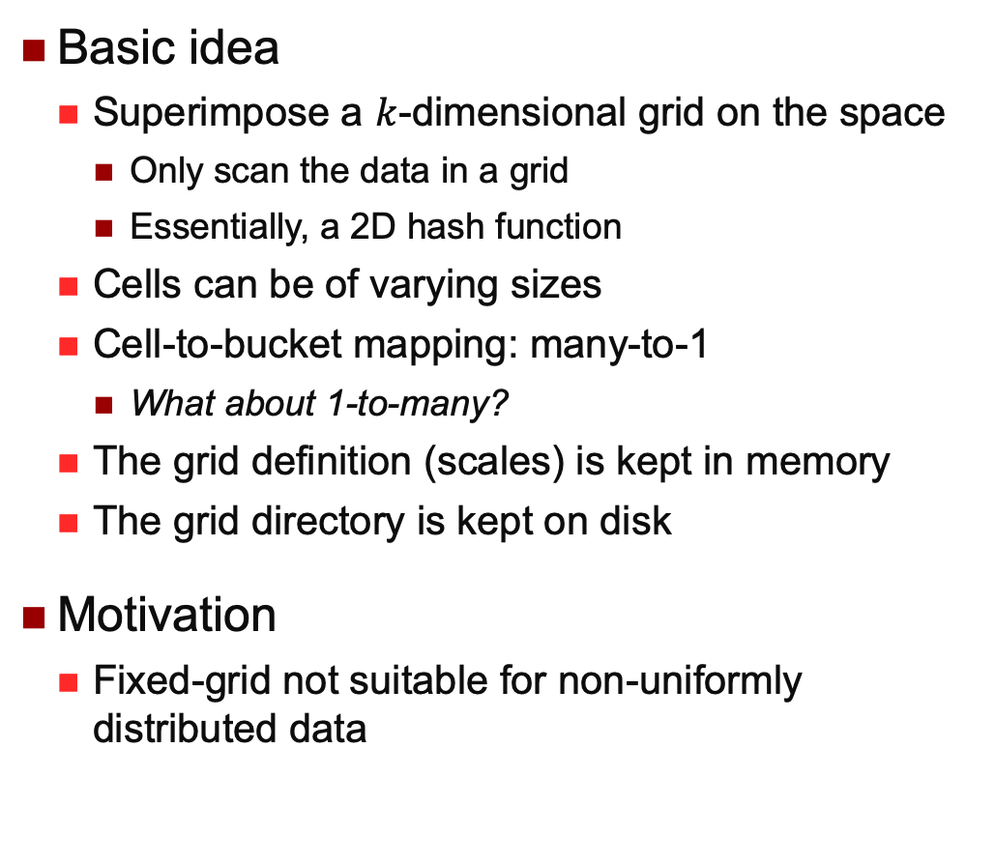
Grid File
Basic idea
Superimpose a $k$-dimensional grid on the space
Only scan the data in a grid
Essentially, a 2D hash function
Cells can be of varying sizes
Cell-to-bucket mapping: many-to-1
What about 1-to-many?
The grid definition (scales) is kept in memory
The grid directory is kept on disk
Motivation
Fixed-grid not suitable for non-uniformly distributed data

Slide 7
Grid File
To answer a point query:
Use the scales / definition to locate the cell
Read the cell from disk
The loaded cell contains a reference (pointer) to data bucket
Read data bucket
On average two disk accesses
To answer a range query:
Examine all cells that overlap the search region
Read the corresponding data buckets(s)

Slide 8
Grid File
To insert a point:
Search (point query) the matching cell and data bucket
If there is sufficient space, insert into data bucket
Else: add a vertical or horizontal line to split, if necessary, and move data accordingly
To delete a point:
Search …
Merge if necessary
Problems:
Have to remember all the definitions of the grids
Why not uniformly?

Slide 9
EXCELL
EXtendible CELL
Motivation
Fixed grid is easier to manage and more efficient to use
Basic Ideas
All cells are of the same size
No need to keep grid definition (scales) in memory
But it’s still necessary to remember how to map grid cells to buckets
Somewhere splits, everywhere splits
p₈
p₇
p₆
p₃
p₂
p₁
p₅
Data buckets
Capacity = 3

Slide 10
Data Access Methods
One dimensional
Hashing and B-Trees
Line Data
Segment Tree, Interval Tree
Point data
Hashing: GRID and EXCELL
Hierarchical
Quadtree: Point and Region Quadtrees
kd-Tree
Z-values and B-tree
Polygon data
Transformation: End point mapping and z-values
Overlapping: R-tree and R*-tree
Clipping: R⁺-tree

Slide 11
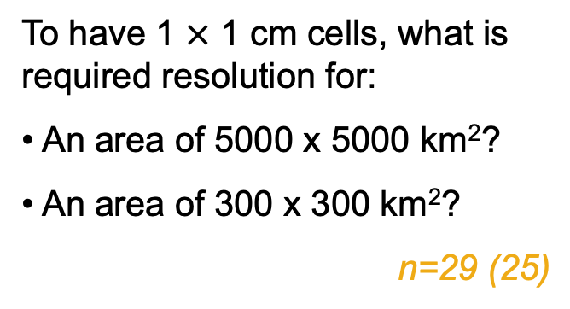
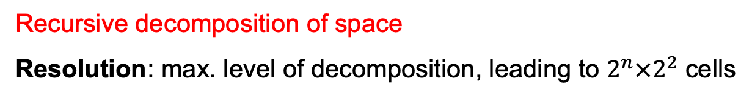
Uniform Decomposition
Recursive decomposition of space
Resolution: max. level of decomposition, leading to $2^{n}×2^{2}$ cells
To have 1 $×$ 1 cm cells, what is required resolution for:
An area of 5000 x 5000 km²?
An area of 300 x 300 km²?
n=29 (25)
How many times do you need to fold a piece of paper to make it reach the moon?
Average thickness of paper sheet = 0.1mm
Distance between earth & moon = 384,403km

Slide 12
Quadtree – Basic Idea
1
2
3
NW
SE
4
5
NE
SW
1
6
7
8
13
14
9
10
2 3 4 5
6
11 12 13 14
19
11
12
15
16
19
17
18
N
7 8 9 10
15 16 17 18
W
E
Index node
Data node
S

Slide 13

Quadtree – Basic Idea
Not a binary tree
Four-way comparison instead of two in 2D
In $d$ dimensions, inner node has $2^{d}$ children
Not necessarily balanced
Tree shape depends on the data distribution / insertion order

Slide 14

Point Quadtree Construction
Insertion
Random insertion roughly $N\log_{4}{N}$
When is the worst case?
Insertion takes $N(N−1)/2$
P1
p₈
NW
SE
p₇
NE
SW
p₃
p₆
P2
P3
P5
p₂
p₁
P6
P7
p₅
P8
N
W
E
S

Slide 15
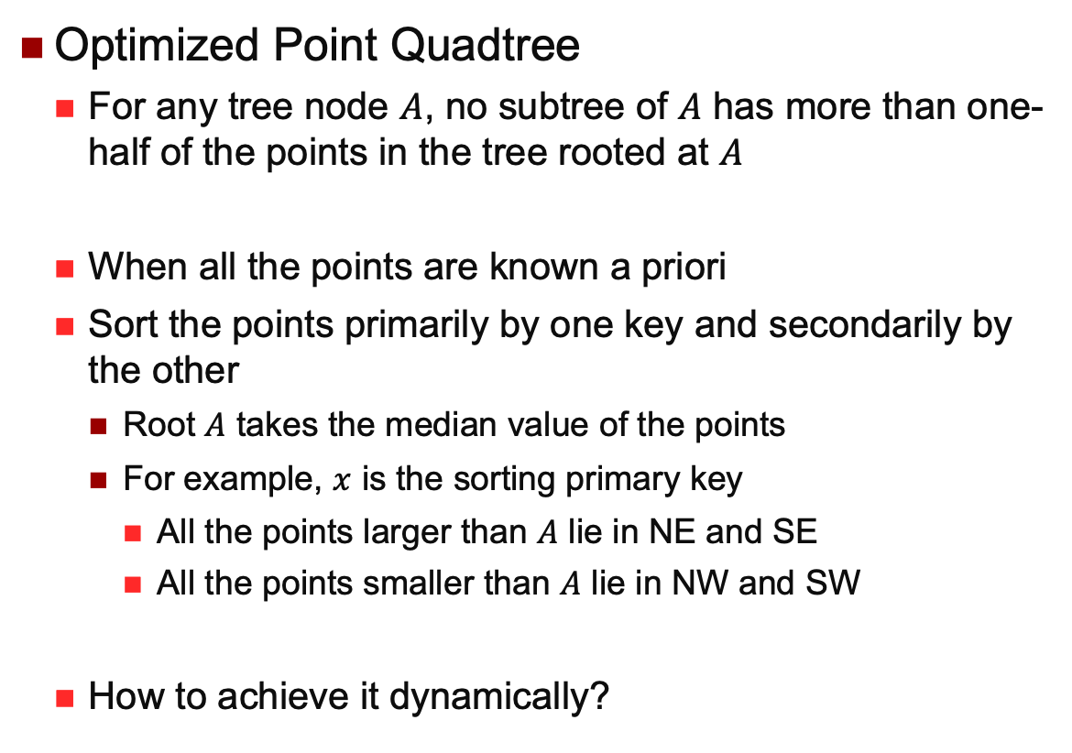
Point Quadtree Construction
Optimized Point Quadtree
For any tree node $A$, no subtree of $A$ has more than one-half of the points in the tree rooted at $A$
When all the points are known a priori
Sort the points primarily by one key and secondarily by the other
Root $A$ takes the median value of the points
For example, $x$ is the sorting primary key
All the points larger than $A$ lie in NE and SE
All the points smaller than $A$ lie in NW and SW
How to achieve it dynamically?

Slide 16
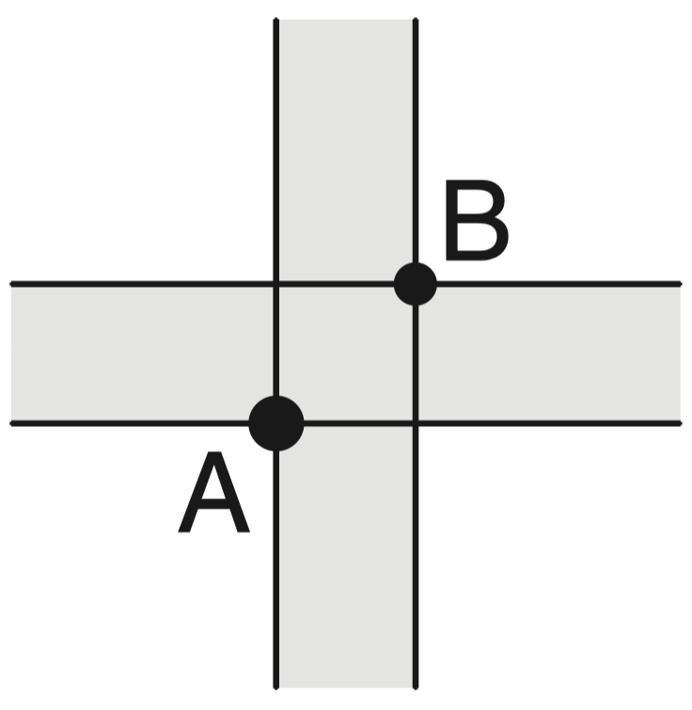
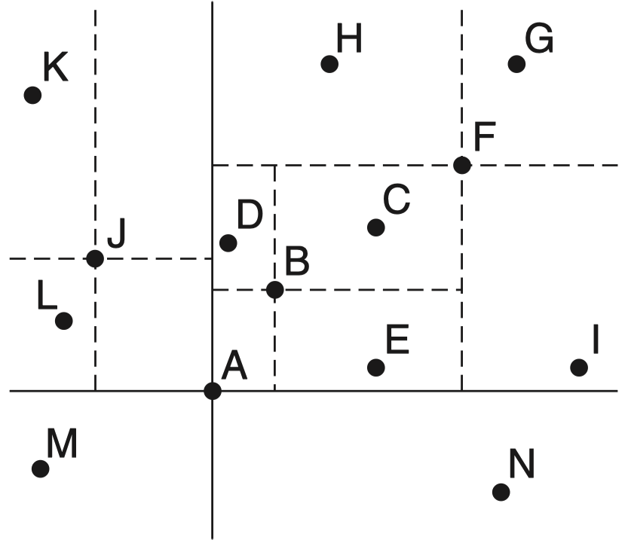
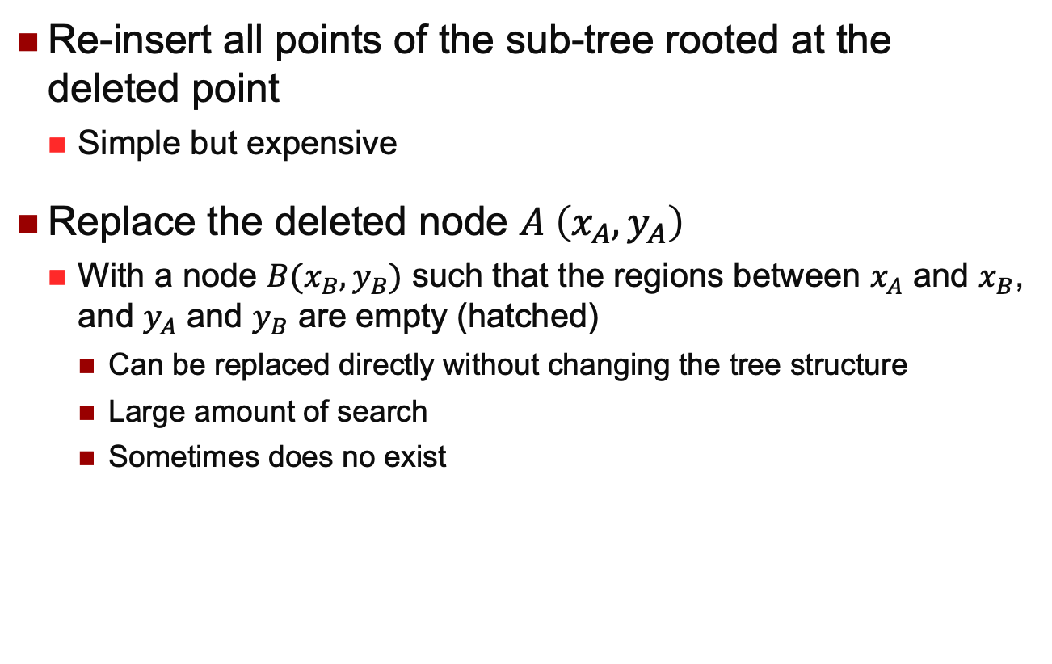
Point Quadtree Deletion
Re-insert all points of the sub-tree rooted at the deleted point
Simple but expensive
Replace the deleted node $A \left(x_{A},y_{A}\right)$
With a node $B(x_{B},y_{B})$ such that the regions between $x_{A}$ and $x_{B}$, and $y_{A}$ and $y_{B}$ are empty (hatched)
Can be replaced directly without changing the tree structure
Large amount of search
Sometimes does no exist

Slide 17
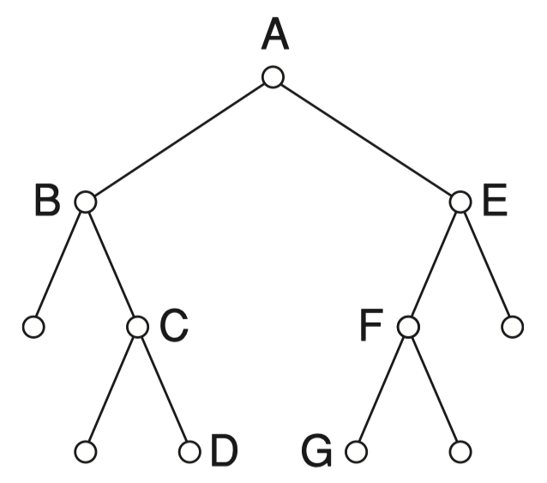
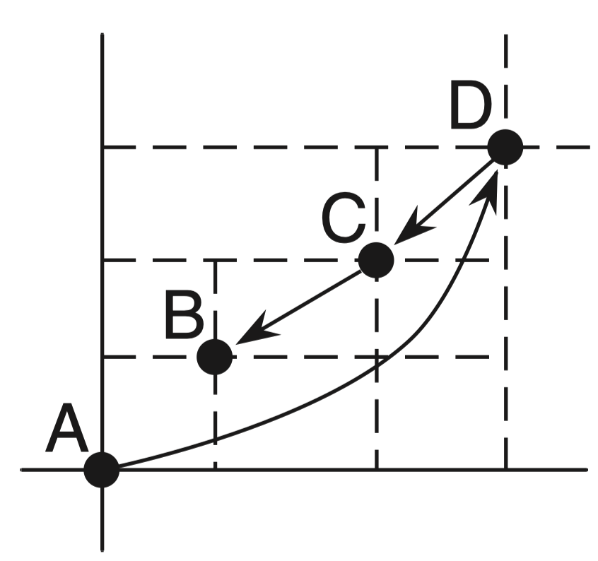
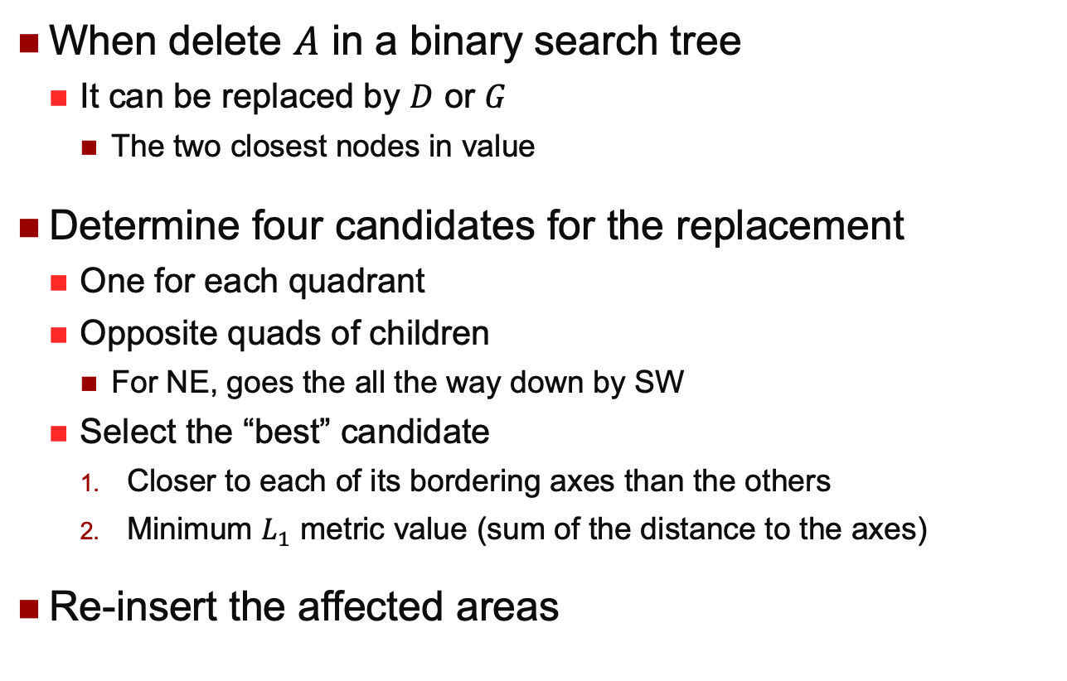
Point Quadtree Deletion
When delete $A$ in a binary search tree
It can be replaced by $D$ or $G$
The two closest nodes in value
Determine four candidates for the replacement
One for each quadrant
Opposite quads of children
For NE, goes the all the way down by SW
Select the “best” candidate
Closer to each of its bordering axes than the others
Minimum $L_{1}$ metric value (sum of the distance to the axes)
Re-insert the affected areas

Slide 18
Region Quadtree
PR Quadtree
p₈
p₇
p₃
NW
SE
NE
SW
p₆
p₂
P3
P5
P1
p₁
P8
P7
P6
P2
p₅
Based on regular decomposition of the universe
Recursively decomposing a region into four congruent blocks
Only leaves contain data

Slide 19
Region Quadtree
PR Quadtree Deletion
After deletion, if at most one siblings has a point
Merge the siblings
p₈
p₇
p₃
p₆
p₂
NW
SE
NE
SW
P3
P5
P1
p₁
p₅
P8
P7
P6
P2

Slide 20
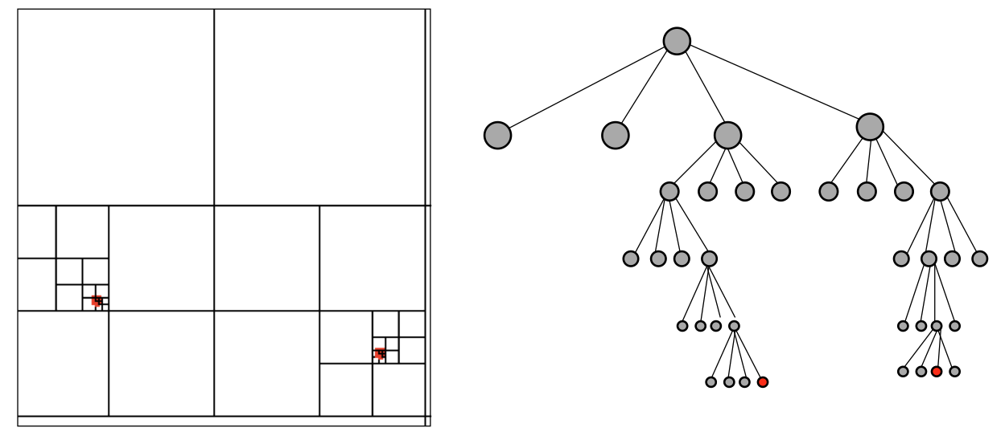
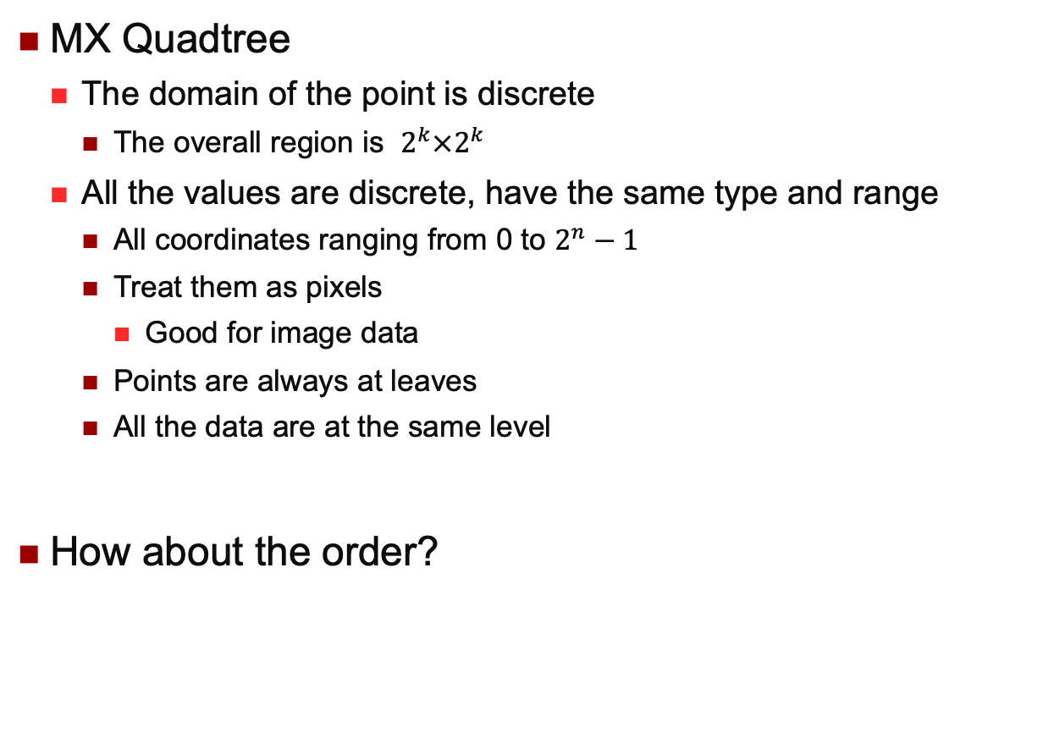
Region Quadtree
MX Quadtree
The domain of the point is discrete
The overall region is $2^{k}×2^{k}$
All the values are discrete, have the same type and range
All coordinates ranging from 0 to $2^{n}−1$
Treat them as pixels
Good for image data
Points are always at leaves
All the data are at the same level
How about the order?

Slide 21
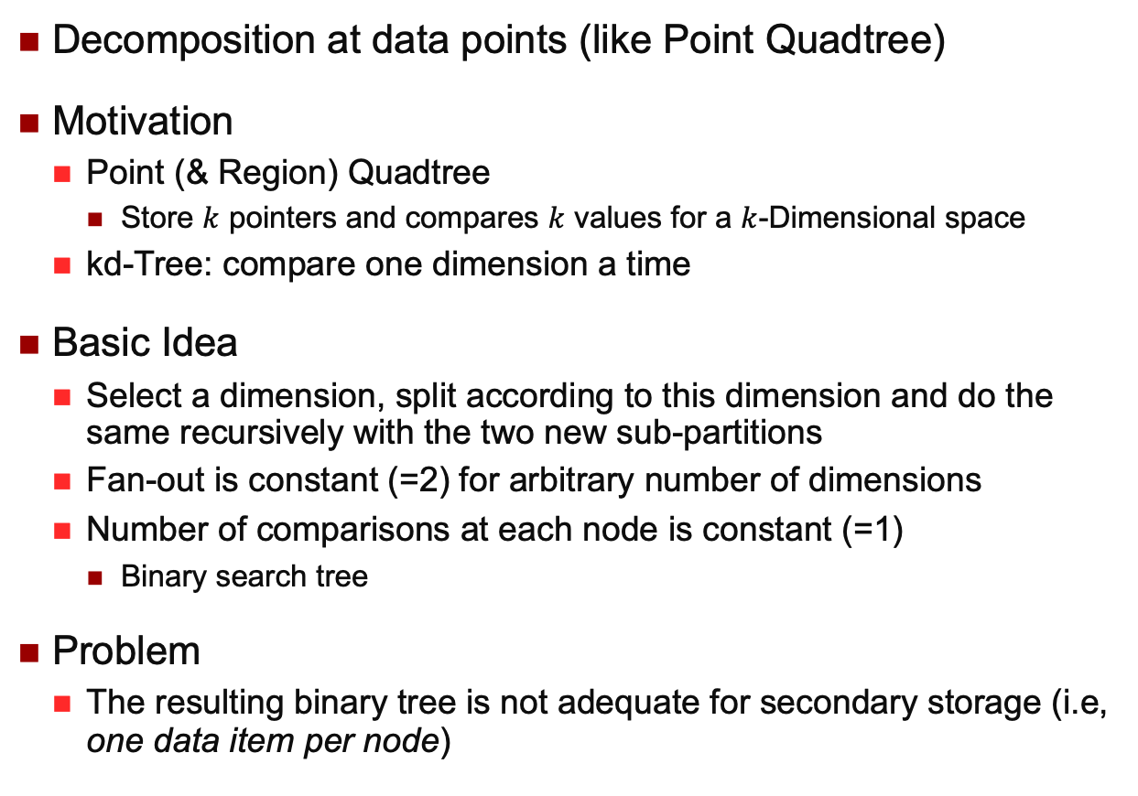

kd-Tree ($k$-dimensional Tree)
Decomposition at data points (like Point Quadtree)
Motivation
Point (& Region) Quadtree
Store $k$ pointers and compares $k$ values for a $k$-Dimensional space
kd-Tree: compare one dimension a time
Basic Idea
Select a dimension, split according to this dimension and do the same recursively with the two new sub-partitions
Fan-out is constant (=2) for arbitrary number of dimensions
Number of comparisons at each node is constant (=1)
Binary search tree
Problem
The resulting binary tree is not adequate for secondary storage (i.e, one data item per node)

Slide 22



kd-Tree Construction
p1
$$x$$
p₆
p₃
p3
p2
$$y$$
p₂
p₁
p7
p6
p4
$$x$$
p₇
p₄
p₅
p5
$$y$$
Depends on the order of insertion (not robust for sorted data).
Variations: non-alternative, data at leaves only, representing regions etc.

Slide 23
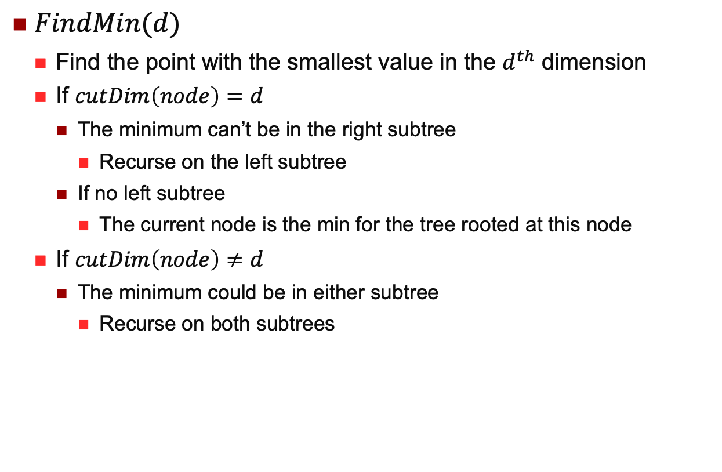
kd-Tree FindMin
$FindMin(d)$
Find the point with the smallest value in the $d^{th}$ dimension
If $cutDim\left(node\right)=d$
The minimum can’t be in the right subtree
Recurse on the left subtree
If no left subtree
The current node is the min for the tree rooted at this node
If $cutDim\left(node\right)≠d$
The minimum could be in either subtree
Recurse on both subtrees

Slide 24
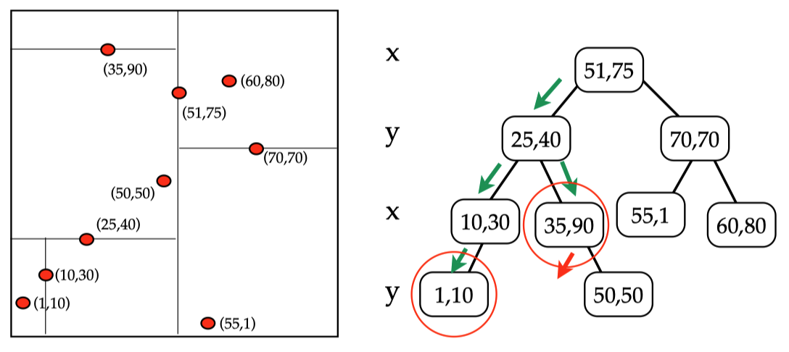
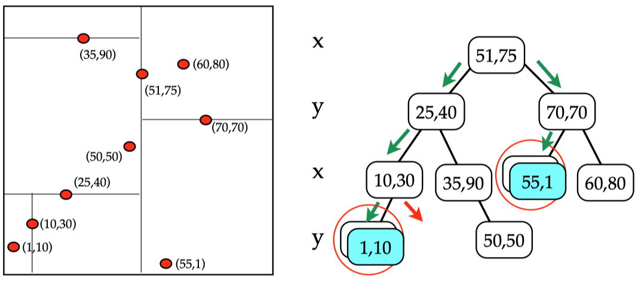

kd-Tree FindMin
$FindMin\left(x\right)$
$FindMin\left(y\right)$

Slide 25
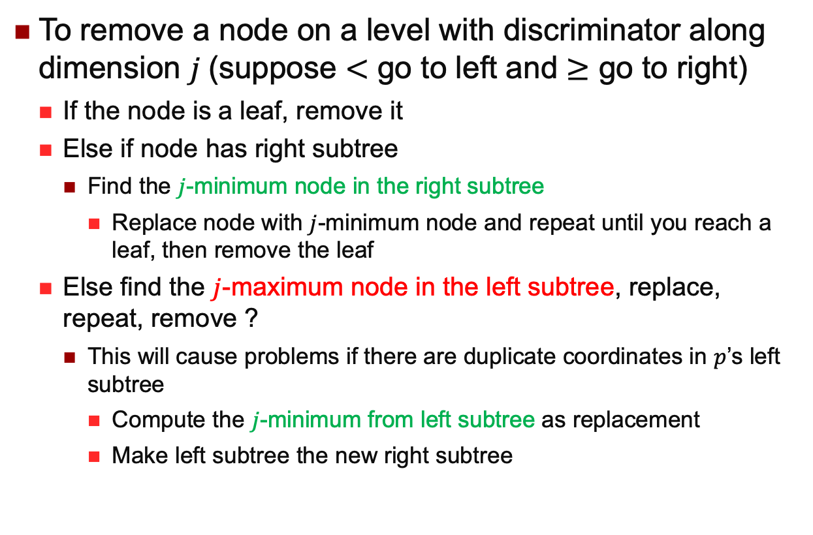
kd-Tree: Deletion
To remove a node on a level with discriminator along dimension $j$(suppose $<$ go to left and $≥$ go to right)
If the node is a leaf, remove it
Else if node has right subtree
Find the $j$-minimum node in the right subtree
Replace node with $j$-minimum node and repeat until you reach a leaf, then remove the leaf
Else find the $j$-maximum node in the left subtree, replace, repeat, remove ?
This will cause problems if there are duplicate coordinates in $p$’s left subtree
Compute the $j$-minimum from left subtree as replacement
Make left subtree the new right subtree
Example in Tutorial

Slide 26
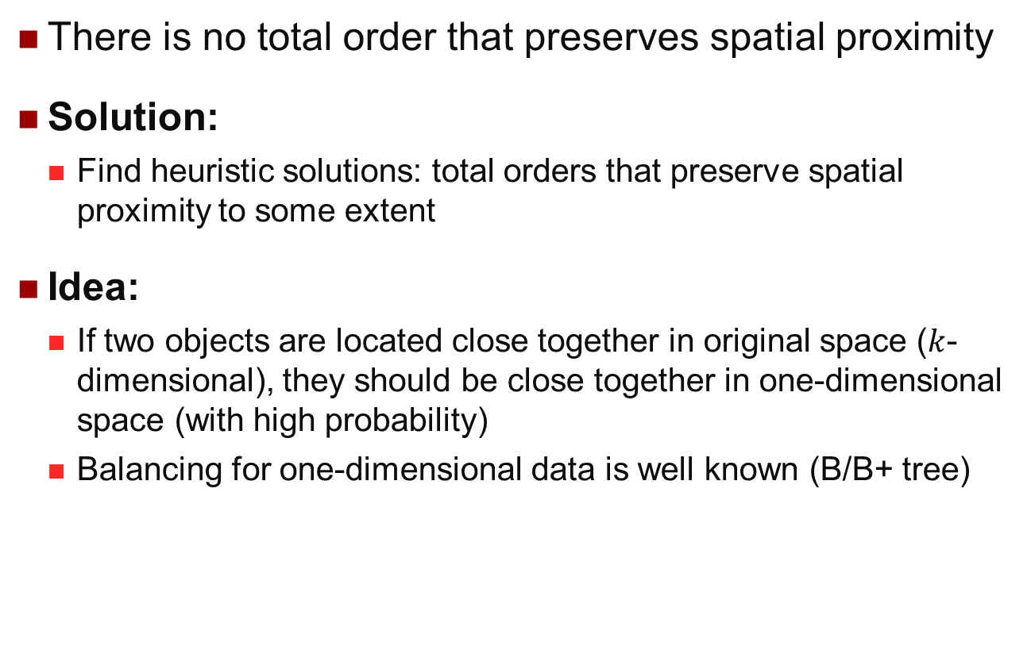
Multidimensional Data
There is no total order that preserves spatial proximity
Solution:
Find heuristic solutions: total orders that preserve spatial proximity to some extent
Idea:
If two objects are located close together in original space ($k$-dimensional), they should be close together in one-dimensional space (with high probability)
Balancing for one-dimensional data is well known (B/B+ tree)

Slide 27
Space-Filling Curves (I)

Slide 28
Space-Filling Curves (II)
Row-order
2
3
0
1

Slide 29
Space-Filling Curves (III)
Z-order (Peano Order)
1
3
0
2
- Easy and elegant way to encode cells.
- SIRO-DBMS (SDM) and Oracle use this order.
Giuseppe Peano (/piˈɑːnoʊ/) was an Italian mathematician (1858 – 1932).

Slide 30
Space-Filling Curves (IV)
Hillbert Order
1
2
0
3

Slide 31
Space-Filling Curves (V)
Gray order
1
2
0
3

Slide 32
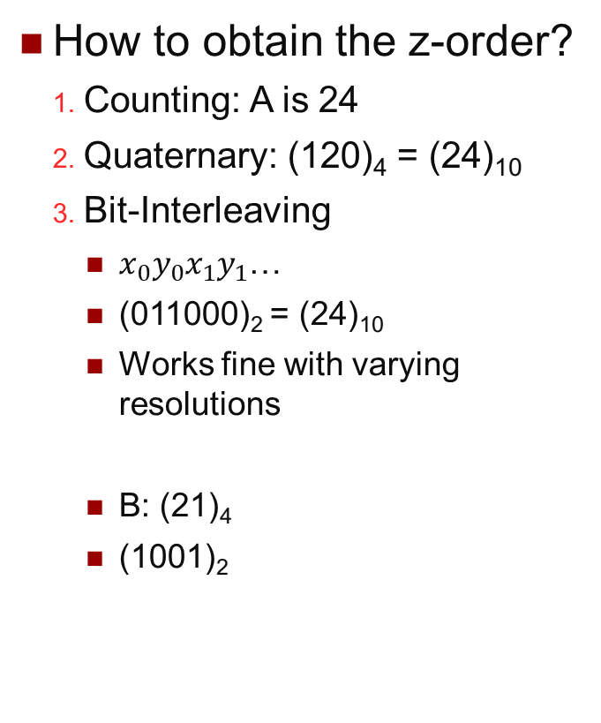
Z-Order
How to obtain the z-order?
Counting: A is 24
Quaternary: (120)₄ = (24)₁₀
Bit-Interleaving
$x_{0}y_{0}x_{1}y_{1}$…
(011000)₂ = (24)₁₀
Works fine with varying resolutions
B: (21)₄
(1001)₂
111
11
1
110
10
101
100
A
011
B
01
010
0
001
1
3
00
000
0
2
000
001
010
011
100
101
110
111
00
01
10
11
0
1
x

Slide 33
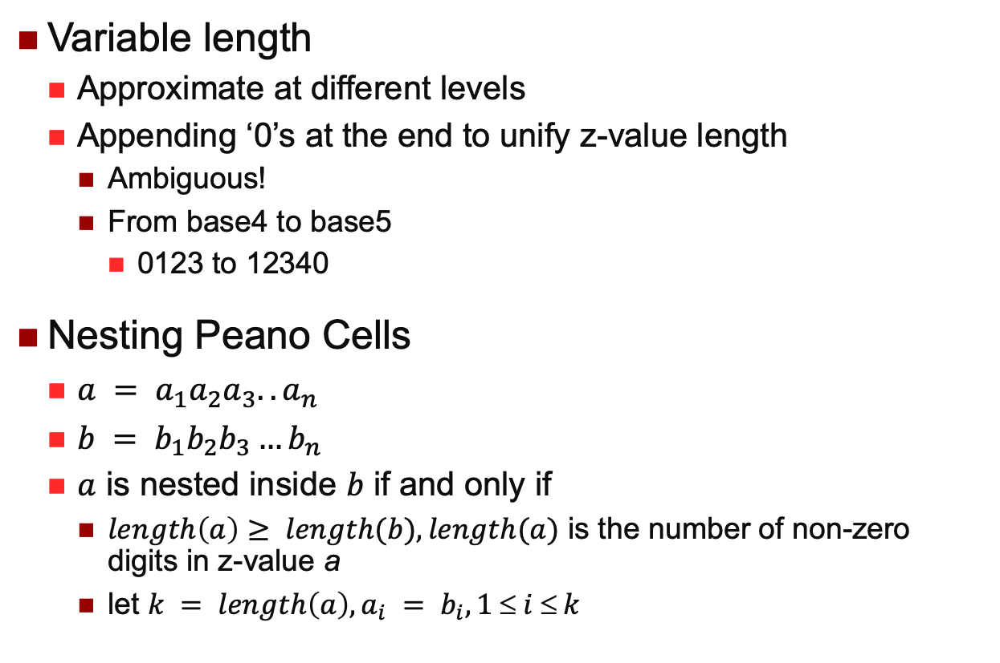
Some Properties of Z-Values
Variable length
Approximate at different levels
Appending ‘0’s at the end to unify z-value length
Ambiguous!
From base4 to base5
0123 to 12340
Nesting Peano Cells
$a = a_{1}a_{2}a_{3}..a_{n}$
$b = b_{1}b_{2}b_{3}…b_{n}$
$a$ is nested inside $b$ if and only if
$length\left(a\right)≥ length(b), length(a)$ is the number of non-zero digits in z-value a
let $k = length\left(a\right), a_{i} = b_{i}, 1 ≤ i ≤ k$

Slide 34
Z-Value Example
B Covers C (Base 4)
B: 21
C: 210
B covers C (Base 5)
B: 320
C: 321
111
11
1
110
10
101
100
A
011
B
01
C
010
0
001
1
3
00
000
0
2
000
001
010
011
100
101
110
111
00
01
10
11
0
1
x

Slide 35
Using Z-Values and B-Tree (I)
Motivation
Use standard B-tree to manage multidimensional data
Basic Idea
A Peano cell corresponds to a bucket
Peano cells are of varying sizes
Z-values are managed by B-tree
B1
B2
B3

Slide 36
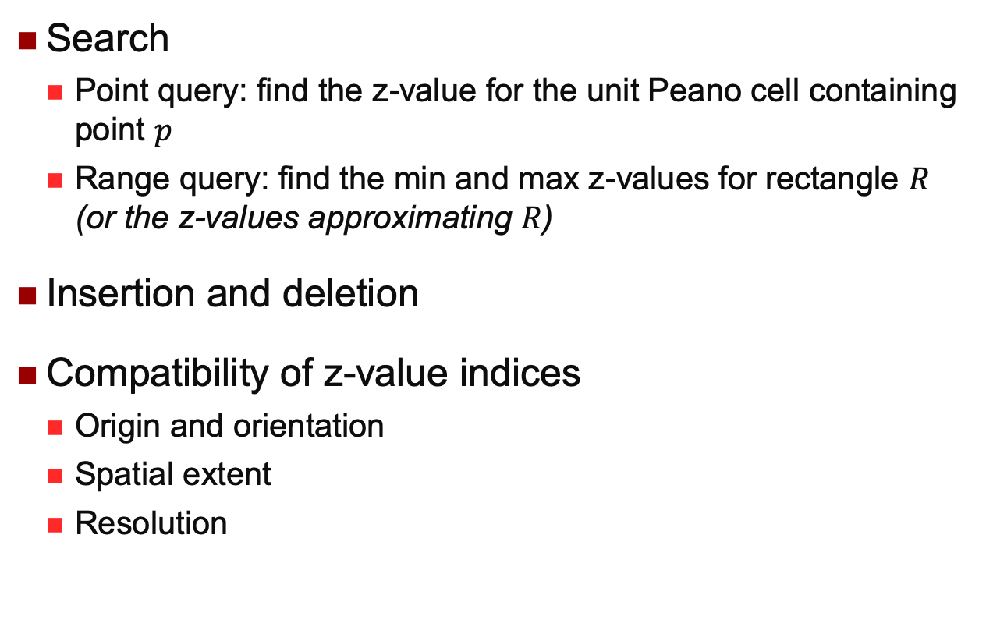
Using Z-Values and B-Tree (II)
Search
Point query: find the z-value for the unit Peano cell containing point $p$
Range query: find the min and max z-values for rectangle $R$ (or the z-values approximating $R$)
Insertion and deletion
Compatibility of z-value indices
Origin and orientation
Spatial extent
Resolution
R
p

Slide 37
Data Access Methods
One dimensional
Hashing and B-Trees
Line Data
Interval Tree, Segment Tree
Point data
Hashing: GRID and EXCELL
Hierarchical
Quadtree: point and region quadtrees
kd-Tree
Z-values and B-tree
Polygon data
Transformation: End point mapping and Z-values
Overlapping: R-tree and R*-tree
Clipping: R⁺-tree

Slide 38
Indexing Objects with Spatial Extent
Rectangles more difficult than points as they do not fall into a single cell of a bucket partition.
Three strategies
Transformation: End point mapping and Z-values
Overlapping: R-tree and R*-tree
Clipping: R⁺-tree

Slide 39
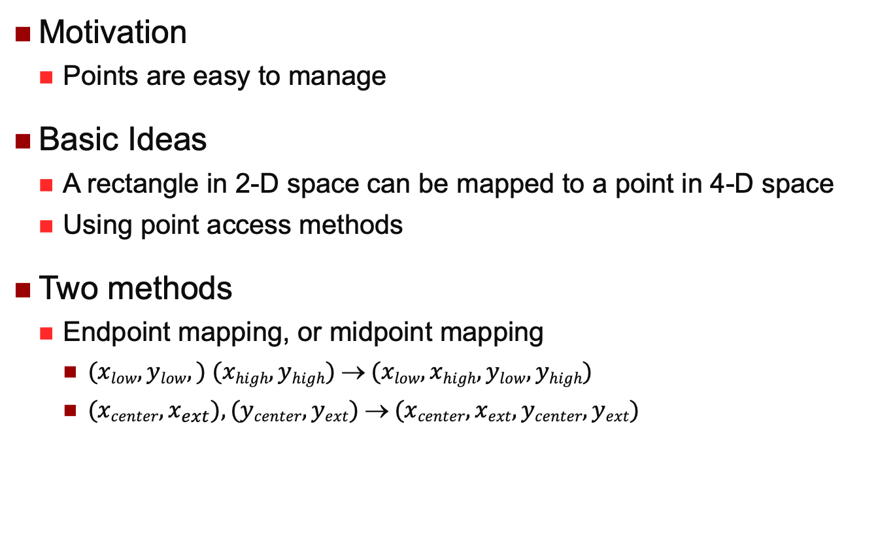
Transformation: High Dimensional Points
Motivation
Points are easy to manage
Basic Ideas
A rectangle in 2-D space can be mapped to a point in 4-D space
Using point access methods
Two methods
Endpoint mapping, or midpoint mapping
$(xlow, ylow,) (xhigh, yhigh)  (xlow, xhigh, ylow, yhigh)$
$(xcenter, x_{ext}),(ycenter, yext)  (xcenter, xext, ycenter, yext)$

Slide 40
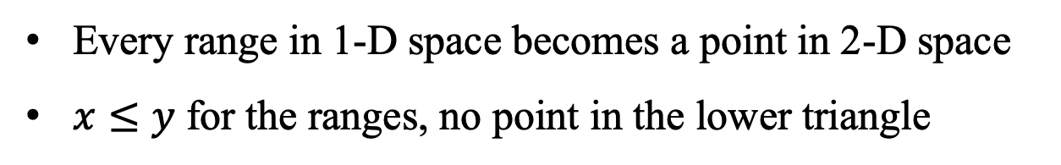



Endpoint Mapping
$$x = y$$
$$y = i_{2}$$
$$x=[i1 i2 ]$$
Every range in 1-D space becomes a point in 2-D space
$x≤y$ for the ranges, no point in the lower triangle

Slide 41
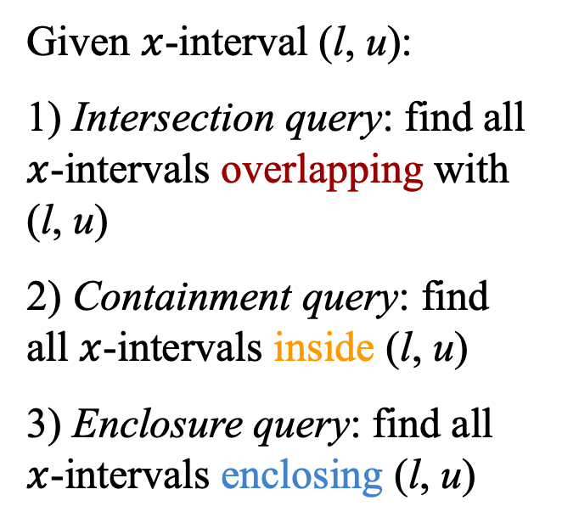

Query Processing Using Endpoint Mapping
y
Given $x$-interval (l, u):
1) Intersection query: find all $x$-intervals overlapping with (l, u)
2) Containment query: find all $x$-intervals inside (l, u)
3) Enclosure query: find all $x$-intervals enclosing (l, u)
$$x = y$$
u
l
x
y
l u
x
l
u
Very intuitive, but…

Slide 42
Problems with Endpoint Mapping
Points in the higher-D space are highly skewed
Not distributed evenly in the space
Only half, mapped into higher but smaller space
Almost no relationship between the distances of two objects in the original space and the higher-D space
A simple, intuitive query in the original space becomes complex and difficult to understand in the higher-D space
Query processing in the higher-D space less efficient
…conceptually very simple, but...

Slide 43
Transformation: Using Z-Ordering
Motivation
Still using point access methods, but without drawbacks of the previous approach
Basic Ideas
Instead of mapping a polygon into a point, decompose a polygon into a set of Peano cells and map each Peano cell into a number (i.e., z-value)
Reverse of end point mapping: Higher D to lower D

Slide 44
Transformation: Using Z-Ordering
Granularity
{11}, or {111, 112, 114}, or {111, 1121, 1123, 1124, 1141, 1142}
When decomposition stops
Current cell either fully
out or in the polygon
Reached the “resolution”
2
4
1
3
…the entire space is 1.

Slide 45
Redundancy in Z-Ordering
Finer granularity
Improves approximation accuracy
Can reduce the number of “false hits”
Too many index entries degrade
query performance because of
inflated index table
May identify the same object
multiple times in spatial
query processing
The 4-Key method (Compromise)
Any objects, use no more than 4 values
Intuitively, a small object in the very middle, what happens?

Slide 46
Overlapping Regions
Motivation
Single index entry for a polygon
Basic ideas
One object (or its key) in one bucket only
Cell boundary calculated according to polygons inside the cell
Allow overlapping cells: inevitable!
Problems
Multiple cells need to be examined to search an object
Where to insert?

Slide 47
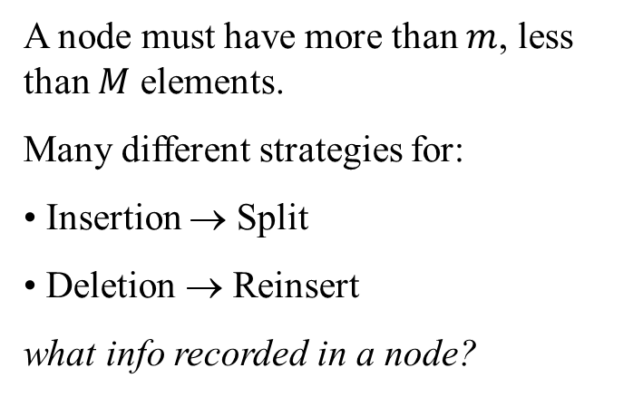
R-Tree and R*-Tree
P1
A
P8
A node must have more than $m$, less than $M$ elements.
Many different strategies for:
Insertion → Split
Deletion → Reinsert
what info recorded in a node?
P3
P9
P7
P2
P6
B
P5
C
P10
P4
A
B
C
P1
P2
P3
P4
P5
P6
P7
P8
P9
P10

Slide 48
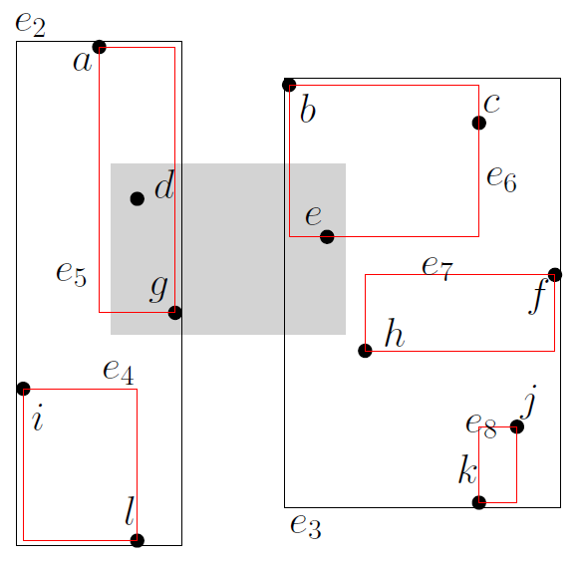
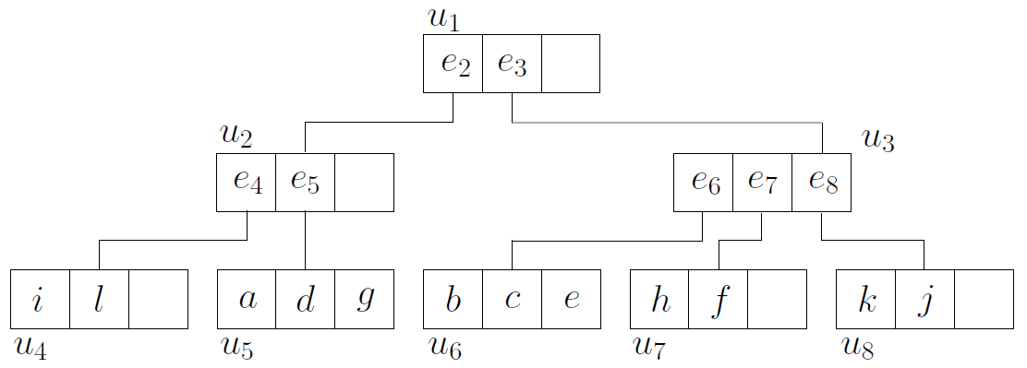

R-Tree Range Query
$u_{1},u_{2},u_{3},u_{5},u_{6}$ are accessed

Slide 49
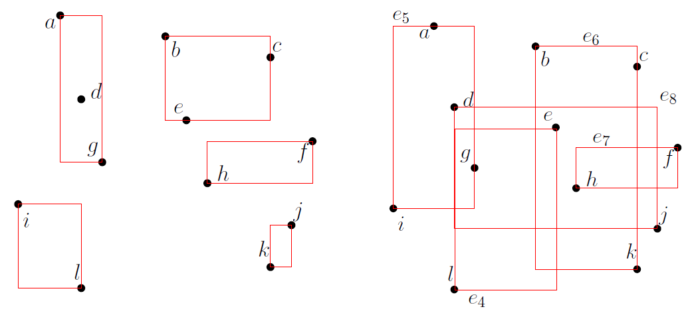
R-Tree Construction
R-Tree construction can be “arbitrary”
Bottom-up
No formal constraint on the grouping of data into nodes
The left tree has a smaller perimeter sum than the right one

Slide 50

R-Tree Construction
Why not minimize the area?
A rectangle with a smaller perimeter usually has a smaller area, but not the vice versa

Slide 51
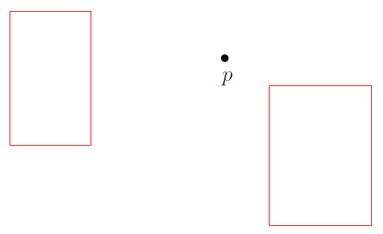
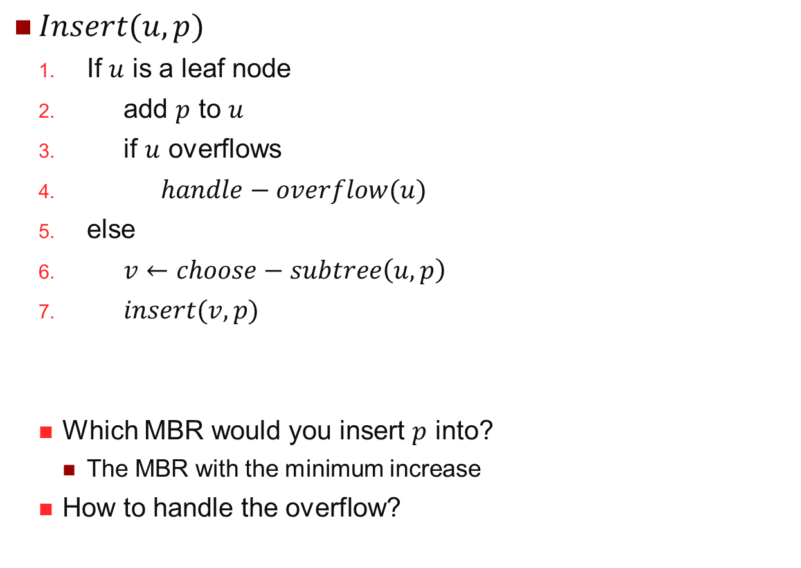
R-Tree Insertion
$Insert(u, p)$
If $u$ is a leaf node
add $p$ to $u$
if $u$ overflows
$handle−overflow(u)$
else
$v←choose−subtree\left(u,p\right)$
$insert(v,p)$
Which MBR would you insert $p$ into?
The MBR with the minimum increase
How to handle the overflow?

Slide 52
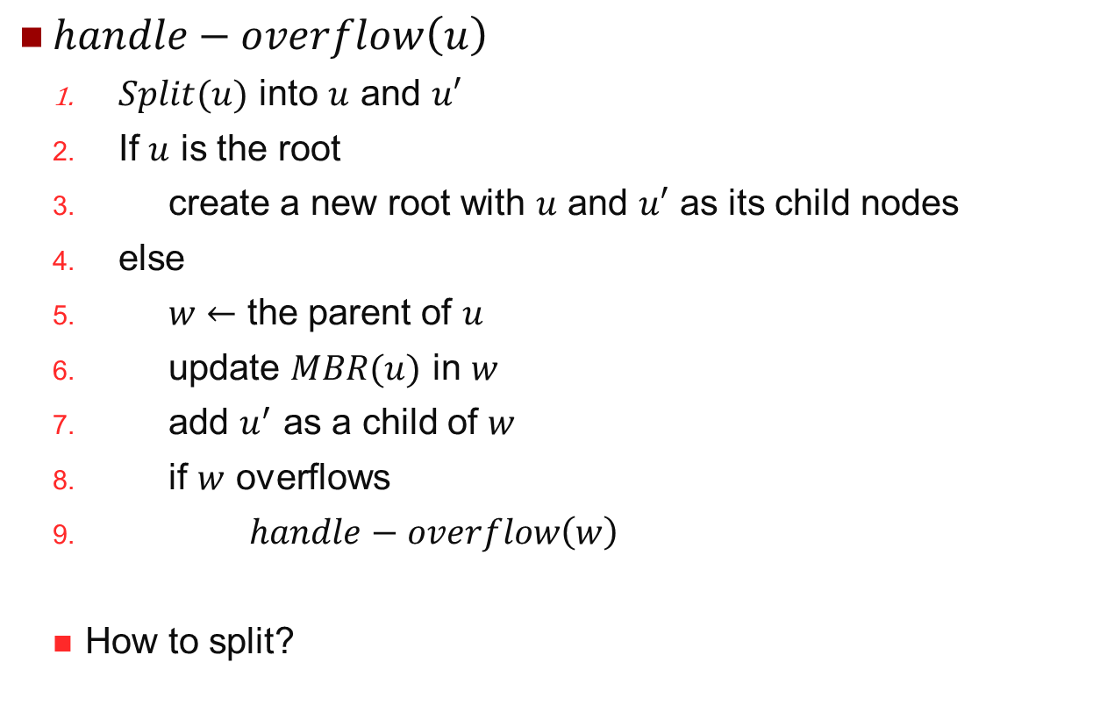
R-Tree Handle Overflow
$handle−overflow\left(u\right)$
$Split(u)$ into $u$ and $u′$
If $u$ is the root
create a new root with $u$ and $u′$ as its child nodes
else
$w←$ the parent of $u$
update $MBR(u)$ in $w$
add $u^{′}$ as a child of $w$
if $w$ overflows
$handle−overflow\left(w\right)$
How to split?

Slide 53
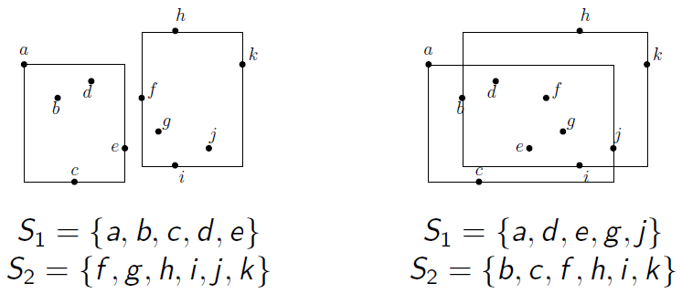

R-Tree Splitting a Leaf
Let $S$ be a set of $B+1$points
Divide $S$ into two disjoint sets $S_{1}$ and $S_{2}$ to minimize the perimeter sum of $MBR(S_{1})$ and $MBR\left(S_{2}\right)$
$\left|S_{1}\right|≥0.4B$, $\left|S_{2}\right|≥0.4B$

Slide 54
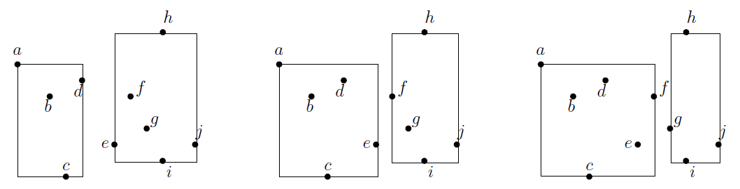
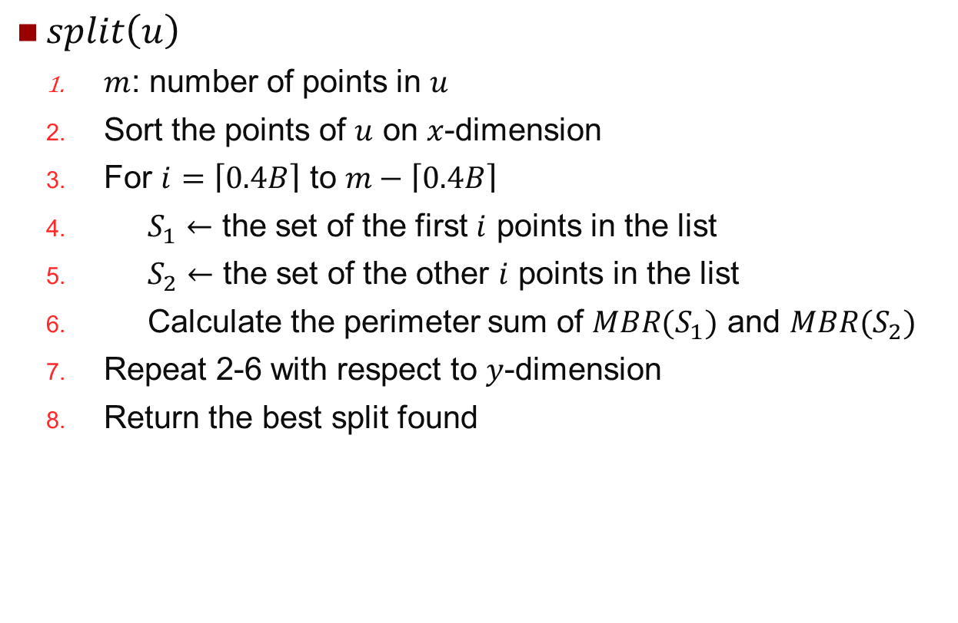
R-Tree Splitting a Leaf
$split\left(u\right)$
$m$: number of points in $u$
Sort the points of $u$ on $x$-dimension
For $i=\left\lceil 0.4B\right\rceil$ to $m−\left\lceil 0.4B\right\rceil$
$S_{1}←$ the set of the first $i$ points in the list
$S_{2}←$ the set of the other $i$ points in the list
Calculate the perimeter sum of $MBR(S_{1})$ and $MBR(S_{2})$
Repeat 2-6 with respect to $y$-dimension
Return the best split found

Slide 55
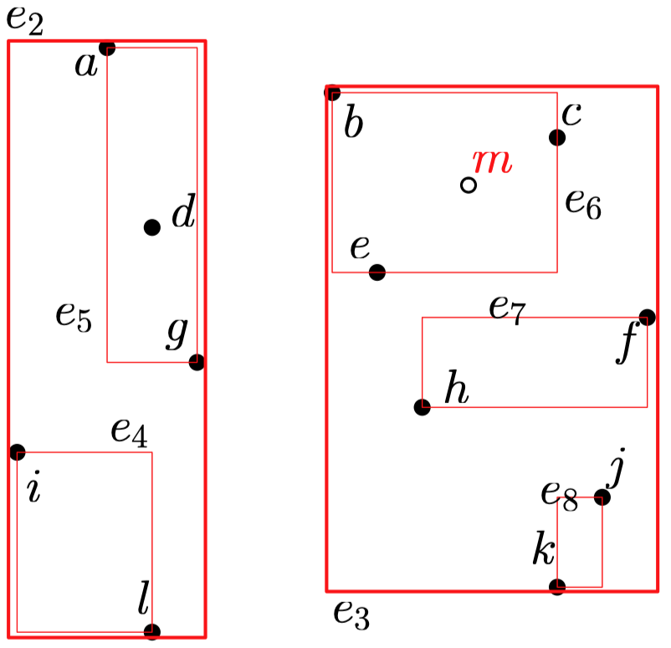
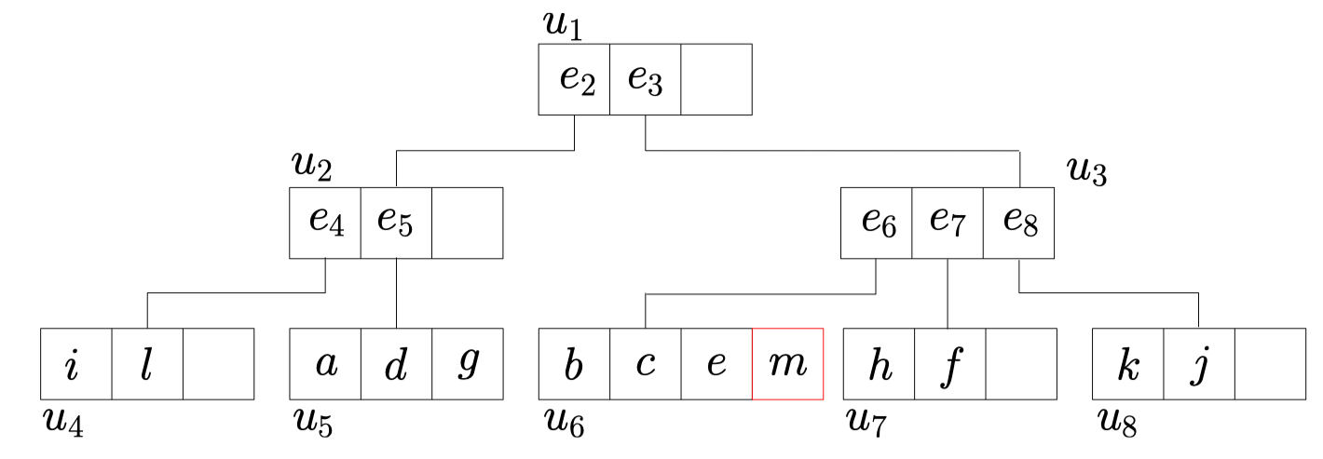

R-Tree Insertion Example
$\text{Let} S \text{be} \text{a} \text{set} \text{of} B+1 \text{rectangles}$
$\text{Divide} S \text{into} \text{two} \text{disjoint} \text{sets} S_{1} \text{and} S_{2} \text{to} \text{minimize} \text{the} \text{perimeter} \text{sum} \text{of} MBR(S_{1}) \text{and} MBR\left(S_{2}\right)$
$\left|S_{1}\right|≥0.4B\text{, }\left|S_{2}\right|≥0.4B$
Node $u_{6}$ splits, generating $u_{9}$

Slide 56
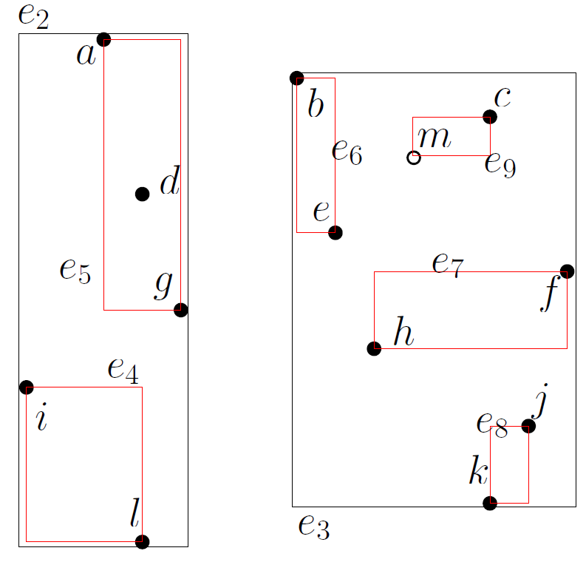
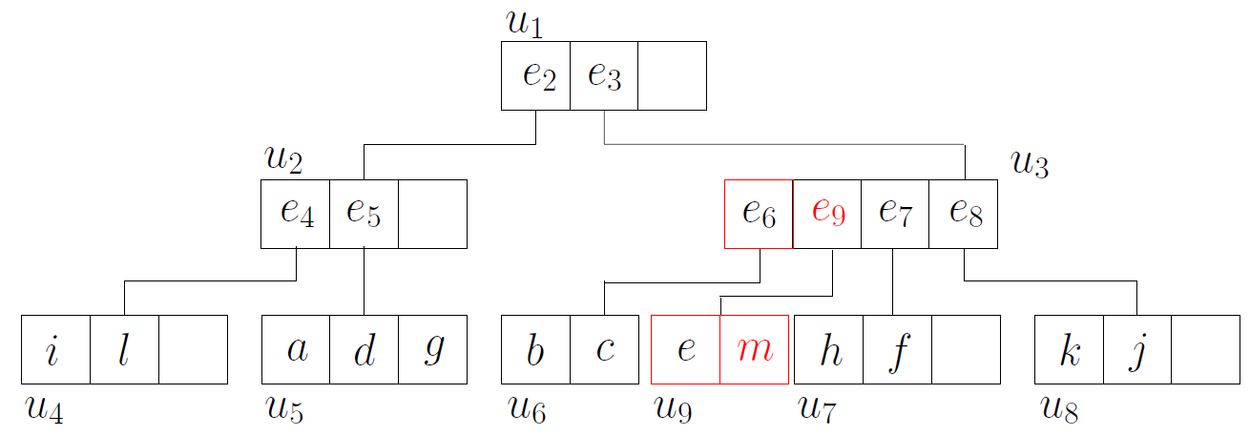

R-Tree Insertion Example
Adding $u_{9}$ as a child of $u_{3}$ causes $u_{3}$ to overflow

Slide 57
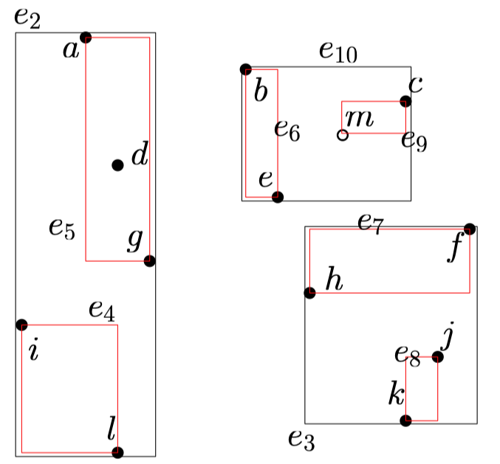
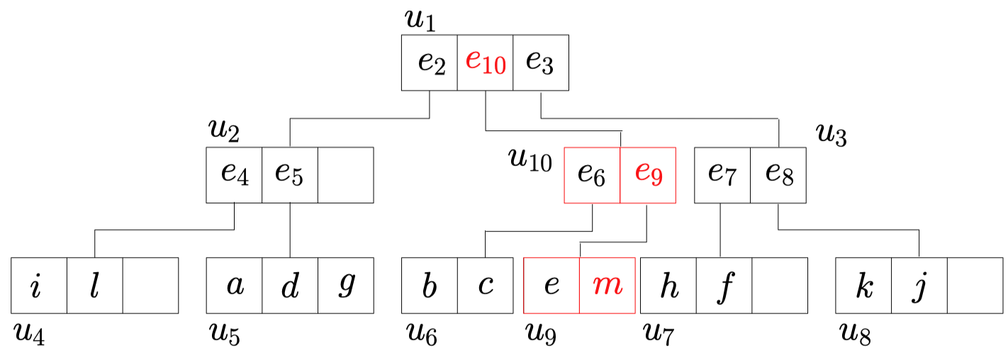

R-Tree Insertion Example
Node $u_{3}$ splits, generating $u_{10}$ as a child of the root

Slide 58
Query Processing Using R-Trees
A node records the MBR of all objects in the subtree rooted from the node
Point query
Window query
Spatial join query
Nearest Neighbor query
Skyline query
…

Slide 59
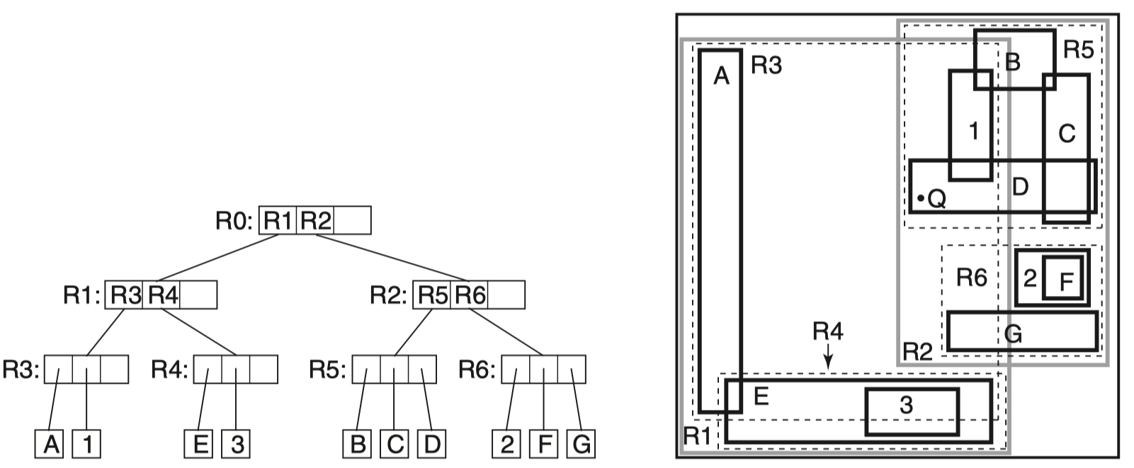

Clipping
Motivation
R-Tree: May examine all the MBRs at all levels
Because the MBR may overlap, the space is not disjointly decomposed
Query point$Q$ in the example
Single search path for a point query

Slide 60


R⁺-Tree
Basic ideas
A hierarchy of overlapping MBRs $→$ A hierarchy of disjoint MBRs
Regular grid / Irregular grid
Clipping polygon at cell boundaries
Whenever an MBR at a lower level overlaps with another MBR, decompose it into a collection of non-overlapping sub-MBRs
Allowing one polygon in multiple cells
Non-overlapping is achieved at the cost of space

Slide 61
R⁺-Tree
Insertion
Insert an object’s MBR into all of the leaf nodes that overlap it
Find all the intersected nodes and clipped the object’s MBR
Overflow
Propagate to the parents, like R-Tree
Propagate to the children
A split of the parent node may introduce a space partition that affects the children nodes
Deletion
Remove from all the leaves
Lead to Merge, but not always possible
Periodically re-organization

Slide 62

R⁺-Tree
Split
When A is split, its child B has to be split, and B’s child C has to be split…
Split the children might further require the split the parent
Split parent may require split the children (repartitioning creates overflow)
Up and down and up and down…
Deadlock!
Upper-bound is $M$ MBRs
A node contains M+1 MBRs that encloses recursively
C
B
A
Partition Line

Slide 63
R⁺-Tree
Problems
Multiple index entries for an object
Increased search time (return the same object more than once for window query)
Overflow more likely
Cascading splitting
Deadlock

Slide 64
Query Processing Using R⁺-Trees
Point query
Window query
Within buffer / distance
Spatial join query

Slide 65
Data Access Methods
One dimensional
Hashing and B-Trees
Line Data
Interval Tree, Segment Tree
Point data
Hashing: GRID and EXCELL
Hierarchical
Quadtree: point and region quadtrees
kd-Tree
Z-values and B-tree
Polygon data
Transformation: End point mapping and Z-values
Overlapping: R-tree and R*-tree
Clipping: R⁺-tree

Slide 66
Indexing High Dimensional Data
GIS applications in 2- or 3-D only
Multimedia DB can have data with several hundred dimensions.
While point/polygon access methods can be generalized for higher-D applications, they may be not efficient
High-D indexing is a hard problem

