Slide 1
Self-driving Databases
Team 23 Yuan Cao, Jiahao Chen, Zhiquan Lai, Mingyang Liu
Notes:
Our group have conducted a survey on the development of self-driving databases.

Slide 2
Outline
Background
Architecture
Workload prediction
Behaviour modelling
Physical design tuning
Optimisations
Notes:
Here is the outline of our today’s presentation.

Slide 3
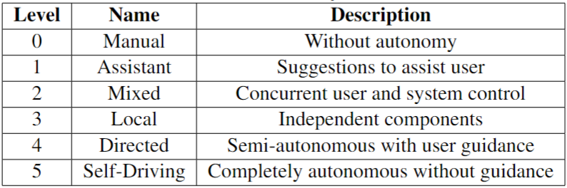
Background
Motivation: increasing complexity of modern DBMSs
Basics
Storage and computational hardware
Cloud technologies
Machine learning
Levels of autonomy in DBMSs [1]
Notes:
The motivation of developing self-driving databases is due to the increasing complexity of modern DBMSs. Database administrators have to spend huge amount of time on tuning the system for optimal performance. Meanwhile, The advancement of storage and computational hardware nowaday, the achievements in the area of machine learning, together with the widespread of cloud technologies, have paved the way for developing fully autonomous self-driving databases.
Similar to self-driving vehicles, DBMSs can be classified into 5 levels as the table shows.
Next, Zhiquan will first talk about some architectures of self-driving databases.

Slide 4
Architecture
Peloton [2]
Generalized Self-Driving Framework [3]
NoisePage [1]
Notes:
We have looked through three well-known architecture in self-driving database Peloton, Generalized Self-Driving Framework and NoisePage

Slide 5
Peloton
Goal
Main Components:
Workload Classification
Workload Forecasting
Action Planning & Execution Workload
Challenges
human distrust and explainability
hints from the DBA on whether the system should focus more on optimizing OLTP or OLAP
override mechanism for DBAs
Notes:
Peloton is one of the first architecture in this area. The goal is to automate traditionally labor-intensive and expertise-required task including tuning, physical design, and resource provisioning, leveraging techniques from machine learning and control theory
The Peloton architecture includes 3 main parts, Workload Classification, Workload Forecasting and Action Planning & Execution
Workload Classification involves classifying incoming queries into workload types by machine learning algorithm. Then the workload history is used to forecast future query behaviors. Finally, a proper action is executed based on the prior classification and forecasting.
みかんせい
But it has three challenges
[Challenges :1.human distrust and explainability, 2.hints from the DBA on whether the system should focus more on optimizing OLTP or OLAP 3. override mechanism for DBAs]

Slide 6
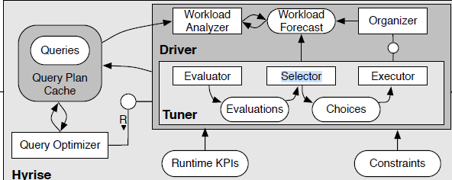
Generalized Self-Driving Framework
Notes:
Generalized Self-Driving Framework is proposed by Jan Kossmann. This framework is dedicated to create more efficient and adaptable self driving database systems
It starts with feeding query plans into the Query Plan Cache from the Query Optimizer. Subsequently, the Workload Analyzer generates workload forecasts utilizing data derived from the Query Plan Cache. The forecast results is then used by the Organiser and the Tuner. Organiser is for controlling and overseeing the tuning process. Tuner has three process, the Elevator evaluates all potential actions and the selector selects the most beneficial action according to the evaluation, then an executor will execute the selected action.

Slide 7
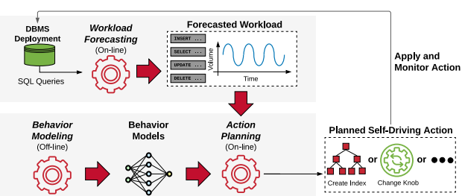
NoisePage
three main components:
workload forecasting,
behavior modeling
action planning
Notes:
The third architecture is Noisepage which has three main components, Workload Forecasting, Behavior Modeling and Action Planning
： NoisePage use online workload forecast to predict future workloads based on the past data. When NoisePage receives the workload from the clients, it stores query arrival rates and parameter samples, then periodically sends those data to train and reinforce the forecast models.
:
For behavior modeling, noise page uses modelbot2. Which will be introduced in the later section
: Action Planning is for deciding when to apply which actions to optimize the objective given the workload forecast and model estimation. NoisePage uses receding horizon control (RHC) together with Monte Carlo tree search (MCTS) to balance between planning cost and quality.
Noise page will account for the current and future workloads, satisfy all system constraints (e.g., maximum memory consumption), and provide explanations for the past and future planned actions.

Slide 8
Workload Prediction
General Approaches
QueryBot5000 [4]
DBMind [5]

Slide 9
General Approaches
Collecting Metrics
Time-Series Analysis
Machine Learning Models / Deep learning Models
Validate and Update Models

Slide 10
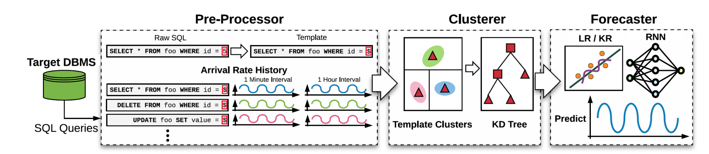
QueryBot5000
three main components:
Pre-Processor
Clusterer
Forecaster

Slide 11
Pre-Processor
Replace all constant entries with identifiers
Normalisation of queries formats
Advantage
simple to implement and is mainly string processing
Disadvantage
matches will miss

Slide 12
Clusterer
Further reduce the total number of templates
Clustering Features
On-line Clustering
Cluster Pruning

Slide 13
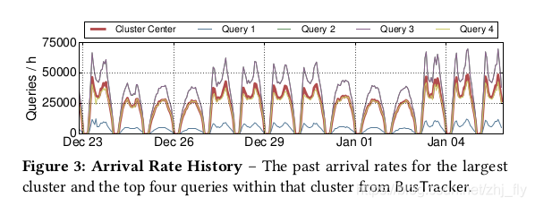
Clustering Features
Physical
Logical
Arrival rate history

Slide 14
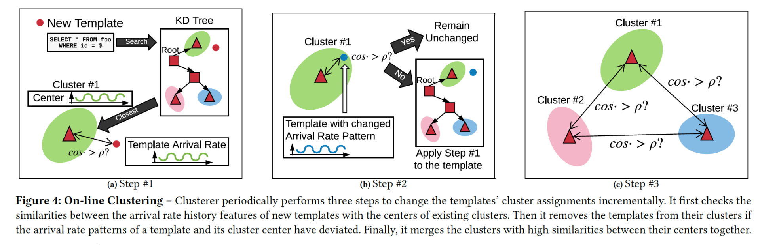
On-line Clustering (Algorithm)
Calculates new template similarity score with the existing cluster
Re-compare templates that are already part of the cluster with centre.
Merge

Slide 15
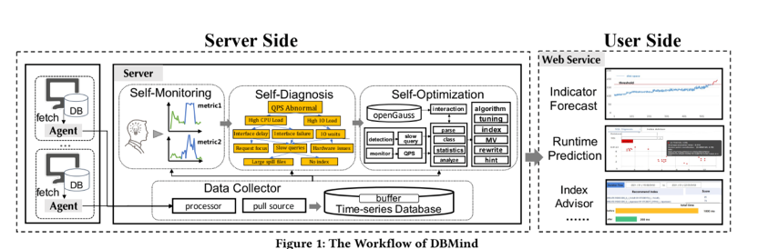
DBMind
Automatic index selection

Slide 16
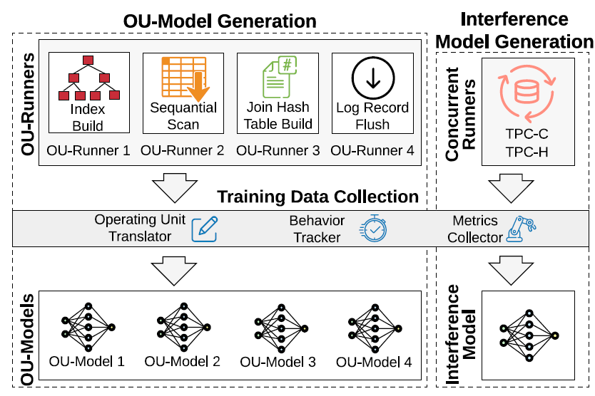
Behaviour Modelling
ModelBot2 (MB2) [6]
Generates models offline
Debuggable, explainable, and adaptable
OU-Units
Reduce input dimensions
Interference model
Notes:
For behaviour modelling, we will introduce the ModelBot2, which is applied in the NoisePage architecture.
Its design has two primary considerations: (1) MB2 generates models offline in a workload and dataset-independent manner to make the process less time-consuming and costly, (2) MB2's models are debuggable, explainable, and adaptable, reducing development complexity and providing insight into DBMS action choices. MB2 decomposes the DBMS into independent operating units (OUs), each corresponding to a specific DBMS task. It pairs each OU with an OU-runner, which exercises the DBMS component related to the OU. These runners help to generate training data by exploring the parameter space of the component.
To simulate concurrent environments and orchestrate data collection, MB2 uses concurrent runners executing end-to-end workloads. It uses training data to build interference models to estimate impacts of resource competition, cache locality, and internal contention among concurrent OUs.
Given forecasted workload and potential action inputs, MB2 uses the models to predict the behavior of each OU, adjust for the impact of concurrent OUs, and provide actionable information to guide the DBMS's planning system. These OU-models, compared to a single monolithic model for the entire DBMS, have smaller input dimensions, require less training time, and provide performance insight to each DBMS component.

Slide 17
Physical Design Tuning
DBA Bandits [7]
Multi-armed bandit (MAB)
Regret bounds
Hierarchical Multi-armed Bandit (HMAB) [8]
Layer 1: candidate physical design structure (PDS) selection
Layer 2: selects the final configuration
Notes:
Next, let’s look at some methods for tuning physical design.
The first two are online strategies.
DBA bandits is a form of online index selection method. It uses multi-arm bandit, which is a form of Markov decision process. Unlike traditional methods that rely on possibly inaccurate cost models, MABs learn from actual performance observations. They balance between exploring untried actions and exploiting actions that maximize the observed rewards. Compared to other learning techniques for physical design, MABs offer regret bounds, ensuring the suitability of dynamically proposed indices.
HMAB is the first online learned approach to tune multiple PDS in an integrated search space. It is a hierarchical structure for MABs for physical design tuning, which comprises two layers. The first layer is responsible for candidate physical design structure (PDS) selection, and the second one selects the final configuration considering all the candidate structures together. The proposed solution combines the advantages of integrated and iterative search approaches for PDS tuning, and extends the existing contextual and combinatorial bandit to handle large action spaces and make use of parallel processing capabilities. It uses a hybrid approach, learning from actual query execution while minimally utilising optimiser knowledge to reduce exploration space, leading to better recommendations and reduced PDS creation time.

Slide 18
Physical Design Tuning
Storage structure selection [9]
Pruning
Generating candidates
Evaluation
Explain-Tun [10]
Decision-Tree & Random-Forest
Notes:
There are also many other approaches.
For example, Wang et al. proposed a machine-learning algorithm in selecting storage structure of database system, consisting of three stages: Pruning, generating candidates and evaluation. The pruning process will collect performance data based on generated workload and then the model will generate candidates by traversing search space and enumerating solutions based on current workload, followed by evaluating and applying the optimal storage plan through comparisons by costs.
Also, Explain-Tun is a new and comprehensible AI-model selecting physical structure (PS) of the database system. This model is based on Decision-Tree (DT) and Random-Forest (RF). Providing explanations of tuning decisions can help human experts to optimize and refine the machine learning models

Slide 19
Optimisation method
Replicated training [11]
Column compression [12]
Tscout [13]

Slide 20
Replicated training
Machine-learning model utilisation
Distributed master-replica architecture
Master node
Replica
Importance:
Balances the resource-intensive task
Imposes performance overhead
Enable autonomous capabilities

Slide 21
Column-based compression（GD）
Shared type values within columns
Generalized deduplication (GD):
Phase:
Transform function: input → base + deviation
Deduplicate base + determine base index
Advantage:
Enhance query performance
Higher compression ratio (than row-based)
Reduce I/O and disk space usage
Optimization:
Automatic deviation size selection
Different compression strategies

Slide 22
Tscout
Offline vs online training data
Kernel-space vs user-space data collection
Internal vs External
Tscout:
Setup phase
Runtime phase

Slide 23
Thank you

Slide 24
References
[1] Pavlo, A., Butrovich, M., Ma, L., Menon, P., Lim, W.S., Van Aken, D. and Zhang, W., 2021. Make your database system dream of electric sheep: towards self-driving operation. Proceedings of the VLDB Endowment, 14(12), pp.3211-3221.
[2] Pavlo, A., Angulo, G., Arulraj, J., Lin, H., Lin, J., Ma, L., Menon, P., Mowry, T.C., Perron, M., Quah, I. and Santurkar, S., 2017, January. Self-Driving Database Management Systems. In CIDR (Vol. 4, p. 1).
[3] Kossmann, J., 2018. Self-Driving: From General Purpose to Specialized DBMSs. In PhD@ VLDB.
[4] Ma, L., Van Aken, D., Hefny, A., Mezerhane, G., Pavlo, A. and Gordon, G.J., 2018, May. Query-based workload forecasting for self-driving database management systems. In Proceedings of the 2018 International Conference on Management of Data (pp. 631-645).
[5] Zhou, X., Jin, L., Sun, J., Zhao, X., Yu, X., Feng, J., Li, S., Wang, T., Li, K. and Liu, L., 2021. Dbmind: A self-driving platform in opengauss. Proceedings of the VLDB Endowment, 14(12), pp.2743-2746.
[6] Ma, L., Zhang, W., Jiao, J., Wang, W., Butrovich, M., Lim, W.S., Menon, P. and Pavlo, A., 2021, June. MB2: decomposed behavior modeling for self-driving database management systems. In Proceedings of the 2021 International Conference on Management of Data (pp. 1248-1261).

Slide 25
[7] Perera, R.M., Oetomo, B., Rubinstein, B.I. and Borovica-Gajic, R., 2021, April. DBA bandits: Self-driving index tuning under ad-hoc, analytical workloads with safety guarantees. In 2021 IEEE 37th International Conference on Data Engineering (ICDE) (pp. 600-611). IEEE.
[8] Perera, R.M., Oetomo, B., Rubinstein, B.I. and Borovica-Gajic, R., 2022. HMAB: self-driving hierarchy of bandits for integrated physical database design tuning. Proceedings of the VLDB Endowment, 16(2), pp.216-229.
[9] Wang, H., Wei, Y. and Yan, H., 2023. Automatic single table storage structure selection for hybrid workload. Knowledge and Information Systems, pp.1-27.
[10] Ouared, A., Amrani, M. and Schobbens, P.Y., 2023. Explainable AI for DBA: Bridging the DBA's experience and machine learning in tuning database systems. Concurrency and Computation: Practice and Experience, p.e7698.
[11] Mezerhane, G.E.A., 2019. Replicated Training in Self-Driving Database Management Systems (Doctoral dissertation, Carnegie Mellon University Pittsburgh, PA).
[13] Fehér, M., Lucani, D.E. and Chatzigeorgiou, I., 2022. An Adaptive Column Compression Family for Self-Driving Databases. arXiv preprint arXiv:2209.02334.
[14] Butrovich, M., Lim, W.S., Ma, L., Rollinson, J., Zhang, W., Xia, Y. and Pavlo, A., 2022, June. Tastes Great! Less Filling! High Performance and Accurate Training Data Collection for Self-Driving Database Management Systems. In Proceedings of the 2022 International Conference on Management of Data (pp. 617-630).

