Slide 1
Self-driving Databases
Team 23 Yuan Cao, Jiahao Chen, Zhiquan Lai, Mingyang Liu

Slide 2
Outline
Background
Architecture
Workload prediction
Behaviour modelling
Physical design tuning
Optimisations

Slide 3
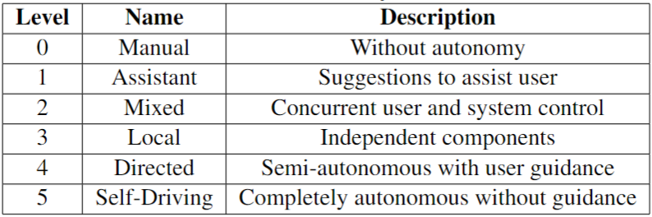
Background
Motivation: increasing complexity of modern DBMSs
Basics
Storage and computational hardware
Cloud technologies
Machine learning
Levels of autonomy in DBMSs [1]

Slide 4
Architecture
Peloton [2]
Generalized Self-Driving Framework [3]
NoisePage [1]

Slide 5
Peloton
Goal
Main Components:
Workload Classification
Workload Forecasting
Action Planning & Execution Workload
Challenges
human distrust and explainability
hints from the DBA on whether the system should focus more on optimizing OLTP or OLAP
override mechanism for DBAs

Slide 6
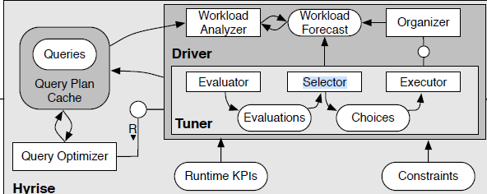
Generalized Self-Driving Framework

Slide 7
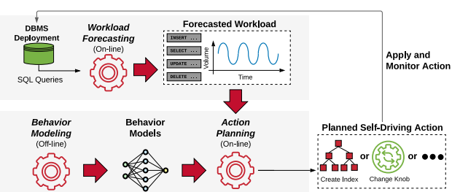
NoisePage
three main components:
workload forecasting,
behavior modeling
action planning

Slide 8
Workload Prediction
General Approaches
QueryBot5000 [4]
DBMind [5]

Slide 9
General Approaches
Collecting Metrics
Time-Series Analysis
Machine Learning Models / Deep learning Models
Validate and Update Models

Slide 10
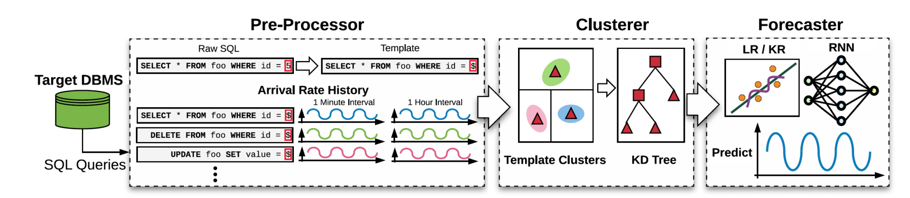
QueryBot5000
three main components:
Pre-Processor
Clusterer
Forecaster

Slide 11
Pre-Processor
Replace all constant entries with identifiers
Normalisation of queries formats
Advantage
simple to implement and is mainly string processing
Disadvantage
matches will miss

Slide 12
Clusterer
Further reduce the total number of templates
Clustering Features
On-line Clustering
Cluster Pruning

Slide 13
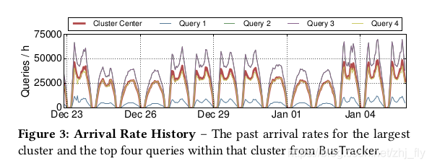
Clustering Features
Physical
Logical
Arrival rate history

Slide 14
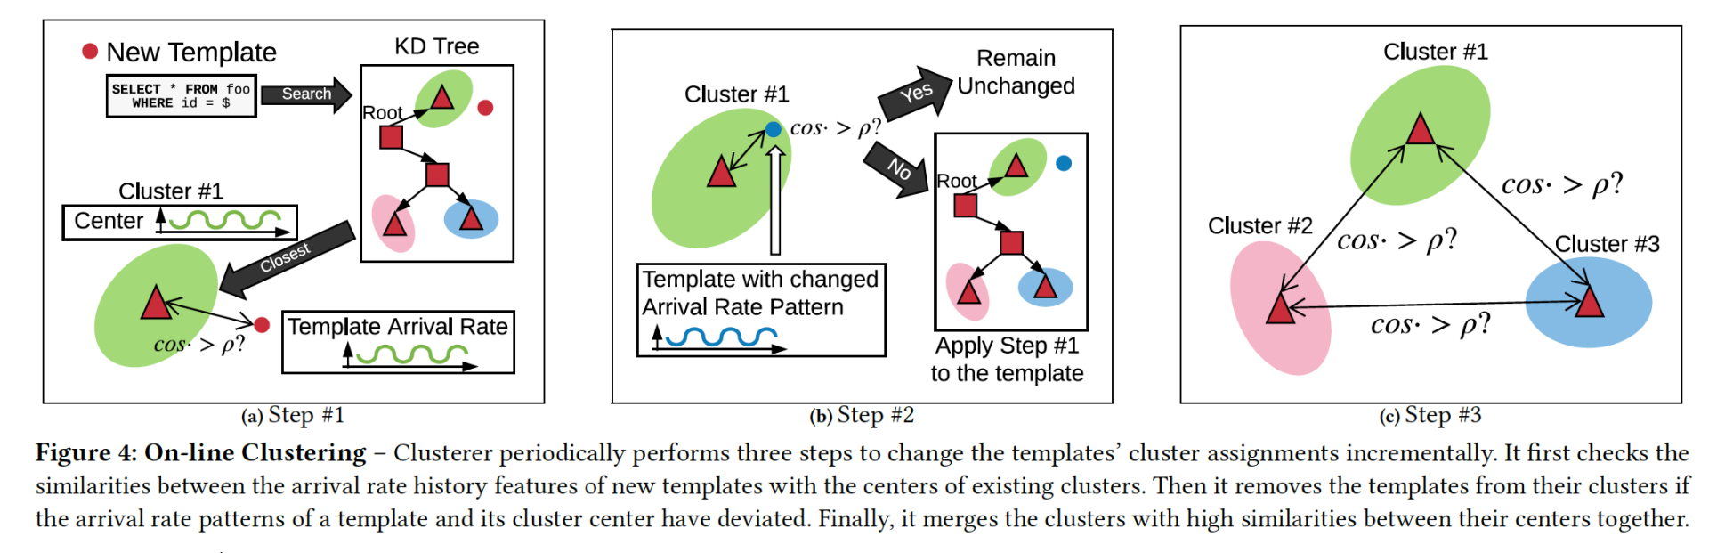
On-line Clustering (Algorithm)
Calculates new template similarity score with the existing cluster
Re-compare templates that are already part of the cluster with centre.
Merge

Slide 15
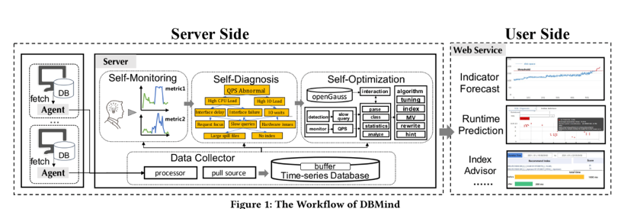
DBMind
Automatic index selection

Slide 16
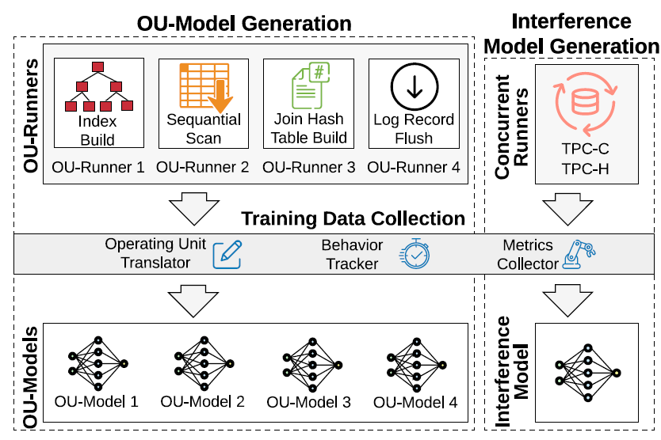
Behaviour Modelling
ModelBot2 (MB2) [6]
Generates models offline
Debuggable, explainable, and adaptable
OU-Units
Reduce input dimensions
Interference model

Slide 17
Physical Design Tuning
DBA Bandits [7]
Multi-armed bandit (MAB)
Regret bounds
Hierarchical Multi-armed Bandit (HMAB) [8]
Layer 1: candidate physical design structure (PDS) selection
Layer 2: selects the final configuration
Notes:
Next, let’s look at some methods for tuning physical design.
The first two are online strategies.
DBA bandits is a form of online index selection method. It uses multi-arm bandit, which is a form of Markov decision process. Unlike traditional methods that rely on possibly inaccurate cost models, MABs learn from actual performance observations. They balance between exploring untried actions and exploiting actions that maximize the observed rewards. Compared to other learning techniques for physical design, MABs offer regret bounds, ensuring the suitability of dynamically proposed indices.
HMAB is the first online learned approach to tune multiple PDS in an integrated search space. It is a hierarchical structure for MABs for physical design tuning, which comprises two layers. The first layer is responsible for candidate physical design structure (PDS) selection, and the second one selects the final configuration considering all the candidate structures together. The proposed solution combines the advantages of integrated and iterative search approaches for PDS tuning, and extends the existing contextual and combinatorial bandit to handle large action spaces and make use of parallel processing capabilities. It uses a hybrid approach, learning from actual query execution while minimally utilising optimiser knowledge to reduce exploration space, leading to better recommendations and reduced PDS creation time.

Slide 18
Physical Design Tuning
Storage structure selection [9]
Pruning
Generating candidates
Evaluation
Explain-Tun [10]
Decision-Tree & Random-Forest

Slide 19
Optimisation method
Replicated training [11]
Column compression [12]
Tscout [13]

Slide 20
Replicated training
Machine-learning model utilisation
Distributed master-replica architecture
Master node
Replica
Importance:
Balances the resource-intensive task
Imposes performance overhead
Enable autonomous capabilities

Slide 21
Column-based compression（GD）
Shared type values within columns
Generalized deduplication (GD):
Phase:
Transform function: input → base + deviation
Deduplicate base + determine base index
Advantage:
Enhance query performance
Higher compression ratio (than row-based)
Reduce I/O and disk space usage
Optimization:
Automatic deviation size selection
Different compression strategies

Slide 22
Tscout
Offline vs online training data
Kernel-space vs user-space data collection
Internal vs External
Tscout:
Setup phase
Runtime phase

Slide 23
Thank you

Slide 24
References
[1] Pavlo, A., Butrovich, M., Ma, L., Menon, P., Lim, W.S., Van Aken, D. and Zhang, W., 2021. Make your database system dream of electric sheep: towards self-driving operation. Proceedings of the VLDB Endowment, 14(12), pp.3211-3221.
[2] Pavlo, A., Angulo, G., Arulraj, J., Lin, H., Lin, J., Ma, L., Menon, P., Mowry, T.C., Perron, M., Quah, I. and Santurkar, S., 2017, January. Self-Driving Database Management Systems. In CIDR (Vol. 4, p. 1).
[3] Kossmann, J., 2018. Self-Driving: From General Purpose to Specialized DBMSs. In PhD@ VLDB.
[4] Ma, L., Van Aken, D., Hefny, A., Mezerhane, G., Pavlo, A. and Gordon, G.J., 2018, May. Query-based workload forecasting for self-driving database management systems. In Proceedings of the 2018 International Conference on Management of Data (pp. 631-645).
[5] Zhou, X., Jin, L., Sun, J., Zhao, X., Yu, X., Feng, J., Li, S., Wang, T., Li, K. and Liu, L., 2021. Dbmind: A self-driving platform in opengauss. Proceedings of the VLDB Endowment, 14(12), pp.2743-2746.
[6] Ma, L., Zhang, W., Jiao, J., Wang, W., Butrovich, M., Lim, W.S., Menon, P. and Pavlo, A., 2021, June. MB2: decomposed behavior modeling for self-driving database management systems. In Proceedings of the 2021 International Conference on Management of Data (pp. 1248-1261).

Slide 25
[7] Perera, R.M., Oetomo, B., Rubinstein, B.I. and Borovica-Gajic, R., 2021, April. DBA bandits: Self-driving index tuning under ad-hoc, analytical workloads with safety guarantees. In 2021 IEEE 37th International Conference on Data Engineering (ICDE) (pp. 600-611). IEEE.
[8] Perera, R.M., Oetomo, B., Rubinstein, B.I. and Borovica-Gajic, R., 2022. HMAB: self-driving hierarchy of bandits for integrated physical database design tuning. Proceedings of the VLDB Endowment, 16(2), pp.216-229.
[9] Wang, H., Wei, Y. and Yan, H., 2023. Automatic single table storage structure selection for hybrid workload. Knowledge and Information Systems, pp.1-27.
[10] Ouared, A., Amrani, M. and Schobbens, P.Y., 2023. Explainable AI for DBA: Bridging the DBA's experience and machine learning in tuning database systems. Concurrency and Computation: Practice and Experience, p.e7698.
[11] Mezerhane, G.E.A., 2019. Replicated Training in Self-Driving Database Management Systems (Doctoral dissertation, Carnegie Mellon University Pittsburgh, PA).
[13] Fehér, M., Lucani, D.E. and Chatzigeorgiou, I., 2022. An Adaptive Column Compression Family for Self-Driving Databases. arXiv preprint arXiv:2209.02334.
[14] Butrovich, M., Lim, W.S., Ma, L., Rollinson, J., Zhang, W., Xia, Y. and Pavlo, A., 2022, June. Tastes Great! Less Filling! High Performance and Accurate Training Data Collection for Self-Driving Database Management Systems. In Proceedings of the 2022 International Conference on Management of Data (pp. 617-630).

