Slide 1

SIH26262
ApproveFlow AICTE
Approval & Compliance Command Centre
Integrated AICTE approval workflow automation, compliance monitoring and alert management
Team: [add team name] · Institution: [add institution]
Notes:
Introduce the product and the problem statement. All data in the prototype is fictional.

Slide 2
The problem: manual follow-up, missed deadlines
What the official statement asks for
Applications move through scrutiny, re-scrutiny, EVC and competent-authority stages, each with its own rules.
Undertakings and lease or document renewals carry due dates that institutions must meet.
Stage-wise pendency, EVC scheduling and expiring documents are tracked by hand across regions.
Missed deadlines and expired documents lead to escalations that come late, or not at all.
What we must not do
Automation must not approve, reject, verify or close a case. Statutory scrutiny, inspection and decisions stay with the competent authority.
ApproveFlow · SIH26262
2
Notes:
The safeguard is part of the problem, not an afterthought.

Slide 3
One platform for approvals and compliance
Six modules, one set of rules, one audit trail
Workflow engine
EVC scheduling
Undertakings
Five configurable routes; checklists, owners and target days.
Queue, board, calendar and list; visits must be recorded first.
Conditions, evidence versions, reviewer verification.
Document validity
Alerts & escalation
Audit & reports
Expiry tracking, renewals kept as versions, review before use.
Deadline rules, one alert per trigger, automatic escalation.
Append-only audit trail, nine reports, authorised CSV export.
ApproveFlow · SIH26262
3

Slide 4
Routing that follows the approval handbook
Route “New institution”: four configured stages, each with an owner
1
2
3
4
Scrutiny
Re-scrutiny
EVC visit
Competent decision
Bureau officer
Committee reviewer
EVC coordinator
Competent authority
Target 15 d
Target 10 d
Target 30 d
Target 10 d
A stage can only be completed by its owner role, with every checklist item confirmed.
The EVC stage cannot close until the visit is recorded. Returns need a written reason.
Only the competent authority can record the final outcome, with a stated reason.
ApproveFlow · SIH26262
4

Slide 5
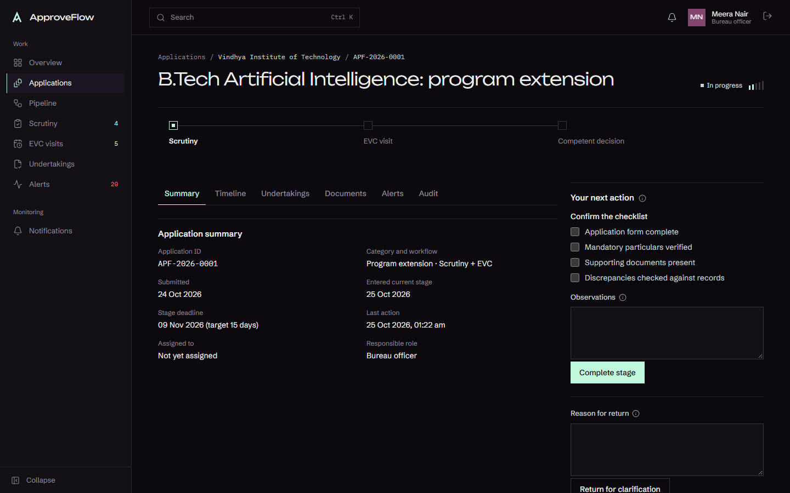
Every application has one timeline
Stage, checklist, next action and deadline in one place
The bureau officer sees only the actions their stage allows.
Each step is written to the timeline and the audit trail.
Deadlines show as on track, due soon or overdue.
ApproveFlow · SIH26262
5
Application detail: stepper, checklist, assignee and deadline

Slide 6
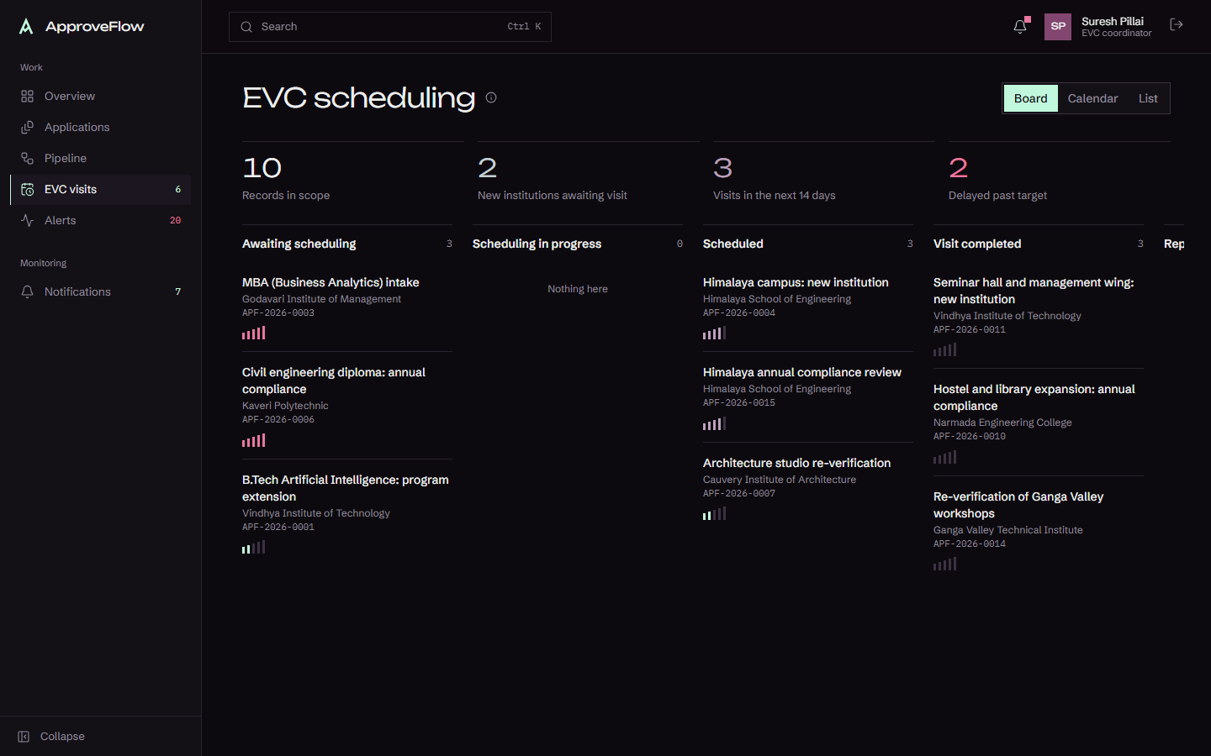
EVC queue: from waiting to visit completed
New institutions are tagged; overdue visits are flagged in red
Applications enter the queue only after their preliminary stage.
Board, month calendar and list views all open the same record.
Visit date and observations are recorded before the stage can close.
ApproveFlow · SIH26262
6
EVC status board

Slide 7
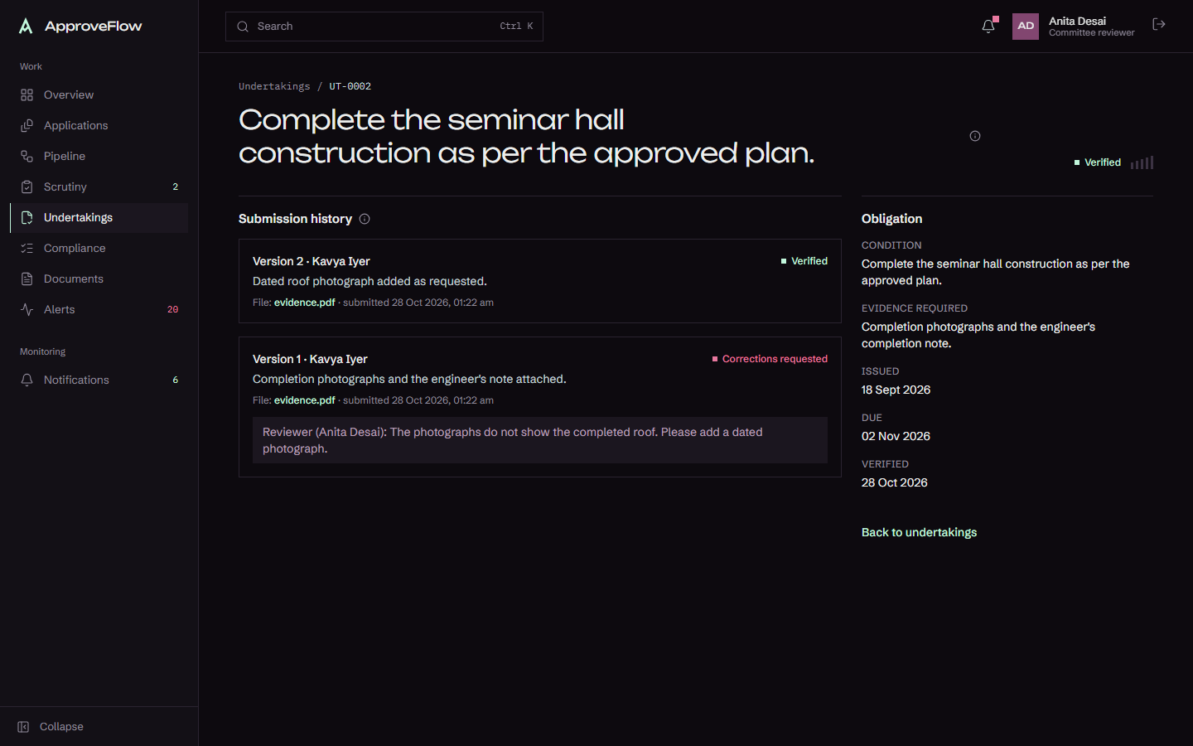
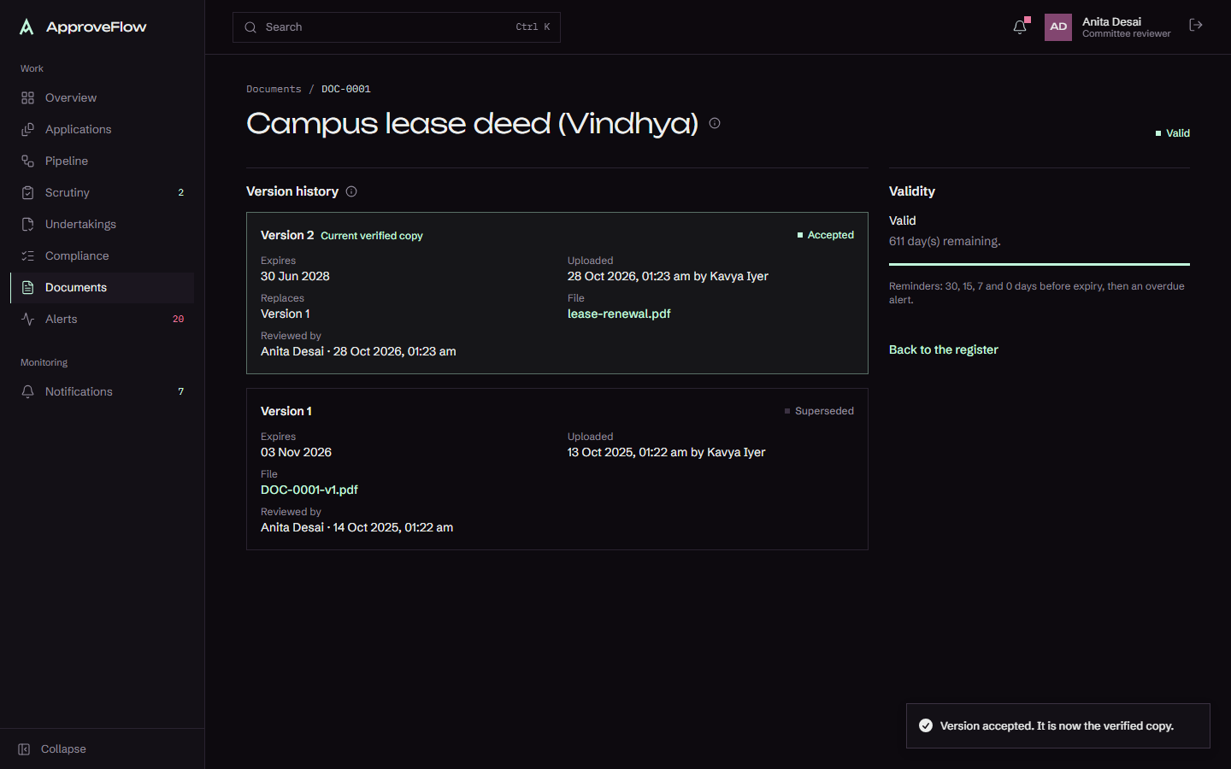
Evidence is verified, never assumed
Submissions are versions; the verified copy changes only on reviewer acceptance
Undertaking: two evidence versions, reviewer remarks kept
Lease renewal: version 1 kept as superseded
ApproveFlow · SIH26262
7

Slide 8
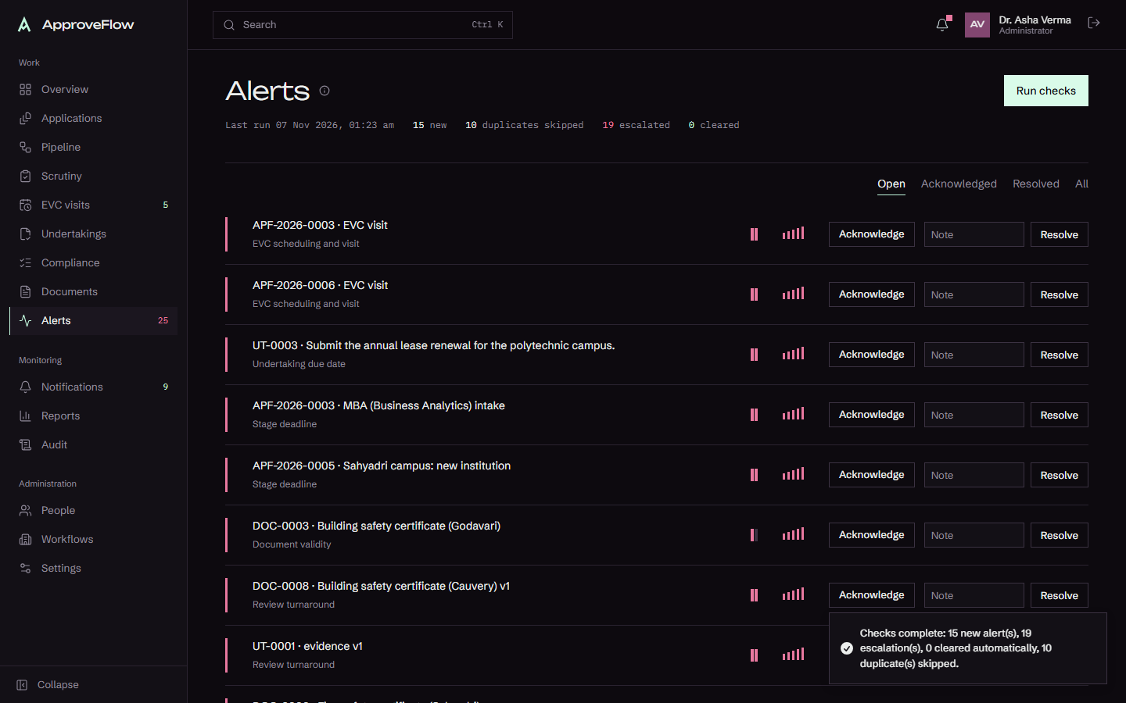
Alerts that escalate, and never duplicate
Run the checks again and nothing new is created for the same trigger
One alert per trigger
Re-runs are idempotent. The second run in the demo reports 0 new alerts and 0 escalations.
Escalation ladder
Assignee, then regional supervisor, then the designated administrative authority. Each level fires once.
Tasks & escalations after the clock moved forward ten days
ApproveFlow · SIH26262
8

Slide 9
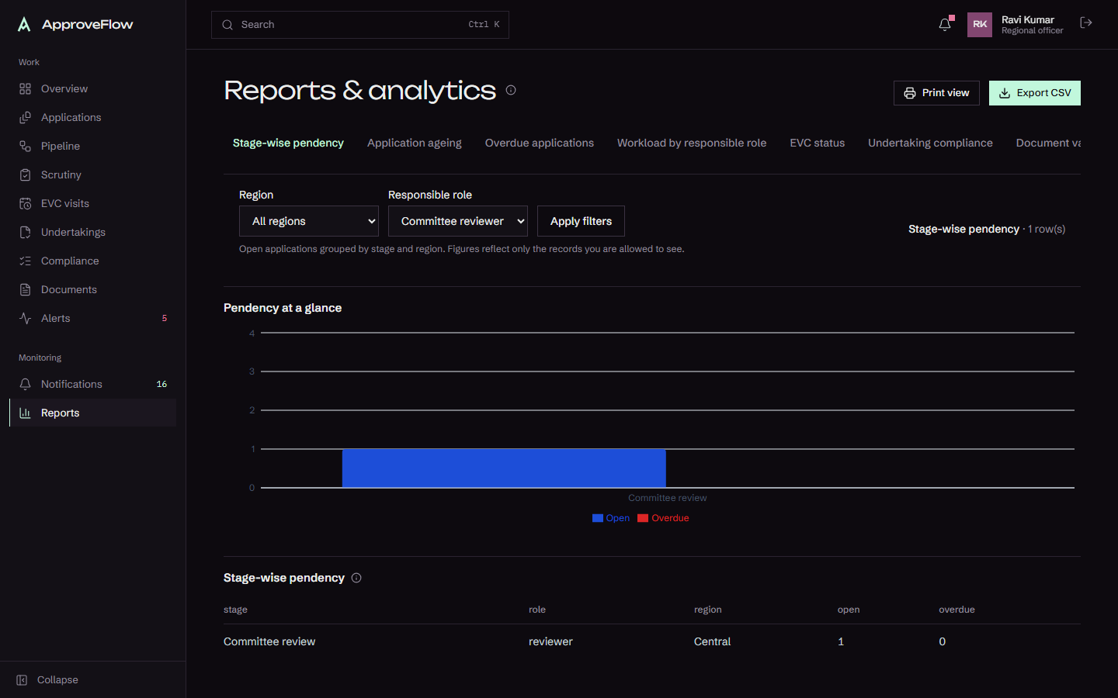
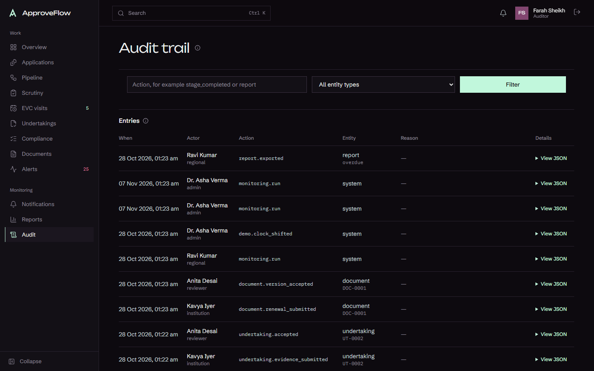
Reports and an audit trail nobody can edit
Authorised CSV export; the database refuses edits to audit rows
Pendency by stage, with overdue cases in red
Audit trail with JSON details
ApproveFlow · SIH26262
9

Slide 10
Access by role, enforced on the server
Hidden buttons are a convenience; every write and query is checked
Record scope
Files
Institution users see only their institution. Regional officers see their region.
PDF, PNG or JPG up to 10 MB, checked by content; downloads are authorised and logged.
Exports
Demo sign-in
CSV is limited to authorised roles and neutralises spreadsheet formulas.
Fictional accounts only. Production needs real identity and encryption at rest.
ApproveFlow · SIH26262
10

Slide 11
Automation supports. People decide.
Alerts, reminders and escalations inform the responsible officer. They never change a decision.
A case cannot be approved, rejected or closed by an alert or an overdue timer.
Institution submissions do not count as verification until a reviewer accepts them.
Every decision carries a recorded reason and is kept in the audit trail.
ApproveFlow · SIH26262
11

Slide 12
Verified, not just demonstrated
Results from the final run
59
7
0
24
unit and integration tests passed
browser walkthroughs passed
type or lint errors
routes in the production build
Tests cover deadline boundaries, deduplication, escalation idempotency, permissions, scoping, file checks and audit immutability.
Walkthroughs A to E run through the real interface, including a mobile check.
ApproveFlow · SIH26262
12

Slide 13
How the official requirements are covered
Full mapping in docs/REQUIREMENTS_MAP.md
Requirement | Where it is met
A. Routing and stages | Five configured routes; owner-only stages; returns with reasons
B. Dashboards and pendency | Role overviews, pendency charts, ageing, workload
C. EVC scheduling and alerts | Queue, calendar, visit gating, EVC deadline alerts
D. Undertakings | Due dates, evidence versions, reviewer verification
E. Lease and document validity | Expiry windows, renewals as versions, history kept
F. Notifications, escalation, reports | In-app notifications, escalation ladder, nine reports
ApproveFlow · SIH26262
13

Slide 14
Built to run on any laptop
No install beyond Node.js and npm
Next.js 16 with React 19 and strict TypeScript; server actions keep writes on the server.
PGlite: real Postgres running in-process, with versioned migrations and append-only triggers.
Zod validation shared across forms and the server; Motion for purposeful animation.
Vitest for unit and integration tests; Playwright for walkthroughs and screenshots.
ApproveFlow · SIH26262
14

Slide 15
Honest limits and next steps
What is simulated, and what comes next
Not built yet
Next steps
Email and SMS providers. Connection to AICTE systems (none exists). A background scheduler. Row-level database policies. Production identity and encryption at rest. Hindi and other language support.
Confirm every timeline, category and role against the APH. Connect to an official API only with authorisation. Add a scheduler and email notifications. Move to managed Postgres with encryption at rest.
ApproveFlow · SIH26262
15

Slide 16
Thank you
Live demo: npm run db:reset, npm run dev, then follow docs/DEMO_SCRIPT.md
ApproveFlow · SIH26262
16

