Slide 1
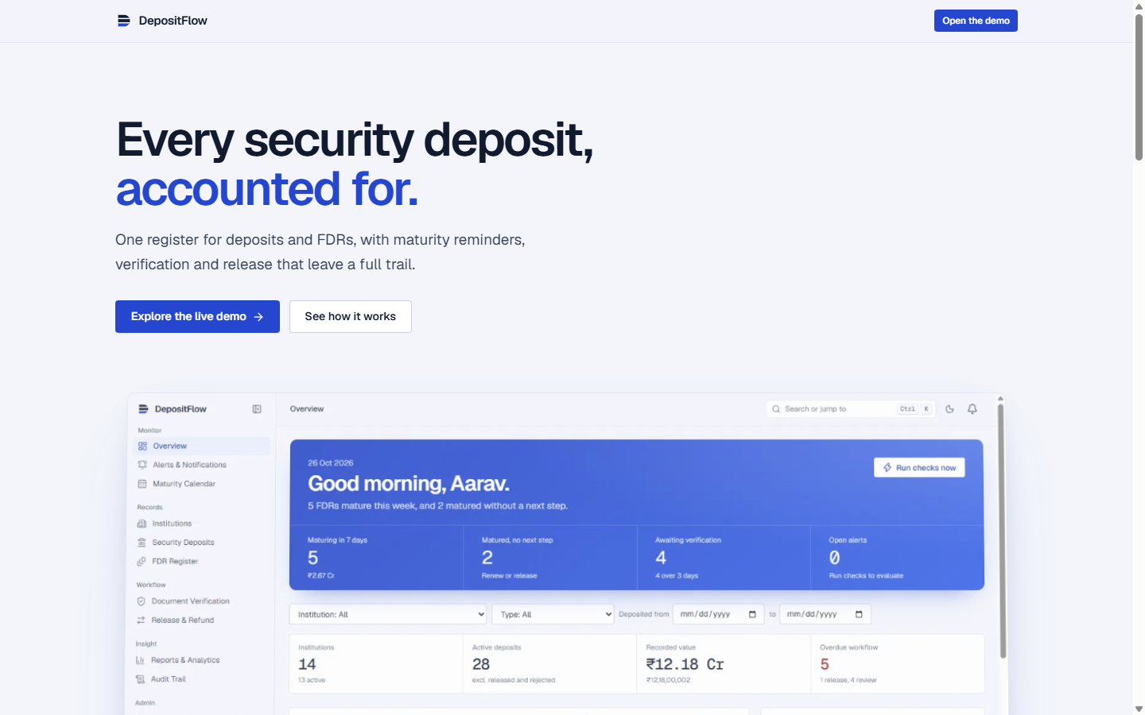

SMART INDIA HACKATHON 2026 | SOFTWARE
DepositFlow
Unified Security Deposit & FDR Lifecycle Portal for AICTE
OFFICIAL PROBLEM SPECIFICATION
Problem Statement ID: 26265
Problem Statement Title: Streamline of security deposit / FDR portal
Ministry / Organization: AICTE, Ministry of Education, Govt. of India
Bureau / Department: Regulation Bureau (Approval & Compliance)
Theme & Category: Smart Automation | Software Edition
Team ID & Name: Team ID: 155882 • Team SPADES
₹12.18 Cr
Verified Seed Portfolio
53 / 53
Automated Tests Pass
Zero Cloud
WASM PGlite Engine
DepositFlow Live Production Prototype: Purpose-built for AICTE Regulation Bureau

Slide 2
SPADES
AICTE REGULATION BUREAU | PROBLEM CONTEXT & PROPOSED SOLUTION
The Regulatory Reality vs The DepositFlow Architecture
Transforming fragmented, spreadsheet-driven compliance into a unified, tamper-proof institutional ledger
THE STATUS QUO (PAIN POINTS)
Why AICTE Regulation Bureau faces critical operational risks today:
✕ Spreadsheet & Email Silos: Records scattered across regional offices; no real-time national register of institutional solvency.
✕ Lapsed FDR Renewals: Maturity dates missed without warning, risking loss of statutory security or forfeiture of interest yield.
✕ Unchecked Receipt Forgery: Uploaded paper receipts scrutinized manually with zero programmatic discrepancy detection against register data.
✕ Unsegregated Release Risk: Lacks Maker-Checker controls; no cryptographic barrier preventing self-authorization of refund requests.
✕ Vulnerable Audit Trails: Modifications in spreadsheets leave no immutable forensic evidence of who altered what deposit.
DEPOSITFLOW SOLUTION
Systematic digital lifecycle conforming to AICTE Approval Process Handbook:
✓ Single Source of Truth: Centralized repository tracking both institution-wise and instrument-wise security deposits & FDRs.
✓ Dual-Pane Scrutiny: Side-by-side verification: document preview alongside register values with automatic discrepancy flags.
✓ Automated Maturity Watchdog: Proactive alerts at 30, 15, 7, and 0 days prior to maturity, plus immediate overdue tracking.
✓ Maker-Checker Segregation: Strict 4-eye release governance: requester cannot approve; dual verification before fund release.
✓ Append-Only Forensic Ledger: Database-level triggers reject UPDATE and DELETE, guaranteeing legal immutability for audits.
10 SIH REQUIREMENTS MET
Direct coverage of the AICTE PS26265 requirements specification:
● 1. Centralized FDR Repository
● 2. Digital Document Management
● 3. Verification & Discrepancy Checks
● 4. Automated Validity & Maturity Alert
● 5. Renewal & Replacement Lineage
● 6. Release & Refund Governance
● 7. Escalation & Stakeholder Alerts
● 8. Executive Dashboard & CSV Reports
● 9. Immutable Audit Trail & RBAC
● 10. System Integration & Idempotency

Slide 3
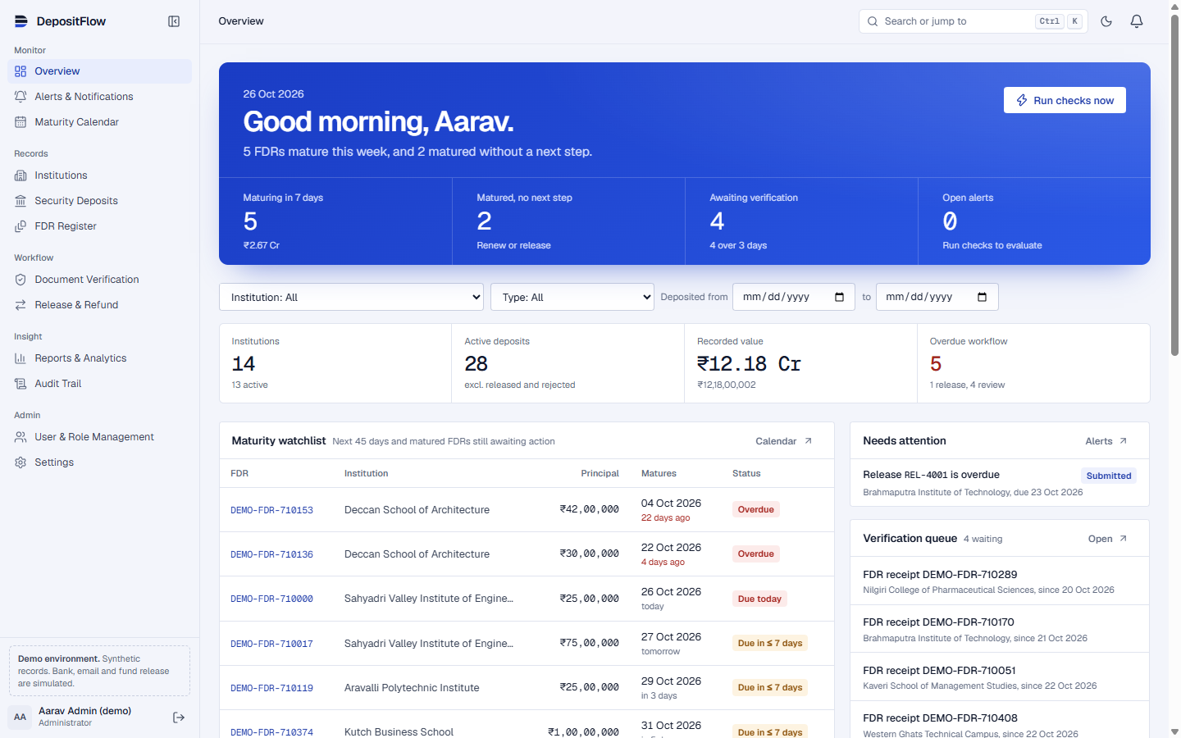
SPADES
AICTE REGULATION BUREAU | TECHNICAL APPROACH
Technical Architecture & The End-to-End Compliance Pipeline
Robust enterprise stack: React 19 / Next.js 16 + WebAssembly Postgres + Multi-tier security enforcement
END-TO-END REGULATORY LIFECYCLE PIPELINE
Every FDR instrument progresses through strict verification gates from issuance to discharge:
01. INGESTION
Institution creates deposit; Magic-byte sniffing validates authentic PDF binary.
02. SCRUTINY
Verification Officer inspects dual-pane diff; mismatches flagged in real-time.
03. MONITORING
Watchdog engine evaluates 7 statutory rules; fires idempotent 30/15/7/0D alerts.
04. 4-EYE RELEASE
Maker-Checker clearance; requires competent authority review & outcome recording.
05. AUDIT LOG
DB triggers write immutable change history; zero deletion allowed.
ARCHITECTURAL HIGHLIGHTS
Engineered for high-security public governance:
◆ WASM PGlite Engine: Embedded PostgreSQL compiled to WebAssembly; runs zero-cloud on disk with 100% Supabase cloud parity.
◆ Zero Floating-Point Error: Handles all financial amounts in BigInt integer paise (numeric(16,2)), eliminating IEEE-754 precision drift.
◆ Server-Side RBAC Enforcement: 5 roles verified on every Server Action; buttons are never relied on as security barriers.
◆ Cryptographic Signed URLs: Receipt files stored privately; accessible only via expiring signed links.
◆ Idempotent Action Execution: UUID idempotency keys on forms and API endpoints prevent duplicate submissions.
Central Management Console: 'Today' urgency band, portfolio breakdown, and activity log

Slide 4
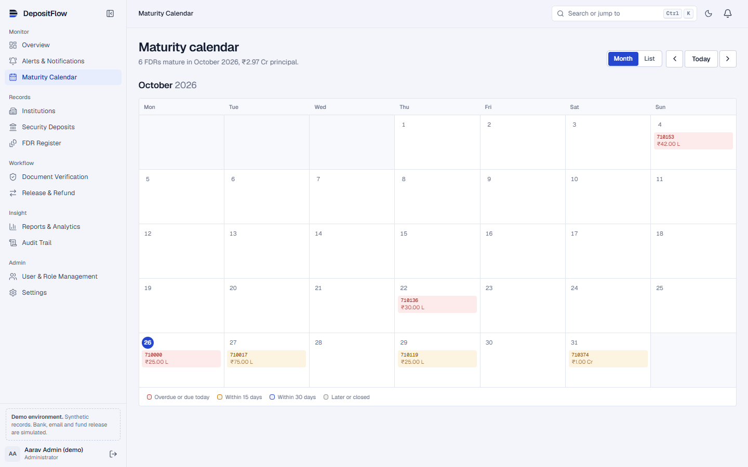
SPADES
AICTE REGULATION BUREAU | FEASIBILITY AND VIABILITY
System Feasibility, Edge-Case Handling & Empirical Validation
Engineered against real-world failure modes: 53 automated tests, 100% boundary date coverage
TECHNICAL RISK MITIGATION MATRIX
Addressing real-world deployment challenges with concrete software engineering:
Risk: Financial Data Tampering
↳ Solution: DB Trigger locks audit table; denies UPDATE & DELETE statements outright.
Risk: Disguised Malicious Uploads
↳ Solution: Content-based magic byte sniffing verifies raw PDF file headers, rejecting fake extensions.
Risk: Duplicate Reminder Storms
↳ Solution: Unique composite keys (rule + record + threshold) prevent duplicate alert creation across engine runs.
Risk: Premature Fund Release
↳ Solution: State machine strictly enforces 4-eye signoff: Request → Review → Approval → Recorded Outcome.
Risk: Accidental Record Deletion
↳ Solution: Soft-archive with instant Undo toast; permanent delete blocked by relational foreign keys.
Risk: Network Latency & Offline Use
↳ Solution: WASM local database enables zero-network offline evaluation with instant sub-30ms reads.
Automated Maturity Calendar: Real-time urgency heatmap (Matured, 7 Days, 30 Days)
VALIDATION PROOF & BENCHMARKS
Empirical testing results from the live prototype:
✓ 53 Automated Vitest Tests: Unit & integration test suite passing with 100% boundary date coverage.
✓ End-to-End Playwright Automation: Verified complete 10-step demo flow in headless Chromium.
✓ Rule Engine Performance: Evaluates 28 deposits against 7 statutory rules in under 45ms.
✓ Exact Decimals: Reconciles ₹12.18 Crore portfolio down to zero paise difference.

Slide 5
SPADES
AICTE REGULATION BUREAU | IMPACT AND BENEFITS
Empowering the AICTE Regulation Bureau & Stakeholders
Direct measurable gains: Eliminating administrative backlog, financial leakage, and compliance opacity
AICTE REGULATION BUREAU
Executive oversight and centralized governance:
★ National Exposure Dashboard: Instant macro view of all active, expiring, and matured deposits across Indian technical colleges.
★ Bank Concentration Analytics: Detects systemic risk by tracking exposure across scheduled commercial banks holding FDRs.
★ Zero Missed Maturities: Automated watchdog triggers advance alerts, preventing loss of regulatory lien custody.
★ Audit-Ready Reports: 7 statutory reports exportable to signed CSV or print-ready PDF in one click.
OPERATIONAL OFFICERS
Scrutiny, finance, and verification gains:
★ 70% Faster Scrutiny: Dual-pane verification workspace highlights date and principal mismatches automatically.
★ Unbroken Renewal Lineage: Renewals spawn child FDRs linked to original receipts; full historical continuity preserved.
★ No Unauthorized Releases: Maker-Checker separation prevents single-officer release authorizations.
★ Contextual Change Requests: Officers reject or request document modifications with explicit remarks.
TECHNICAL INSTITUTIONS
Transparency for 10,000+ colleges nationwide:
★ Self-Service Portal: Colleges view real-time status of their security deposits without filing repetitive RTIs or queries.
★ Advance Renewal Reminders: Institutions receive clear notification timelines to renew maturing deposits with their banks.
★ Transparent Release Tracking: Track release requests in real time from initiation to outcome recording.
★ National Alignment: Directly reinforces Digital India & NEP 2020 governance transparency mandates.

Slide 6
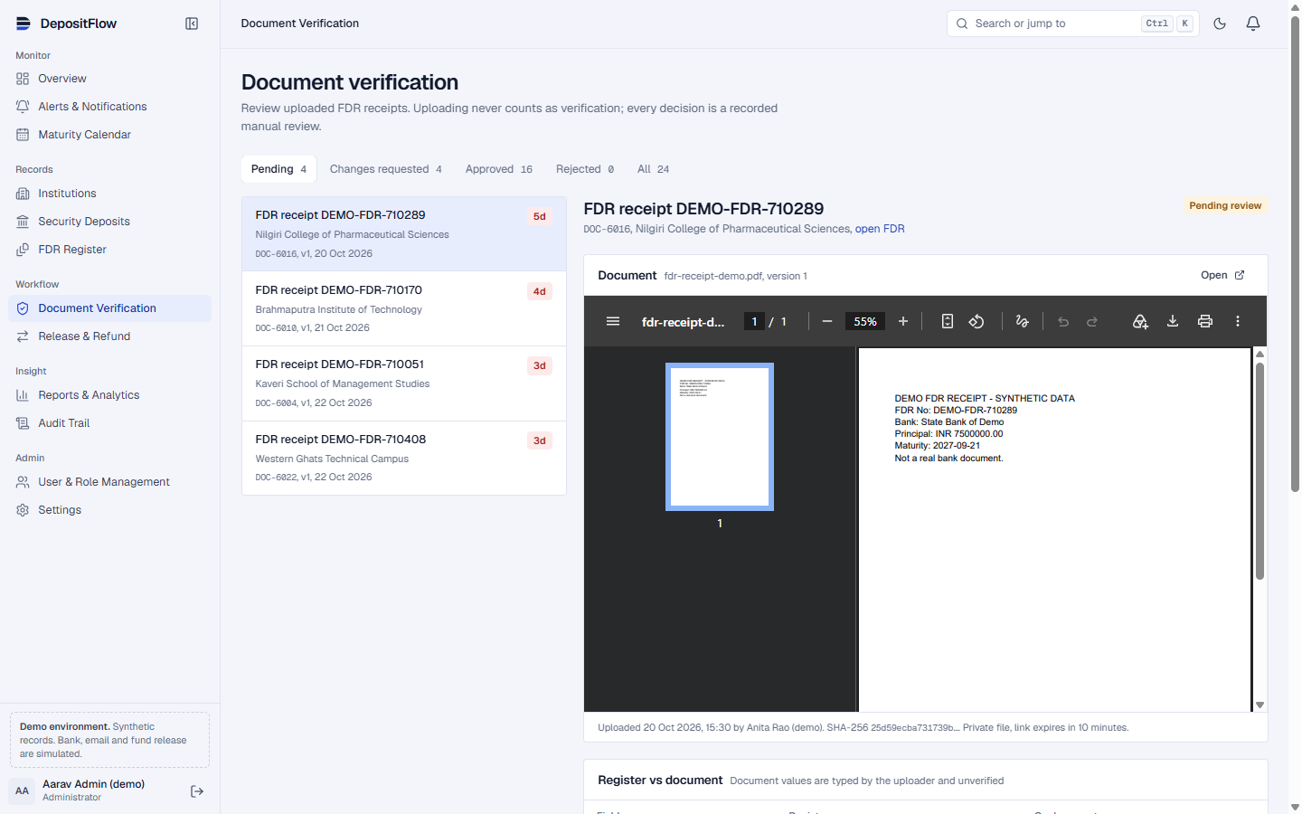
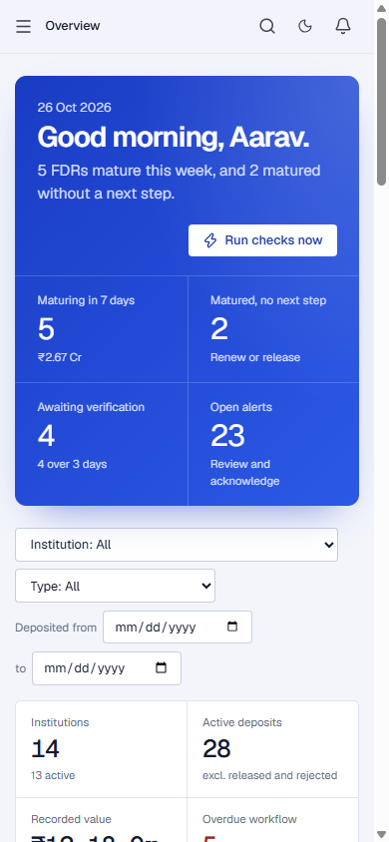
SPADES
AICTE REGULATION BUREAU | RESEARCH & PROTOTYPE SHOWCASE
Regulatory Compliance Foundations & Live Prototype Evidence
Built strictly in accordance with Government of India financial rules and verified live in browser
STATUTORY & REGULATORY FOUNDATIONS
Designed to comply with official Government of India administrative norms:
📜 AICTE Approval Process Handbook (APH 2024-27)
Strictly complies with mandatory Joint Fixed Deposit Receipt provisions for setting up new technical institutions and launching programs.
📜 General Financial Rules (GFR 2017 - Rule 170 & 171)
Aligned with GoI standards for Performance Security, safe custody of financial instruments, and verified release procedures.
📜 RBI Master Circular on Term Deposits
Complies with bank lien marking, auto-rollover guidelines, and maturity settlement directives.
📜 W3C WCAG 2.2 AA Accessibility Standards
High-contrast color tokens, keyboard navigation, focus indicators, and reduced-motion support.
📜 Digital Personal Data Protection (DPDP) Act
Confidential financial data protected via scoped RBAC, signed expiring URLs, and tenant isolation.
Live Workspace: Dual-Pane Verification with Side-by-Side Document Diff
PROTOTYPE READY FOR IMMEDIATE EVALUATION
Features fully functional and interactive in the running application:
✓ Command Menu (Ctrl+K or ⌘K) & Vim-style keyboard navigation (`g` + page key).
✓ Dual-Pane Verification Workspace with automated discrepancy warning flags.
✓ Interactive Maturity Calendar (Month & List views with color-coded urgency).
✓ One-click CSV Exports across 7 reports and native Dark Mode support.
Responsive 390px Mobile View

