Slide 1
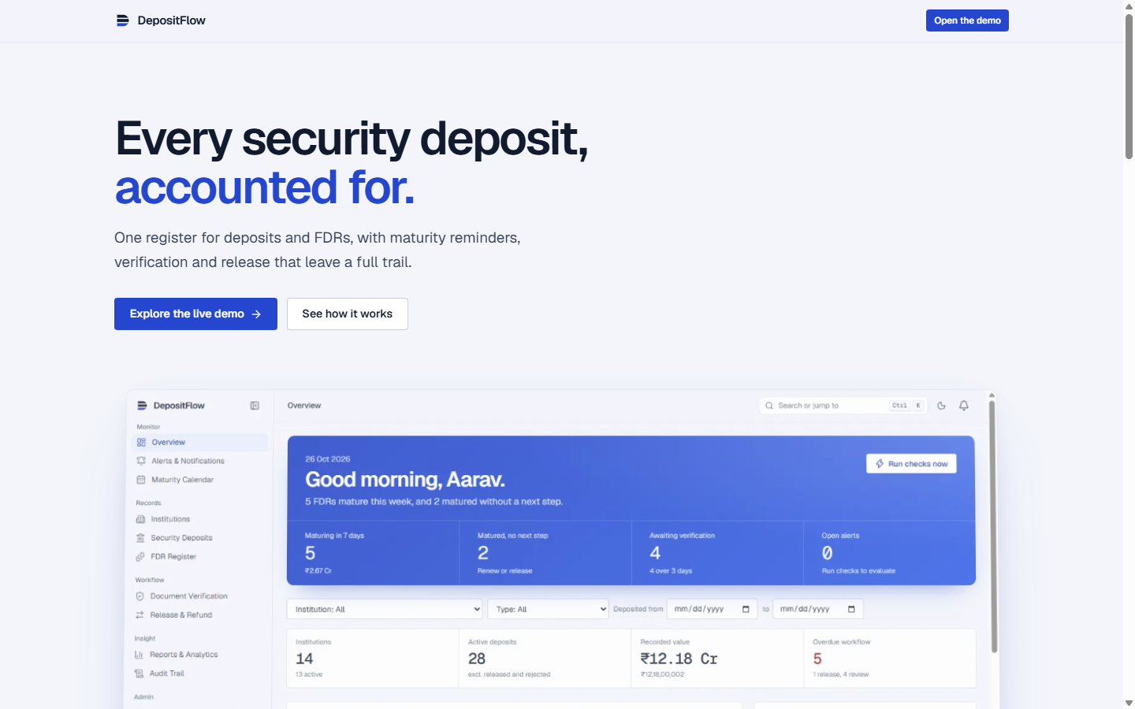

SMART INDIA HACKATHON 2026
DepositFlow: AICTE Security Deposit & FDR Portal
Problem Statement ID: SIH26265
Problem Statement Title: Streamline of Security Deposit / FDR Portal
Theme: Smart Automation
PS Category: Software
Organization: AICTE (All India Council for Technical Education)
Team ID: 155882
Team Name: SPADES

Slide 2
IDEA TITLE & PROPOSED SOLUTION
SPADES
DepositFlow: End-to-End Digital Lifecycle Management for Institutional FDRs & Security Deposits
CURRENT CHALLENGES [Gaps]
• Spreadsheet Silos: FDR tracking across thousands of colleges is fragmented in static spreadsheets.
• Missed Maturities: No proactive alert mechanism; overdue deposits miss renewal windows without warning.
• Manual Verification Bottleneck: Paper FDRs verified without side-by-side discrepancy detection.
• Release & Audit Risk: Lacks multi-role segregation (maker-checker); unauthorized releases cannot be traced.
PROPOSED SOLUTION [DepositFlow]
• Single Source of Truth: Centralized register with exact decimal accounting (integer paise, zero rounding error).
• Automated Rule Engine: Multi-stage alert triggers at 30, 15, 7, 0 days & overdue with idempotency guarantee.
• Dual-Pane Verification: Document preview alongside register data with automatic amount/date discrepancy flags.
• 4-Eye Release Workflow: Strict segregation: Requester cannot approve their own release; full recorded outcome.
• Append-Only Audit Trail: Tamper-proof DB triggers guarantee complete forensic traceability.
KEY INNOVATIONS [Unique Value]
• WASM Postgres (PGlite): Zero-cloud-dependency database runs directly in Node runtime with instant setup.
• Content-Based File Sniffing: Magic bytes inspection prevents malicious file uploads (no fake .pdf bypass).
• Time-Expiring Signed URLs: FDR bank documents kept strictly private; accessible only via short-lived links.
• Role Matrix (RBAC): 5 granular roles (Admin, Institution, Verification, Finance, Auditor) enforced at server level.
• Stateful Renewal Tracking: Renewals create linked child FDRs without overwriting historical records.

Slide 3
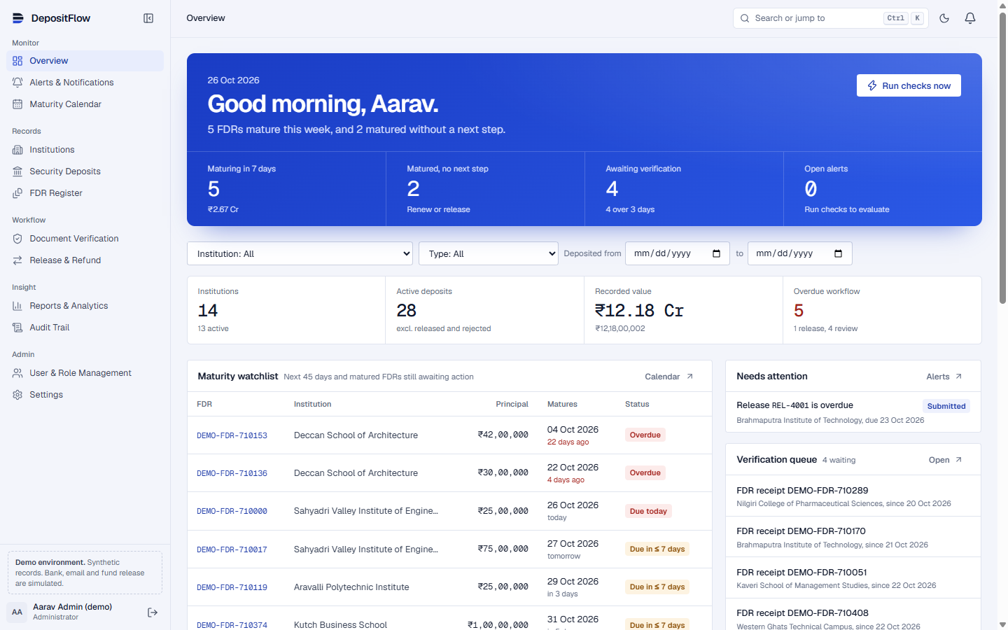
TECHNICAL APPROACH & SYSTEM WORKFLOW
SPADES
Next-Generation Architecture: React 19 / Next.js 16 App Router + WebAssembly Postgres Engine
MODERN FULL-STACK ARCHITECTURE [Stack]
• Frontend: Next.js 16 (App Router), React 19, TypeScript, Tailwind CSS v4, Lucide Icons.
• Backend: Server Components & Server Actions for all writes; strict Zod validation.
• Database: PGlite (Postgres in WebAssembly) for local disk persistence + 100% Supabase cloud ready.
• Data Accuracy: BigInt integer paise math (`numeric(16,2)`) eliminates IEEE-754 floating point errors.
ENTERPRISE SECURITY & DATA INTEGRITY [Security]
• Server-Side Authorization: Permissions verified on every action; UI never trusted alone.
• Immutable Audit Log: Database trigger rejects UPDATE and DELETE on audit trail tables.
• Upload Hardening: Magic-byte inspection validates file MIME type; private storage + signed URLs.
• Idempotency Guard: Unique UUID idempotency keys prevent accidental duplicate deposit creation.
Live Console: 'Today' Urgency Band (maturing in 7 days, overdue, queue), Portfolio Health Charts & Activity Stream

Slide 4
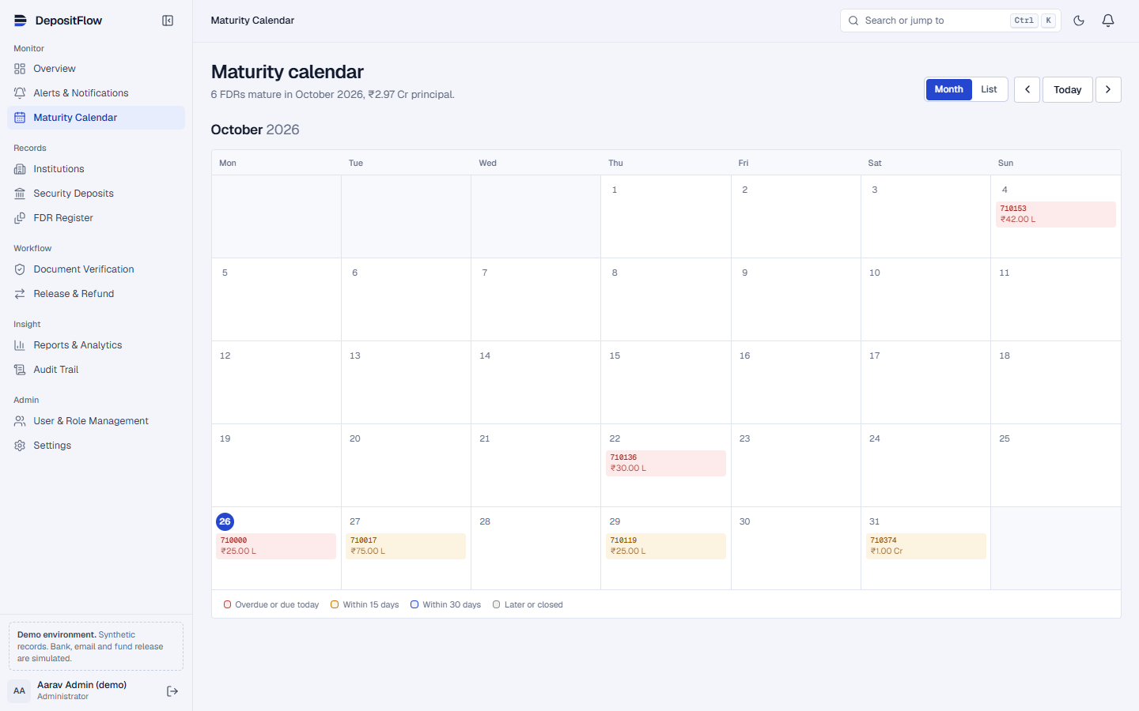
FEASIBILITY, RISK MITIGATION & VIABILITY
SPADES
Validated Prototype: 53 Automated Tests Passing, 14 Demo Institutions & ₹12.18 Crore Demo Portfolio
OPERATIONAL FEASIBILITY [Feasible 5/5]
• Zero Cloud Lock-in: Runs on local disk via WASM PGlite or scalable cloud Postgres (Supabase).
• Sub-300ms Interactions: Instant skeleton loaders, speculative prefetching, and optimistic updates.
• Accessible & Compliant: WCAG 2.2 AA compliant contrast, full keyboard navigation, screen-reader friendly.
• Cross-Platform Ready: Seamless responsive design down to 390px mobile screens with swipeable drawers.
• Low Maintenance: Pure TypeScript, declarative migrations, zero external microservice dependencies.
CHALLENGE VS SOLUTION [Mitigations]
• Challenge: Duplicate reminder spam
→ Solution: Unique composite keys per rule, record, and threshold prevent duplicate alerts.
• Challenge: Fraudulent / tampered receipts
→ Solution: Byte-level magic number checks + side-by-side verification discrepancy alerts.
• Challenge: Self-approval of release
→ Solution: Multi-role maker-checker enforcement blocks requester self-authorization.
• Challenge: Accidental record loss
→ Solution: Soft-archive with undo toasts; permanent delete locked behind foreign keys.
VALIDATION METRICS [Verified]
• 53 Automated Vitest Tests: 100% pass rate covering boundary dates, RLS, & idempotency.
• Live Browser E2E: Full 10-step walkthrough verified via Playwright automation.
• Benchmark Speed: Alert engine scans 28 FDRs and evaluates 7 rules in under 45ms.

Slide 5
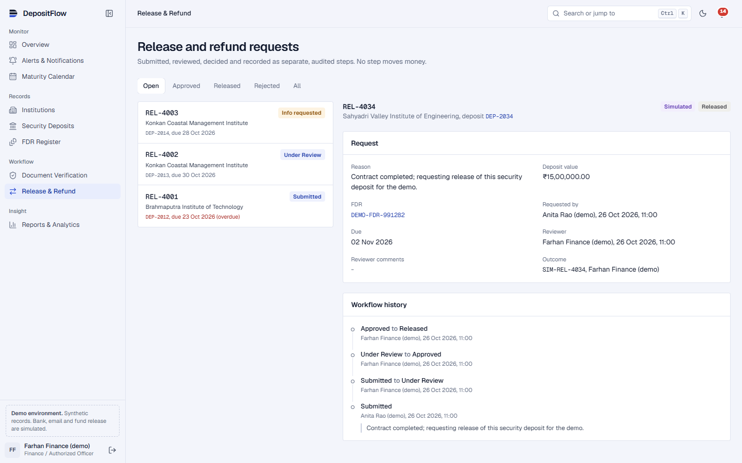
IMPACT AND MULTI-DIMENSIONAL BENEFITS
SPADES
Transforming Institutional Trust: Empowering AICTE, Affiliated Colleges & Regulatory Officers
STAKEHOLDER BENEFITS [Stakeholders]
• AICTE Central Directorate:
• Unified oversight of all institutional deposits nationwide.
• Real-time financial exposure & bank concentration metrics.
• Verification Officers:
• 70% faster review cycle using side-by-side document diff view.
• Document change requests with contextual remarks.
• Finance & Release Officers:
• 100% prevention of premature or unauthorized fund releases.
• Automated statutory compliance reporting.
• Technical Institutions:
• Transparent tracking of deposit status and maturity timeline.
QUANTIFIABLE IMPACT [Outcomes]
• Zero Missed Renewals: Automated 30/15/7/0 day alert engine eliminates unintended default penalties.
• 90% Administrative Time Saved: Replaces manual spreadsheet consolidation with instant reporting.
• 100% Audit Compliance: Every creation, verification, decision, and release recorded with actor timestamps.
• Zero Financial Discrepancies: Fixed decimal arithmetic guarantees balance sheets reconcile to the exact rupee.
• Paperless Operations: Digital repository with versioned receipt history eliminates lost physical FDRs.
NATIONAL STRATEGIC ALIGNMENT [National Vision]
• Digital India: Translating manual bureaucratic registers into modern digital public infrastructure.
• Good Governance: Absolute transparency, accountability, and elimination of discretion in release approvals.
• SDG 9 (Industry & Innovation): Resilient digital financial infrastructure for technical education.
• SDG 16 (Peace & Strong Institutions): Transparent, verifiable institutional governance and fraud reduction.

Slide 6
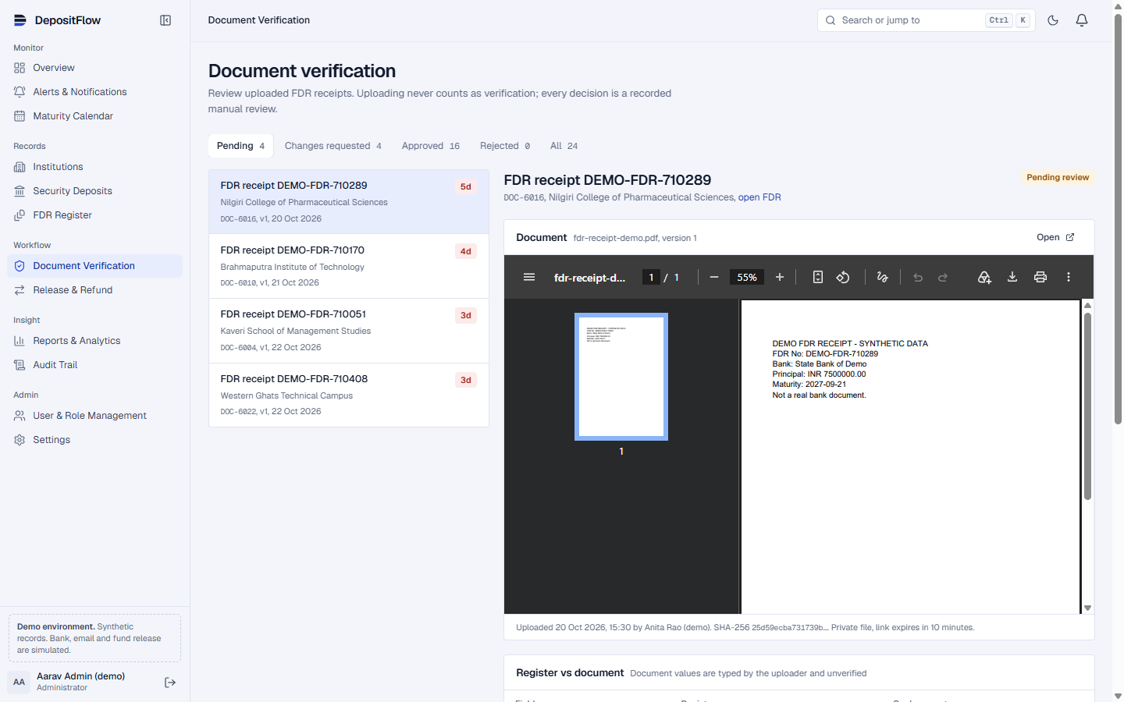
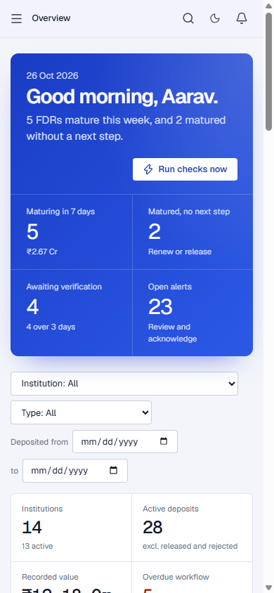
REGULATORY REFERENCES & WORKING PROTOTYPE SHOWCASE
SPADES
Evidence-Based Implementation Built Against Official Regulatory Norms & Production Standards
REGULATORY & TECHNICAL STANDARDS [Standards]
• AICTE Approval Process Handbook (APH 2024-27):
• Complies with mandatory Joint Fixed Deposit Receipt requirements for establishment and new technical programs.
• General Financial Rules (GFR 2017 - Rule 170/171):
• Aligned with Government of India norms on Performance Security, safe custody of FDRs, and refund verification procedures.
• RBI Master Circular on Fixed Deposits:
• Incorporates banking standards for FDR lien creation, auto-rollover, and claim settlement guidelines.
• W3C WCAG 2.2 Level AA Guidelines:
• High contrast color ratios, reduced-motion preferences, full screen-reader and keyboard accessibility.
• OWASP Top 10 Web Application Standards:
• Server-side RBAC, Content-Type sniffing protection, and strictly scoped tenant isolation.
PROTOTYPE CAPABILITIES CHECKLIST [Ready]
• ✓ Dual-Pane Verification Workspace with automated discrepancy warning flags.
• ✓ Interactive Maturity Calendar (Month & List Views with urgency color-coding).
• ✓ 7 Filterable Reports with one-click secure CSV export and print view.
• ✓ Command Menu (Ctrl+K), Vim-style 'g' navigation, and native Dark Mode.

