Slide 1
E-COMMERCE WEBSITE
"From Concept to Code: Developing Successful Online Store"

Slide 2

CONTRIBUTORS :
PRIYANSH ARORA
(2210990684)
PALAK BISHT
(2210990631)
PRANAV MANGAL
(2210990995)
Pranav Gupta
(2210990666)

Slide 3
TABLE OF CONTENT :
Introduction
Objectives
Problem Statement
Market Competitors
Features
Upcoming Features
Technical Stack
Technical Nodes
Source Code

Slide 4
INTRODUCTION
This project focuses on developing the back end of an e-commerce website. The back end is crucial for managing the server, database, and application logic, ensuring seamless operations for an online store.

Slide 5
OBJECTIVE
User-Friendly Interface
Ensure Security and Trust
Scalability and Performance
Build Brand Awareness
Adapt to Technological Trends

Slide 6
PROBLEM STATEMENT
Develop an e-commerce website to enhance brand visibility by showcasing products and enabling online purchases.
Provide a seamless shopping experience for customers.
Create a visually appealing, user-friendly, and secure platform that efficiently manages customer inquiries and orders.

Slide 7
FEATURES
User Authentication and Security
Proper Scalability and Flexibility
Integration Options
Product and Catalog Management

Slide 8
UPCOMING FEATURES
Front End Integration
Responsive and adaptive design
Enhanced security features

Slide 9
TECHNOLOGY STACK
FRONT END : HTML , CSS , JS
BACK END : NODE.JS , EXPRESS.JS
DATABASE : MONGODB
OTHER-TOOL : VERSION CONTROL(GIT)

Slide 10
TECHNICAL NODES
Subject / Area / Topic | Technical Nodes
MongoDB | NoSQL database for storing product information, user data, orders, and other relevant data.
Express.js | Web application framework for Node.js that simplifies server-side development
React.js | Frontend library for building user interfaces.
Javascript | JavaScript runtime environment that allows server-side execution of JavaScript code.
Payment Integration | Use payment gateways like Razor pay or PayPal for processing transactions.
Responsive Design | Use CSS frameworks like Tailwind for styling

Slide 11
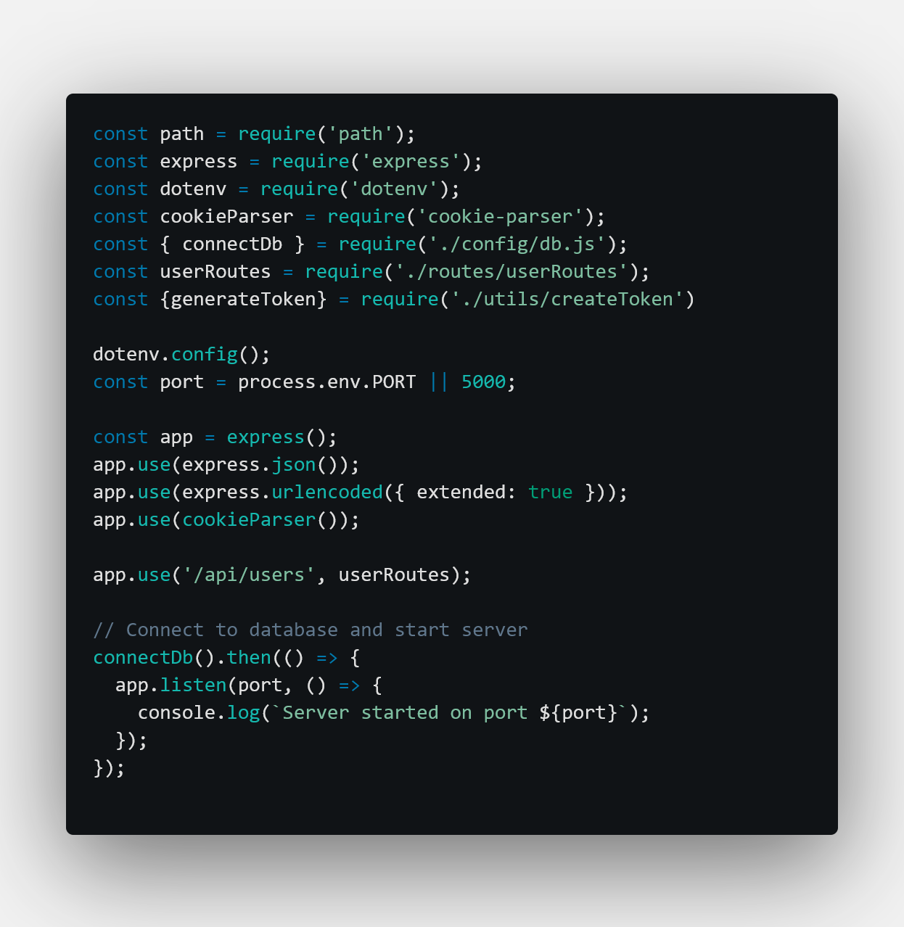
Source Code
Server.js

Slide 12
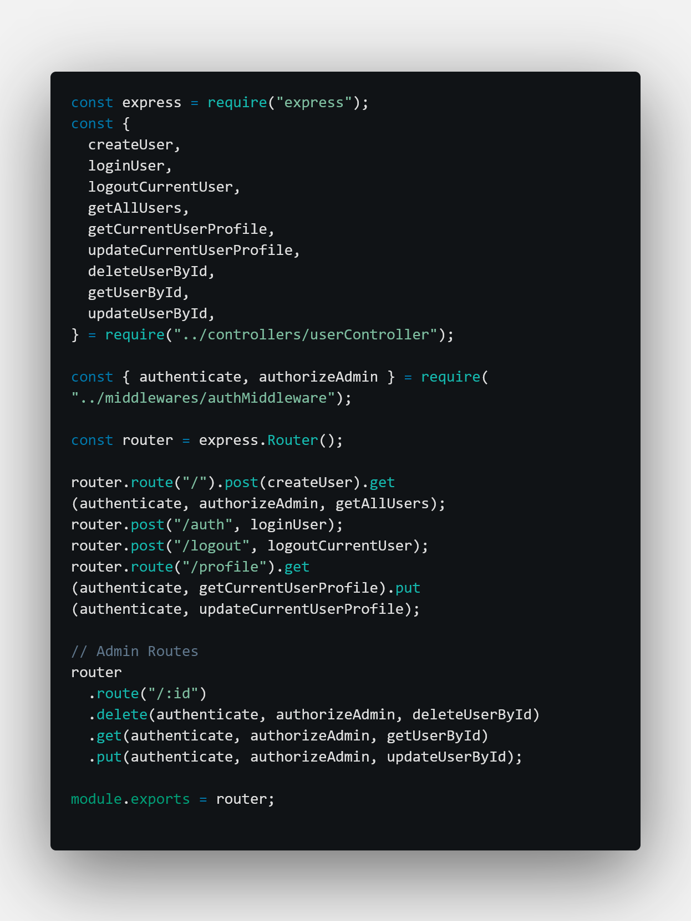
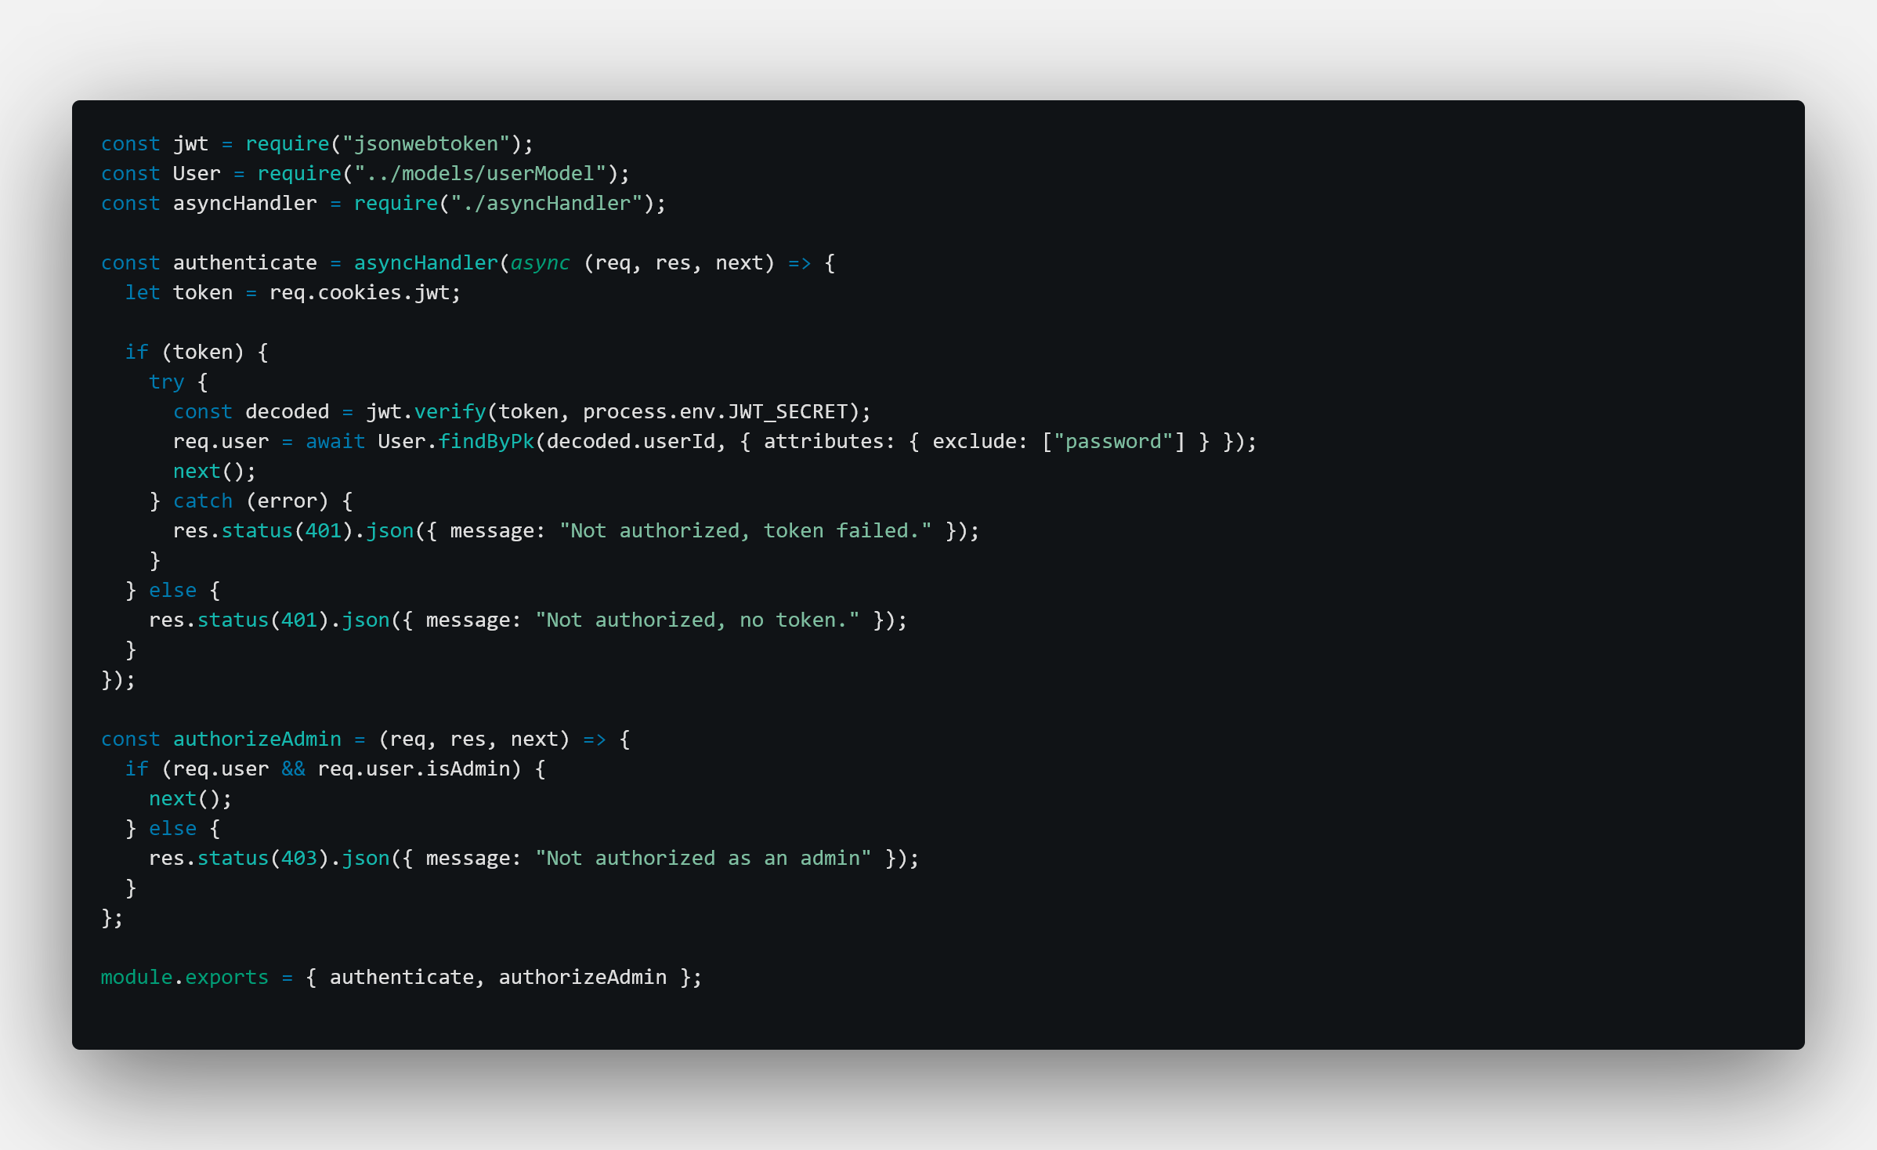
user_route.js
Auth_middleware.js

Slide 13
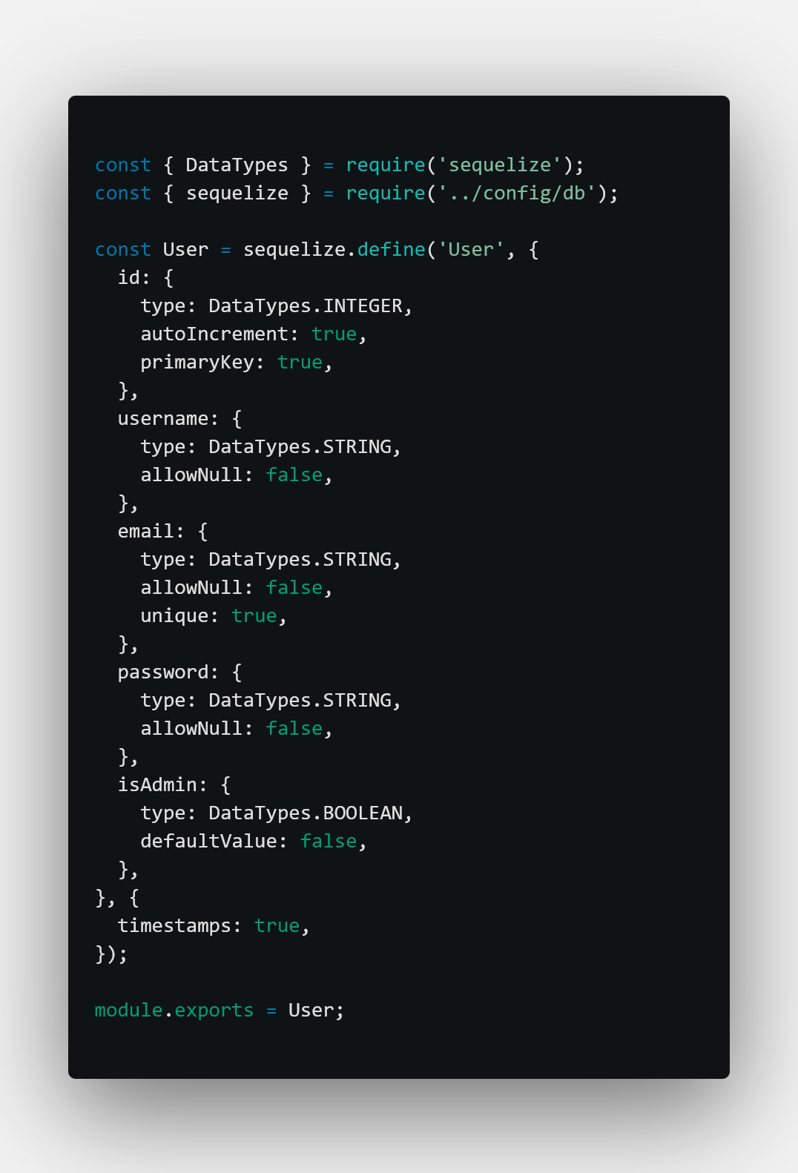
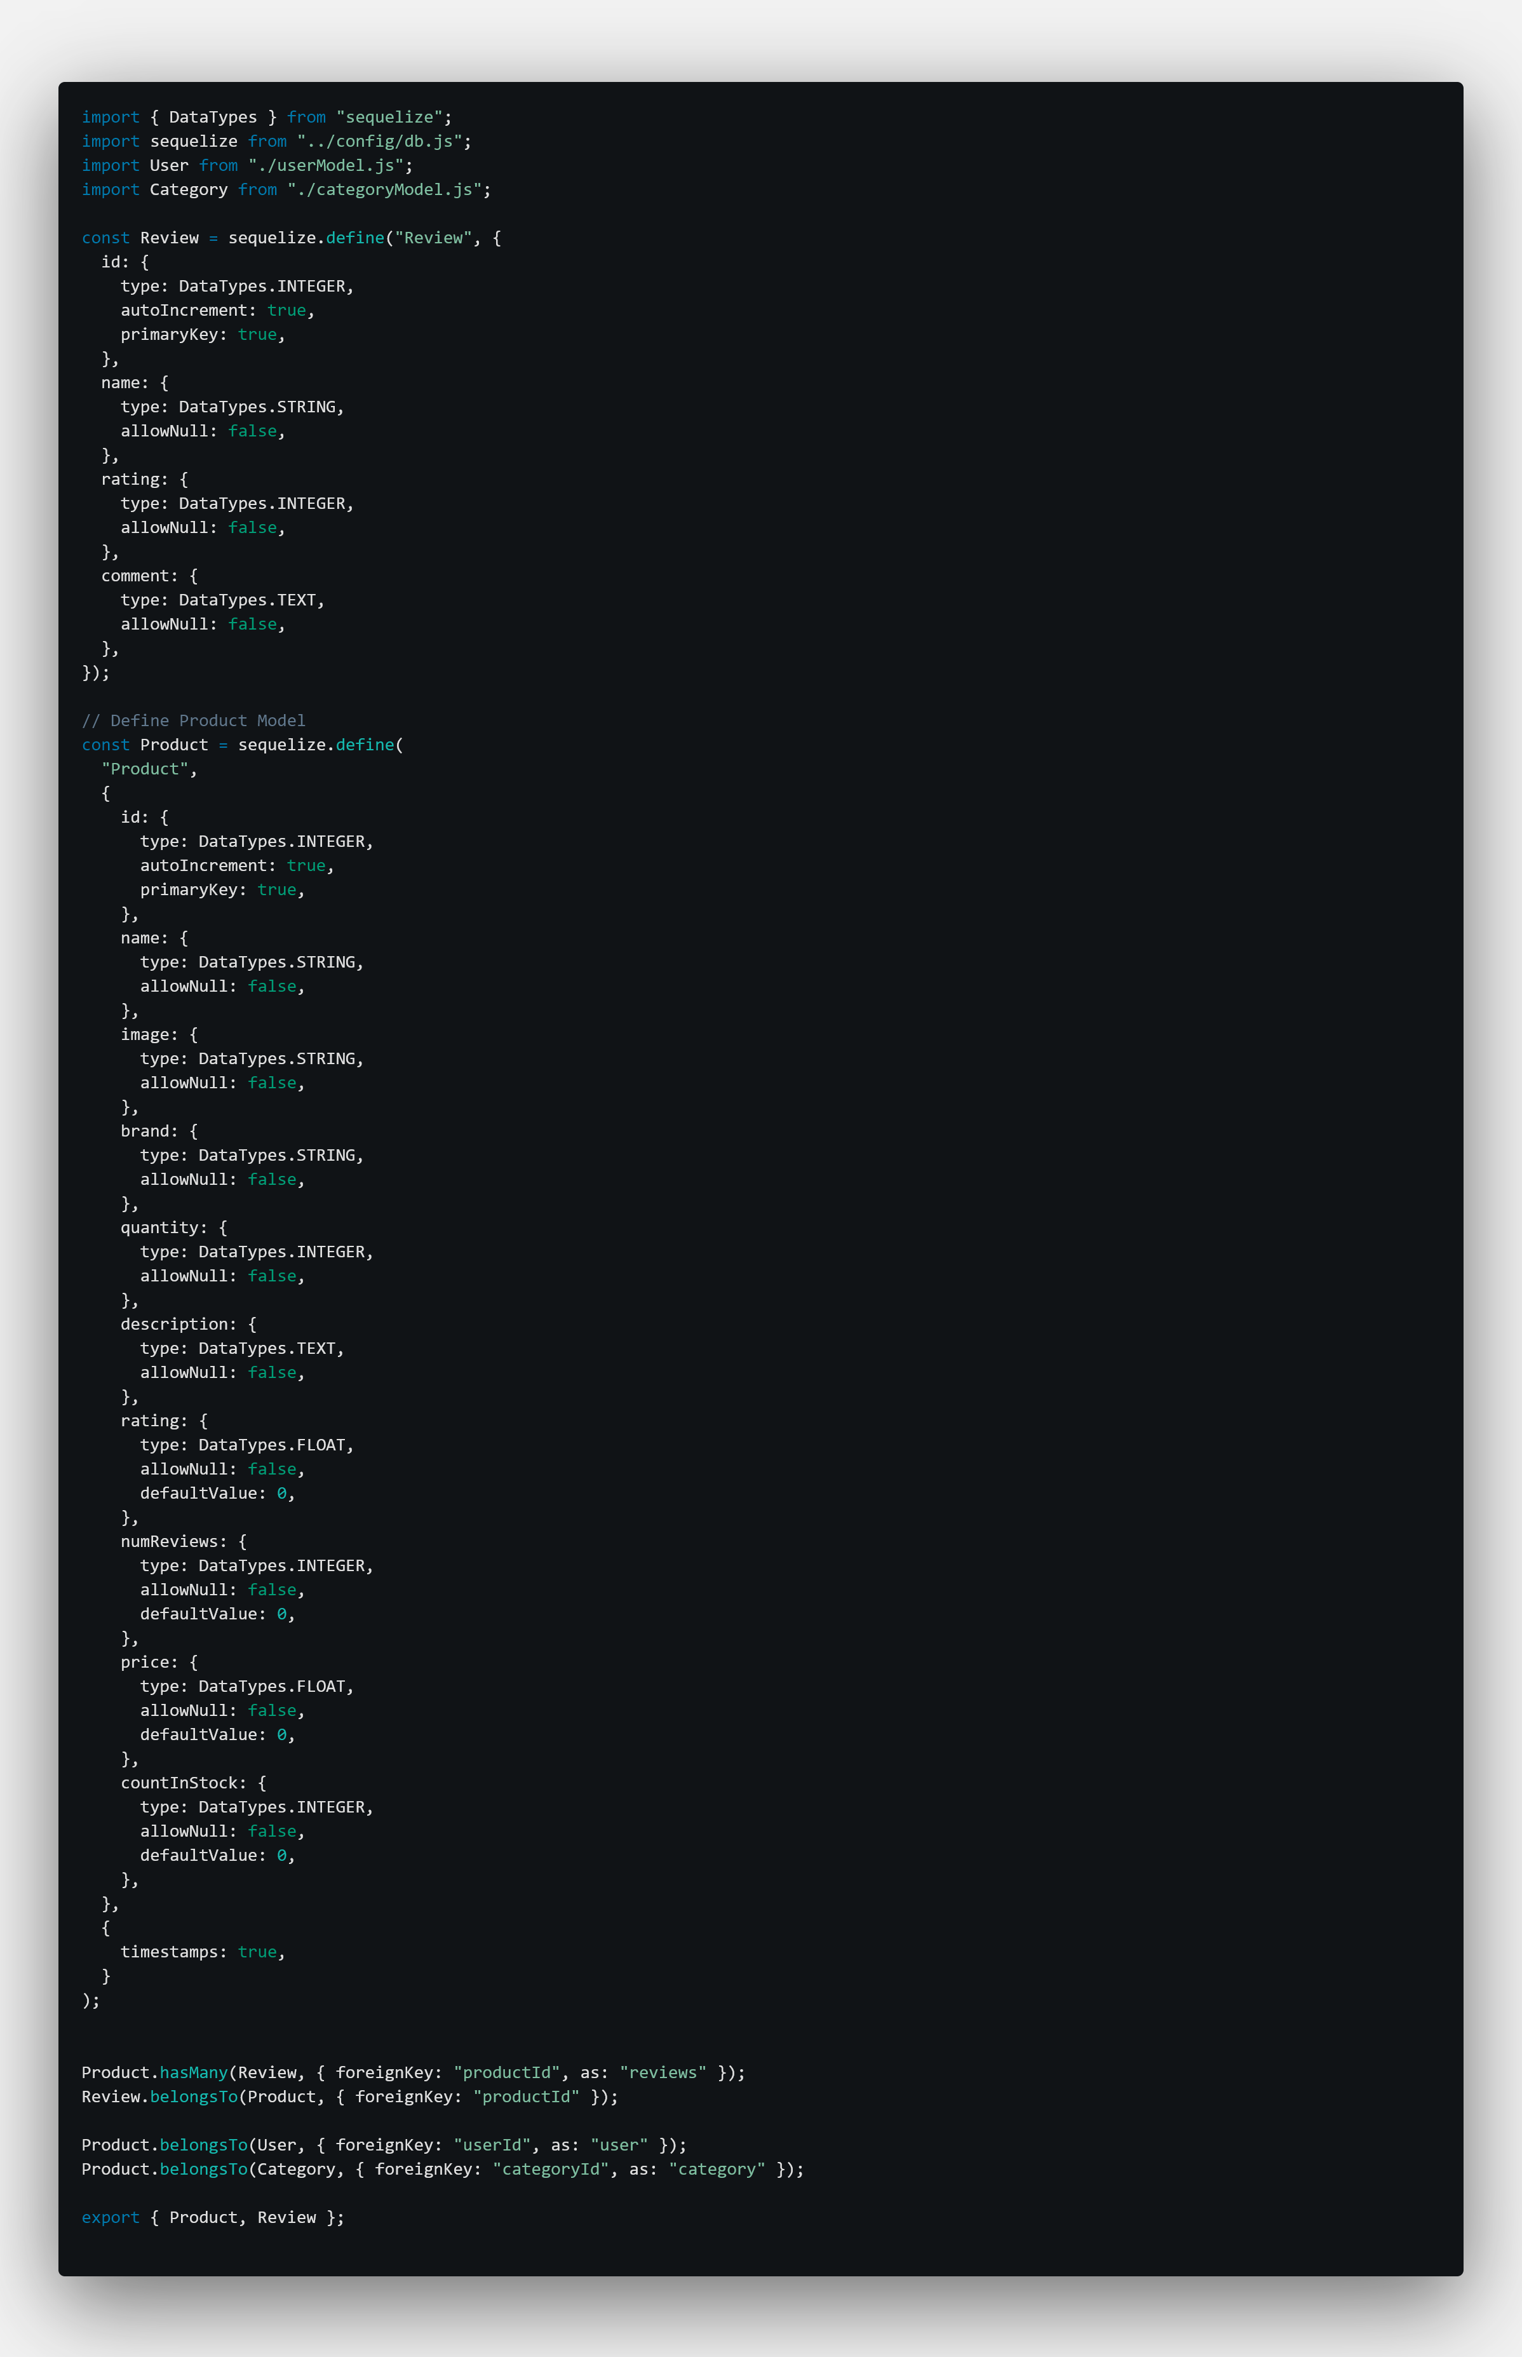
User_model.js
Product_model.js

Slide 14
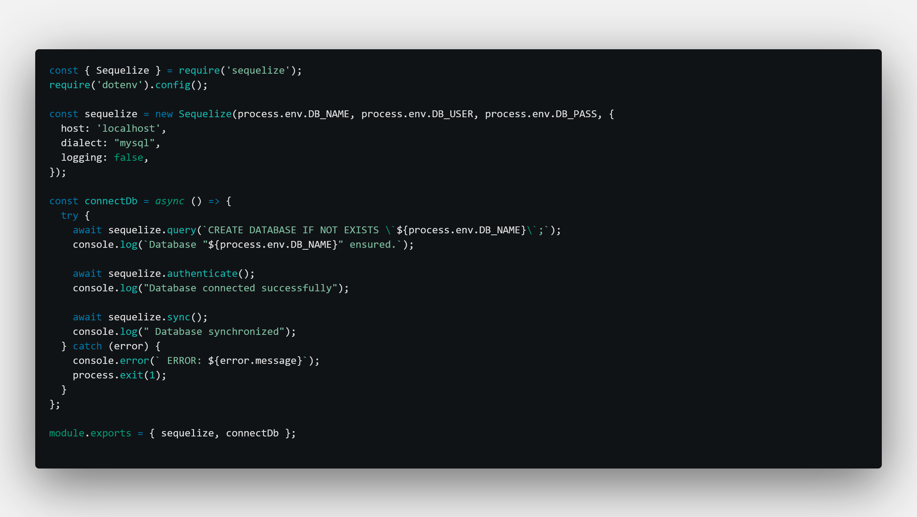
Db.js

Slide 15
REFRENCES
React js: https://react.dev
Node js: https://nodejs.org/en
MySQL: https://dev.mysql.com/doc/
W3schools: https://www.w3schools.com
Geek for geeks: https://www.geeksforgeeks.org

Slide 16


