Slide 1
Multi-Variable LSTM and Wavelet Analysis for Weather Pattern Recognition
Changjie Lu
3790 Midterm

Slide 2
Outline
1. Motivation
2. Methodology
3. Data Processing
4. Model and Results
Weather Comfort Index
IMV-LSTM
Wavelet Analysis
5. Conclusion

Slide 3
Motivation
Sharma et. al (2011) using SVM to predict the weather
Qing et. al (2018) using LSTM to predict some variable(each time only one)
John et. Al (2008) using Morlet as activation function in Neural Network
At present, the work of combining multivariate LSTM and wavelet analysis has not been carried out. Multivariate LSTM can find the relationship between various variables in time step. Combined with wavelet analysis, we can get the evolution law of weather.

Slide 4
Methodology
Using IMV-LSTM to jointly learn network parameters, variable and temporal importance.
Using Wavelet Analysis to define the weather change time period in long term patten and causal relationship.

Slide 5
Data processing
Hourly meterological data for LGA, JFK and EWR (three sensors)
Variable | Description
temp | Temperature
dewp | Dewpoint
humid | Relative humidity
wind_dir | Wind direction
wind_speed | Wind speed
precip | Precipitation
pressure | Sea level pressure in millibars
visib | Visibility in miles

Slide 6
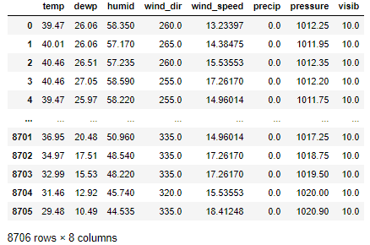
Data processing
Using the upper and down in ten hours to fill the NaN value
Using the average value of the JFK and EWR sensors

Slide 7
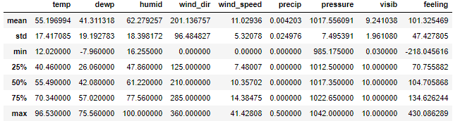
Data information
The average annual temperature is about 13 degrees Celsius,
and the average dew point temperature is about 5 degrees Celsius.
The average relative humidity is around 62%. .
The southwest winds blow most of the year..
The rainfall is about 925mm totally in one year.

Slide 8
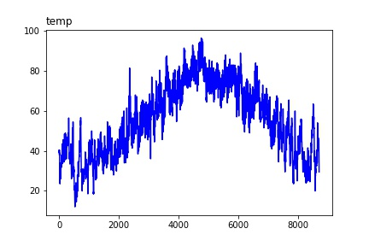
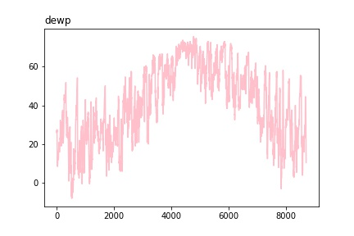
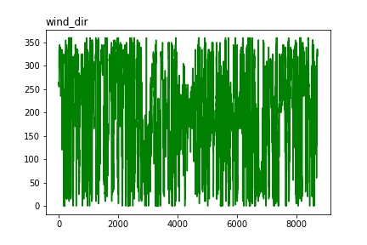
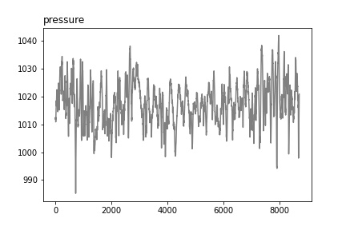
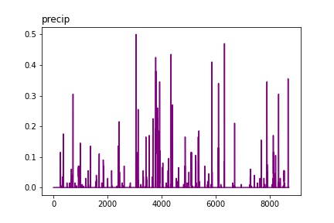
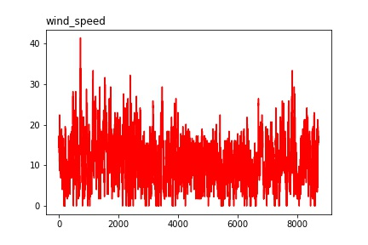
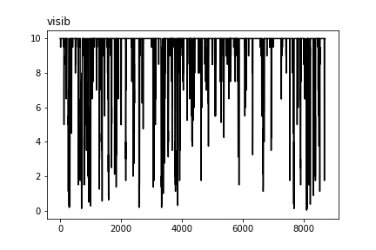
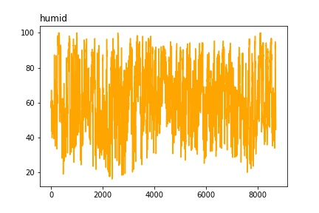
Data visualization
temperature
dewpoint
wind direction
pressure
precipitation
wind speed
visibility
humidity

Slide 9
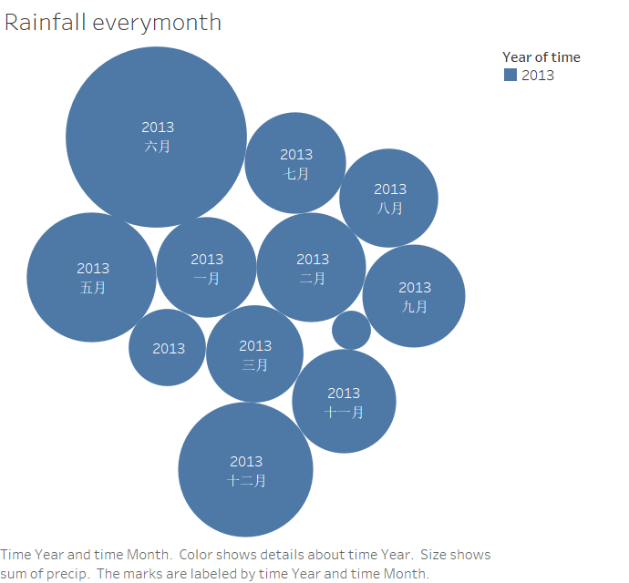
Rainfall distribution

Slide 10
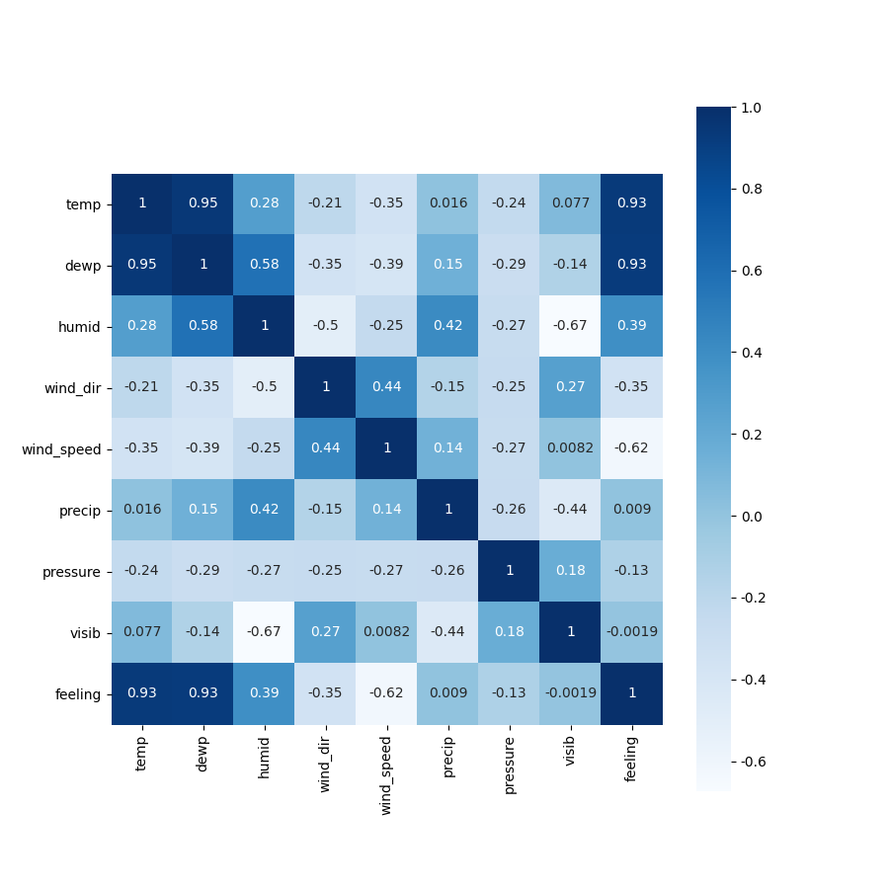
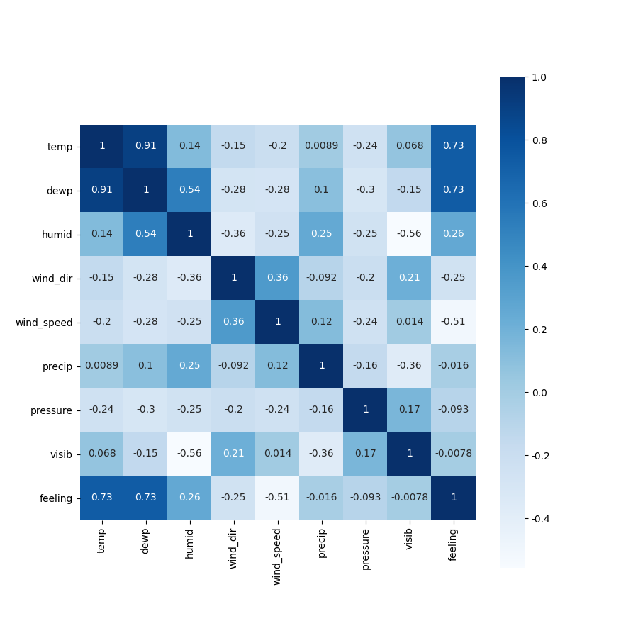
Correlation Coefficient (day and hour)

Slide 11
Weather Comfort Index
Feeling =
(1.818t+ 18.18)(0.88 + 0.002f)+(t- 32) / (45 -t)- 3.2v+ 18.2
Where t is the temperature, f is relative humidity, v is the speed of the wind.
(《人体舒适度研究现状及其开发应用前景》,2002)

Slide 12
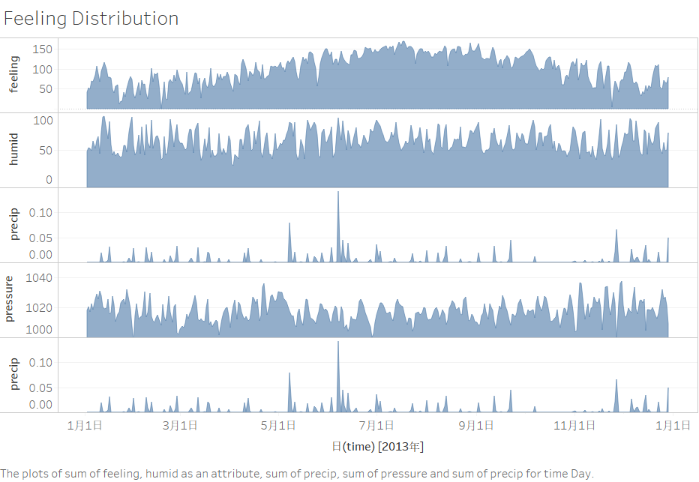
The relationship of feeling and features

Slide 13
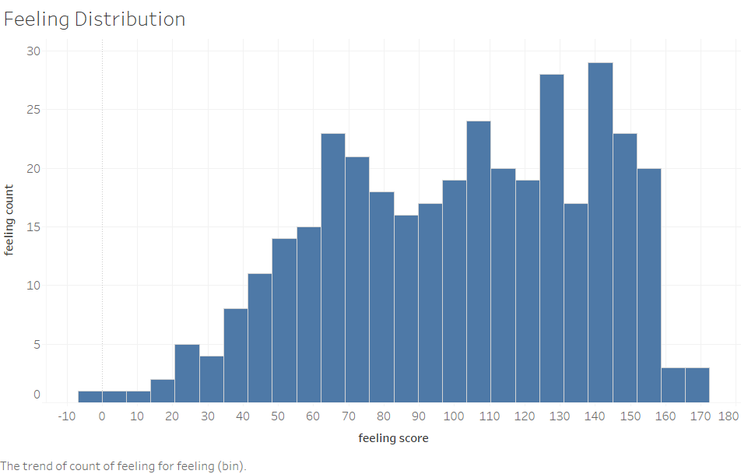
The relationship of feeling and features
The comfort index is mostly in the 60-150 range.

Slide 14
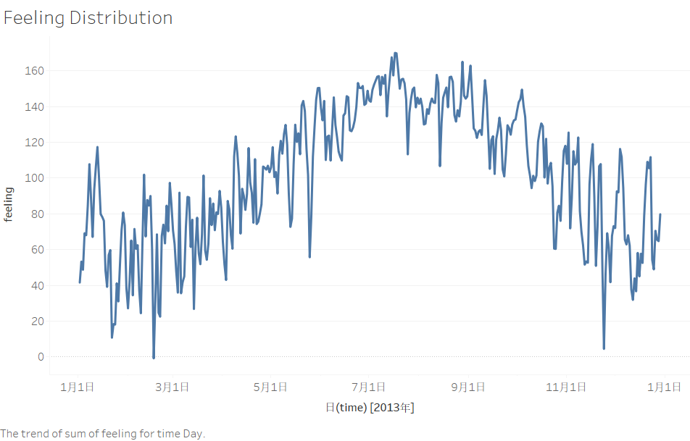
The relationship of feeling and features
Due to the unstable temperature
in spring and autumn, rainfall
and strong winds often occur,
resulting in large fluctuations
in human comfort in
these two seasons.
However, spring and autumn
are generally comfortable.
We define that an index between 60 and 120 is the standard range for human comfortable feeling

Slide 15
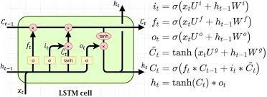
Long Short Term Memory Neural Network

Slide 16
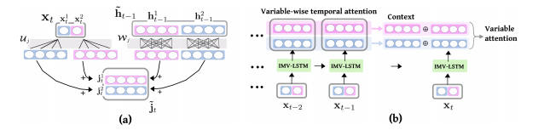

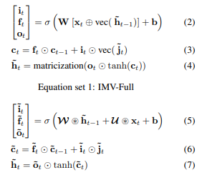
IMV-LSTM(Guo, Lin, Nino, 2019, ICML)
IMV-Full: With vectorization in Eq. (2) and (3), IMV-Full updates gates and memories using full h˜t−1 and ˜jt regardless of the variable-wise data in them. By simple replacement of the hidden update in standard LSTM by ˜jt, IMV-Full behaves identically to standard LSTM while enjoying the interpretability shown below

Slide 17
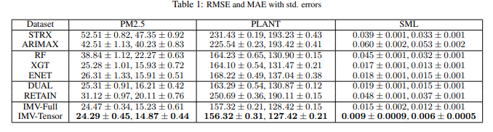
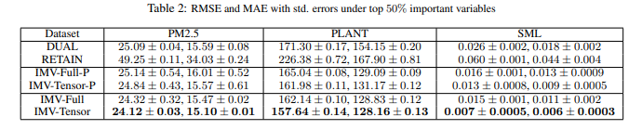
Model Advantage (Guo, Lin, Nino, 2019)

Slide 18
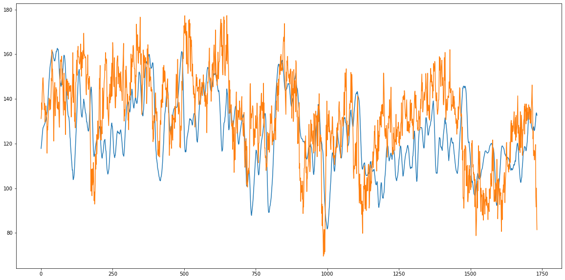
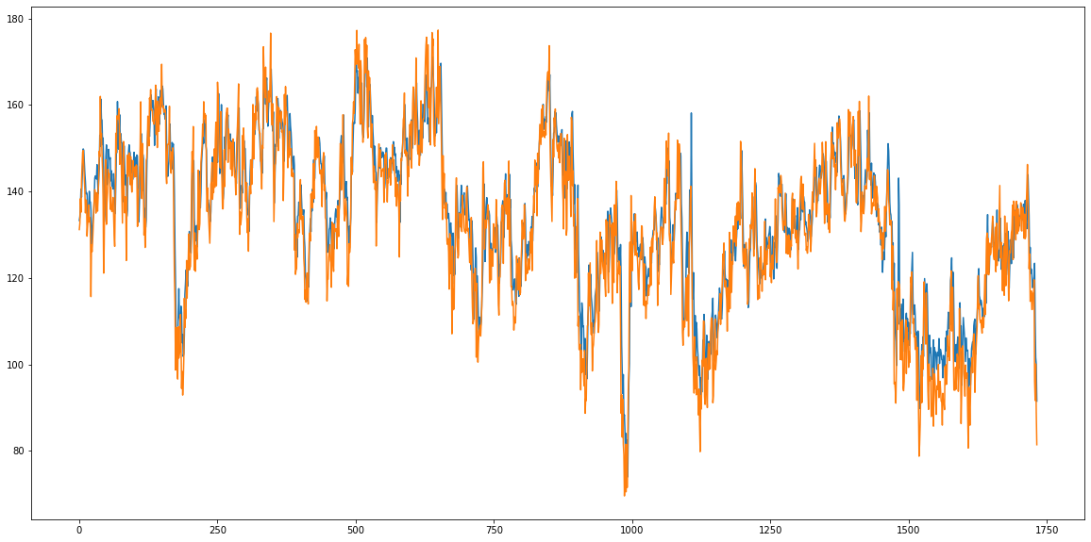
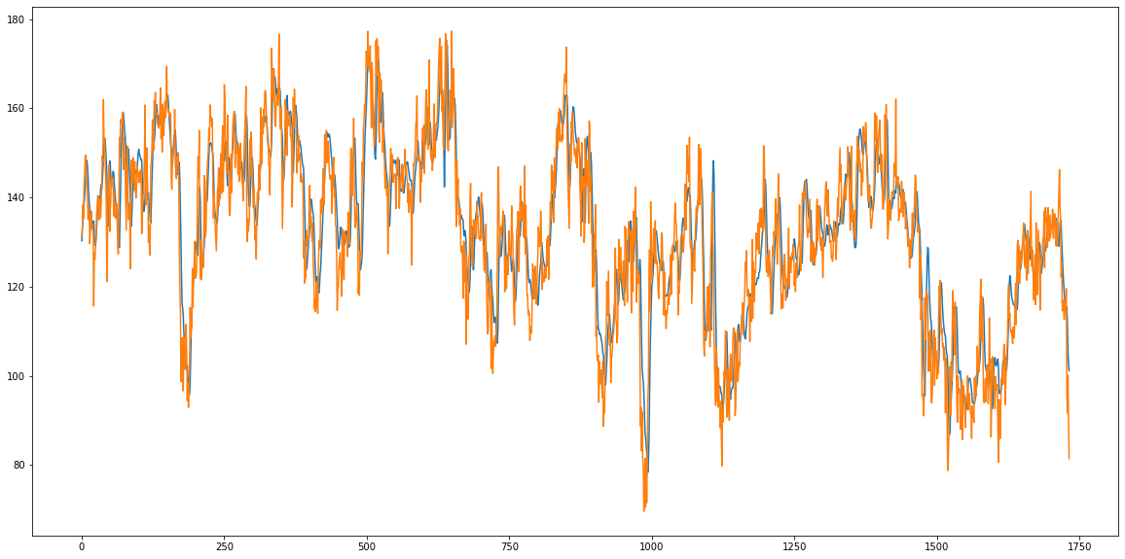
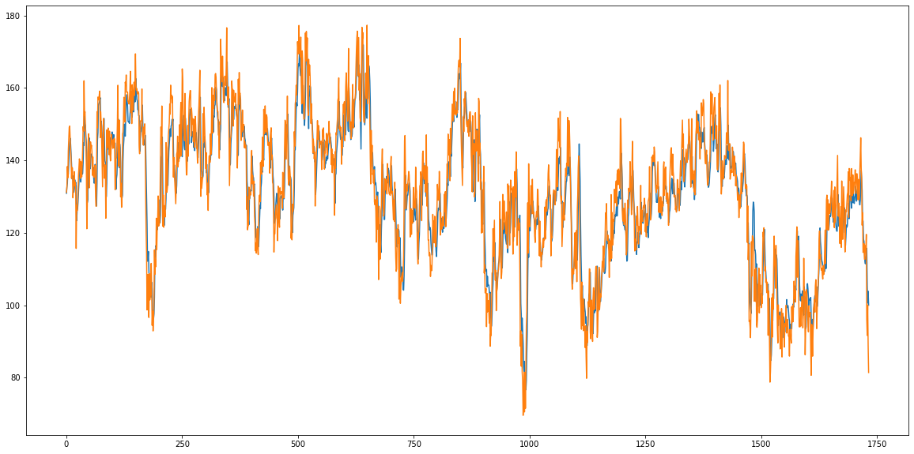
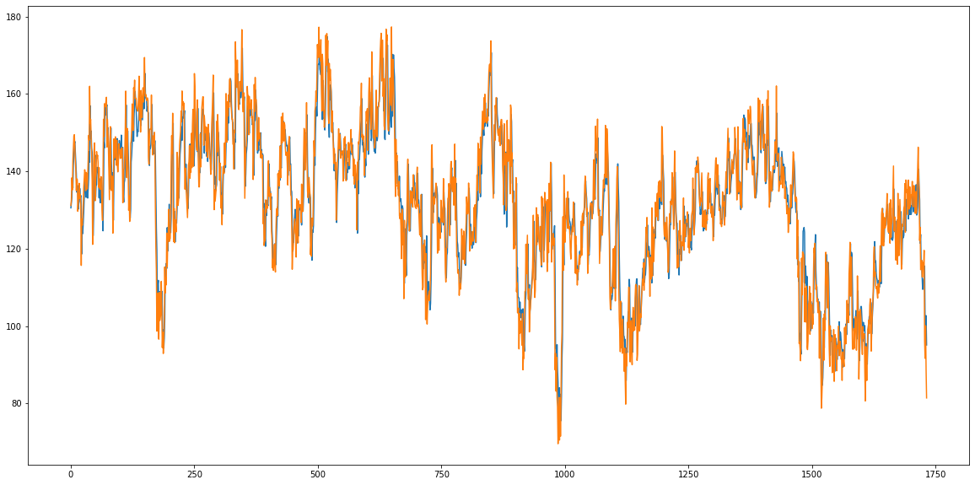
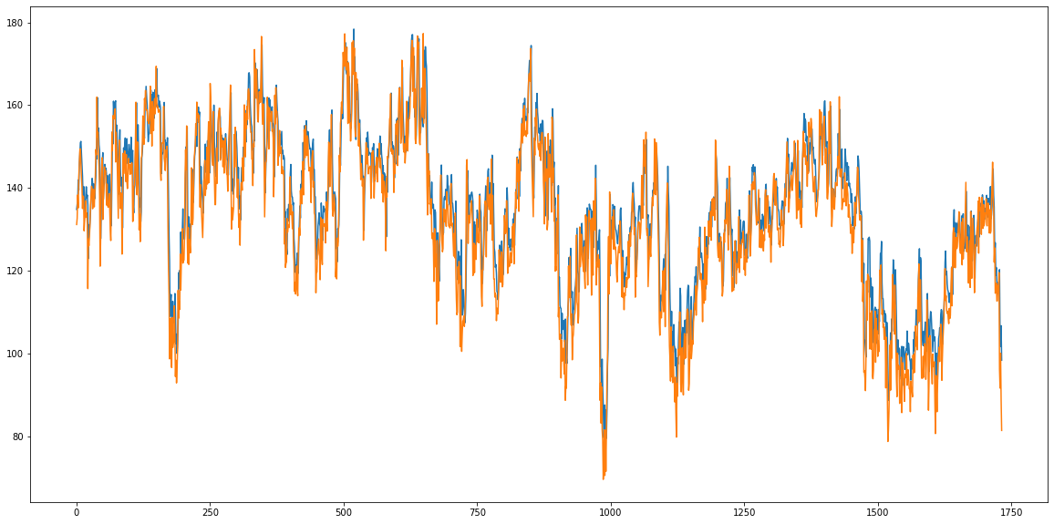

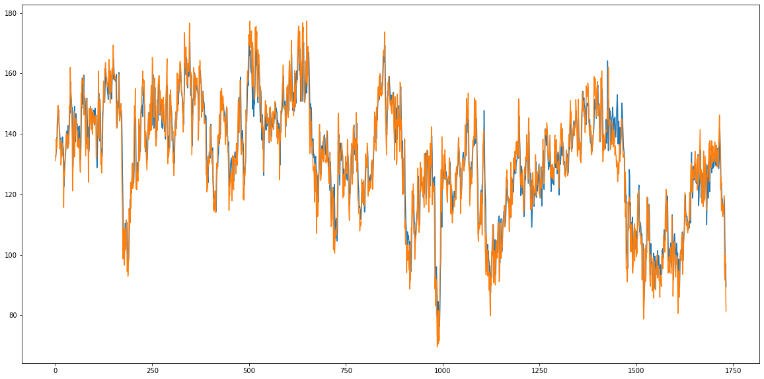
Training on own dataset (feeling as target)
feeling
Epoch 0
Epoch 20
Epoch 40
hour
Epoch 60
Epoch 80
Epoch 100
Training for 150 Epochs (on 2080TI GPU for
about 5min)
Loss converges to 50.2 MSE, 5.1 MAE.
Epoch 120
Epoch 140

Slide 19
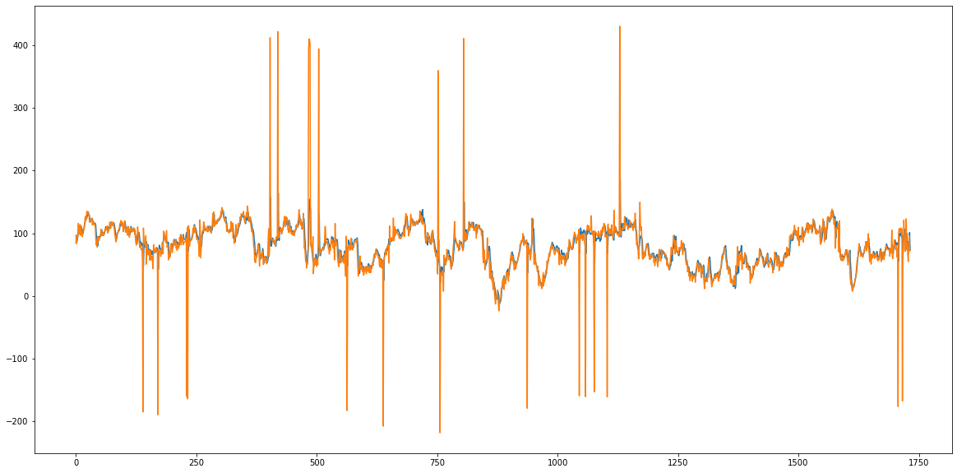
On Test Data
feeling
hour
MSE: 1218.5
MAE: 11.6
The model combined 7 characteristics to predict feeling.
Therefore, the model performs well and stably for most test data.

Slide 20

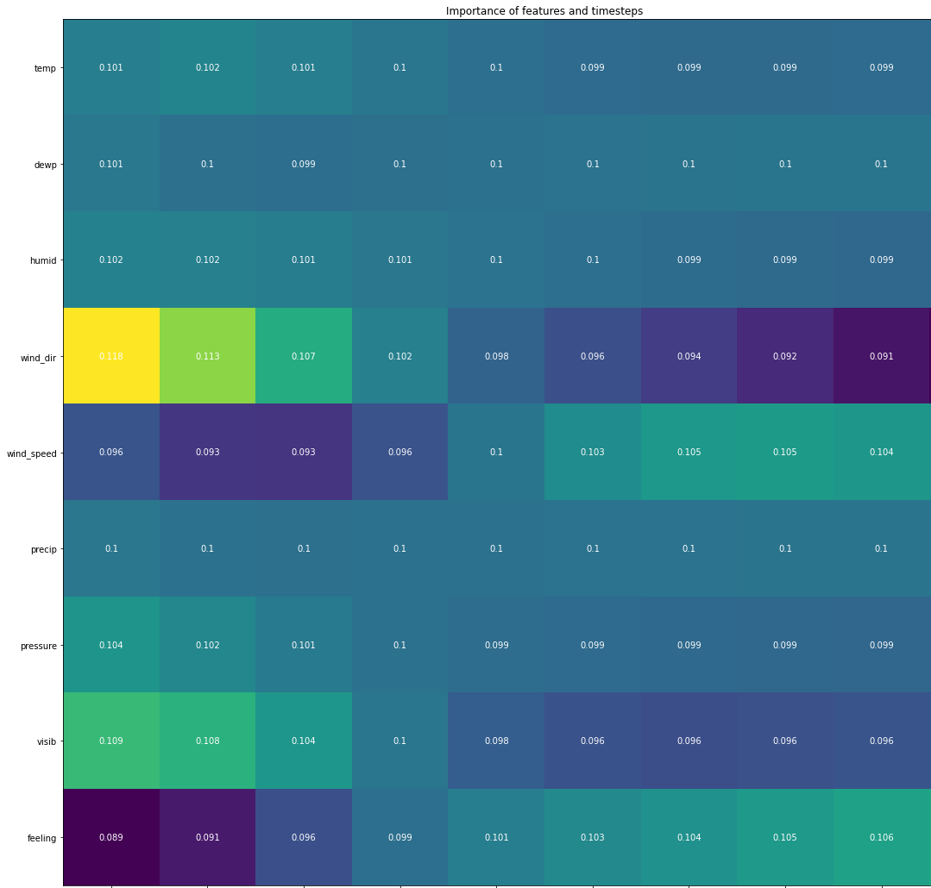
Importance of feature and timesteps
This table describes the importance of each feature at different time steps. As can be seen from the table, the wind direction has a high influence on the comfort level 8 hours in advance. This shows that the change of wind direction leads to the possibility of rain and wind in the next few hours, which leads to the change of comfort level.
t-8
t-7
t-6
t-5
t-4
t-3
t-2
t-1
t-0

Slide 21
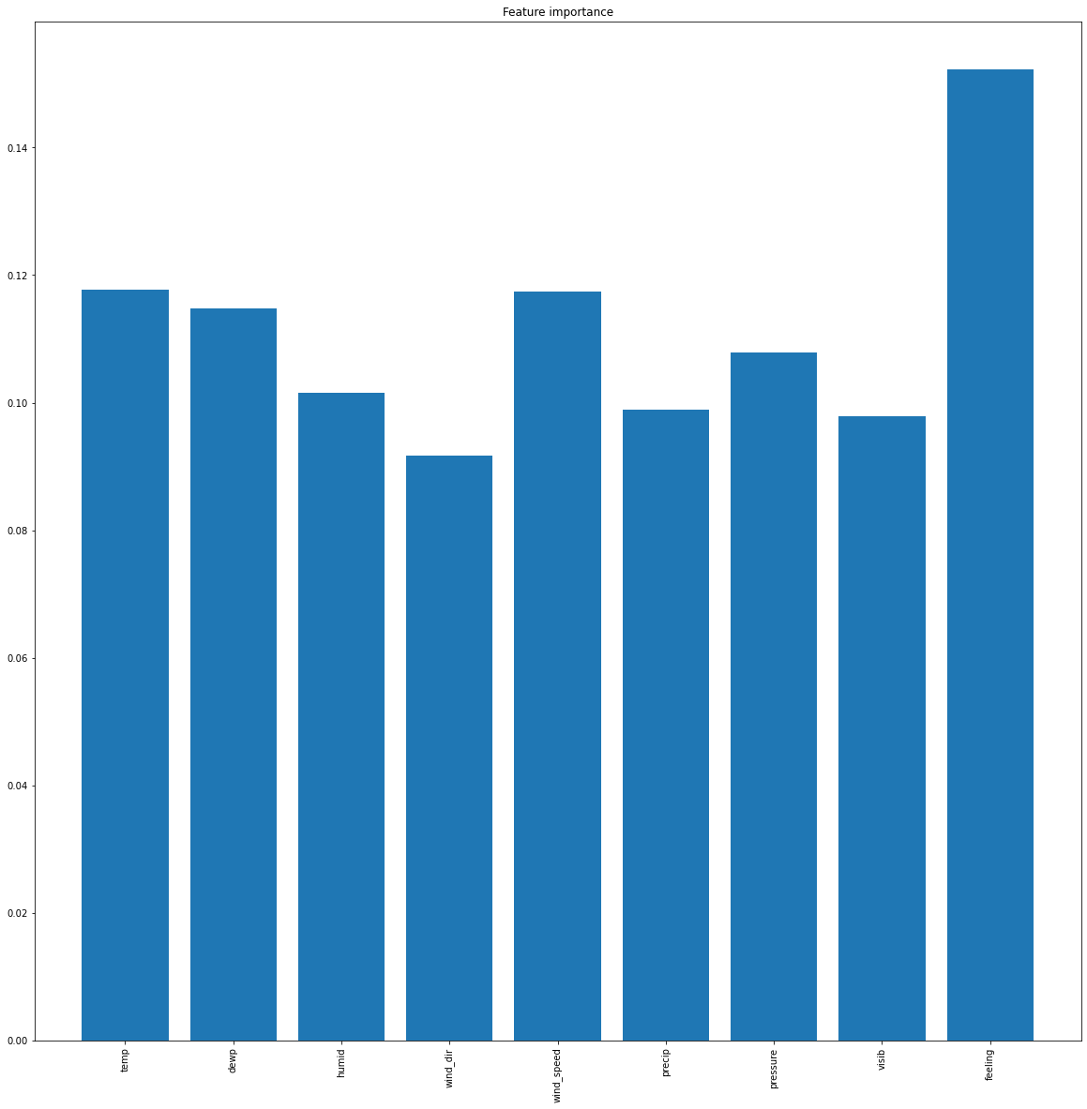
Feature Importance
0.14
0.08
0.00

Slide 22


Wavelet analysis (Torrence, 1998)
The wavelet coherence coefficient is defined as the ratio of the cross-wavelet power spectrum of two time series divided by the product of the spectrum after the square root of each wavelet power:
Where S is smoothing operator defined as:

Slide 23
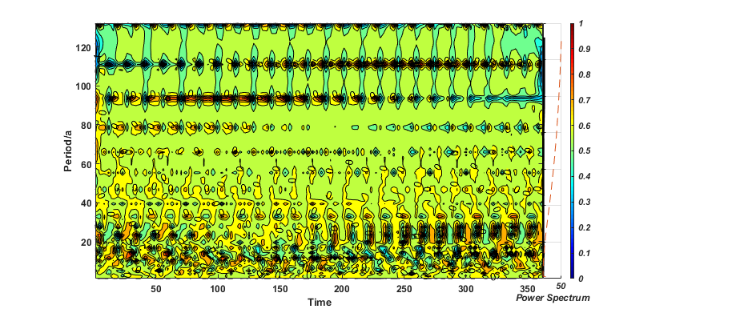
Wavelet analysis of feeling
The comfort level is affected by temperature, humidity, and wind speed.
There is no periodic relationship in the area.

Slide 24
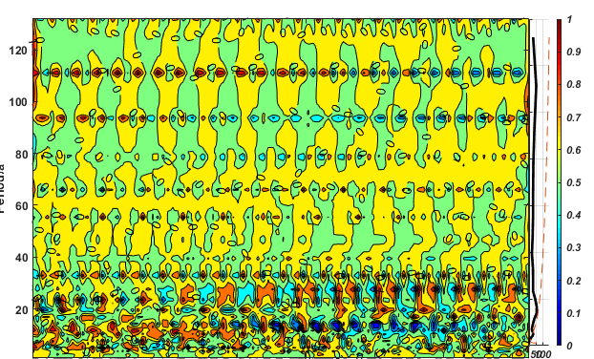
Wavelet analysis of humidity
period
The change period of relative humidity is more significant at about 17 days. This means that it rains every 17 days on average.

Slide 25
Wavelet relationship understanding
As for phase pattern, one can judge the causality from the direction of arrow in wavelet coherence diagram: when arrows points to the right, then series x, y are in-phase(implies x, y are positive correlated ), when arrows points to the left, then series x, y are anti-phase(implies x, y are negative correlated ). while arrows point to right and upward or to left and downward φx,y ∈ (0, π/2),(−π, −π/2) indicates that x leads/causes y. Similarly, arrows point to right and downward or to left and upward φx,y ∈ (−π/2, 0),(π/2, π) indicates that y leads/causes x. (Torrence, 1998)

Slide 26
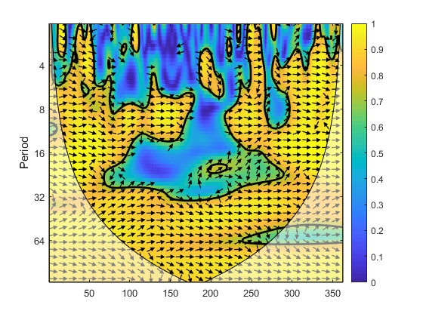
Wavelet Relationship
In the relationship between temperature and dew point, there is a consistent correlation between temperature and dew point over an eight-day period. However, the correlation is not obvious in the seasonal change from summer to autumn, which indicates that the temperature and humidity change in this area is relatively disorder when summer turns to autumn.
At most of the junction, the arrow points to ↗, indicating that temperature causes a change in dew point.
Temperature-dewpoint

Slide 27
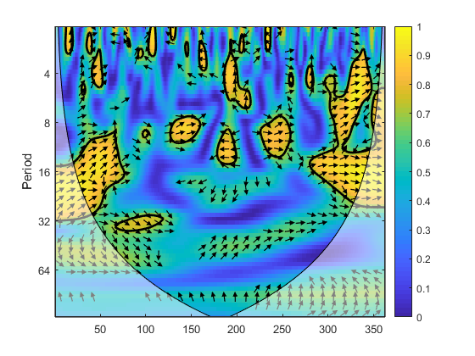
Wavelet Relationship
In the relationship between temperature and humidity, there are some sporadic positive correlations during the transition of seasons. These relationships run on an 16-day cycle remarkable in the winter.
Temperature-humidity

Slide 28
Conclusion
The climate is humid all the year round, especially in summer. The lowest temperature of the year is about 0 degrees, and the highest temperature is about 30 degrees. Average wind direction is 210 degrees. So it is defined as Temperate Marine climate located at the west coast of the US.
Wind direction change 8 hours before the change of the feeling, which indicates that the rainfall will come after the change of the wind direction.
Wavelet analysis shows that the summer precipitation cycle is not significant, indicating that the summer is affected by some monsoon.

Slide 29
Key References
Guo, T., Lin, T., Antulov-Fantulin, N. (2019, May). Exploring interpretable LSTM neural networks over multi-variable data. In International Conference on Machine Learning (pp. 2494-2504). PMLR.
Torrence, C., Compo, G. P. (1998). A practical guide to wavelet analysis. Bulletin of the American Meteorological society, 79(1), 61

