Slide 1
Role of Machine Learning in Biomedical Science
Changjie Lu
Department of Mathematical Science

Slide 2
Content
Medical
image
analysis
Surgical
assistance
Structural biology analysis

Slide 3
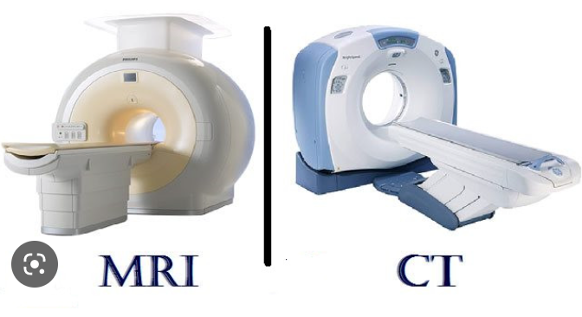
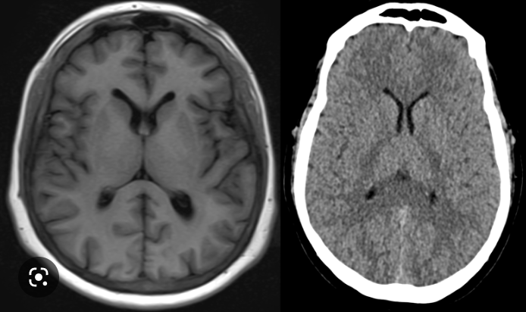
Medical image ANALYSIS
MRI (Magnetic resonance imaging)
CT (Computerized tomography)
US (Ultrasound)
Diagnosis based on medical images.

Slide 4
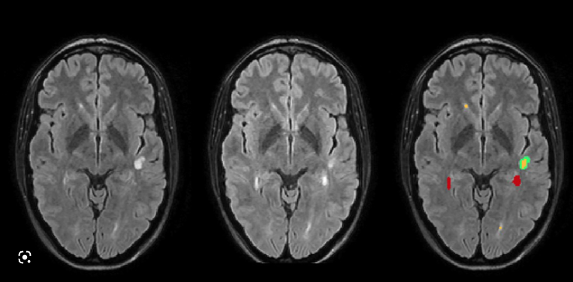
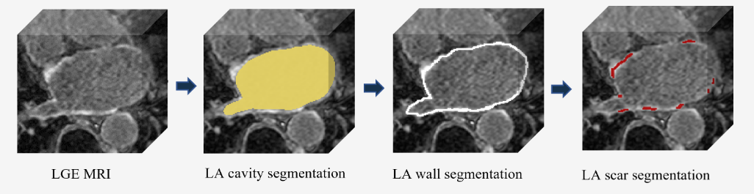
Lesion in brain images
Scars (lead to atrial fibrillation) in left atrium (cardiac) images

Slide 5
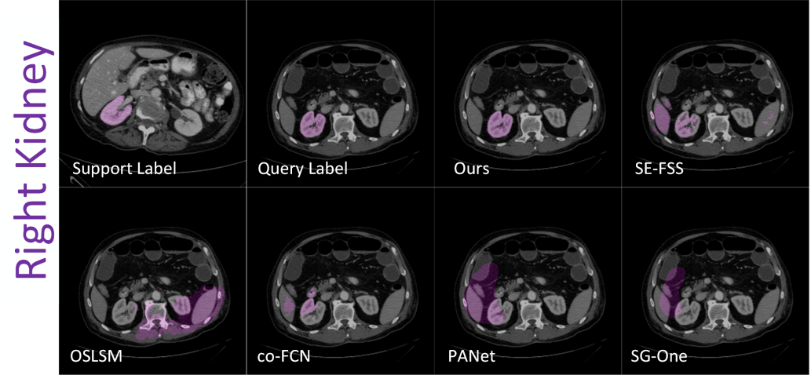
Challenge I: Limited Data
Data privacy
Ethical considerations
Solution: Few-shot Learning, Meta Learning, etc.

Slide 6
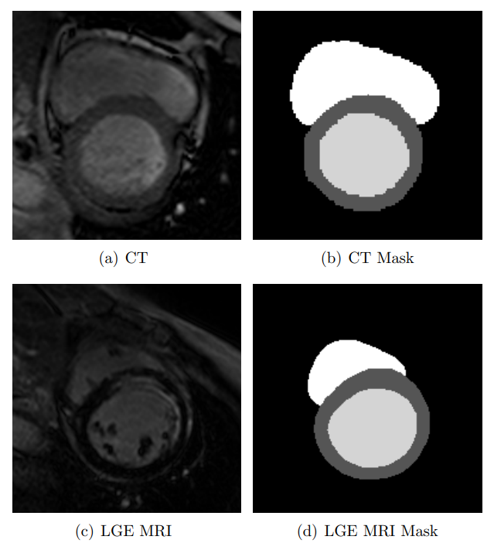
Challenge II: Multi-modality Data
Modality: LGE-MRI, CT, US, PET, etc.
Machine type: T3, T5, T7
How to transfer knowledge between different domains?
Solution: Domain adaptation (e.g. Metrics learning/ adversarial learning in latent space, image-to-image translation)

Slide 7
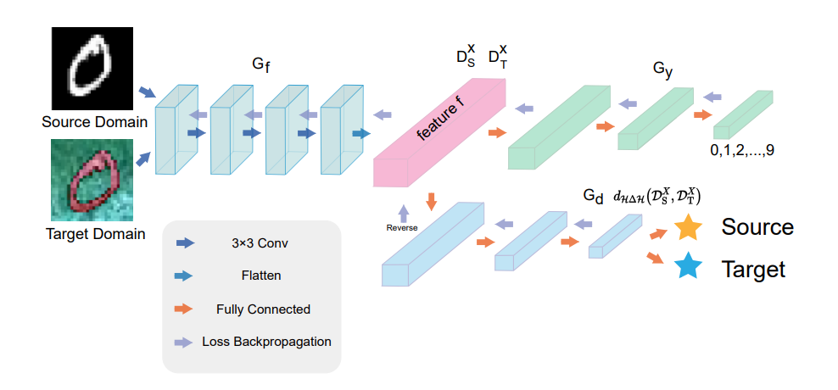
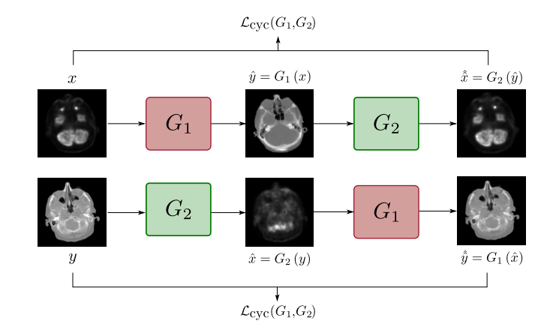
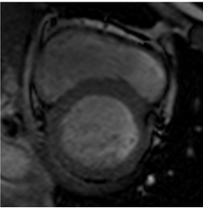
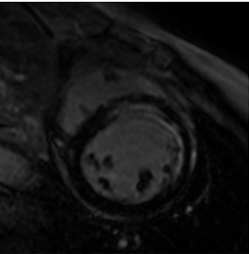
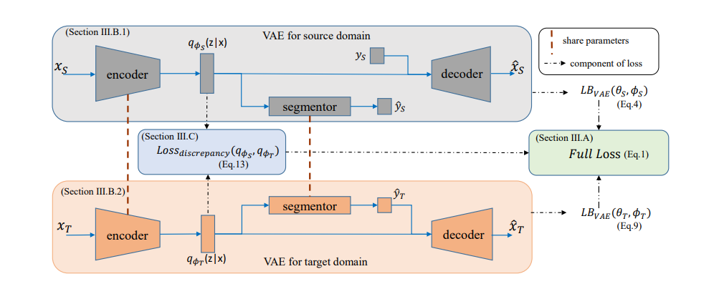
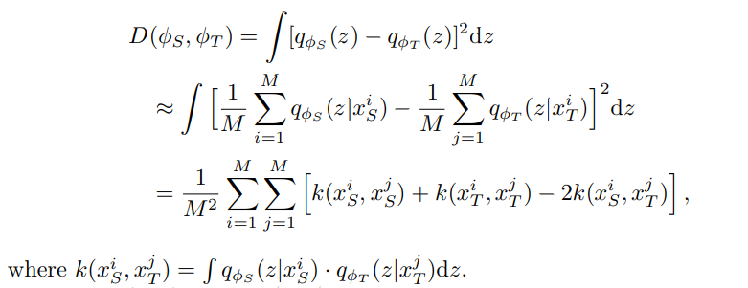
Adversarial domain adaptation
Image-to-image translation
Metric learning in latent space

Slide 8
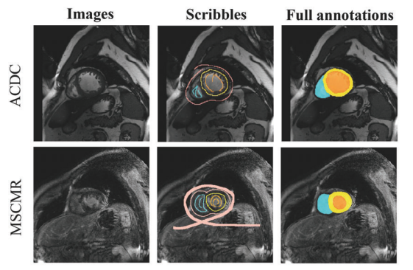
Challenge III: Limited labeled/scribble Data
Less time, heavy work
Limited doctors
Solution: Semi Supervised learning,
Weakly Supervised learning etc.
Scribble Data

Slide 9
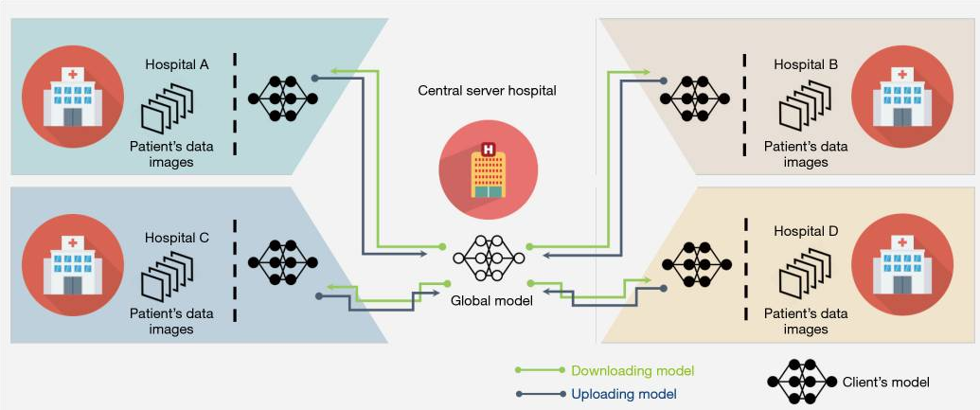
Challenge IV: Multi-Center Data
Data privacy
Multi hospitals need a large and union model
Solution: Federated learning
Share the model not the data

Slide 10
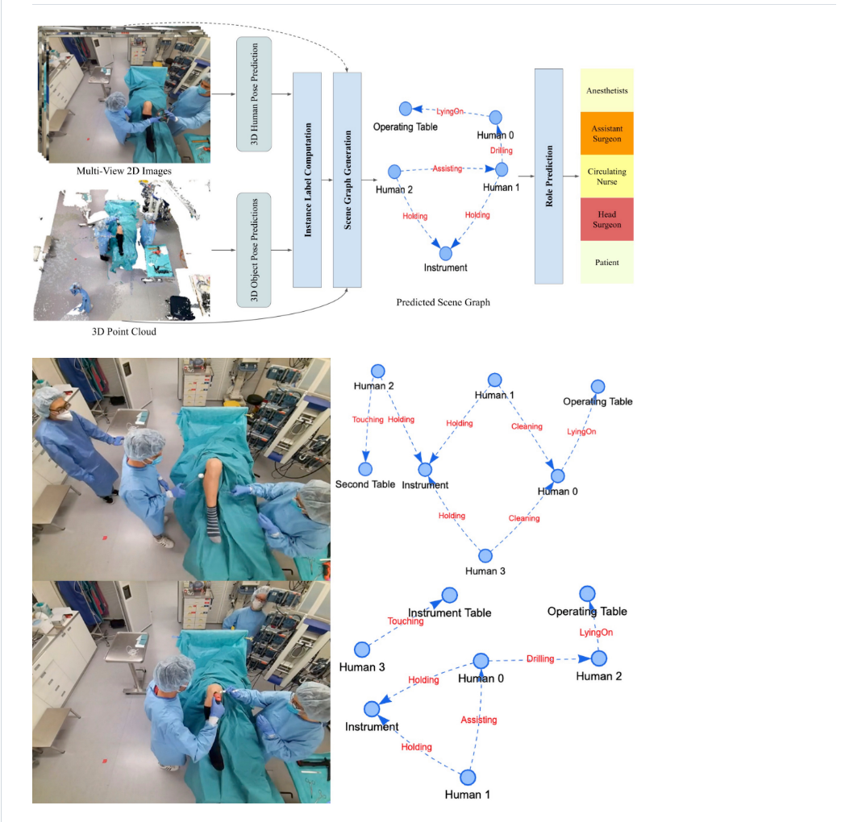
Surgical assistance
Scene graph generation
To ensure the orderly operation process,
and facilitate post-operative review
Image/Point cloud -> relationship graph

Slide 11
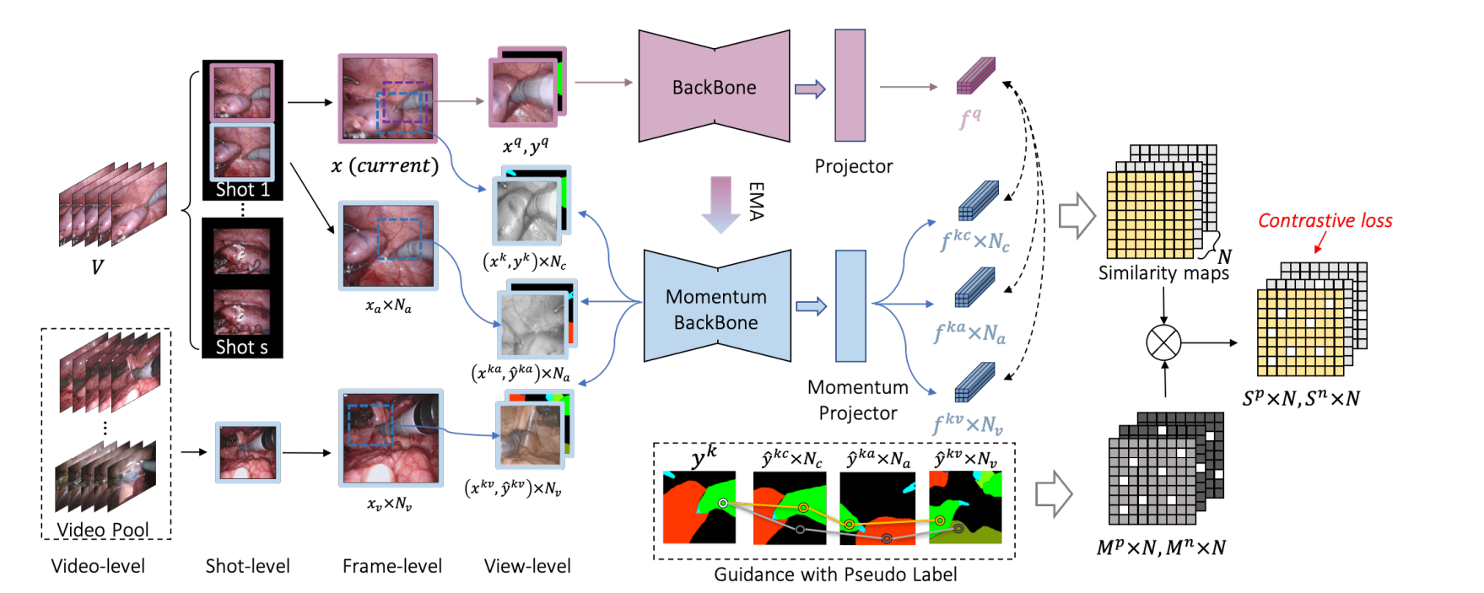
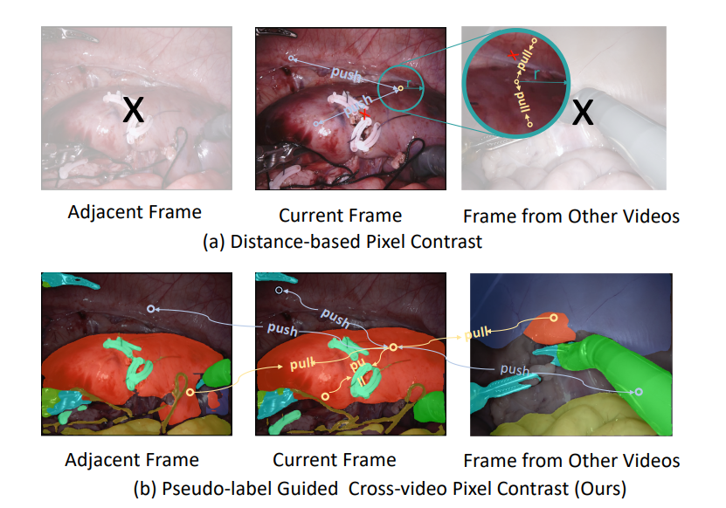
Robotic Surgical Scene Segmentation
Pseudo-label guided contrastive learning with limited annotations

Slide 12
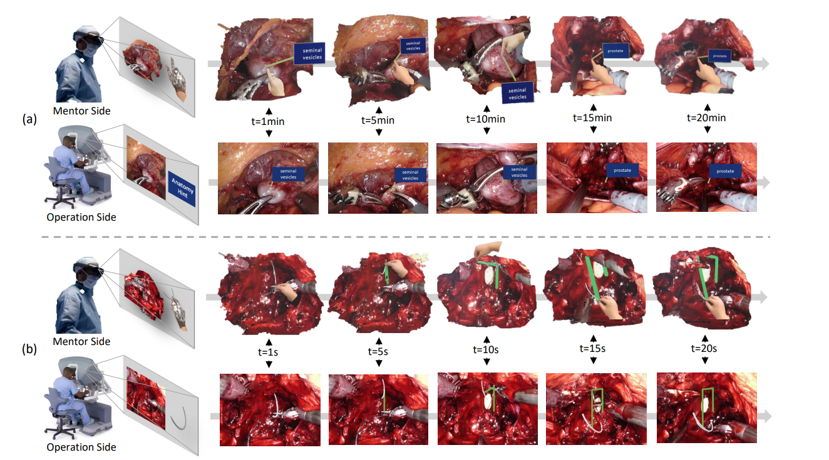
Robotic Surgery Remote Mentoring via AR
Mentor points key anatomies.
Surgeon manipulates a virtual needle.

Slide 13
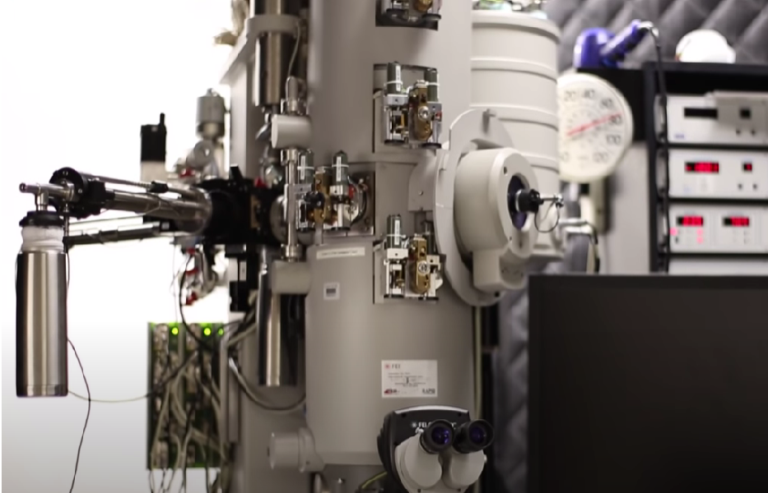
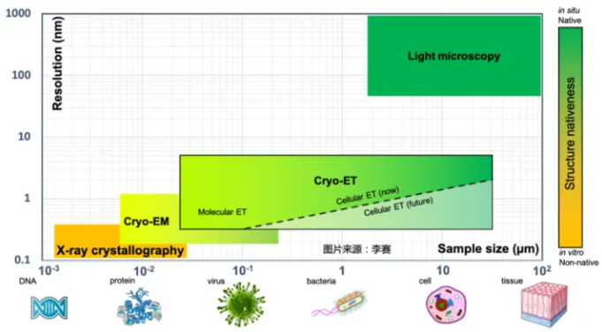
cryo-ET: structural biology analysis
Cryo-electron tomography
Observe the structure of near
atomic resolution inside the cell
Cryo-electron Machine

Slide 14
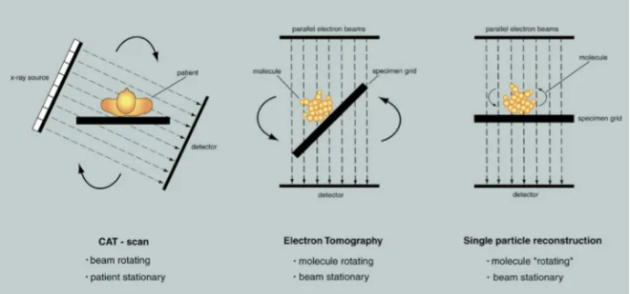
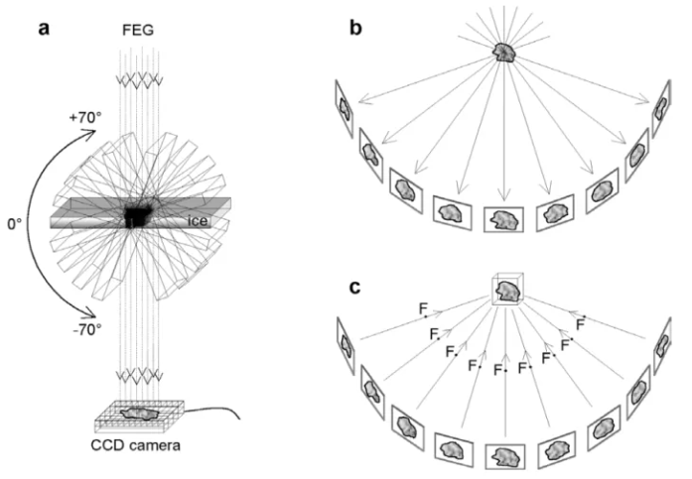
CT ET EM
Cryo-ET image-forming principle
Low dose Electron leads to low SNR(Signal to Noise Ratio)
Limited slices
Solution: Reconstruction using machine learning

Slide 15
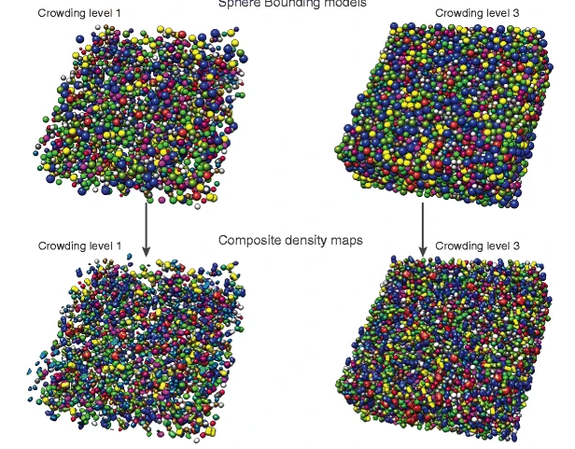
Tasks I:
Particle Picking
Crowded molecules
make reconstruction difficult.

Slide 16
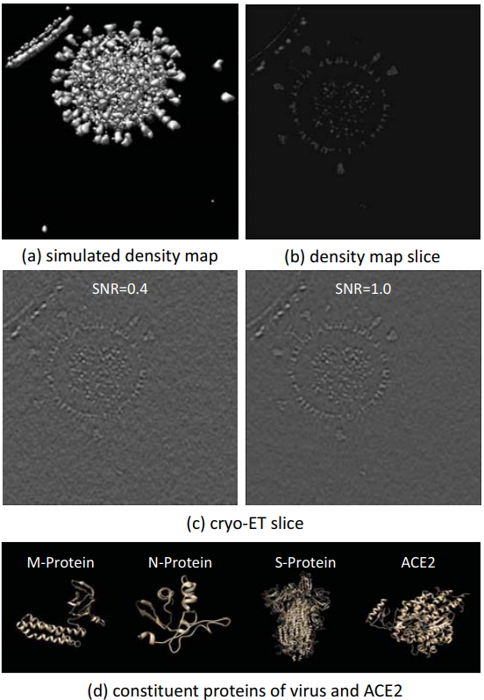
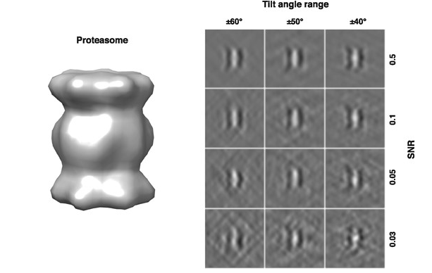
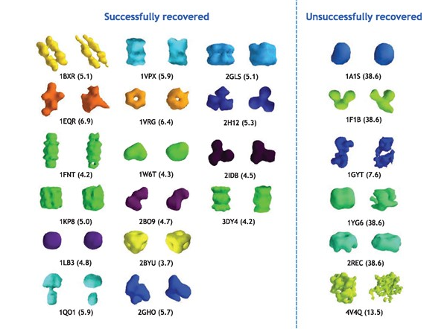
Tasks II:
Subtomogram Classification,
Segmentation
Proteasome 3D reconstruction
Isosurfaces structure prediction.
SARS-CoV-2 protein segmentation

Slide 17
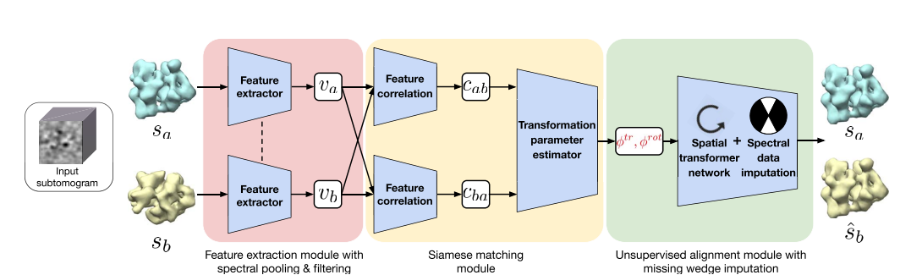
Tasks III:
Subtomogram Alignment and Averaging
Help recover macromolecular structures for
a better understanding of the molecular machinery
in cellular processes

Slide 18
Conclusion
Application
Medical image analysis
Surgical assistance
Structural biology analysis
Machine learning is an important step towards precise, safe and efficient biomedical science.

Slide 19
References
Li, R., Zeng, X., Sigmund, S. E., Lin, R., Zhou, B., Liu, C., ... & Xu, M. (2019). Automatic localization and identification of mitochondria in cellular electron cryo-tomography using faster-RCNN. BMC bioinformatics, 20(3), 75-85.
Pei, L., Xu, M., Frazier, Z., & Alber, F. (2016). Simulating cryo electron tomograms of crowded cell cytoplasm for assessment of automated particle picking. BMC bioinformatics, 17(1), 1-13.
Xu, M., Singla, J., Tocheva, E. I., Chang, Y. W., Stevens, R. C., Jensen, G. J., & Alber, F. (2019). De novo structural pattern mining in cellular electron cryotomograms. Structure, 27(4), 679-691.
Yan, R., Venkatakrishnan, S. V., Liu, J., Bouman, C. A., & Jiang, W. (2019). MBIR: A cryo-ET 3D reconstruction method that effectively minimizes missing wedge artifacts and restores missing information. Journal of structural biology, 206(2), 183-192.
Liu, S., Ma, Y., Ban, X., Zeng, X., Nallapareddy, V., Chaudhari, A., & Xu, M. (2020, December). Efficient cryo-electron tomogram simulation of macromolecular crowding with application to SARS-COV-2. In 2020 IEEE International Conference on Bioinformatics and Biomedicine (BIBM) (pp. 80-87). IEEE.

Slide 20
Xu, M., Chai, X., Muthakana, H., Liang, X., Yang, G., Zeev-Ben-Mordehai, T., & Xing, E. P. (2017). Deep learning-based subdivision approach for large scale macromolecules structure recovery from electron cryo tomograms. Bioinformatics, 33(14), i13-i22.
Zeng, X., & Xu, M. (2020). Gum-net: Unsupervised geometric matching for fast and accurate 3d subtomogram image alignment and averaging. In Proceedings of the IEEE/CVF Conference on Computer Vision and Pattern Recognition (pp. 4073-4084).
Li, L., Zimmer, V. A., Schnabel, J. A., & Zhuang, X. (2022). Medical image analysis on left atrial LGE MRI for atrial fibrillation studies: A review. Medical Image Analysis, 102360.
Ronneberger, O., Fischer, P., & Brox, T. (2015, October). U-net: Convolutional networks for biomedical image segmentation. In International Conference on Medical image computing and computer-assisted intervention (pp. 234-241). Springer, Cham.
Wu, F., & Zhuang, X. (2021). Unsupervised domain adaptation with variational approximation for cardiac segmentation. IEEE Transactions on Medical Imaging, 40(12), 3555-3567.
Lu, C., Zheng, S., & Gupta, G. (2022). Unsupervised Domain Adaptation for Cardiac Segmentation: Towards Structure Mutual Information Maximization. In Proceedings of the IEEE/CVF Conference on Computer Vision and Pattern Recognition (pp. 2588-2597).
Zhang, K., & Zhuang, X. (2022). CycleMix: A Holistic Strategy for Medical Image Segmentation from Scribble Supervision. In Proceedings of the IEEE/CVF Conference on Computer Vision and Pattern Recognition (pp. 11656-11665).

