Slide 1
Travel & Tour Booking System
Final Exam Project
Course: Best Programming Practices and Design Patterns

Slide 2
1. Topic & Problem Statement
Topic: Design and Development of an Automated Travel and Tour Booking System.
Case Study: Wanderlust Travels Ltd
Problem Statement:
- The company relies on manual booking processes using phone calls and Excel.
- This leads to inefficiencies, double-bookings, and delayed payment tracking.
- A centralized system is required to manage online bookings and track revenue.

Slide 3
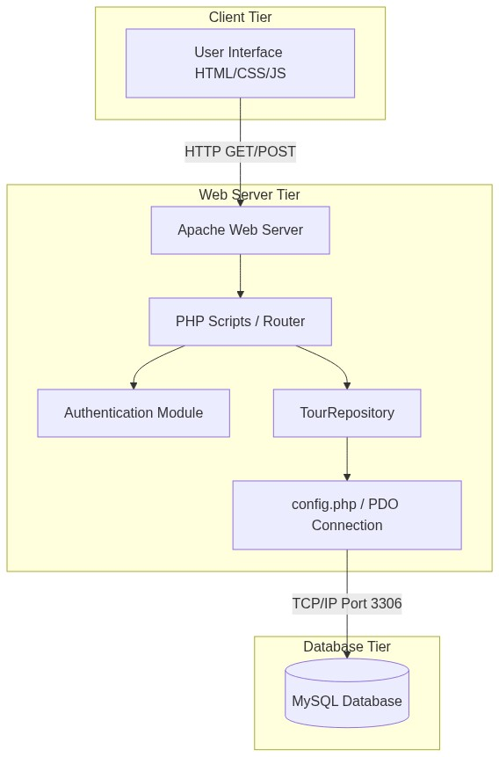
Phase 1: Component Diagram (Functional)

Slide 4
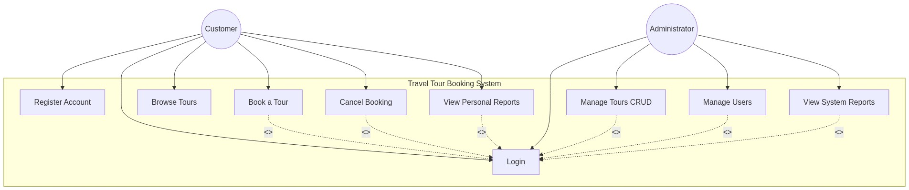
Phase 1: Use Case Diagram

Slide 5
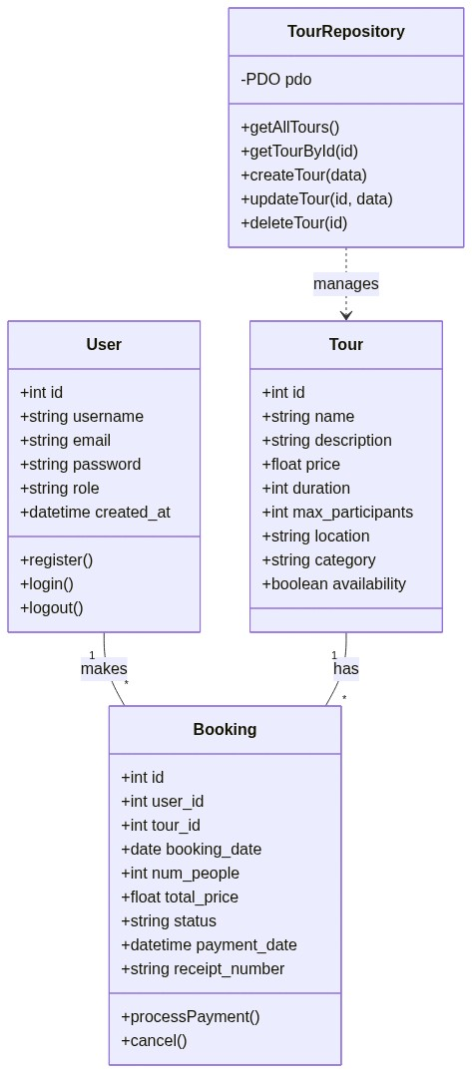
Phase 1: Class Diagram

Slide 6
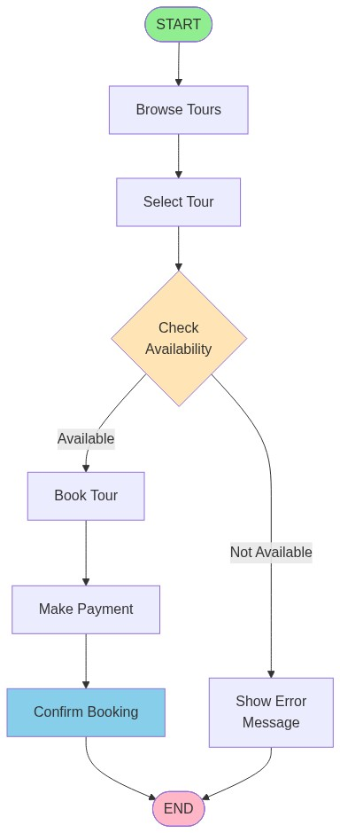
Phase 1: Activity Diagram

Slide 7
Phase 1: Sequence Diagram
[Image sequence diagram.png not available]

Slide 8
Phase 2: Software Prototype
Fully functional prototype using PHP, MySQL, HTML, and CSS.
User Journeys: Login -> Dashboard -> Browse Tours -> Book Tour -> Logout.
Input Processing: Forms for Registration, Login, and Booking are validated.
Database: Actual MySQL database integration simulates real-time availability.

Slide 9
Phase 2: Best Programming Practices & Design Pattern
Practices Used:
- Meaningful variable names ($tour_id vs $x).
- Single Responsibility Principle separated into modular files.
- Clear comments explaining logic.
Design Pattern: Repository Pattern
- A TourRepository class encapsulates all database logic.
- Frontend calls methods like getAllTours() instead of raw SQL.

Slide 10
Phase 3: Dockerizing & Version Control
Docker Implementation:
- The app is containerized using a Dockerfile and docker-compose.yml.
- Containers include Apache Web Server and MySQL Database.
- Eliminates environment inconsistencies across developer machines.
Version Control:
- Managed using Git.
- .gitignore prevents pushing sensitive credentials like the .env file.

Slide 11
Phase 4: Software Test Plan
Testing Goals:
- Ensure the booking system prevents double bookings and secures user data.
Test Cases (Normal & Edge Cases):
- TC01: User logs in with correct credentials -> Dashboard
- TC02: User tries to book more slots than available -> Rejected
Tools for Tracking:
- PHPUnit for automated unit tests (e.g. TourRepositoryTest.php).
- GitHub/GitLab Issues used as a Kanban board to track bugs.

