Slide 1
ISY5002 PATTERN RECOGNITION SYSTEM
Traffic Monitoring
and Forecasting
Workbench
A modular prototype
Wang Mingyang · Su Tanjia · Fu Junchun · Yan Yi · Wang Zimo
Notes:
This presentation reports on the Traffic Monitoring and Forecasting Workbench. The project addresses two connected tasks: detecting vehicles in Singapore camera images, and forecasting short-term traffic from a calibrated sensor series. The work covers four outputs: a detection pipeline, a forecasting benchmark and model, an operator workbench, and a public LTA image dataset. The presentation is organized into five parts.

Slide 2
PART 01 / 05
01
01
Problem and system
Two data domains, one system:
LTA images for detection, PEMSD8 series for forecasting.
Notes:
Part one explains the two data domains and the system architecture.

Slide 3
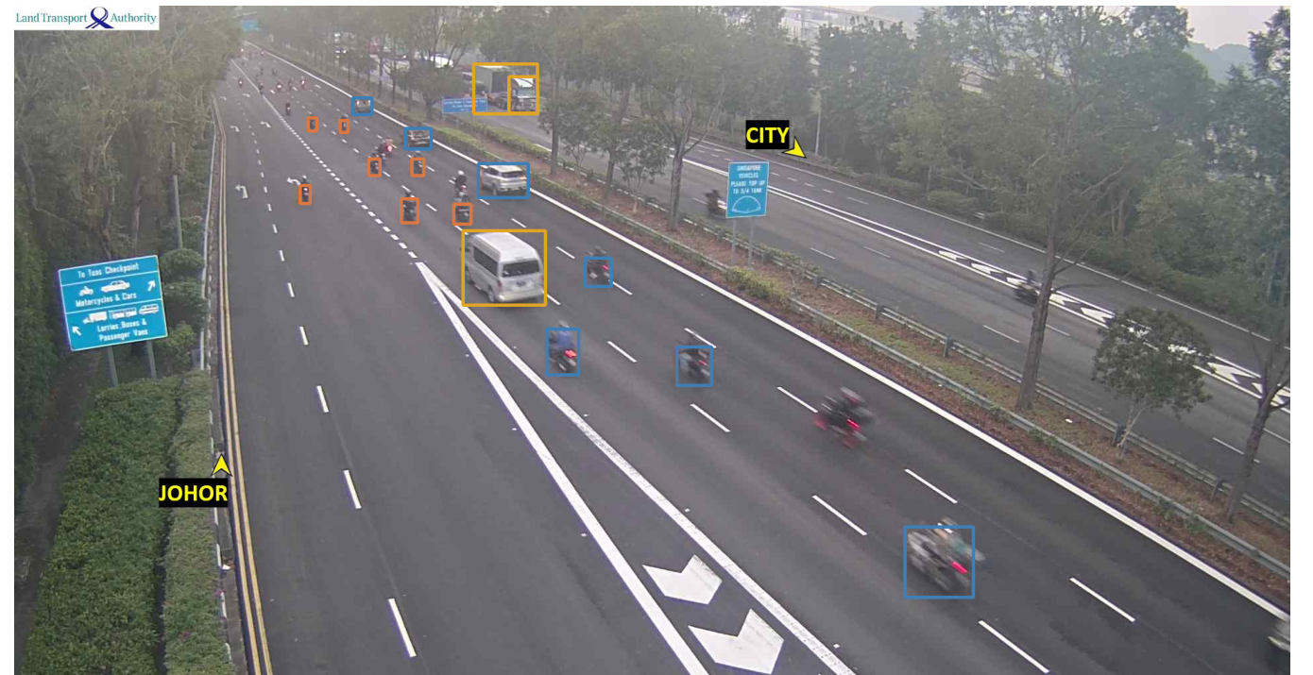
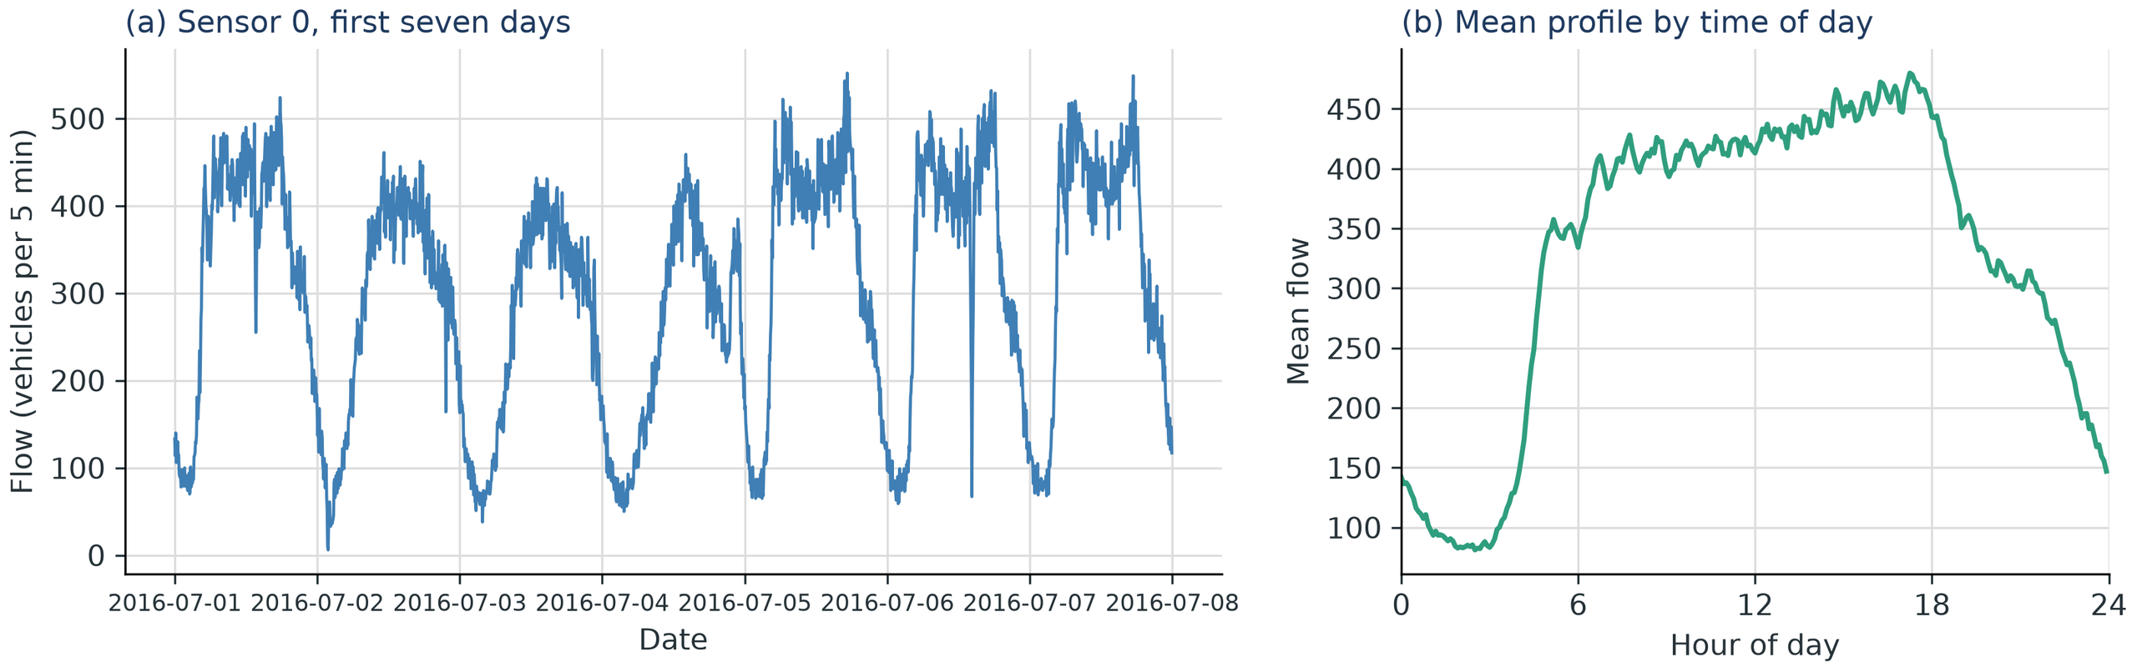
CHAPTER 1 · PROBLEM AND SYSTEM
LTA for detection; PEMSD8 for forecasting
LTA · Singapore
8 cameras · 15,316 images
Two weeks · 10-minute stills
Per-frame vehicle counts
Used for detection, filtering and congestion
Night is the hardest case
PEMSD8 · California
170 sensors · 17,856 five-minute observations
Flow, occupancy and speed
Used for forecasting and model comparison
LTA supplies images; PEMSD8 supplies calibrated series for forecasting.
WHY TWO DATASETS
LTA provides camera images, few labels and only 10-minute stills.
Forecasting models need a calibrated five-minute flow/occupancy/speed series.
So LTA is used for detection, PEMSD8 for forecasting; the workbench joins their outputs.
Notes:
The project uses two datasets because they serve different tasks. LTA provides images from eight Singapore cameras: 15,316 frames over two weeks, sampled every ten minutes. The images support detection, filtering and congestion grading, but they carry few labels and only per-frame vehicle counts. A forecasting model requires a regular calibrated series of flow, occupancy and speed. LTA cannot supply that series directly. PEMSD8 provides it: 170 sensors, 17,856 five-minute observations, with flow, occupancy and speed. PEMSD8 is a California network, so it serves as a public benchmark rather than a local deployment dataset. The division is deliberate: LTA for detection, PEMSD8 for forecasting, and the workbench joins their outputs with source labels.

Slide 4
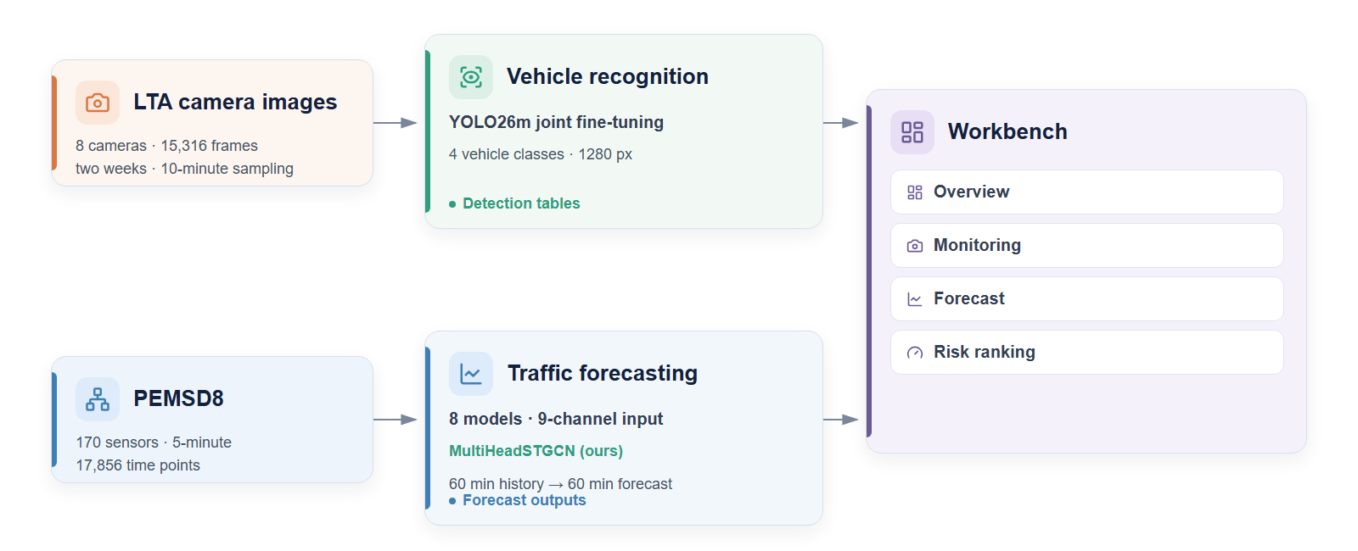
CHAPTER 1 · PROBLEM AND SYSTEM
Two data pipelines meet in one workbench
The two pipelines meet only in the workbench.
Detection and forecast outputs are joined there with source labels.
The data domains stay separate; the workbench is a historical replay.
Notes:
The architecture follows the same division. The upper path runs from LTA images through vehicle recognition to detection tables. The lower path runs from the PEMSD8 series through forecasting to twelve-step outputs. The two pipelines meet only in the workbench. Detection and forecast outputs are presented together, but the data domains remain separate and every output keeps its source label. The current workbench is a historical replay, so it demonstrates the operator flow without claiming a live connection.

Slide 5
PART 02 / 05
02
02
Detection
Fine-tuning adapts YOLO to LTA;
road regions support filtering and congestion grading.
Notes:
Part two covers detection: adapting YOLO to LTA, checking that adaptation, and using road regions for filtering and congestion.

Slide 6
CHAPTER 2 · DETECTION
Fine-tuning adapts a public detector to LTA
Source data
Leakage-safe split
Teacher-student
MIO-TCD supplies four vehicle classes
Near-duplicate frames are grouped by scene.
A stronger teacher labels LTA frames.
with human labels.
LTA supplies eight fixed cameras
Whole groups go to train, dev or test.
The student trains on MIO-TCD
at ten-minute intervals.
plus LTA pseudo-labels.
Viewpoint, lighting and scale differ.
Test groups are scored once.
A 63-frame human-corrected subset
Every frame stays inside one split.
is frozen before scoring.
Design rationale
Question
Design choice
What it protects
Will the model memorize scenes?
Group near-duplicate frames by scene.
Test scenes stay unseen.
Where do LTA labels come from?
Teacher pseudo-labels on LTA frames.
Target-domain supervision without full annotation.
How do we check the teacher?
63-frame human-corrected subset.
Human check frozen before scoring.
Notes:
The detection work starts from MIO-TCD, which provides four vehicle classes with human labels. LTA provides fixed camera views with different viewpoints, lighting and vehicle scale. The first design choice is the split: near-duplicate frames are grouped by scene, and whole groups are assigned to training, development or test. This prevents the same scene from appearing on both sides of the evaluation. The second choice is teacher-student adaptation. A YOLO26x teacher labels LTA frames; a YOLO26m student trains on MIO-TCD labels and LTA pseudo-labels. The third choice is the human check: a 63-frame human-corrected subset is frozen before scoring. The rationale is a chain: scene groups protect the test set, teacher labels provide target-domain supervision, and the human subset checks the teacher. The design separates learning data from evaluation evidence.

Slide 7
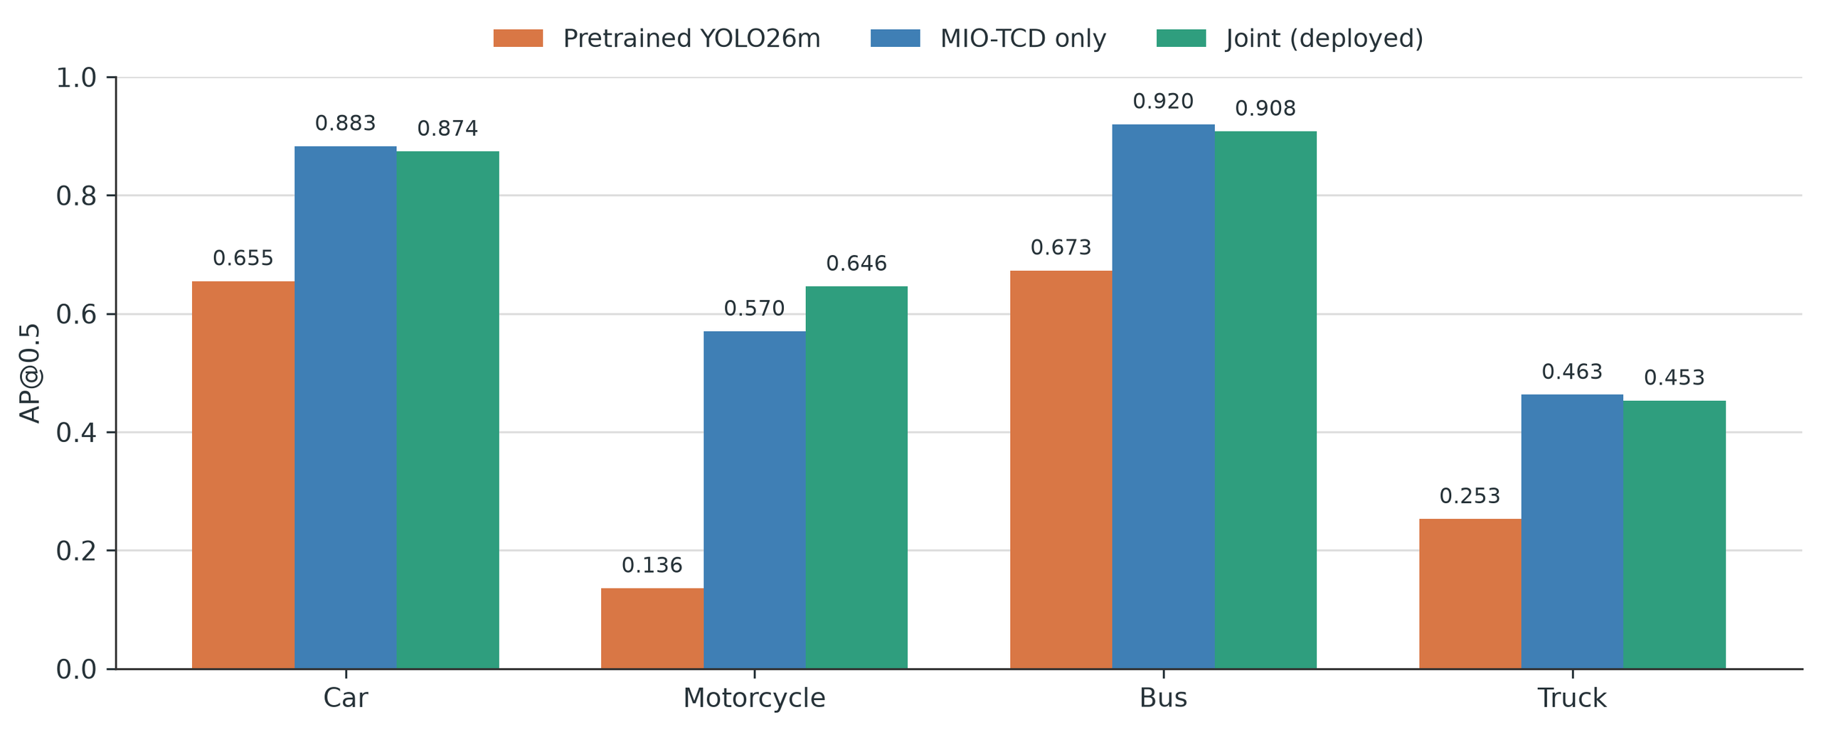
CHAPTER 2 · DETECTION
MIO-TCD fine-tuning drives mAP; LTA training adds recall
MIO-TCD · HUMAN LABELS
0.430 → 0.720
Model
mAP@0.5
Count MAE
Pretrained YOLO26m
0.430
1.212
MIO-TCD only
0.709
0.650
Joint fine-tuning
0.720
0.698
Most mAP gain comes from MIO-TCD training; LTA joint training mainly adds recall.
HUMAN-CORRECTED LTA · 63 IMAGES
0.467 → 0.478
mAP difference +0.011;
95% CI −0.043 to 0.060
0.394 → 0.547
The gain is class-agnostic recall:
coverage rises while precision stays flat.
Absolute scores are lower than against the teacher because human labels add small vehicles.
Notes:
On human-labelled MIO-TCD, most of the gain comes from supervised fine-tuning: mAP at 0.5 rises from 0.430 to 0.709. Joint training with LTA adds a small further gain to 0.720, while count error increases slightly from 0.650 to 0.698. The per-class panel shows the largest improvement on motorcycles. On the human-corrected LTA subset, mAP is essentially flat, from 0.467 to 0.478, but recall rises from 0.394 to 0.547. The gain is therefore coverage of small vehicles rather than overall precision. This is the central detection result: the model sees more LTA vehicles, but it does not become uniformly more accurate.

Slide 8
CHAPTER 2 · DETECTION
Teacher agreement depends on resolution and domain
Model
mAP@0.5 @960
mAP@0.5 @1280
HOW TO READ THE TABLE
Metric: teacher agreement on LTA
Pretrained YOLO26m
0.555
0.660
Not human accuracy; teacher row is the ceiling.
MIO-TCD only
0.175
0.201
At 960 px: joint > pretrained > MIO-only
0.635 > 0.555 > 0.175.
Joint fine-tuning
0.635
0.638
At 1280 px: pretrained > joint > MIO-only
0.660 > 0.638 > 0.201.
Teacher YOLO26x
0.707
0.775
Night sets the count limit
Agreement with the frozen teacher; teacher row is a reference ceiling.
1,437 of 1,478 zero-detection frames are at night.
Higher resolution favors pretrained; joint training buys LTA recall.
These are teacher-agreement numbers; human-corrected results are on the previous page.
Notes:
This page uses teacher agreement, not human accuracy, so it answers a different question from the previous page. The teacher is the reference ceiling. At 960 pixels, joint fine-tuning is the best student, with 0.635, ahead of pretrained at 0.555 and MIO-only at 0.175. At 1280 pixels, the order changes: pretrained reaches 0.660, joint 0.638 and MIO-only 0.201. Higher resolution therefore favors the pretrained model, while joint training mainly buys LTA recall. MIO-only is worst at both resolutions. The night result is the main operational limit: 1,437 of 1,478 zero-detection frames occur at night, so night counts should be read as a lower bound.

Slide 9
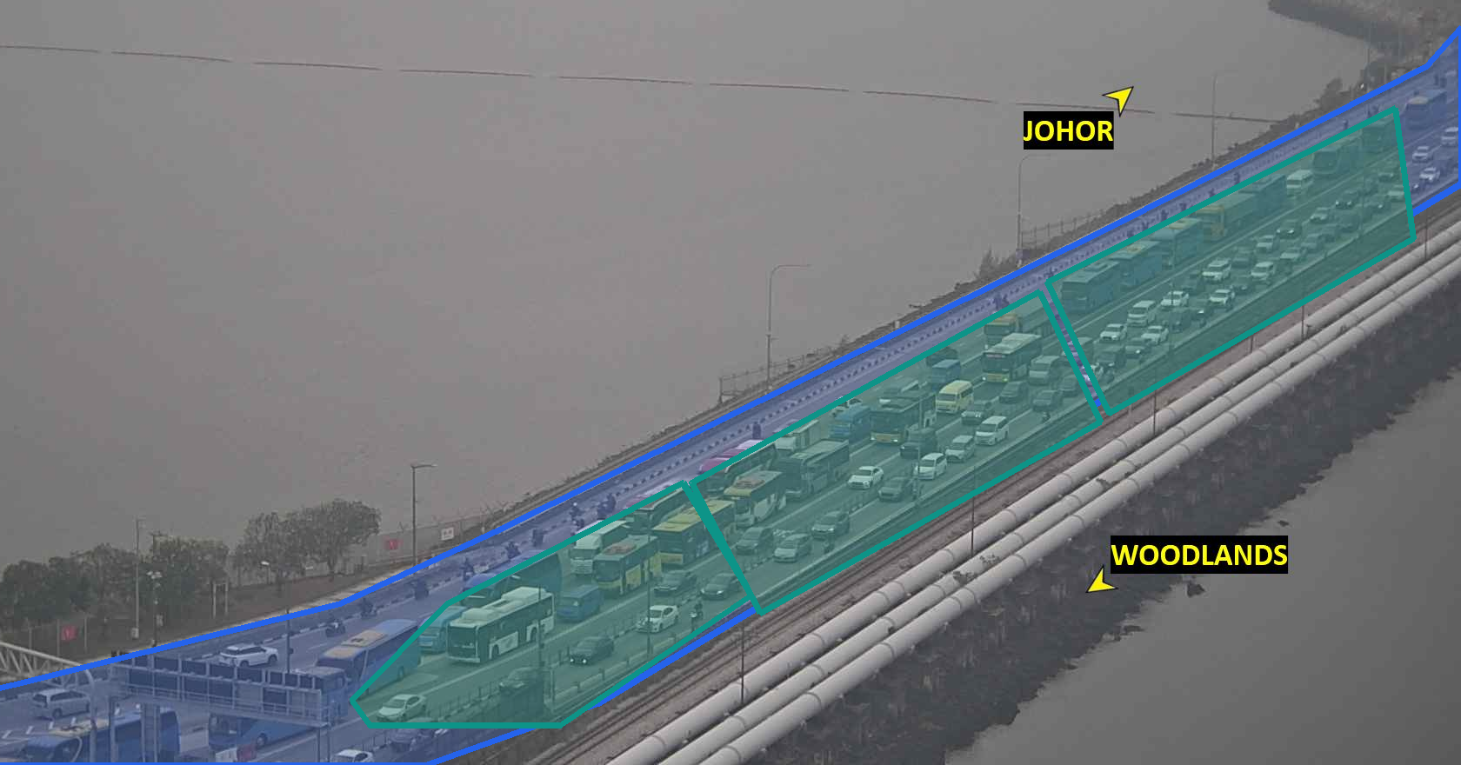
CHAPTER 2 · DETECTION
Road regions support filtering and congestion grading
01
Road region
02
Road filter
03
Congestion voters
04
Stacked rating
Road polygons, exclusion set and
detection zones per camera
5,536 boxes removed (2.0%)
Precision 0.816 → 0.833; recall −0.4
Detector count / occupancy
Background edges; OpenCLIP
74.3% accuracy; κ 0.704
Congested P/R 0.88 / 0.84
HOW THE FILTER WORKS
A detection is kept when the bottom-centre of its box
falls inside a road polygon; exclusion zones remove
known false-positive areas.
HOW CONGESTION IS GRADED
Three voters score the same detection zones: detector
count/occupancy, background edges and OpenCLIP.
A stacked classifier combines them into a level.
Labels: free / moderate / congested; 400-frame human-labelled test set.
Accuracy is 60–94% by camera; night 77% vs day 73%.
Road region
Detection zone
Notes:
The post-processing stage uses one per-camera road calibration for two tasks. For filtering, a detection is kept only when the bottom centre of its box falls inside a road polygon; exclusion zones remove known false-positive areas. The filter removes 2.0 percent of boxes and raises precision from 0.816 to 0.833, while counting remains essentially unchanged because the detector already misses many vehicles. The same detection zones support congestion grading. Three voters score each frame: detector count and occupancy, background edges, and OpenCLIP. A stacked classifier combines them into a level. On a 400-frame human-labelled test set, the labels are free, moderate and congested, and the stacked rating reaches 74.3 percent accuracy with kappa 0.704. Per-camera accuracy ranges from 60 to 94 percent; night accuracy is 77 percent versus 73 percent in daytime. The overlay shows the road region in blue and the three detection zones in teal.

Slide 10
PART 03 / 05
03
03
Forecasting
One protocol compares eight models;
MultiHeadSTGCN is tested by default, ablation and equal input.
10
Notes:
Part three covers forecasting: one protocol, one custom model, and three levels of comparison.

Slide 11
CHAPTER 3 · FORECASTING
Eight models share one protocol and two input regimes
PEMSD8
EIGHT MODELS · SEVEN LIBCITY + OURS
170 sensors · 17,856 observations
Flow, occupancy and speed
7:1:2 split; scaler fit on train
12 steps in → 12 steps out (60 min)
GWNET
MTGNN
AGCRN
STGCN
learned graph
learned graph
node embeddings
road adjacency
GRU
LSTM
FNN
MultiHeadSTGCN
sequence
sequence
sequence
road adjacency + calendar
METRICS
Graph models reuse or learn spatial structure; sequence baselines treat sensors independently.
Masked MAE / RMSE / MAPE · 15 / 30 / 60 min
TWO REGIMES
Native configuration
Unified input
1 / 2 / 9 input channels as published
Each model's own training recipe
Complete-method comparison
Graph models vs sequence baselines
Flow + time-of-day + seven day-of-week
Same input information for every model
Top four re-run on seeds 0–4
Paired differences with 95% intervals
Notes:
Forecasting uses PEMSD8: 170 sensors, 17,856 observations, a 7:1:2 chronological split, 12 input steps and 12 output steps, covering 60 minutes. Eight models are compared: GWNET, MTGNN, AGCRN and STGCN from the graph family; GRU, LSTM and FNN as sequence or feed-forward baselines; and our MultiHeadSTGCN. Seven are LibCity implementations, and one is our model. Two input regimes are reported separately. The native regime preserves each model's published input channels and training recipe. The unified regime gives every model the same nine channels: flow, time of day and day of week. The top four models in the unified regime are rerun on five seeds. Metrics are masked MAE, RMSE and MAPE at 15, 30 and 60 minutes.

Slide 12
CHAPTER 3 · FORECASTING
MultiHeadSTGCN predicts all twelve steps in one pass
Four design changes
INPUT
TEMPORAL
SPATIAL
HEADS
01
Direct multi-step output
12 steps × 9 channels
2 × temporal conv
Graph convolution
12 per-step
02
Per-step output heads
Calendar inputs
Spatial operator
03
Calendar inputs
time-of-day + seven day-of-week
Chebyshev or directed dual path
04
Selectable spatial operator
OUTPUT · 12 STEPS × 170 SENSORS
The four changes sit on the unchanged STGCN blocks.
1
2
3
4
5
6
7
8
9
10
11
12
Design rationale
Avoids autoregressive error accumulation.
Each horizon gets its own mapping.
Backbone kept intact
Daily and weekly cycles are explicit.
STGCN temporal and spatial blocks are unchanged;
Directed road structure can be tested.
the four changes are isolated by the ablation on the next page.
Notes:
MultiHeadSTGCN keeps the STGCN temporal and graph blocks and changes the output side. The input is 12 steps by 9 channels. Temporal convolutions model short-term dynamics, graph convolution models spatial dependence, and twelve per-step heads produce the twelve future steps in one forward pass. The model also receives time-of-day and day-of-week inputs, and the spatial operator can switch between symmetric Chebyshev convolution and a directed dual-path form. There are four design changes. Direct multi-step output avoids autoregressive error accumulation. Per-step heads give each horizon its own mapping. Calendar inputs make daily and weekly cycles explicit. The selectable spatial operator allows directed road structure to be tested. The backbone is unchanged, so the ablation on the next page can isolate these four choices.

Slide 13
CHAPTER 3 · FORECASTING
GWNET has the lowest default MAE; ours is second
GWNET
14.648
MultiHeadSTGCN (ours)
14.839
MTGNN
15.106
AGCRN
15.612
STGCN
17.436
GRU
19.706
FNN
21.246
LSTM
21.779
0
4
8
12
16
20
24
MAE · vehicles per five-minute interval
Protocol-internal comparison: default recipes differ; GWNET first, MultiHeadSTGCN second, sequence baselines behind.
Notes:
This is the default-configuration comparison. GWNET has the lowest MAE at 14.648, and MultiHeadSTGCN is second at 14.839. MTGNN and AGCRN follow at 15.106 and 15.612; STGCN is at 17.436, and the sequence baselines are further back. The chart carries all eight values. The important caveat is that each model uses its own input channels and training recipe, so this is a protocol-internal complete-method comparison, not an equal-input comparison or a literature leaderboard.

Slide 14
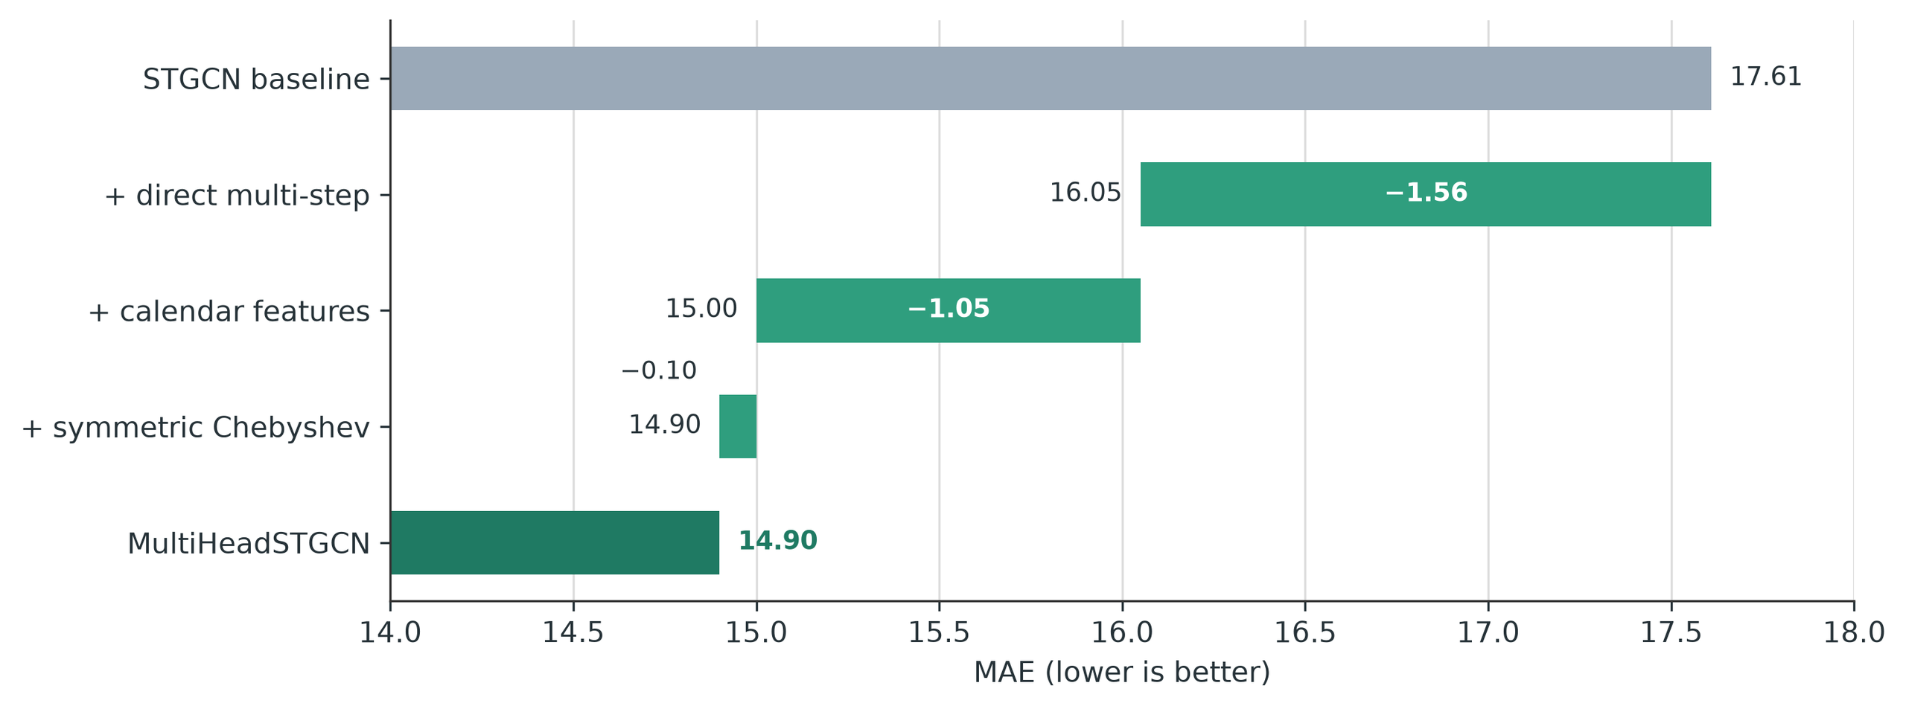
CHAPTER 3 · FORECASTING
The custom model's gain is a complete-recipe effect
COMPARISON SETTINGS
Default recipes
17.44 → 14.84 (−14.9%)
Unified nine-channel
16.11 → 14.84 (−7.9%)
Staged ablation
17.61 reference; different STGCN run
Each setting uses a different protocol.
Chebyshev step is within rerun noise.
Main effects
Scope of the claim
Direct multi-step output and calendar inputs
contribute most of the gain; the spatial-operator
step is small and within rerun noise.
The 14.9% difference includes recipe changes
as well as architecture. Multi-target training
left flow unchanged; one head is used.
Notes:
The ablation isolates the custom model's changes. Moving from the STGCN reference to the full recipe reduces MAE from 17.44 to 14.84, a 14.9 percent difference. Direct multi-step output and calendar inputs carry most of the gain. The spatial-operator step is small and within rerun noise. In the unified nine-channel setting, the same comparison is 16.11 to 14.84, a 7.9 percent difference. The staged ablation uses a different STGCN run at 17.61, so the three settings are not interchangeable. The 14.9 percent figure is a complete-recipe difference; it is not an architecture-only effect. Multi-target training left flow performance unchanged, so one head is used.

Slide 15
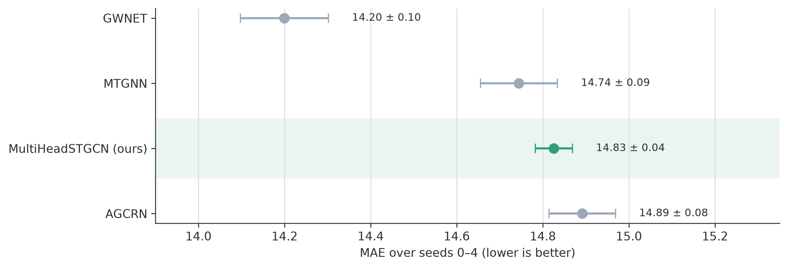
CHAPTER 3 · FORECASTING
Our model is comparable to MTGNN and AGCRN
PAIRED DIFFERENCE (MODEL − OURS)
−4.22%
GWNET
95% CI −4.98 to −3.47 · 5/5 seeds
−0.55%
MTGNN
95% CI −1.29 to +0.20 · includes zero
+0.44%
AGCRN
95% CI −0.38 to +1.27 · includes zero
Negative = lower MAE than ours.
What the intervals show
MTGNN and AGCRN intervals include zero, so their differences are unresolved.
GWNET is lower on every paired seed; our model has the tightest spread.
Caveat: top four were selected on seed 0, so this is descriptive. Whiskers show ±1 SD; the right panel uses 95% confidence intervals.
Notes:
The final forecasting check uses five seeds under the unified input. The chart shows means and one-standard-deviation whiskers; the right panel shows paired differences against our model. GWNET is 4.22 percent lower in MAE, with a 95 percent confidence interval from minus 4.98 to minus 3.47 percent, and it wins on all five seeds. MTGNN differs by 0.55 percent, but its interval includes zero. AGCRN differs by 0.44 percent, and its interval also includes zero. We therefore describe our model as comparable to MTGNN and AGCRN, not better. Our model has the tightest spread across seeds. The top four models were selected on seed zero, so this analysis is descriptive rather than pre-registered.

Slide 16
PART 04 / 05
04
04
Workbench
A single operator surface for monitoring,
congestion and short-term forecasts.
Notes:
Part four presents the workbench: the design intent, the two data paths, and the operator views.

Slide 17
CHAPTER 4 · WORKBENCH
One workbench for monitoring and forecasting
Now: LTA monitoring
Next: PEMSD8 forecasting
INPUT
INPUT
Camera images · 10-minute stills
Calibrated 5-minute series · 170 sensors
MODEL
MODEL
YOLO26m joint fine-tuning
Eight models · MultiHeadSTGCN
OUTPUT
OUTPUT
Detection tables · per-frame counts
12-step forecasts · 60 minutes
BOUNDARY
BOUNDARY
Forecasting uses calibrated flow and speed
California network · separate from LTA
Why two pipelines?
LTA shows what is on the road now; PEMSD8 supplies the calibrated series forecasting needs.
The workbench puts both into one operator flow, so monitoring and prediction are used together.
The goal is one operator view of vehicles, congestion and the next traffic state.
Notes:
The workbench is the design intent of the project. The aim is one operator surface that monitors vehicles, grades congestion and forecasts the next traffic state. The two pipelines look independent because they use different data. The LTA path shows what is on the road now: camera images, detection tables and per-frame counts. The PEMSD8 path provides the calibrated series that forecasting needs: 170 sensors, five-minute observations, and twelve-step outputs. The workbench puts both into one operator flow, while keeping the two data domains separate. The current interface is a historical replay, not a live feed.

Slide 18
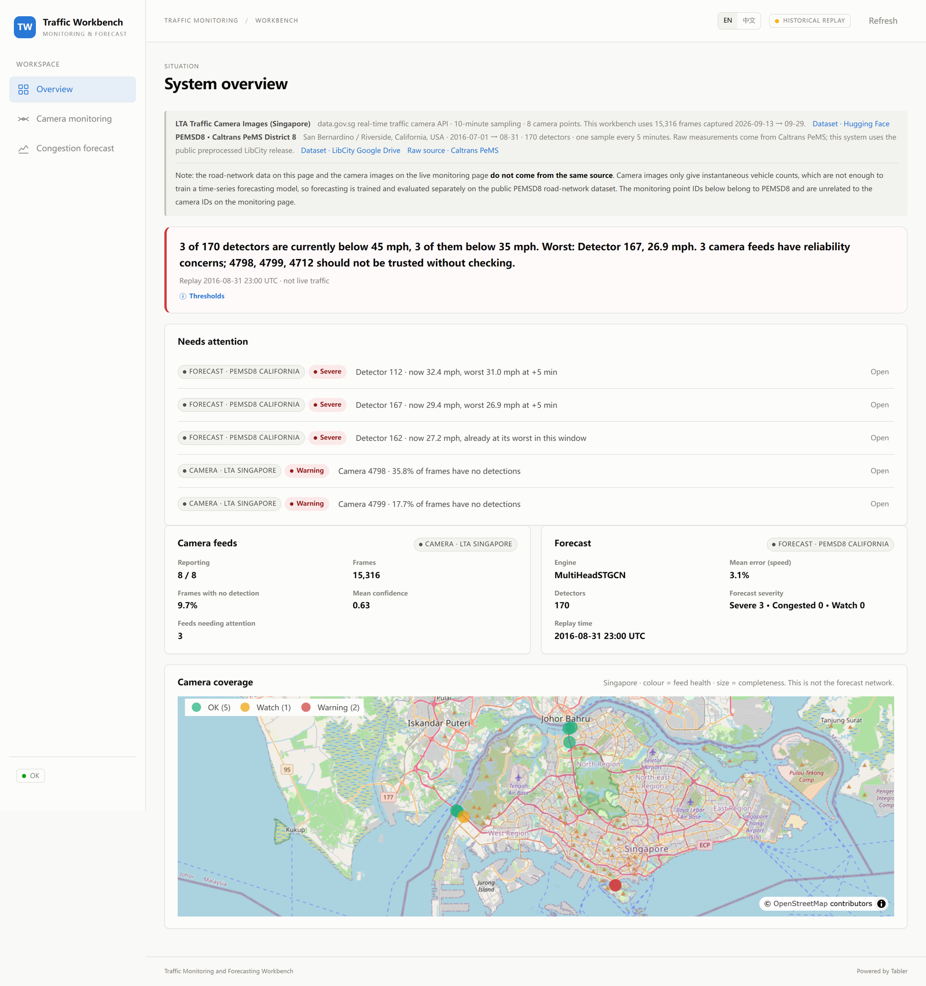
CHAPTER 4 · WORKBENCH
Three views for monitoring, congestion and forecasts
Overview
Situation, health cards, needs-attention queue and coverage.
Monitoring
Camera picker, time-controlled frame, reliability and per-class counts.
Filter overlay; each frame's congestion level.
Forecast
Replay time, 15/30/60-minute horizons, severity network and speed curve.
Threshold-based congestion risk ranking.
SOURCE LABELS
Monitoring labels each frame as LTA Singapore.
Forecast labels its series as PEMSD8 California, a public benchmark.
A historical-replay badge marks recorded data, so the interface reads as a replay.
Source labels stay visible in every view, so LTA monitoring and PEMSD8 forecasts are not conflated.
Notes:
The workbench has three views: Overview for the current situation, Monitoring for LTA frames and congestion, Forecast for PEMSD8 replay and risk ranking. Source labels remain visible in every view.
To show how they work together, we will now play a short screen recording. The recording uses a historical replay. After the video, we will return to the presentation.
[VIDEO CUE — play Traffic_Workbench_Demo.mp4, 00:57. The video has its own narration; do not speak over it.]
[AFTER THE VIDEO — spoken transition:]
That completes the demonstration. We now continue with the final chapter.

Slide 19
PART 05 / 05
05
05
Limitations and conclusion
The project delivers a prototype and a public dataset;
the next step is calibrated local sensing.
Notes:
Part five states what was delivered, what remains, and the main contributions.

Slide 20
CHAPTER 5 · LIMITATIONS AND CONCLUSION
Delivered scope and remaining work
Delivered
Remaining work
Leakage-aware MIO-TCD split and YOLO26m fine-tuning
Calibrated local flow/occupancy/speed at camera sites
Eight-model forecasting benchmark and MultiHeadSTGCN
A larger independent human-labelled LTA test set
Road-region filtering and congestion grading
A live data connection; the workbench runs a replay
Source-labelled workbench with historical replay
Operational deployment and long-run monitoring
Public LTA image dataset mirror (15,316 images)
A user evaluation of the workbench interface
These items sit beyond the course timeline:
they need new data collection, annotation and engineering time.
Notes:
The project delivered five items: the leakage-aware MIO-TCD split and YOLO26m fine-tuning; the eight-model forecasting benchmark and MultiHeadSTGCN; road-region filtering and congestion grading; the source-labelled workbench with historical replay; and the public LTA image dataset mirror. Five items remain: calibrated local flow, occupancy and speed at the camera sites; a larger independent human-labelled LTA test set; a live data connection; operational deployment and long-run monitoring; and a user evaluation of the workbench. These sit beyond the course timeline because they require new data collection, annotation and engineering time.

Slide 21
CHAPTER 5 · LIMITATIONS AND CONCLUSION
What this project contributes
Detection
Forecasting
Scene-group split and YOLO26m fine-tuning
MIO-TCD mAP 0.430 → 0.720
LTA recall 0.394 → 0.547
Road-region filtering and congestion grading
Four vehicle classes at 1280 px
One protocol for eight models
MultiHeadSTGCN default MAE 14.84
Second behind GWNET on default recipes
Default and unified input regimes
Workbench
Dataset contribution
Source-labelled overview, monitoring and forecast
Two pipelines joined at the presentation layer
Historical replay of recorded data
Risk ranking from forecast outputs
15,316 LTA images · 8 cameras · two weeks
Public mirror on Hugging Face
huggingface.co/datasets/LOVEIII486/isy5002-lta-traffic-images
Notes:
The main contributions are four. Detection: a scene-group split, YOLO26m fine-tuning, MIO-TCD mAP from 0.430 to 0.720, LTA recall from 0.394 to 0.547, and road-region filtering with congestion grading. Forecasting: one protocol for eight models, MultiHeadSTGCN at a default MAE of 14.84, second behind GWNET on default recipes, with default and unified input results. Workbench: a source-labelled operator surface joining the two pipelines. Dataset: 15,316 LTA images from eight cameras over two weeks, publicly mirrored on Hugging Face. The next step is a calibrated local series at the camera sites; retraining follows.

Slide 22
Thank you！
ISY5002 Pattern Recognition Systems
github.com/LOVEIII486/ISY5002-TrafficPrediction
Notes:
Thank you. The code and experiment scripts are available in the repository.

