Slide 1
Problem Statement
In a DevOps lab, every student machine has a different software setup. Faculty wants the same environment for Python, Git, and dependencies on every system.
Student Task
Create a reusable Docker image and show how it can be shared using Docker Hub or another registry.

Slide 2
Why this problem happens
Normally, student systems differ in:
Python version
Installed libraries
Git availability
OS differences
Missing environment variables
Different package versions
Because of this, the same Python project may:
work on one laptop
fail on another
produce inconsistent output in the lab

Slide 3
Why Docker solves it
Docker packages the application environment into a portable image.
That image contains:
operating system layer
Python
Git
required Python packages
project files
startup command
So every student runs the same container, which means the same software setup everywhere.

Slide 4
Goal of the solution
We will create a reusable Docker image that contains:
Python
Git
application dependencies
project code
Then we will:
build the image
test it locally
tag it properly
push it to Docker Hub
allow all student machines to pull and run the same image

Slide 5
Real-world DevOps thinking
This is important in DevOps because DevOps focuses on:
repeatability
consistency
portability
automation
reducing “it works on my machine” problems
A Docker image becomes a standard lab environment that can be reused by all students and faculty.

Slide 6
Step-by-step implementation

Slide 7
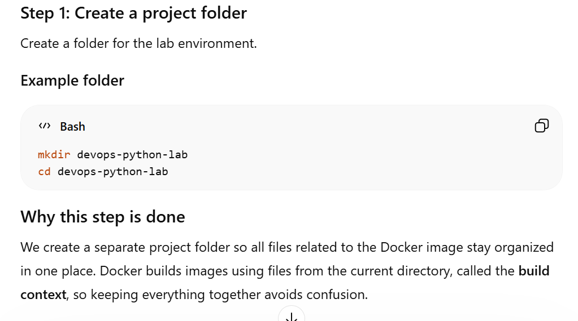

Slide 8
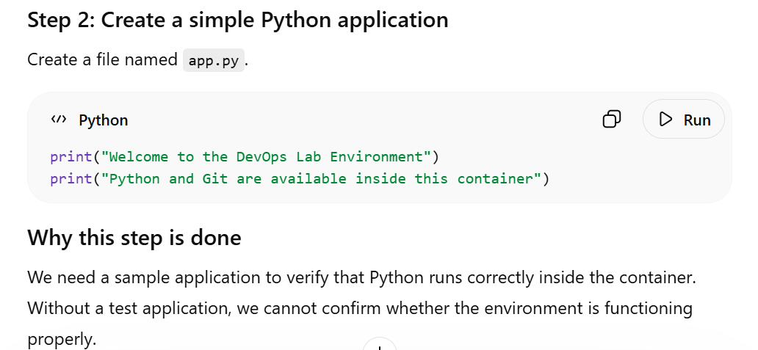

Slide 9
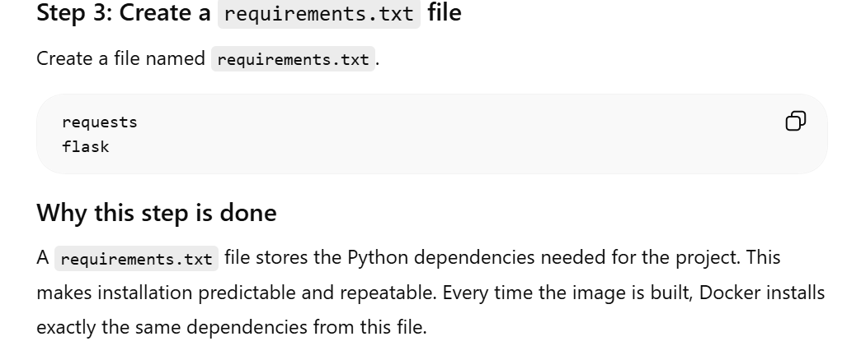

Slide 10
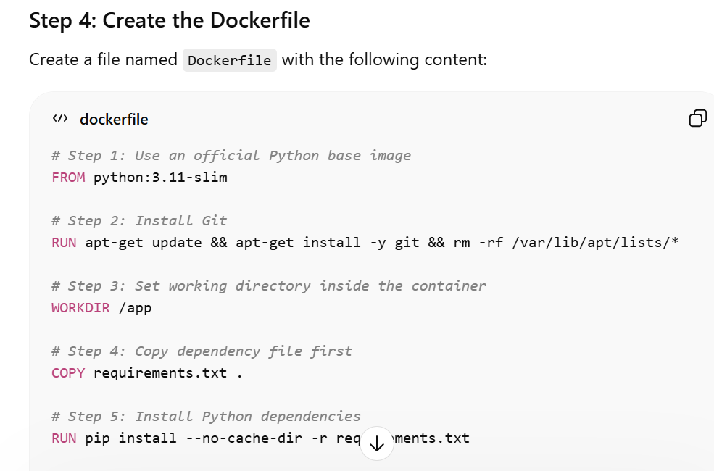

Slide 11
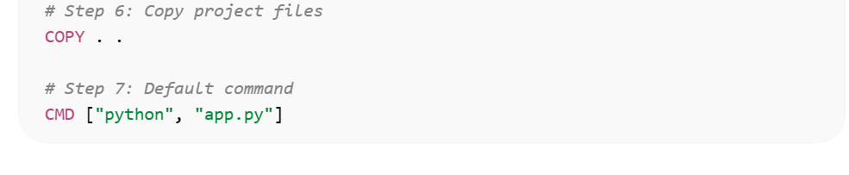

Slide 12
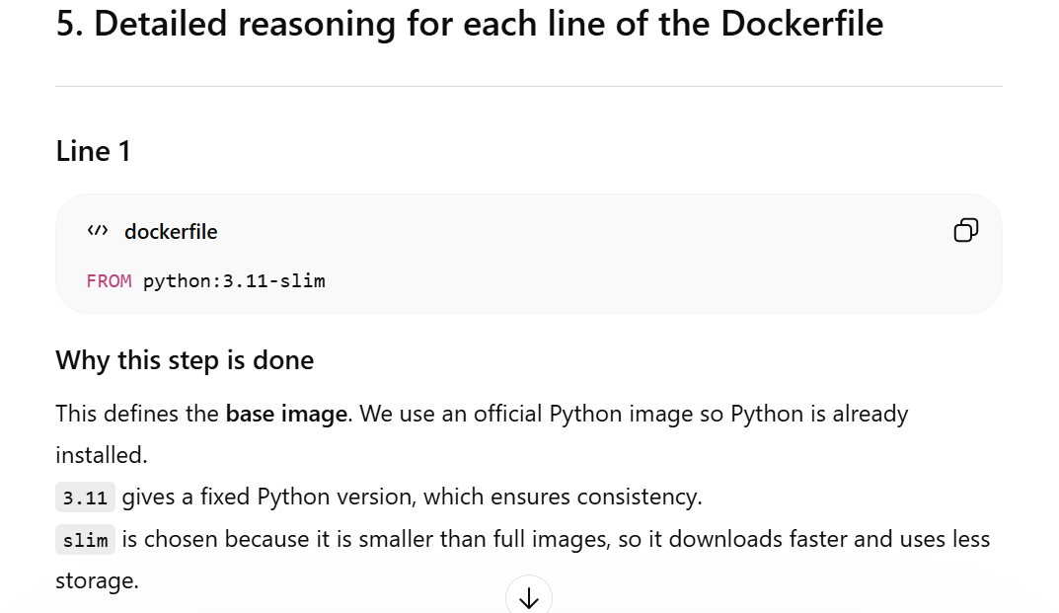

Slide 13
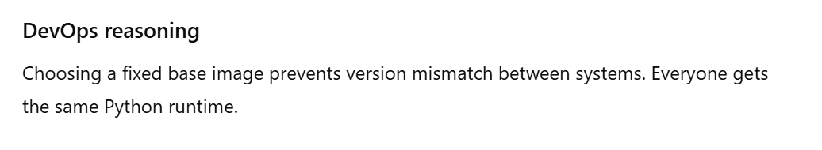

Slide 14
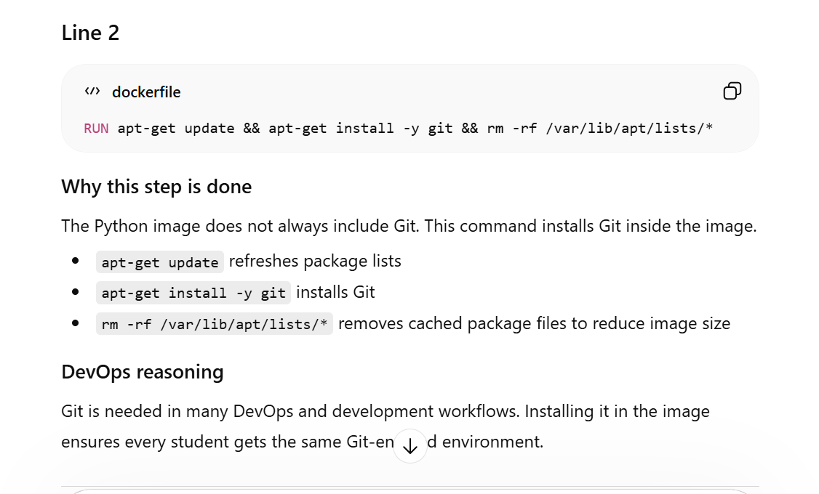

Slide 15
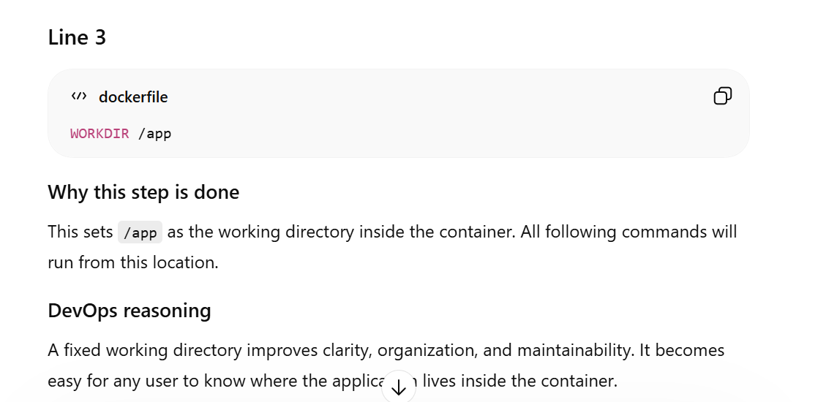

Slide 16
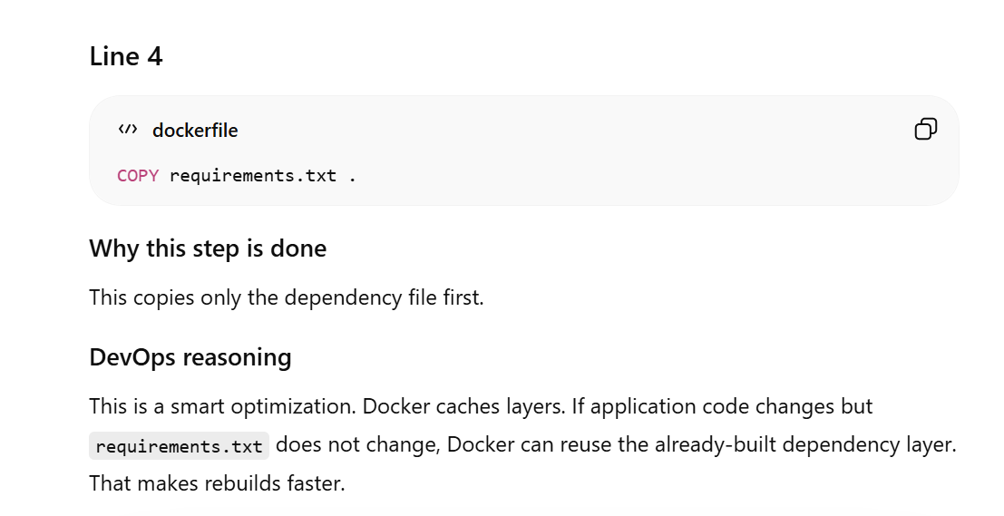

Slide 17
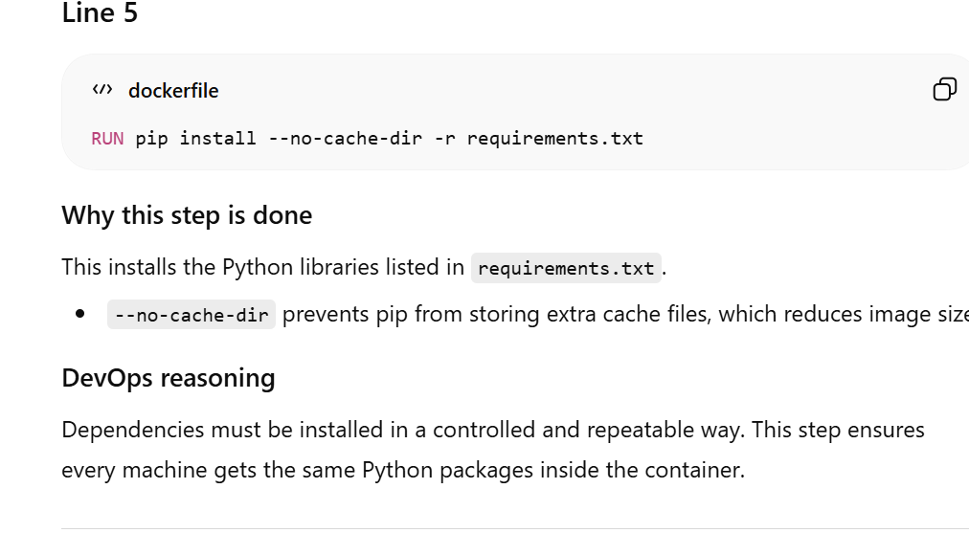

Slide 18
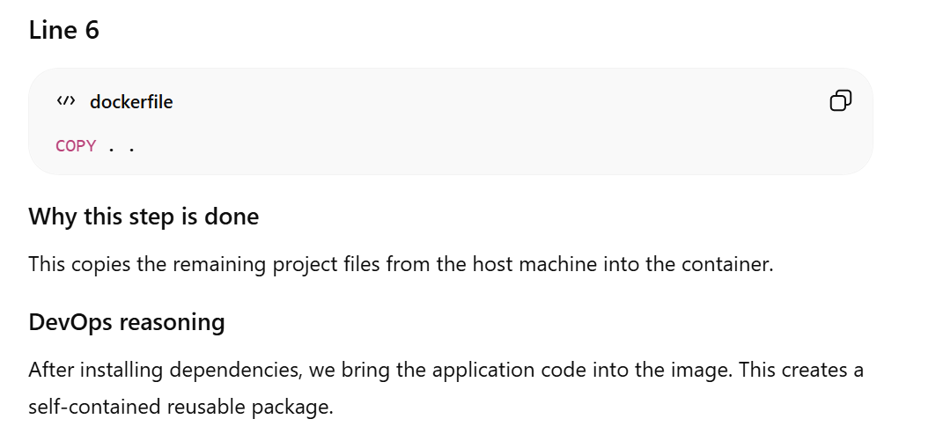

Slide 19
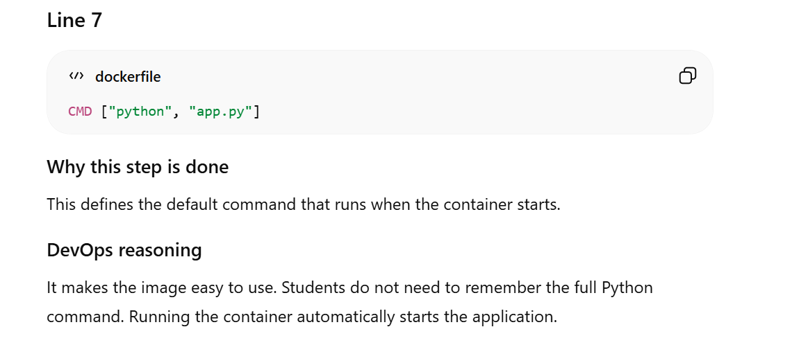

Slide 20
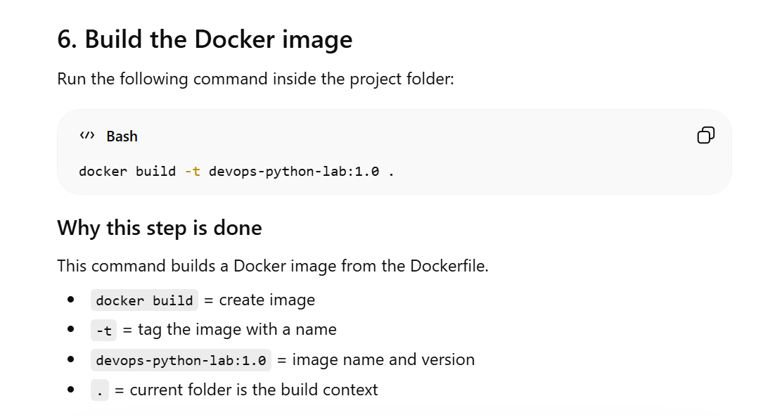

Slide 21
DevOps reasoning
Tagging the image with a version is important. It helps in version control, reuse, rollback, and proper release management.
Faculty can distribute version 1.0 today and 1.1 later if needed.

Slide 23
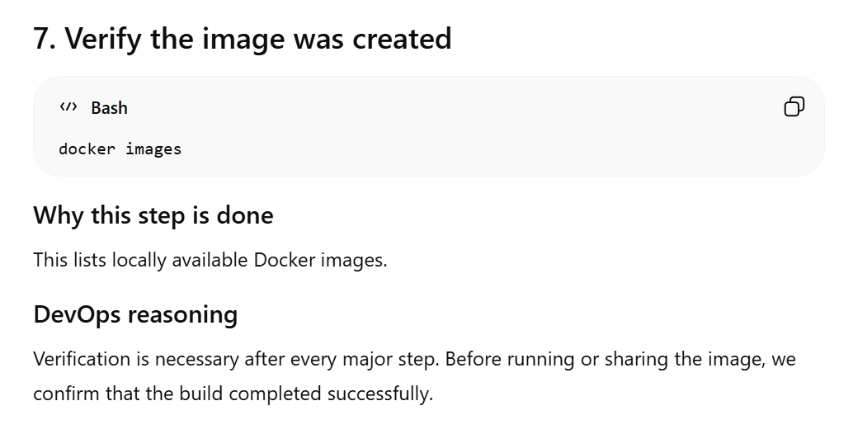

Slide 24
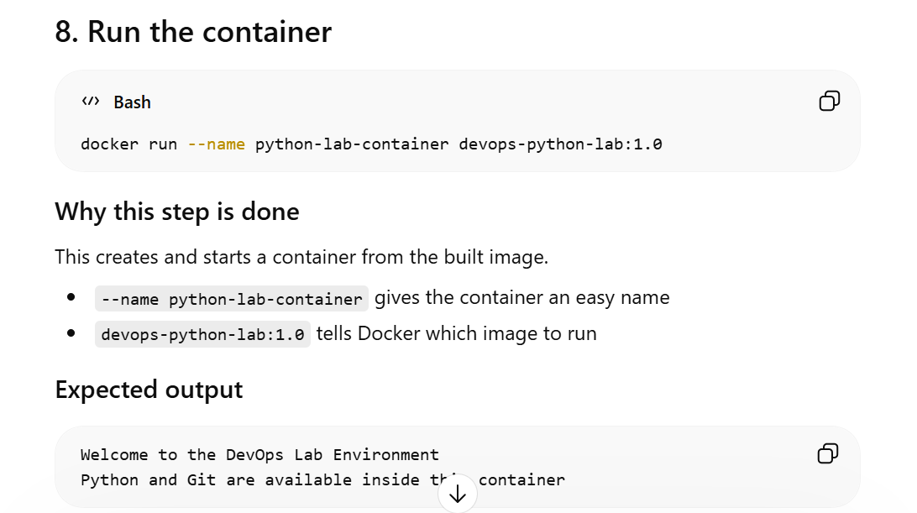

Slide 25
DevOps reasoning
Running the container validates that the image works correctly. A built image is useful only if it can actually run successfully in a container.

Slide 26
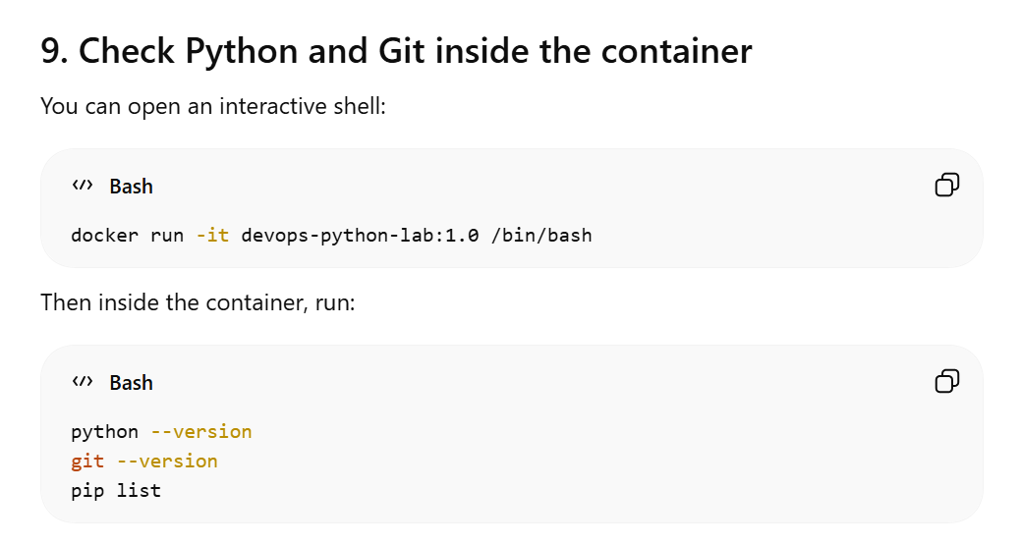

Slide 27
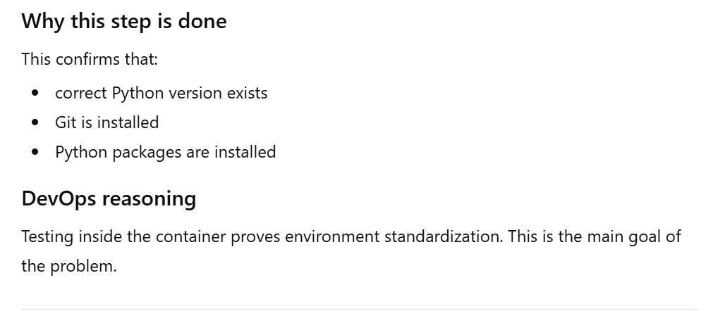

Slide 28
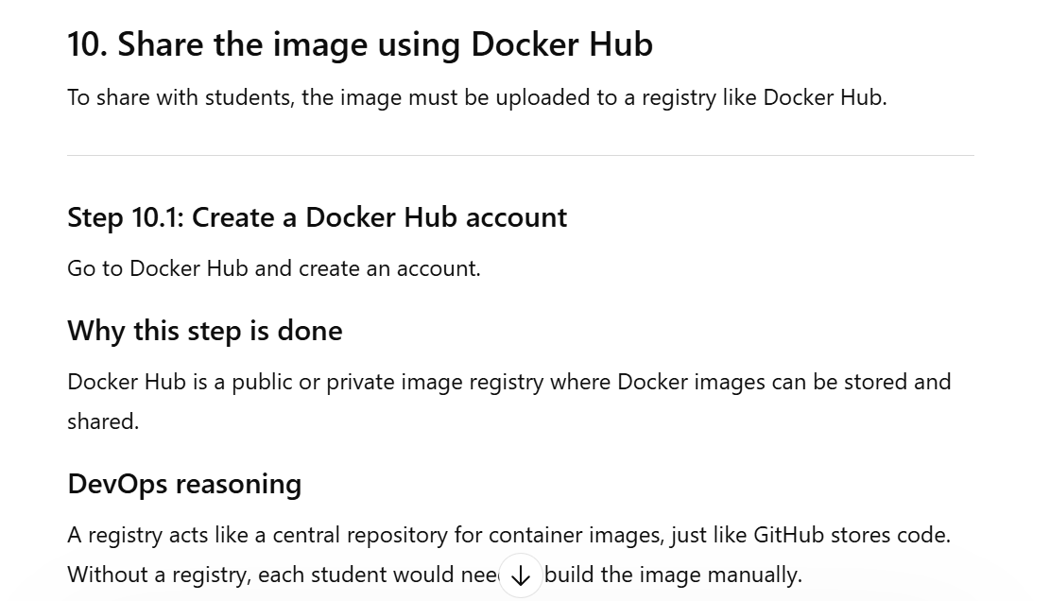

Slide 29
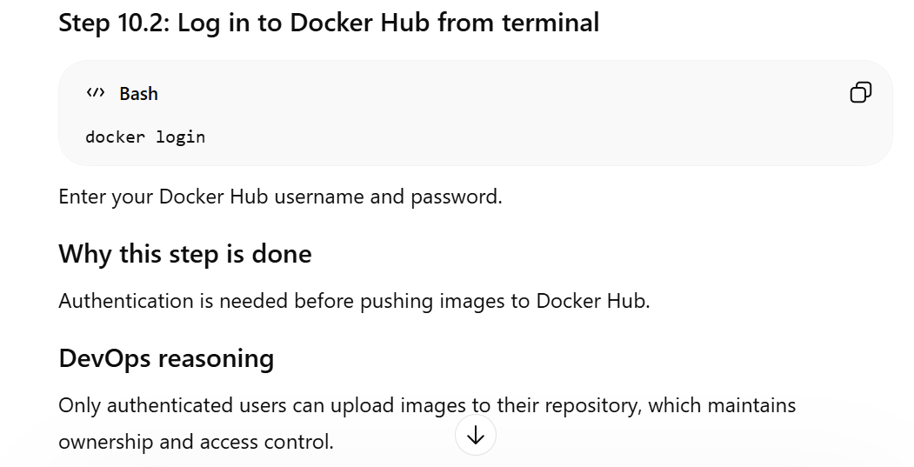

Slide 30
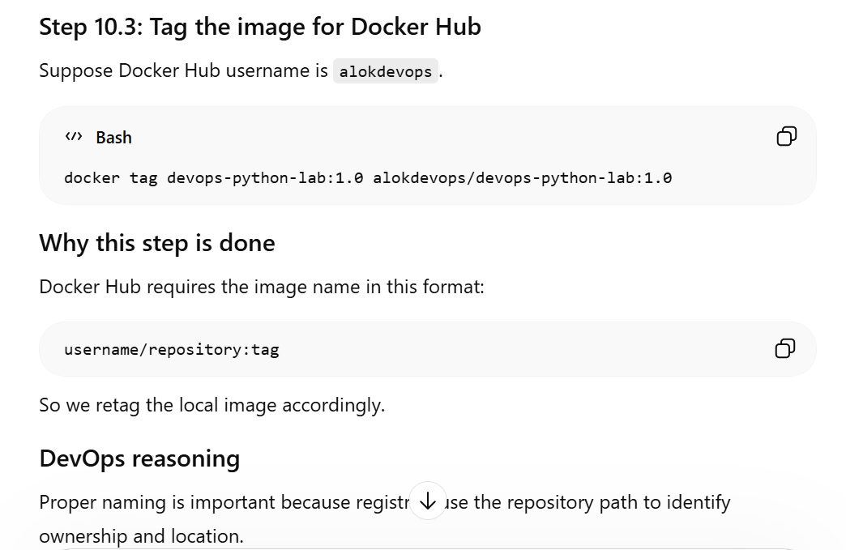

Slide 31
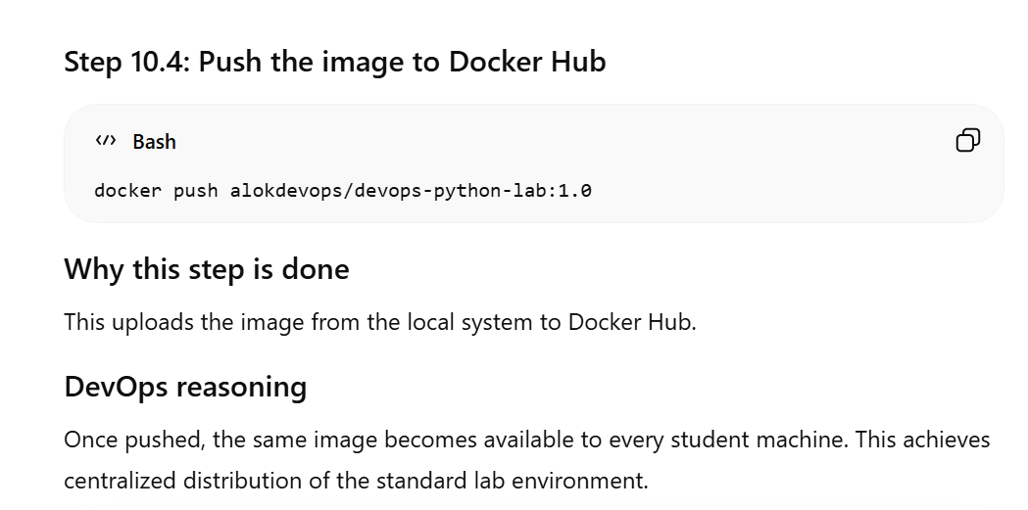

Slide 33
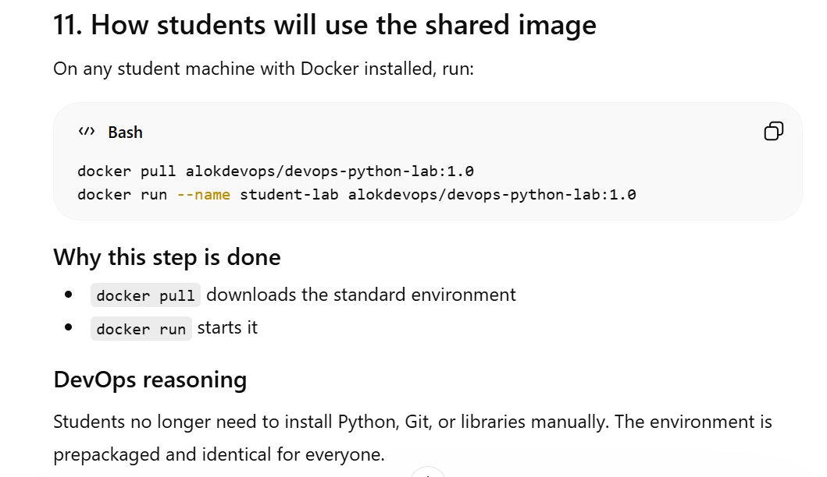

Slide 34
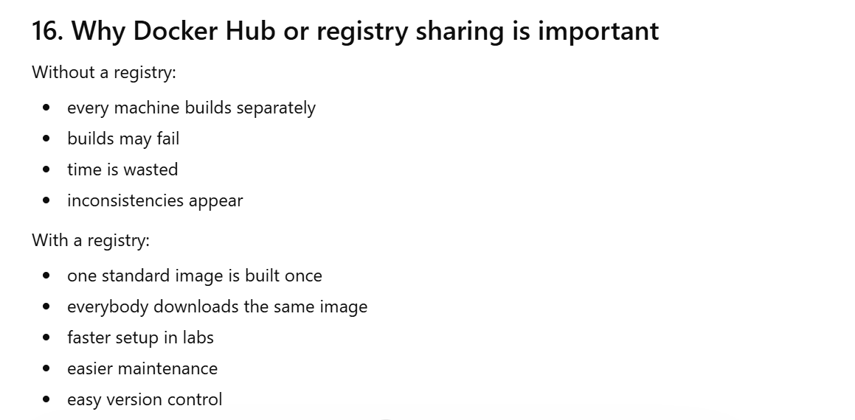

Slide 35
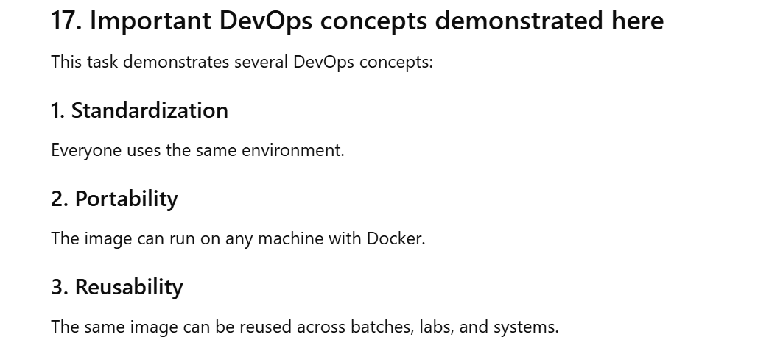

Slide 36
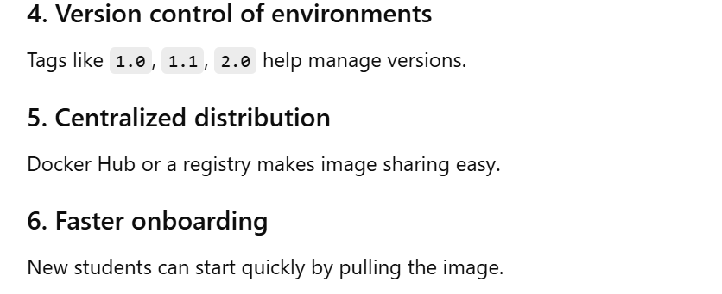

Slide 38
