Slide 1

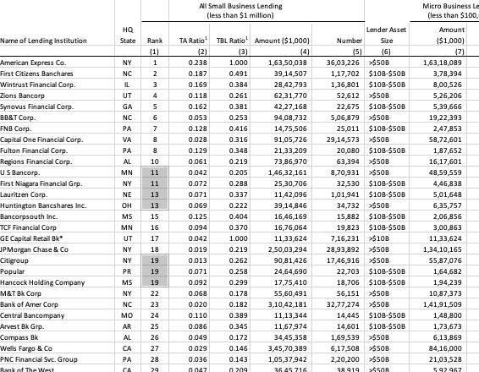
Un- Cleaned Data with
Matching Ranks
Regular expressions

Slide 2


Cleaning regular expressions with Column mean.

Slide 3


Categorizing the lending asset size

