Slide 1

E-schooler

Slide 2
Table of contents
Our team
The Idea
Stages of working
Tools used
project

Slide 3





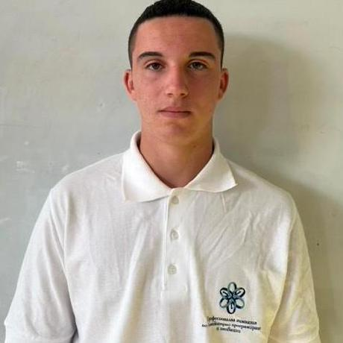
Our team
LESSON 1
LESSON 3
Loris Zadikyan
Scrum Trainer
9G
LESSON 2
Presiyan Tenev
Back-end Developer
9G
LESSON 4
Bozhidar Stanev
Front-end Developer
9B
Yanko Yanakiev
Back-end Developer
9V

Slide 4
The Idea
e-schooler is a digital classroom platform where students can learn lessons, practice exercises, and take automatically generated tests in one place.
Its main idea is to make learning interactive and efficient, with automatic grading and progress tracking so students can easily see their performance.

Slide 5
Stages of working
Week 1.
Week 2.
Week 3.
The project was set up, .gitignore was configured, the main menu was created, and the first lesson was added.
Environmental considerations
Bugs were fixed, statistics and test improvements were added, documentation was updated, and code was commented.
New lessons, subjects, and tests were added, the code was improved, and features like class statistics were implemented.

Slide 6






Tools used

Slide 7

Now lets see the project!

