Slide 1
2Market Analysis and Insights
Leonard Okhani
Notes:
Good afternoon. My name is Leonard Okhani and this is my Analysis and Insights presentation for the 2Market CEO. In this presentation, I will be going through 3 dashboards I have designed myself and answer 3 questions that will assist 2Market in having better understanding of their customer demographics, purchasing behaviour/product popularity and the effectiveness of their current advertising channels. I hope you find this presentation incredibly helpful in your goal in improving the sales for your company. Thank you.

Slide 2
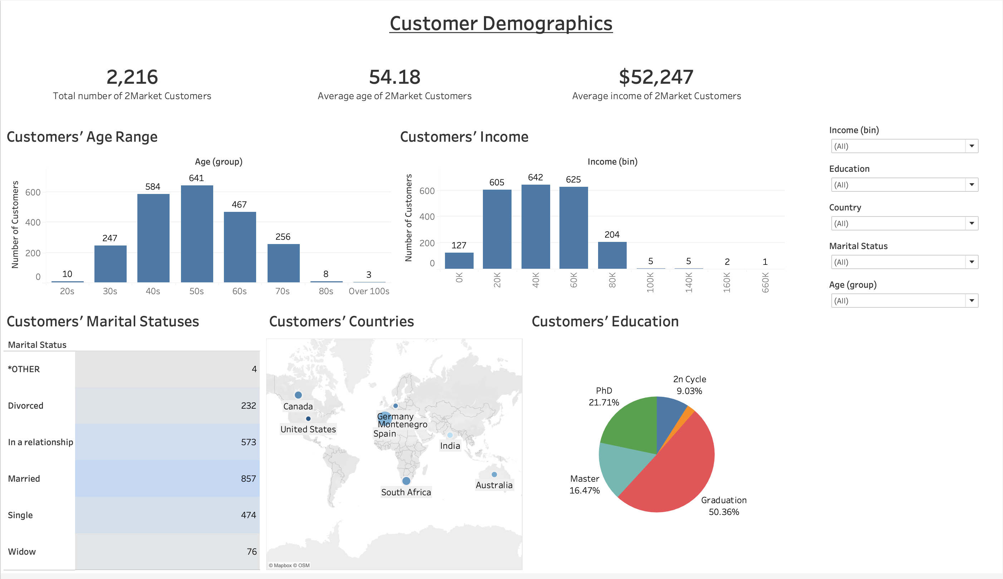
Notes:
This is the first dashboard - Customer Demographics. Here we have the total number of customers - 2,216. We have their average age - 54 or more specifically, 54.18. We also have their average income - 52,247 dollars. There are 2 bar charts - the one of the left shows the number of customers in each age range and the one on the right which shows the number of customers who earn within specific yearly incomes. Below, we have 3 different charts. A highlight table to show the number of customers in each marital status. The bluer a row is, the more customers they have. A map which shows the locations of the 8 countries 2Market operates in. If you flicker your mouse on each dot, it will show information about the number of customers and the median income in each country. The size of the dot represents the number of customers in each country while the shade of the colour represents the median incomes. Finally, we have a pie chart which displays the percentages of customers in each education level. The size represents the number of customers in each education as well. There’s a filter container to the right that contains filters from all 5 worksheets - each filter can be applied to all of the worksheets on the dashboard.

Slide 3
Question 1: Which customer demographics do the products appeal to the most?
The majority of 2Market customers:
Are aged between 40 and 69 years old.
Earn an income salary between $20K - $80K.
Married or in a relationship (although there are many customers who are single).
Live in Spain (although there are many customers who live in South Africa).
Have a bachelor’s degree (although there are many customers who have a PhD).
Notes:
Our first question - which customer demographics do the products appeal to the most? After designing the dashboard, these are the insights I discovered about the customers. Most of them are in the 40s, 50s and 60s and earn an income ranging from 20K to 80K dollars. A lot either have spouses or partners, although there are many customers who are currently single. Spain has over 1000 customers, although there are over 300 in South Africa. Over 50% of the customers have a bachelor’s degree, although there are many with a PhD. These are the type of customers that are attracted to 2Market the most.

Slide 4
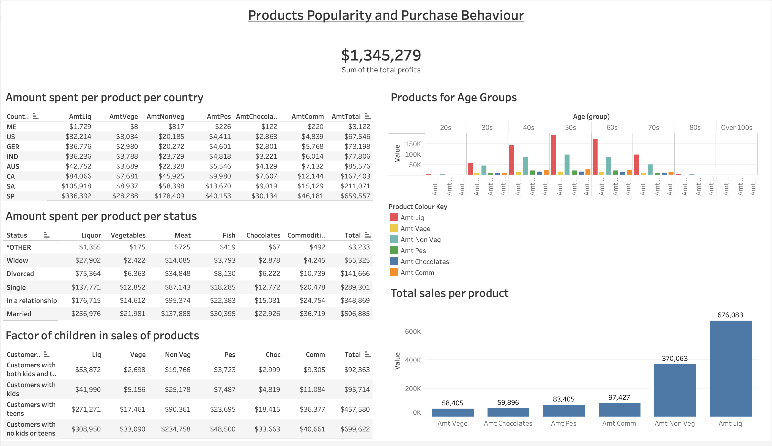
Notes:
The second dashboard - Products Popularity and Purchase Behaviour. 2Market sells 6 products - Liquor, Vegetables, Meat, Fish, Chocolates and Commodities. Altogether, they have created a sum of 1,345,279 dollars. On the left, we have 3 text tables - one to show the amount spent per product and total per country, second one to show the amount spent per product and total per status and the last one to show the amount spent per product and total on the conditions of whether the customers had children or not. Top right, we have a side-by-side bar to show which products were popular in each age group. Bottom right, we have a bar chart displaying the amount spent per product in descending order. As we see here, Liquor and Meat are the most popular while Chocolates and Vegetables are the least.

Slide 5
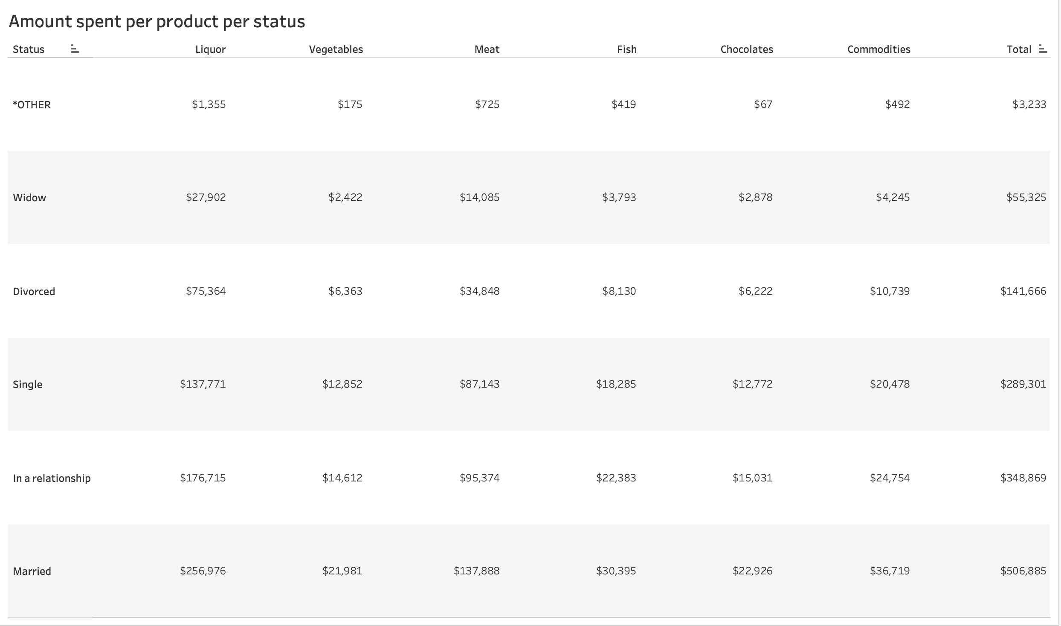
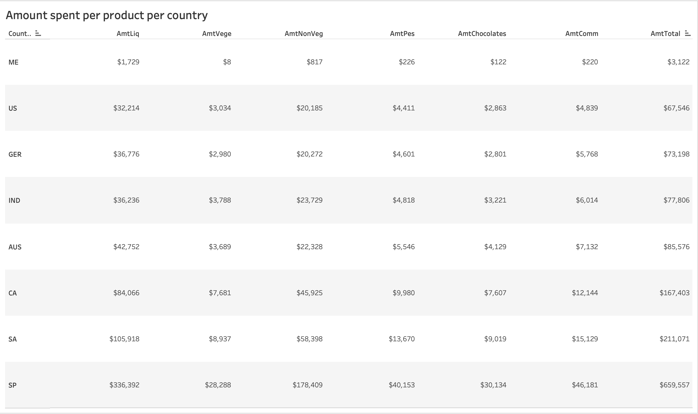
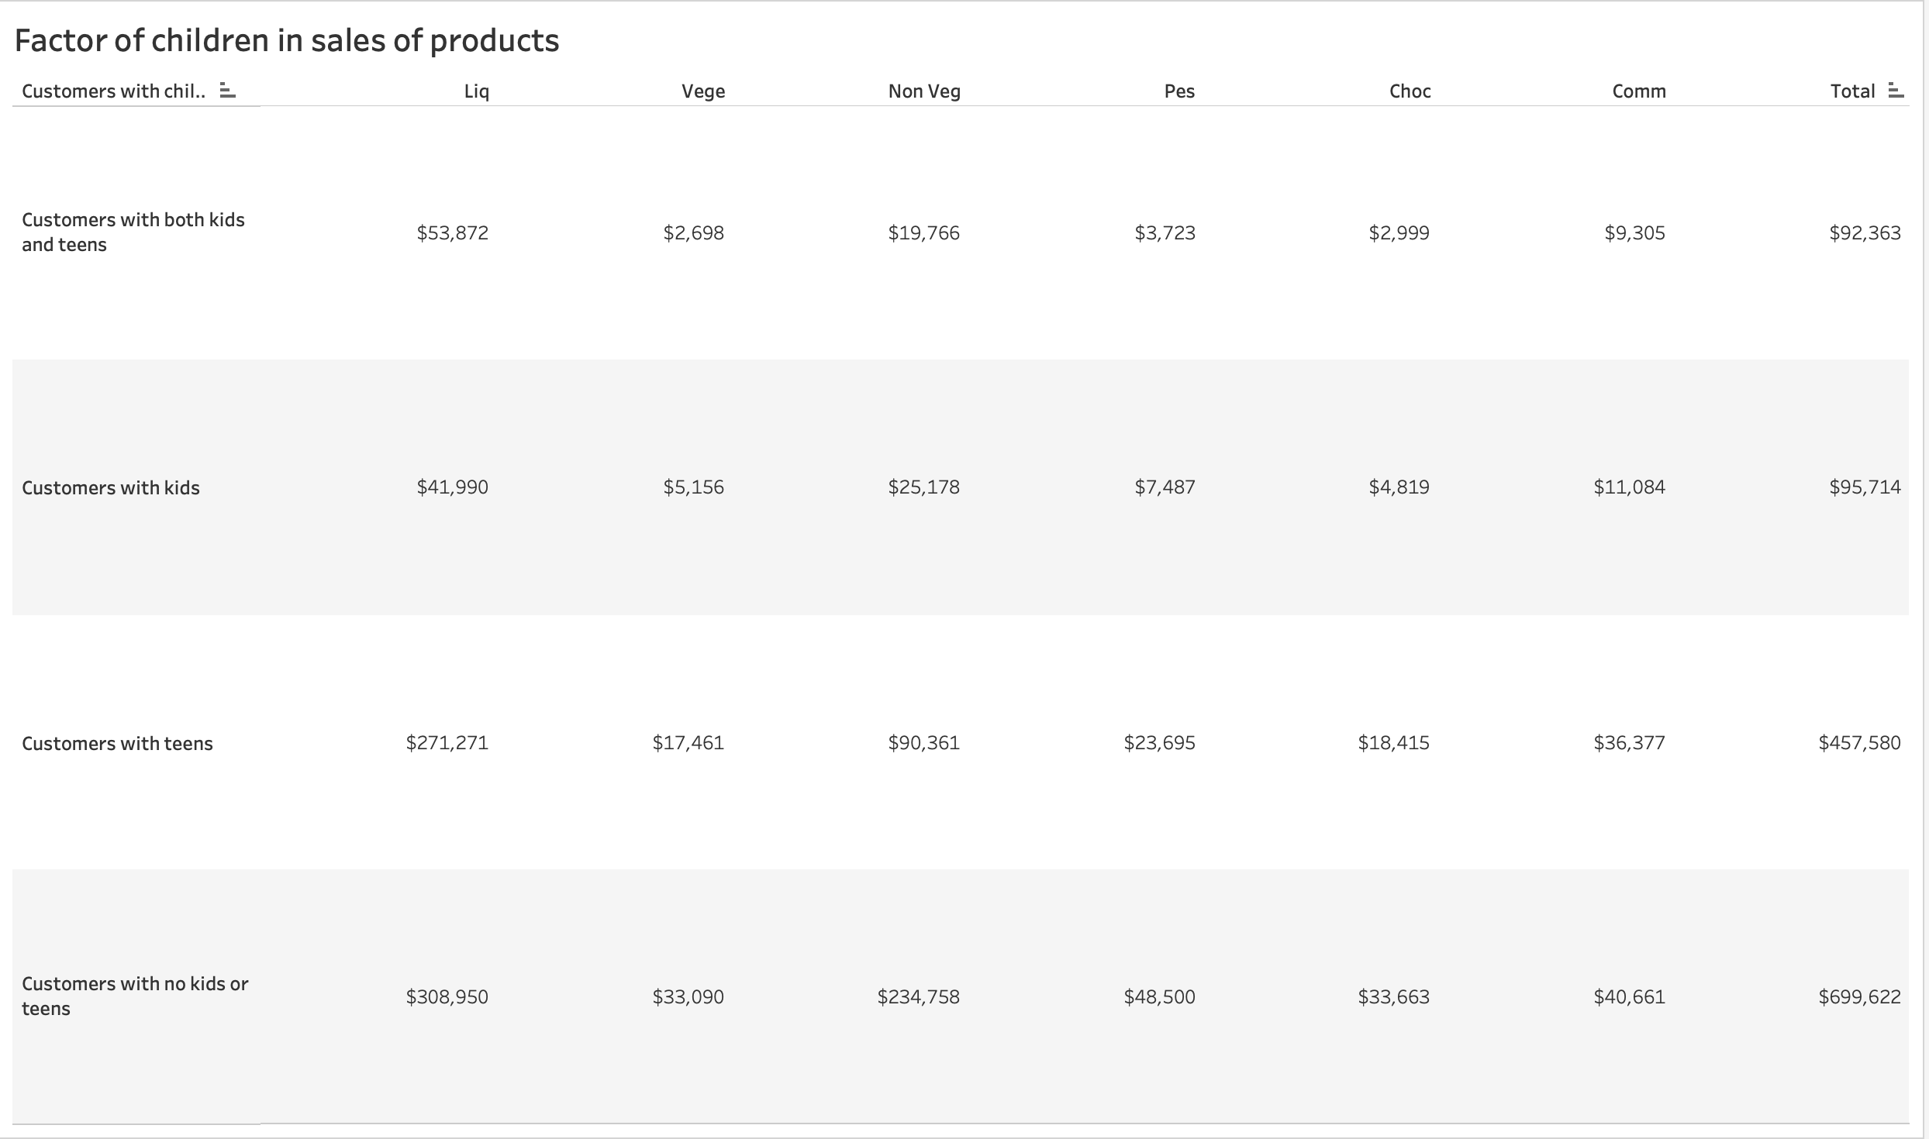
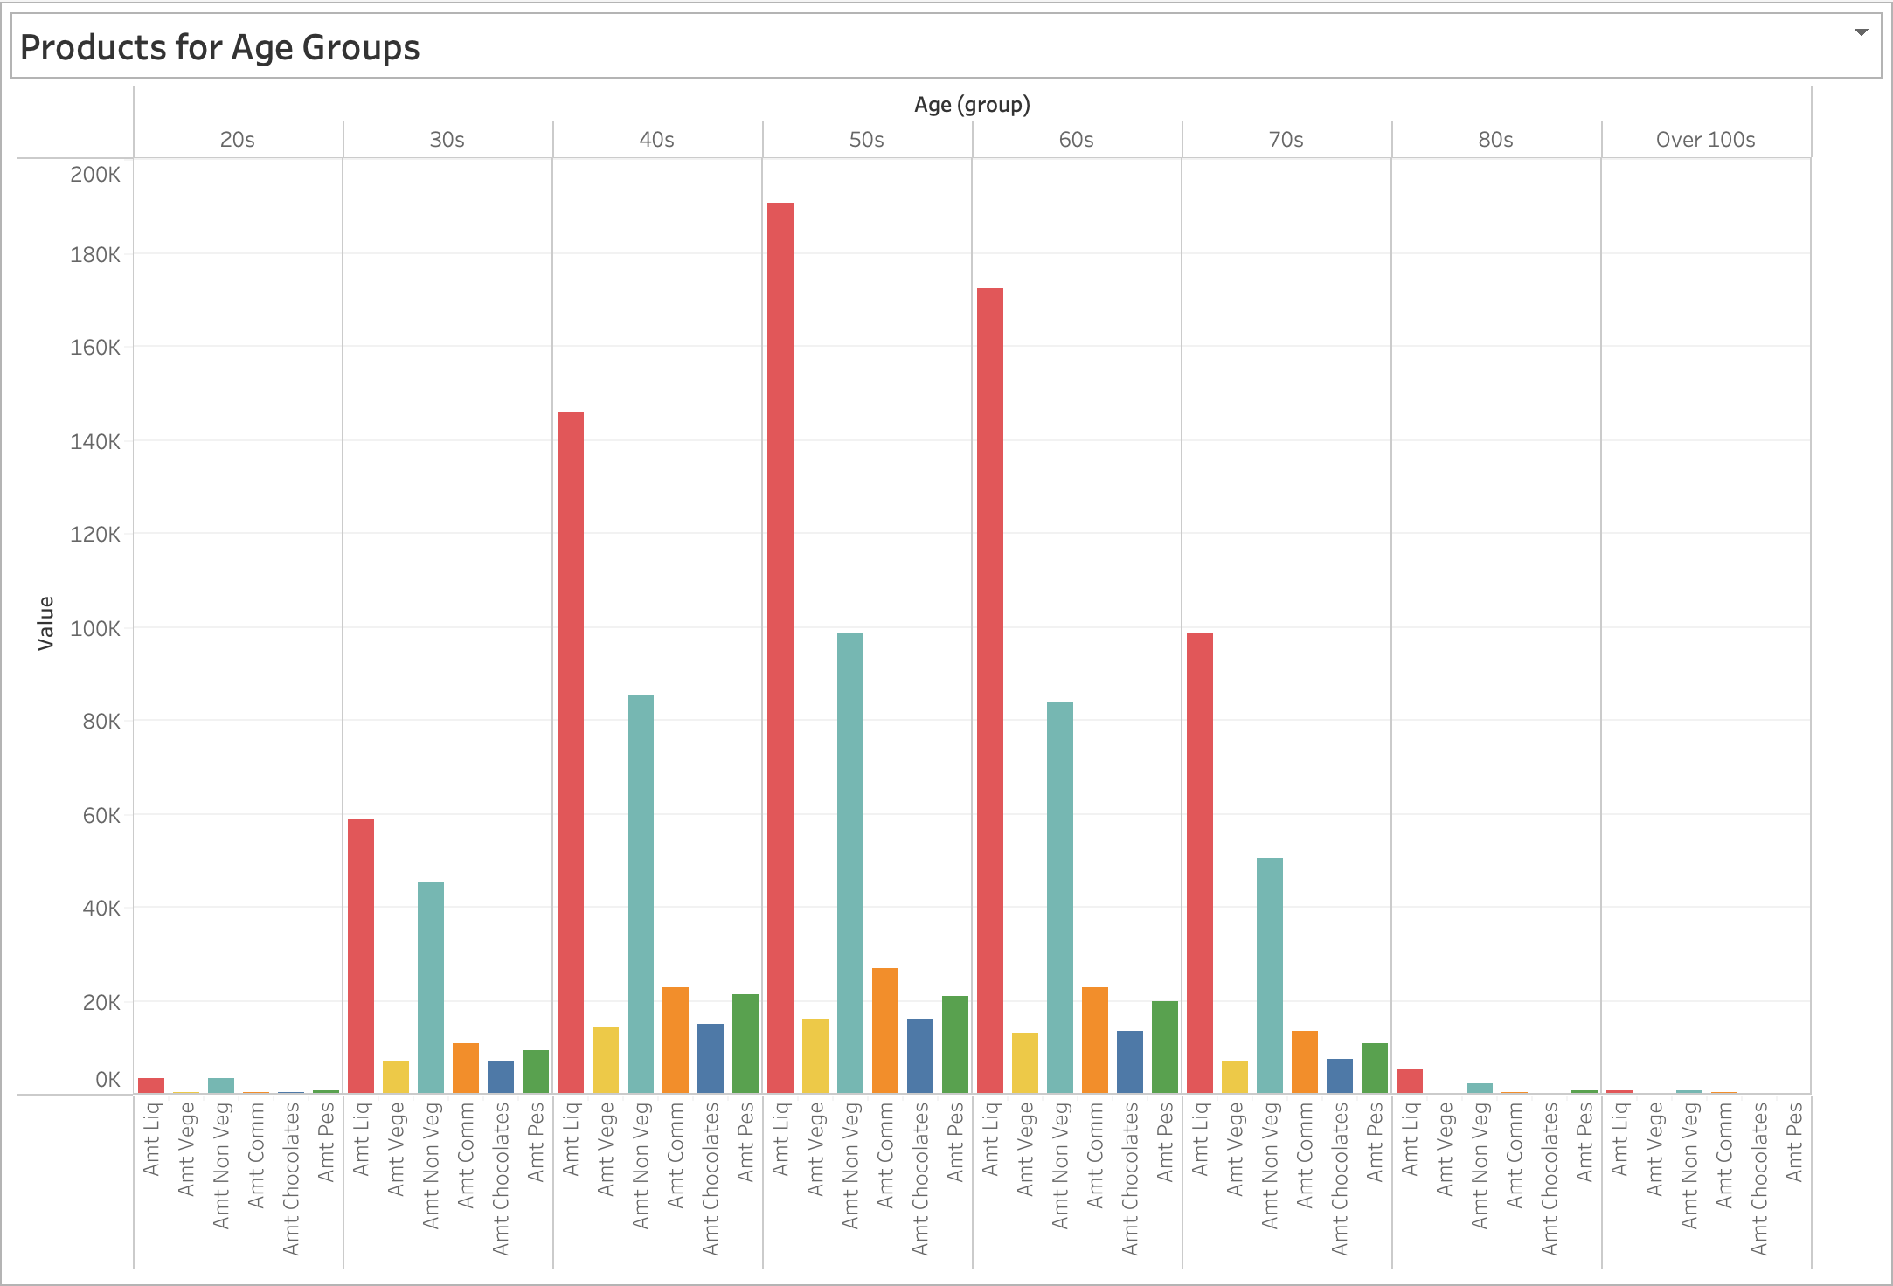
Question 2: Do the sales of the 2Market products vary based on the demographics?
Notes:
The second question - do the sales of the 2market product vary based on the demographics? As we just saw, liquor and meat were the 2 most popular products while chocolates and vegetables were the least overall. We put them up against the customer demographics to see if that will change. Throughout the analysis, liquor and meat were always the top 2 products with the most sales. In fact, other from 20s age group where meat sold more by only 6 dollars, Liquor has constantly been the most popular product. With vegetables and chocolates however, they often switch up in terms of being the product that brings in the least revenues with each demographic. I do believe the customer demographics affect the product sales but not too much since there was always the same top 2, same middle 2 and same bottom 2 products.

Slide 6
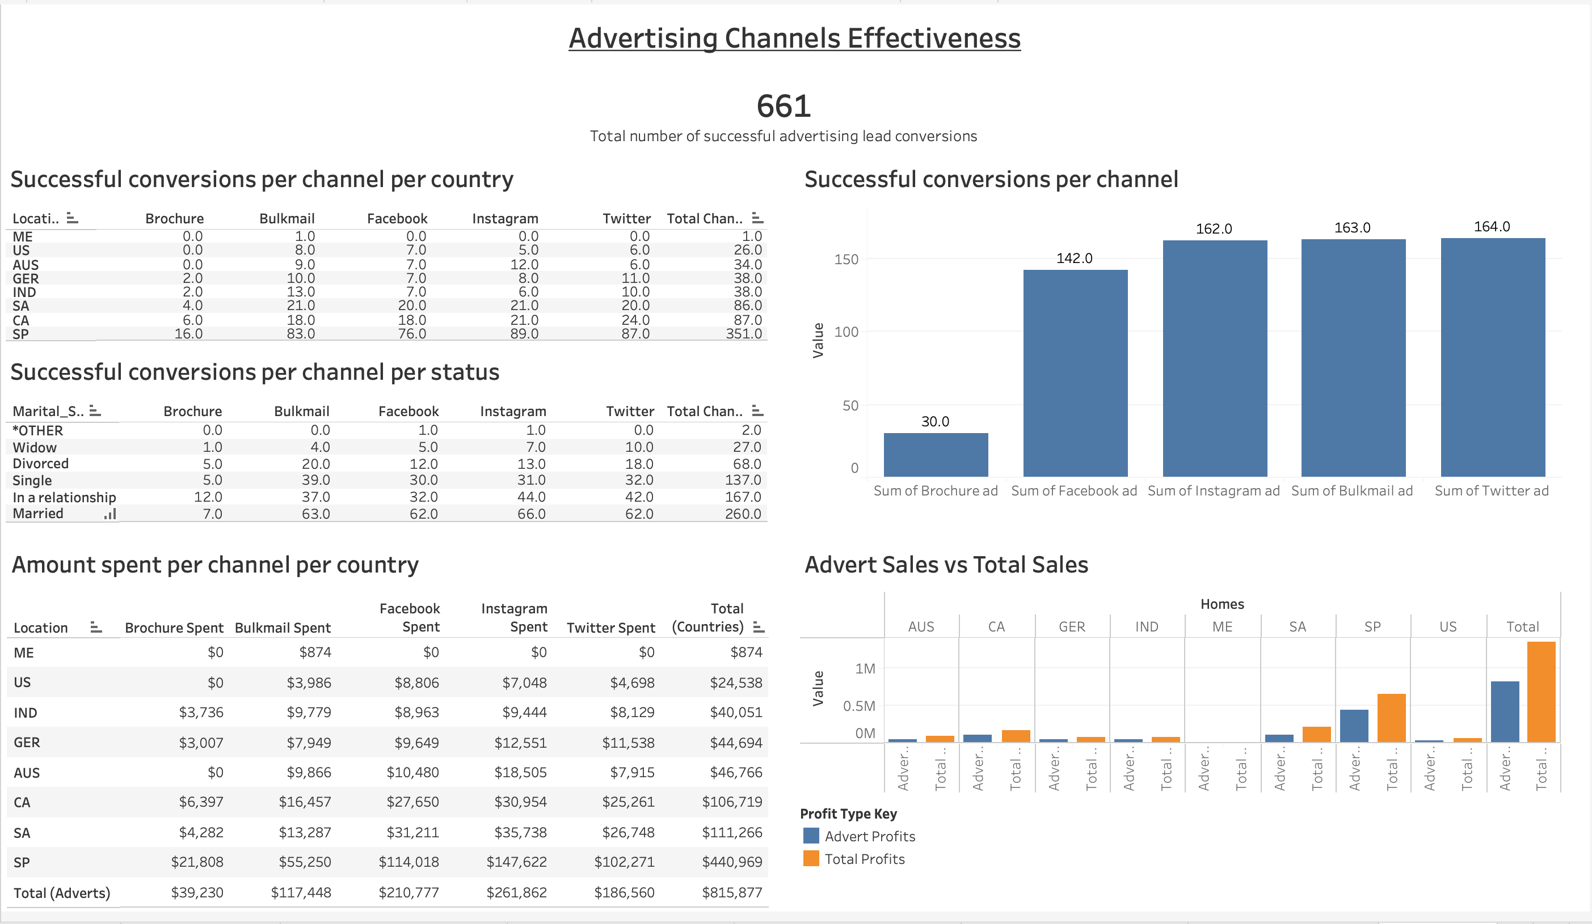
Notes:
The third and final dashboard - Advertising Channels Effectiveness. 2Market currently uses 5 advertising channels - Brochure, Bulk-email, Facebook, Instagram and Twitter. Together, they have lead to a total of 661 successful advertising lead conversions. Top left, we have 2 text tables - one which shows the successful conversions per channel for each country and another to show the successful conversions per status - both with totals. Top right, a bar chart to show the number of successful lead conversion per channel. As we see, all of them have been quite effective apart from Brochure. Bottom left, we have another text table showcasing the amount spent per channel and total per country. The bottom right displays a side-by-side bar to compare the sales which comes from the advertising channels to the total sales overall.

Slide 7
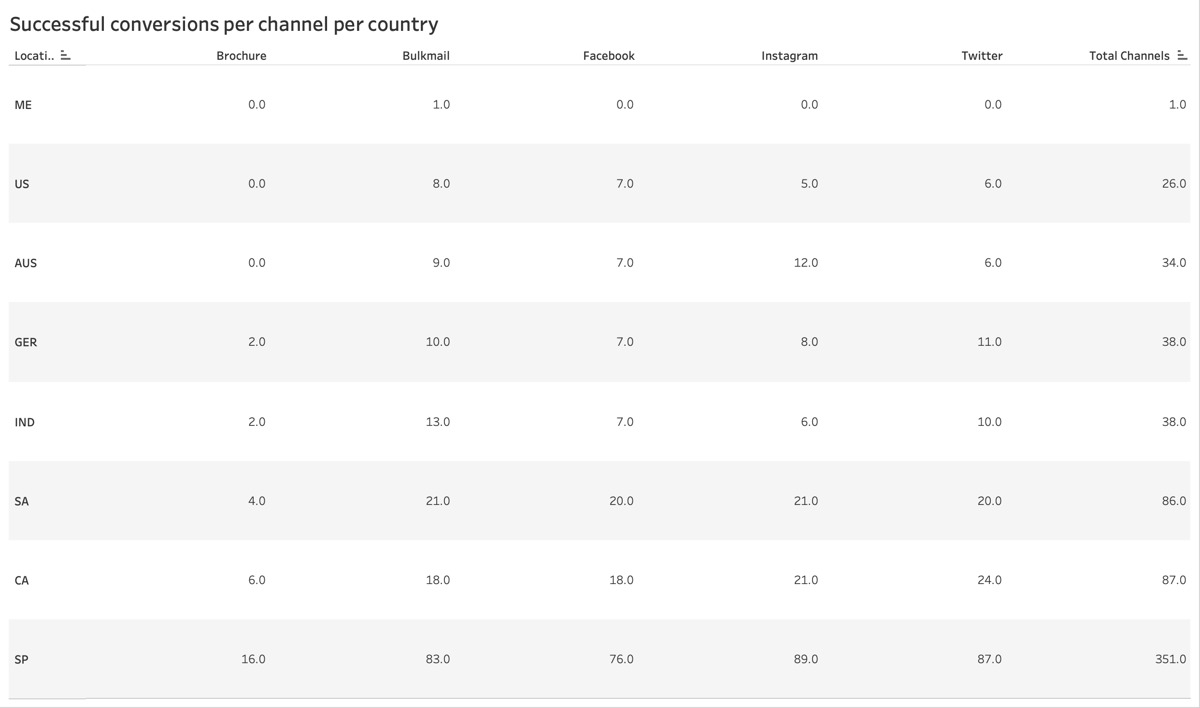
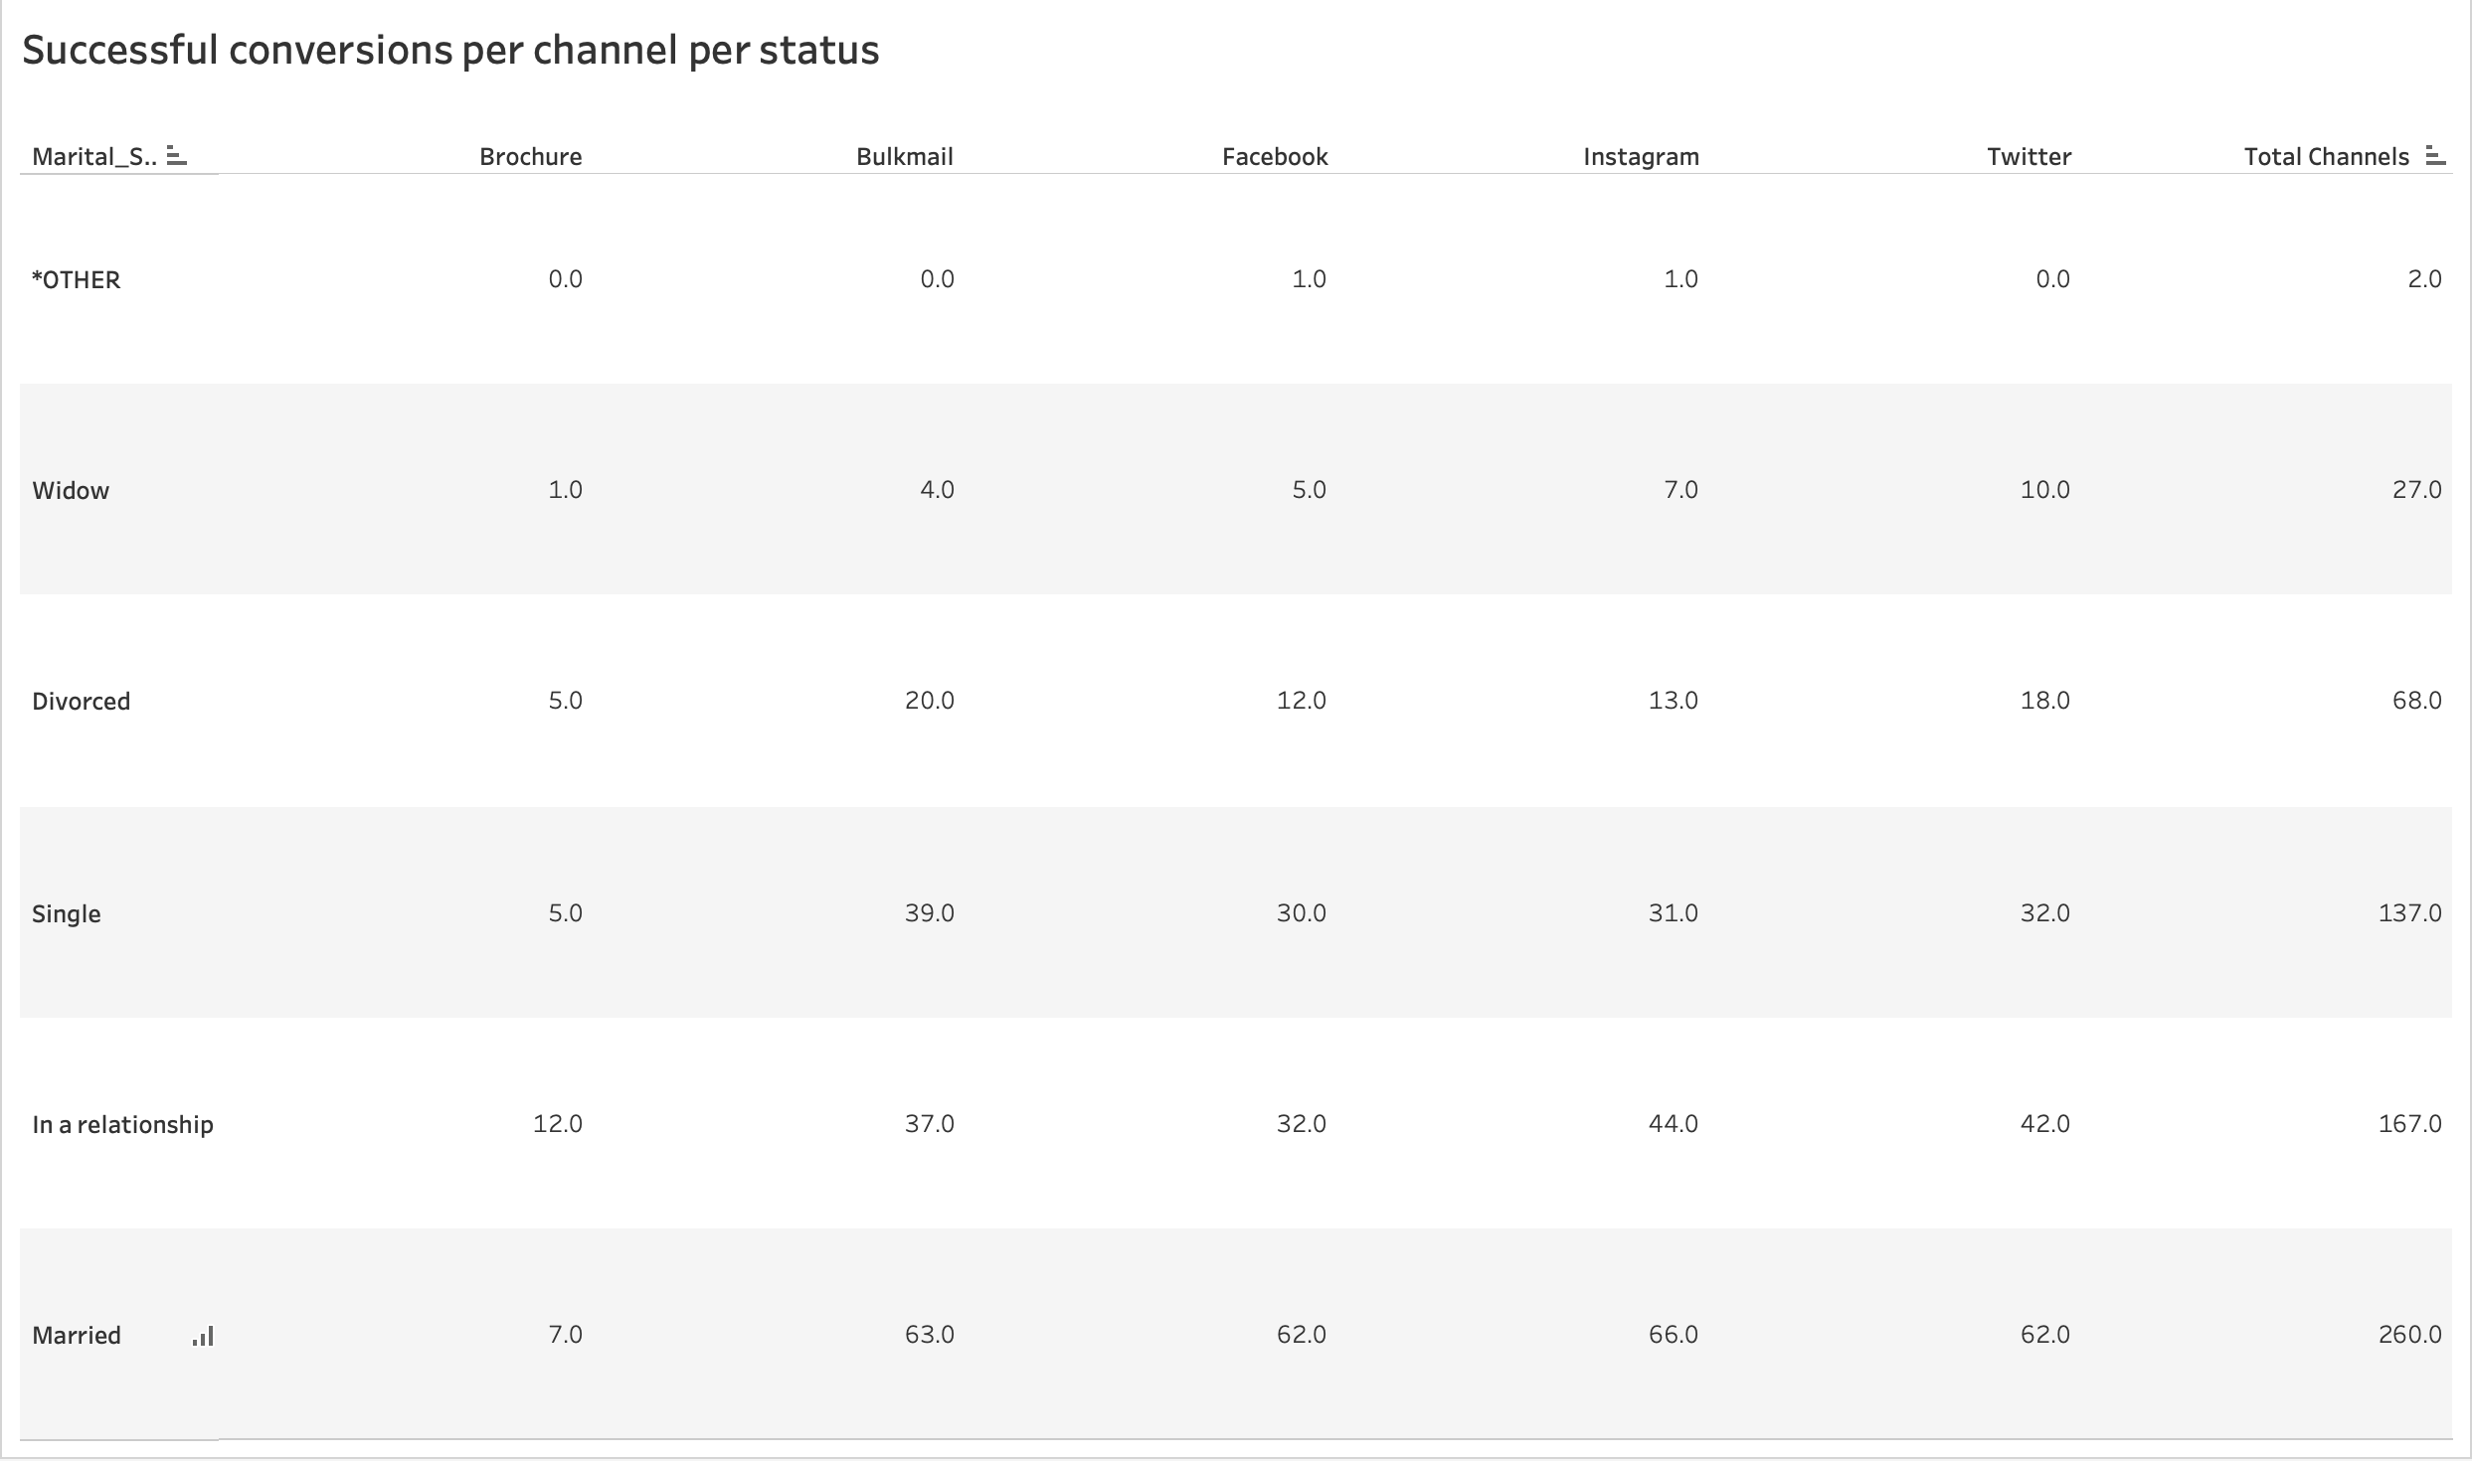
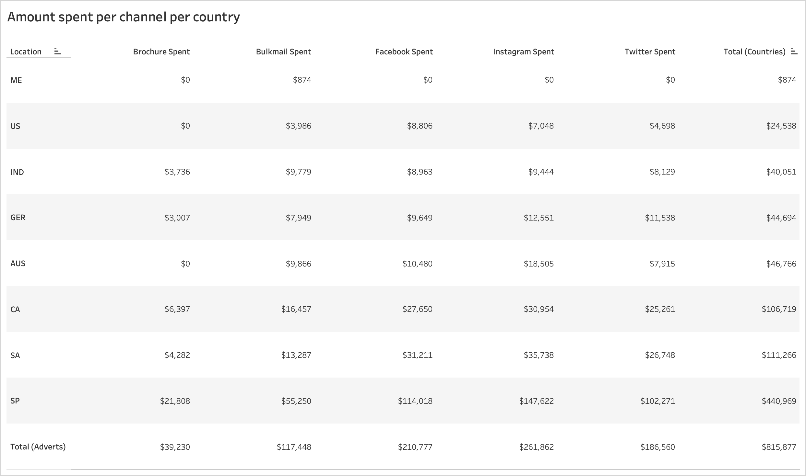
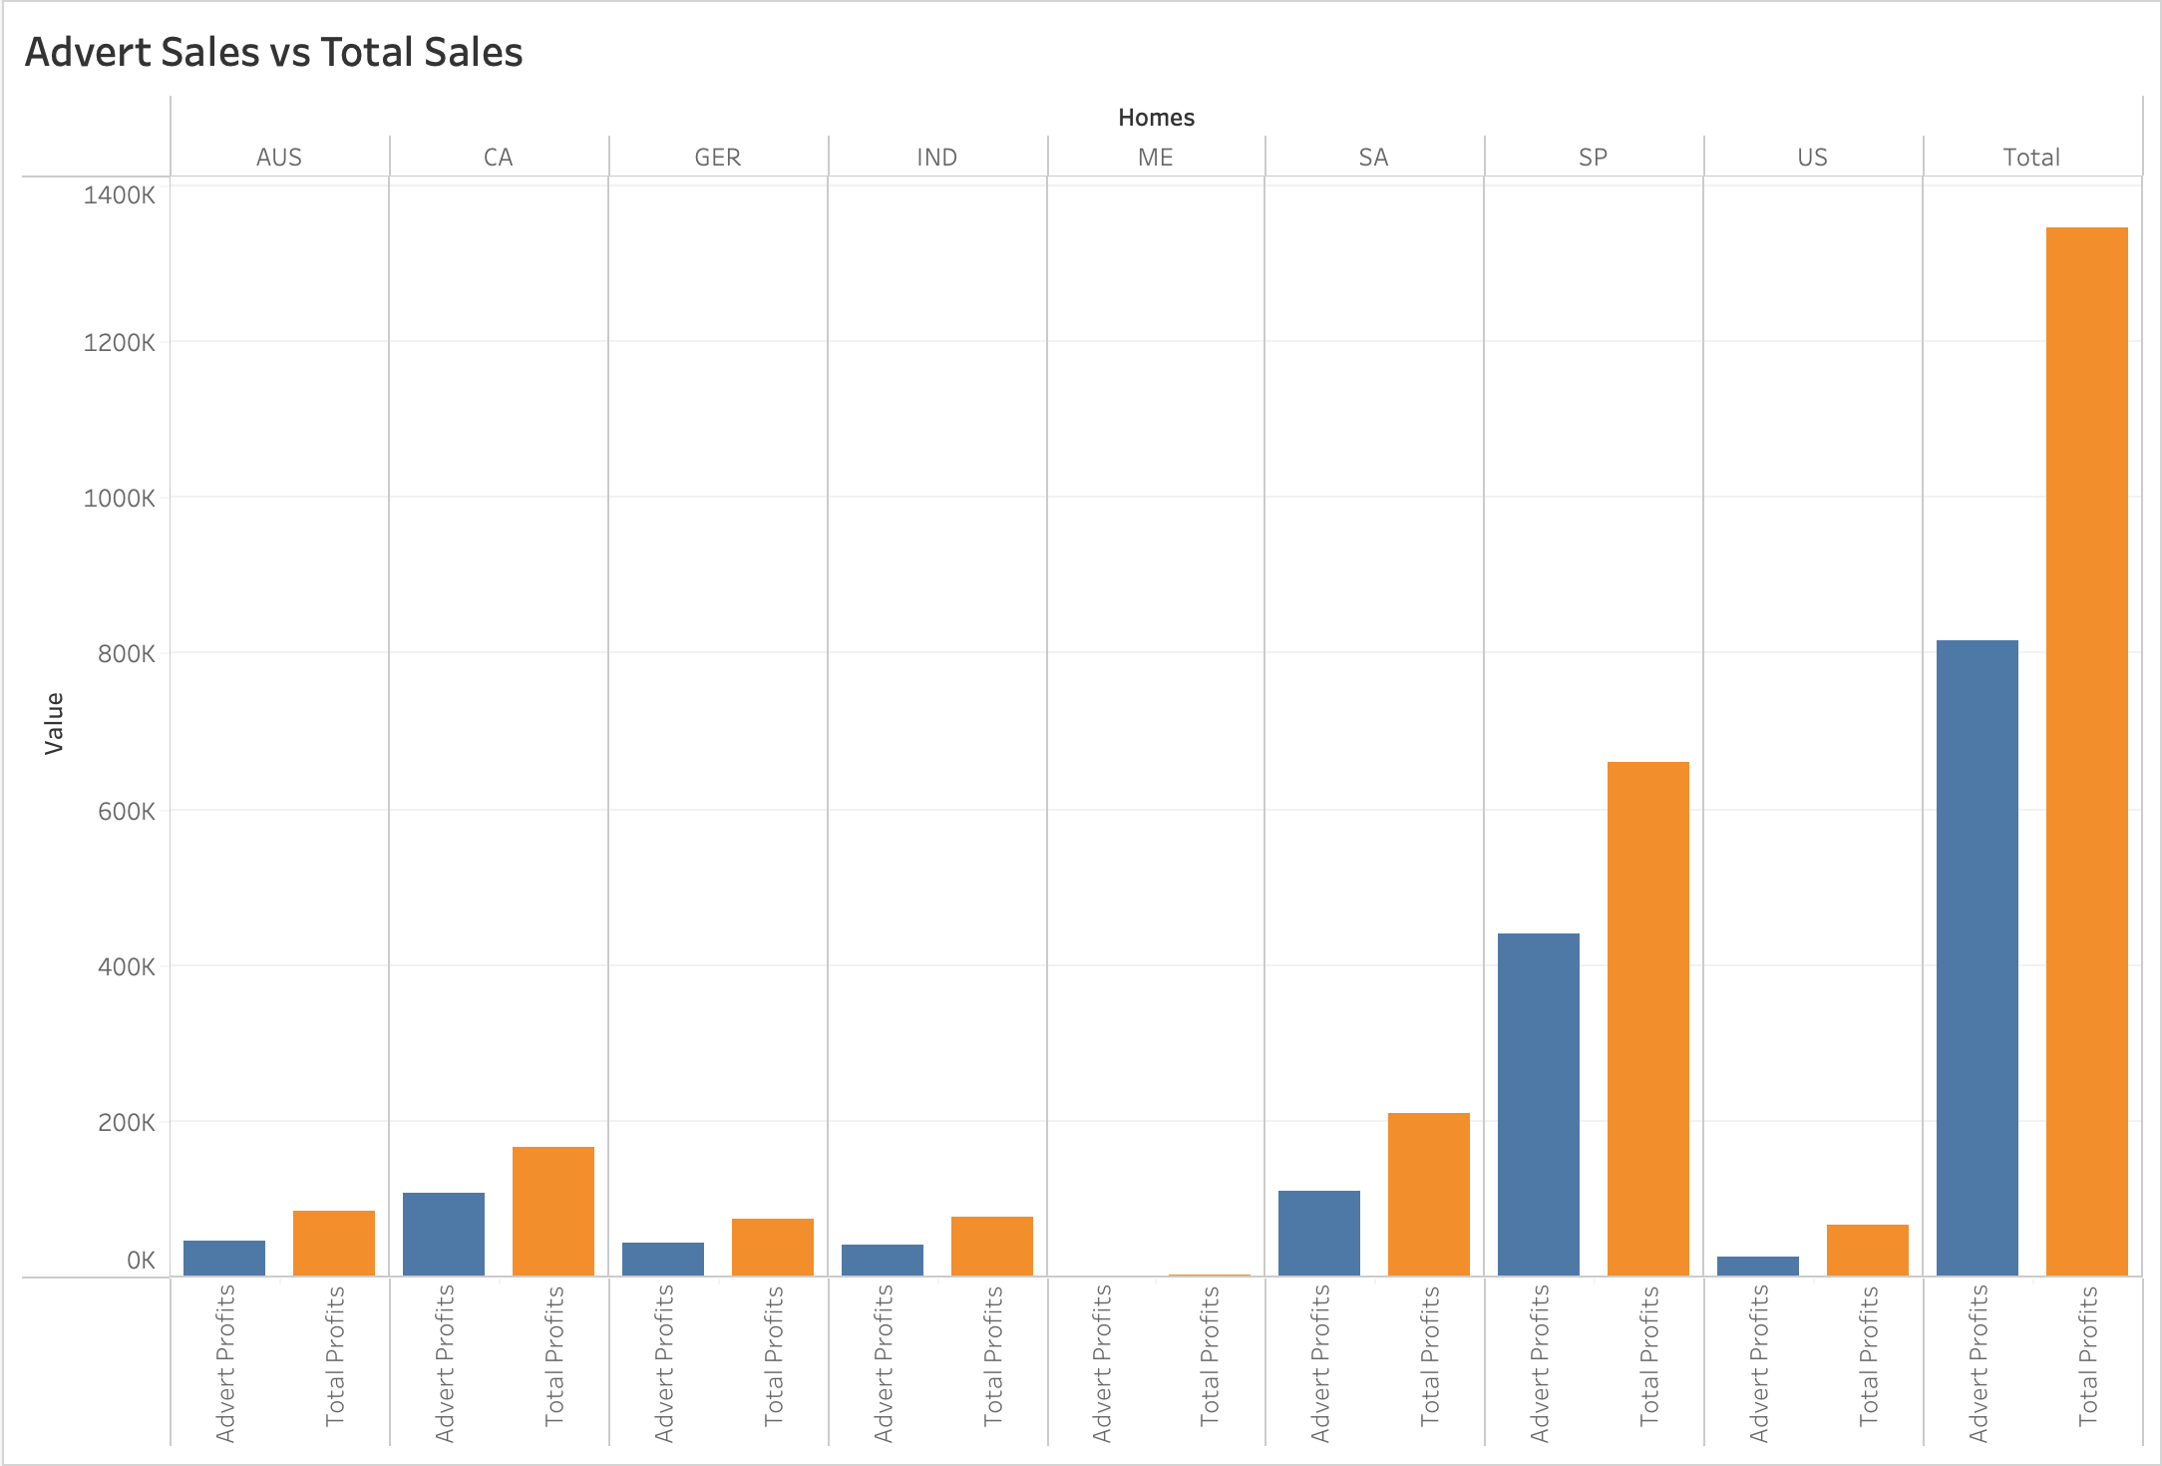
Question 3: How effective are the current advertising channels used by 2Market
Notes:
The final question - how effective are the current advertising channels used by 2Market? If we look at the country table, the channels have been quite effective in countries such as Canada, South Africa and specially Spain. In terms of marital statuses, they supported customers who are in relationships, although some single customers have been lead by the channels. When looking at the profits, the channels earn quite a lot, especially with the social media platforms. I compared these profits to the original total profits and the advertising channels actually earn approximately 60% of the profits. In my opinion, given that the adverting channels earn more then 50% of the profits, I would say they have been highly effective, with the exception of brochure.

Slide 8
Recommendations and Conclusion
Customers: As Spain has been the most successful country, 2Market should apply their success plans to other locations. In terms of customers, appeal to the ones who are aged 40-69, have no children, earn high-median incomes and has a partner/spouse.
Products: Promote the sales for liquor and meat and cease all sales for chocolate and vegetables.
Advertising channels: Stop using Brochure immediately but continue with the other 4 advertising channels, particularly the social media platforms (Instagram, Facebook, Twitter). As Instagram is the channel that brought in the most revenues, It would be advantageous to make it the main advertising channel on the company.
Notes:
These are my recommendations in each of the 3 categories
Customers: As Spain has been the most successful country, 2Market should apply their success plans to other locations. In terms of customers, appeal to the ones who are aged 40-69, have no children, earn high-median incomes and has a partner/spouse.
Products: Promote sales with liquor and meat and cease all sales with chocolate and vegetables.
Advertising channels: Stop using Brochure immediately but continue with the other 4 advertising channels, particularly the social media platforms (Instagram, Facebook, Twitter). As Instagram is the channel that brought in the most revenues, It would be advantageous to make it the main advertising channel on the company.
That’s my presentation. I hope you have found it useful. Thank you for the opportunity and good luck.

