Slide 1

NHS Analysis and Insights
Leonard Okhani
Notes:
Good morning. My name is Leonard Okhani, and this is the Analysis and Insights Presentation for the NHS. For this project, my team and I have utilized Python to create visualizations to identify any trends and uncover any useful insights to support the NHS. In this presentation, I will be going through the datasets which were analyzed for this project, the visualizations created for the trends and insights as I mentioned before, answer 2 questions, which were asked by the NHS themselves and the final recommendations my team and I came up with for the company. I hope you find the information provided in this presentation useful. Thank you.

Slide 2
The Scenario
The NHS are concerned about utilization of services and number of missed appointments.
It costs an average of £30 for each missed appointments – leading to costing the NHS around £216 million per year for missed appointments. £216 million could cover over 2 thousand full-time GPs.
Over 15 million GP appointments are being wasted each year due to patients not turning up for their appointments and failing to tell their doctors that they will not be attending.
Approximately 7.2 million are associated with busy family doctors and this adds up to more than 1.2 million GP hours which are wasted per year. This is equivalent to more than 600 GPs working full time each year.
Notes:
So why are we here? The NHS have some real concerns regarded how their services are being utilized and the growing number of missed appointments without reasons. For every missed appointment, it cost the company about £30, which will eventually lead to costing over £216 million per year for missed appointments. It covers over 2 thousand full time GPs. In addition, more than 15 million GP appointments are wasted per year with patients not showing up for their appointments and not telling their doctors beforehand. About 7.2 million are with busy family doctors, which adds up to over 1.2 million GP hours wasted each year. This equals over 600 GPs working full time for a year.

Slide 3
Datasets
actual_duration.csv – Details of appointments made by patients.
appointments_regional.csv– Details of the type of appointments made by patients.
national_categories.xlsx – Details of the national categories of appointments made by patients.
tweets.csv – Data regarding the UK healthcare (taken from Twitter).
Notes:
For this project, my team and I analysed the following 4 datasets. Actual_duration.csv, which contains details of appointments made. Includes information about date, duration. Appointments_regional.csv, which contains details of the type of appointments made. Includes information about appointment mode, appointment month, appointment status, duration between booking and appointment and healthcare professional. National_categories.xlsx, which contains details of the national categories of appointments. Includes information about the context types, national categories and service settings. In addition, all 3 of them contain data regarding the number of appointments per class and region. Tweets.csv, which contain info about the UK healthcare – taken from Twitter, which is currently known as X.

Slide 4
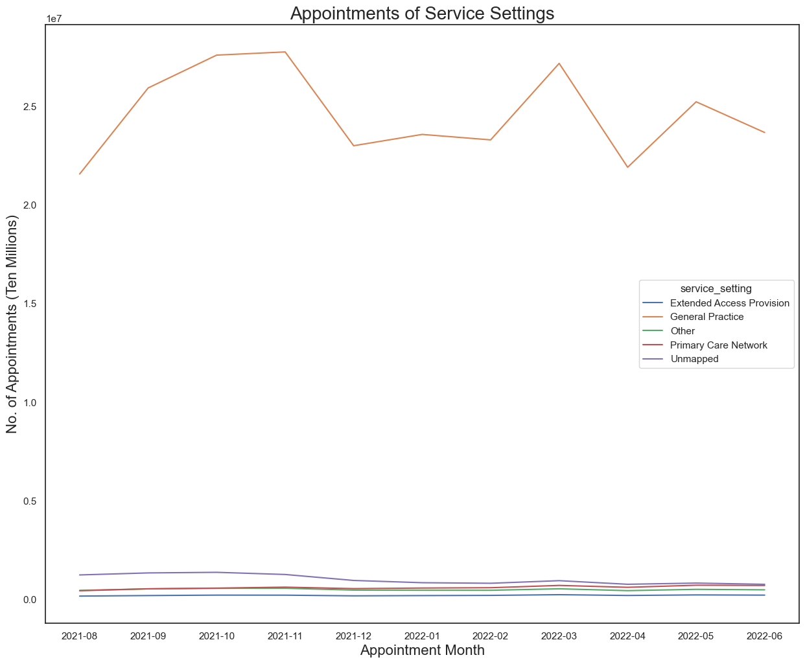
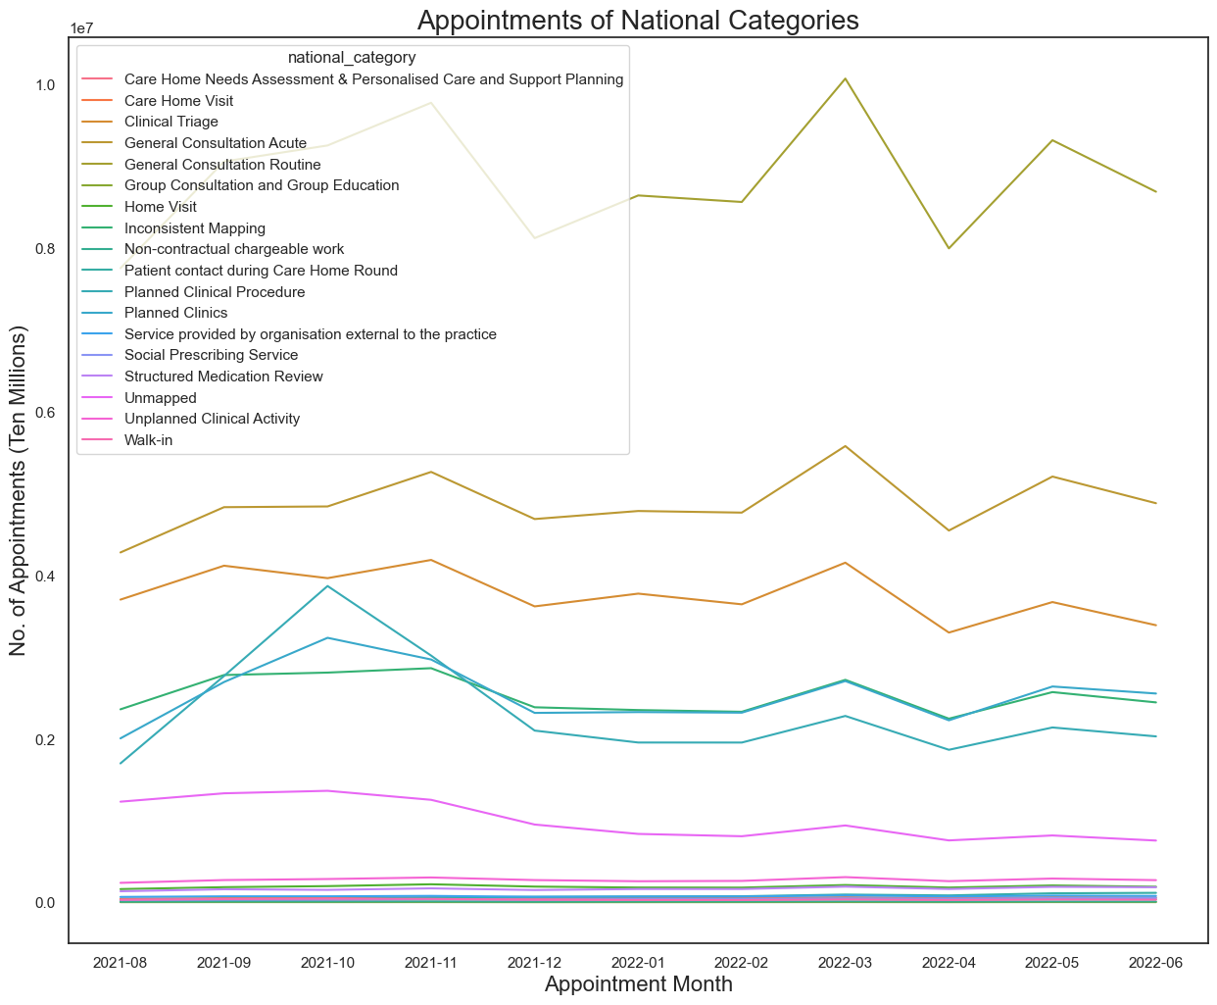
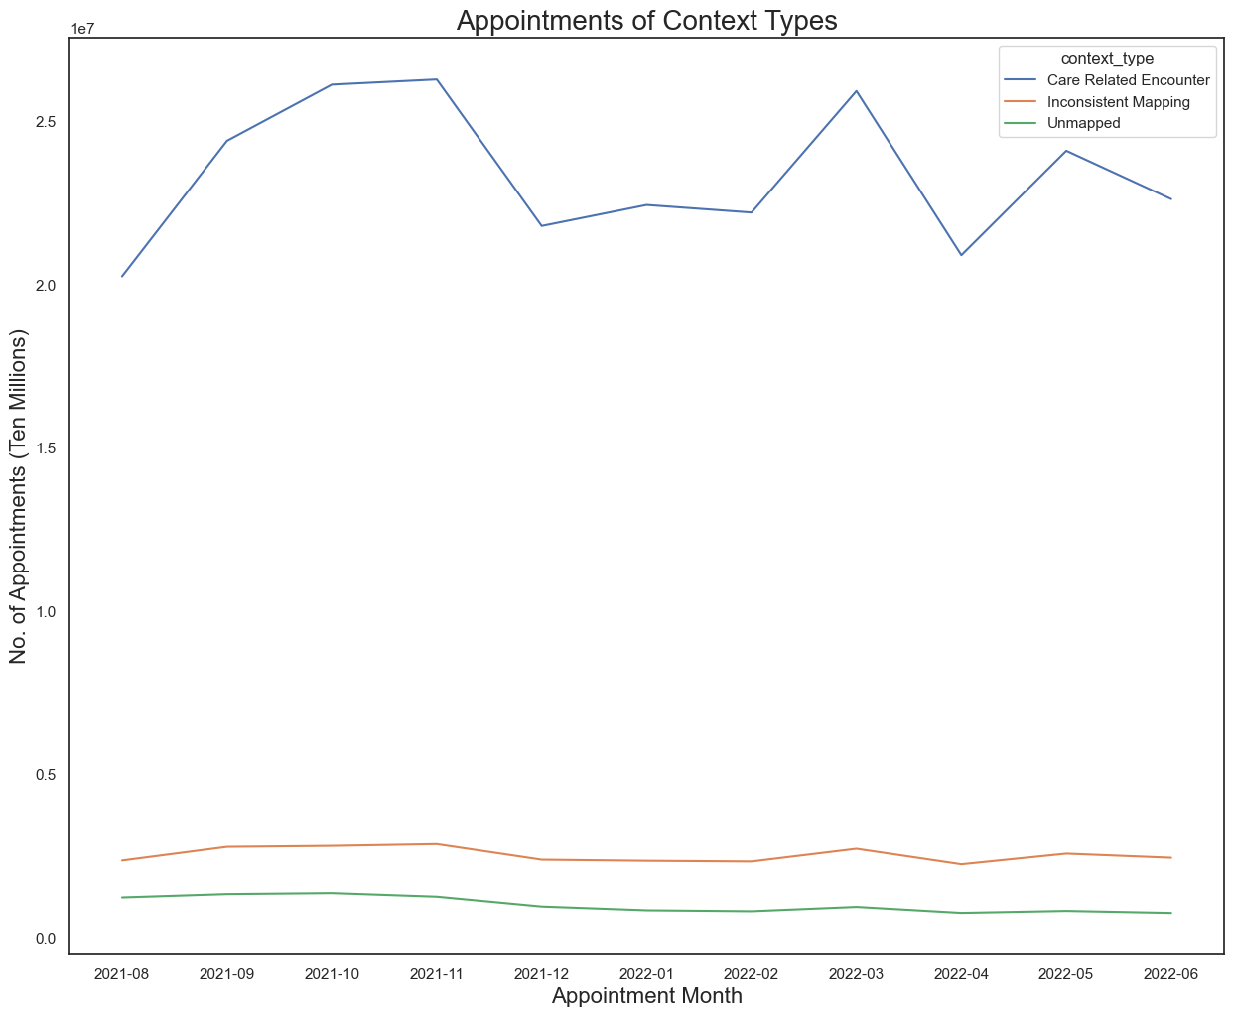
Categories
Notes:
As I previously mentioned, there are 3 categories in the national category dataset - service settings, context types and national categories. It’s undeniably important to be aware of the type of services patients go to the NHS for, especially as there could be a reason for the number of missed appointments. So here we have, 3 lineplots for the service settings, national categories and context types. For each of the categories, they have a popular type. For the service settings, the most popular is General Practice, which is no surprise. Regarding the national categories, the most common is Care Related Encounter. Finally, the most popular context type is General Consultation Routine. It’s also worth noting that the top 3 peaks for each of these categories were in October and November 2021 and March 2022, which were by no coincidence the 3 months with the most appointments.

Slide 5
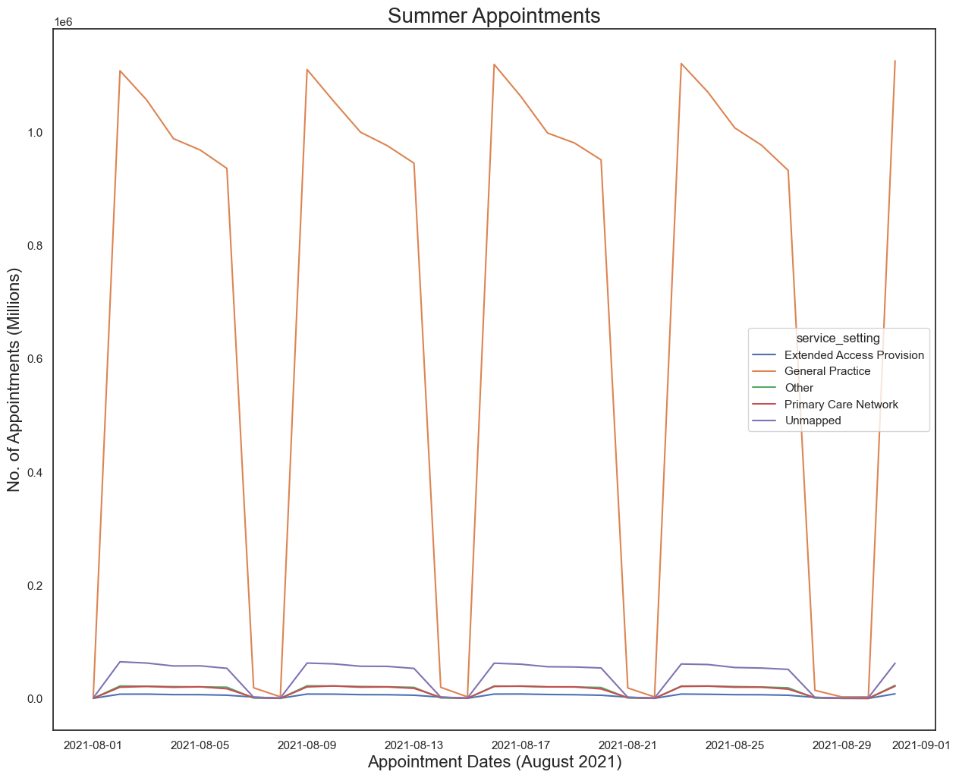
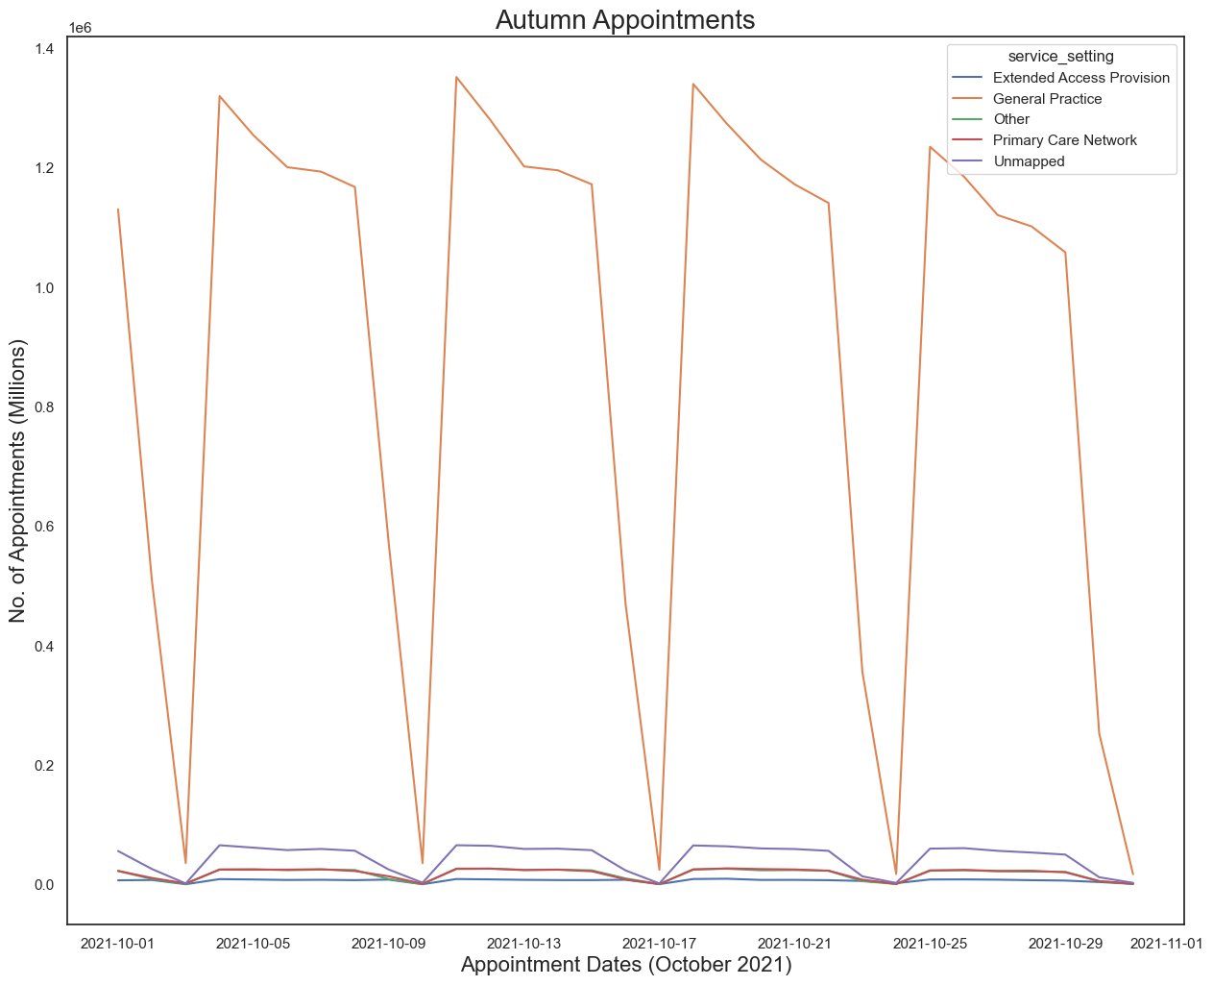
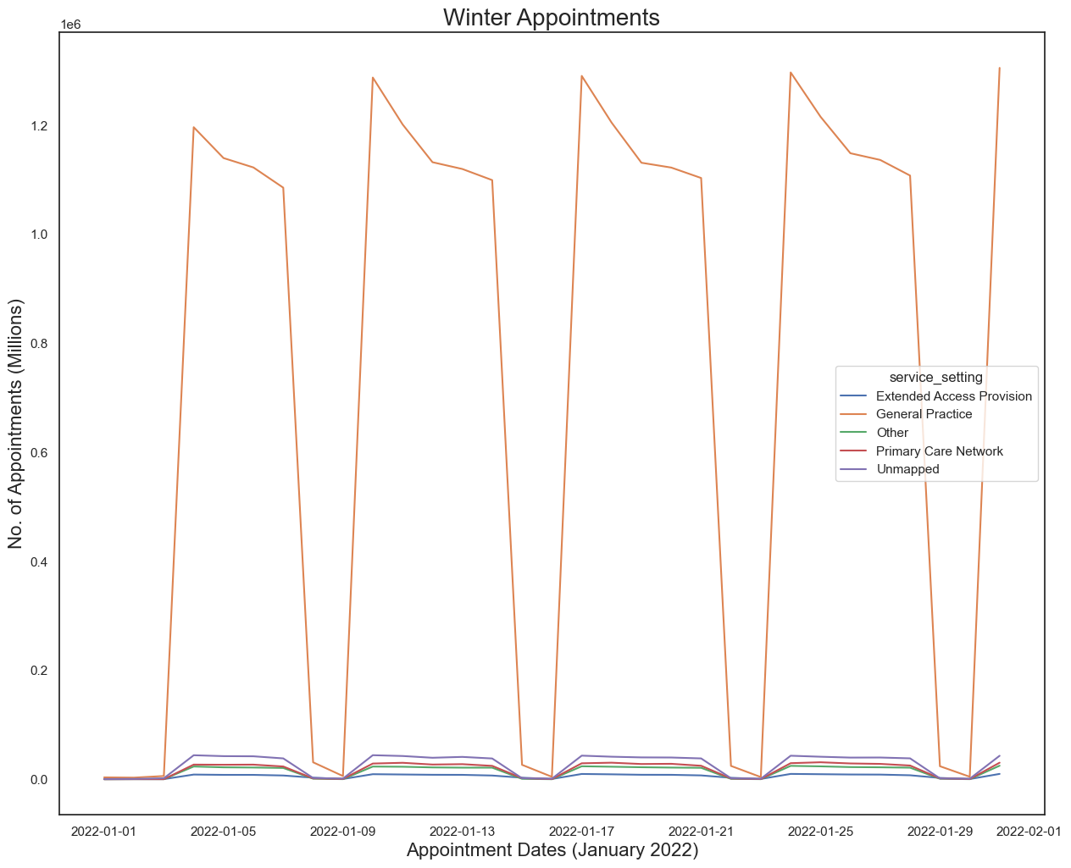
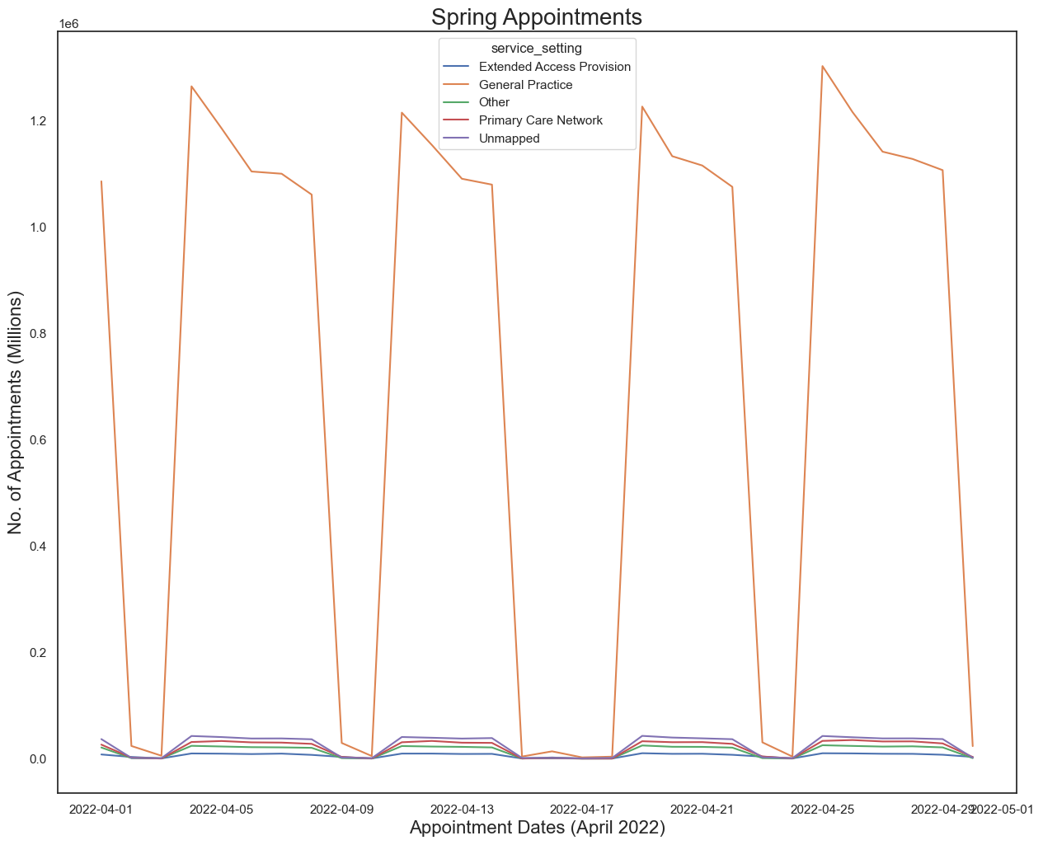
Seasons
Notes:
Furthermore, I have created visualizations to showcase if the number of appointments would change based on the 4 seasons – Summer, Autumn, Winter and Spring. For each season, I selected one month to visualized for fair comparisons. As you can see, they all have very similar patterns, particularly with their peaks being at the beginning of the weeks - showing that Monday is the most popular day of the week for appointments. They also share the common fact of ‘General Practice’ being the most popular Service Setting. My investigation also revealed that Autumn was the season with the most appointments while the least popular season was Summer.

Slide 6
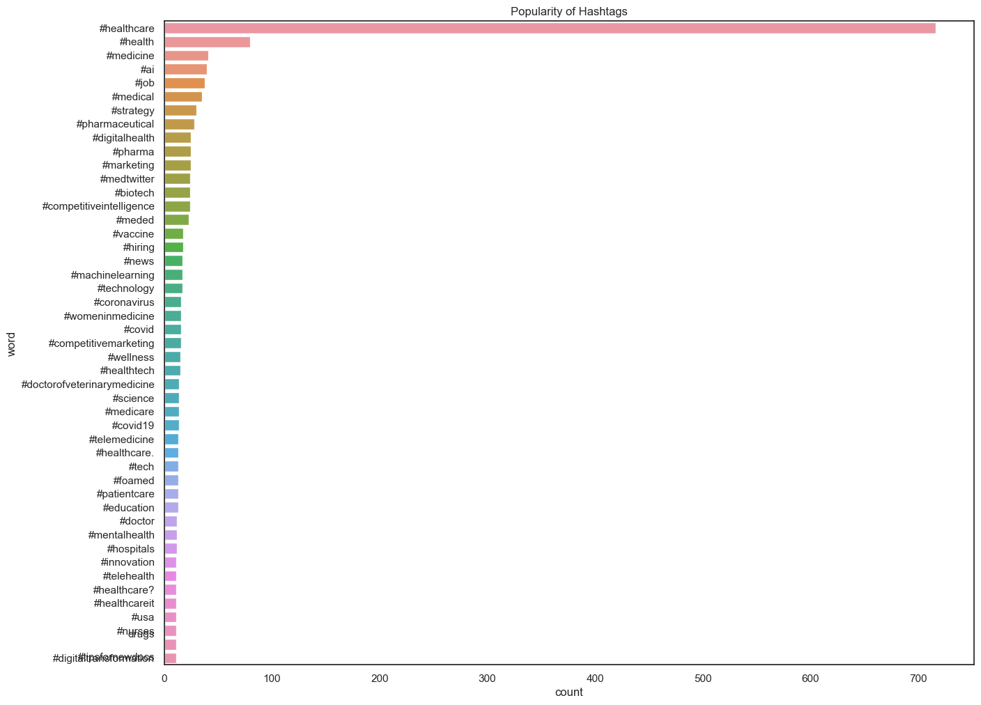
Hashtags
Notes:
During the analysis, I also closely inspected the tweets dataset. This was to check the most trending hashtags. I do believe it is important to know about popularity of the hashtags as they serve as a very powerful tool for organizing over a thousand healthcare related tweets around the social media. Here we have is a Seaborn barplot displaying all the hashtags which have been used over 10 times. As we can see here, #healthcare is undoubtedly the most popular hashtag with a count of over 700. Although none else come even close, there are other commonly used hashtags such as #health, #medicine and #ai, which are all very relevant topics in today’s world.

Slide 7
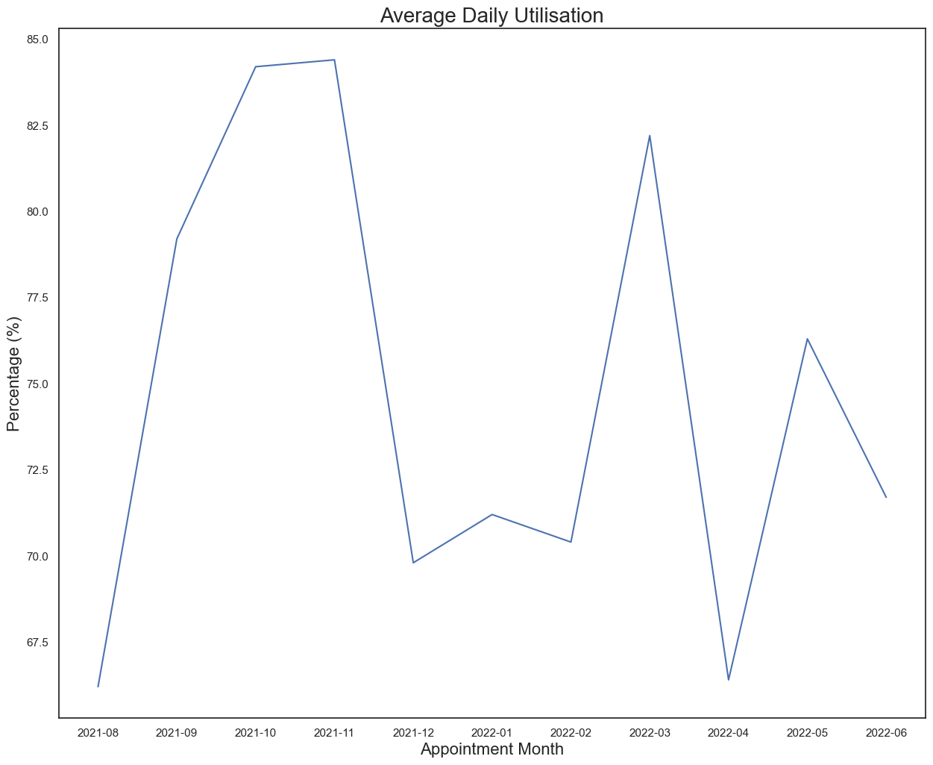
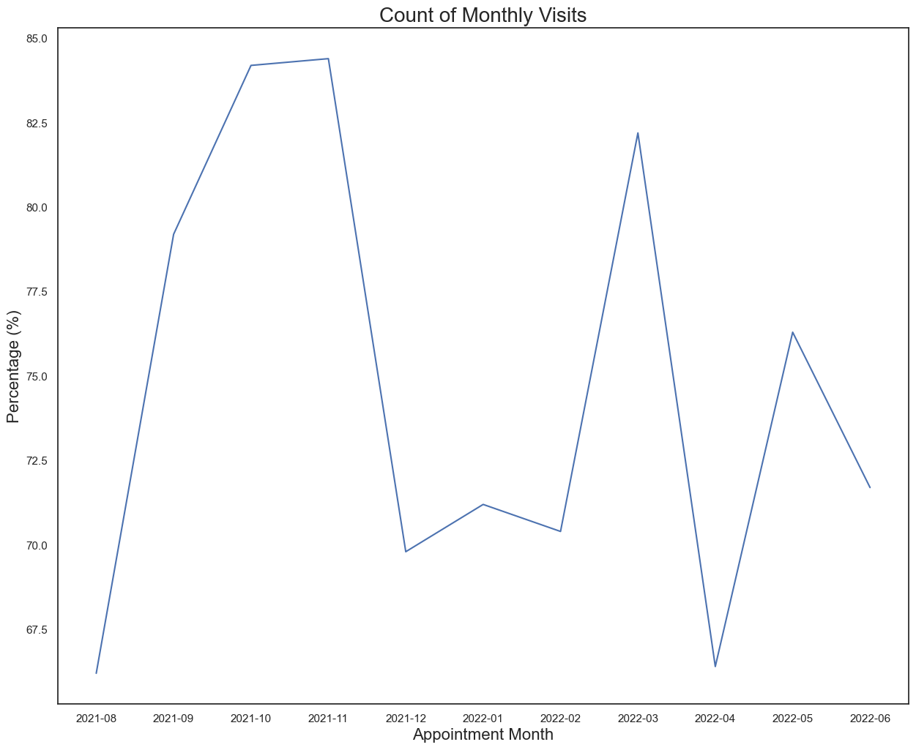
Question 1: Has there been adequate staff and capacity in the networks?
Notes:
At the beginning of this presentation, I mentioned that the NHS asked 2 questions for this project. For these questions, my team and I chose to focus between August 2021 and June 2022 as this was the period where the Covid restrictions started to dial down and everyone was working as usual. Here we have the first question – has there been adequate staff and capacity in the networks? The NHS have revealed to have a maximum capacity of 1,200,000 appointments per day. Since there are averagely 30 days for each month, this will lead to an approximate capacity of 36,000,000 appointments for each month. November 2021 is the month with the most appointments – with their daily number of appointments reaching 84% of the maximum capacity, this shows that the NHS have an adequate amount of staff and capacity in their networks.

Slide 8
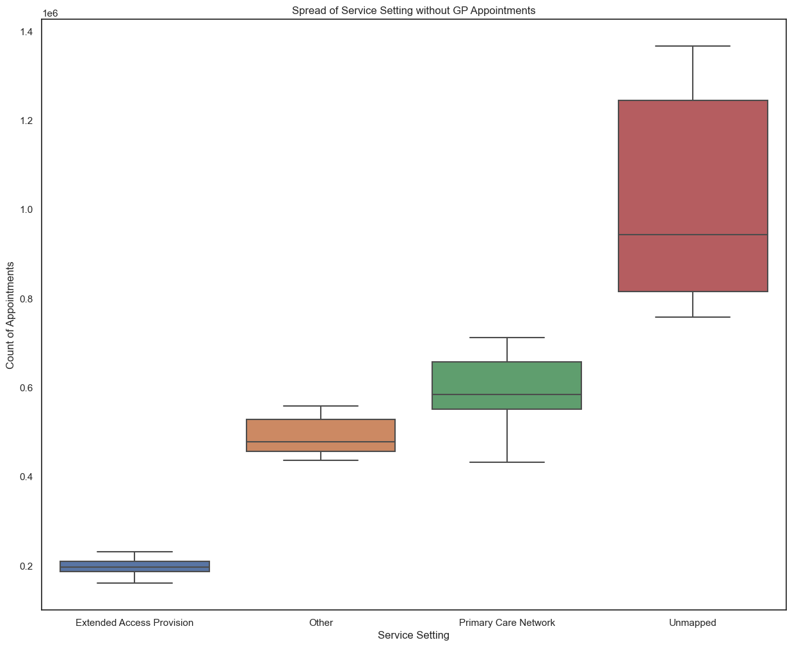
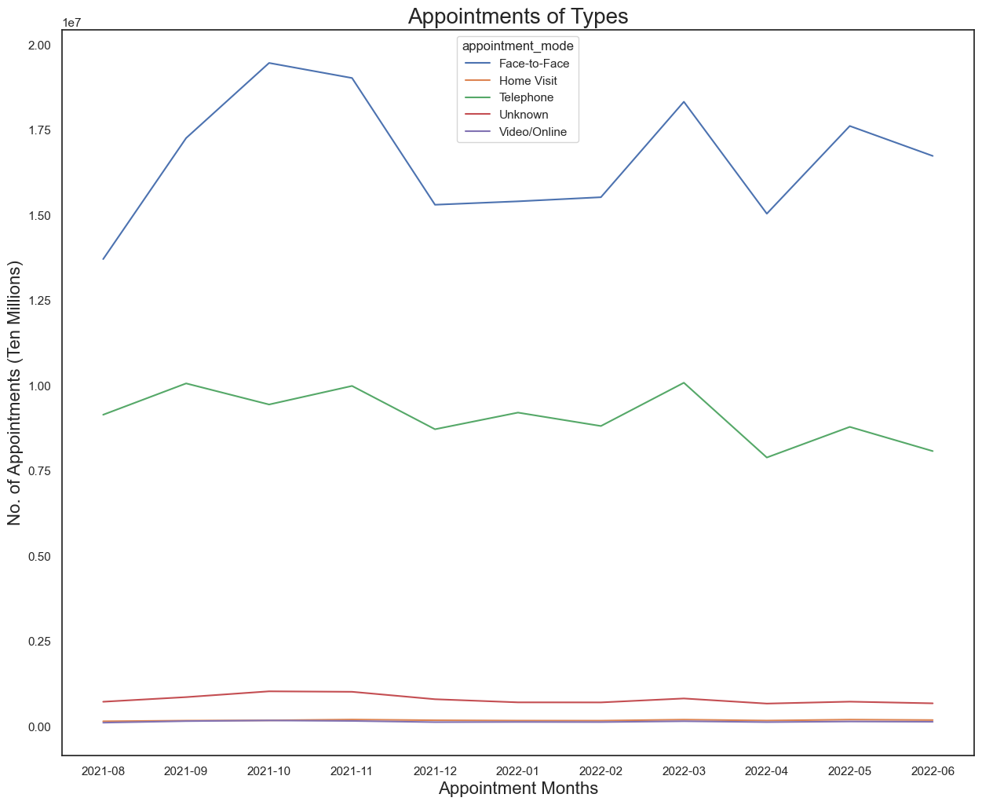
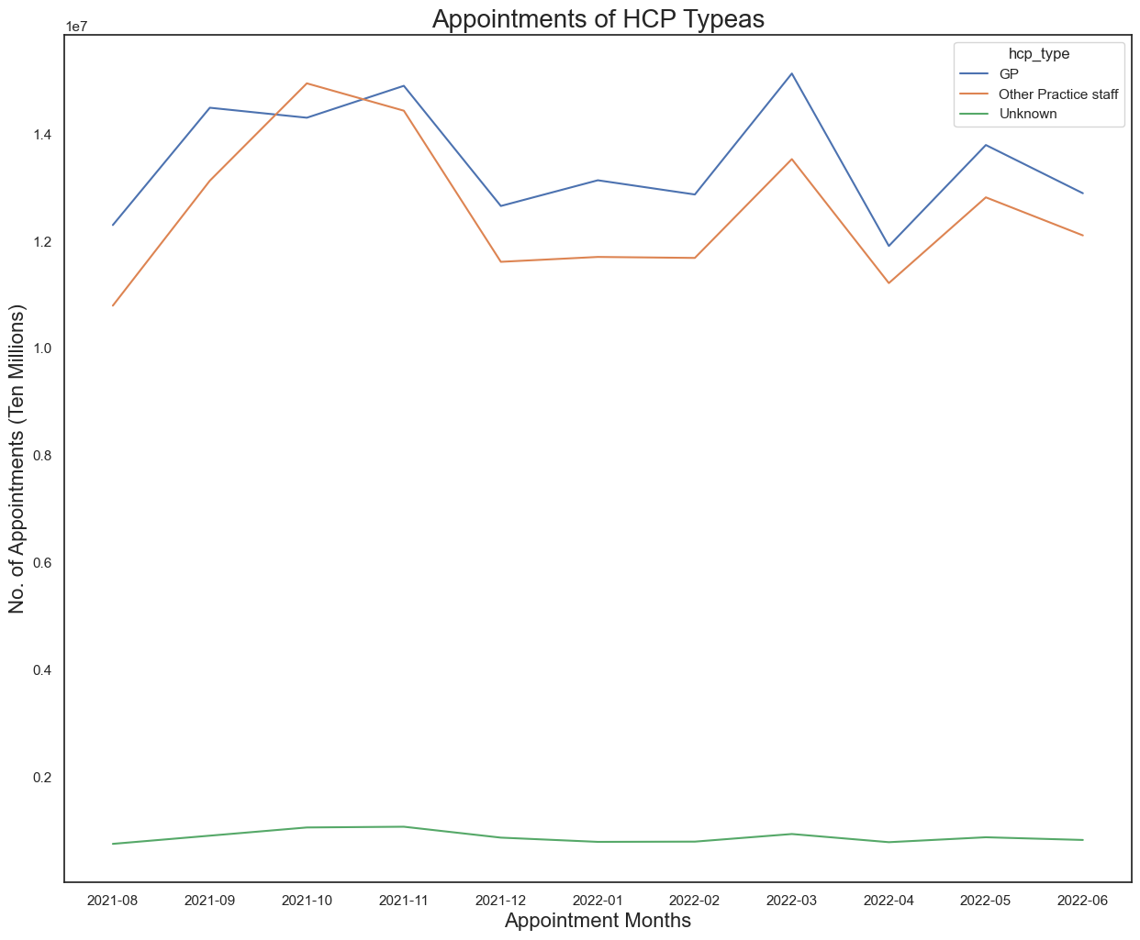
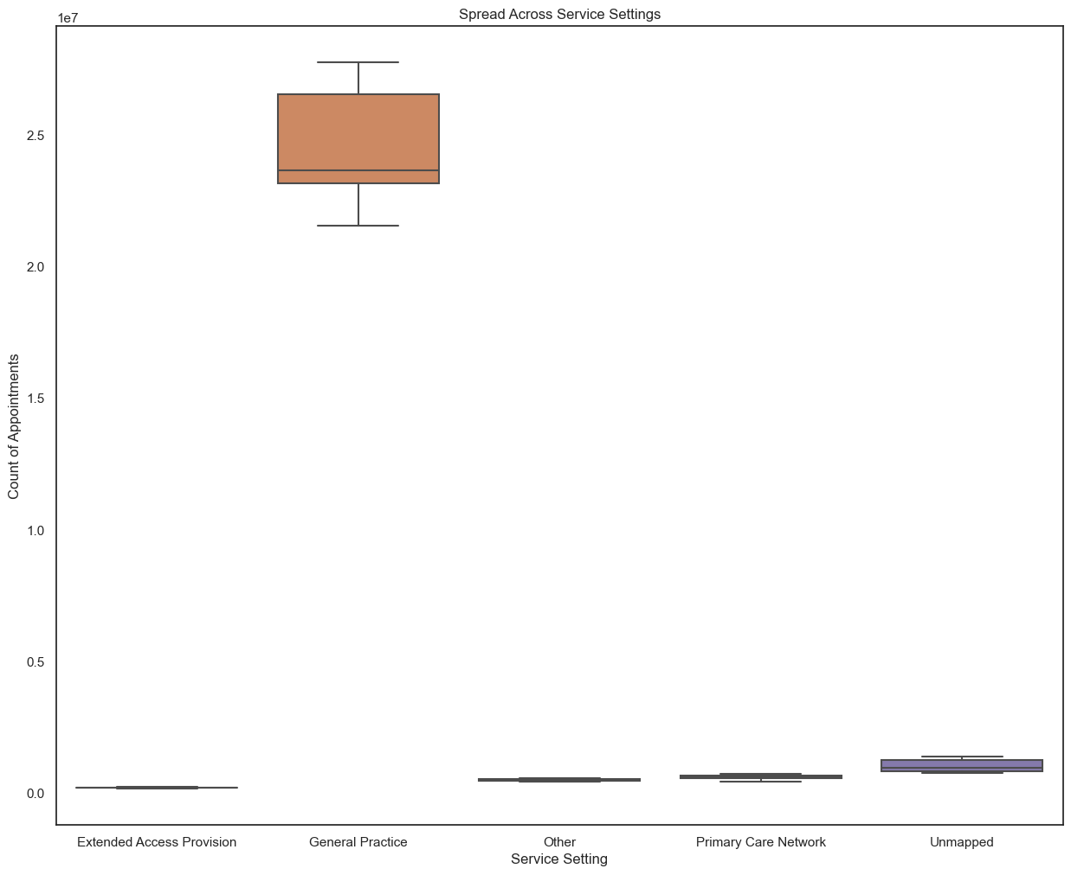
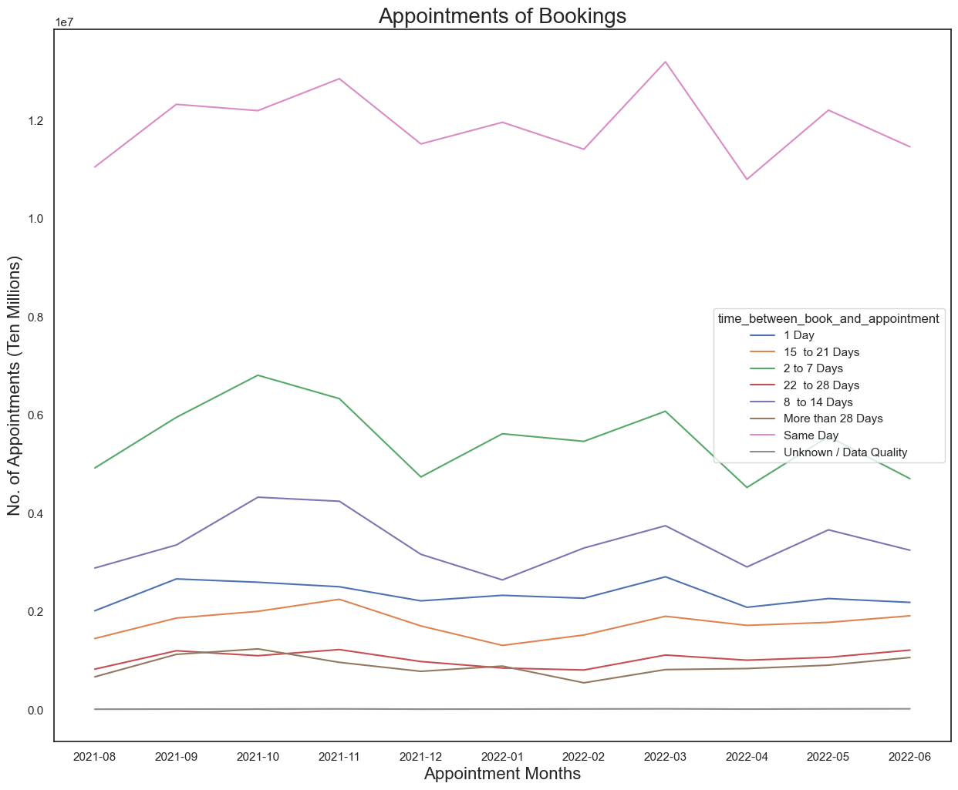
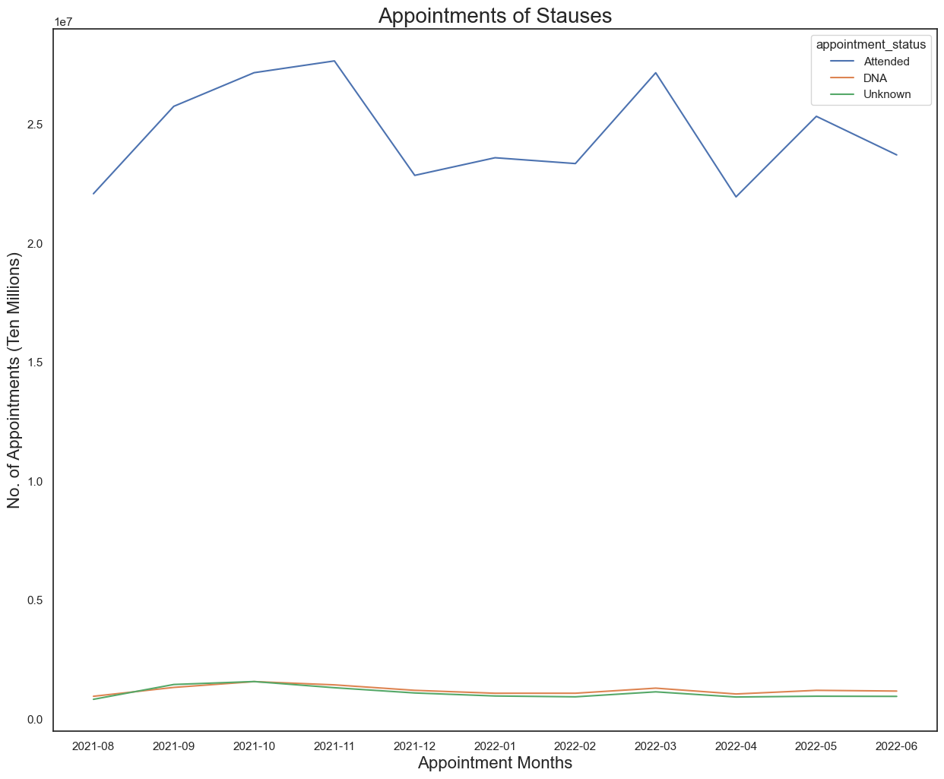
Question 2: What was the actual utilization of resources?
Notes:
The second question – what was the actual utilization of resources? The NHS have a lot to offer for the public. For example, they have a lot of healthcare professionals, particularly in General Practice. The NHS app, which leads to the majority of the patients managing and attending their appointments. They offer many appointment modes. Although face to face is the most common type of appointment, home visits, telephone ,videos are also available if face-to-face is not an option. NHS go out and beyond to support the public and this shows how.

Slide 9
Recommendations
Make sure reminders are sent to the patients by either call, text message or email at least a day before the appointment.
Make sure patients are aware of the consequences if appointments are not attended.
Extend the hub hours during the weekends.
Check that the appointments are assigned category data.
Verify that the patients know what they are going in for and they are prepared.
Notes:
After completing the analysis and uncovering the insights and trends I have just discussed, these are the recommendations my team and I would give to the NHS. The most common case of patients not attending their appointments is that they simply forget so last minute alerts through phone, email or app would help, especially if the patients need to either cancel or change their appointments. Patients need to know that not only are they costing the NHS money if they don not attend their appointments but they could be fined too. During the investigation, we worked out that the weekend is the least popular period of the week for appointments so increasing the hub hours on Saturdays and Sundays could be good, especially for those who work full time on weekdays. We also found out that apart from GP, unmapped is the most popular service setting, which means some appointments lack category data, which is one possible reason of why appointments are missed. Finally, make sure the patients are 100% of what they are getting to, because I as mentioned in a previous slide, the services the patients are assigned could be why they choose not to show up.

Slide 10
Conclusion
Thank you
Notes:
This has been my presentation. I hope you have found it insightful, and it will support you in reducing the number of appointments. I really appreciate to be given an opportunity such as this. Thank you.

