Slide 1
Turtle Games Analysis and Insights
Leonard Okhani
Notes:
Good morning. My name is Leonard Okhani and this is my Analysis and Insights presentation for Turtle Games. I am truly honoured to be here and I hope you find the information provided in this presentation useful for the business.

Slide 2
Scenario
Turtle Games is a game manufacturer and retailer with a global customer base. The company manufactures and sells its own products, along with sourcing and selling products manufactured by other companies. Its product range includes books, board games, video games, and toys. The company collects data from sales and customer reviews. Turtle Games has a business objective of improving overall sales performance by analysing and considering customer trends. To improve overall sales performance, Turtle Games has developed an initial set of questions. You’ll explore these questions in greater depth through the weekly assignment activities. The questions are:
How do customers engage with and accumulate loyalty points?
How can customers be segmented into groups, and which groups can be targeted by the marketing department?
How can text data (e.g. social data such as customer reviews) be used to inform marketing campaigns and make improvements to the business?
Can we use descriptive statistics to provide insights into the suitability of the loyalty points data to create predictive models (e.g. normal distribution, skewness, or kurtosis) to justify the answer.)
Notes:
So why are we here today? Turtle Games is a game manufacturing and selling company, which sells their own original products as well as products from other companies. These products include books, video games and more. The company is dedicated in improving their sales performance by analysing their customers’ purchasing behaviour and reviews. To support Turtle Games, an analysis was made my team to investigate the customers’ sales and be able to answer the following 4 questions:

Slide 3
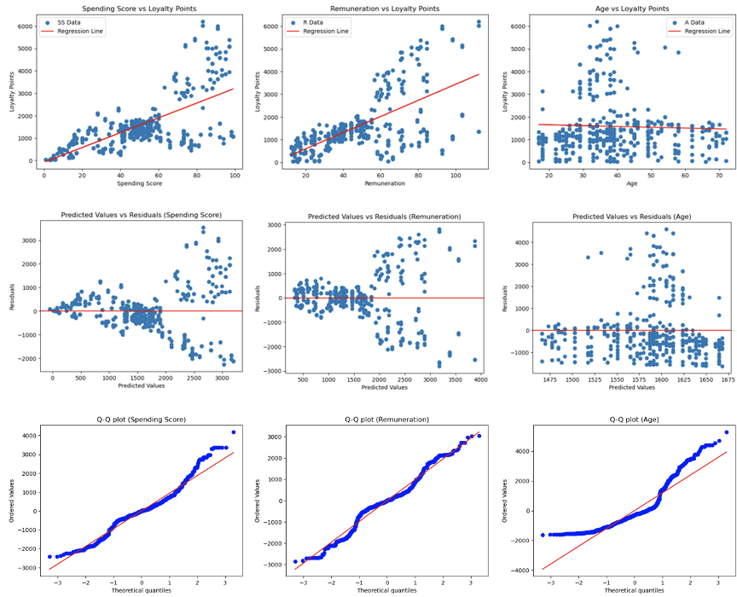
Question 1 – How do customers engage with and accumulate loyalty points?
Notes:
To work out how the customers accumulate loyalty points, an investigation was made to see if the loyalty points had any existing relationships with the age, remuneration and spending score. The top row shows scatter plots with regression lines, which represent the simple linear relationships. As we can see here, as the spending score and remuneration increases, so do the loyalty points but no relationship with age. The middle row is the residual plots – residuals are the differences between the actual and predicted values. With the spending score and remuneration, it shows to be a non-linear relationship with the loyalty points, but age has random scattering, which doesn’t suggest a relationship. The bottom row displays the q-q plots, which are used to see whether the residuals follow a normal distribution. Spending score and remuneration mostly follow the distribution while age does not. Overall, customers who spend more will gain more loyalty points. Although not to the same extent, those with higher incomes are more likely to gain more points. Age however is not a factor at all – anyone of any age can gain as much loyalty points as they can.

Slide 4
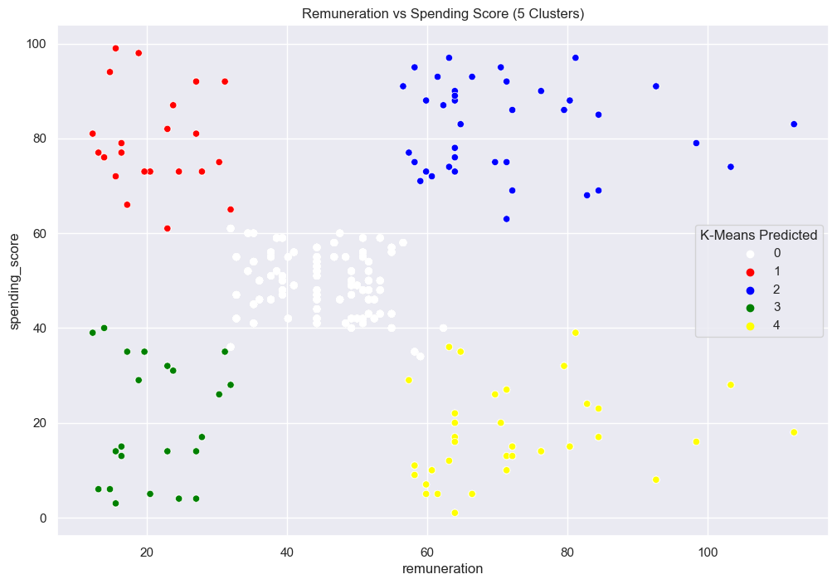
Question 2 – How can customers be segmented into groups, and which groups can be targeted by the marketing department?
Notes:
Since remuneration and spending score proved to be the best predictors for the loyalty points based on the previous regression analysis, the marketing department would want to seek evidence of their usefulness in improving their business. With the aid of K-means clustering, the 2000 customers were segmented into 5 groups in terms of their spending scores and remuneration – mid-earning mid spenders, low-earning big spenders, high-earning big spenders, low-earning small spenders and high-earning small spenders. After my team and I investigated each group, we believed it would be beneficial for the company to send different surveys to each segment to understand their needs as well as tailor the loyalty programs for each of them.

Slide 5
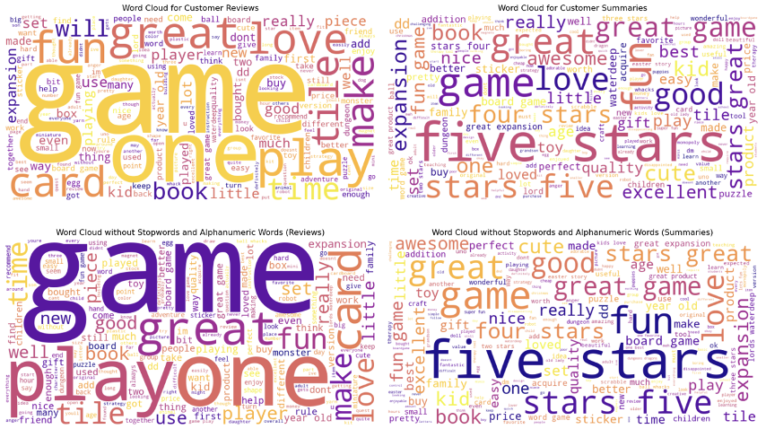
Question 3 – How can text data (e.g. social data such as customer reviews) be used to inform marketing campaigns and make improvements to the business?
Notes:
The data we analysed for this project wasn’t just full of quantitative data – it also included qualitative data – the reviews and summaries. This is where sentiment analysis came in – so we could truly understand the customers’ true feelings about the company and the products. By applying tokenization, we broke the dataset into words and produced the word clouds you see in the top row. As for the review word cloud, the dominant words were ‘fun’, ’great’ and ‘love’, which indicates a positive sentiment. Words like ‘card’ and ’book’ occurred, which suggested the popularity of these products. Regarding the summary word cloud, the dominant words were also ‘great’, ‘love’ and ‘fun’ as well as ‘excellent’. It is also hard to ignore the phrase ‘five stars’. The team and I went through the process of removing alphanumeric characters (1st, 2nd, 4) and stopwords (the, will, and, really) from the wordclouds so we could really emphasize on the more important words. After the process, we produced the wordclouds again as seen in the bottom row. The same words as before were still dominant, which proves the customers have a mainly positive feeling about Turtle Games, particularly with card-based and book-based games.

Slide 6
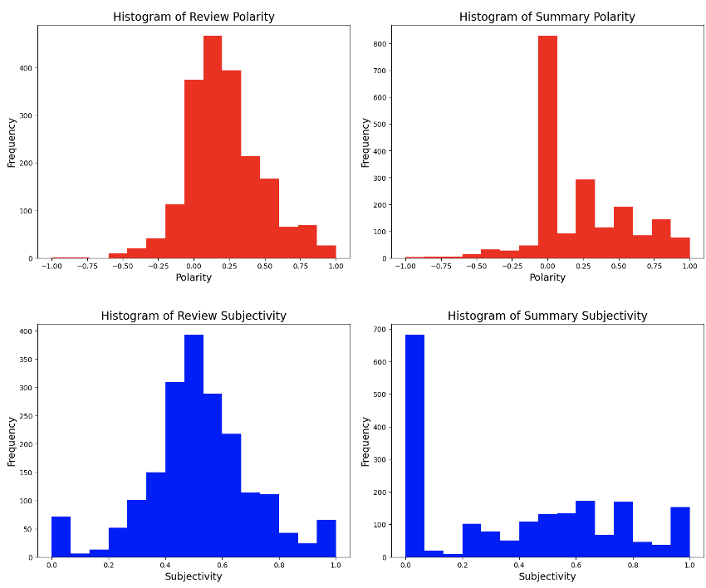
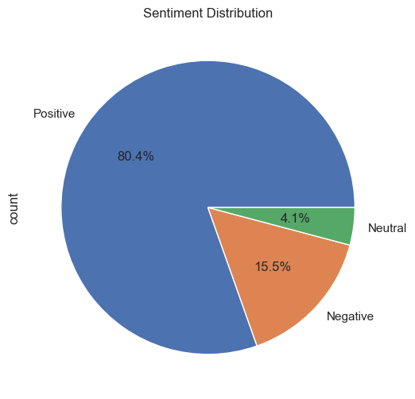
Sentiment Analysis Continuation
Notes:
During the sentiment analysis as we spoke about when discussing the third question, other visualizations were created to see if they back the results of the wordclouds. The first was histograms. We first based it on polarity, which ranges from -1 (negativity) to +1 (positivity). With the review polarity, we can see that it is right-skewed, which shows that there are more positive reviews than negative reviews. The summary polarity peaked at 0, showing that many of the summary texts were neutral. Next was to check the level of subjectivity, which ranges from 0 (objectivity) to 1 (subjectivity). Regarding the review subjectivity, it peaked at 0.5, so the reviews were subjective but not too much. With a huge spike at 0.0 with the summary subjectivity, this suggest that most of the summaries were completely objective. The next visualization was a pie chart, which was used to measure the sentiments of the reviews. As you can see here, 80% of the reviews were positive – backing the results of the word clouds that most of the customers are happy with Turtle Games.

Slide 7
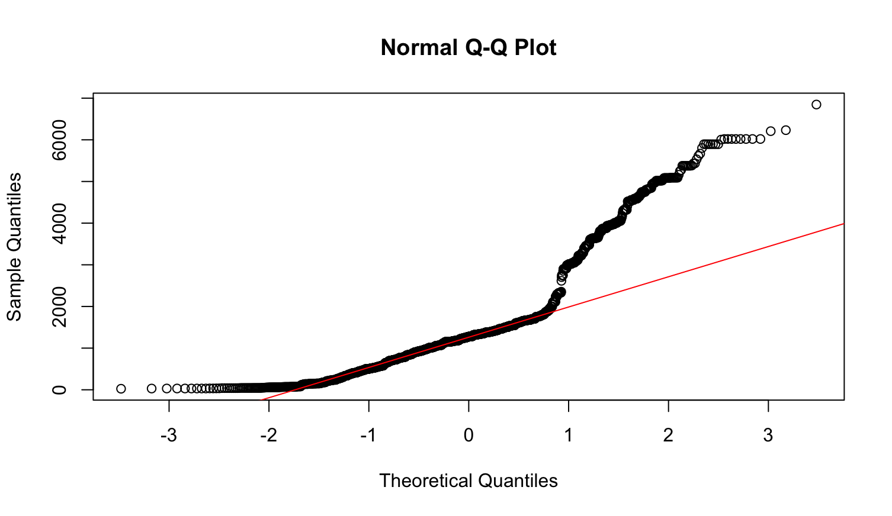
Question 4 – Can we use descriptive statistics to provide insights into the suitability of the loyalty points data to create predictive models (e.g. normal distribution, skewness, or kurtosis) to justify the answer.)
Notes:
The previous questions were answered by the analysis of Python. With this final question, my team and I had to rely on R programming. We had to prove that descriptive statistics can provide useful insights into the suitability of the loyalty points data to create predictive models, which included testing for the normal distribution, skewness and kurtosis. To do this, we put the loyalty points data through a Shapiro-Wilk test, which led to the creation of this q-q plot. As we can see here, the data deviated strongly from the diagonal line, which showed a significant departure from normality. This was also supported by the positive skewness and leptokurtic distribution for the kurtosis. My team and I debated whether we should have tried to log the data to get it closer to the normal distribution before we proceeded to the multiple linear regression to create the model but at the end, we all agreed to keep it as it is. This was because we wanted to maintain the interpretability of the results and multiple linear regression doesn’t require the data to be normally distributed. Fortunately, the model that came from the regression part still performed strongly with the 3 independent variables – covered approximately 84% of the loyalty points variance.

Slide 8
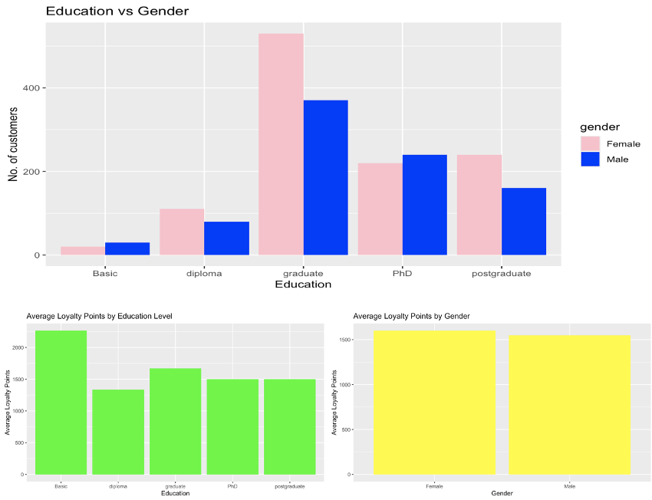
Customer Demographics
Notes:
While checking the relationships between the loyalty points with age, remuneration and spending score, age was always the one that barely provided a relationship but while remuneration and spending score are behavioral characteristics, age is a demographic, so my team and I decided to analyse the other demographics of the customers – their gender and education. Out of the 2000 customers, almost 60% were females and the rest were males. Almost a half of the customers have a bachelor’s degree, although there are many customers with a PhD or master’s. My team and I proceeded to work out the loyalty points averages for each group in both demographics. Ironically, even though basic education had the least number of the customers, they had the highest average. With the gender, despite females populating over 50% of the customers, there wasn’t too big of a difference between their average with the males.

Slide 9
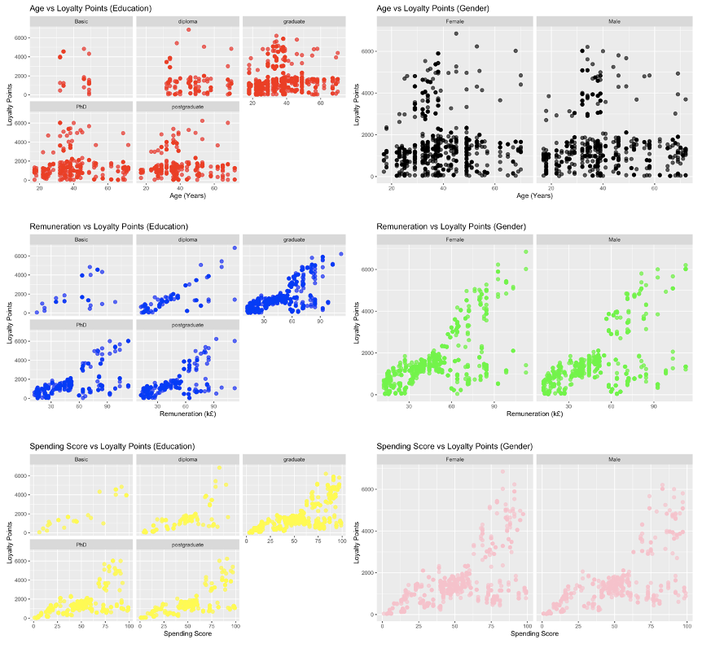
Demographics vs Behaviour
Notes:
To further continue the analysis of whether demographics still had an effect on the loyalty points accumulation, my team and I created scatter plots to explore the relationships between the loyalty points with the 3 key variables and splitting the data with gender and education. As we can see in each of the 6 scatter plots, there is barely a difference in terms of the linear relationship between the loyalty points with the key variables, even with education and gender. In the remuneration vs loyalty points (education) plot, the higher education do have a stronger correlations however higher educated customers tend to earn more, so we can still say this is more down to their behaviour than the demographic of education alone.

Slide 10
Recommendations
Adopt behaviour-based targeting.
Tailor loyalty programs by customer segment.
Prioritise high-spending customers.
Promote high-performing products categories.
Notes:
After coming to the conclusion that accumulation of loyalty points comes more from the customers’ behaviour than their demographics, these are the recommendations we came for Turtle Games. 1. Focus less on demographic segmentation and create more behavorial data such as purchase frequence and product preferences – this is lead to more accurate targeting. 2. Design loyalty programs that tailor to each customer segment based on their spending and earning, such as exclusive rewards for high spending customers or milestone-based rewards to get customers to keep coming back. 3. As spending score is by the far the best predictor for loyalty points acuumulation, make the high spending customers the priority and target them with VIP treatment, which can include early access to upcoming products. 4. As we saw in with the word clouds, card and book-s based games have proven to be the most popular types of games so promote them with discounts and deals to further expand their popularity. This has been my presentation. I hope you found it useful. Thank you and good luck.

