Slide 1
1D FW-CADIS Implementation
L. Pohlmann

Slide 2
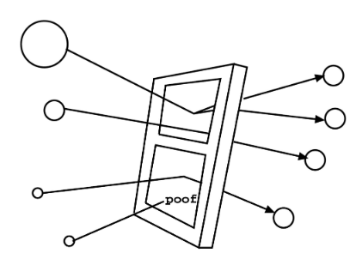
A Brief Overview of Weight Windows
Weight windowing is a VR technique that looks to control the population thought splitting (dividing high-weight particles into many fewer particles) and Russian roulette (stochastically killing particles with low weight and adding their weights to particles that survive)
A weight window assigns upper and lower bounds for weights.
The sum of the weights coming into and leaving the window are equal, maintaining a fair game.
Cartoon illustration of weight-windows.
Taken from Munk and Slaybough [3].
NPRE 555

Slide 3
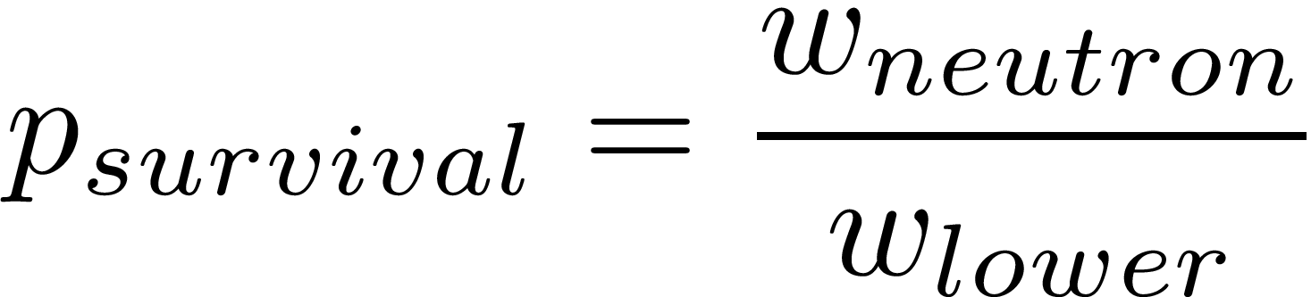
Russian Roulette
What happens when a neutron passes through a window but doesn’t meet the threshold?
Throw a random number and compare it to the probability of survival.
If it doesn’t survive, terminate the history.
If it survives, increase the weight to the target weight.

Slide 4
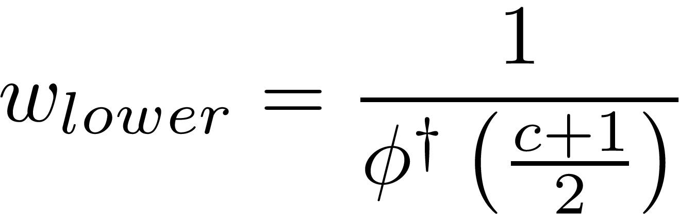
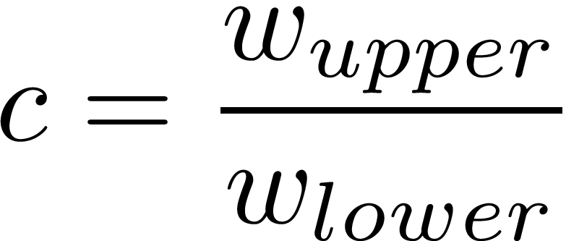
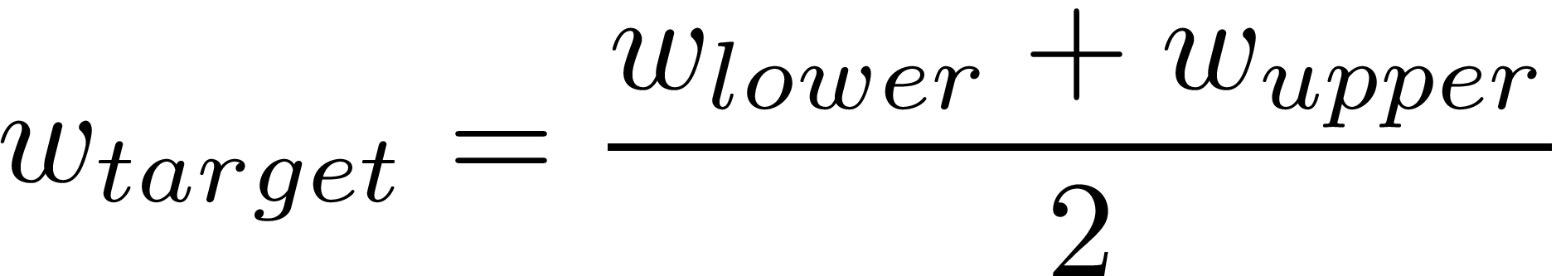
Weight Windows Generation
In FW-CADIS, we can only solve for the target (or center) weight, so we need a relation.
The window width is set by the user at runtime, the rest is automated.
NPRE 555

Slide 5
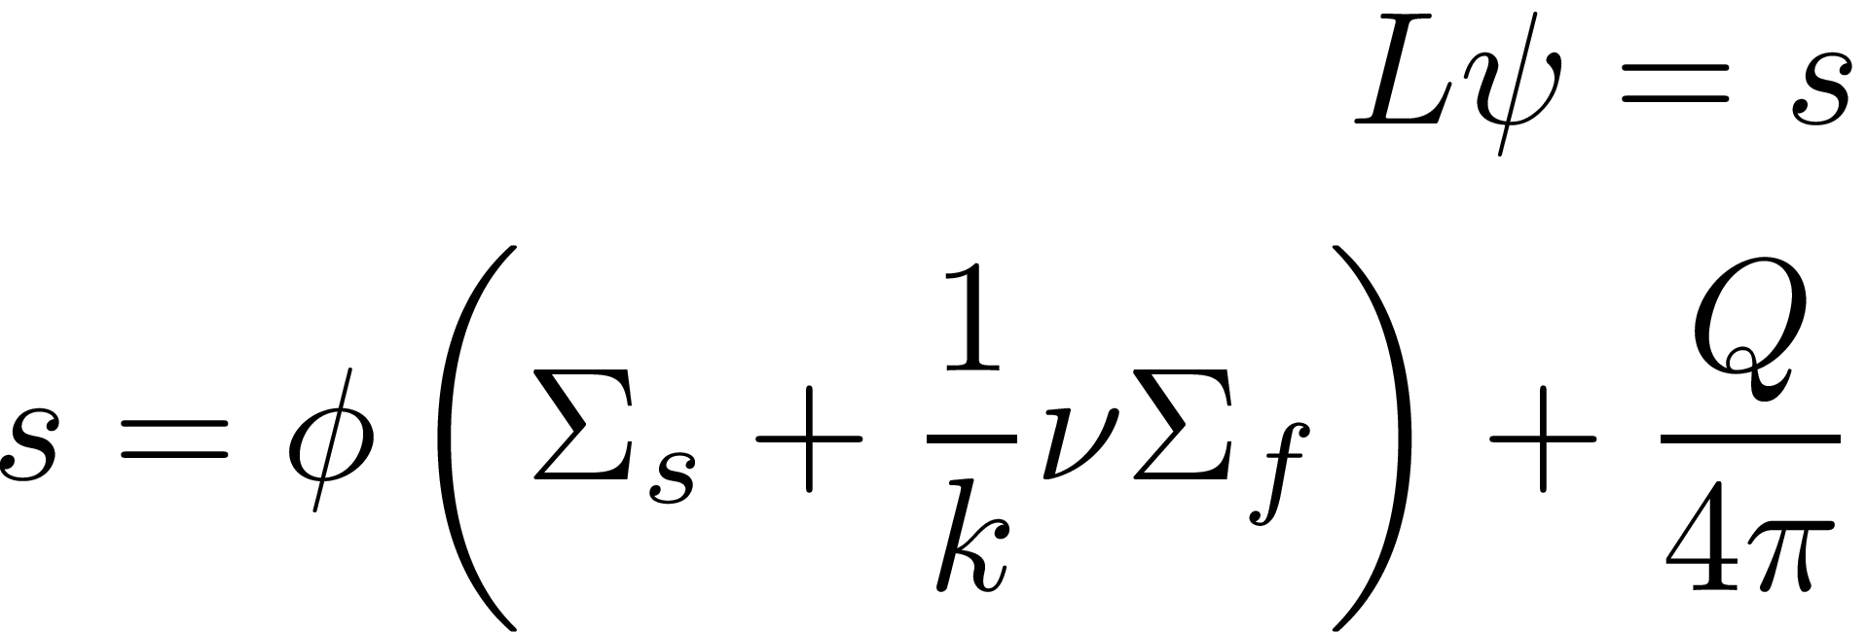
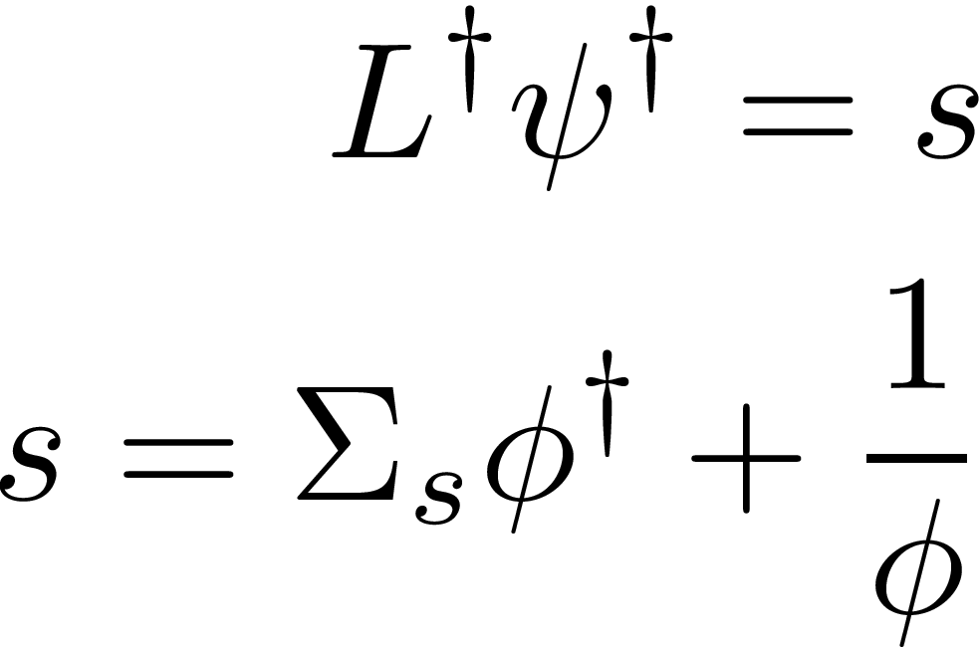
Process
Solve forward problem using simple deterministic method (in my case, I used SN)
Use the inverse of the the forward flux as a volumetric source for a fixed-source adjoint solve.
Use the inverse of the adjoint solve as the targe weight for weight windows
NPRE 555

Slide 6
Solving the Adjoint
The only thing different about solving the adjoint for constant properties is the streaming direction.
Also, we flip the boundary conditions (nothing leaves).
This means we sweep in reverse, yet the diamond difference equations are the same!
NPRE 555

Slide 7
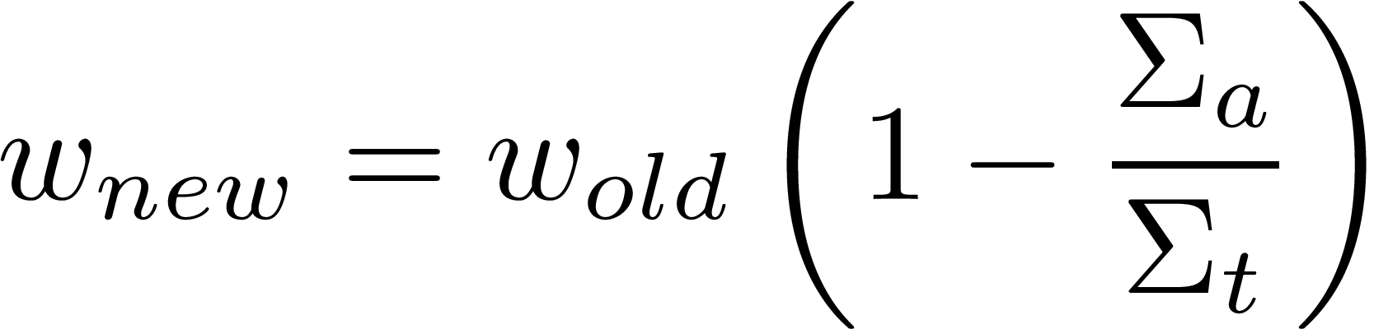
Additional Work – Survival Biasing
When a collision occurs, instead of testing for survival, we say the particle survives no matter what, then reduce its weight.
This allows for continued histories into deep parts of the problem.
Struggling with assigning correct weights for each fission...
NPRE 555

Slide 8
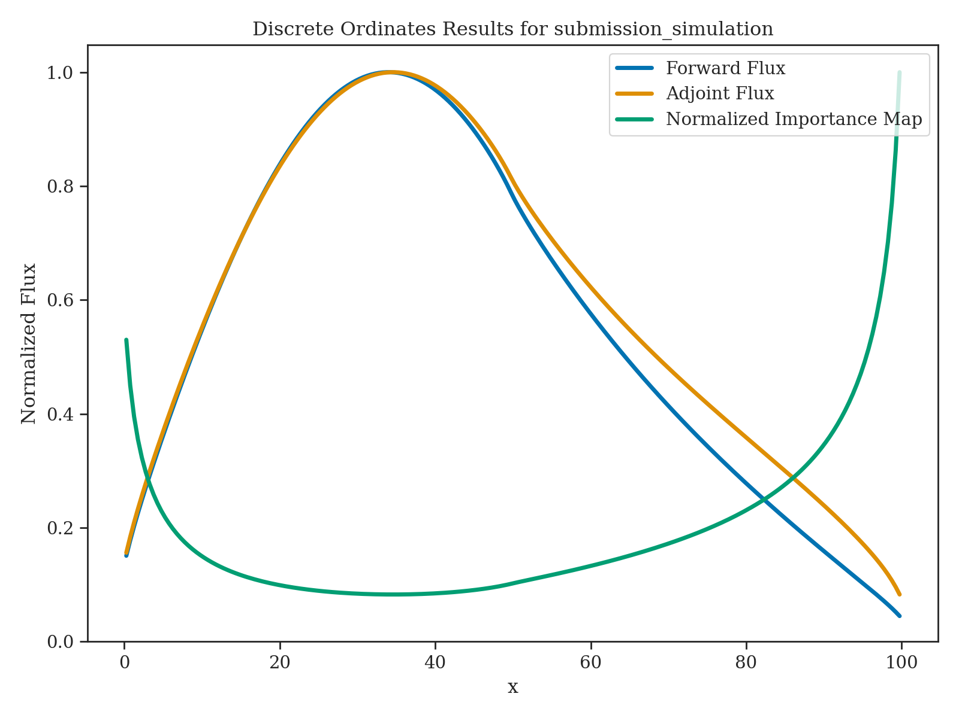
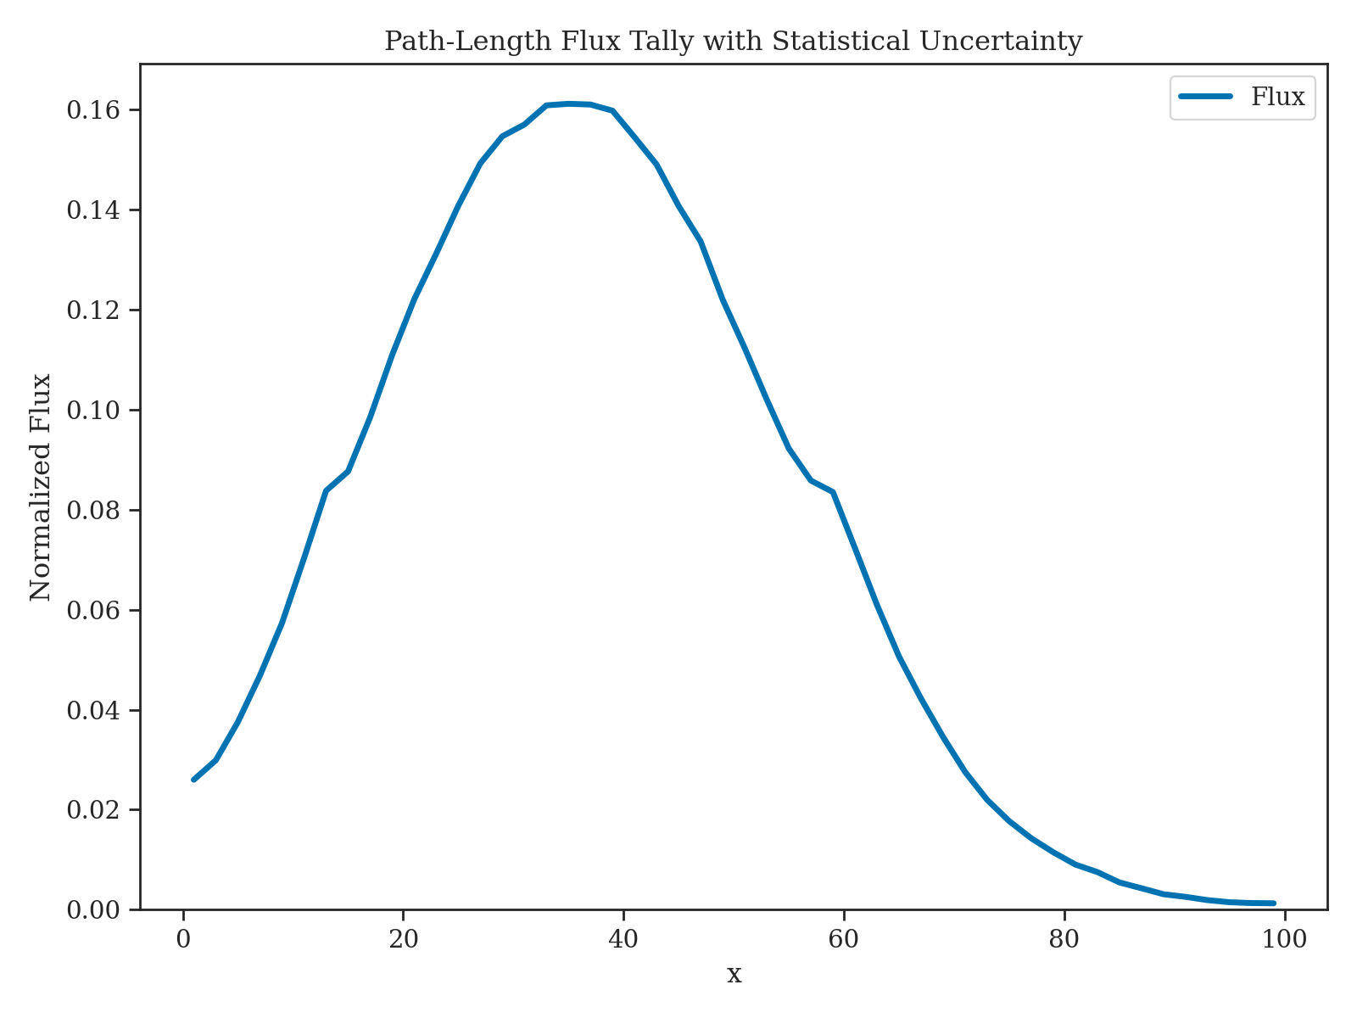
Preliminary Results
K-eff for Monte Carlo is predicting about 1.06, which is about 0.11 off...
NPRE 555

Slide 9
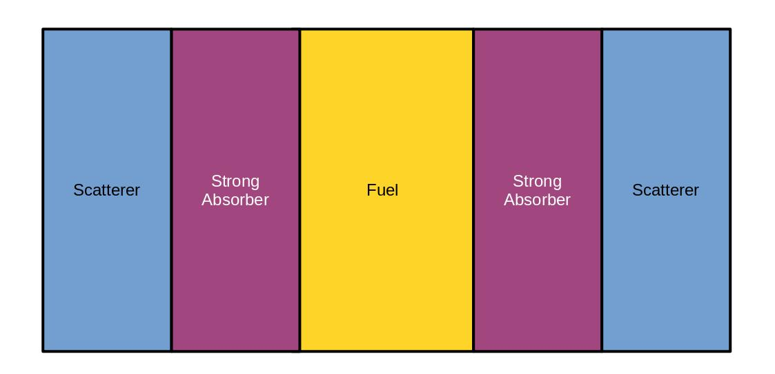
Tests
Starting with previous problems on simple slabs (such as the one from CP1 and the one listed in CP3)
See below for my suggested test problem...
NPRE 555

Slide 10
Challenges
Setting the correct weight for new particles created by fission
  This is normally just 1.0 when doing analog, but this assumes every particle maintains its weight through a history.
Implicit capture is way overestimating k-eff (likely the same problem as above...)
NPRE 555

Slide 11
Sources
[1]J. C. Wagner and A. Haghighat, “Automated Variance Reduction of Monte Carlo Shielding Calculations Using the Discrete Ordinates Adjoint Function,” Nuclear Science and Engineering, vol. 128, no. 2, pp. 186–208, Feb. 1998, doi: 10.13182/NSE98-2.
[2]E. E. Lewis and W. F. Miller, Computational Methods of Neutron Transport. American Nuclear Society, Inc., 1993.
[3]J. C. Wagner, D. E. Peplow, and S. W. Mosher, “FW-CADIS Method for Global and Regional Variance Reduction of Monte Carlo Radiation Transport Calculations,” Nuclear Science and Engineering, vol. 176, no. 1, pp. 37–57, Jan. 2014, doi: 10.13182/NSE12-33.
[4]M. Munk and R. N. Slaybaugh, “Review of Hybrid Methods for Deep-Penetration Neutron Transport,” Nuclear Science and Engineering, vol. 193, no. 10, pp. 1055–1089, Oct. 2019, doi: 10.1080/00295639.2019.1586273.
NPRE 555

