Slide 1
1D FW-CADIS Implementation
L. Pohlmann

Slide 2
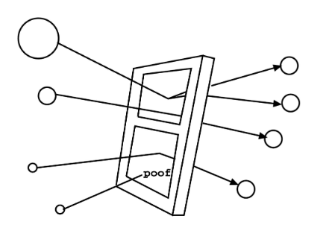
A Brief Overview of Weight Windows
Weight windowing is a VR technique that looks to control the population thought splitting (dividing high-weight particles into many fewer particles) and Russian roulette (stochastically killing particles with low weight and adding their weights to particles that survive)
A weight window assigns upper and lower bounds for weights.
The sum of the weights coming into and leaving the window are equal, maintaining a fair game.
Cartoon illustration of weight-windows.
Taken from Munk and Slaybough [3].
NPRE 555

Slide 3
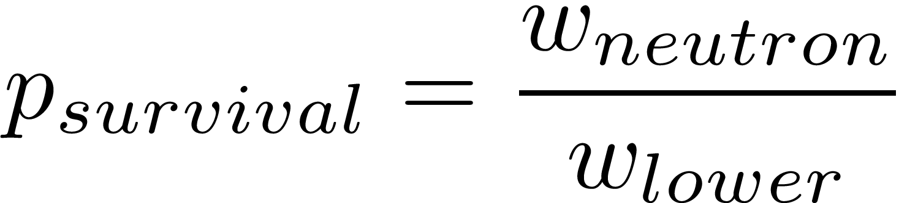
Russian Roulette
What happens when a neutron passes through a window but doesn’t meet the threshold?
Throw a random number and compare it to the probability of survival.
If it doesn’t survive, terminate the history.
If it survives, increase the weight to the target weight.

Slide 4
Weight Windows Generation
Previous methods for WW generation was to calculate the adjoint flux between a neutron source and a detector. This doesn’t work as nicely for a global problem.
NPRE 555

Slide 5
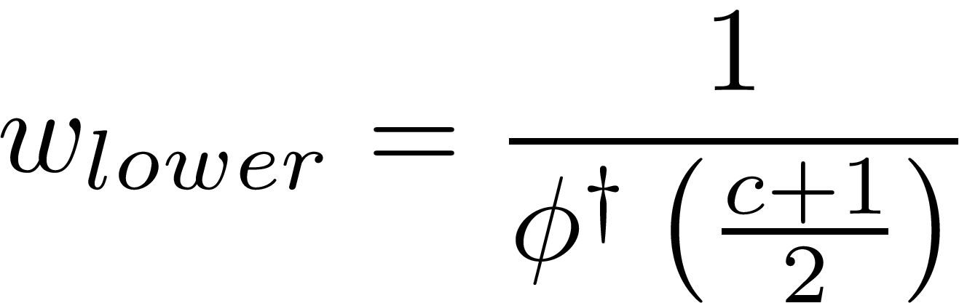
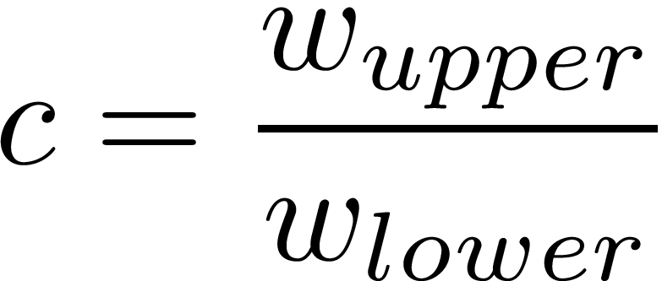
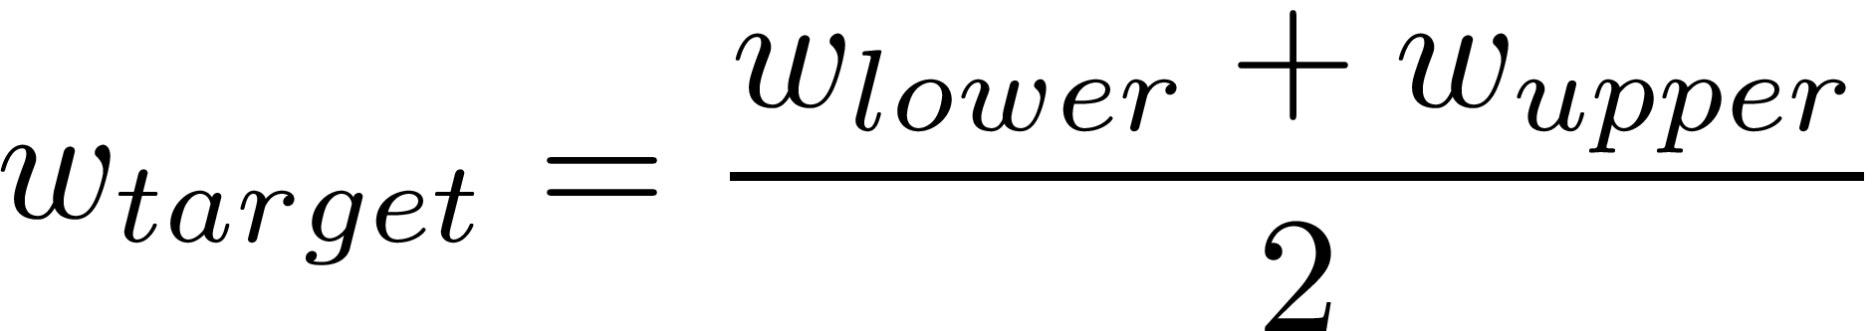
Weight Windows Generation
In FW-CADIS, we can only solve for the target (or center) weight, so we need a relation.
The window width is set by the user at runtime, the rest is automated.
NPRE 555

Slide 6
Process
Solve forward problem using simple deterministic method (in my case, I used SN)
Use the inverse of the the forward flux as a volumetric source for a fixed-source adjoint solve.
Use the inverse of the adjoint solve as the targe weight for weight windows
NPRE 555

Slide 7
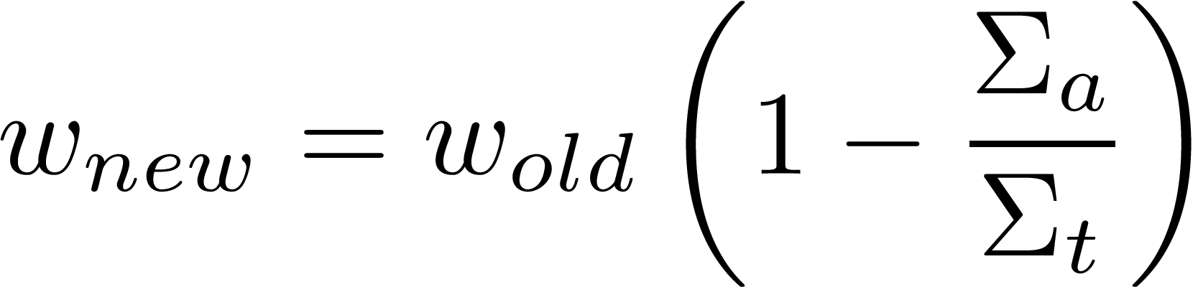
Additional Work – Survival Biasing
When a collision occurs, instead of testing for survival, we say the particle survives no matter what, then reduce its weight.
This allows for continued histories into deep parts of the problem.
Struggling with assigning correct weights for each fission...
NPRE 555

Slide 8
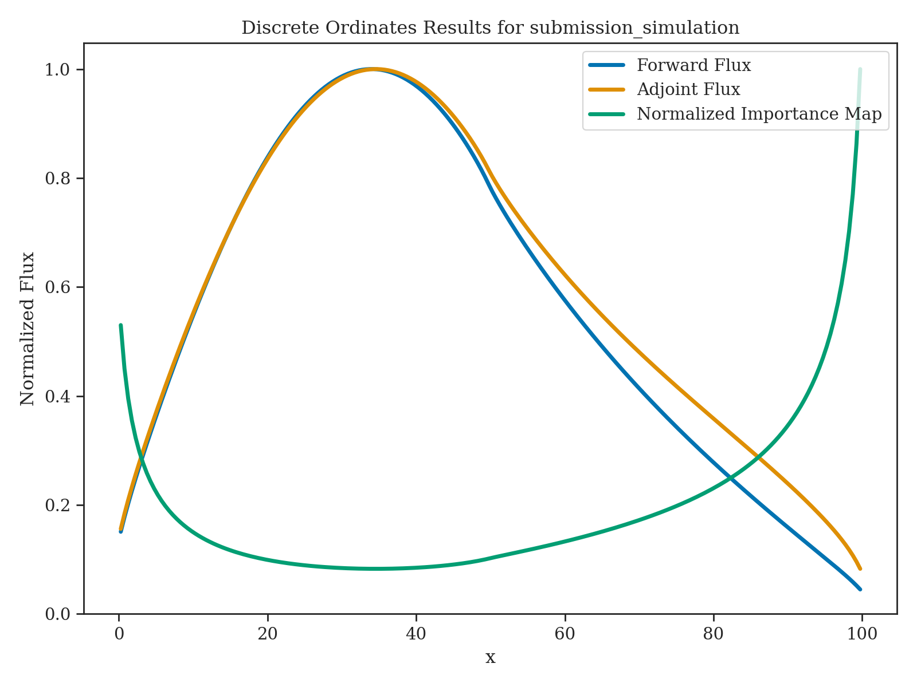
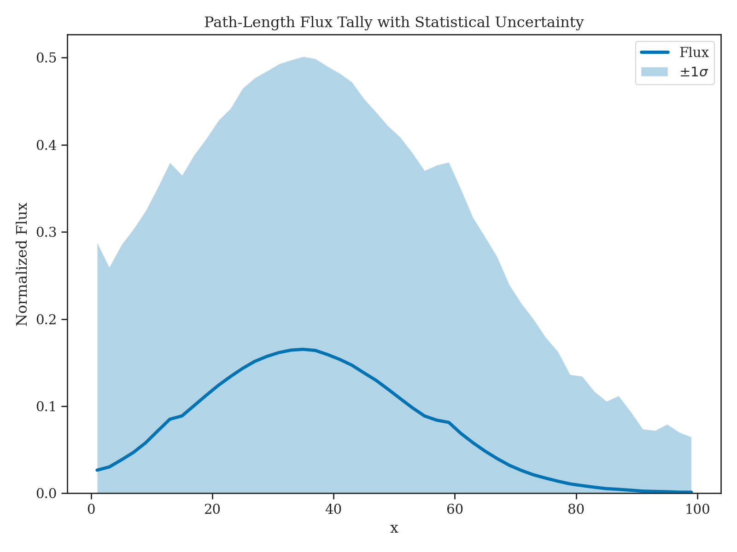
Preliminary Results
NPRE 555

Slide 9
Work for Tomorrow
Will be plotting the FOM as defined by Wagner
Fixing code bugs (send good juju)
Choosing a challenge problem (fissile material with a strong absorber)
Write report
NPRE 555

Slide 10
Issues
K-eff for Monte Carlo is not converging to the correct value (but it’s kinda close…)
Variance is very large
Very unsure about adjoint solution...
NPRE 555

Slide 11
Challenges
Setting the correct weight for new particles created by fission
  This is normally just 1.0 when doing analog, but this assumes every particle maintains its weight through a history.
Implicit capture is way overestimating k-eff (likely the same problem as above...)
NPRE 555

