Slide 1

UNM Nuke LaTeX Templates
Liam Pohlmann¹
Nuclear Engineering Department, University of New Mexico, Albuquerque, NM

Slide 2
Welcome to the Wonderful World of LaTeX!
Content Outline:
  What is LaTeX, and how does it make my life easier?
  Getting started
  Using the templates → walk-through example of a lab report

Slide 3
What is LaTeX?
Stylized software for typesetting documents
  It’s Word for real academics
Used primarily in the academic and scientific world
First developed in the 1980s, and has since had a strong following

Slide 4
Is It Right for You?
Pros
  Standardized text formatting across documents
  Excellent equation editing
  Robust handling of cross-referencing and citations
  Automated bibliography and table of contents generation
  Lots of options for formatting, including many packages
  A general feeling of superiority
Cons
  There is a learning curve…
  Takes more effort upfront to get a template made
  Harder to format figures within the text

Slide 5
Getting Started
Need some way to compile
  Overleaf: https://www.overleaf.com
    Simply make an account to start. Fremium cloud-based service
  TeX Live: https://www.tug.org/texlive/
    More work upfront, but I think it pays off
Need some way to edit files easily
  Overleaf (editor is already included)
  PyCharm (with TeXiFy IDEA plugin)
  VSCode?
Need some way to manage citations (need BibTeX files!)
  https://www.zotero.org/
    Better BibTeX: https://github.com/retorquere/zotero-better-bibtex
  Other options such as Mendeley and BibMe work too

Slide 6
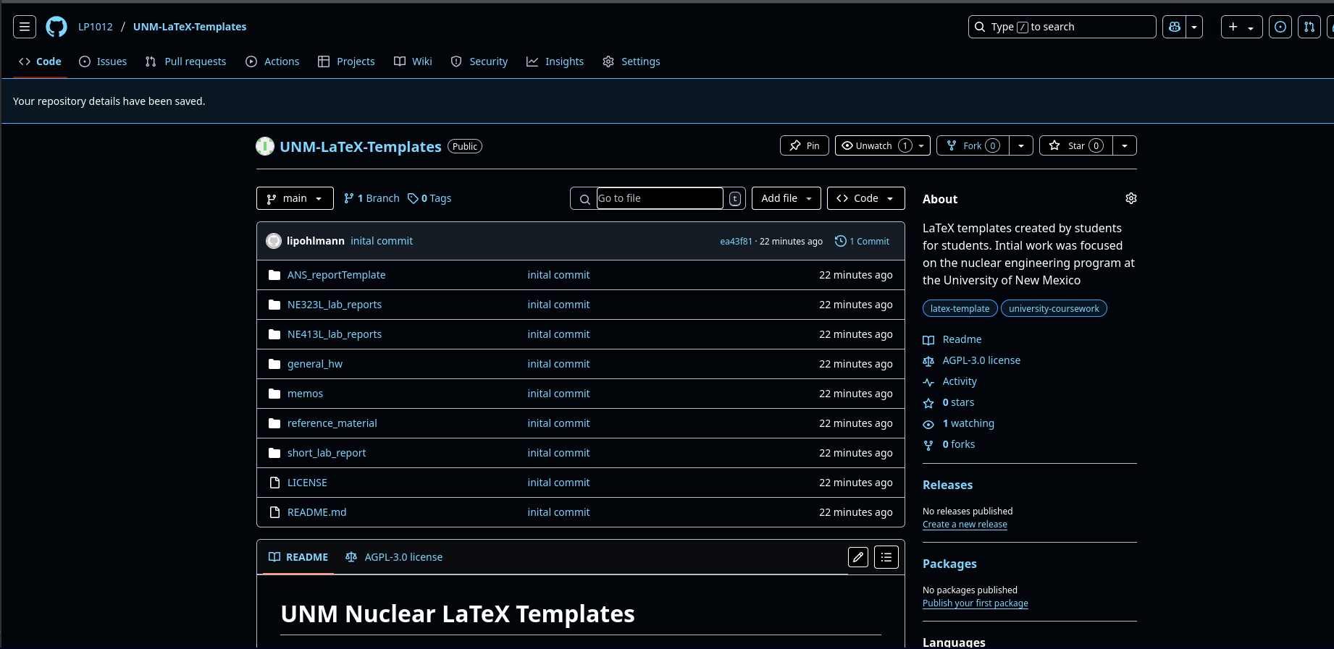
Getting the Templates
Need to pull templates from GitHub: https://github.com/LP1012/UNM-LaTeX-Templates

Slide 7
Walk-Through Example

Slide 8
General Notes
Organization is incredibly important
  Have an individual directory per project
  Use different directories for figures, data, etc.
Automate as much as possible
Check for packages that do what you want (the `physics` package is incredibly useful for equations)
Google is your friend.

