Slide 1

Game of Words Project

Slide 2
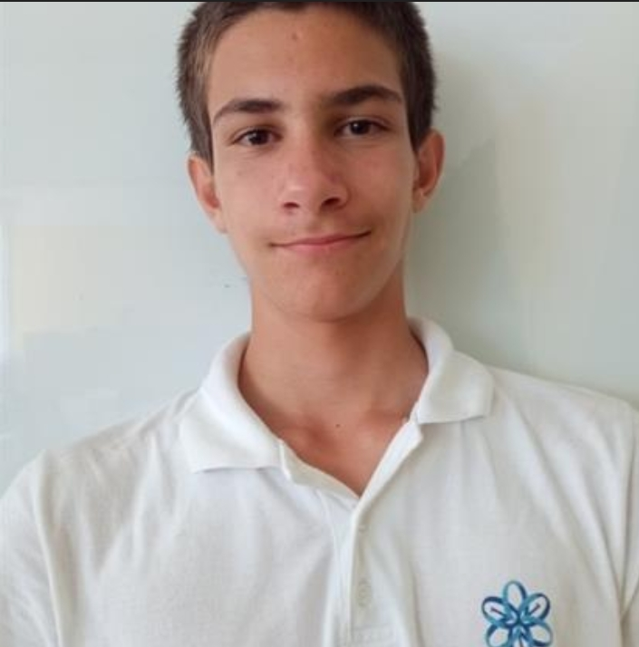
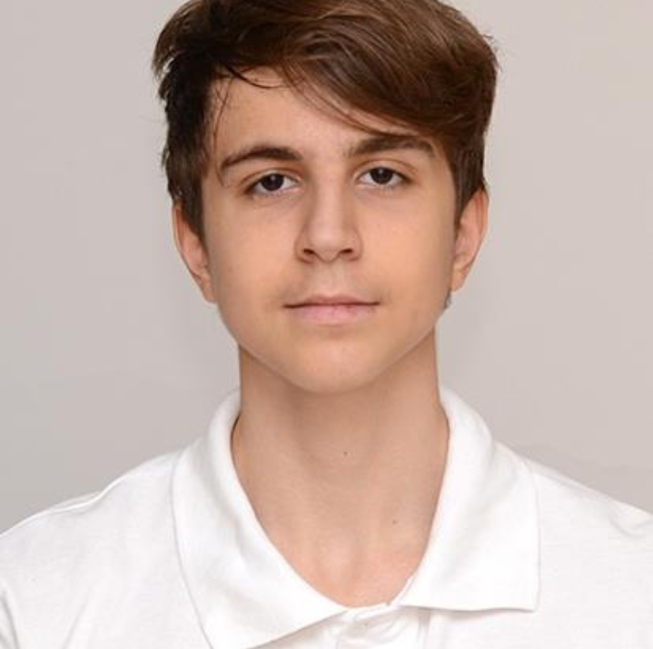
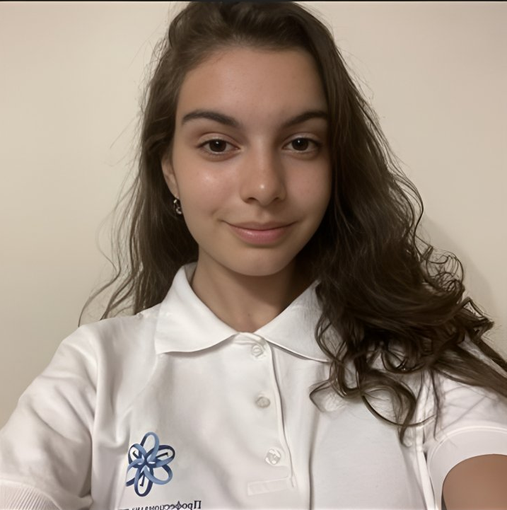
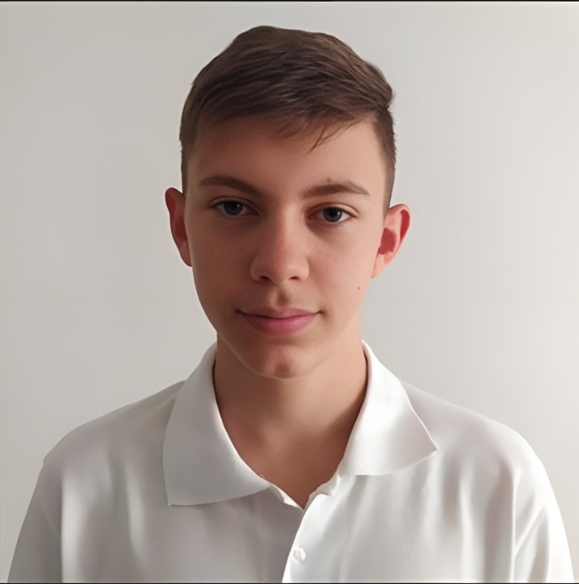
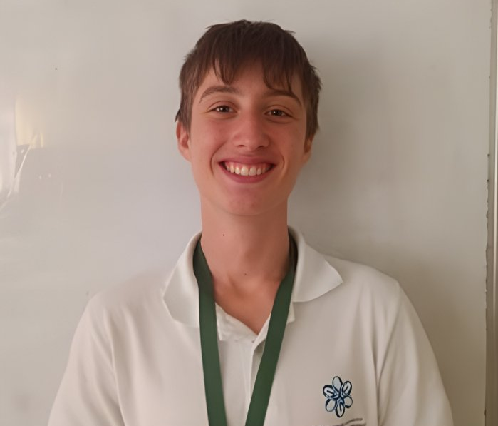
Our team
Лазар Апостолов
Петър Мацалиев
Scrum Trainer
Mentor
Кристина Желева
Иван Цвятков
Божидар Дуков
Frontend Developer
Q&A engineer
Backend Developer

Slide 3
Work Stages
1
2
3
Creating our team
Everyone chooses their role
Hard Work
4
5
Practice speaking in front of people
Presentation of our project

Slide 4






Used technology and languages

Slide 5
I think that’s enough talking. Now let’s jump into our game.

