Slide 1

create a connection between Windows and ubuntu using SSH. shift files or images from ubuntu to Windows and vice versa.
Waleed Ahmed
2022-CS-41

Slide 2
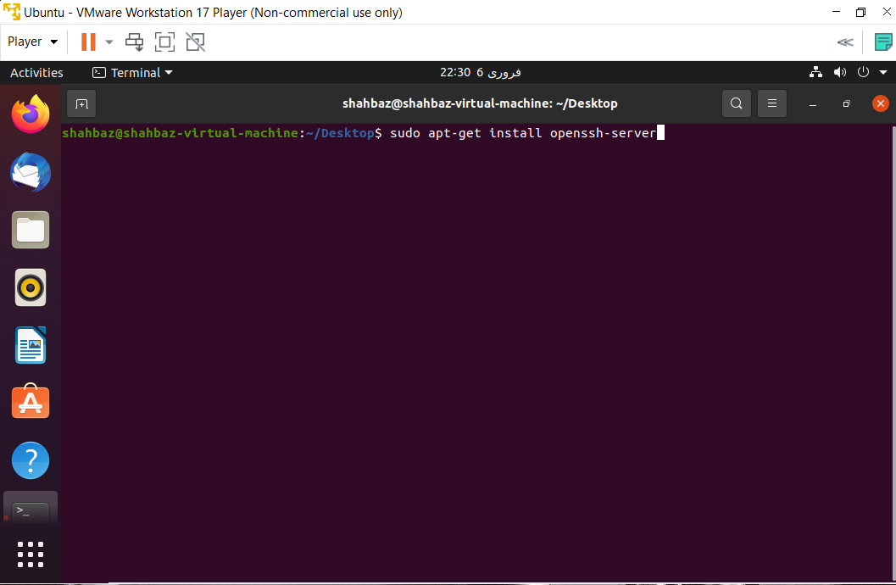
First of all install ssh-server on your ubuntu system by run a command
sudo apt-get install openssh-server

Slide 3
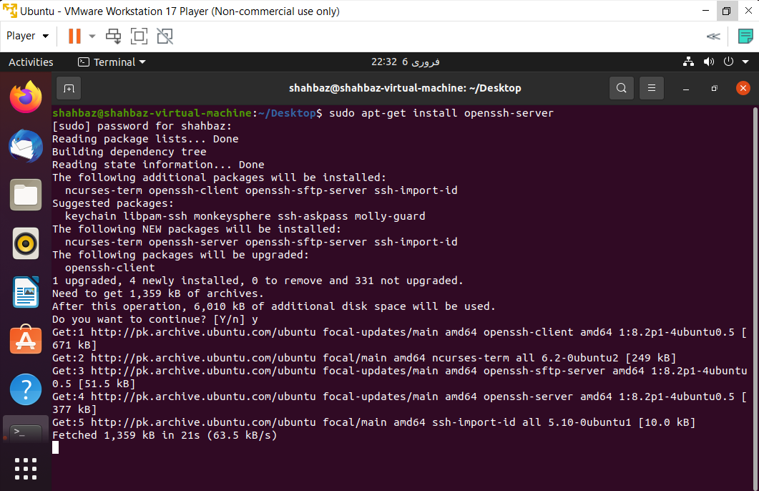
After pressing enter openssh-server will installing like this

Slide 4
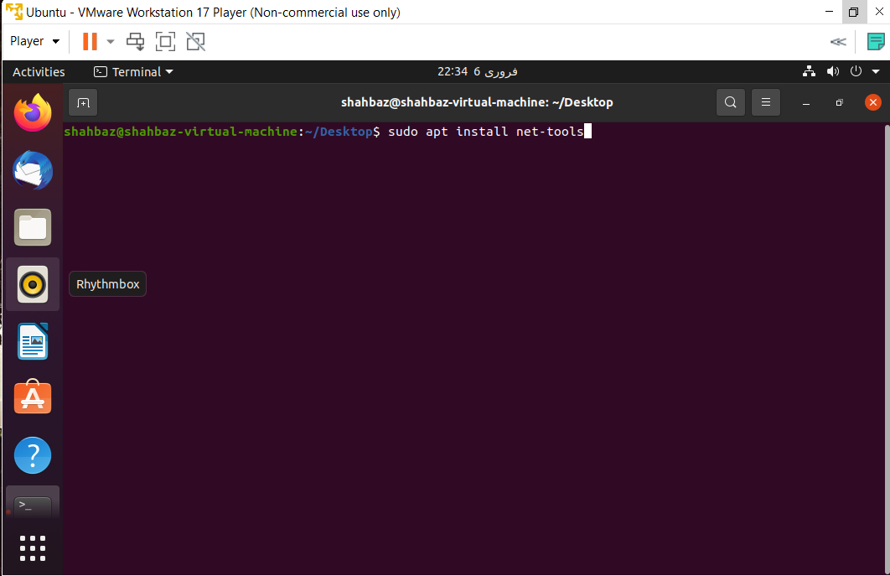
Now install net-tools on ubuntu system this is for running ifconfig command on ubuntu system which gives the ip address of the ubuntu system. run command
sudo apt install net-tools

Slide 5
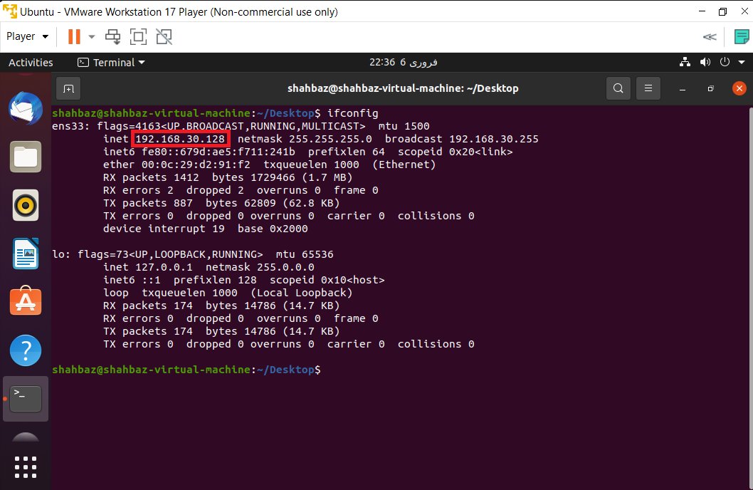
Now after net-tools installed run command ifconfig
It will give the ip address of the ubuntu system. An IP address is a unique address that identifies a device on the internet or a local network. IP stands for "Internet Protocol," which is the set of rules governing the format of data sent via the internet or local network.

Slide 6
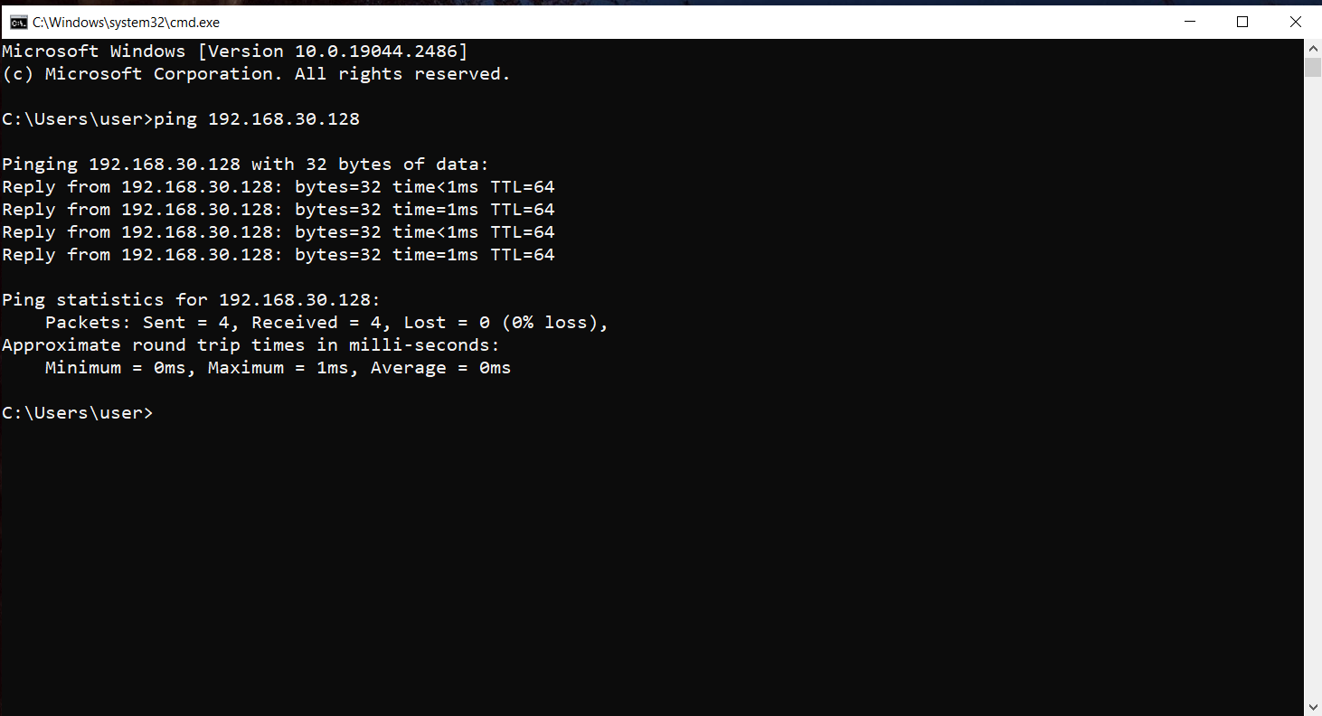
Now you can test this ip address using ping command on you cmd of windows. Ping Command tests that either given ip address exists on not. Open your command prompt on cmd and run command
ping your_Ubuntu_IP

Slide 7
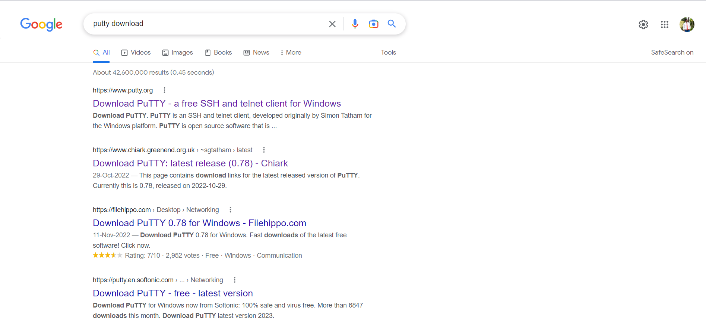
So it shows that the ip address is exists. So now we can connect our ubuntu server with windows server. For this we need some type of tool to conenct window with ubuntu so we can Use PuTTy for this. Go to Google Chrome and search Putty Download.

Slide 8
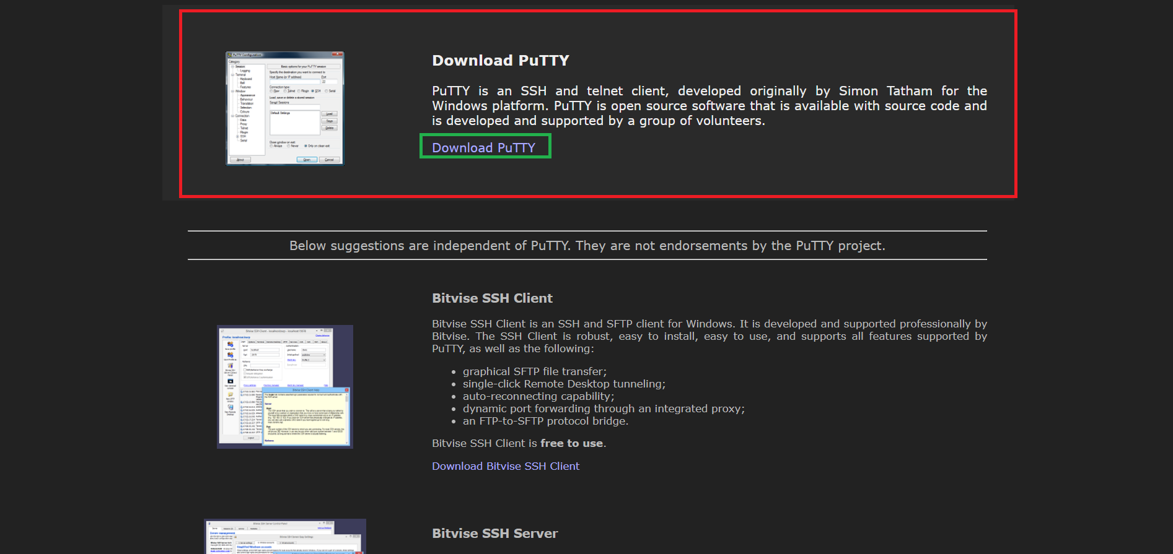
Go to the very first website.

Slide 9
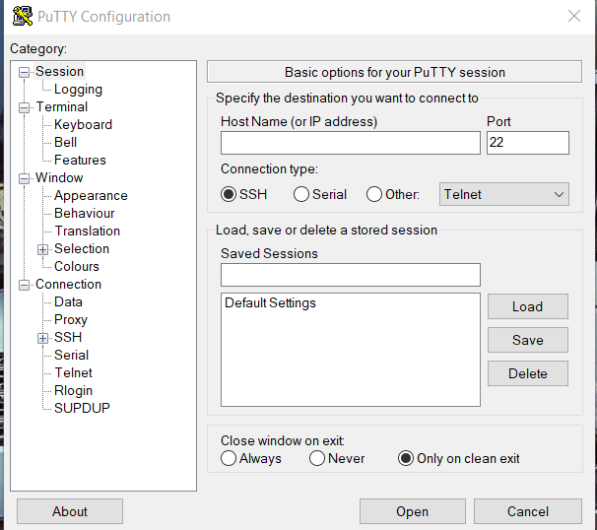
Click on Download PuTTY and after download install this on your window system. After installing it seems like. Here Port number is 22. A port number is a way to identify a specific process to which an internet or other network message is to be forwarded when it arrives at a server. All network-connected devices come equipped with standardized ports that have an assigned number.

Slide 10
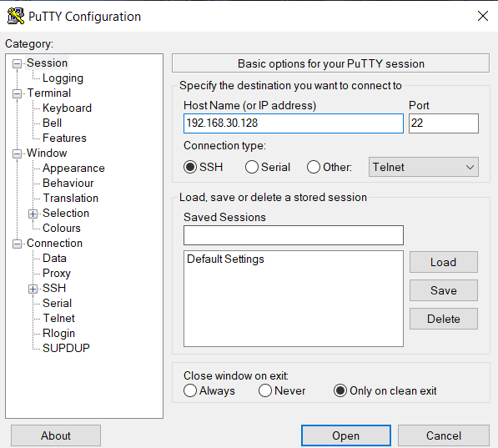
Enter your ubunto IP Address here in Host Name (or IP address) field and click on open.

Slide 11
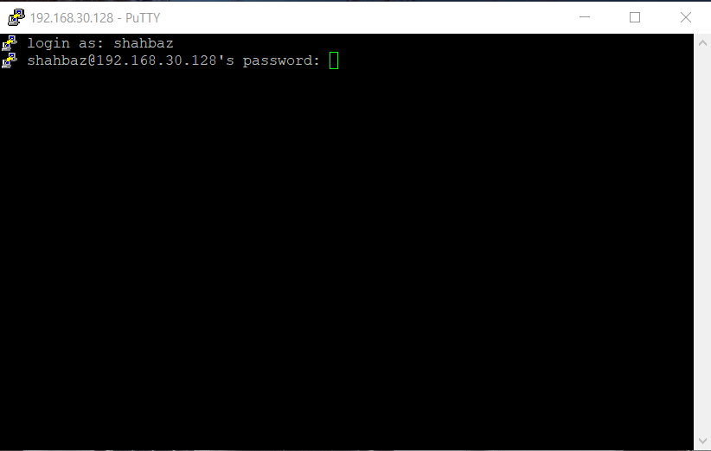
After you click on open a screen will show which ask you login as enter you ubuntu username and password on those fields and hit enter afer this you will be connected to your ubuntu server.

Slide 12
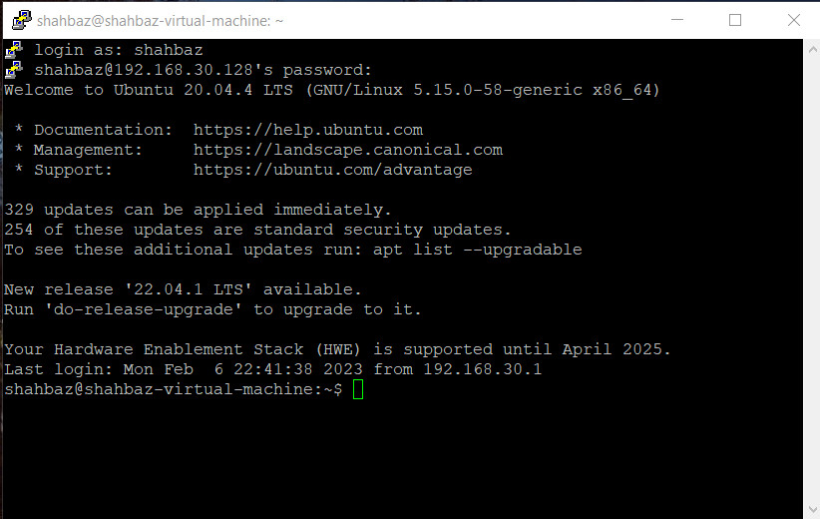
After enter your ubuntu username and password you will be connect to your ubuntu server.

Slide 13
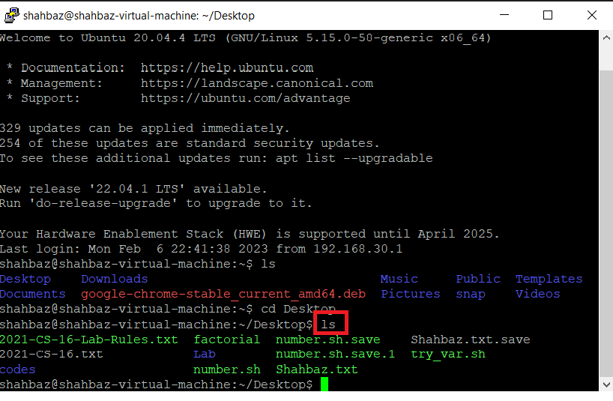
You can check your directories by run a command ls and it will show you the home files of your ubuntu system.

Slide 14
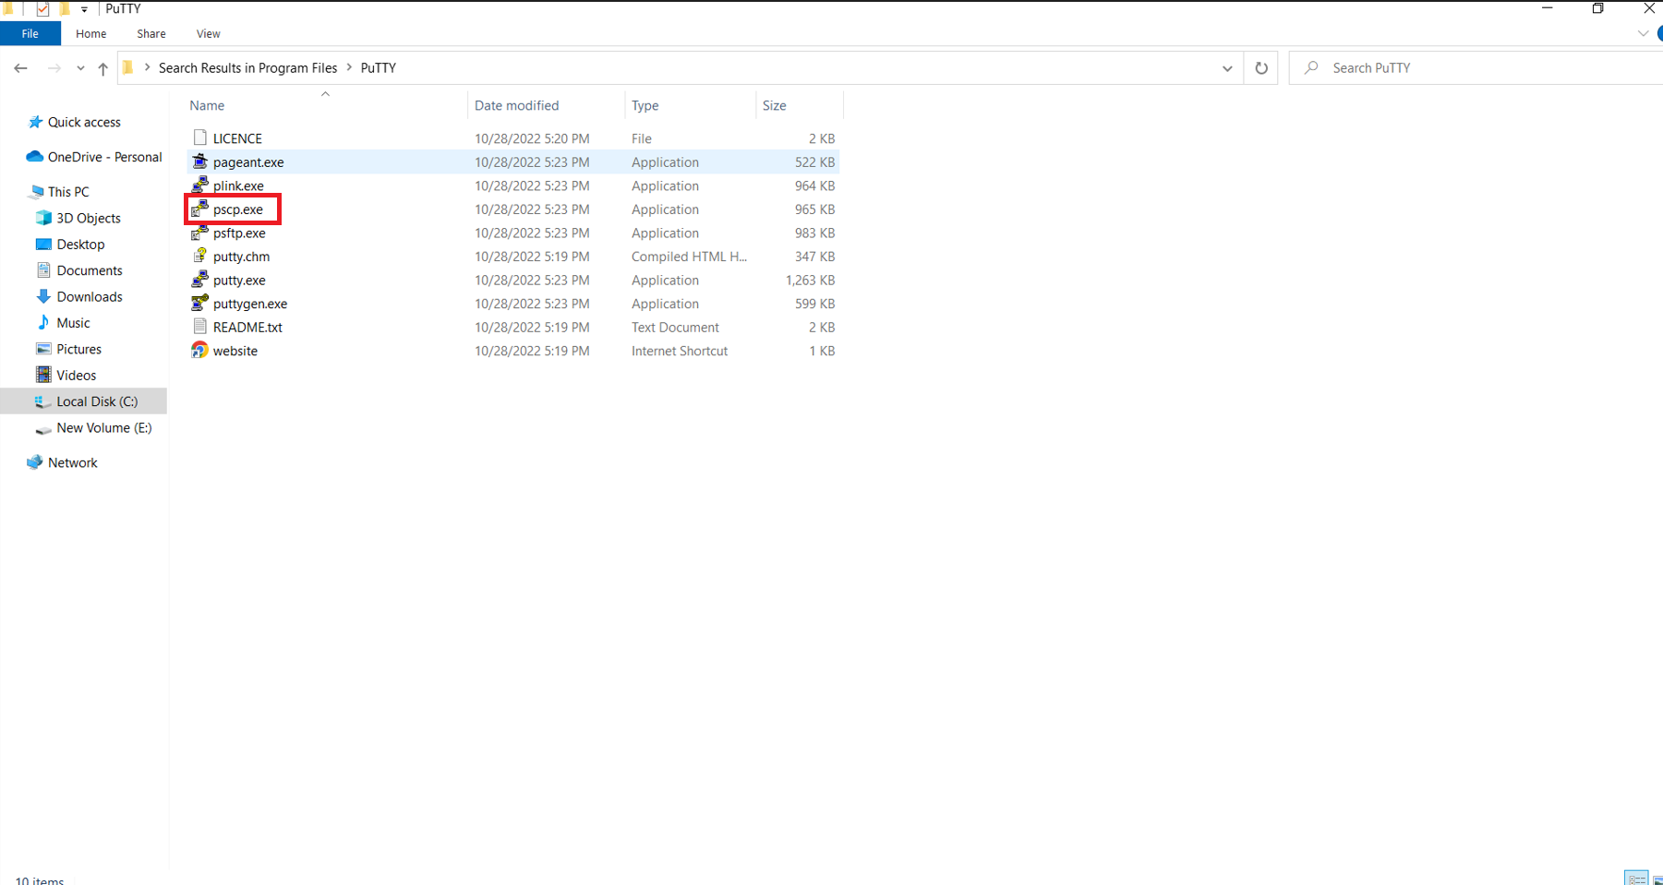
Sending Files from Window to Ubuntu
Now our goal is how to share window files to ubuntu? So its not a tough work. Go to C Drive where you install you putty then go to Program Files and open PuTTy folder.

Slide 15
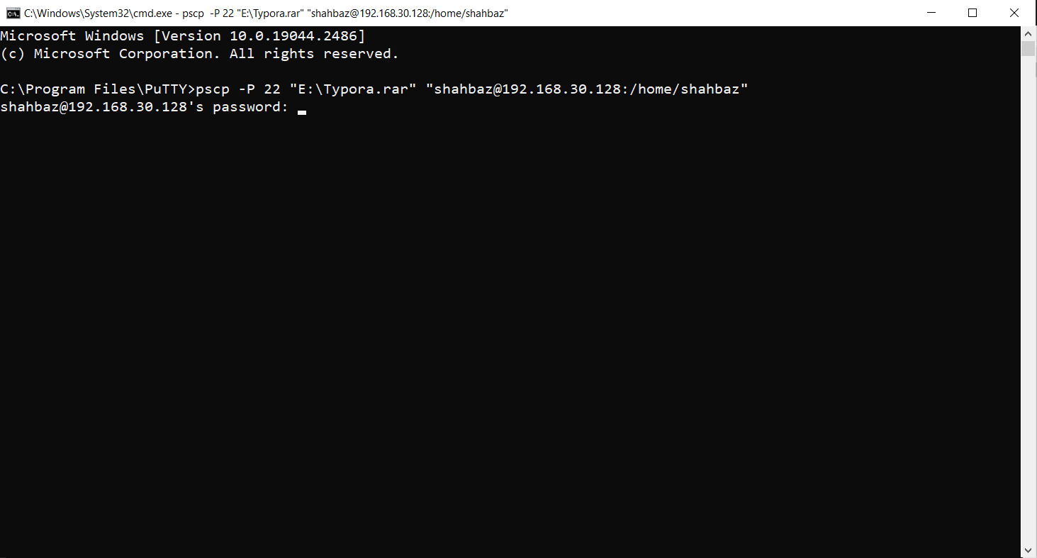
Here you will see a pscp.exe which we will use to share files from window to ubuntu and also from ubuntu to windows.
open cmd terminal in this directory and run command
pscp -P 22 "windowfromDirectory" "UbuntuToDirectory"

Slide 16
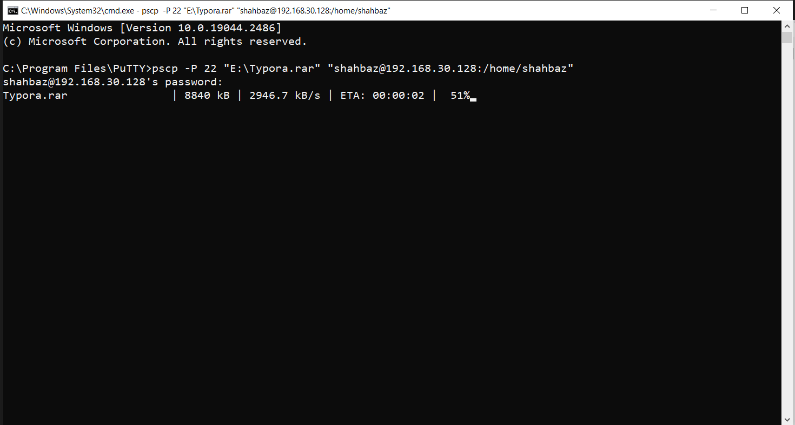
Enter your ubuntu system password and hit enter

Slide 17
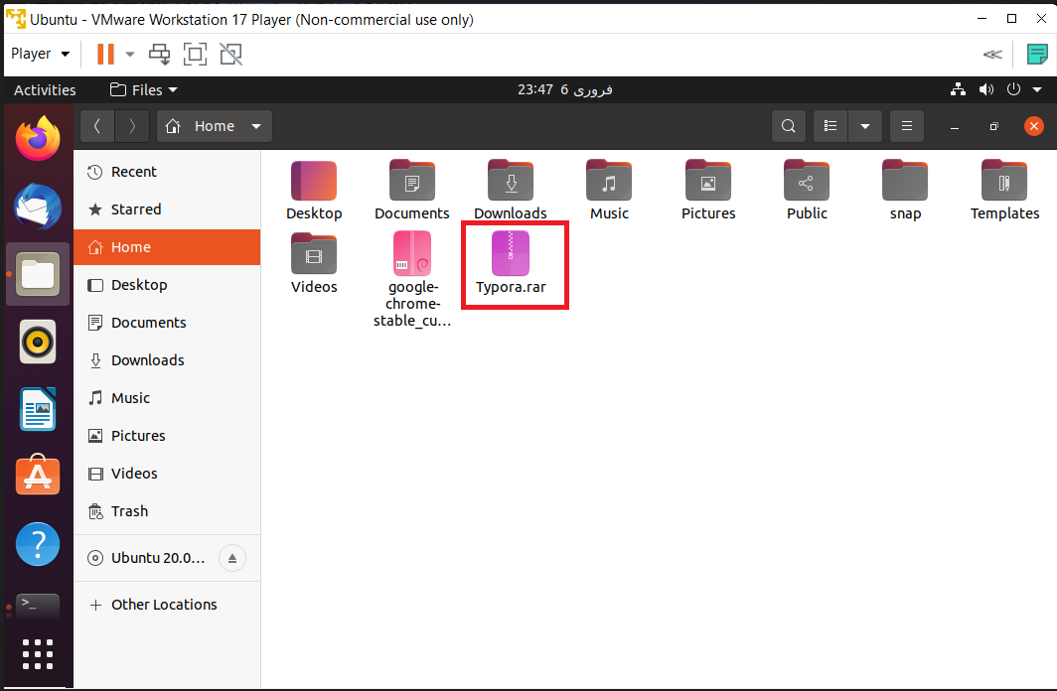
After this you will see that files will start sharing to ubuntu system and file will send to ubuntu.
Now go to your Ubuntu home and you will see that the file you have share from window will show
here on ubuntu system.

Slide 18
Share files from ubuntu system to windows system
Sharing files from ubuntu system to windows system is same as that we have send files from window system to ubuntu system
Again go to C drive Program files and in PuTTy folder open cmd here and run command
pscp -P 22 "ubuntuFromDirectory" "WindowsToDirectory"

Slide 19
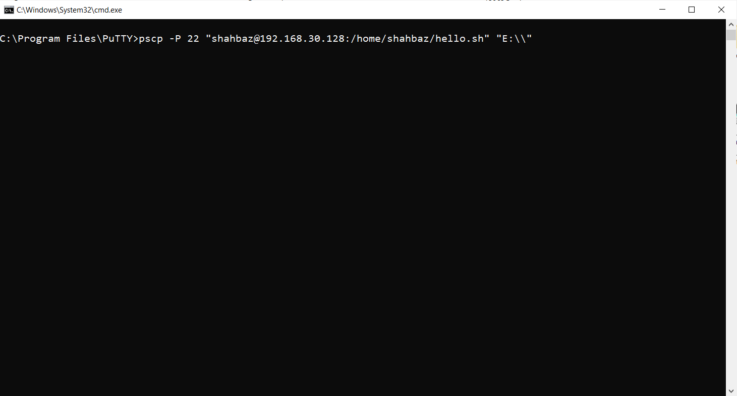
Now simple hit enter and give password of ubuntu server and file will be share to window system

Slide 20
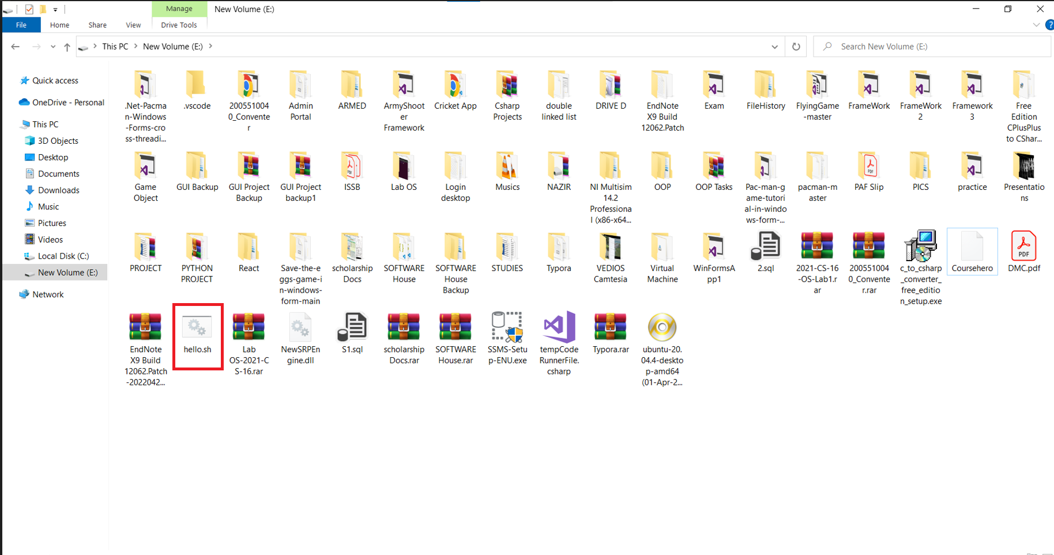

Slide 21
After complete sharing of file you can to your windowsToDirectory and you will see that Ubuntu file will show here.
Thats how we can connect our ubuntu & Windows system and Share files from windows system to Ubuntu system and vice versa.

Slide 22

But if you want to Share files from ubuntu server to another ubuntu or linux server?

Slide 23
How to Share files from ubuntu server to other ubuntu or linux server?
For this purpose we can use SCP (Secure Copy) command.
scp (secure copy) command in Linux system is used to copy file(s) between servers in a secure way. The SCP command or secure copy allows secure transferring of files in between the local host and the remote host or between two remote hosts.

Slide 24
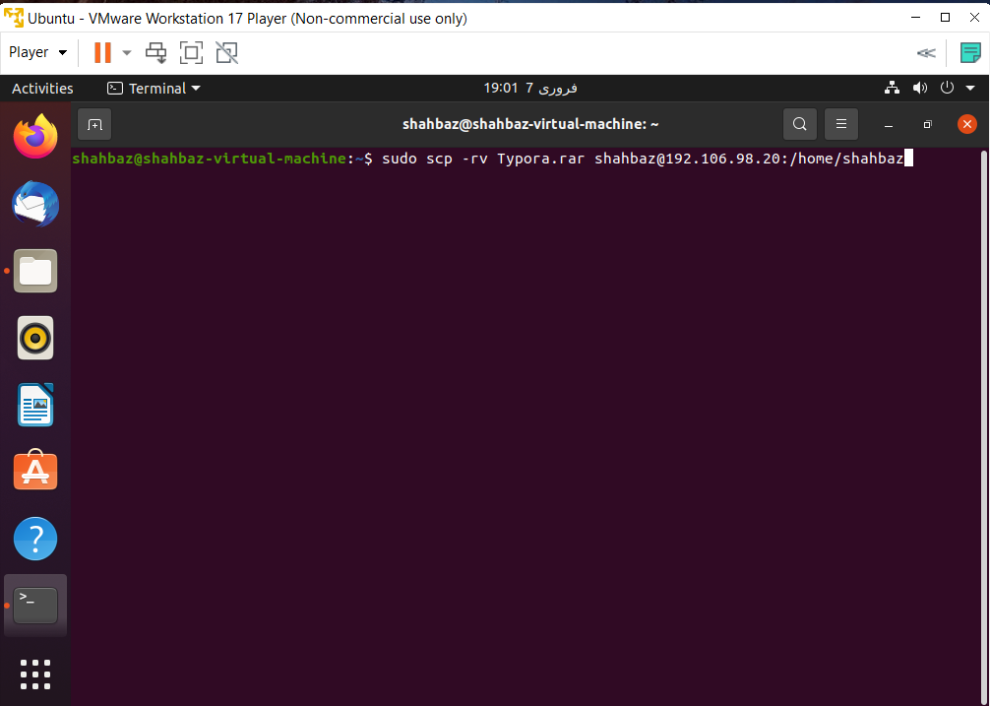
In ubuntu go the directory from where you want to share your file to another ubuntu or linux server and open terminal to run command
sudo scp –rv filepath username@ipaddress:server-destination-path
Here you will give username of your destination ubuntu or linux server and also its ip-address.
And this way you can share file from one ubuntu server to another.

