Slide 1
OS Lab 5- Shell Scripting (Arrays)
20-Mar-24
1
Notes:
1

Slide 2
Arrays
An array is a systematic arrangement of the same type of data.
In Shell script Array is a variable
which contains multiple values may be of same type
or different type
An array is zero-based i.e., indexing start with 0.
Notes:
2

Slide 3
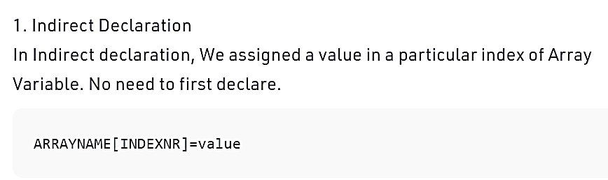
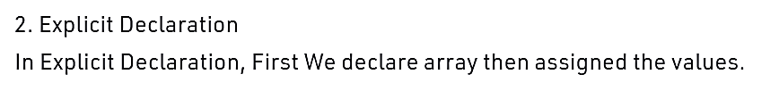
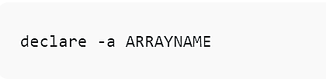
Declaring an array

Slide 4
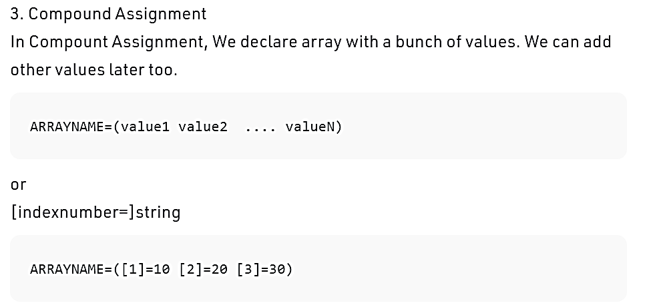
Declaring an array

Slide 5
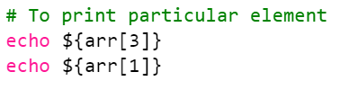
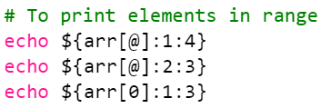
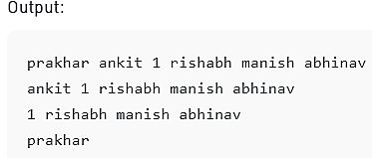
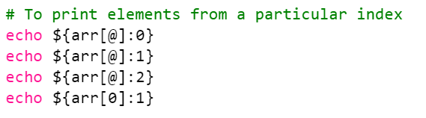
Printing the value of arrays
To Print Selected index element
echo ${ARRAYNAME[INDEXNR]}

Slide 6
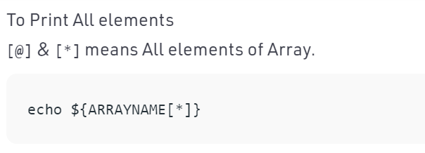
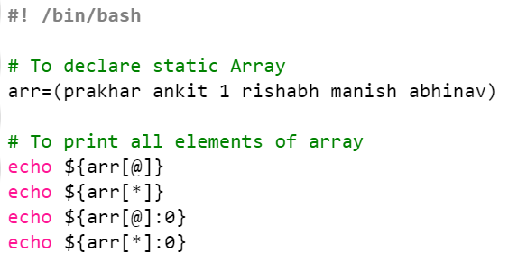

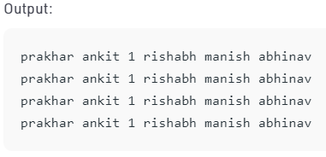
Printing the value of arrays

Slide 7
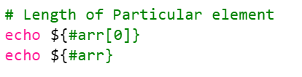
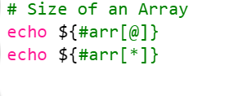
Find length of an array and its element

Slide 8
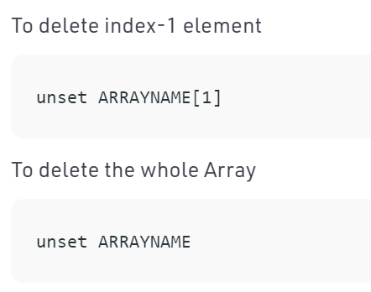
Deletion

Slide 9

Multi-dimensional Arrays
Bash does not support multi-dimensional arrays
But we can create associative array and you need to explicitly declare that the variable (array) is an associative array.
Declare –A arrayname

Slide 10
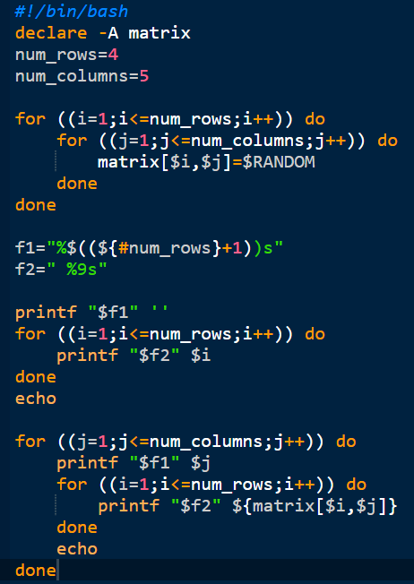
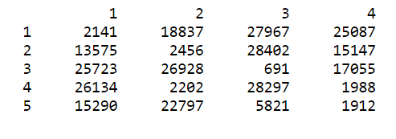
2D arrays

Slide 11
Managing strings
#!/bin/bash
# Basic for loop
declare -a names=("Stan kil" "Kyle" "Cartman")
for name in "${names[@]}"
do
echo $name
done
echo All done

