Slide 1
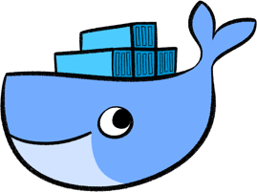
Docker
Larry Phouthavongsy

Slide 2

What is Docker?
Docker is a platform for operating-system-level virtualization also known as containerization.

Slide 3

Scenario
My build | Their build
Ubuntu 17.10 | Ubuntu 15.04
Numpy 1.3 | Numpy 2.0
… | …

Slide 4
Solution 1 – Virtual Machine
Pros | Cons
Original environment can be duplicated. | Must be installed on every computer.
 | Large file.

Slide 5
Solution 2 – Docker
Pros | Cons
Original environment can be duplicated. | Security issues.
Files are small.
Can be shared. (Cluster, cloud)

Slide 6
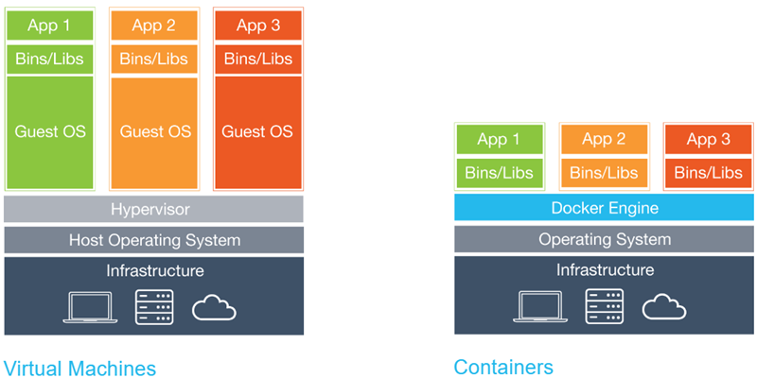

Slide 7
