Slide 1


Streaming ETL with Apache Kafka
Szymon Chojnacki,
Enterprise Architect
LPP SA
PyData Gdańsk 14.XI.2018

Slide 2
Agenda
Apache Kafka
Stream processing model
ETL Design patterns
Demo of KSQL

Slide 3
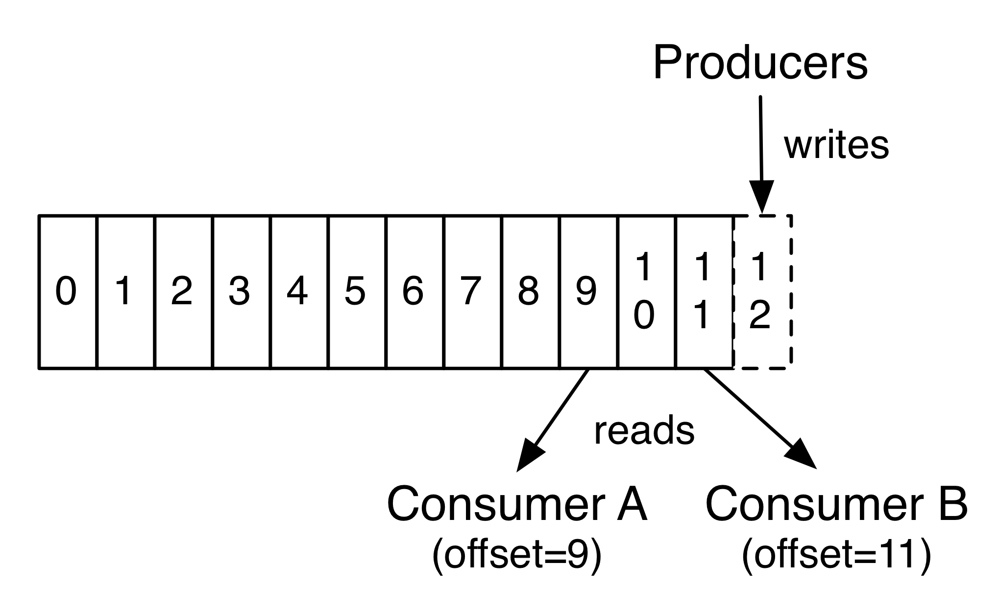
Apache Kafka
Apache Kafka is a distributed streaming platform
Used to build streaming data pipelines, real-time streaming applications.
Source: https://kafka.apache.org/intro

Slide 4
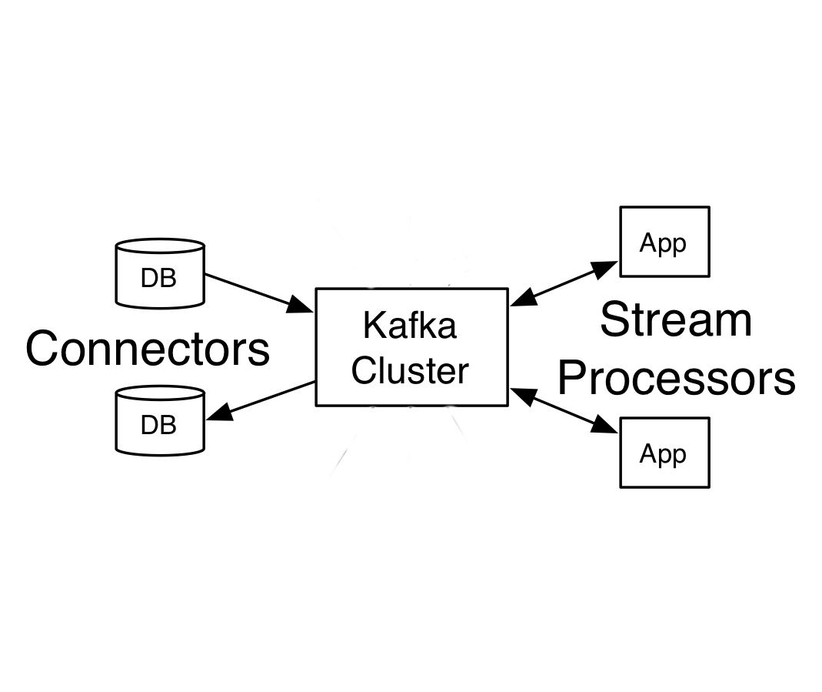
Stream processing model
Event streams are ordered
Immutable data records
Event streams are replayable
Other streaming platforms: Spark, Flink, Storm, Samza, Pub/Sub, Kinesis
Source: Kafka The Definitive Guide, Real-time data and stream processing at scale. Neha Narkhede, Gwen Shapira & Todd Palino

Slide 5
ETL Design patterns
Single event processing
Processing with local state
Stream - Table Join
Streaming Join
Insert Into
Source: Kafka The Definitive Guide, Real-time data and stream processing at scale. Neha Narkhede, Gwen Shapira & Todd Palino

Slide 6
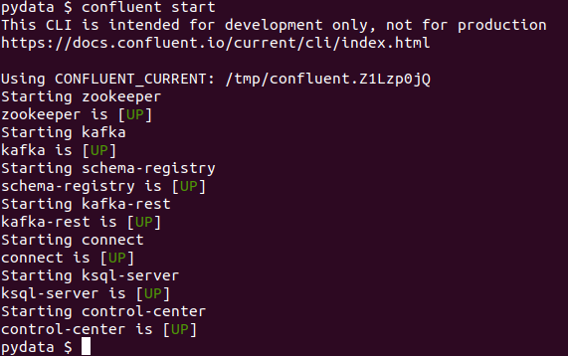
Demo - Customer 360°
Start Confluent Platform CLI
Note: In the demo we only use following components: zookeeper, broker and ksql server
Download from: https://www.confluent.io/download/

Slide 7
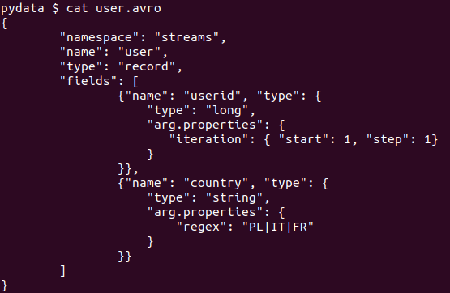
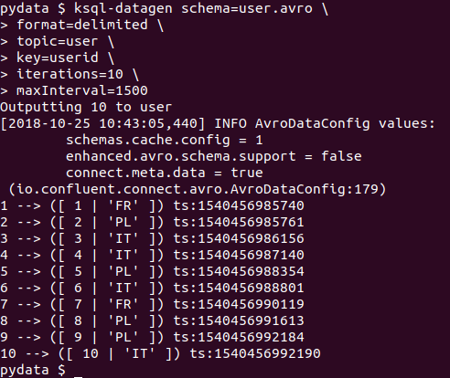
Generate users
1
1
2
2

Slide 8
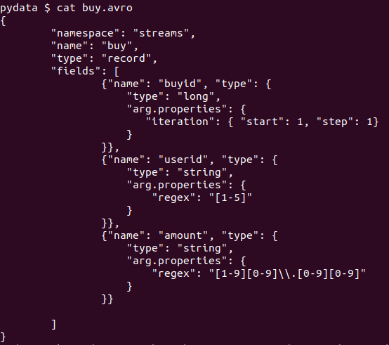
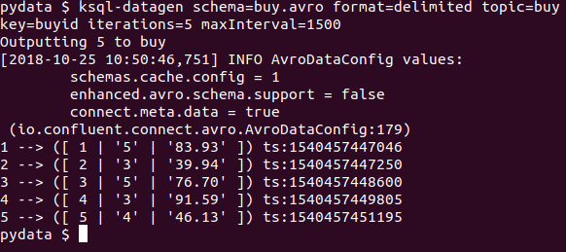
Generate purchases
1
2
1
2
3
3

Slide 9
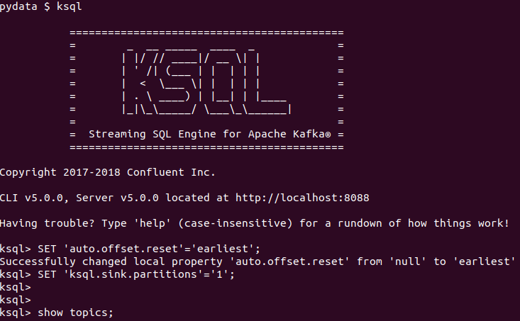
Start KSQL Client
KSQL client’s binary is in <confluent-path>/bin

Slide 10
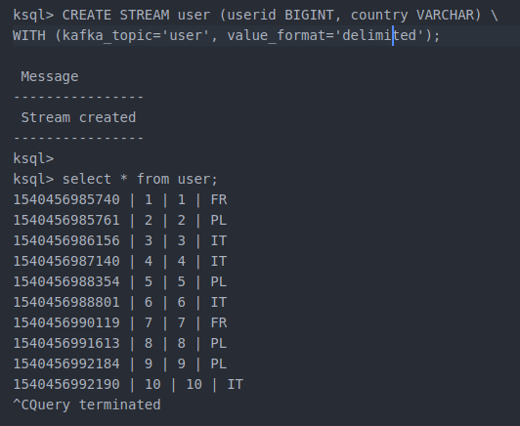
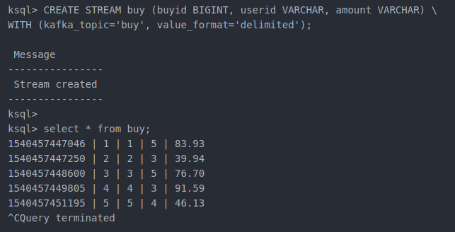
Step 1/7 – Create KStreams
Users stream with 10 events
Transactions stream with 5 events

Slide 11
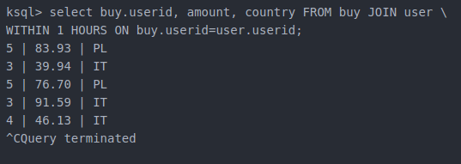

Step 2/7 – Join Stream-Stream
Join gives output for 1 hours window
There is no output for 1 minutes window

Slide 12
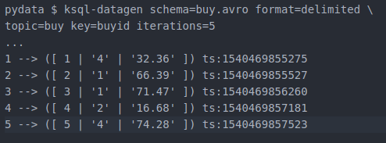
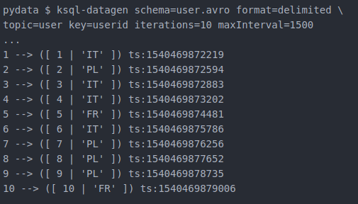
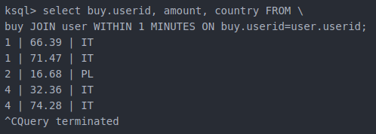
Step 3/7 – Join Stream-Stream more data
1. Generate more transactions
3. Generate more users
2. Still no output

Slide 13
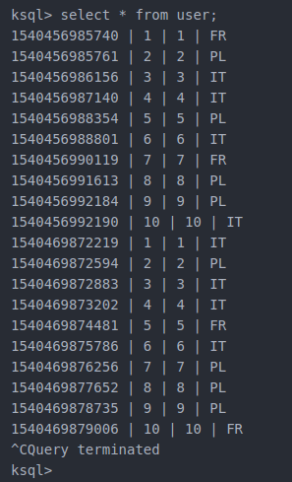
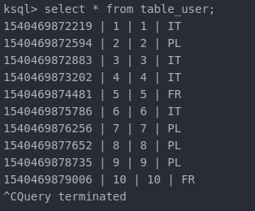
Step 4/7 – Create KTable
Content of user stream
Create KTable user
Content of KTable

Slide 14
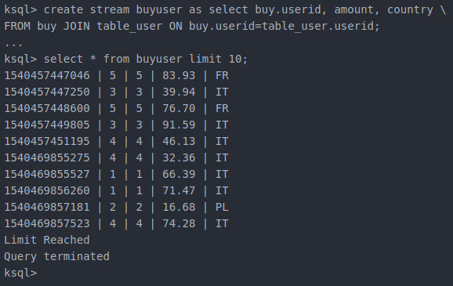
Step 5/7 – Join Stream with KTable
New transaction is joined with most recent record from KTable.
No need for windowing.

Slide 15
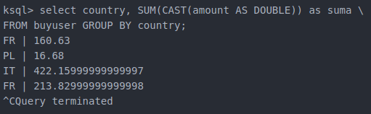
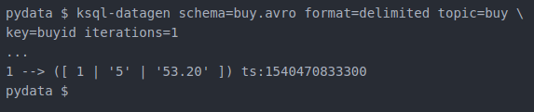
Step 6/7 Aggregate by country
Group by statement
Generate one more transaction
Stream gets updated

Slide 16
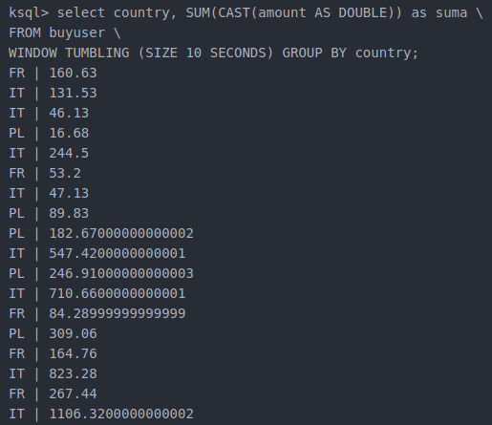
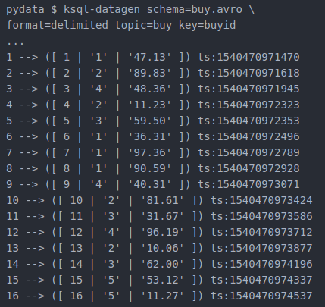
Step 7/7 Aggregate with windows
Flow of transactions
Flow of aggregates

Slide 17


