Slide 1
IBM Innovate 2012
Rational Functional Tester scripting with Jython
Sean McAdams
Applications Development Analyst II
Lender Processing Services
Sean.McAdams@lpsvcs.com
Sean.j.McAdams@gmail.com
Michael Freeman
Sr. Applications Development Analyst
Lender Processing Services
Michael.Freeman@lpsvcs.com
mlfreeman@gmail.com
Notes:
Author Notes:
This is the PowerPoint template for the Innovate 2012 Track Sessions
IBMers can find additional information on presentation resources on Rational’s Managing the Brand W3 Intranet site:
https://w3-03.ibm.com/software/marketing/marksite.nsf/AllMarketingPages/Brand-Rational-rt_rtb?opendocument?opendocument
Imagery
Avoid using cartoon like clip-art, use photo-art instead. Third party material cannot be used in a presentation without written permission (this includes product and Web page screen shots). Images must be acquired from a ‘royalty-free to use’ source such as:
Microsoft or Lotus Symphony Clip Art library
http://www.freebyte.com/clipart_images_photos_icons/#freevectorgraphics
http://www.freedigitalphotos.net/
IBMers can use images from IBM approved image libraries: https://w3-03.ibm.com/software/marketing/marksite.nsf/AllMarketingPages/Brand-Rational-rt_rtb?OpenDocument&ExpandSection=4#_Section2

Slide 2
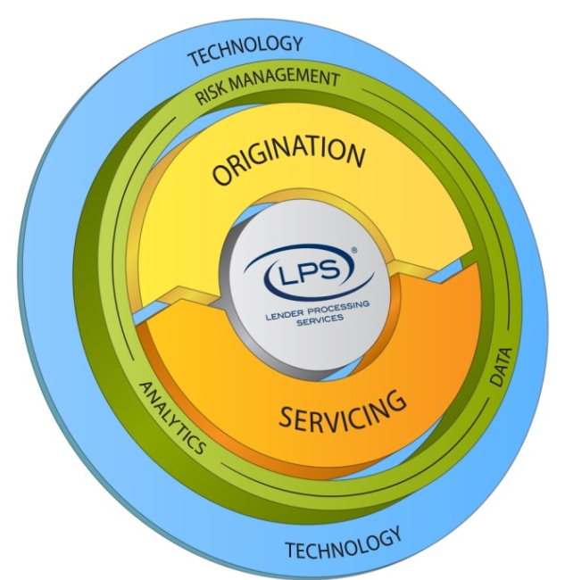
Who is LPS (Lender Processing Services)? A leading provider of technology, processing, data and outsourced services to the financial services industry:
#1 U.S. provider of Mortgage Servicing Systems
#1 U.S. provider of Mortgage Default Solutions
#1 U.S. provider of Centralized Settlement Services
#1 U.S. provider of Valuations
LPS ranked #7 in FinTech’s top 100 Global Enterprise Technology Companies
Largest combined public records, loan-level servicing and securities database
Headquartered in Jacksonville, FL
Over 8,000 employees
Industry’s most comprehensive range of integrated applications and services
Deep and long-term relationships with nation’s top lenders
  On average, LPS’ top 10 customers have been with us for 19 years
Strong organic growth and free cash flow
# 877 on Fortune’s top 1000 list
Notes:
Aimee:
So let’s get started! First on our agenda, who is LPS? Lender Processing Services, as you can see, has earned a few number 1s in our industry!
LPS is the leading provider of a wide range of mortgage service solutions. We are headquartered in beautiful Jacksonville, FL, and we employ over 8,500 employees nationwide.
As a service company in the mortgage arena, LPS technology serves as the #1 backbone uniting and facilitating clients and vendors engaged in every aspect of mortgages.
That includes; origination, analysis, servicing, risk management, settlement, and default services—which is the division we belong to.

Slide 3
Overview
What is Jython?
Benefits of Jython
Introduction to Jython
The JythonLauncher
Developing in PyDev
RFT Methods implemented as Jython
Script Debugging

Slide 4

What is Jython?
Java implementation of Python
Object Oriented Scripting Language
Runs in the JVM
http://www.jython.org/

Slide 5
Benefits of Jython
Access to Java and Python libraries
Faster development
Easy to read and maintain
Module-based development
Dynamic design

Slide 6
What benefit does Jython give over normal RFT scripting?
Easy to learn syntax
Less development overhead
Extensive API
Even with only a basic understanding of Jython and RFT users can develop scripts quickly and reliably.
We started developing it because of the complexity of the Java code that was required for some of our development. Understanding the framework takes a while but understanding RFT takes much longer.
Java is very robust, but being robust tends to make it tedious to code. Jython keeps all of the power of Java and the development speed of Python to make a strong programming language.

Slide 7
Loss of existing code
There is none.
Everything developed in Java can be used or extended using Jython.
Users comfortable with Java can continue to use Java or switch to Jython.
New users can choose to start in either language, depending on preference.
It is another tool that can be used when you need to develop quickly or for those that feel the Java style of programming is too rigid.

Slide 8

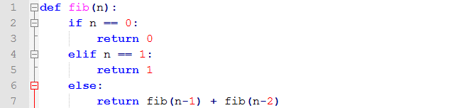
Introduction to Jython
Dynamic Typing – No need to declare types in variable declarations, but variables do have types.
Whitespace Delimited – Spaces, Tabs, and Linefeeds/Newlines determine blocks.

Slide 9

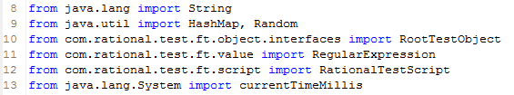
Library Imports
Normal Python imports
Importing Java Classes in Jython

Slide 10
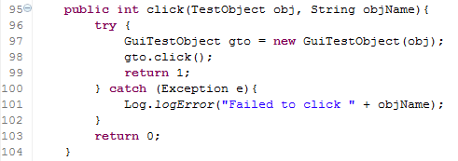
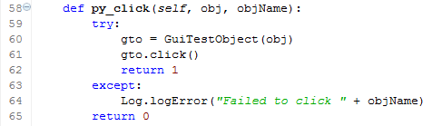
Java Objects in Jython
When interfacing with Java APIs you still need to construct the object normally in order for Jython to be able to use the object’s method.
Java
Jython

Slide 11
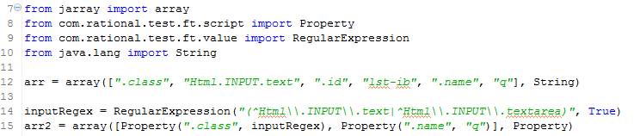
Array Types
Classic Python array
Arrays when interfacing with some Java methods
Allows Jython to pass arrays with specific types to Java functions.
e.g. public string findObject(String[] properties)

Slide 12
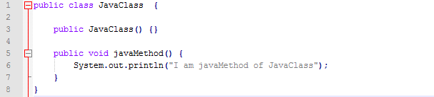
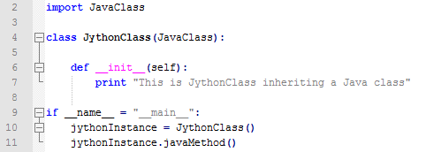
Extending Java Classes
Initial Java Class
Jython class extending a Java class

Slide 13

Super Constructor
Syntax: super(callingObject, self).__init__(*args)
Jython constructs the __init__ method from the constructors of the Java class to keep with standard python syntax.
Note: The arguments for the super.__init__ must be resolvable to Java types if the super class is Java.

Slide 14
Protected methods and attributes
Jython does not provide easy access to protected methods and attributes, but there are two ways to access them.
For protected methods you can use the following syntax:
      self.super__methodName(*args)
  Example:
These methods are generated at runtime for protected methods. However, protected attributes are not accessible like this unless you create getters/setters for them.
2. Set python.security.respectJavaAccessibility = false in the [jythonhome]/registry file
This is not suggested since it ignores the security aspects of Java, however with this set to false you can access protected methods and attributes with the normal self.methodName(*args) or self.attribute syntax

Slide 15
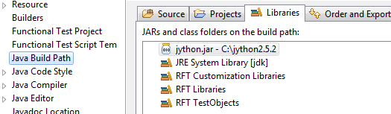
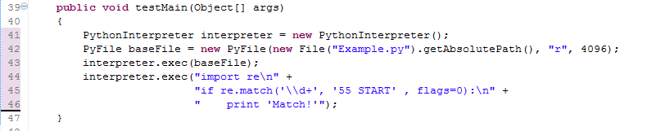
Using Jython from Java
Jython.jar – standalone JAR used to interact with Jython scripts.
PythonInterpreter class

Slide 16
About the JythonLauncher
The JythonLauncher is our implementation of a RFT script that can launch/run Jython scripts utilizing the RFT API.
Why is it needed?
  RFT loads classes before launching a script with a testMain
  Allow multiple scripts to be executed in sequence without re-launching every time.
  PyDev’s debugger needs to be added to the sys.path before a script can utilize it
  Easy to use Jython’s Python Interpreter through testMain
Alternative:
  Recreate class loading done by RFT on start with the Jython script (good luck)

Slide 17

About PyDev
Integrated with Eclipse
  Can be installed along with RFT
  Keeps all development in a single tool.
Highly customizable
  Since it is part of Eclipse you have a lot of choices in the layout and styling of the IDE and code.
Well maintained
  Strong user and development following.
  Is updated and improved upon often.
  Lots of information online on how to use and configure.
http://pydev.org/

Slide 18
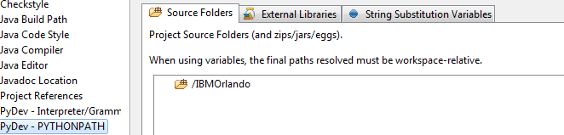
Interpreter and Source file references
After initializing a PyDev project (by creating a new one or through the Right-Click menu PyDev-> Set as PyDev Project) there are a couple of setup steps needed to complete the setup
Configure the interpreter
  Window -> Preferences -> PyDev -> Interpreter – Jython: Click “New” and target the jython.jar from your jython installation
  Right click project -> Properties -> PyDev – Interpreter/Grammer -> select Jython and choose the version information and the Interpreter you added in Step A.
In the PYTHONPATH section of the project’s properties add the root project to the Source Folders tab
Configure External Libraries

Slide 19
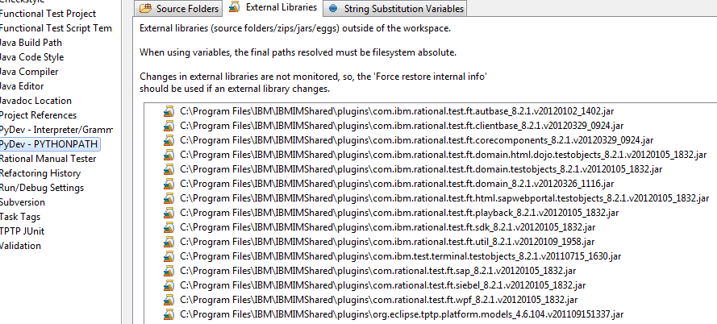
PyDev PYTHONPATH
Adding RFT Jars to the PYTHONPATH allows code auto completion and removes import errors.
loads classes into PyDev so the IDE can resolve the imports

Slide 20
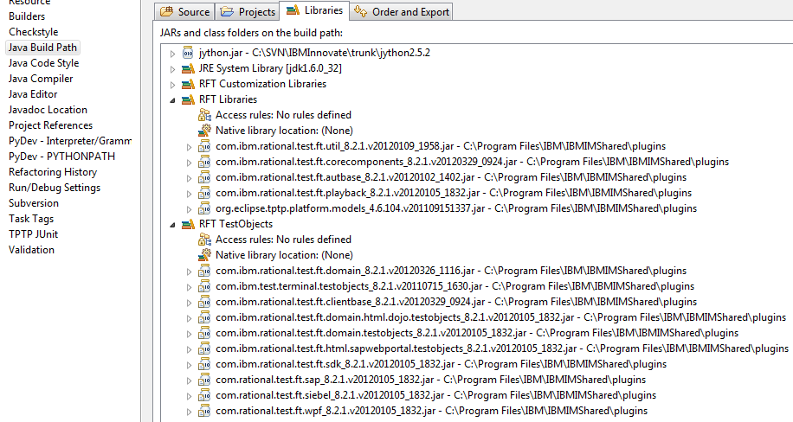
Location of list of libraries you need to include in the PYTHONPATH

Slide 21

www.ibm.com/software/rational
Notes:
Author Note: Optional Rational slide. Graphic is available in English only.

Slide 22
Code Design
Wrap up code in methods / classes.
  Ensures consistency, reusability, and clarity of scripts.
    Consistency:
      Calling one function guarantees same actions always happen and same things always get logged.
    Reuse:
      You’re only writing a given action / group of actions once.
    Clarity:
      login(username, pass); is easier to read than userName.setText(username);
      password.setText(password);
      loginButton.click();

Slide 23
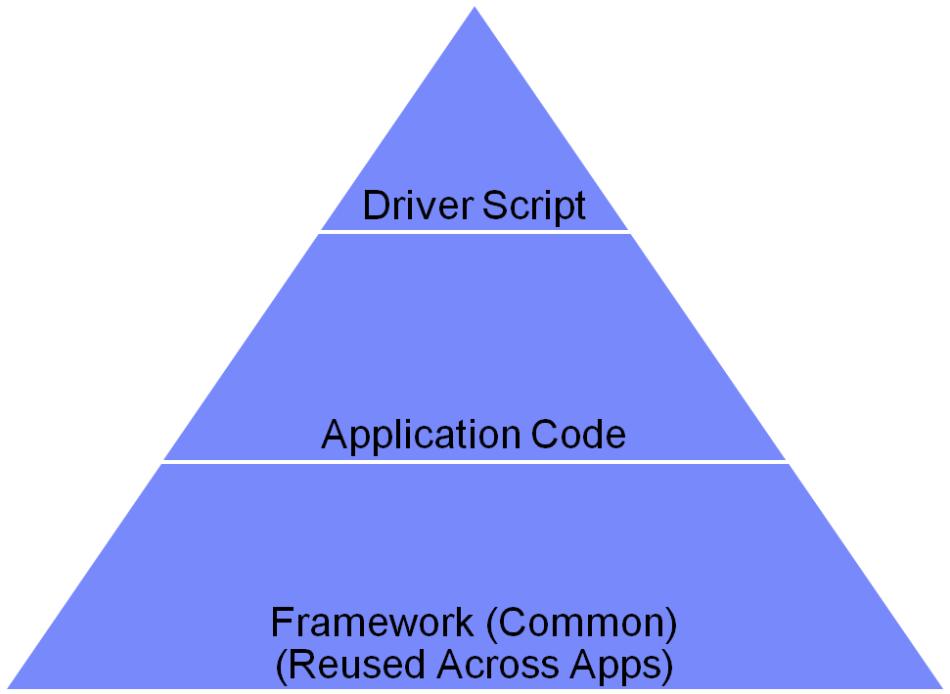
Code Design
Separate per-application code from commonly reused code.
Build a framework
  Maximizes code reuse.
Use Two Projects
  Common project
  Application project

Slide 24
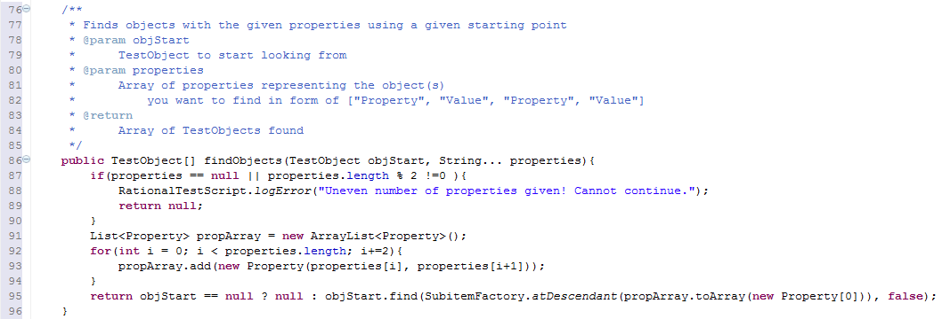
Find Objects Java

Slide 25
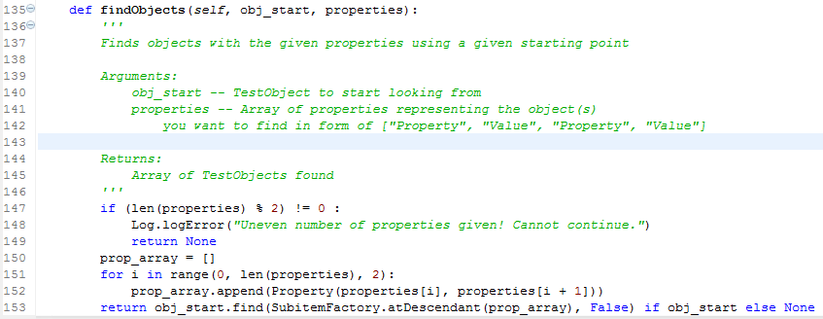
Find Objects Jython

Slide 26
Actions
6 Major Actions that span almost all types of applications
Type
Toggle
Hover
Select
Drag
Click
With these actions implemented you can do basic GUI automation. However, several other methods are required for verification points and screen validation. Some of them are included in the demo code.

Slide 27
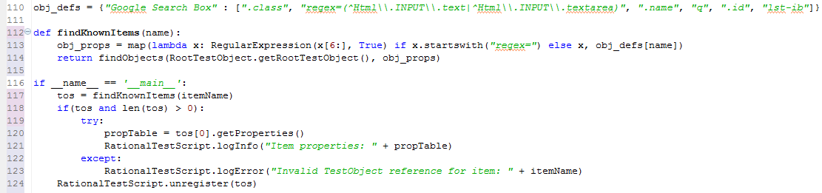
Find by regular expression
Simple find with regular expression
Find using pre-defined object definitions (similar to the object map)

Slide 28
www.ibm.com/software/rational
Notes:
Author Note: Optional Rational slide. Graphic is available in English only.

Slide 29
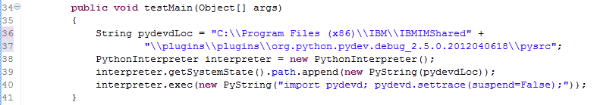
Jython Debugging with PyDev
When debugging a Jython script run from a Java script, you have to do more than just launch the script in debug mode in RFT.
Jython has to make a separate debug connection to PyDev in order to debug Python code in addition to Java.
  This is possible by using PyDev’s “Remote Debugging” feature.
  You have to start PyDev’s debug server and add some additional code to Jython’s startup process.
    See JythonLauncher for the actual code.
Example of appending to Python’s “sys.path” variable in Java before launching.

Slide 30
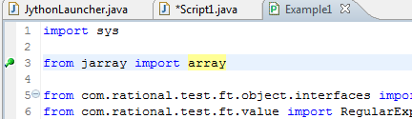
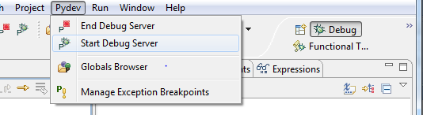
How to debug a RFT Jython script
1. Set breakpoint in the script you want to debug
2. Start the PyDev Debug Server

Slide 31
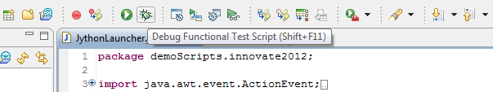
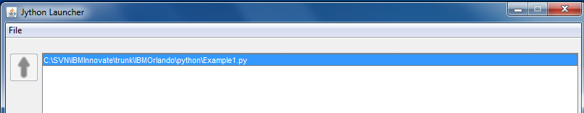
How to debug a RFT Jython script
3. Start JythonLauncher in debug mode
4. Launch script with JythonLauncher

Slide 32
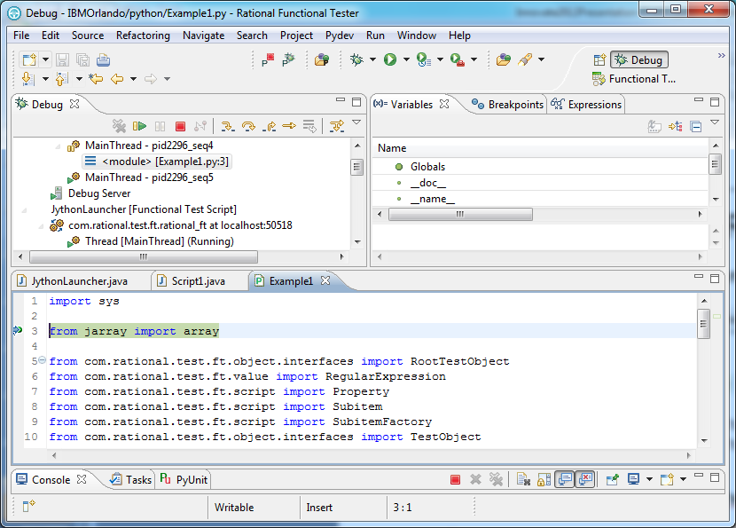
View of a Jython script being debugged through the PyDev Remote Debugger

Slide 33
www.ibm.com/software/rational
Notes:
Author Note: Optional Rational slide. Graphic is available in English only.

Slide 34
Manipulating RFT Log Files
Only a single log file is generated per RFT script.
Since the JythonLauncher is only a single RFT script if you want a log file for each Jython script you need to manipulate how the logs are generated.
Only a single log file can be manipulated at a time since the built in logging methods for RFT are static.
Solution:
  Artificially start/stop the log files (may involve unsupported code)
    JythonLauncher *CAN* do this as an option.
  Create your own logging framework instead of RFT’s

Slide 35
Future Concepts
Replace the JythonLauncher with an Eclipse plug-in.
Figure out how to launch Jython first, then use RFT APIs
Use IronPython to build on top of the VB.Net RFT API
  This may allow a single Python RFT script to run on both RFT Java and RFT VB
Have scripts integrate other automation tools like Sikuli (which uses Jython as well) along side RFT for even more options and power to control user interfaces.

Slide 36

www.ibm.com/software/rational
Notes:
Author Note: Optional Rational slide. Graphic is available in English only.

Slide 37
Acknowledgements and disclaimers
Availability: References in this presentation to IBM products, programs, or services do not imply that they will be available in all countries
in which IBM operates.
The workshops, sessions and materials have been prepared by IBM or the session speakers and reflect their own views. They are provided for informational purposes only, and are neither intended to, nor shall have the effect of being, legal or other guidance or advice to any participant. While efforts were made to verify the completeness and accuracy of the information contained in this presentation, it is provided AS-IS without warranty of any kind, express or implied. IBM shall not be responsible for any damages arising out of the use of, or otherwise related to, this presentation or any other materials. Nothing contained in this presentation is intended to, nor shall have the effect of, creating any warranties or representations from IBM or its suppliers or licensors, or altering the terms and conditions of the applicable license agreement governing the use of IBM software.
All customer examples described are presented as illustrations of how those customers have used IBM products and the results they may have achieved. Actual environmental costs and performance characteristics may vary by customer. Nothing contained in these materials is intended to, nor shall have the effect of, stating or implying that any activities undertaken by you will result in any specific sales, revenue growth or other results.
© Copyright IBM Corporation 2012. All rights reserved.
  U.S. Government Users Restricted Rights - Use, duplication or disclosure restricted by GSA ADP Schedule Contract with IBM Corp.
IBM, the IBM logo, ibm.com, Rational, the Rational logo, Telelogic, the Telelogic logo, Green Hat, the Green Hat logo, and other IBM products and services are trademarks or registered trademarks of International Business Machines Corporation in the United States, other countries, or both. If these and other IBM trademarked terms are marked on their first occurrence in this information with a trademark symbol (® or ™), these symbols indicate U.S. registered or common law trademarks owned by IBM at the time this information was published. Such trademarks may also be registered or common law trademarks in other countries. A current list of IBM trademarks is available on the Web at “Copyright and trademark information” at www.ibm.com/legal/copytrade.shtml
If you have mentioned trademarks that are not from IBM, please update and add the following lines:
[Insert any special third-party trademark names/attributions here]
Other company, product, or service names may be trademarks or service marks of others.
Notes:
IBM IOD 2011
Prensenter name here.ppt

Slide 38

www.ibm.com/software/rational
© Copyright IBM Corporation 2012. All rights reserved. The information contained in these materials is provided for informational purposes only, and is provided AS IS without warranty of any kind, express or implied. IBM shall not be responsible for any damages arising out of the use of, or otherwise related to, these materials. Nothing contained in these materials is intended to, nor shall have the effect of, creating any warranties or representations from IBM or its suppliers or licensors, or altering the terms and conditions of the applicable license agreement governing the use of IBM software. References in these materials to IBM products, programs, or services do not imply that they will be available in all countries in which IBM operates. Product release dates and/or capabilities referenced in these materials may change at any time at IBM’s sole discretion based on market opportunities or other factors, and are not intended to be a commitment to future product or feature availability in any way. IBM, the IBM logo, Rational, the Rational logo, Telelogic, the Telelogic logo, and other IBM products and services are trademarks of the International Business Machines Corporation, in the United States, other countries or both. Other company, product, or service names may be trademarks or service marks of others.
Notes:
Author Note: Mandatory Rational closing slide (includes appropriate legal disclaimer). Graphic is available in English only.

