Slide 1
String

Slide 2
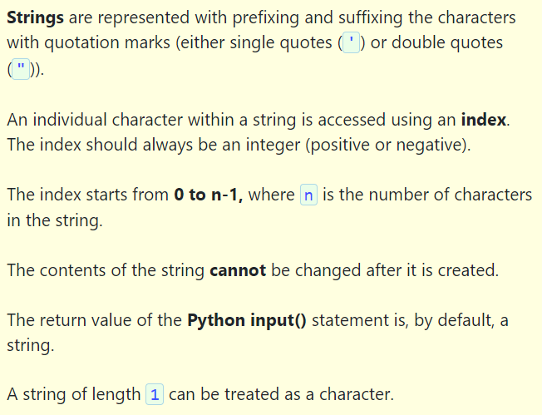

Slide 3



Slide 4
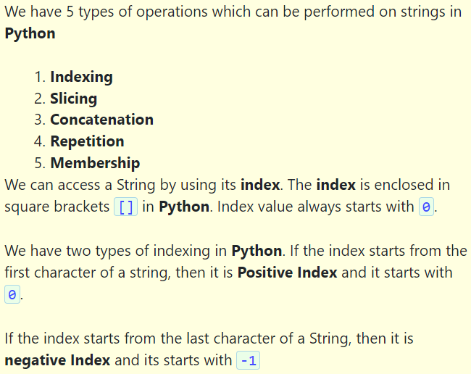

Slide 6
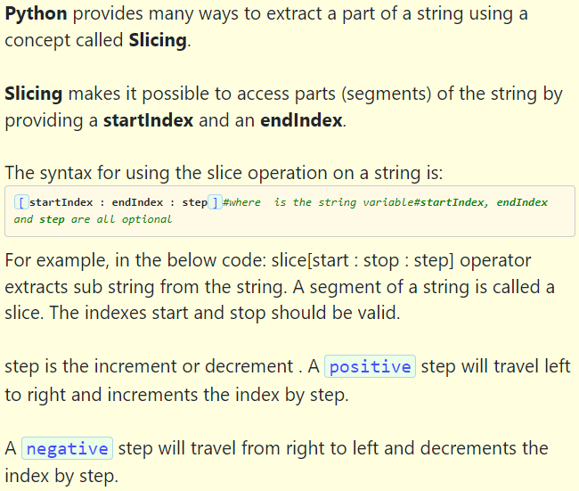

Slide 7
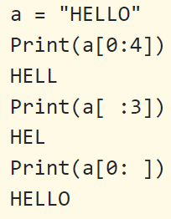
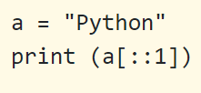

Slide 8
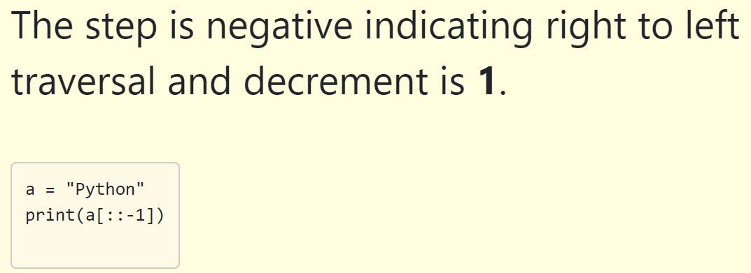

Slide 9




Slide 10
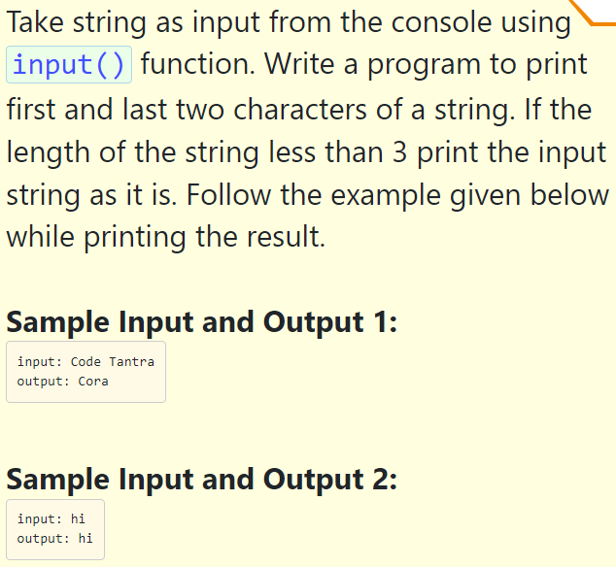

Slide 11
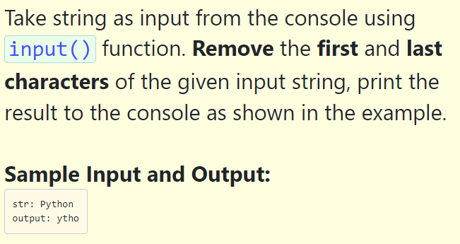

Slide 12
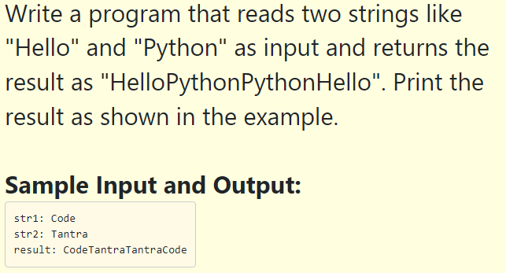

Slide 13
String function
capitalize() | Converts the first character to upper case
count() | Returns the number of times a specified value occurs in a string
find() | Searches the string for a specified value and returns the position of where it was found
lower() | Converts a string into lower case
upper() | Converts a string into upper case
title() | Converts the first character of each word to upper case
swapcase() | Swaps cases, lower case becomes upper case and vice versa
index() | Searches the string for a specified value and returns the position of where it was found

Slide 14
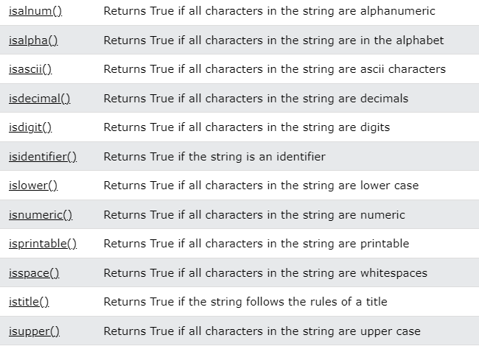

Slide 15
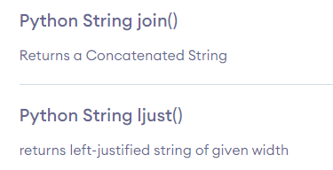
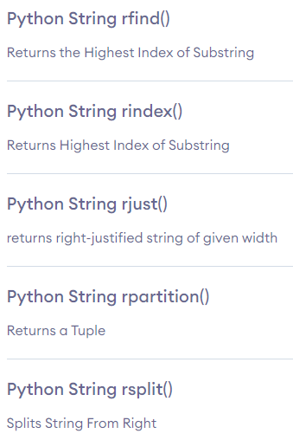
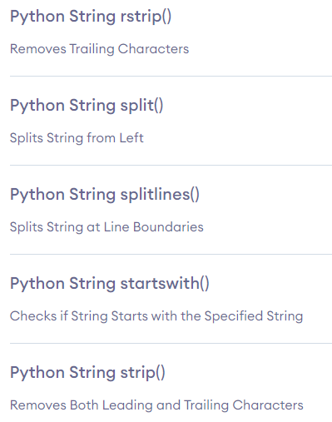

Slide 16
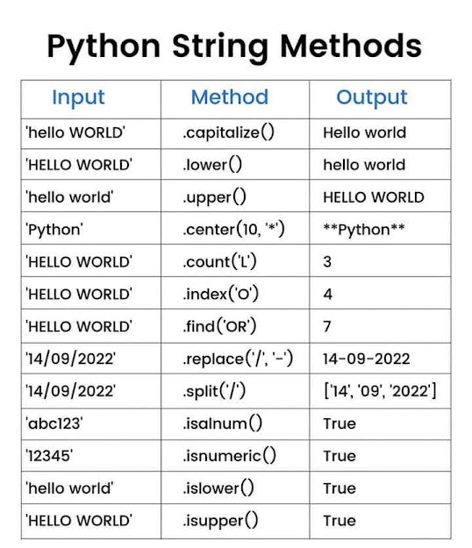
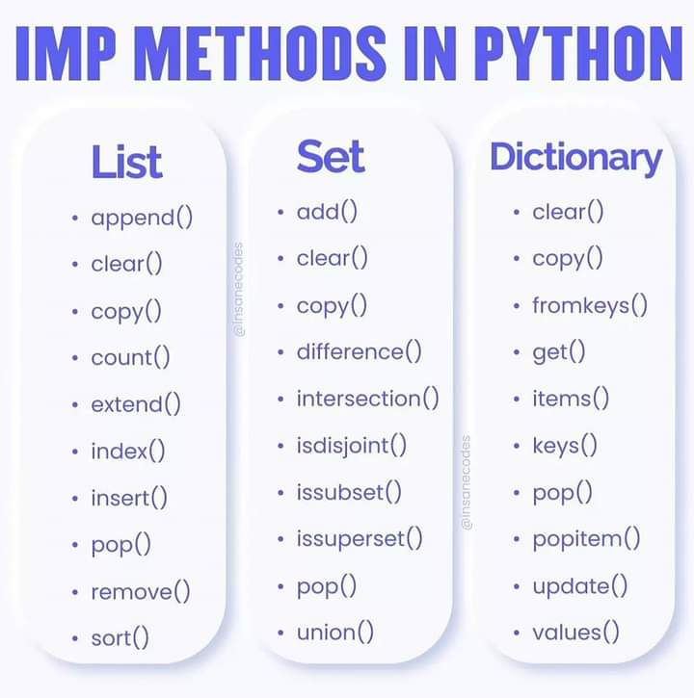

Slide 17
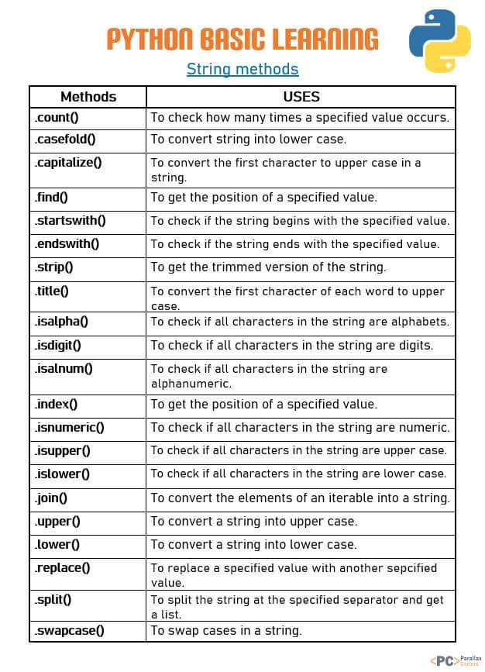

Slide 18
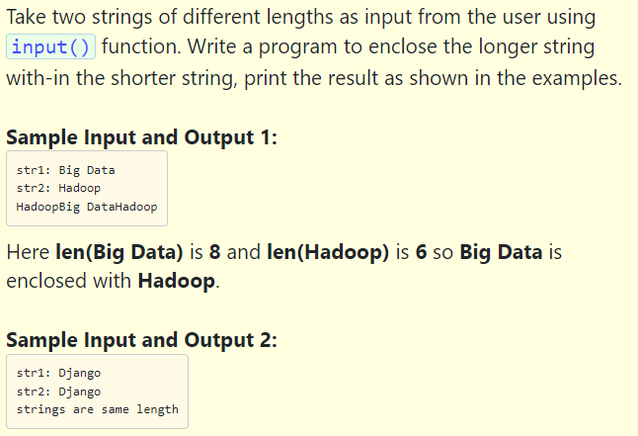

Slide 19
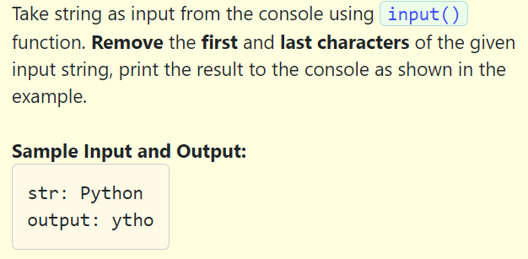

Slide 20
String Programs
Write a program to count vowels in a string.
Write a program to count characters in a string.
Write a program to reverse a string
Write a program to print a substring made of the first 2 and the last 2 chars
Write a program to print all substring of a string.
Python Program to Remove all special characters From a String
Write a program to check a string is a correct gmail id or not.
Python Program to Check If Two Strings are Anagram
Python Program to print all the Permutation of the String
Python Program to Count the Number of Occurrence of a Character in String

Slide 21
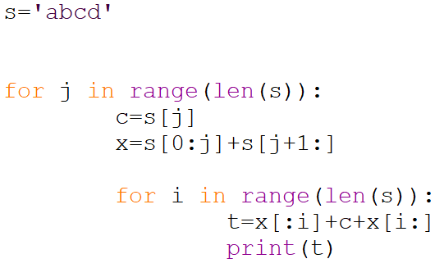

Slide 22
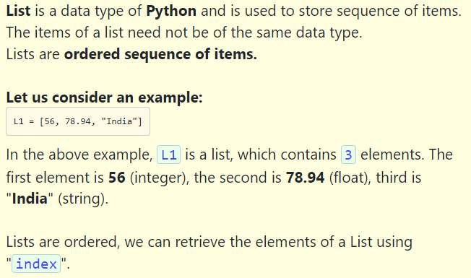

Slide 23
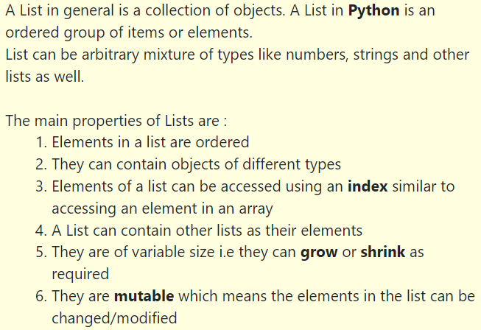
List Method

Slide 24
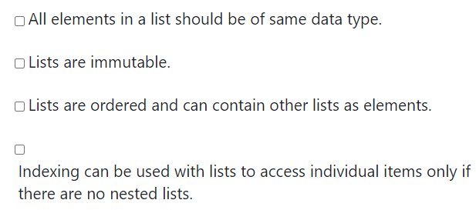

Slide 25
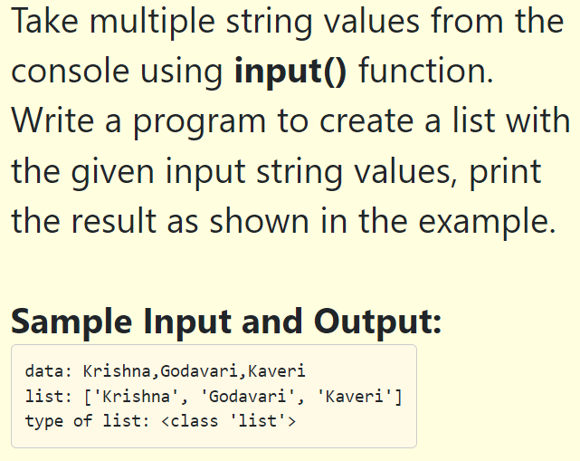

Slide 26
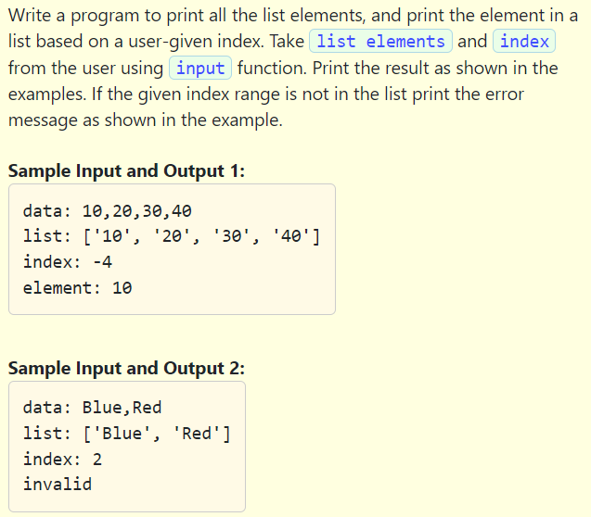

Slide 27
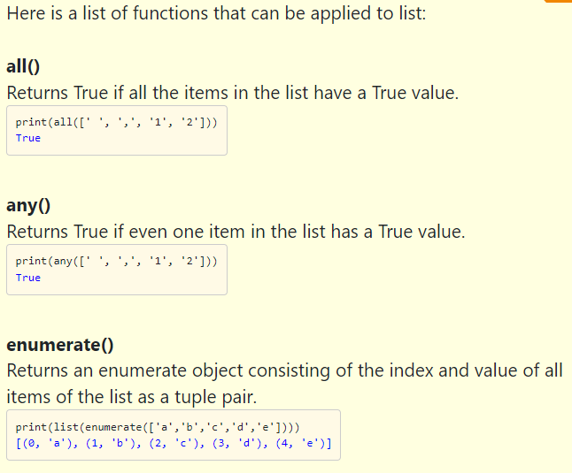

Slide 28
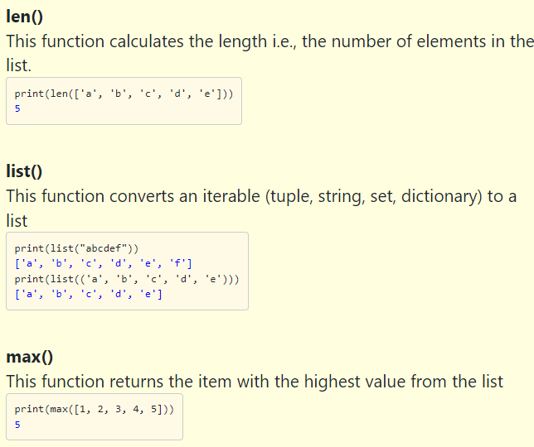

Slide 29
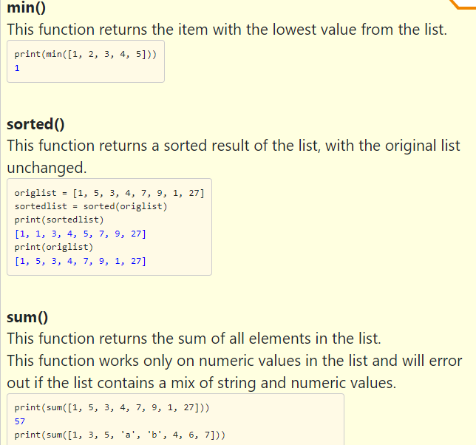

Slide 30
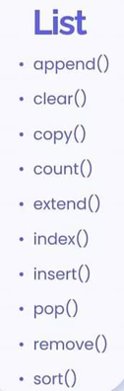
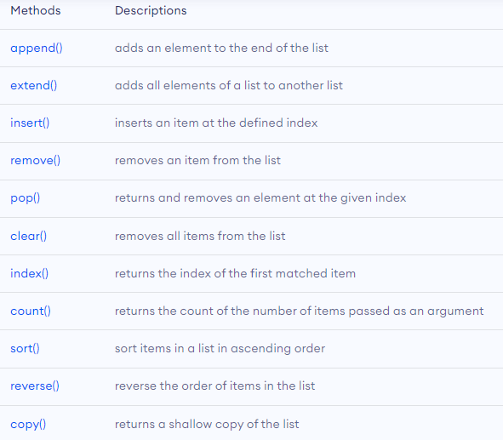
List Method

Slide 31
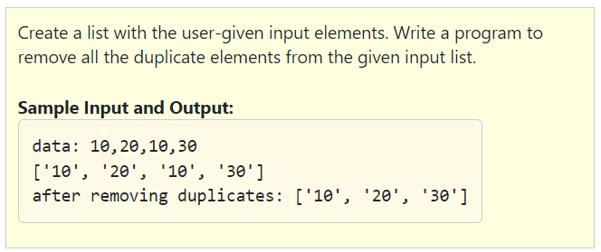

Slide 32
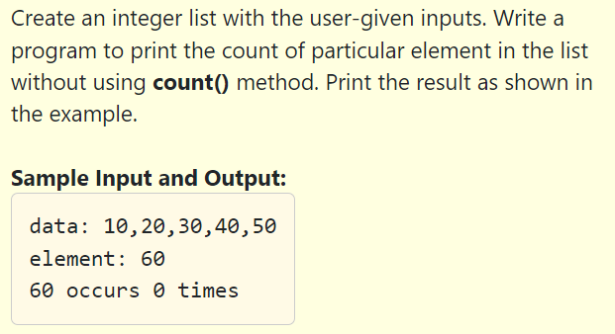

Slide 33
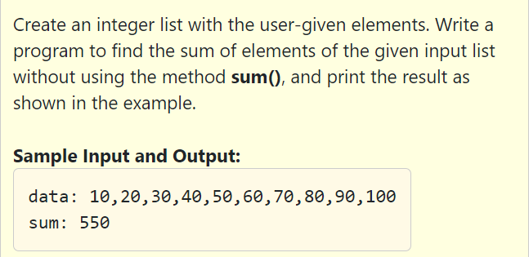

Slide 35
List Programs
Write a program to merge the two sorted list
Write a program to print common elements from two lists.
Print alternating elements of the list.
Write a program to Interchange First and Last Element of a List
Python program to find the cumulative sum of elements of a list
Program to find the position of minimum and maximum elements of a list.
Program to remove duplicate elements from the list.
Python program to find N largest and smallest elements from the list
Check all elements are unique or not
Rotate a list n times

Slide 36
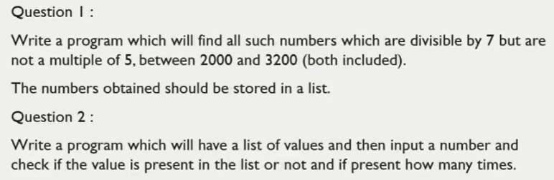

Slide 37
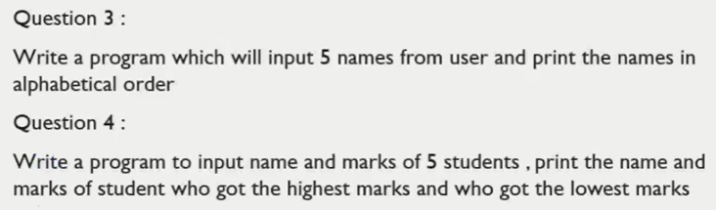

Slide 38
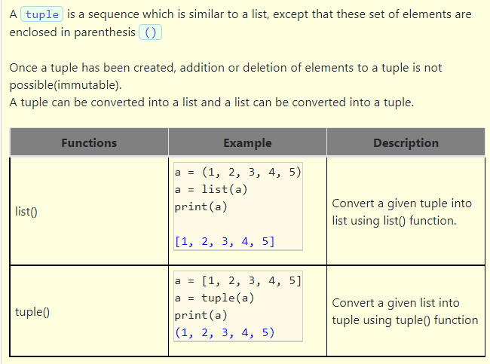
Tuples

Slide 39
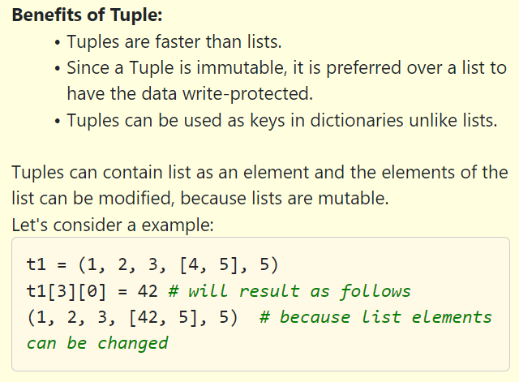

Slide 40
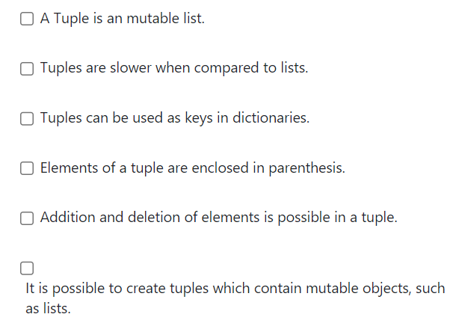

Slide 41
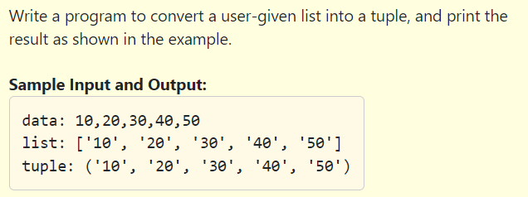

Slide 42
Tuples Operations
Operation | Example
Creating a Tuple | a = (20, 40, 60, "apple", "ball")
Indexing | print(a[0]) -→ 20 print(a[2]) -→ 60
Slicing | print(a[1:3]) --→ (40,60)
Concatenation | b = (2, 4) print(a + b) --→ (20, 40, 60, "apple", "ball", 2, 4)
Repetition | b = (2, 4) print(b * 2) -→ (2, 4, 2, 4)
Membership | a = (2, 3, 4, 5, 6, 7, 8, 9, 10) print(5 in a) ---→ True
Comparison | a = (2, 3, 4, 5, 6, 7, 8, 9, 10) b = (2, 3, 4) print(a == b) False

Slide 43
Tuples Method
count()
Index()

Slide 44
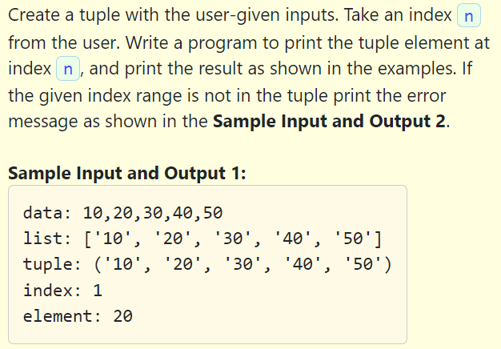
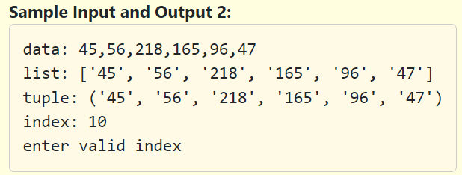

Slide 45
len(tuple)
min(tuple)
max(tuple)
index(x)
sum(tuple)
tuple(list)

Slide 46
Questions
Q1. Create a tuple and try to changing value of any one element, also display the length of list.
Q2. Create a tuple having single element and append two tuples.
Q3. Create a tuple and sort it.
Q4. Create a tuple of numbers and print sum of all the elements.
Q5. Program to compare elements of tuples.
Q6. Program to find maximum and minimum of tuple.
Q7. Count the occurrence of element in tuple in a specific range.
Q8. Reverse a tuple.
Q9.Write a loop that traverses the previous tuple and prints the length of each element. What happens if you send an floating number in index?

Slide 47

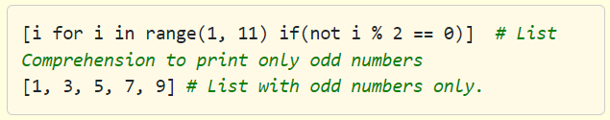


Slide 48

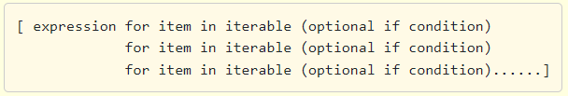

Slide 49
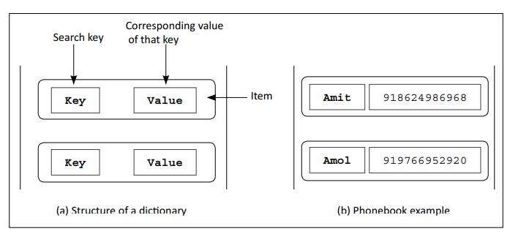
Basics of Dictionaries
Dictionary is a collection that stores values along with keys.
The sequence of such key and value pairs is separated by commas. These pairs are sometimes called entries or items.
A colon (:) separates a key and its value .
Dictionary are enclosed in curly brackets { and }.
Keys are like an index operator in a dictionary. A key can be of any type.
Example: Phonebook - {“Amit”:“918624986968”, “Amol”:“919766962920”}

Slide 50
phonebook={'Ram':1234567890, 'John':1112223334, 'Aman':2345678921}
menu = {"Bread":10.0, "Pasta":30.0, "Rice":100.0, "Oils":200.0, "Soups":50.0, "Cheese":70.0, "Eggs":60.0}

Slide 51
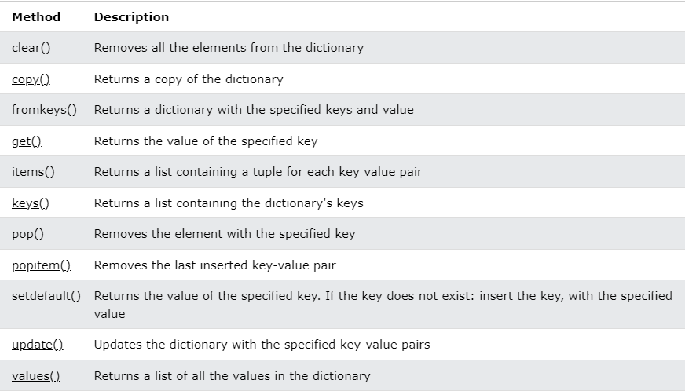

Slide 52

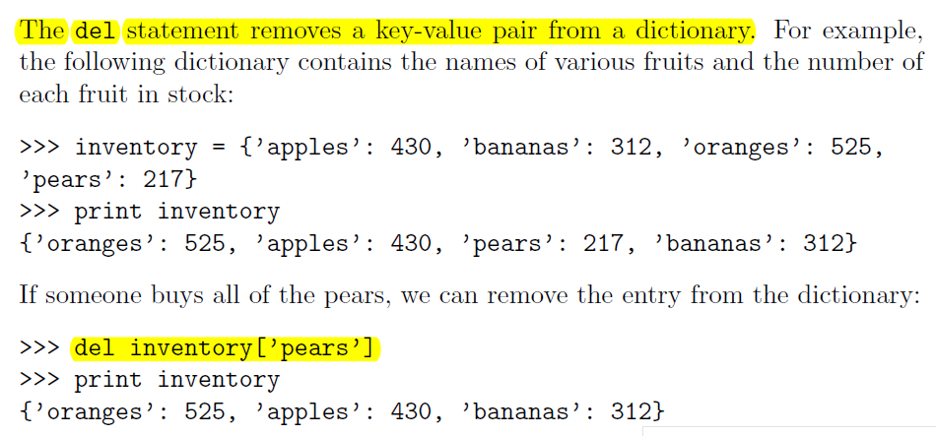

Slide 53
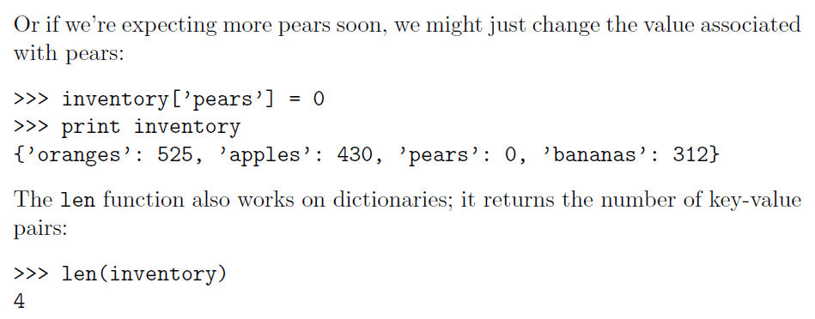

Slide 54

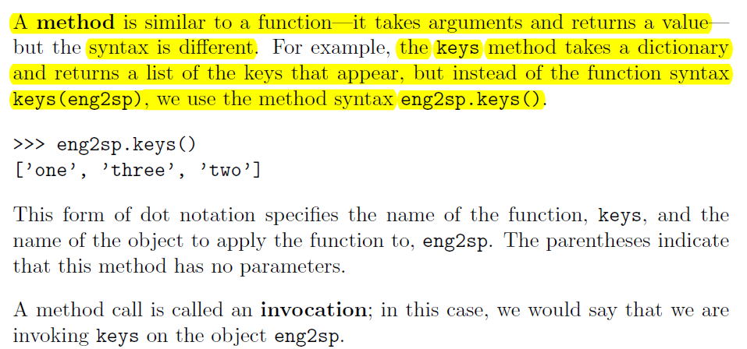

Slide 55
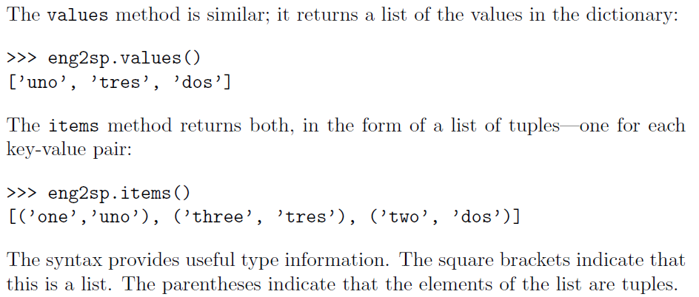

Slide 56

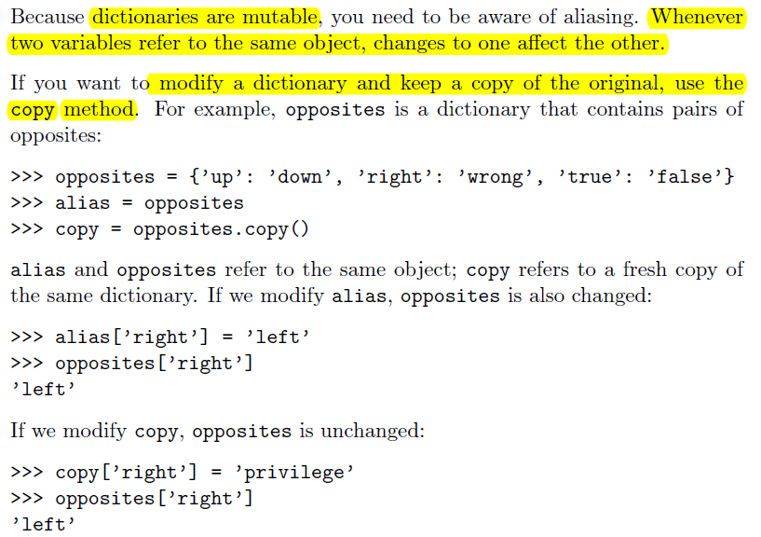

Slide 57

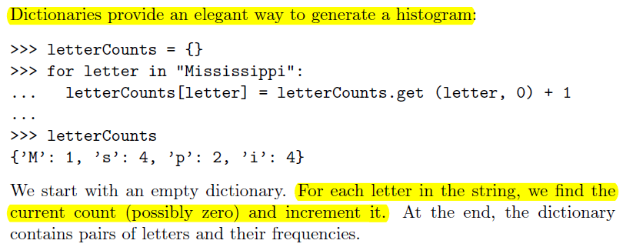

Slide 58


Slide 59
Iterate over Python dictionaries using for loops
d={'red':1,'green':2,'blue':3}
for color_key, value in d.items():
print(color_key,'corresponds to', d[color_key])
OUTPUT:
blue corresponds to 3
green corresponds to 2
red corresponds to 1
Remove a key from a Python dictionary
myDict = {'a':1,'b':2,'c':3,'d':4}
print(myDict)
if 'a' in myDict:
del myDict['a']
print(myDict)

Slide 60
OUTPUT:
{'d': 4, 'a': 1, 'b': 2, 'c': 3}
{'d': 4, 'b': 2, 'c': 3}
Sort a Python dictionary by key
color_dict = {'red':'#FF0000',
'green':'#008000',
'black':'#000000',
'white':'#FFFFFF'}
for key in sorted(color_dict):
print(key,” :”, color_dict[key]))
OUTPUT:
black: #000000
green: #008000
red: #FF0000
white: #FFFFFF

Slide 61
Dictionaries Programs
Write a Python script to add a key to a dictionary.
Write a Python script to concatenate two dictionaries to create a new one.
Write python program to count number of occurrence of a character and create a dictionary.
Write a program that has dictionary of names of the students and a list of their marks in 4 subjects. Create another dictionary that has name of the students and their total marks. Find out the topper and his score.
Write a Python script to check if a given key already exists in a dictionary.
Write a Python script to print a dictionary where the keys are numbers between 1 and 15 (both included) and the values are square of keys.
Find the maximum and minimum value of a Python dictionary

Slide 62
Find the maximum and minimum value of a Python dictionary
my_dict = {'x':500, 'y':5874, 'z': 560}
key_max = max(my_dict.keys(), key=(lambda k: my_dict[k]))
key_min = min(my_dict.keys(), key=(lambda k: my_dict[k]))
print('Maximum Value: ',my_dict[key_max])
print('Minimum Value: ',my_dict[key_min])
OUTPUT:
Maximum Value: 5874
Minimum Value: 500

Slide 63
Concatenate two Python dictionaries into a new one
dic1={1:10, 2:20}
dic2={3:30, 4:40}
dic3={5:50,6:60}
dic4 = {}
for d in (dic1, dic2, dic3): dic4.update(d)
print(dic4)
OUTPUT:
{1: 10, 2: 20, 3: 30, 4: 40, 5: 50, 6: 60}
Test whether a Python dictionary contains a specific key
fruits = {}
fruits["apple"] = 1
fruits["mango"] = 2
fruits["banana"] = 4

Slide 64
if "mango" in fruits:
print("Has mango")
else:
print("No mango")
if "orange" in fruits:
print("Has orange")
else:
print("No orange")
OUTPUT:
Has mango
No orange

Slide 65
QUESTIONS
Q1:Write a Python script to add a key to a dictionary.
Sample Dictionary : {0: 10, 1: 20} Expected Result : {0: 10, 1: 20, 2: 30}
Q2: Write a Python script to concatenate following dictionaries to create a new one.
Sample Dictionary : dic1={1:10, 2:20} dic2={3:30, 4:40} dic3={5:50,6:60} Expected Result : {1: 10, 2: 20, 3: 30, 4: 40, 5: 50, 6: 60}
Q3: Write a Python script to check if a given key already exists in a dictionary.
Q4: Write a Python script to print a dictionary where the keys are numbers between 1 and 15 (both included) and the values are square of keys.
Sample Dictionary {1: 1, 2: 4, 3: 9, 4: 16, 5: 25, 6: 36, 7: 49, 8: 64, 9: 81, 10: 100, 11: 121, 12: 144, 13: 169, 14: 196, 15: 225}

Slide 66
Q5: Write a Python script to merge two Python dictionaries.
Q6: Write a Python program to sum all the items in a dictionary.
Q7: Write a Python program to multiply all the items in a dictionary.
Q8: Write a Python program to remove a key from a dictionary.
Q9: Write a Python program to remove duplicates from Dictionary.
Q10: Write a Python program to create and display all combinations of letters, selecting each letter from a different key in a dictionary.
Sample data : {'1':['a','b'], '2':['c','d']} Expected Output: ac ad bc bd

Slide 67


Slide 68


Slide 69



Slide 70


Slide 71


