Slide 1
Scrum has been used by:
Microsoft
Yahoo
Google
Electronic Arts
High Moon Studios
Lockheed Martin
Philips
Siemens
Nokia
Capital One
BBC
Intuit
Intuit
Nielsen Media
First American Real Estate
BMC Software
Ipswitch
John Deere
Lexis Nexis
Sabre
Salesforce.com
Time Warner
Turner Broadcasting
Oce

Slide 2
Scrum has been used for:
Commercial software
In-house development
Contract development
Fixed-price projects
Financial applications
ISO 9001-certified applications
Embedded systems
24x7 systems with 99.999% uptime requirements
the Joint Strike Fighter
Video game development
FDA-approved, life-critical systems
Satellite-control software
Websites
Handheld software
Mobile phones
Network switching applications
ISV applications
Some of the largest applications in use

Slide 3
Characteristics
Self-organizing teams
Product progresses in a series of month-long “sprints”
Requirements are captured as items in a list of “product backlog”
No specific engineering practices prescribed
Uses generative rules to create an agile environment for delivering projects
One of the “agile processes”

Slide 4





Scrum
24 hours
Sprint
2-4 weeks
Sprint goal
Return
Sprint backlog
Potentially shippable
product increment
Return
Cancel
Gift wrap
Coupons
Gift wrap
Cancel
Coupons
Product
backlog

Slide 5

Putting it all together
Image available at www.mountaingoatsoftware.com/scrum

Slide 6
Sprints
Scrum projects make progress in a series of “sprints”
  Analogous to Extreme Programming iterations
Typical duration is 2–4 weeks or a calendar month at most
A constant duration leads to a better rhythm
Product is designed, coded, and tested during the sprint

Slide 7
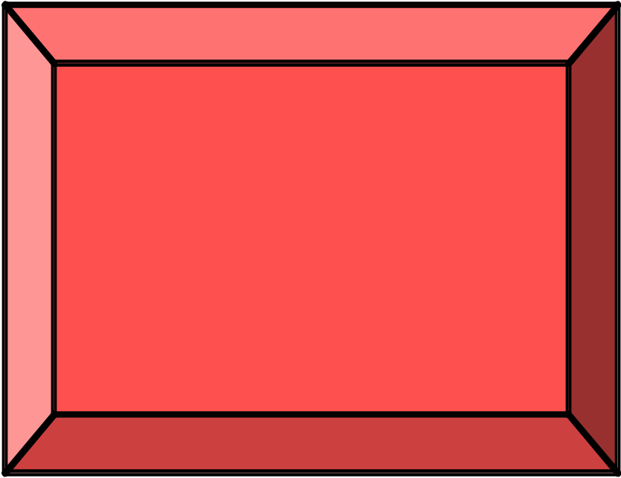
No changes during a sprint
Change
Plan sprint durations around how long you can commit to keeping change out of the sprint

